Slide 1
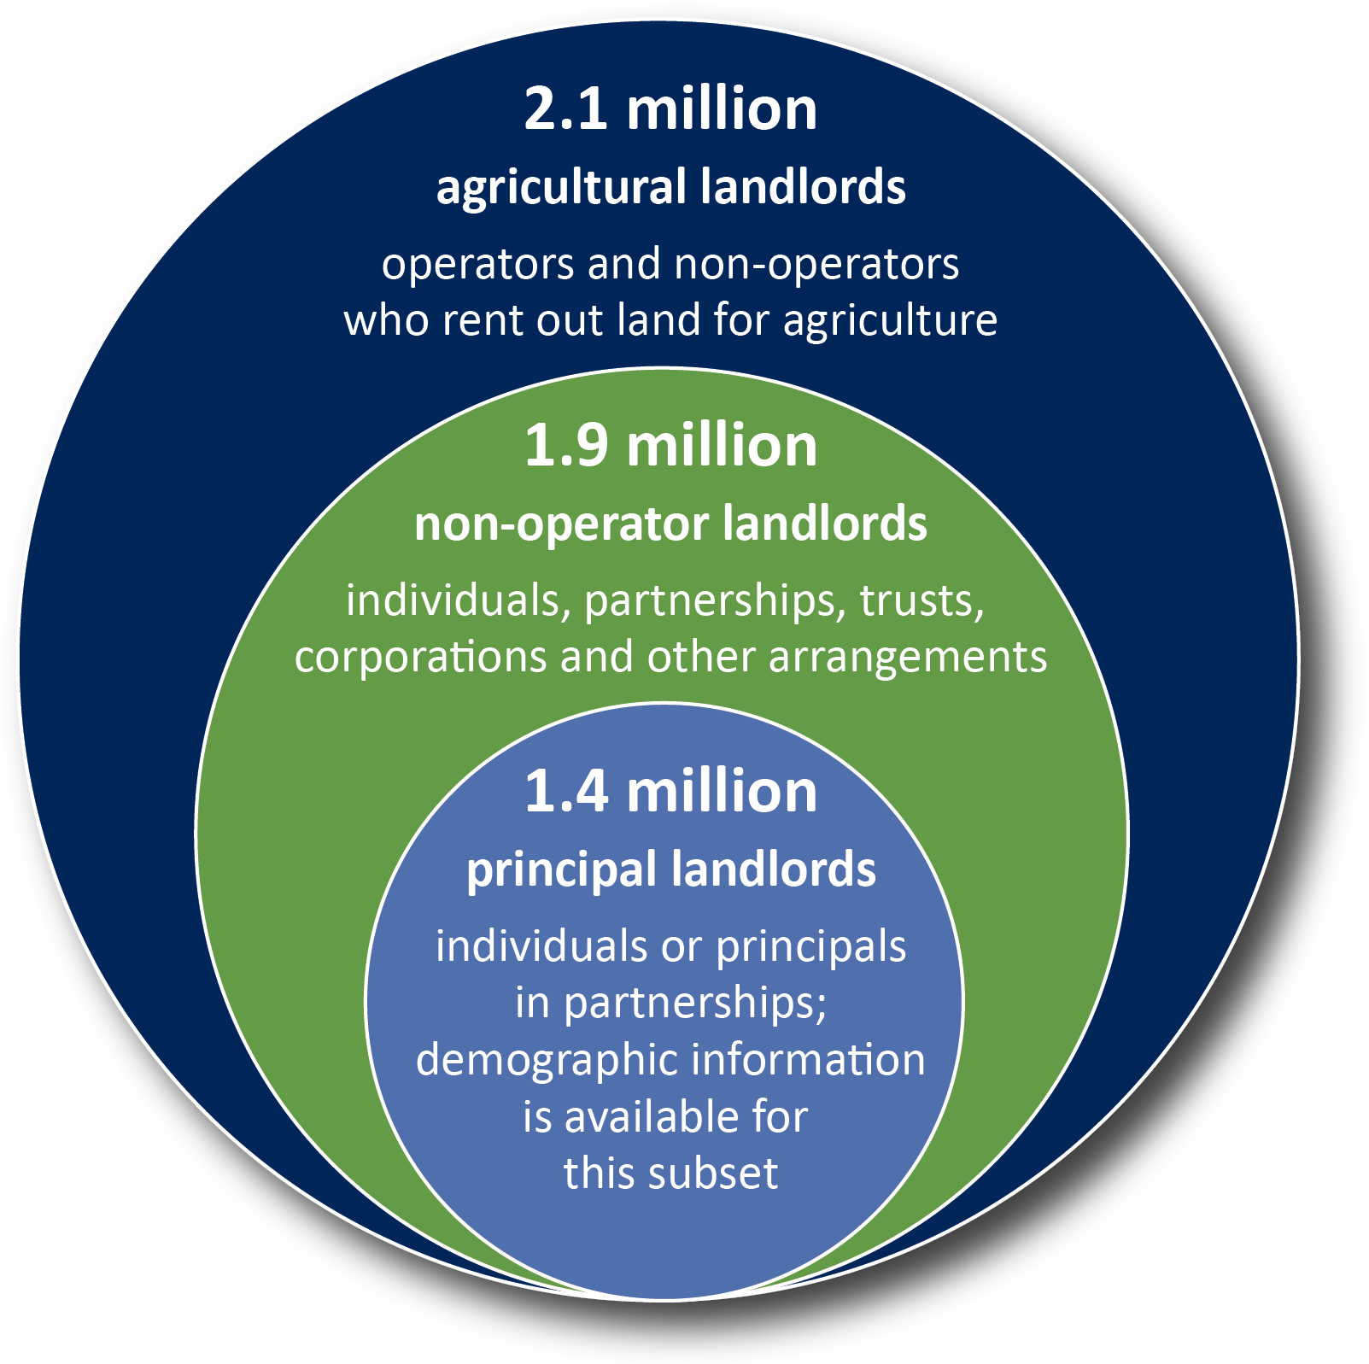
Agricultural Landlords
Source: 2014 Tenure, Ownership, and Transition of Agricultural Land Survey
Compiled by the Farmland Information Center – www.farmlandinfo.org
Notes:
In 2014, there were 2.1 million (2,131,840) agricultural landlords. Of these, 13 percent were operators (i.e., farmers and ranchers) and 87 percent were non-operators.
In 2014, there were 1.9 million (1,851,796) “non-operator landlords”—individuals, partnerships, trusts, corporations or other entities—who rent out owned land to farmers and ranchers for agriculture.
Of the non-operator landlords, 1.4 million (1,432,065) were “principal landlords”—individual owners or the principal in a partnership arrangement. Demographic information is available for this subset.

Slide 2
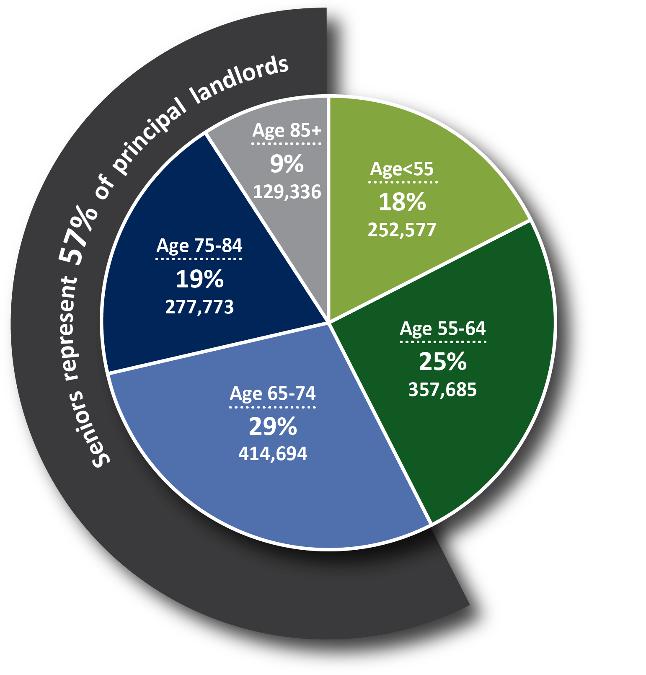
Number of Principal Landlords
Source: 2014 Tenure, Ownership, and Transition of Agricultural Land Survey
Compiled by the Farmland Information Center – www.farmlandinfo.org
Notes:
In 2014, 821,803 principal landlords were 65 and older. They represented 57 percent of all principal landlords.

Slide 3
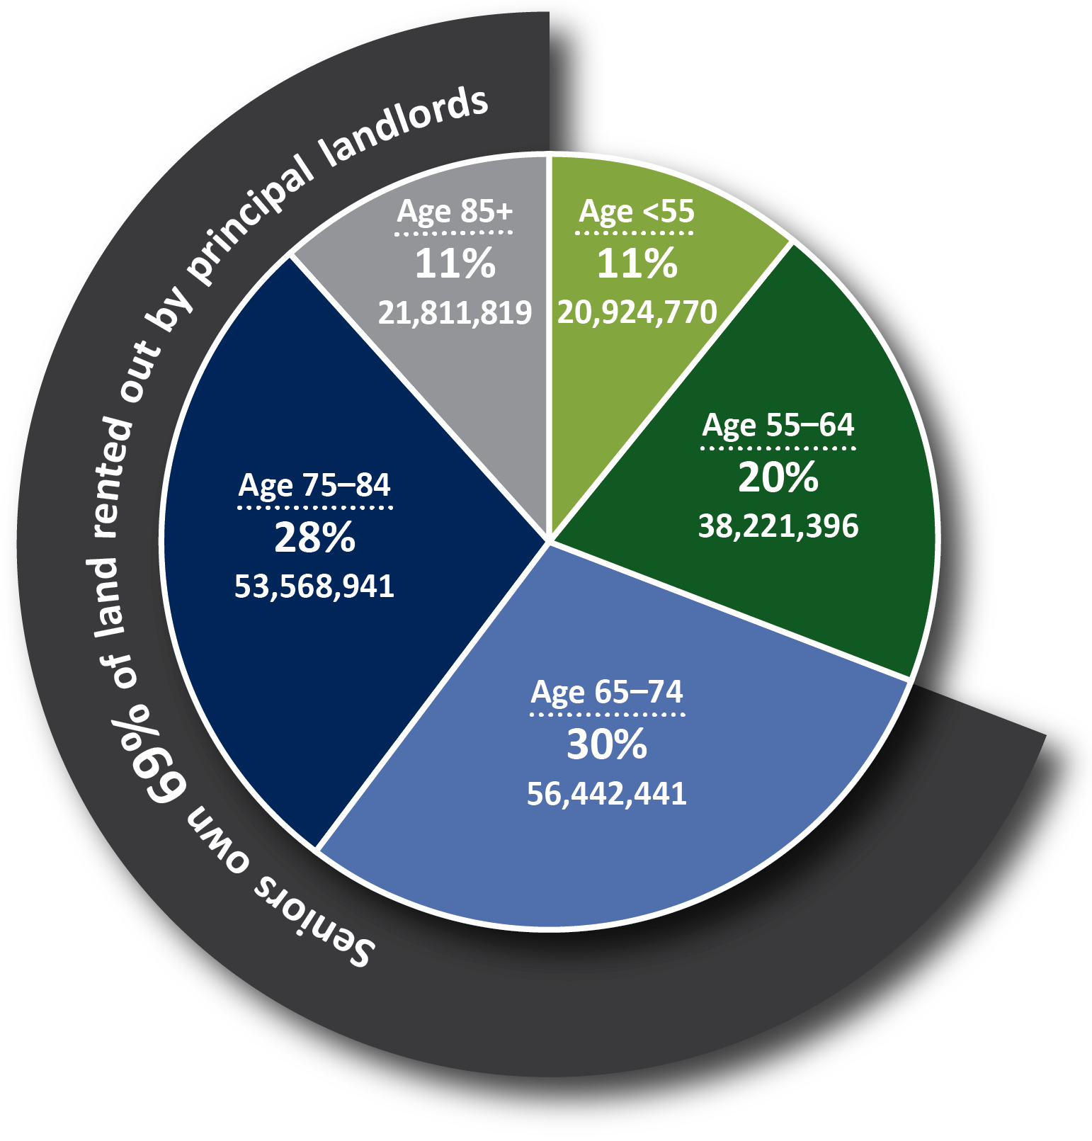
Acres of Agricultural Land Owned and Rented Out by Principal Landlords
Source: 2014 Tenure, Ownership, and Transition of Agricultural Land Survey
Compiled by the Farmland Information Center – www.farmlandinfo.org
Notes:
Principal landlords 65 and older owned 131,823,201 acres or 14 percent of the 911 million acres used for agriculture in 2014, 37 percent of the 354 million acres rented out for farming and 69 percent of the land rented out by principal landlords.

Slide 4
Farmland that Could Change Hands in Next 20 Years
132 million owned by senior principal landlords
239 million owned by senior principal operators
> 370 million acres
of farmland likely to transfer in 20 years
Sources: 2014 Tenure, Ownership, and Transition of Agricultural Land Survey and 2012 Census of Agriculture
Compiled by the Farmland Information Center – www.farmlandinfo.org

