Slide 1
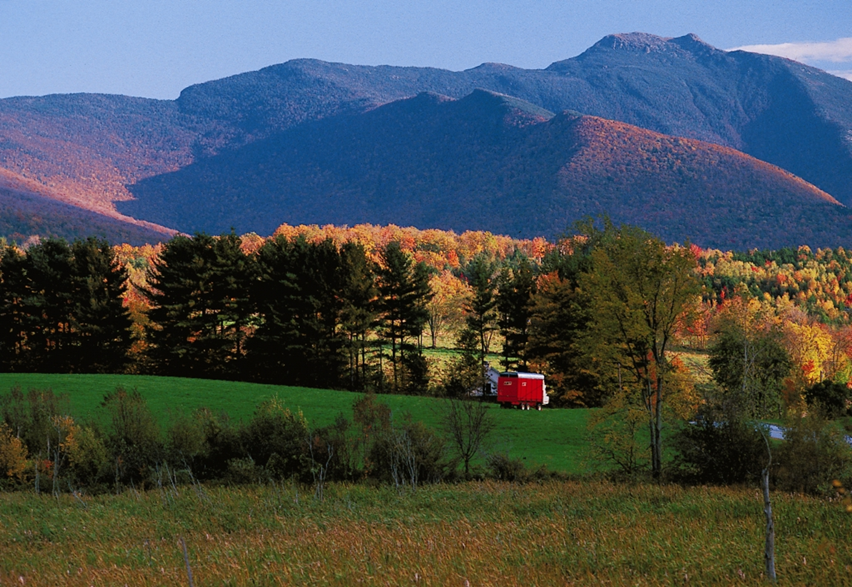
Gaining Insights, Gaining Access
INFOGRAPHIC COLLECTION
Notes:
This presentation collects infographics from the Gaining Insights, Gaining Access project for ease of dissemination and use. It is not intended as a stand-alone presentation. You may save and use the included infographics with attribution.

Slide 2
Gaining Insights Infographics
This presentation collects infographics from the Gaining Insights, Gaining Access research project for ease of dissemination and use.
It is not intended as a stand-alone presentation.
You may save and use the included infographics with attribution.

Slide 3
Gaining Insights Research Project
Objective: To improve our understanding of senior farmers—what they are farming, and with whom; their motivations; and their concerns about their future—in order to keep land in farms and farmers on the land as these seniors exit farming.
As part of the project we:
Completed special tabulations of 2012 Census of Agriculture data
Conducted senior farmer focus groups
Results: Regional and state fact sheets, webinar recordings and additional materials available from AFT’s Farmland Information Center, www.farmlandinfo.org/special-collections/4621
American Farmland Trust and Land for Good worked in partnership to complete this seven-state project (New York and New England).
Notes:
Aim of this is to help next generation, by focusing on current generation.
Focus group feedback:
Almost all want to see land protected
Almost all feel that there are not enough young farmers who really want to work
All want/need help on finding a farmer
Most want to mentor
Most need to get value out of their land

Slide 61
www.farmland.org www.farmlandinfo.org
Saving the Land that Sustains Us

