Slide 1
Purchase of Agricultural Conservation Easement programs operate in 32 states
Source: Farmland Information Center 2015 PACE Survey – www.farmlandinfo.org
Notes:
Purchase of agricultural conservation easement (PACE) programs use public funds to compensate property owners for keeping their land available for agriculture. PACE is known as Purchase of Development Rights (PDR) in some locations.
As of January 2015, at least 28 states have state-level PACE programs. Of these, 16 also have local PACE programs. Four additional states (Illinois, Minnesota, Montana and Oregon) only have PACE programs at the local level. This activity is depicted in the PACE map. Montana’s state PACE authority expired in 2003. Its previous activity appears on the state PACE table. Three more states (Arizona, Georgia and Missouri) have authorized programs but have not yet purchased agricultural conservation easements.
PACE data are from the Farmland Information Center 2015 PACE survey, which tracks activity in calendar year 2014.

Slide 2
Easements and Acres
States that have acquired the most easements to date
Pennsylvania | 4,732
Maryland | 2,752
New Jersey | 2,303
Massachusetts | 874
Delaware | 808
States that have protected the most acres to date
Colorado | 675,990
Pennsylvania | 502,757
Maryland | 378,193
New Jersey | 212,748
Vermont | 149,300
Source: Farmland Information Center 2015 PACE Survey – www.farmlandinfo.org
Notes:
As of January 2015, 28 state-level programs had acquired 14,541 easements to protect 2,579,878 acres of farm and ranch land. Programs acquired 5.5 percent more easements and protected 54.1 percent more acres in 2014 than 2013.
For every acre protected by state PACE programs, we converted nearly 10 acres of agricultural land to other uses.
During 2014, state programs acquired 560 easements covering 125,176 acres.

Slide 3
A few state programs did most of the work in 2014
Source: Farmland Information Center 2015 PACE Survey – www.farmlandinfo.org
Notes:
Pennsylvania accounted for 35.7 percent of all easements purchased.
Maryland accounted for 16.4 percent and New Jersey accounted for 14.8 percent of all easement purchases.
Together, these three states acquired 67 percent of the agricultural easements purchased by state programs in 2014!

Slide 4
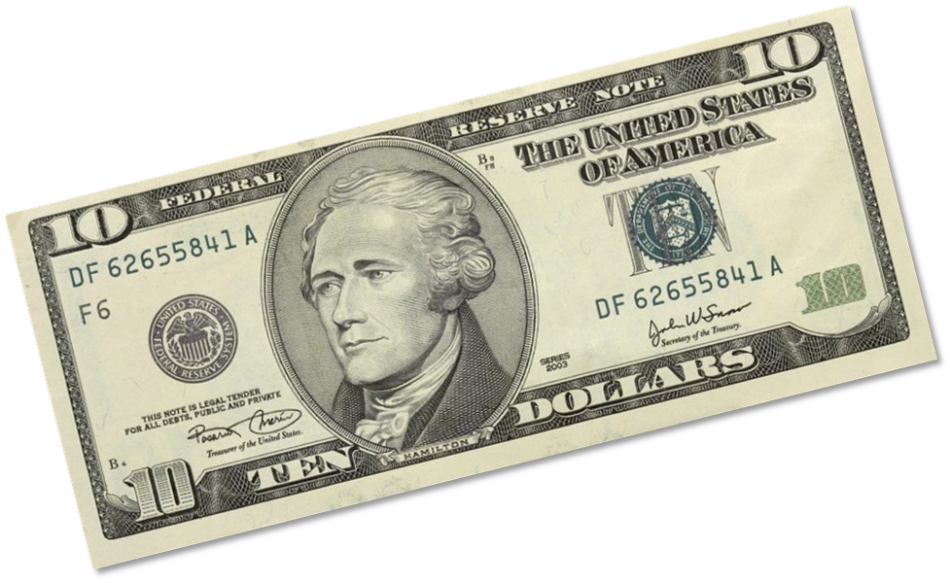
For every penny states invest to save farmland, they spend more than $10 on highways
Sources: Farmland Information Center 2015 PACE Survey and U.S. Department of Transportation State Disbursements for Highways 2014. Compiled by the Farmland Information Center – www.farmlandinfo.org
Notes:
Current data show that states invested $105 million in one year to protect farm and ranch land but spent $108 billion—about 1,000 times more—on highways.

Slide 5
Farmland Protection Spending
States that have invested the most in farmland protection to date
New Jersey | $1,018,628,563
Pennsylvania | $913,000,000
Maryland | $721,279,102
Massachusetts | $217,973,534
Colorado | $184,669,410
State programs that have invested the most on an average annual basis
New Jersey | $35,115,385
Pennsylvania | $33,954,285
MD Rural Legacy Program | $16,039,000
MD Agricultural Land Preservation Foundation | $13,275,860
Great Outdoors Colorado | $9,233,471
Source: Farmland Information Center 2015 PACE Survey – www.farmlandinfo.org
Notes:
State PACE programs invested nearly $3.9 billion since 1979 (the year of the first acquisition by a state program) to save farm and ranch land—vital agricultural infrastructure. States have leveraged this investment with nearly $2.5 billion in additional funding from federal programs, local governments, land trusts, foundations and individuals.
In 2014, state programs spent $105 million to protect farm and ranch land. This spending leveraged additional funding totaling more than $25 million.

Slide 6
Farmland Protection Spending
Sources: Farmland Information Center 2015 PACE Survey and U.S. Department of Transportation State Disbursements for Highways 2014. Compiled by the Farmland Information Center – www.farmlandinfo.org
Notes:
Currently, for every dollar invested to save farmland—critical agricultural infrastructure—states spent more than $1,000 on highways. Or, for every penny invested to save farmland, states spent more than $10 on highways.
In just one year, states spent nearly $108 billion on highways—more than 1,000 times recent spending on farmland protection.
All 50 states spent money on highways, but only 28 states have farmland protection programs, and in 2014 only 19 programs spent money on easement purchases.
Spending in 2014 was down 69 percent from the $336 million reported in 2009 and represented an eight-year low. If state programs had kept up the 2009 level of spending, we estimate they could have purchased 3,565 additional easements protecting 632,504 additional acres.

