Slide 1
2023 Survey of State PACE Programs
The graphics in these slides show the results of the Farmland Information Center’s annual survey of state Purchase of Agricultural Conservation Easement (PACE) programs.
When using them please acknowledge AFT’s Farmland Information Center, which receives support from USDA Natural Resources Conservation Service.

Slide 2
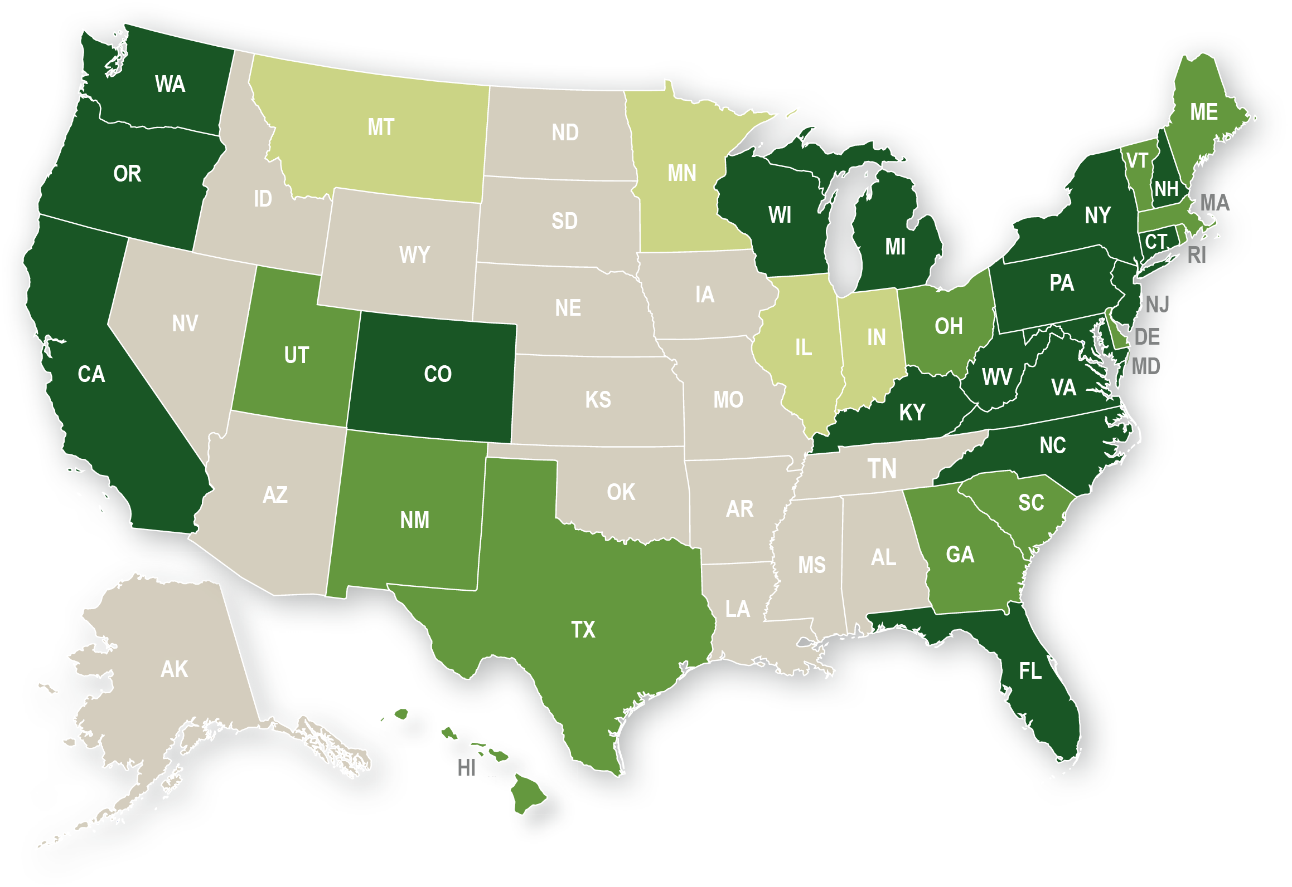
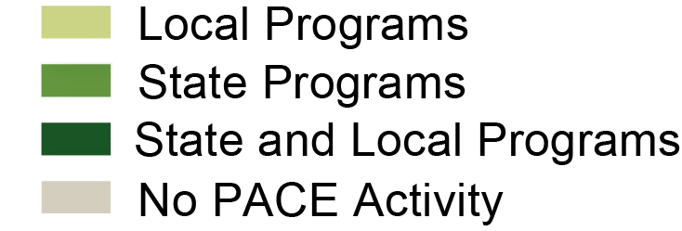
PACE Programs as of January 2023
Notes:
AFT’s Farmland Information Center (FIC) conducts an annual survey of state purchase of agricultural conservation easement (PACE) programs. Every four years the FIC conducts a survey of local PACE programs. This map shows the states with state and/or local PACE programs.
As of January 2023, 28 states had state-level PACE programs (there are 35 active programs among these 28 states, not including Washington’s newest PACE program). Of these, 17 also have local PACE programs. Four additional states—Illinois, Indiana, Minnesota, and Montana—only have PACE programs at the local level. In 2017, Oregon authorized a state-level program. They received funding in 2021 but have not acquired any easements as of January 2023. Missouri has authorized PACE but does not yet have a program; Georgia has authorized a PACE program, but it does not yet have funding. Montana’s state program expired in 2003 and is not an active program. Montana and Alabama no longer have active programs but are included in the table because they have funded easement purchases in the past.

Slide 3
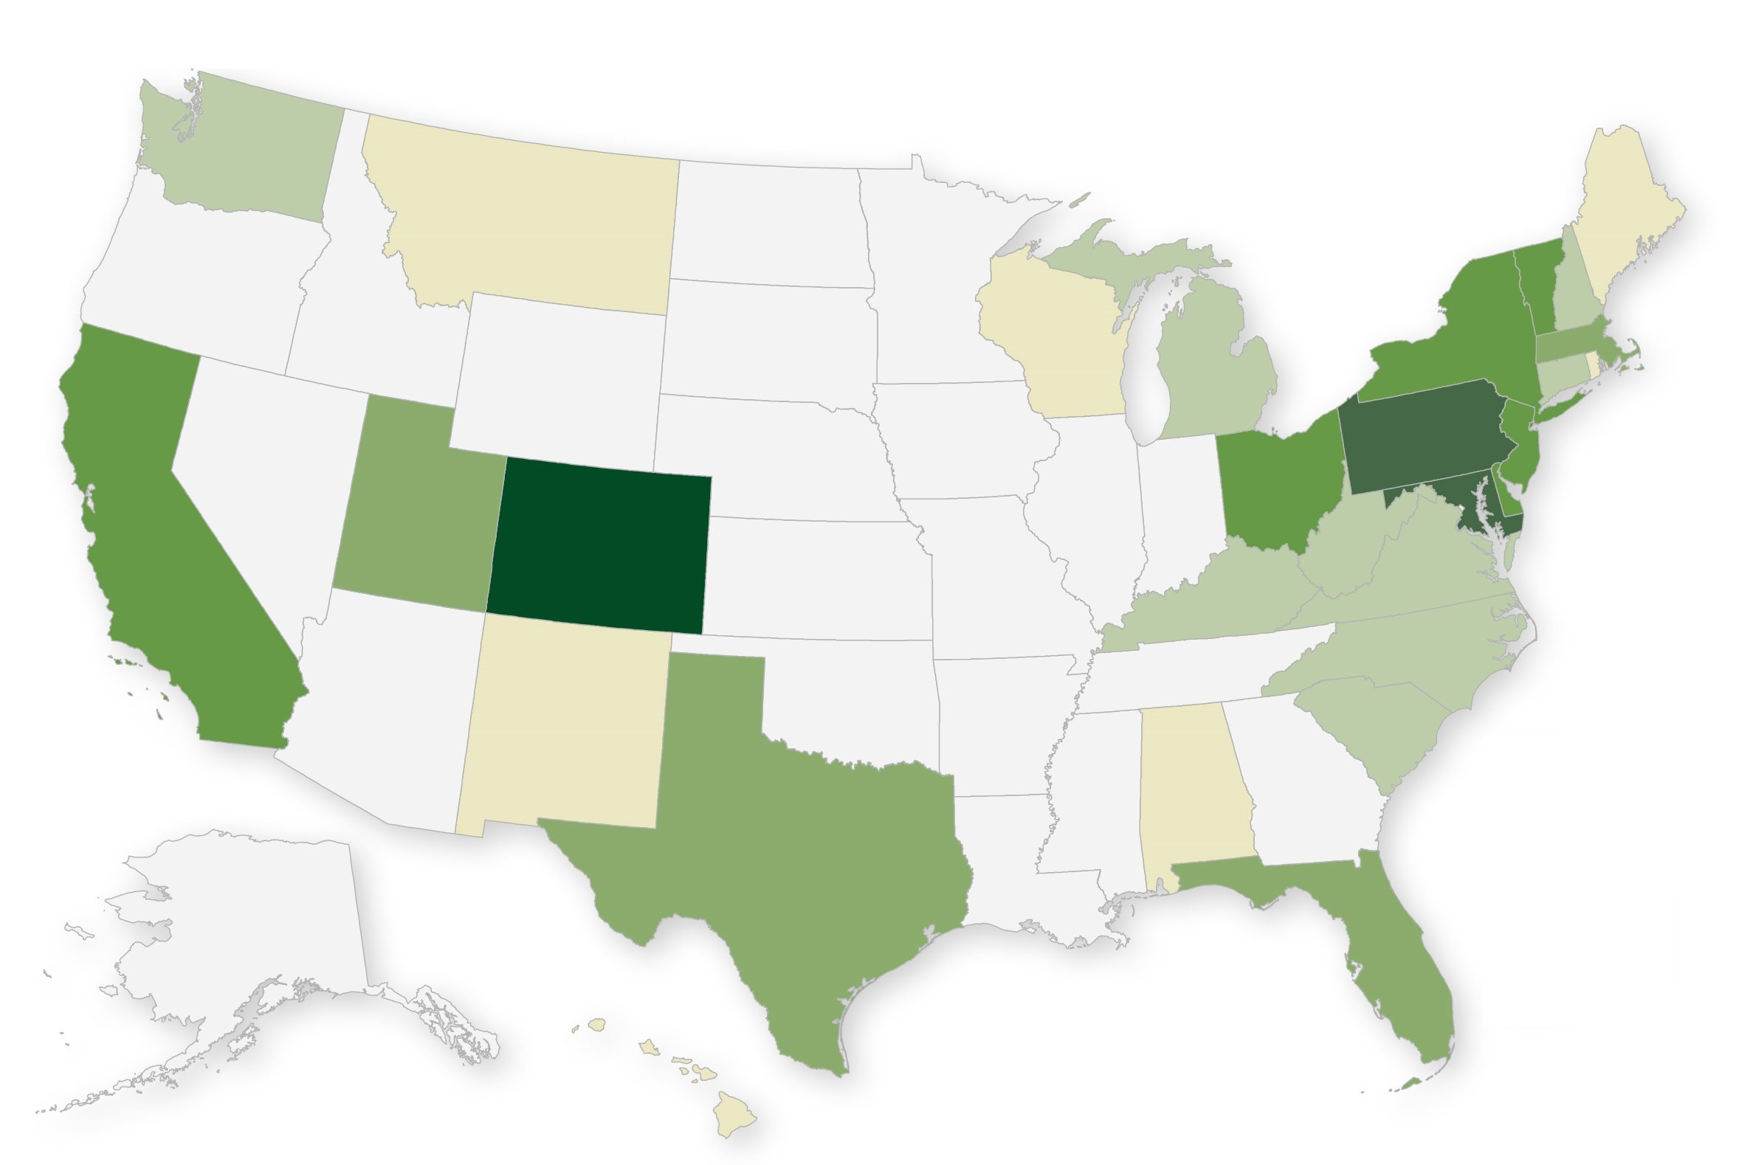
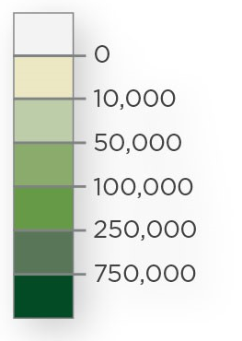
State PACE Program Activity

Slide 4
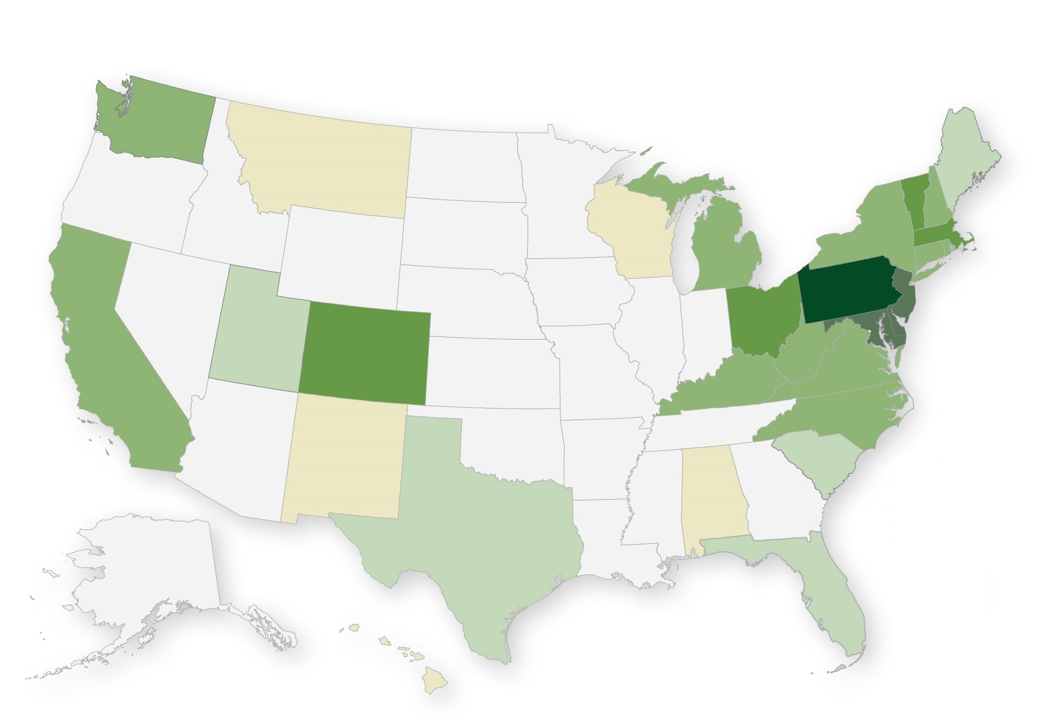
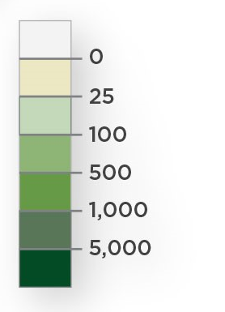
State PACE Program Activity

Slide 5
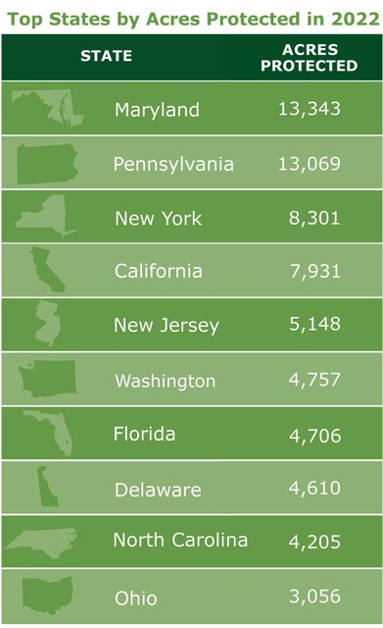
State PACE Program Activity

Slide 6
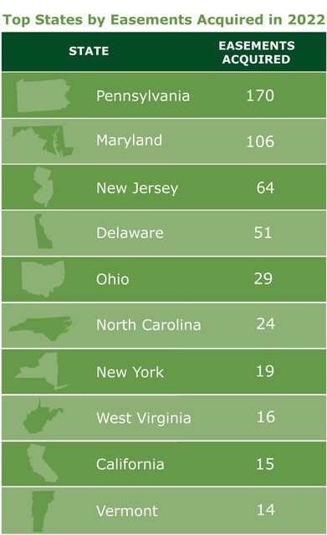
State PACE Program Activity

