Slide 1
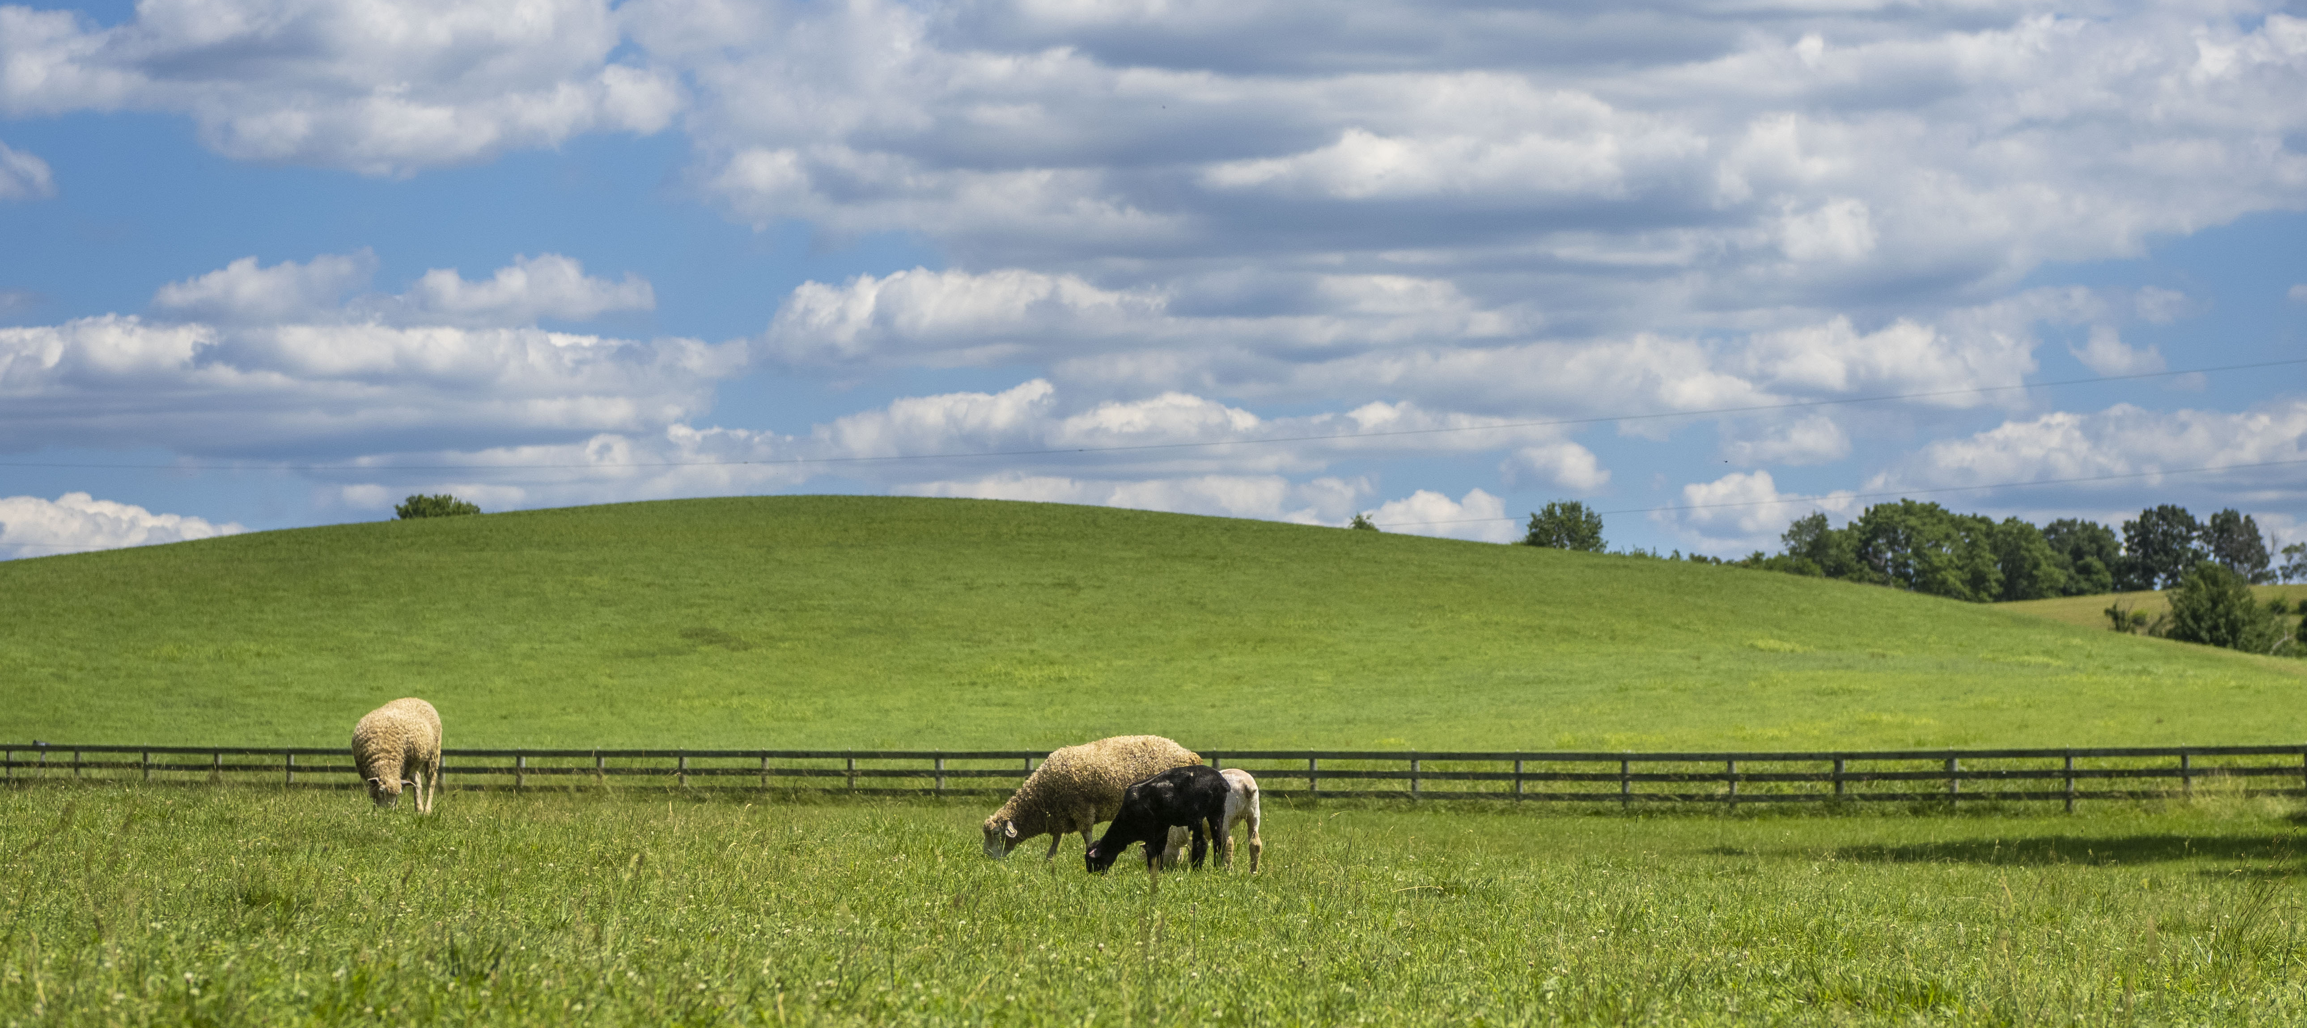
Transitioning Land to a New Generation
Getting Started with Farm or Ranch Transfer
Notes:
This module introduces the Transitioning Land to a New Generation Curriculum and prepares participants to engage in a farm or ranch transfer process.
It is the first of five consecutive modules—or workshops—designed to help participants gain the basic skills needed to participate in a farm, ranch or land transfer process.
We understand that each participant has a unique situation and there is no "one-size-fits-all" approach, so we focus on providing you with skills to build relationships with people involved in the process, to help you have needed conversations, make important decisions, and navigate the process.
This module prepares participants to prepare to engage in a transfer process.
The Learning Objectives include:
Identify key steps of a transfer process.
Clarify your values, vision, and goals.
Name key people involved in your transfer.
Assess needs and assets of the parties involved.
Describe ways to strengthen key relationships.

Slide 2
Acknowledgments
Transitioning Land to a New Generation was created by American Farmland Trust, supported by an Educational Enhancement grant from the USDA Beginning Farmer and Rancher Development Program.
Award # 2020-49400-33257
Thanks also to Farm Credit, the team of national experts in farmland transfer and access, and the members of American Farmland Trust.
Notes:
This curriculum was created by American Farmland Trust with support from a national Educational Team of advisors and a group of subject matter experts.
It was made possible by a grant from the USDA Beginning Farmer and Rancher Development Program Award #2020 - 49400 – 3325 with additional support from Farm Credit and the members of AFT.

Slide 3
Welcome
** TRAINERS: This slide is optional. Design it with information, such as:
names and photos of presenters
your logo
logos of any co-sponsors
Notes:
Welcome to this workshop. This is the first of 5 modules or workshops American Farmland Trust has created to help you get ready to be part of a farm or ranch transfer process.
We have found that most training on this about farm/ranch transfer and transfer cover succession and/or estate planning within farm families, and mostly from the point of view of the senior generation.
Since land transfers increasingly occur between non-relatives, we have tried to make our training as inclusive as possible: for those of you who come from farm families and for those who don’t, for younger producers and/or beginners as well as for land holders looking for someone to take on management of their land, their operation, or both.
It is designed especially for people who have land and/or farm or ranch business in mind and have at least started to talk with someone about transferring it – from young and beginning farmers and ranchers to landholders who may be retiring, or planning their estates, or who want to make land available for a new generation.
Trainer Instructions:
Have trainer(s)/presenter(s) introduce themselves
Review workshop agenda
Ask participants to introduce themselves

Slide 4
Today You Will Learn To:
Identify
Identify key steps of a transfer process.
Clarify
Clarify your values, vision, and goals.
Assess
Practice
Practice ways to build & strengthen key relationships.
Name
Name key people involved in your transfer.
Assess needs and assets of the parties involved.
Notes:
This workshop—or module—introduces the Transitioning Land to a New Generation Curriculum and prepares you to engage in a farm or ranch transfer process.
You will learn to identify key steps of a transfer process, clarify your values, vision, and goals, name the key people involved in your transfer, assess your needs and assets as well as the needs and assets of other key parties involved, and describe ways to strengthen relationships among key parties to improve the chances of a successful farm or ranch transfer.

Slide 5
Let’s Get to Know Each Other
Break into pairs. Find someone else if you came to the workshop with someone you know.
First person take 1 minute to introduce yourself:
Name,
where you are from,
what kind of farm/ranch property you have or want,
what you want to get from the training.
Switch roles.
Come back together with the group.
Each person introduces the other person based on what you heard.
Notes:
Motivation Activity
Let’s break into pairs. Take a couple of minutes to introduce yourselves to each other. Then we're going to ask you to introduce each other to the group. Not only will we get to know each other, this is a way to practice listening, an important communication skill that we will reinforce throughout the training.
Please turn to your neighbor and take 1 minute to tell them a little bit about your situation: Your name, where you are from, what kind of farm/ranch property you have or want, and what you want to get out of the training.
After a minute, switch roles and have the other person do the same.
We’ll come back together and introduce each other to the group. You’ll be introducing your partner, so you’ll want to practice listening carefully here.
Trainer Instructions:
As you set up this exercise, explain that throughout the curriculum communications skills will be emphasized to build and sustain relationships. We will address this in greater depth in Modules 4 and 5, but an important building block for relationships is to develop active listening skills.
See Teaching Plan for instructions and the Training Manual for suggested activity steps. Consider adding different questions. We recommend adding fun questions that help lighten the mood of the space.
Bring the group back together and have each person introduce the other person to the group.

Slide 6
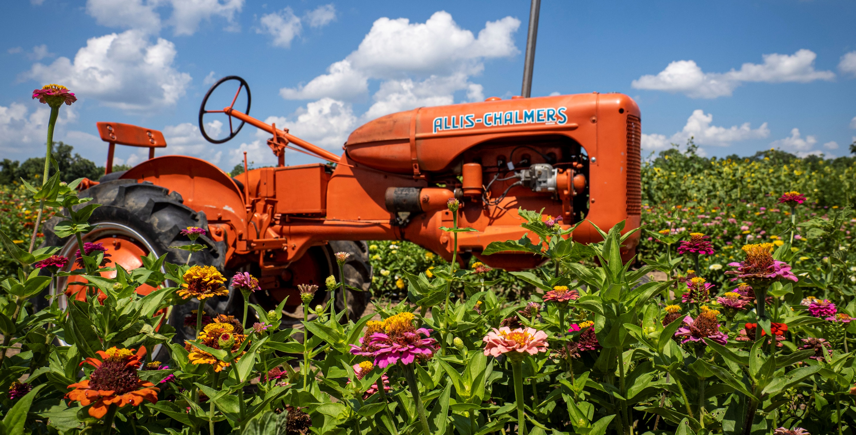
Part 1: The Transfer Process
Getting Started
Notes:
Transferring land, and potentially an entire farm or ranch operation, takes time and honest and clear communication, whether within a farm family or between non-relatives. This training is meant for both.

Slide 7
Who and What are Involved in the Transfer?
Within a family or between non-relatives?
Land?
A farm or ranch business?
Other farm or ranch assets?
Water rights? Mineral rights?
Notes:
The kind of transfer you choose and what will be involved in the transfer process depends on your own unique situation. It is important to be clear from the outset about what kinds of assets are involved as well as the types of relationships.
Will the transfer just involve raw land? If so, it’s going to be a lot simpler than if it also includes a farm or ranch business. Will it include any buildings or equipment? This may make it more complicated than just raw land but still straightforward.
Transferring a farm or ranch business can be complicated. It can happen all at once or over time. It can involve transferring everything to one person or dividing up assets between many and includes the transfer of knowledge and management.
When transferring a farm or ranch business, it also will be important to assess whether both parties’ goals and needs align with existing facilities. We’ll talk about this more in Module 3.
Depending on whether the transfer is within a farm family or between non-relatives, the number of people involved and the issues you need to prepare for likely will be different.
Timing is important, too. When will the transfer begin and end? Will it start happening soon, or will it take place after you or someone else retires or dies?
All in all, the process will have two or three main parts: the people involved, the land and farm/ranch assets involved, and the activities or business on the land.

Slide 8
10 Key Steps in a Farm or Ranch Transfer
Assess finances.
Describe your values, vision, & goals.
Tell your story.
Create your support team.
Identify your needs.
Negotiate.
Choose which tools to use.
Identify and strengthen key relationships.
Finalize documents.
Outline and adapt your plan.
Notes:
There are series of steps in a farm or ranch transfer process. We have broken it down into 10 steps. You likely will take most if not all of them, but it is not a linear process, so while a certain amount of order makes sense, you likely will find you move forward and back several times before you are done.
Today we are going to look at three of these steps:
Describing our Values, Vision, and Goals;
Identifying our needs
Identifying and strengthening key relationships

Slide 9
Where are You in the Transfer Process?
Find a Partner
Discuss where you are in the transfer process. Include any challenges or delays you are facing getting to the next step. Switch roles.
Regroup as a class and discuss highlights.
Notes:
Practice Activity
Trainer Instructions
The goal of this activity is to help participants identify where they are at in the transfer process and to recognize the various steps and stages, they may need to go through for a transfer to be successful.
Participants will use the 10 key steps diagram to describe where they are in a transfer process. This activity will help set the tone for the workshop, allow you to adjust the course of the workshop, and personalize the material for the audience .
1. Share the 10 Key Steps Handout.
2. Display the 10 Key Steps in a Farm or Ranch Transfer diagram for your participants. (Found in M1 Storyboard).
3. Discuss the major steps involved. Confirm sequence and timing may change depending on the situation.
4. Going through each step, ask participants to identify which they have started. You can choose how they identify (hand raise, standing, moving to point in the room, etc.)
5. Record how many responses to which step in the process. Use this to guide the emphasis and delivery of your training.
6. Make time for group reflection on this activity.
See the Engage Groups Guide in the Training Manual for ideas on group engagement.
Adapt this slide to adjust how you would like to run this activity.

Slide 10
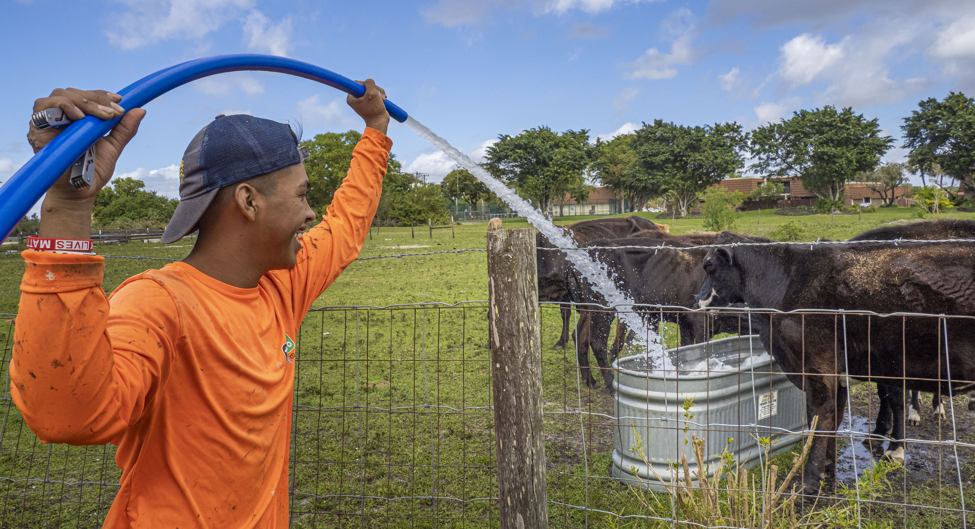
Part 2: Values, Vision & Goals
_
Notes:
In this section of the workshop, we will begin exploring your values, vision and goals, and how they relate to the land transfer(s) you are a part of.

Slide 11
Values
Vision
Goals
Notes:
Your values reflect the beliefs which guide your life and actions, with friends and family, at work—or on the farm—and in our communities.
Your vision is a statement of where you’re headed and what you want to achieve moving forward. If you have, or will need to have a business plan, you might translate your vision into a mission statement. But for this training, we are going to focus on the big picture and think of your vision as your hoped-for destination—where you want to be in the future after your farm or ranch transfer process succeeds.
Your goals are more concrete steps along the way. You likely will have both personal and business goals for your transfer situation.

Slide 12
What are your values?
Notes:
This is a visualization of different values. It is not a prioritized list but only an example! The size of the words is random and the importance of any of them will be different to different people.
The key take away is that successful relationships are built on values. If your process doesn’t uphold your values, it may not succeed.
Values are the priorities or principles that guide our behavior, whether in our personal life or business. They’re constant, and they’re at the heart of who we are, how we see the world, and how we measure how well our lives are going. Whether or not you are aware of them, they guide how you approach decisions and relationships.
Examples of values are things like being family or community oriented, fairness and equality, dependability and a strong work ethic. For your farm or ranch, they might be something like producing high quality products, meeting the needs of consumers, or protecting the environment.
Values are important because they help us live lives of purpose. Sharing values also can help move the farm or ranch transfer process along. But since they are different for each of us, it is important to be able to state clearly what yours are.

Slide 13
What is your vision?
“We will focus on the sustainable production of premium quality, identity-preserved grains. We will pursue sound investments in farmland and make every effort to be an asset to our community. We will provide a farming legacy for our children so they can participate in the family business.”
Notes:
Your vision describes where you want to be in the future – usually at least five years forward but even as much as 20 or more. It’s good to know where you want to be in the future so you can make a plan to get there. It’s important to ground your vision in your values.
-What values do you hold that you won’t compromise?
-What characteristics of your values and your future farm or ranch operation do you want to portray?
-What principles do you stand for?
-Ultimately, what do you want in life?
Here’s a slightly edited version of a vision statement of a diversified farm in the Midwest as an example. To explore these concepts more, I’m going to ask you to draft a vision statement of your own. This can inform a mission statement for your operation, which you will need for a business plan, but it also should inform the way you approach the transfer process.

Slide 14
What are your personal goals?
What do you want your life to be like?
What life-work balance do you want?
What are your family goals?
What are your income goals?
Notes:
After you have clarified your current values and your vision of where you want to go, you will want to think about what will get you there.
Your goals should be specific guideposts to help you achieve your vision, based on your values.
You’ll want to set personal and business goals that work well together. A few examples of personal goals are listed here.
Trainer Instructions:
This is s good place for some discussion and participant engagement.
Let’s think of some examples to get more specific about these goals.
What do you want your life to be like? – give examples – I want to take a vacation every December. What are some other examples of what you want your life to be like?
What life-work balance do you want? – give examples – I want to work equally year-round – or I want to have time for my ballroom dancing classes once a week. What are some other examples.
Let’s think about business goals now.

Slide 15
What are your business goals?
Acquire or transfer land.
Pass on a farm/ranch business.
Leave a legacy.
Be a good steward of the land.
Notes:
This list offers suggestions of some business goals ideas.
What do you want your farm or ranch business to look like? We’re already touched on this as part of both your current situation and your vision of the future, but it is important to be specific about the kind of operation you want to have. These are some key questions to answer – We won’t have time in this workshop to fully fill these out, but we have a worksheet to help you think through it on your own time.
In a farm transfer situation, it also is important to learn about the needs of the other party in the transfer. Usually, the goals of an incoming producer are different from those of the exiting landowner so be sure to have an open dialogue and try to find common ground.

Slide 16
Set “SMART” Goals
SMART goals are:
S = Specific
M = Measurable
A = Attainable
R = Results-Focused
T = Timely
Notes:
Goals setting can take a lot of time, so we’re not going to go into depth on it here. I’ll share a worksheet with you for homework, but I do want to cover some of the basics of setting solid goals. Setting useful goals can be difficult. They should be simple, yet specific enough to clearly define what you want to accomplish. They should cover the 5 Ws: Who, What, Where, When, and Why, as well as How.
Many people use the SMART goals framework to set useful and actionable goals. SMART goals are:
S = Specific well-defined and clear.
M= Measurable because when you measure results, you know whether (or not) you have achieved your goals.
A=Attainable and realistic enough that you can achieve them with time and effort.
R=Results-Focused meaning they include the resources, knowledge and time you need to reach your goals.
T=Timely or timebound, meaning linked to a realistic timeframe. A goal without a timeline is just a dream.
Let’s work through an example. A broad goal might be “To inherit my grandfather’s vegetable operation.” That’s a worthy goal to start. but it doesn’t answer the deeper SMART questions.
To make it more Specific you might refine the goal to be “To inherit my grandfather’s operation and produce a seasonally diverse mix of fruits and vegetables to sell at farmers markets and to local schools.”
To make that Measurable you might add: “Earn an annual gross income of $150,000, increase crop yields 5 percent by improving nutrient management, and increase sales by $25,000, by adding 2 farmers’ markets and a local school to the marketing portfolio.”
Then check to make sure these are all Attainable. Even if it’s a stretch, could you accomplish these things in 2 years? What resources do you need? Do you have them or what else do you need to get the help that you need?
Finally, make sure you have a realistic timeframe. For example: “To increase crop yields by 5 percent next year by improving nutrient management and pest control” or “To increase sales by $10,000, by reaching out to at least 25 new sales prospects in the coming 6 months.”

Slide 17
Values, Vision and Goals
Select 3 to 5 values most important to you.
Create a short phrase expressing your values related to your transfer.
Draft a vision statement.
Set a goal for your transfer process.
Notes:
Practice Activity
We’ve talked about Values, Vision, and Goals. In a farm or ranch transfer, it’s important these things be clear to you, so you can clarify them to others involved.
Now we are going to take a little time to fill out the questions on the Vision, Values and Goals Worksheet. (tell your participants how much time)
First, review the Values Information Sheet. Pick 3 to 5 which are most important to you as you move forward in your farm or ranch transfer process. If you hold values that are not found on the Values Information Sheet, feel free to add your own.
Next create a short phrase or sentence combining these and other words to express what is important to you in a values statement related to your farm or ranch transfer.
Move on to a draft vision statement. Think of it as your destination at least five to 10 years in the future. It should be based on your values to guide you as you move forward with your farm or ranch transfer.
Lastly, in a sentence or two, describe what you want to get out of your farm or ranch transfer process. This will serve as a high-level goal or set of goals. For homework, you are going to take your goals and make them SMART. This exercise will help get you started.

Slide 18
Part 3: Assess Your Needs
And the needs of others involved in the transfer
Notes:
Now that you’ve clarified your current situation and where you want to go, it’s time to think about what you want and need to get there.
You will also start identifying who else is involved, and what they want or need to get out of the transfer process?

Slide 19
What are your needs?
What do you need to get out of the transfer to meet your goals?
Buildings or equipment?
Income?
Community networks?
Health Care?
Legacy?
Land?
Notes:
Now let’s turn to your farm transfer opportunity. You can take a look at the Needs Assessment Worksheet. We’ll make to time to work through this more in a minute, but if you want to start writing ideas out now you can.
What do you need to get out of it to achieve your goals? For example, if you are the incoming producer do you only need raw land, or do you need farm or ranch infrastructure like buildings, fencing, irrigation systems, as well? Or are you the landowner and what you really need is retirement income and to leave a legacy for your heirs?
If you are negotiating with a non-relative, you may want to develop or maintain relationships and/or community networks.
One way to assess what you need is to think about the gaps between your current situation and your goals. You already started filling out your worksheet and will spend more time working on this outside the workshop. For now, think about how the farm transfer could address these gaps. For example, could the transfer improve your housing situation? Could it provide employment and sufficient income for you and other family members? In addition, how could the transfer advance your business goals?
Consider what resources the other party has that you currently use or could use. This might include the farm or ranch business or intangible assets like expertise, business contacts or a client list. It might include management experience. These are the things you will negotiate for during the transfer.

Slide 20
Assets are things of value.
Assets may include:
Cash, savings, and real estate
Social networks and access to resources
Knowledge, experience, and interpersonal skills
Position in a family, institution, or society
Quality soils and plentiful clean water
Notes:
To assess your needs—and the needs of the other parties involved in your transfer situation—it’s important to understand assets.
Assets are things that have value: Both tangible or physical things like land or a bank account, and intangible or nonphysical things like strong family ties or social networks.
In farm transfer situations, people tend to think of assets as resources with financial value which can be reported on a balance sheet. We’ll talk about these kinds of assets more in Modules 2 and 3. They include things like cash and savings, land and buildings, crops and livestock, equipment and inventories, and intangible property such as an established brand or a clients list.
In thinking about the value of a farm/ranch property’ to you, other assets are equally important but may or may not have a value easily shown economically. Assets such as knowledge, skills and abilities are important assets, too. Especially if you’re in—or entering into—a transfer situation that includes any part of a farm or ranch business. Things like farming experience and business management are very important assets. Assets also include things like legal knowledge or strong communication skills.
They also include your relationship to your community, having strong social or business networks, access to information and capital resources, even things like belonging to farm or other associations.
Finally, assets include the different kinds of things that give a person the power to influence other people and affect the use and distribution of resources. These include comfort with cultural norms, holding positions of power or influence within a family, organization, institution, or society.

Slide 21
Which financial assets do you have or need?
Cash or Capital
Land
Crops/livestock
A farm or ranch business
Equipment
Notes:
You can take a look at the Asset Inventory Worksheet. We’ll take time to work through it in a minute, but if you want to write out ideas now you can.
Let’s start with your financial assets. Do you have or need cash or savings, or the ability to acquire capital? Do you have or need agricultural land, equipment, or other assets like crops or livestock? What about a farm or ranch business?

Slide 22
What other assets do you have or need?
Legal Knowledge
Management experience
Communication skills
Business expertise
Community relationships
Access to resources and information
Notes:
Now let’s think beyond financial assets—what other assets do you bring to the table or need to acquire?
For example, do you have or need hands-on farming or ranching experience. Do you have or need production, marketing or management skills? ? What about legal knowledge or business expertise? Or communication skills or community relationship?

Slide 23
Who is involved in your transfer?
Land-owners
Family
Employees
Neighbors
Incoming producers
Government entities
Financial lenders
Notes:
Now you’ve thought about your needs and assets, let’s think about the other people who have an interest or stake in your farm/ranch transfer situation. In your Needs Assessment Worksheet - part 2 – you can start to add your ideas.
If you are an incoming producer, it is most important to think about the person who owns the land and holds other assets that you want to acquire.
If you are the landowner or asset holder, think about the incoming producer and what they need.
Either way, also consider who else could be affected by your transfer situation, like family members, any employees you may have, and depending upon where you are and the type of farm or ranch operation, other people who might have a stake, like neighbors or community members. For example, if the owner is an institution, like a land trust or municipality, members of the community may have an interest in the outcome of the transfer.

Slide 24
What are the needs of those involved in your transfer?
Farm assets?
Income?
Ongoing relationships?
Community networks?
Security and peace of mind?
Legacy?
Land?
Notes:
Before moving forward, step back and consider the transfer from the point of view of the others involved.
What do you know about their current situation, values, vision and goals?
What do they need to get out of the situation? What are their motivations for moving forward in a transfer?
Thinking about their needs from the outset sets the stage for more effective communication and negotiation down the road. We will be talking more about this in Modules 4 and 5.
To get to a “win-win” outcome takes understanding of your own position and the position of the other party so you can find a mutually acceptable agreement which gives you both as much of what you need as possible.
“Win-win” means you both walk away happy, and your needs are met.
It is important to consider what the other party needs and to figure out where there is room for negotiation and compromise.

Slide 25
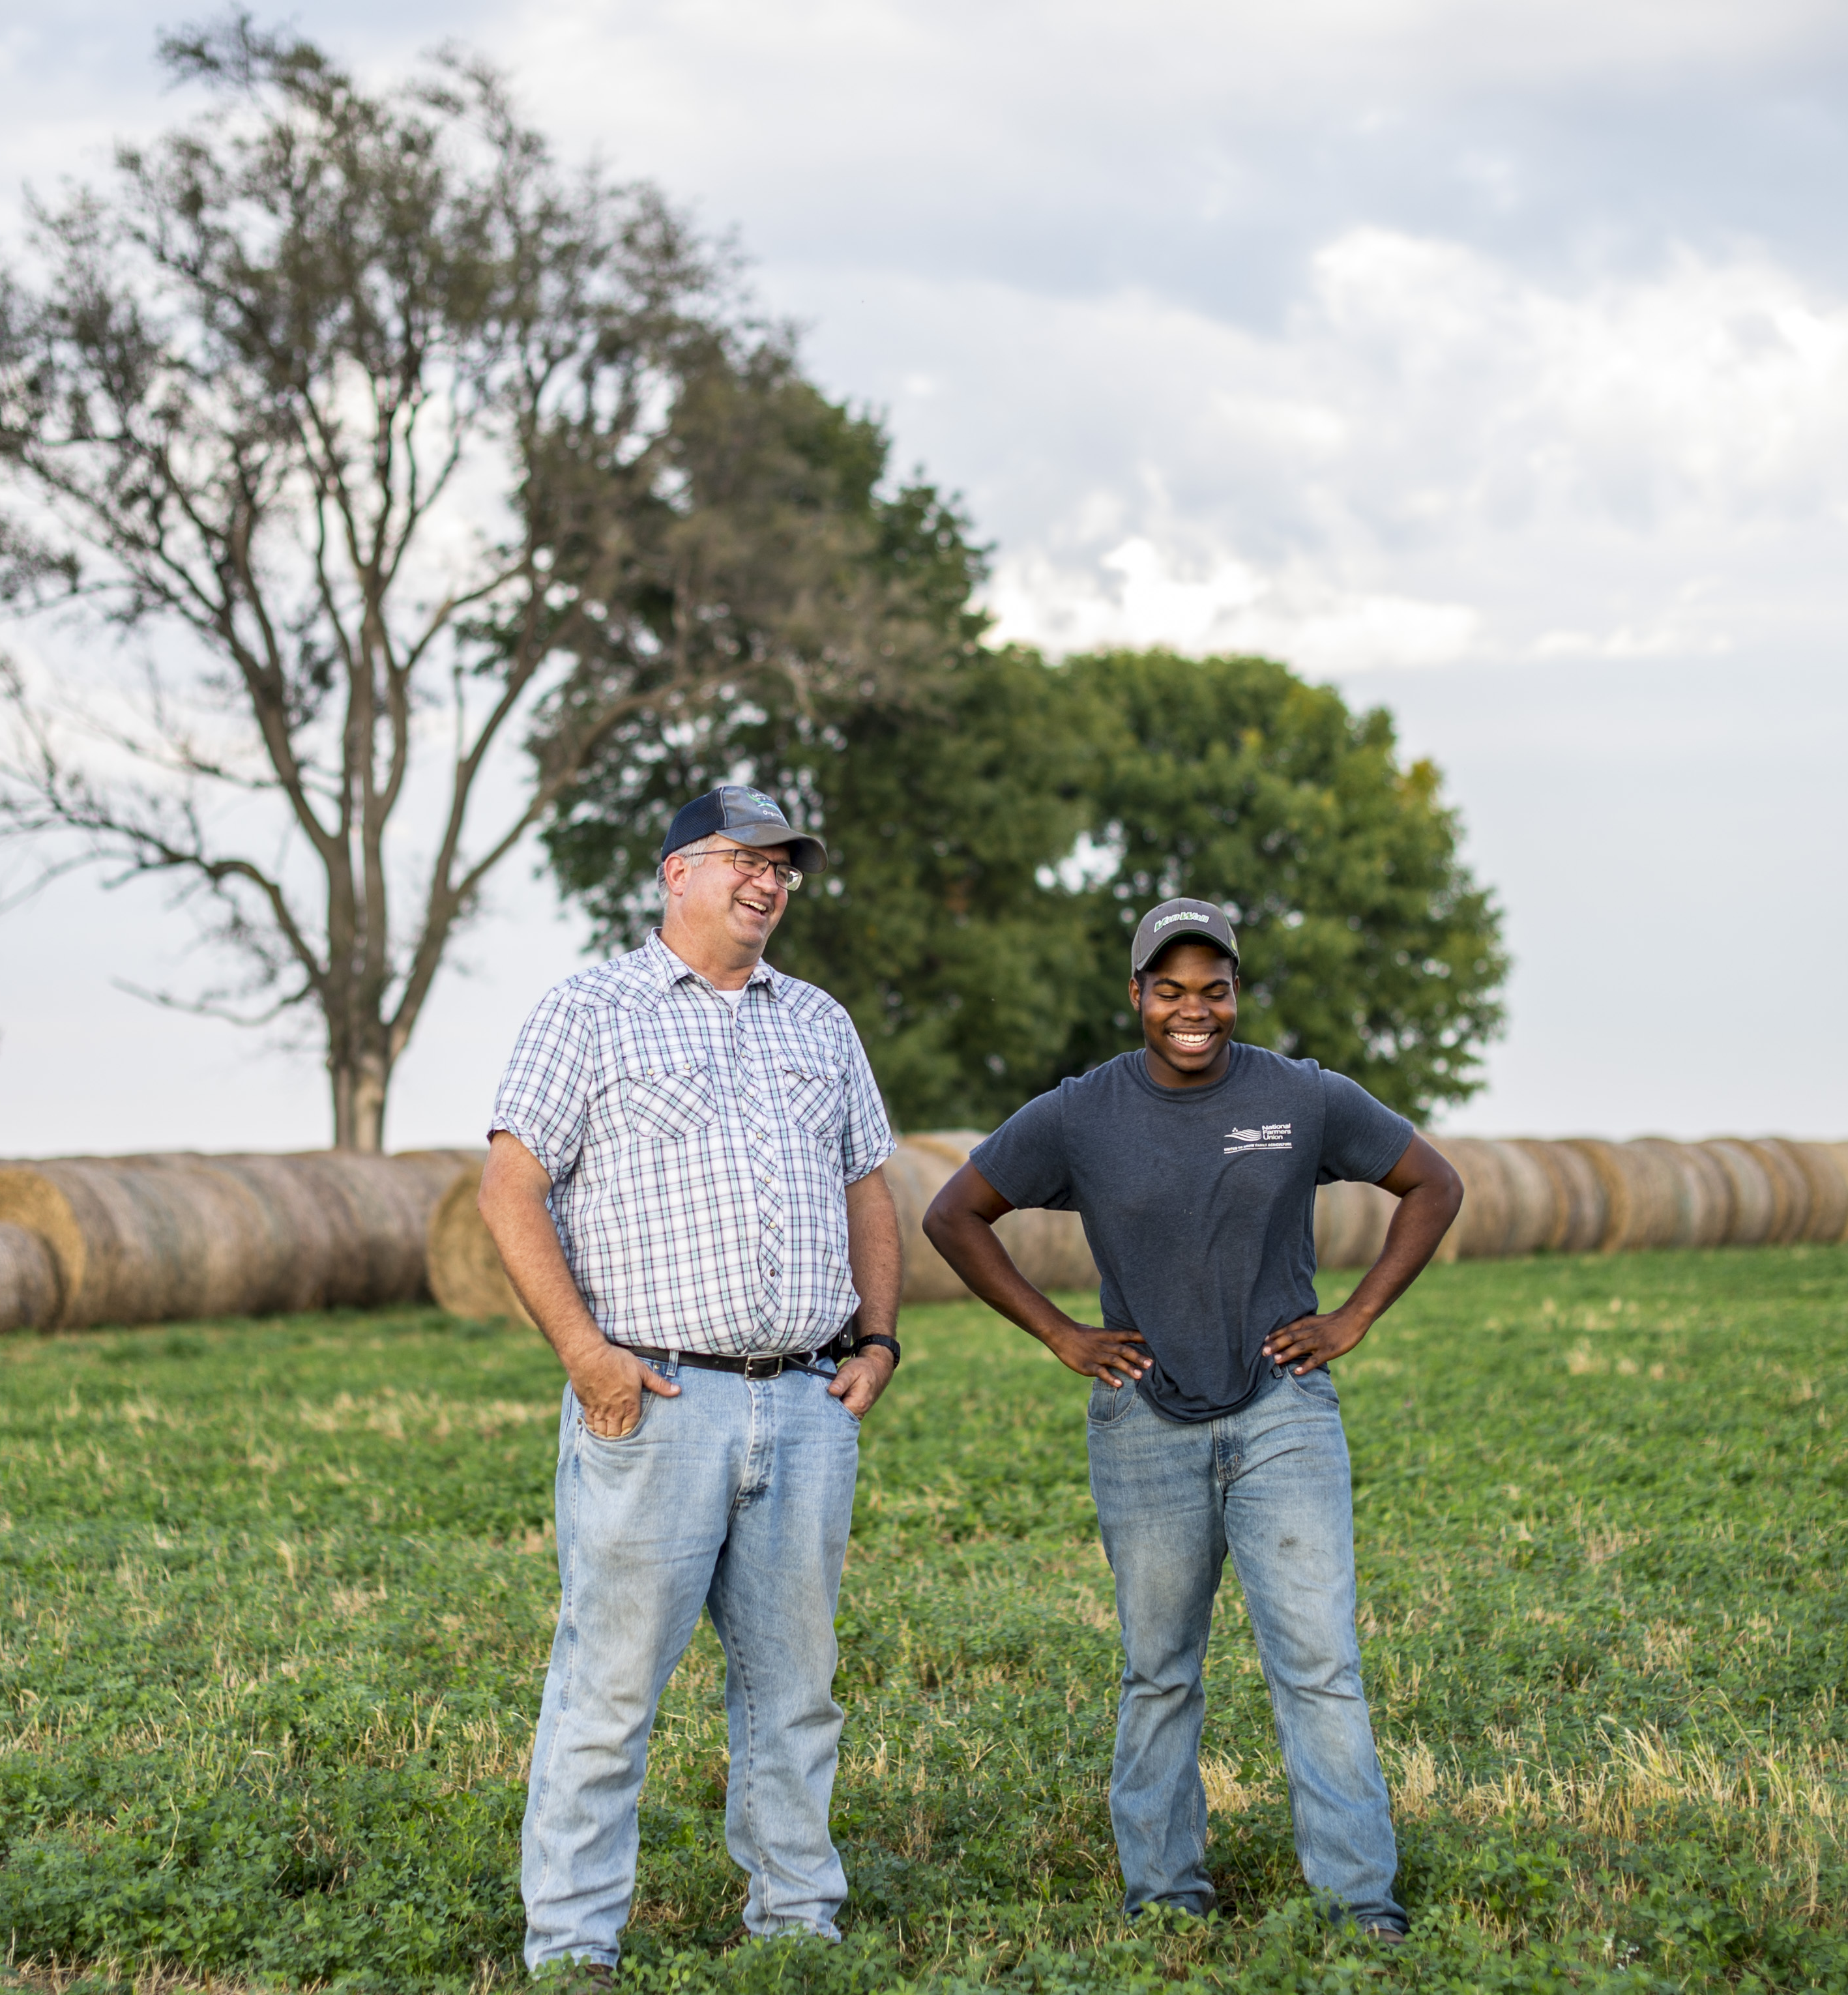
What assets do they have?
Who owns the land and other assets?
Who has a share or interest in the operation?
Who has experience?
Does social identity affect dynamics?
Notes:
A key issue to consider during the farm transfer process is who controls what assets–essentially how much power do the various parties have to make decisions and move things forward. Who owns or controls the land involved in the transfer? Who else has a share or interest in the property or operation and what is their role, their stake, their power to affect the outcome?
Underlying these obvious power dynamics are subtler ones related to identify.
Do social or institutional factors like age, family position, race/ethnicity, gender, education, religion, sexual orientation, or socioeconomic status affect their situation? Or yours?
Think about what assets you have which might balance out these dynamics.

Slide 26
Practice Activity
Review the Needs Assessment and Assets Inventory Worksheets.
Fill out the Needs Assessment Worksheet first. Then start on the Asset Inventory worksheet.
Come back together and discuss.
Notes:
Practice Activity
Trainer Instructions:
See the Training Manual; More than a Worksheet Activity Guide for ideas on engaging groups with worksheets.
Tell participants how much time they have to work on the worksheets.
Possible discussion questions:
Was it easy or hard to fill out the worksheets?
Do you have any questions?
Let’s discuss key themes. Please think about who is involved in your transfers and not only what you have and need, but also what they do. Did you gain any insights from this activity?

Slide 27
Part 4: Build and Strengthen Key Relationships

Slide 28
Why are we talking about relationships?
Land-owners
Family
Employees
Neighbors
Incoming producers
Government entities
Financial lenders
Notes:
It may seem strange or uncomfortable to talk about building relationships in a farm and ranch setting. But relationships can make or break a transfer situation especially when it is happening over time. Building and strengthening relationships is a key step to a successful farm or ranch transfer. Relationships of farming and ranching come in many forms. Some are intimate family relationships, while others are temporary and transactional. In the previous section we identified who is involved in your transfer. Each of those people or organizations comes with their own unique relationship to tend to. Now we are going to talk about how to build or improve the relationships that are important to you in your transfer. We’ll talk through some fundamental communication skills that you can practice and take forward. I encourage you to think about relationships and communication as a key part of transferring your farm or ranch and as a skill you can build over time.
Trainer Instructions:
Before delivering this section, consider your audience and how the power dynamics of their situation may be affecting the relationships they are considering. Determine how you will present this information and if possible, acknowledge and/or invite discussion to understand more about where they are coming from. There are places in this section where you can build discussion on dynamics in.

Slide 29
Healthy relationships are a process of
Understanding the other’s point of view
Cultivating empathy and trust.
Communicating Effectively
Notes:
Farm/ranch transfer is an involved process and may take years to achieve. It isn’t easy. It takes time, and care, and often involves challenging conversations. You likely will need to plan and adapt, and then plan and adapt again. Some conversations may need to happen over time.
Fostering healthy relationships throughout the process will improve your chances of success and lead to better outcomes for all the parties involved. Healthy relationships are a process of communicating effectively , understanding the other party’s point of view, and cultivating empathy and trust.

Slide 30
Effective Communication is a process of giving and receiving to share information and meaning.
We express a message.
We listen to learn and respond.
Repeat to understand and clarify.
Notes:
Effective communication is the process of exchanging information. It involves the person who is expressing themselves, the message or information they want to share, and the people who are listening and receiving their message. In a healthy conversation, each person plays both roles and we repeat the process to create understanding and clarify our meaning.
This may sound simple, in truth it’s quite complex because communication is affected by so many things: Feelings, culture, power, generational preferences as well as the channels through which the message is shared: in the spoken word, as gestures, over email or a message, or around the kitchen table.

Slide 31
How do you Communicate Effectively?
Express yourself clearly
Stay present
Listen carefully
Notes:
There is a lot happening when we communicate. Boiled down, these skills are key to being an effective communicator.
Express yourself clearly: How does this relate to a farm or ranch transfer? You’ve already worked today to define your values, vision, and goals. In a farm or ranch transfer it is important that you can clearly explain or express these to people involved in your transfer. (Module 4 is all about practicing this skill. If this is a skill you would like to practice, ask me for Module 4: Tell Your Story resources). Knowing what you want, what you need, what you have and what you bring to a situation and being able to clearly state it, will help other people understand you. It’s also important to be clear about how you are feeling about a situation so others are aware and can respond accordingly.
Listen carefully: We practiced listening at the very first introduction today. Given it is something we do everyday, active listening can be hard because we can be distracted by work, life, emotions, etc. Putting intention to listening will support you in building relationships as it helps you to understand the other party, gives insight into how to respond, and helps cultivate trust and empathy.
Stay present: Active listening will ensure you stay present in the moment. Again, distractions come in all forms. When it comes to farm or ranch transfers, the conversations needed will require full attention at times. This again, will help support strong relationships. Consider a time when you were talking to someone who was distracted. How did it make you feel – how did it affect your relationship to them?

Slide 32
We express ourselves in two main ways
Verbal
Speaking
Writing
Nonverbal
Body language
Notes:
Here is a little more detail into the first circle of effective communication – Express Yourself Clearly.
There are two key ways we express a message. Verbally and Nonverbally.
Verbal communication is the use of words to convey a message and meaning. It includes speaking and writing.
We use verbal communication in both formal and informal situations. For example, we use verbal communication formally in meetings and business proposals, and informally in personal conversations with family and friends. We use formally it when we write letters, plans, and business agreements. And we use it informally—even casually in notes, texts and social media posts.
Body language, or non-verbal communication also is a very important part of communication. Our faces, hand gestures, and body movement all send a message. Body language can be as important to a conversation as the words that are said. Crossed arms and a scowl can stop a conversation before it starts – or at least start it from a place of defensiveness. A smile and wave can bring someone into the conversation who may be feeling on the side.
Simply bringing awareness to your own body language will help you be a more effective communicator. And learning to read other people’s body language will help you respond effectively.

Slide 33
Listening is the most powerful part of effective communication.
Be present
Pay attention
To meaning
Reflect back
What you hear
Notes:
The 2nd circle of effective communication is listening carefully.
Listening is the most powerful part of communication.
We have 2 ears and 1 mouth. ☺ Listening is the act of receiving information. It gives you information and helps you understand what is important to another person. It also helps you prepare to share your story, enter negotiations and can help avoid conflicts and misunderstandings.
Listening well involves three things:
Being Present: Really paying attention to what the other person is trying to say takes some focus and intention. To be present, quiet your own thoughts. Don’t start preparing a response until the other person has finished speaking. While listening to their words, also listen to the rhythm and tones they are using and their body language. You can show the speaker that you are listening by looking at them, nodding your head, keeping your body language open.
Listening For or Paying Attention to Understand Meaning: It also is important to listen for the meaning behind the words, for what the person is really trying to say. Listen for what they value, what they need and how they feel. In a farm/ranch transfer situation, listening for meaning may take many conversations and happen over years.
Reflecting Back What You Hear: A good listening practice is to reflect it back and clarify what you hear. You can summarize what you’ve heard by saying things like “Sounds like what you’re saying is….” or “What I hear you say is ... “ or “I like your idea to ... “ Ask them to clarify anything you don’t understand. The trick is not to add your own experience or judgement about their situation, but to listen to their experience.
Remember the introduction activity we did at the beginning where you had to listen to introduce tour partner. Knowing you had to introduce the person, helped you stay present in the moment. Try to practice that when you are listening to someone as a way to deepen your listening skills.

Slide 34
Who defines effective communication ?
How do you receive information best?
How does someone communicate something effectively to you?
How do you communicate best?
Ask the same questions for how your audiences communicate.
Notes:
GROUP DISCUSSION
Now that we have talked about some of the skill of effective communication – I want to point out that what is effective for you, may not work for the other parties involved. Just like you are considering the needs of the other party involved in your transfer – you will also want to consider how they communicate.
Trainer Instructions:
Encourage participants to think about what is effective communication to them and what is effective to their audience(s). Ask them to give specific examples of verbal and non-verbal communications. The goal is to give people an opportunity to embrace the fact that we all communicate differently. Encourage finding commonalities even when definitions of communication may be different.
Acknowledge that this process may be frustrating for people of color, for women, people with disabilities, people who are coming to farming with little experience and who traditionally have been left out of land ownership and capital opportunities. It can also be frustrating for people who may just communicate differently. “Effective” communication can be a place where people get frustrated and give up on pursuing their vision or continuing a negotiation. Allow for space to express those frustrations if they occur and focus back on the importance of participants’ authentic stories and finding commonalities in communication. Farming/ranching and the love of it – can be a good way to find commonalities and build empathy.
Popcorn discussion:
Use questions like:
How do you receive information best?
How does someone communicate something well to you?
How do you communicate best?
Based on your communication skills, how might someone else support you?
And now consider who your audience(s) may be
How might they receive information?
What might they consider effective?
How might they best communicate?

Slide 35
Understand the Other Parties’ Point of View
Appreciate cultural and generational differences.
Put yourself in the other person’s shoes.
Practice empathy.
Look for common ground.
Notes:
Moving from effective communication – remember that it is a skill and can be practiced.
The next piece of our healthy relationships diagram is: Understand other points of view,.
It is important to understand the point of view of the other people involved in your farm or ranch transfer situation. We started to talk about this as we identified needs and assets. This is a thread that will run through this curriculum and one that is important to pay attention to as you move along in the process.
Toward this end, take time to recognize and respect any cultural differences including cultural and communication differences between generations. With as much as 40 percent of American farmland owned by seniors, transfers often occur between multiple generations.
Empathy is a word to describe the ability to understand and share the feelings of another. It is a skill that can be learned and is important to creating connection with another person. Thinking about your transfer situation from another’s point of view and putting yourself in their shoes will build greater understanding, reduce the likelihood of conflict that may end negotiations, and help move things along.
Looking for common ground is especially important to negotiations. Try to find the overlap between your wants and needs and theirs so you both benefit from the transfer. One good place to find commonality is usually the love for the land or the honor of farming and ranching. (Module 5: Prepare to Negotiate goes further into this practice).

Slide 36
Put yourself in their shoes…
Landowners may experience…
Concern over different growing practices.
Grief over legacy.
What else?
Land Seekers may experience…
The desire for freedom to change practices.
Frustration about transfer timing.
What else?
Notes:
Putting yourself in someone’s shoes is not to say you must agree with them or get along – but understanding where they are coming from in the transfer process will help keep lines of communication open. It’s important to think through what people on the other side of a transfer are experiencing. Depending on the level of your relationship, you may have to ask and be prepared to listen carefully – as you don’t want to assume what people are thinking or going through. If you don’t know, set aside time to have a conversation. Explicitly making time to talk and understand each other will build trust and empathy and help the process work.
Trainer Instructions:
Potential Discussion Questions:
This is a good place for some group discussion or private reflection.
Ask participants to think about the people they have named in their needs assessment worksheet.
Have them call out or write down some thoughts on what they might be experiencing in their transfer.
Discuss ways they might find out more information if they don’t know what experiences are happening, how they would they find out.
Modules 4 and 5 of this curriculum go more in depth on preparing for different conversations. As you plan for this workshop, there are components of those Modules you may want to carry over.

Slide 37
… to find commonalities
Landowners may experience…
Land Seekers may experience…
Uncertainty about the future.
Feeling disrespected because of age, or life situation.
What else might both experience?
Notes:
Putting yourself in someone’s shoes is a good way to also find commonalities and points of connection. If you can find ways to think about your shared experiences, you’ll be a step closer to the third piece of our healthy relationships pie – Cultivating empathy and trust.
Trainer Instructions:
Potential Discussion Questions:
This is a good place for some group discussion or private reflection.
Ask participants to think about the people they have named in their needs assessment worksheet.
Encourage them to think of commonalities.
Modules 4 and 5 of this curriculum go more in depth on preparing for different conversations. As you plan for this workshop, there are components of those Modules you may want to carry over.

Slide 38
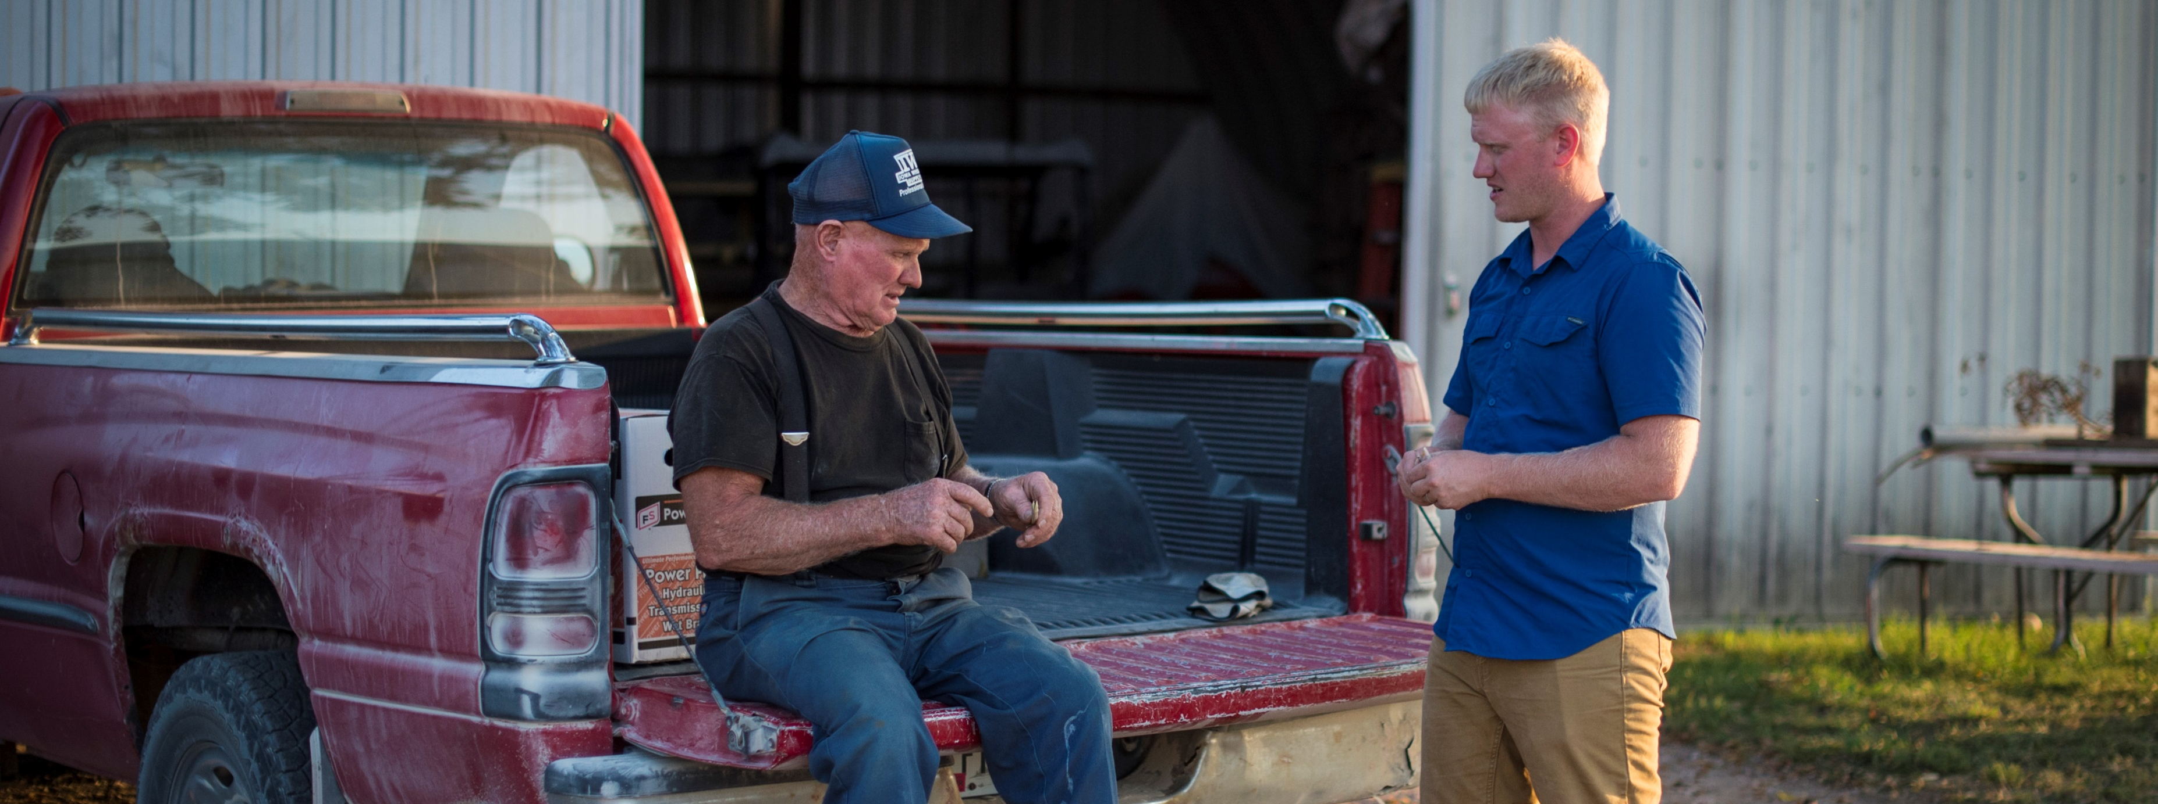
Cultivate Empathy and Trust
Practice Effective Communication
+
Understand the Other Party’s Point of View
Notes:
Bringing it all together, healthy relationships are a process of effective communication and understanding other points of view, all of which will help cultivate empathy and trust. These are all intertwined ideas that work together to strengthen relationships. The final piece of the pie is cultivating empathy and trust. Like a farm or ranch transfer or a growing season – trust and empathy are a process. It may take a transformation of thought from one or both parties. Trust and empathy may exist one day and be challenged the next. Sometimes there is conflict in trust, but effective communication can support moving through conflict. While it is harder to pin down a skill of trust and empathy, there are actions you can take to communicate trust.
Trainer note:
Modules 4 and 5 of this curriculum spend more time talking through and practicing the different kinds of communication that come up in a farm or ranch transfer but hopefully you have some key ideas to take away today.

Slide 39
Ways to Communicate Trust
Be transparent
Show respect and care
Be accountable
Admit if you are wrong
Keep promises
Give appreciation
Be honest
Notes:
Trust can be complicated and is influenced the dynamics of a relationship. Typically, in a farm or ranch transfer the landowner – or person with most financial assets – holds more decision-making power than the incoming generation or land seeker. But the landowner likely has specific needs they are looking to meet. These dynamics certainly affect how trust is communicated and how relationships are maintained. As we have talked about considering other points of view, and communication differences, it is important to recognize these power dynamics affect our ability to give or receive trust.
Although trust is not a simple and straight-forward concept, we can still look at some actions that help to communicate and cultivate trust over time.
Trainer Instructions: This is a good place for group discussion. You can ask for examples of actions that represent each of these ways to communicate trust. You can also choose to point them to the Cultivate Trust Worksheet either to work through on their own, or with a partner or small group.
**Before delivering this section, consider how you will address possible power dynamics that your audience may be experiences. This will greatly affect their ability to engage in a conversation about trust.

Slide 40
Practice Activity
Complete the Cultivate Trust Worksheet and discuss your results with a partner.
Notes:
Practice Activity
Thank you for thinking about the importance of communication in a farm or ranch transfer.
These last skills are important to the logistics of your process and business.
Trainer Instructions:
You have choices for this practice activity. The goal is to practice one of the three components of this section. Choose an activity that suits your style of teaching and your audience.
Effective Communication
Understanding other points of view
Cultivate empathy and trust.
Notes for English Language Learner (ELL) audiences: Instead of a worksheet, you could lead this as a discussion activity, or write your examples on flip chart paper for the class, instead of asking each person to write. This could be a role-play activity where you assign pairs to act out each example, or even “charades” where you explain the examples, they have the audience guess which one is being acted out.
See the Land Transfer Training Manual Activity Guides for additional activity ideas. Recommended activities include: Questions to Cultivate Empathy and Trust, Role Playing, Encourage Conversation with Case Studies.

Slide 41
Wrap Up
Notes:
We’ve covered a lot today and over the rest of this course. One more time for good measure – these are skills that need practice to be more effective. Look back to your workbook for reminders and continue to add to it as you think about and progress through your transfer.

Slide 42
10 Key Steps in a Farm or Ranch Transfer
Assess finances.
Describe your values, vision, & goals.
Tell your story.
Create your support team.
Identify your needs.
Negotiate.
Choose which tools to use.
Identify and strengthen key relationships.
Finalize documents.
Outline and adapt your plan.
Notes:
As a reminder as we begin to wrap-up, here are 10 key actions in farm or ranch transfer planning process. Remember, it’s not a linear process, and while a certain amount of order makes sense, you likely will find you move forward and back several times throughout the process.

Slide 43
Homework
Complete the Needs Assessment and Asset Inventory Worksheet.
Review the SMART Goals Information Sheet.
Fill out the SMART Goals Worksheet.
Complete the Cultivate Trust Worksheet
Notes:
For your homework:
Complete the Needs Assessment and Asset Inventory Worksheet.
Review the SMART Goals Information Sheet.
Fill out the SMART Goals Worksheet.
Complete the Cultivate Trust Worksheet.

Slide 44
**TRAINERS: Design this slide with information, such as:
Names and photos of presenters
Your logo and the logos of co-sponsors
Closing thoughts
Resources
Thank you
Notes:
Trainer Instructions:
Add your own closing notes.
Consider a casual networking time at the end of this workshop to give people time to socialize.
See the Training Manual for ideas on social gatherings.

