Slide 1
2024 Surveys of State and Local PACE Programs Graphics
The graphics in these slides show the results of the Farmland Information Center’s surveys of state and local Purchase of Agricultural Conservation Easement (PACE) programs.
These visuals are available for use with proper attribution to AFT’s Farmland Information Center. Suggestions for additional visuals can be submitted to the FIC via this online form.

Slide 2
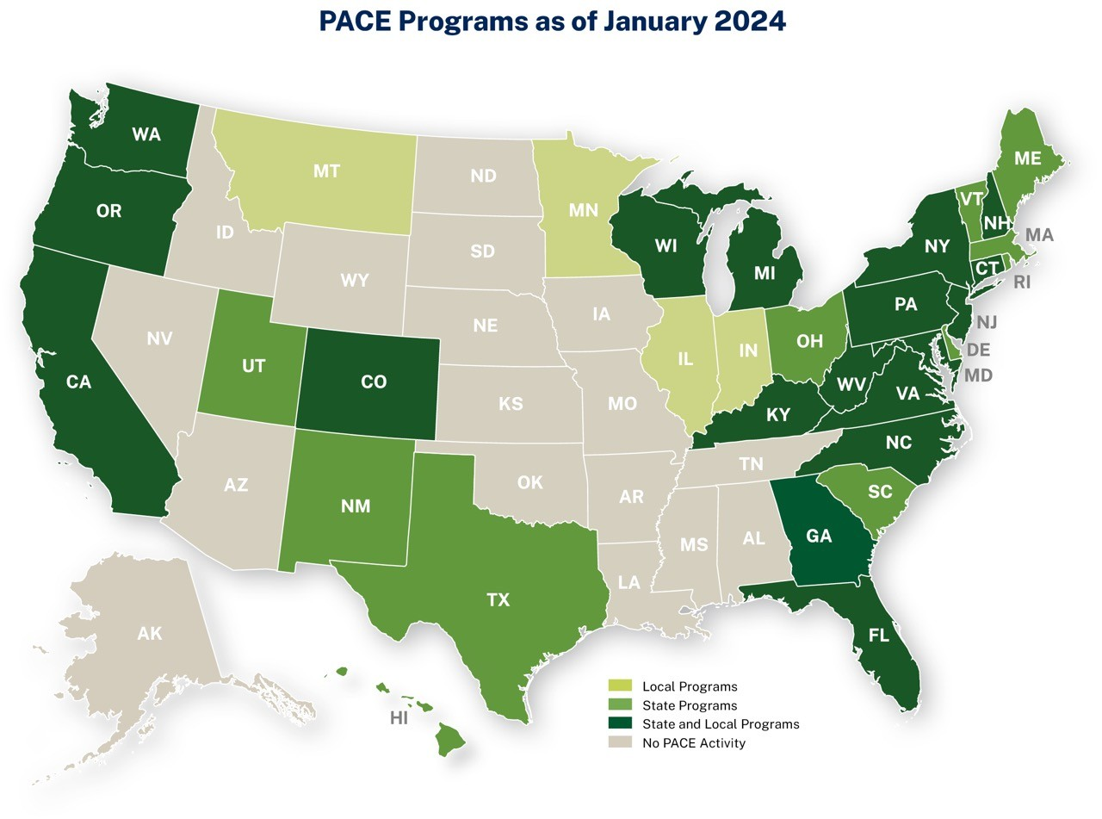
Notes:
AFT’s Farmland Information Center (FIC) conducts a survey of state purchase of agricultural conservation easement (PACE) programs annually and a survey of local PACE programs every four years. This map shows the states with state and/or local PACE programs.
As of January 2024, there were 37 active state-level programs across 29 states. Of these states, 18 also have local PACE programs. Four additional states—Illinois, Indiana, Minnesota, and Montana—only have PACE programs at the local level. Most recently, Georgia authorized a state program in 2023. The program has received funding but, as of January 2024, the program has not yet acquired any easements. Oregon's state program received funding in 2021 but has not acquired any easements as of January 2024. Missouri has authorized PACE but does not yet have a program. Montana’s state program expired in 2003. Montana and Alabama no longer have active programs but are included on this map because they have funded easement purchases in the past.

Slide 3
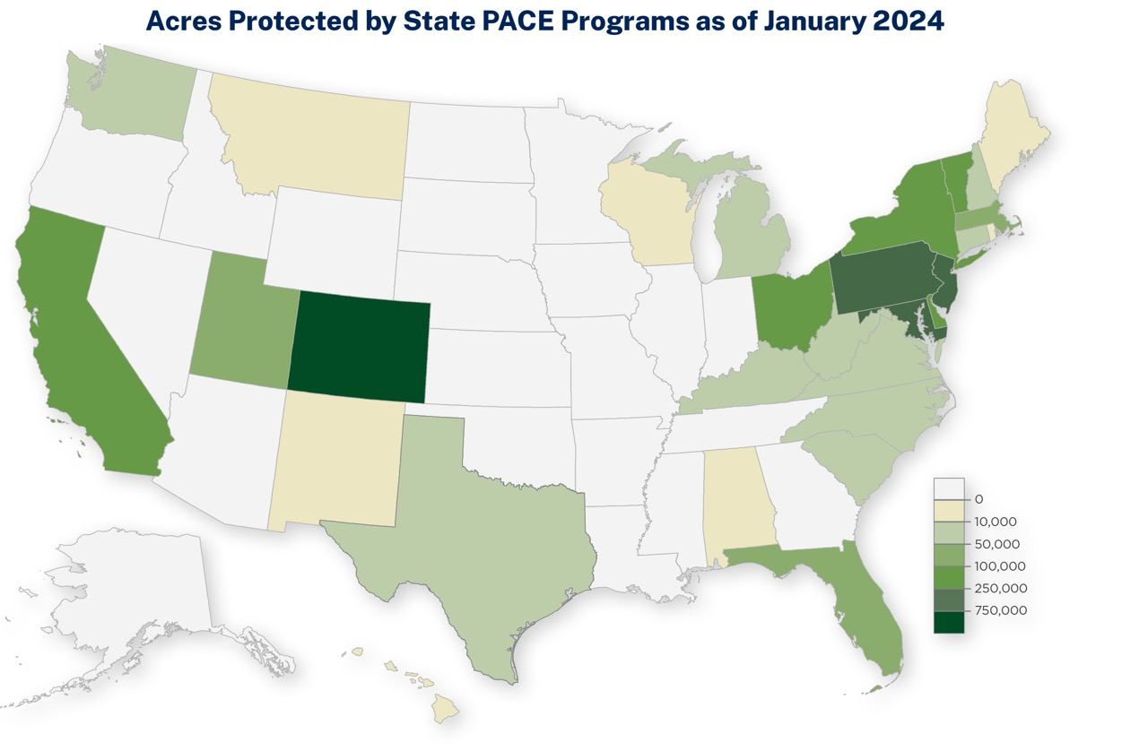

Slide 4
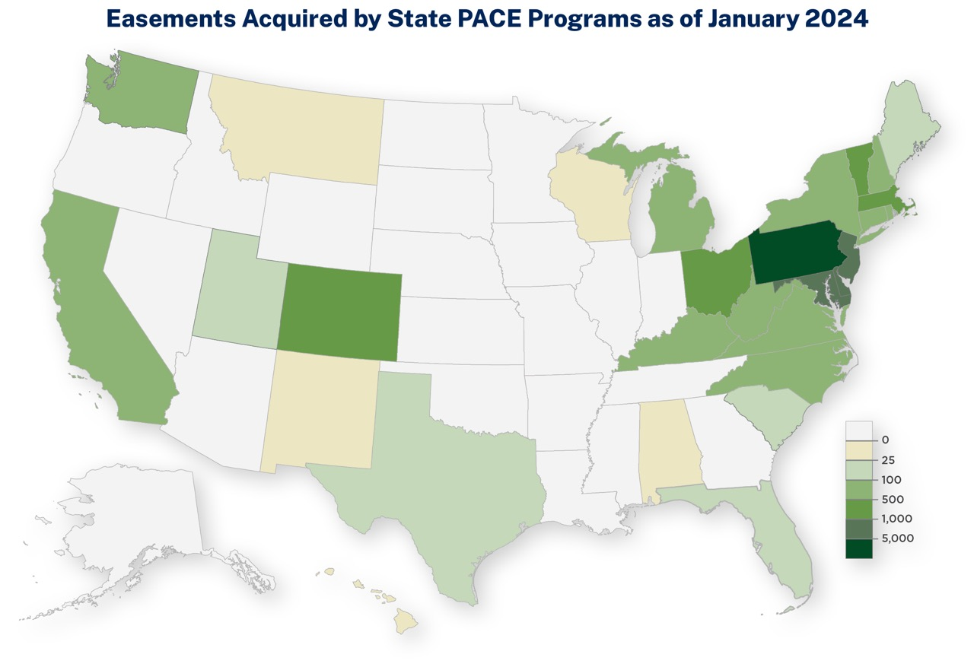

Slide 5
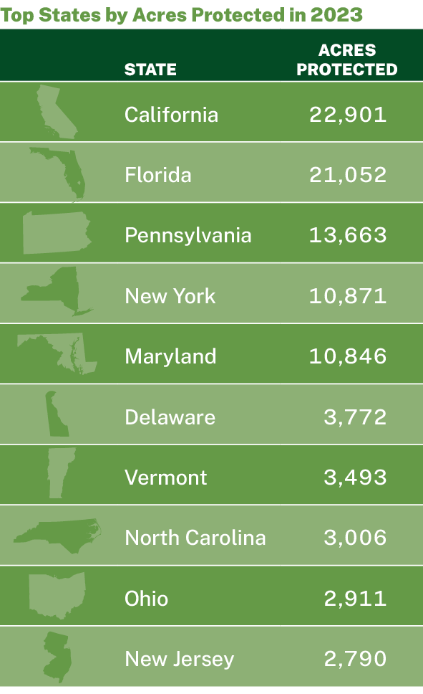
State PACE Program Activity

Slide 6
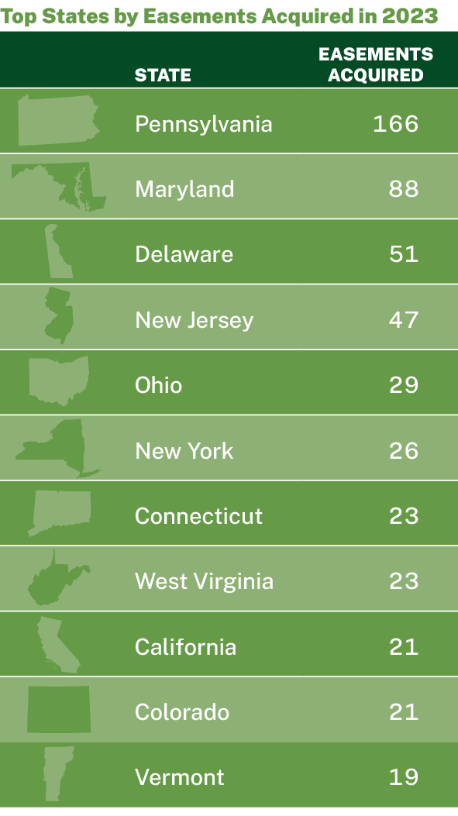
State PACE Program Activity

Slide 7
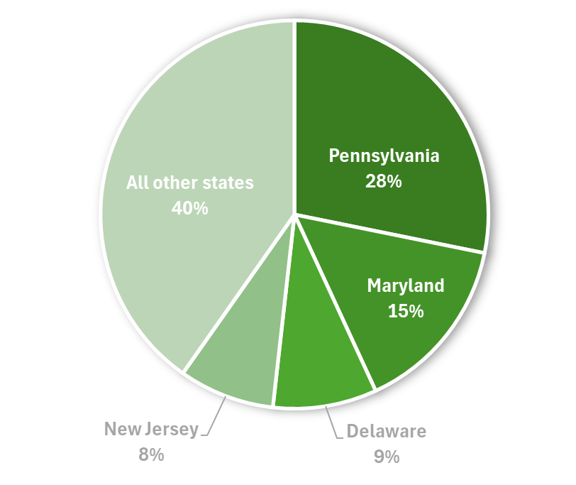
Proportion of Easements Protected by State PACE Programs in 2023

Slide 8
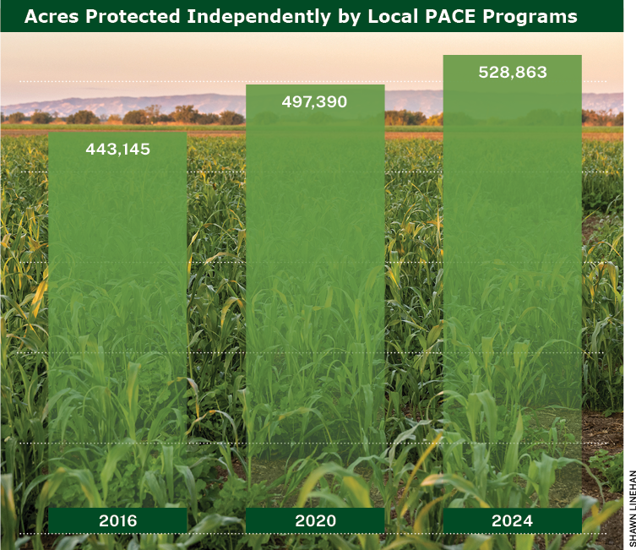
Local PACE Program Activity

Slide 9
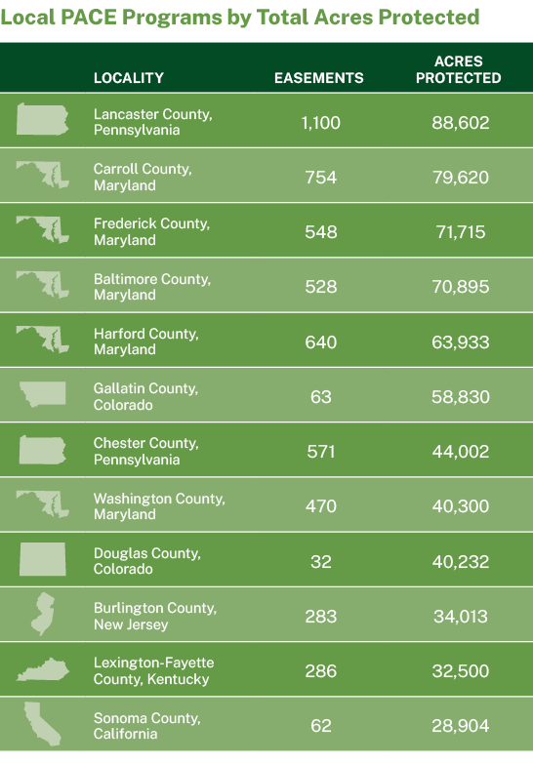
Local PACE Program Activity

