Slide 1
PART 1: LAUNCHING PEER NETWORKS
How to support climate-smart agricultural practice adoption through peer networks
Notes:
Hi my name is Caitlin Joseph and I am the Women for the Land Program and Policy Manager at American Farmland Trust. American Farmland Trust or AFT is a leading national non-profit conservation organization dedicated to saving the land that sustains us by protecting farmland, promoting environmentally sound farming practices, and keeping farmers on the land. Since 1980, AFT has helped permanently protect more than 6.5 million acres of agricultural from development, and supported the adoption of conservation practices on millions more.
In this webinar series we will be supporting folks in agriculture with launching peer networks among agricultural producers in order to drive climate-smart practices on U.S. farms and ranches. In this video, which is Part 1 of this series, we will cover What Peer Networks are, including some of their key characteristics, WHY peer networks are an effective tool for driving practice adoption on agricultural land, and introduce some of the steps you can take to start your own producer peer network.

Slide 2
What are Peer Networks?
Advanced Soil Health Training Cohort, NY
Photo Credit: Caitlin Tucker
Notes:
First, what do we mean by peer network?

Slide 3
DEFINITIONS
Peer-to-Peer Networks:​
A group of people with a shared identity who come together around a particular topic and/or support each other in working toward their goals. ​
Includes a leadership structure that includes its members and emphasizes learning from one another.
Notes:
Mostly broadly, PPN is defined as (slide)
In our case, we are focused on bringing together agricultural producers around shifting their practices, particularly toward climate-smart goals, but part of the benefit of peer networks, as we will discuss in a bit is the holistic nature of peer networks and how these aspects bolster the efficacy of them for encouraging the implementation of new practices on farms and ranches.

Slide 4
CHARACTERISTICS
Includes more than two people
Members have one or multiple common lived-experiences or identities that bind them in important ways
Producers are the primary source of information
Give and take between members
Face-to-face interactions
Producers and service providers form collaborative relationships built on trust (flatten hierarchies)
Producers engage in collaborative problem-solving
Producers gain practical tools and skills from each other
Notes:
Of course these are general and not hard and fast rules, but these characteristics can help give you a sense of what makes peer networks unique from other types of networks or ways of gathering farmers.
[Go through the bullets]
Overall, the emphasis in peer networks is on the members themselves being the “experts”, even when technical service providers are brought in to support the learning. So breaking down the hierarchies between the topical experts and the producers themselves, is an overarching goal of these types of networks and the gatherings that occur within them.

Slide 5
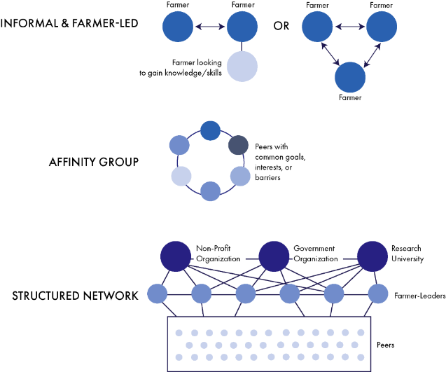
SPECTRUM OF NETWORKS
Notes:
Again, these are not hard and fast rules but this graphic is meant to provide a sense of the different ways peer networks can be imagined and configured.
They can be quite informal, with even just three farmers in a specific geographic region or within a niche production system across geographies supporting each other around particular goals and practices on the ground.
Or they can be a bit more structured based on the audience, such as in an affinity group that might curate the membership based on a shared identity that the producers hold. Examples of such groups might be women or underserved producers with common goals, or beginning farmers in a particular farming system like dairy.
An even more structured version may look like a collaboration between host organizations that support the curation of the peer membership and provide resources and visioning leadership to the network to guide its creation, implementation and outcomes. These are typically even more goal-oriented, as they are often tied of funded work with specific deliverables and outcomes being aimed for.
Each model, as we will explore, has pros and cons, and the biggest take-away we hope you have around these, is that you can start wherever you are and keep this spectrum in mind as the network gets under way and evolves with the relationships built.

Slide 6
WHAT PEER NETWORKS ARE NOT
Formal Mentorship programs
Lecture series or classroom-based, expert-led learning
Purely about research
Michigan Farm Education
Photo Credit: Caitlin Joseph
Notes:
Mentor networks typically have an application process and matching services for two individuals to go deeper with each other. Peer networks are more distributed in terms of relationship building. There may be elements of mentorship that develop organically among peer members, but these are not necessarily the facilitated intent.
Peer networks are spaces for farmers to get their hands dirty together!

Slide 7
WHY ARE PEER NETWORKS IMPORTANT FOR CONSERVATION ADOPTION?
Virginia Women for the Land Cohort
Photo Credit: Rebecca Drobis
Notes:
Now we will share a bit about why peer networks are effective ways to support agricultural producers with making changes, including to how they treat their land and soil.

Slide 8
BARRIERS TO ADOPTING NEW PRACTICES
Notes:
We know there are a lot of barriers farmers face in adopting new conservation practices, even when they are motivated to. These include cost, the risks associated with changing their systems and potential forgoing yields, quality differences in their product or other uncertainties. There is also often not enough information about how to implement practices for a farmer’s specific production model. For example, agricultural research is easier to conduct with certain crops and products than others so many folks don’t have a ton of technical assistance or evidence-based input on how to transition their practices if they produce less “mainstream” products. There are also cultural and social barriers in terms of how folks think they might be perceived by their neighbors or feel alienated from their community if people misunderstand their intentions in implementing new practices. Peer networks are great tools for supporting farmers to surmount many of these barriers in ways that other types of support often fall short of. For example, a farmer might have all the technical and financial assistance they need, but if it is perceived as not acceptable in their peer community, perhaps they will still be unlikely to adopt the practice. Peer networks can help address multiple barriers at once.

Slide 9
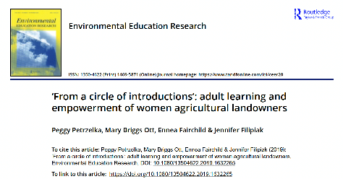
FARMER NETWORKS RESEARCH
Notes:
The efficacy of peer networks to support U.S. farmers in surmounting these barriers is backed by research.
AFT’s own research on the efficacy of the affinity groups we run with women producers, for example, has found that between 70-90% of the women who participate in our conservation cohorts and peer to peer Learning Circles report their intention to implement the practices they learn about at the gatherings. We have found that the collaborative, hands-on nature of the gatherings, coupled with the ways the gatherings demystify the processes of accessing technical and financial assistance are very effective at motivating producers to make changes on their land, including implementing climate smart practices.
Other studies, for example the one featured here on No-Till farming practices found that the “intermediary farmers” in a no-till focused network were more effective than formal university extension providers/programs at driving more farmers to adopt no-till practices. The farmers with experience with no-till themselves were ”the biggest influencers” for other farmers, with social media being one of the key ways that the innovative practices spread.
Overall, that is a key message of the research – farmers are the best influencers for other farmers. So that is what peer networks should hope to cultivate and leverage for driving climate smart practices on more farms.

Slide 10
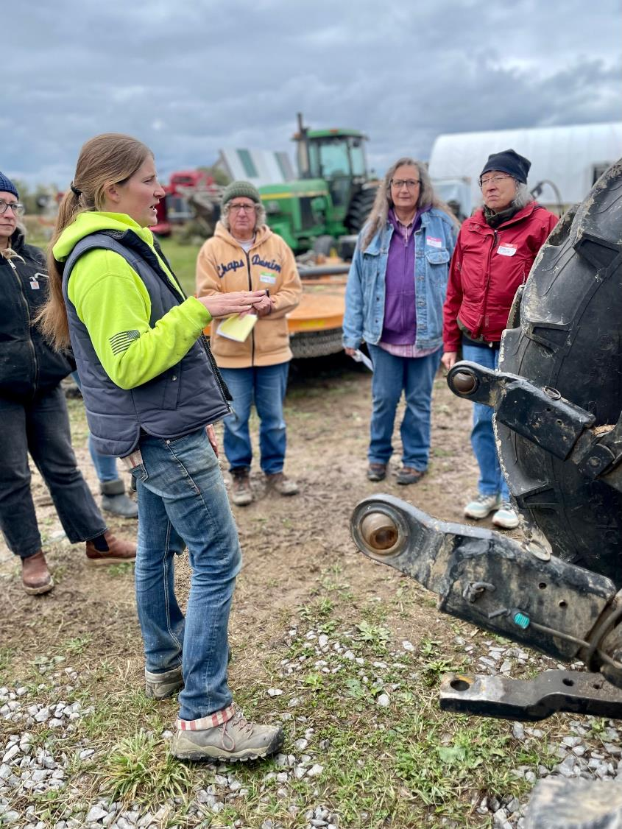
WHAT’S EFFECTIVE?
“Farmers often are most receptive to new information when it comes from other farmers. There is a deeper trust that comes with this process as the receiving farmer feels they are getting the benefit of knowledge gained from others who have had similar life experiences.
- John Fike, Ph.D. Professor of Forage Extension Specialist Virginia Tech
New York Women for the Land
Photo Credit: Stephanie Castle
Notes:
Research has backed up that in many farming communities there is already a practice of “roadside farming”, that is the practice of scrutinizing the fields and practices of other farmers to assess their skills and management abilities. Peer to Peer Networks mobilize this existing dynamic by inviting semi-structured encounters between farmers so that they may engage in both technical and experiential knowledge exchange, while building relationships and reinforcing or sometimes perhaps shifting social norms.

Slide 11
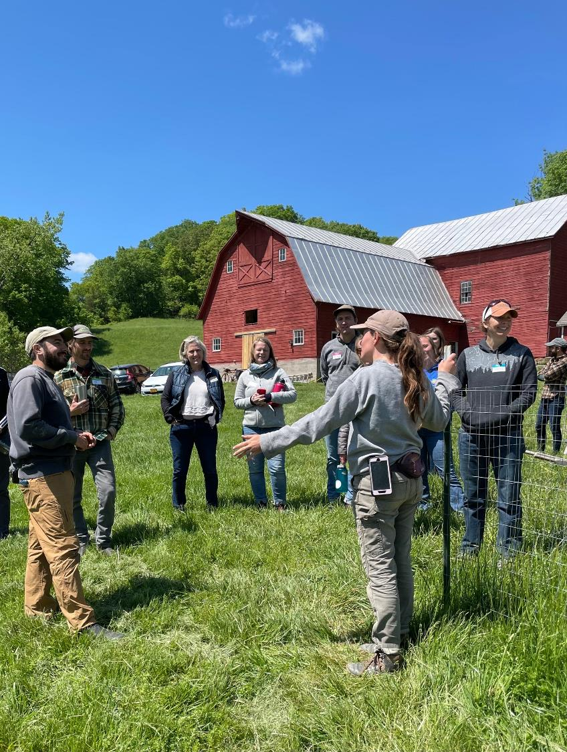
WHAT’S EFFECTIVE?
“Farmers learn directly from other farmers in multiple ways: through conversations and also through visual observation of farming practices….
The particular strength of demonstration activity is that it enables experiential learning and direct communication between peers.”
- Sutherland and Marchand, 2021
Farmland for a New Generation NY
Photo Credit: Stephanie Castle
Notes:
Through peer networks, producers can see with the their own eyes how a practice is implemented and impacting farmers they might identify with. So it builds on the “you can only be what you can see” motto, by helping farmers imagine themselves doing the same as someone else, or at least navigating a similar path, and getting support along the way.

Slide 12
PEER NETWORKS CAN . . .
Connect members to resources
Support members in responding to emerging needs
Build new knowledge on existing knowledge in creative ways
Create opportunities for collaborative learning and problem-solving
Help members build community and foster mutual aid, thus supporting their overall wellness and resilience to future challenges
Notes:
Resources refers to “Both financial and technical resources, including points of contact, publications, webinar series, online forums/groups, etc.
Emerging needs – between gatherings, the members can assess what questions folks still have and work to close gaps in knowledge and this address lingering hesitations or confusion producers may have around implementation of certain practices.
Building knowledge is most effective when it is strategically and slowly added to the existing experiences and worldviews of the members.
Collaborative learning helps to do this by engaging existing strengths in the network and building slowly and incrementally from the foundation the members are starting with.
Community and belonging are built in the process, through relationships. And It should not be underestimated how valuable these relationships are not just to the encouragement of practice adoption but also to the overall wellness of the farmers involved, which is the foundation on which any changes need to be predicated on. It’s difficult to take the risks to implement new practices when you are struggling in other ways. These relationships and sense of belonging can help deal with all of these facets at once in a way that humans are naturally wired to respond to.

Slide 13
PEER NETWORKS ARE . . .
Persuasive
Producers are more likely to adopt practices they see their peers implementing.
As trust is built among network members, awareness of the practices spreads and others become encouraged to engage.
Experiential
Hands-on, collaborative learning can support producers in seeing first-hand the reality and value of implementing a practice = Effective!
Holistic
Members can include both peers with similar lived experiences, as well as resource providers that help members fill in gaps in their tangible needs and knowledge.
Notes:
Ultimately, peer networks are psychologically nourishing, rich, and effective ways to all humans to learn, and especially for farmers and ranchers, who need to see the practices “in the flesh” to be sold on how they might take similar action.
By including both peers and technical experts who agree to participate in an open and non-authoritative way, these networks can provide holistic and persuasive spaces for farmers to change their perspectives and ultimately practices.

Slide 14
LEARN MORE . . .
Notes:
This document provides more detail on what makes peer networks effective and shares a bit more about the broader concept of resilience, both operationally and socially. We will provide a copy of this in the toolkit and links with this training.
Document with this info:
https://farmlandinfo.org/publications/climate-smart-adoption-fact-sheet-series/

Slide 15
HOW TO START A PEER NETWORK
Cleveland Cohort
Photo Credit: Cheryl Cesario

Slide 16
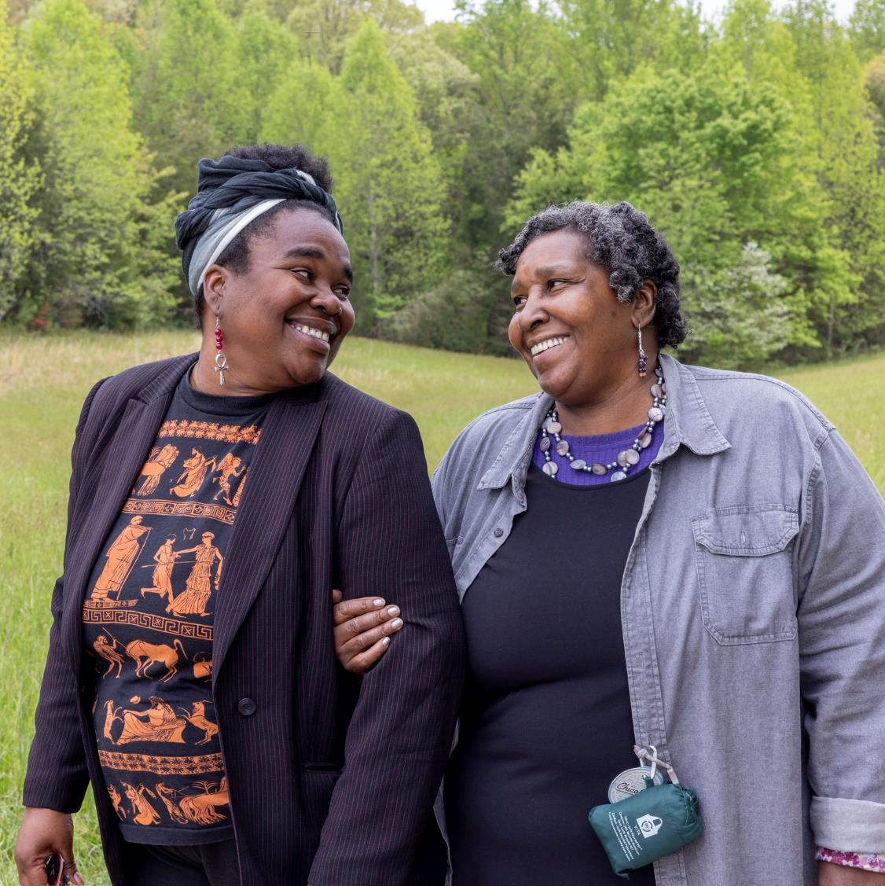
IT STARTS WITH RELATIONSHIPS
Build grounded connections with local farmers/leaders in ag
Identify the needs or gap
Listen first, develop programming later
…If you want to go fast, go alone, if you want to go far, go together…
Virginia Women for the Land Cohort
Photo Credit: Rebecca Drobis

Slide 17
BUILD A STRUCTURE
Determine your budget
Volunteer vs. paid leadership (preferred)
Clear vision, shaped by members
Stipends for participant travel/childcare
Stipends for event hosts
Long-term, succession plan for the life of the network
“There needs to be a strong leader who gets paid to think about [vision] and to help organize meetings. . . having funding to support the network is key to its survival and success.”
– Formal network convener
Notes:
Script for all bullets?
Leadership can be something that builds over time. Get started where you can and look for who has capacity and leadership potential. YOU are the leader to start with, so get started first and consider how these structural components. Get started with what you have, and see what you can build toward over time.
We will provode more detailed examples of different structures in the second part of this webinar series, so please watch the next video for more!

Slide 18
BUILD A MEMBERSHIP BASE
Decide on target peer group – what will be your common thread?
Geography
Demographic affinity
Farm characteristics
Farming practices goals
Build trust and credibility as a convener
Provide clear “value proposition” and outcome expectations
“It works when farms are close enough for them to travel to for group meetings, but they need to be far enough not to be neighbors and therefore competing for land/resources.”
– Farmer cohort leader
Notes:
Another way to think about the Value proposition, is as a pitch to the producers you are targeting that is curated/designed to resonate with and motivate them. The more you understand your audience, the more compelling your pitch to join will be. It also helps to be clear about the what and how of their commitment (when they will meet, with what regularity, what they can expect to get out of the experience, what topics you hope to cover, etc. )

Slide 19
IDENTIFY AND DELEGATE ROLES
Membership management (on-boarding and on-going)
Event facilitation
Outreach support
Logistical support (location host, food, transportation, etc.)
Clarify expectations and time commitments; provide compensation, as able
“Having staff/leadership involved in the project who have substantial lived experience with the type of farming that the farmers in the cohort do is critical to program success.”
- Farmer network leader

Slide 20
IDENTIFY AND DELEGATE ROLES
Notes:
When planning a gathering, a checklist like this can be helpful in the process of delegating tasks to the team you are collaborating with. This allows you to work backwards in time from the date of your gathering and to create a lighter lift through teamwork that is documented in one place so that everyone can use their own time to work on their tasks, but can keep the rest of the team updated on their progress. Uploading such a timeline checklist to a shared drive system such as Google Drive can help you communicate across the team in real time.

Slide 21
COLLABORATIVELY SET THE AGENDA AND NORMS
Co-create agenda/learning plan with members and resource providers
Allow for emerging content
Prioritize time for relationship building and experiential learning at gatherings
“Set clear norms. The premise was 1) the group is always smarter than the individual, and 2) it's always easier to see what someone else should be doing.”
– Farmer cohort leader
Notes:
There are several ways you might co-create the learning plan with members of the peer network. When convening the network, you might send out a survey to gauge folks’ interest in a list of topics and then plan gatherings around those that get the most votes. Or you might start the first gathering focused on just building relationships and use some of the time together to gather input on topics the farmers want to explore and expert speakers they might want to hear from at future gatherings. Or you might use exit surveys from previous gatherings to guide the next topic to cover. Either way, the key is to ensure that the members have input in shaping the learning, as this will build their buy-in to the process and they are more likely to engage meaningfully, thus reinforcing the participation of others.
If farmers experience barriers along the way (for example, a big storm causes flooding, allow for the goals of the network to be explored through the lens of the emerging issues the members are facing. This makes the learning more real, relevant, and practical.
NORMS – Gatherings and communication in between them either online or in-person can really benefit from thoughtful facilitation and norm-setting. This supports the group in building a particular culture that will then become woven throughout the members’ interactions. Examples of norms might be “at each gathering, we begin with a check-in during which each person has a chance to share what is going on in their lives” or “we stand by the idea that everyone has something to learn and everyone has something to teach”. Norms like this should/can be set collaboratively early on in the network’s convening, and can/should evolve as needed throughout the life of the network.

Slide 22
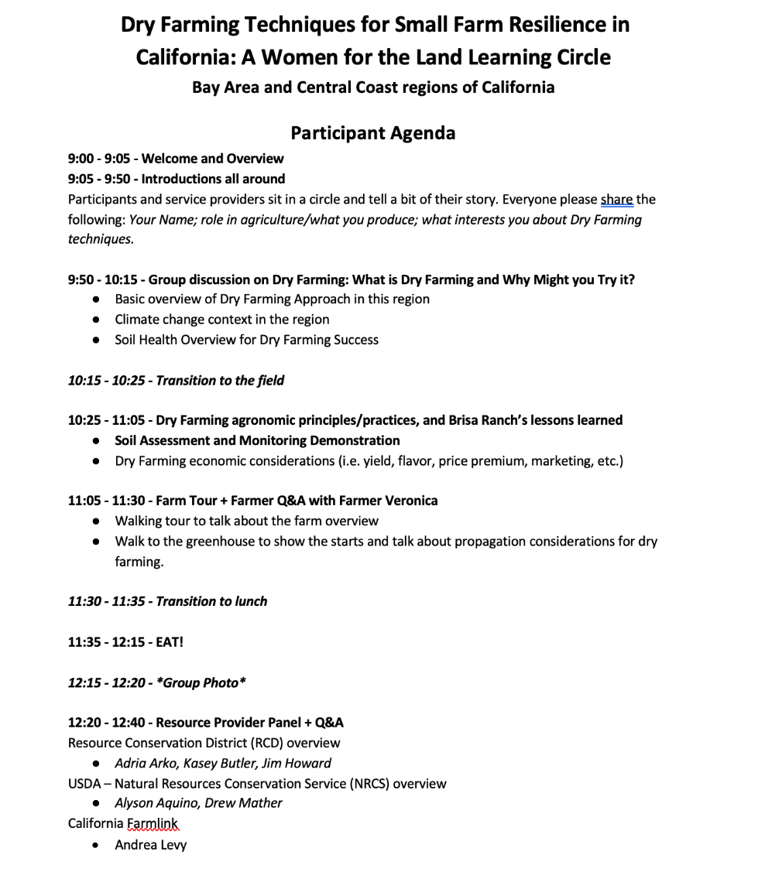
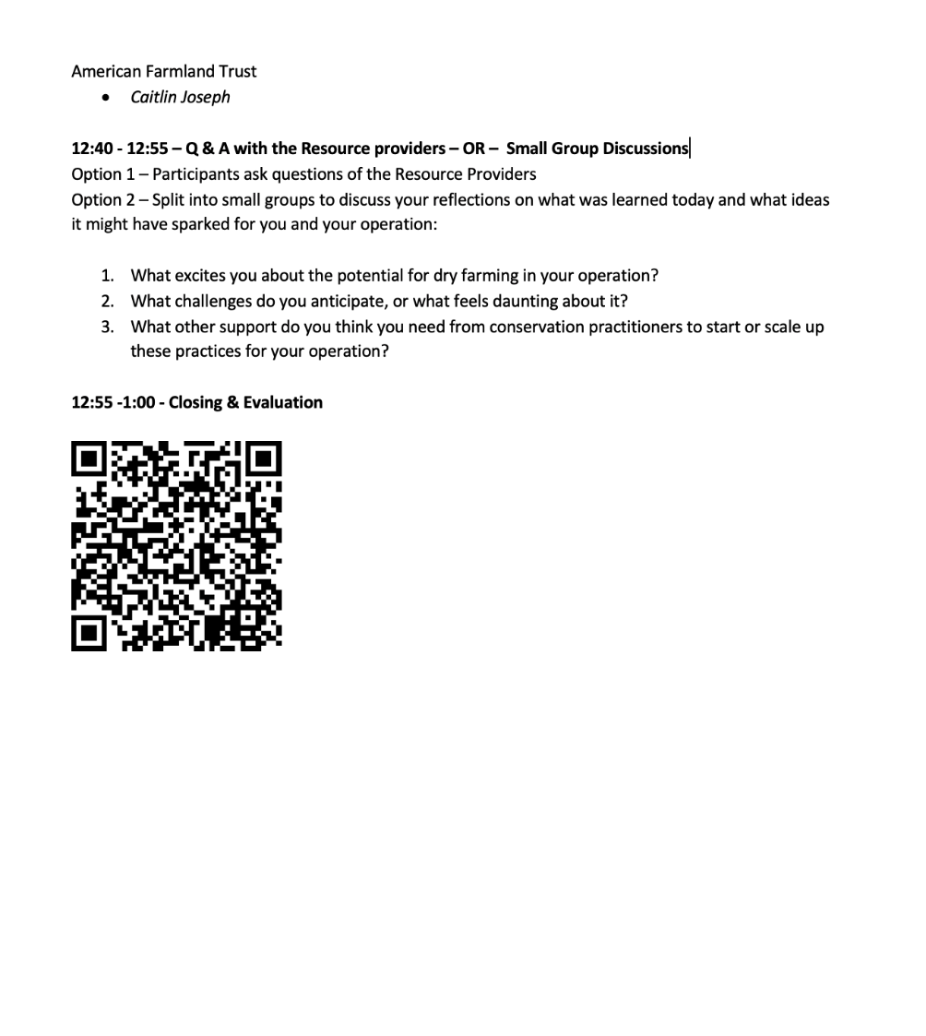
Notes:
Walk through the agenda to help it come to life.

Slide 23
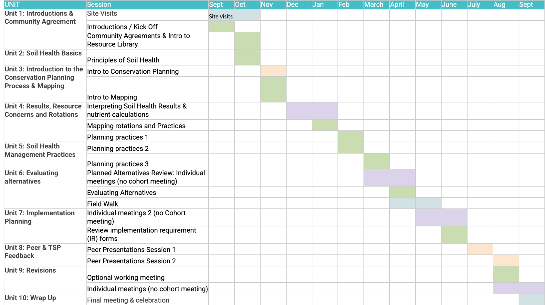
Notes:
Here is another, more big picture way of thinking about setting the agenda for curriculum/learning objectives in a peer network. You can make a plan for a whole course of time, or in a more emergent way, one event at a time with reflection and feedback time in between.
You can see this team made a plan for a year’s worth of curriculum that a cohort of peers would learn about together. They combined online learning via reading and resources (depicted in green), with webinars or meetings in pairs (in purple) and in-person gatherings (blue) and online gatherings (in orange). This gave the network members a variety of ways to connect both with the content and each other throughout the year. It also allowed for a rich learning experience with lots of variety and choice.
This is a very goal-oriented example that had support and leadership from organizational staff, so not all networks have to be this structured, but hopefully this gives you a sense of the types of peer to peer learning that could be pulled together. A more informal version you might be able to imagine could look like a group of farmers coming up with a plan like this in a google doc and sending each other resources on a particular topic via email each week, then meeting monthly over zoom as a group or in pairs to discuss what they read and tried on their farms, and then meeting in person as a full group on a farm quarterly to see examples of how each other might have explored the topics in their own operations.

Slide 24
EFFECTIVE EVENT AGENDAS . . .
Are provided to facilitators and participants to guide the experiences
Emphasize time for getting everyone’s voice in the mix early on (introductions), break down hierarchy, establish peer connections
Include technical info on topic of the event
Avoid PPTs when possible
Speakers avoid jargon and are active participants
Include a shared meal or other informal relational time
Have an experiential/hands on/in-the-field component
Include reflection time and discussion of next steps, including action items members commit to
Notes:
When planning events with the full group, it is very helpful to have agendas for the gathering that the participants can review ahead of time and that the facilitators can all have in front of them as they support the event to stay on track.
Some tips we would like to emphasize for making such group gatherings effective include ensuring that the start of the day includes time for each individual to share something with the group and get their voice into the mix. This helps encourage more equal communication from all members throughout the day.
We also encourage folks to avoid using power point presentations and try to be as hands-on and relational as possible when explaining and demonstrating content that is relevant to the topic or farming practices being explored. Speakers should speak in plain language and avoid acronyms or other technical vocabulary as much as possible to keep the content practical and enable all members to feel welcomed and not overwhelmed.
Sharing food and allowing for some loose networking time is often some of the most valuable parts of these gatherings, so don’t forget to budget time for this at each in person gathering. Even online gatherings can replicate this type of relational time and you should not underestimate the value of carving out time for this type of cultivation of belonging.
Experiential learning is going to be key to driving the practices that the group hopes to work on so be sure to create a rich experiential component at each gathering. This could include a demonstration of a practice and its impact so folks can see, touch, smell, or maybe even taste the difference a practice has made for the farm, or could give producers a chance to try a new piece of equipment or the like.
Lastly, closing with some time to reflect on the learning from the day and offer feedback can help people absorb what they learned that day and can give the members a chance to commit to actions they are going to take to integrate that learning into their production systems and lives.

Slide 25
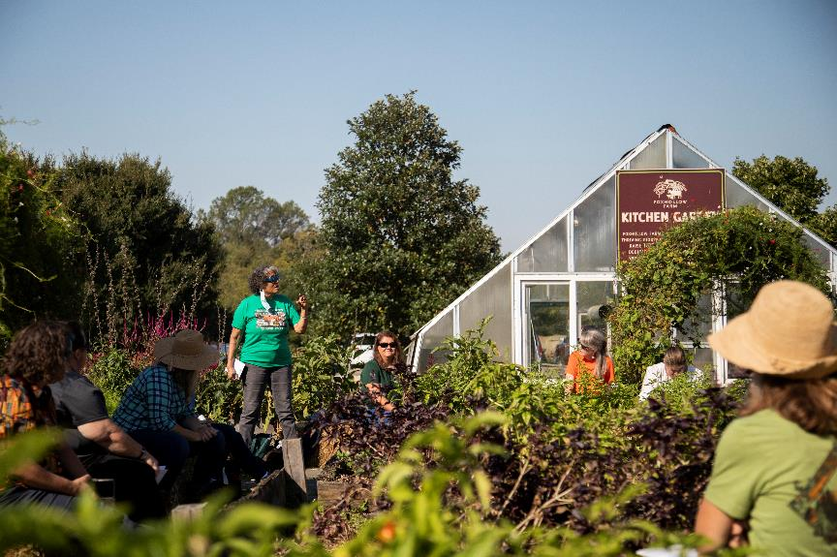
BEST PRACTICES FOR ADULT LEARNING
Make the content relatable
Engage positive emotions
Give learners choice
Identify baseline thinking patterns and perceptions
Address gaps in experience and knowledge
Provide opportunities for practice and application
Kentucky Women for the Land
Photo Credit: Kertis Photography
Notes:
In the big picture, here are a few ideas to keep in mind about what the research shows about adult learning.
People, even children, are never blank slates, so it is important always to do as much as you can to understand where the learners are coming from. This means getting a sense of their prior knowledge, their hesitations or resistances, their economic and cultural contexts, and then doing your best to make the content relevant and relatable to them based on that context.
Engaging positive emotions is also key to learning, as cognitive shifts are most likely to “stick” when they are coupled with feelings of safety, belonging, curiosity, excitement, and joy. That is part of why peer gatherings can be so effective at driving behavior change and action on the ground so the emotional lives of the members should be embraced during the learning.
Giving adults choices makes them more engaged and motivated, and giving people opportunities to practice what they are learning also makes the content more likely to “stick”.

Slide 26
TIPS: OUTREACH AND PROMOTION
Utilize word of mouth networks and key relationships
Be creative
Tailor outreach materials and communication channels to the audience
Use variety of media (online, radio, news outlets, organizational partners, etc.)
Keep aesthetics in mind
Consider incentives
Notes:
Depending on how you have set up your network, you may need to do some outreach either at the beginning to get new members or throughout the network to invite members to gatherings.
If/when you need to conduct outreach keep in mind these tips:
Existing relationships are your best friend – use word of mouth and trusted influencers to spread the word
Be creative with your strategies and your tools – people respond to art, fun, and creative expression, so don’t be afraid to experiment.
Tailor to your audience – do your network members perhaps listen to the Spanish radio station and maybe getting a segment or ad out on that station would best reach them? Or maybe your members all go to the same coffee shop each morning and you can put up a flyer there? Go to where the people already are and tailor their routines.
If you have the budget for it, consider offering travel stipends in the form of visa gift cards for gas money or other incentives (like a children’s play area at the event).

Slide 27
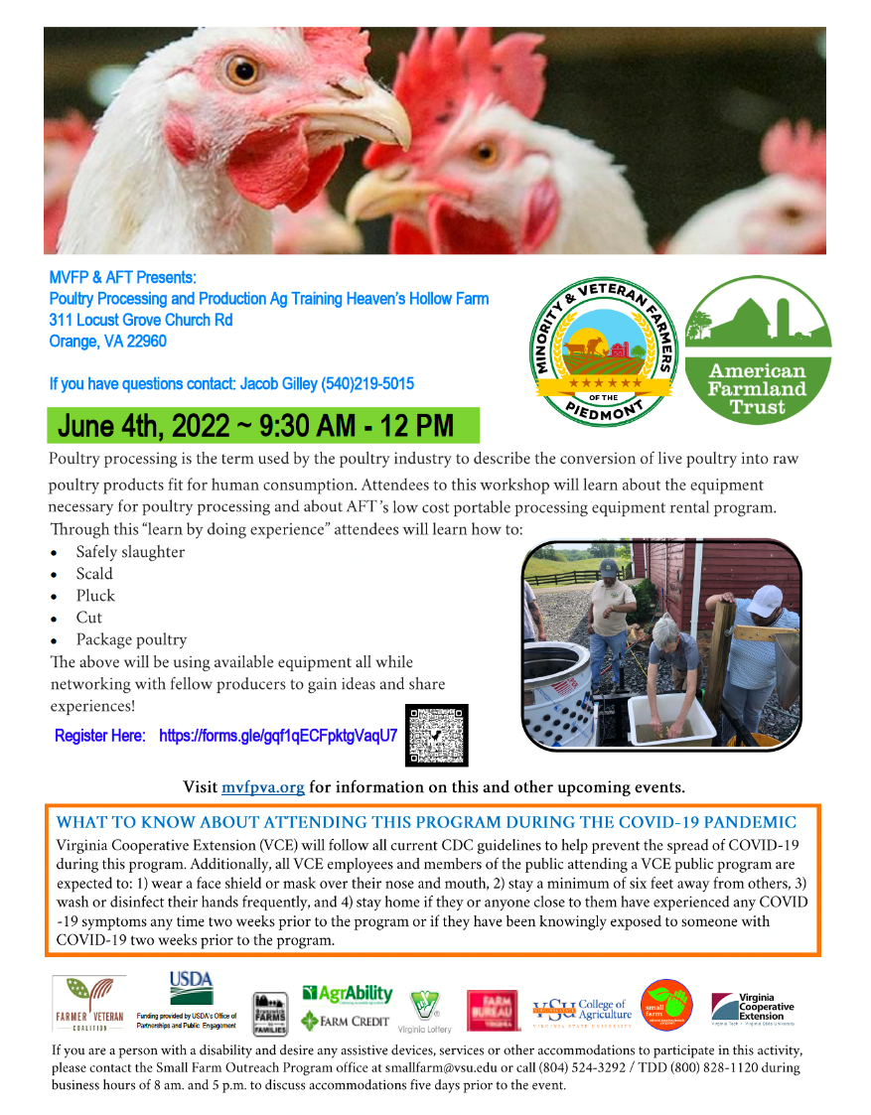
Notes:
Here are some examples of some outreach flyers.

Slide 28
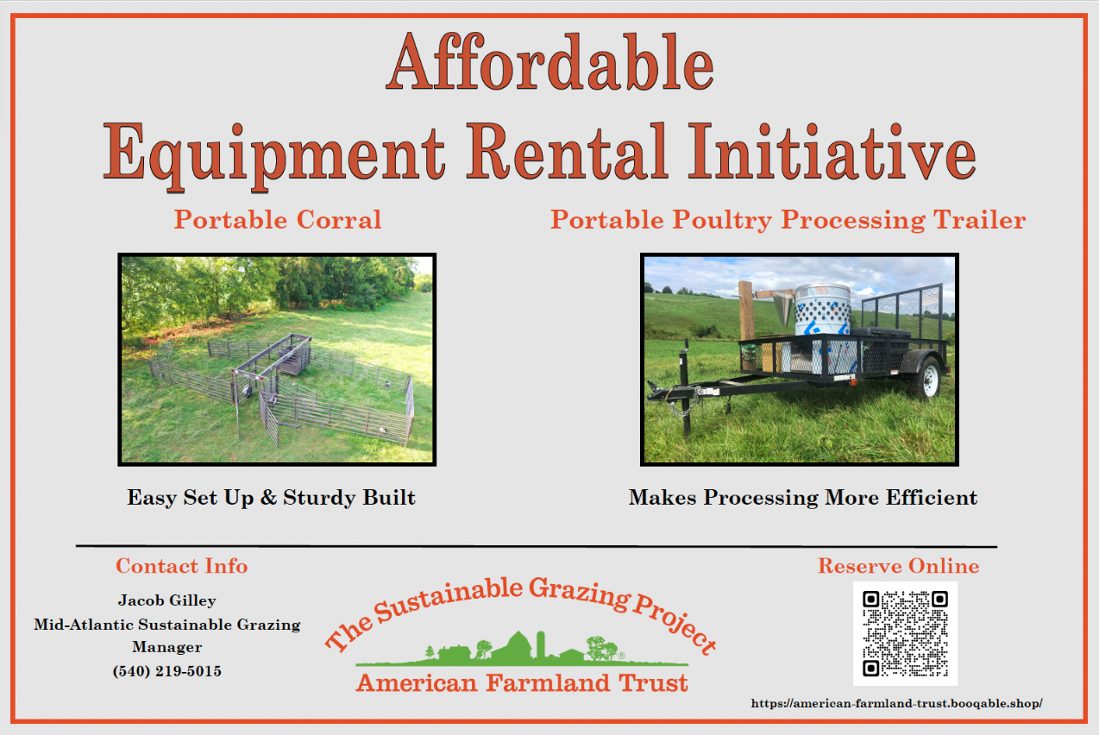
Notes:
That same peer network also offered an equipment rental initiative as part of their network, so this is just a quick example of an additional service your network can provide its members along with content-based learning. This kind of collective offering might require some outreach to get off the ground.

Slide 29
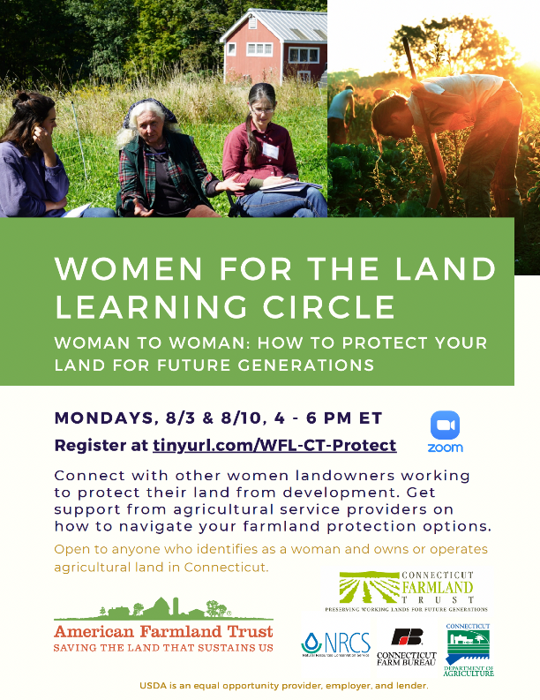
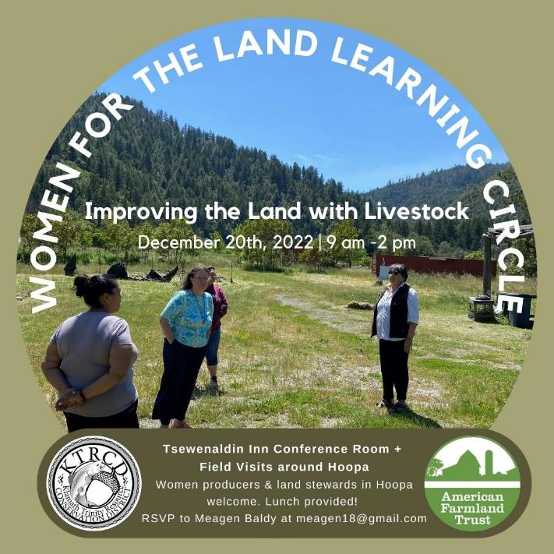
Notes:
You can see in these examples the flyers are tailored to the audience and show something about the nature of the gatherings for these affinity groups among women producers and even more specifically among indigenous women producers on a reservation.
You can also see how one of these depicts a series of online events, which producers could register for all at once.
And in another more informal way, listed just a local person as the contact to gather RSVPs.

Slide 30
Notes:
This shows an example of a physical postcard that was sent in the mail to a hard-to-reach audience, in this case non-operating women landowners. This postcard was sent to specific people who were identified as fitting the criteria for the group and were given more detailed information about the gatherings including the agenda.
Notice it also gives people options, a best practice for adult learning.

Slide 31
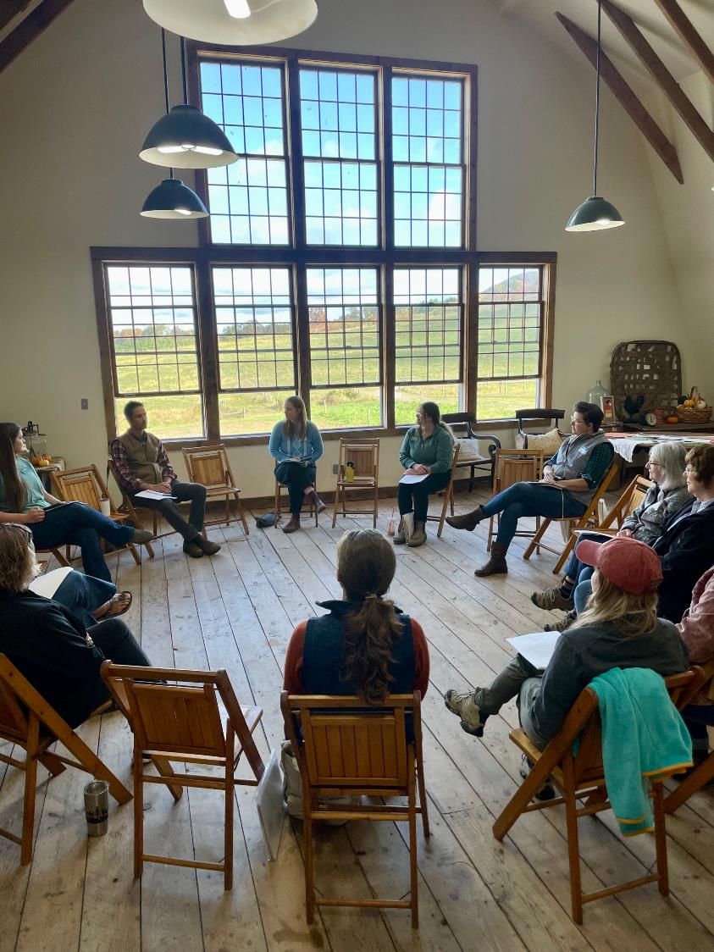
TIPS: FACILITATION
Establish Ground Rules
Support participants
Be intentional in agenda design
Effectively utilize group discussion
Prepare technical contributors
Build-in time for reflection/witnessing
Encourage relationship-building (e.g., carpool, rent a van, etc.)
Always try to have two facilitators
New York Women for the Land
Photo Credit: Stephanie Castle
Notes:
Similar to the best practices for adult learning we discussed, these tips should be employed when facilitating group gatherings. Ground rules based on the norms should be communicated and set at the start so that they can be enforced if needed as discussions get started. Discussions are valuable but they can be difficult especially when emotions are high or there are differences of opinion. Ideally two people facilitating such discussions can create some containment for the group, protect the members from becoming too entrenched in disagreement, and support an effective closure to deep discussion.

Slide 32
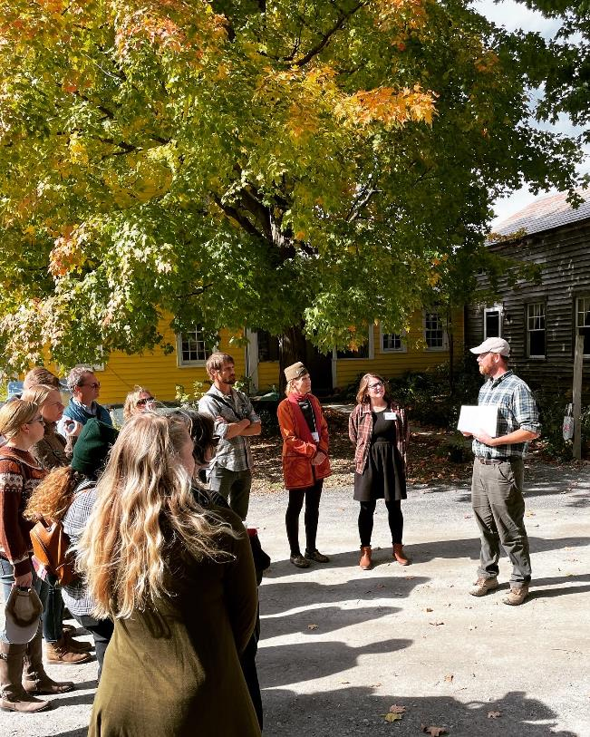
TIPS: FACILITATION
When possible, aim for experiential (on-farm) learning
Give everyone room to speak
Practice active listening
Build trust before diving deep into complex issues
Take time to evaluate, both through leadership reflection and participant feedback
AFT Staff, NY
Photo Credit: Stephanie Castle
Notes:
By modeling active listening skills and reflecting back the statements of others, facilitators can help the group navigate important topics that might not otherwise be discussed, thus fostering deeper understanding among the group members and offering a unique space for learning that producers might not get anywhere else.
At the close of each event, or even throughout, take time to gather feedback from members.

Slide 33
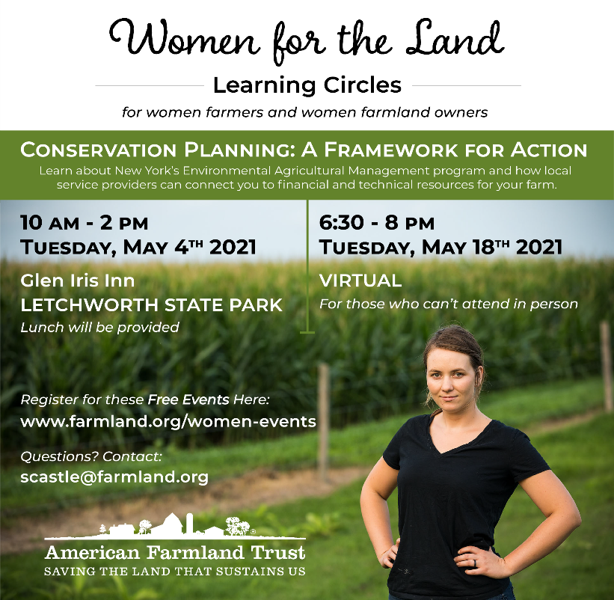
TIPS: VIRTUAL GATHERINGS
Pair with in-person
Cameras on
Gallery setting
Ask people to change the screen name to their preferred name, pronouns, etc.
Get quickly into the discussion
Provide a variety of ways for people to contribute
Provide choice for engagement
Consider language access
Notes:
Gathering online can be another way to enhance networks as they are often more accessible and allow farmers to multi-task, drive less, and focus more on what’s important while still gaining connection with others. Following these tips can help folks get the most out of these experiences:
Hosting online gatherings after everyone has already met in person makes them MUCH more interesting, meaningful, and impactful
Creating as much interaction as possible with cameras on and able to see and name each other can make them more fun.
Prompting people to engage through their video, audio, the chat, and maybe through other shared documents or online activities during the gatherings can really make them more engaging. So again, providing choice.

Slide 34
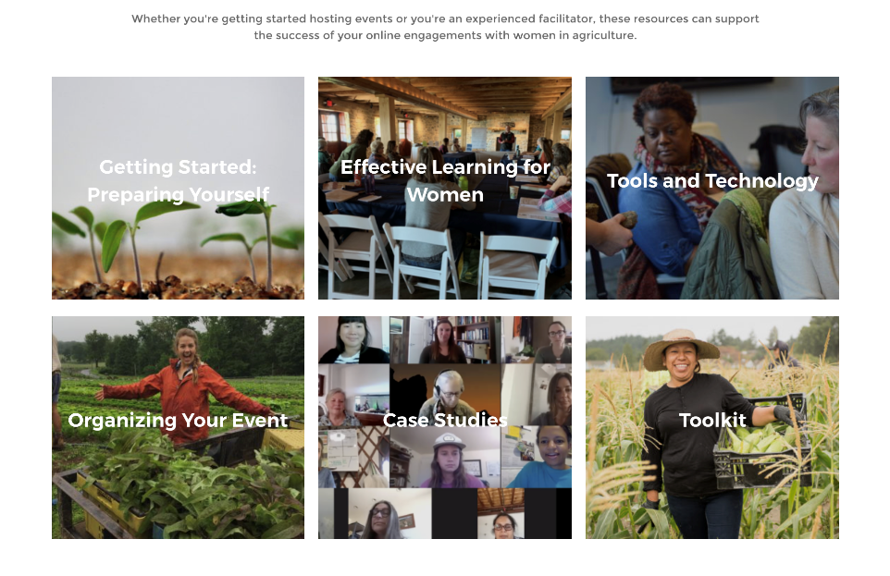
TIPS: VIRTUAL GATHERINGS
For more on this, see the resource Reaching Women in Agriculture: A Guide for Virtual Engagement, which has a suite of best practices and case studies that illustrate strategies for doing more virtual outreach with farmers, specifically women in agriculture.
Notes:
If you want more tips on virtual gatherings you can visit AFT’s website to download this Virtual Engagement Guide. It was created to focus on women- farmer gatherings but is also relevant for other types of peer networks gatherings online.
This and many other resources will also be linked in the Launching Peer Networks Toolkit that our team will be providing as a supplement to these webinars.
Thanks for watching and Please take time to view part 2 of this series which will provide specific in-depth examples of three different types of farmer peer networks, what was effective about each, what some of their challenges were, and how they navigated them to support producers of all kinds in adopting more climate-smart practices in their operations.

Slide 35
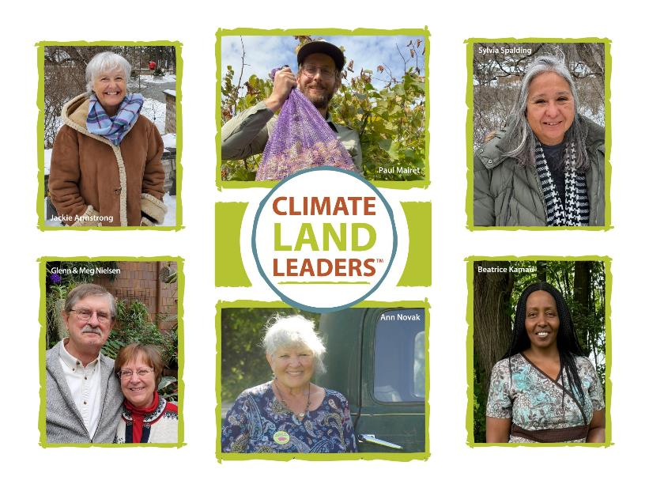
OTHERS LIKE IT
Climate Land Leaders Initiative
Members have shared goals
Across wider geographies (multiple states)
Application process and network login
Soil Health Management Planning Cohorts (AFT New England)
CT Specialty Crops; MA Specialty Crops; CT River Watershed Livestock Cohorts
Non-profit and research institution partnership. Strategy:
Build tools and resources that will last beyond project for farming community
Complement existing opportunities & programs
Notes:
Climate Land Leaders are working with compassion and commitment to address the climate crisis on their lands. As farmland and woodland owners, they are implementing ambitious conservation projects, sharing with and learning from each other, and serving as leaders on climate policy and equity initiatives.
Climate Land Leaders share three goals:
Reduce greenhouse gas emissions in their agricultural operations.
Sequester carbon in soils and biomass.
Ensure that our lands and farms are resilient in the face of a rapidly changing climate.

Slide 36
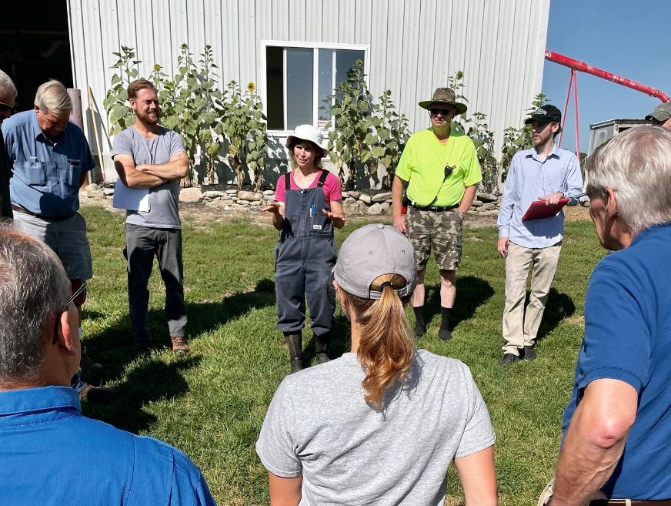
KEY TAKEAWAYS
Networks can be adaptable based on the needs of the community
All networks need a dedicated leader with a clear vision and shared goals
Social & educational events provide opportunities to build community and gain knowledge/skills
Outside funding offsets costs for outreach, participation, and research with less burden on the community
New York Demonstration Farm Network
Photo Credit: Stephanie Castle
Notes:
Let’s review some key takeaways about building your own peer network. First, know that networks can be adaptable based on the needs of your community. They can take many forms and be highly structured or informal. A key component, whatever form the network takes, is that there is a dedicated leader with a clear vision and shared goals. And that the vision and goals are communicated to participants. Incorporating social and educational events provide opportunities for knowledge sharing, skill development, and building community. And last, funding never hurts! Outside funding can offset costs for outreach, participation, and research with less burden on the participants to “pay their way”.
I hope this illuminates how peer networks look and the key components that drive their success. Thank you for your time and attention and best of luck launching your own network!

Slide 37
Online Toolkit
Women for the Land Planning Tools
Learning Circle Facilitation Training
Curriculum Examples:
Future Harvest Beginning Farmer Webinars
Quivera Coalition Events
Peer Network Lit Review

