Slide 1
PART 2: LAUNCHING PEER NETWORKS
How to support climate-smart agricultural practices adoption through peer networks
Notes:
Hi, my name is Stephanie Castle and I am the New York Women for the Land program manager for American Farmland Trust. American Farmland Trust or AFT is a leading national non-profit conservation organization dedicated to saving the land that sustains us by protecting farmland, promoting environmentally sound farming practices, and keeping farmers on the land. Since 1980, AFT has helped permanently protect more than 6.5 million acres of agricultural from development, and supported the adoption of conservation practices on millions more. Our program connects women in all stages of agriculture through peer learning and technical assistance.
In this webinar series we will be supporting folks in agriculture with launching peer networks among agricultural producers in order to drive climate-smart practices on U.S. farms and ranches. In this video, Part 2 of this series, we will cover the steps of how to launch a peer network, including examples of peer networks, how they engage with their communities, measure their impact, and continue their success over time. We hope that by the end of this webinar, you have a better understanding of the components that lead to a network of peers with real impact on conservation practice adoption.

Slide 2
WHAT CAN PEER NETWORKS LOOK LIKE?
North Carolina Women for the Land Cohort
Photo Credit: Rebecca Drobis
Notes:
First, what can peer networks look like? There is a lot of variation in how these networks are structured given the goals of each group, but successful networks tend to have a few things in common that we will cover in this next section.

Slide 3
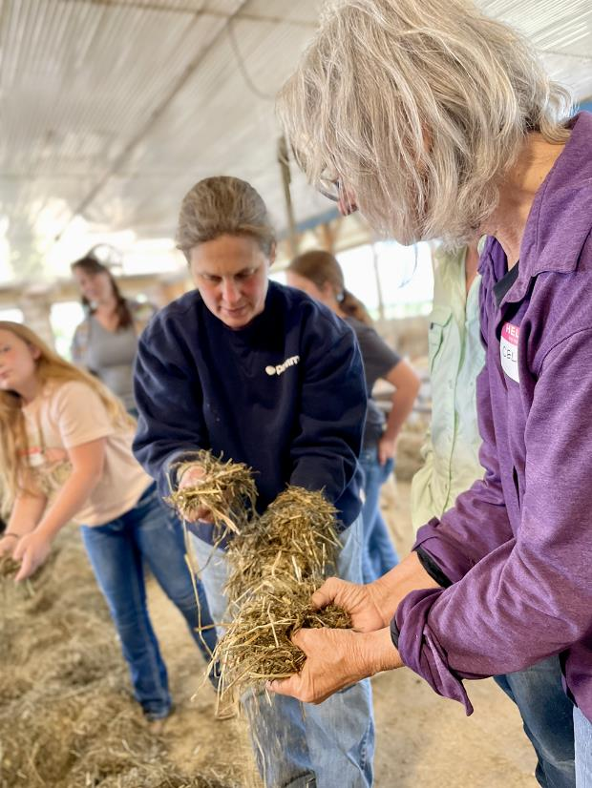
DEFINING "PEERS"
Peer: "one that is equal to another is status, achievement, or value." Merriam Webster dictionary
More than just the same occupation
Long-term relationship​
Shared approach or objectives​
Respect for each others’ knowledge, experience, skills​
Finding others’ ideas to be specific, solutions-based, relevant, accessible​
Belief that they are unbiased or scientific​
Openness to share​
New York Women for the Land
Photo Credit: Stephanie Castle
Notes:
Let’s start by defining what we mean by “peers”. A peer is someone who is equal to another in status, achievement, or value. It’s more than sharing the same occupation. Peers can take many forms and are not at all restricted by age, gender, or other demographics. The most important trait of peers is that they share a similar approach, goal, or objective and respect each other’s knowledge, experience, and skills that allows them to share information, trust that information, and grow individually towards their own goals.

Slide 4
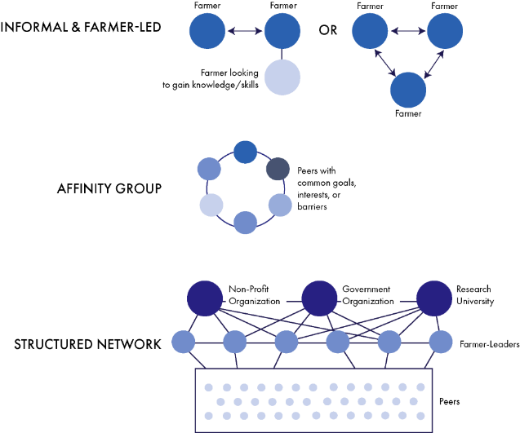
SPECTRUM OF NETWORKS
Peer Networks encourage shared learning and community building.
That can mean very informal farmer relationships, to a group centered around a common affinity, to a highly structured network with oversight from an organization.
Notes:
Let’s dig into the spectrum of networks a little more. At the top of the graphic, we show two types of informal information-sharing networks. These networks can consist of as few as two peers who share common goals and trust one another’s knowledge in order to help them gain skills or overcome a challenge. These networks can have little to no real structure and often progress at the speed of trust. Sometimes, new members who are looking to gain knowledge join this group to learn from elder peers in a supportive setting.
Next, we have an affinity group- this is a community of peers who share a common history, demographic, geography, farm type, or challenge. Their commonality brings them together as a group and the collective affinity helps information sharing and trust.
At the bottom of the graphic, we show a highly structured network led by non-profits, government agencies, and research universities working together towards common objectives. This type of network requires funding to pay staff to keep it organized, pay for research, and host educational events. It relies heavily on selected farmer leaders who are well respected among their peers and willing to test innovative ideas and share their knowledge. At the bottom, there is a large group of peer learners who are learning directly from the farmer-leaders, and building their own community.

Slide 5
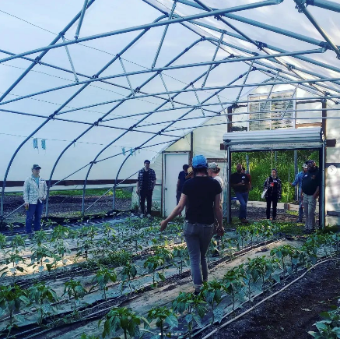
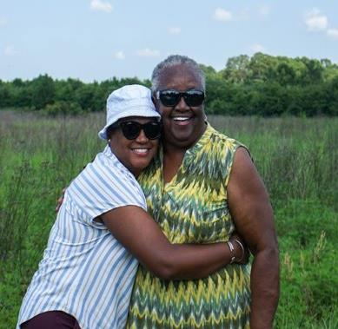
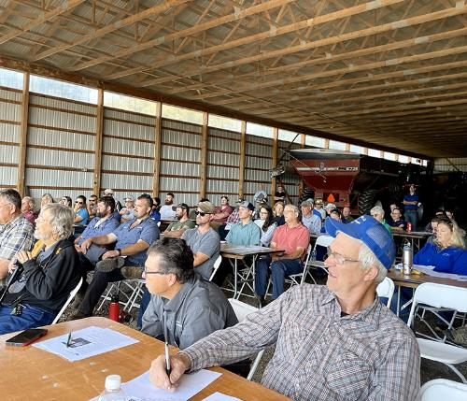
3 EXAMPLES OF NETWORKS
Informal, Farmer-Led
Example 1: Good Farmers Guild
Affinity Group
Example 2: Women for the Land Southeast Climate Cohort
Structured
Example 3: Genesee River Demonstration Farm Network
Notes:
We’ll take you through real-life examples of each of the types of peer networks we just showed: The Good Farmers Guild of Western New York shows us an example of an informal, farmer-led network. The Women for the Land Southeast Climate Cohort shows us an example of an affinity group. And the Genesee River Demonstration Farm Network is an example of a structured peer network.

Slide 6
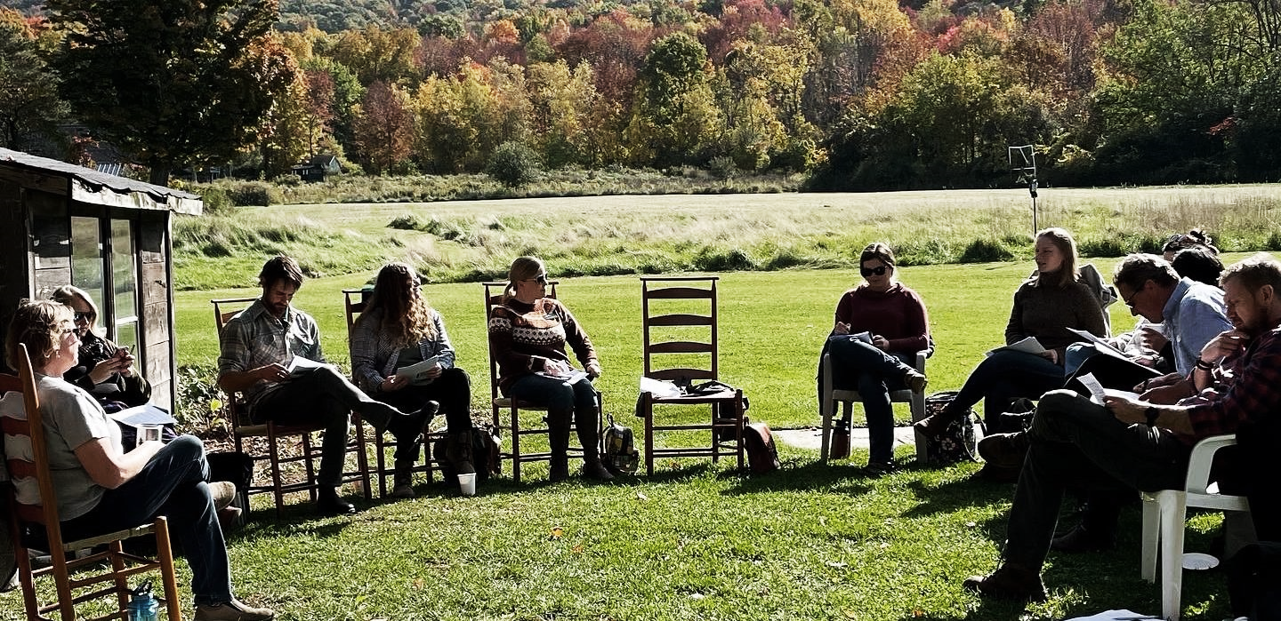
WHAT PEER NETWORKS HAVE IN COMMON
Leadership
Peer Members with Common Goals
Educational + Social Events
Measurement of Impact
Long-Term Vision to Sustain Connection*
Notes:
Though these networks differ in their structure, they all share certain commonalities. For each example, we will share the:
Demographics of members
Leadership structure
What interactions entail
Impact
Succession plan/sustaining connection

Slide 7
DEVELOPING A LONG-TERM VISION
Peer Networks are most successful when they evolve over time, but this requires a forward-thinking vision, which can be accomplished through:
Securing grant funding for outreach activities
Membership dues, or small fees to attend events
Annual meetings to set goals for the upcoming year
2-Year leadership terms, allowing new voices to be heard
Willingness to adapt and change as needs of community evolve
Notes:
In each example, we will share the:
Demographics of members
Leadership structure
What interactions entail
Impact
Succession plan/sustaining connection

Slide 8
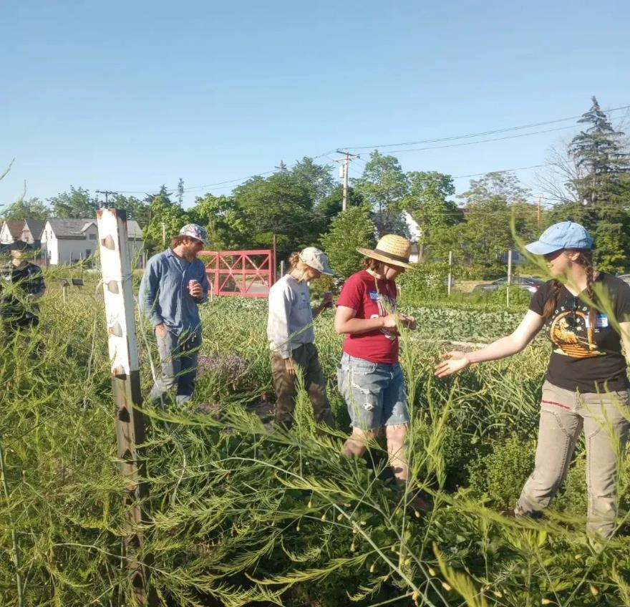
Example 1: GOOD FARMER'S GUILD
PEER COMMUNITY:
Focused on beginning farmers and service providers in western New York
Small geographic range
Similar scale & type of operations
Farmer Field Day
Photo Credit: Good Farmers Guild of Western NY
Notes:
The first example is a farmer-led, loosely structured network called Good Farmer’s Guild. They are based in western New York and formed about four years ago. Their peer community is centered on beginning farmers and their service provider network in a small geographic region. These peers have similar scale, type of operations, and are looking for shared collective knowledge about sustainable farming practices.

Slide 9
Example 1: GOOD FARMERS GUILD
IMPACT:
Several hundred member farmers and service providers have joined the Good Farmers community. The Guild successfully acquired funding to continue educational programming.
Educational events have ranged from pest and disease management, climate adaptation, to crop variety selection and farmer health.
Notes:
The good farmer’s guild measures their impact by the number of people who have joined their community and who regularly attend events and engage with one another. Their events are well attended and provide their community with a wide range of information, on-farm tours, and skill-building workshops.

Slide 10
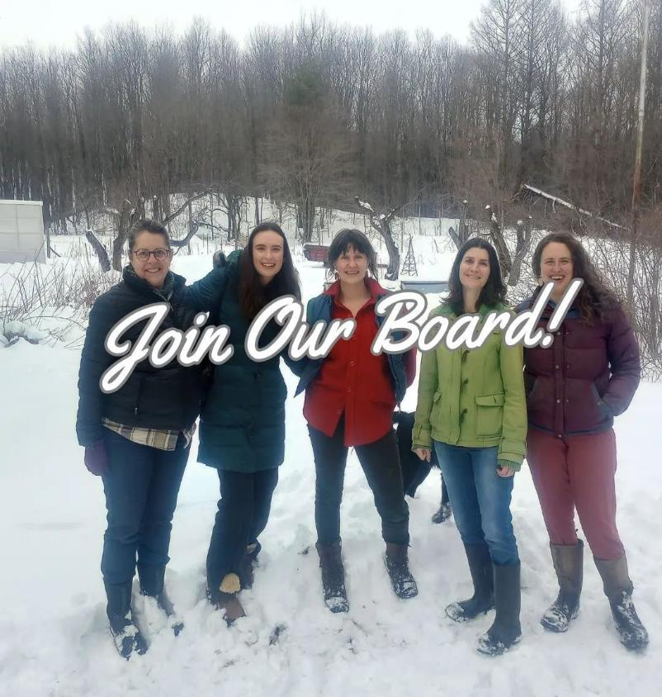
Example 1: GOOD FARMER'S GUILD
LEADERSHIP:
Volunteer board of local, experienced Farmer-Directors with 2-year terms
Committees (events, finance, etc.)
LOCATION: Western New York
www.goodfarmersguildwny.org/
Farmer Field Day
Photo Credit: Good Farmers Guild of Western NY
Notes:
The Good Farmer’s Guild is farmer-led, with a volunteer board of experienced farmer-directors who are voted on by the community. To streamline and disperse tasks, they have several committees with small focus areas: events, finance, etc. This alleviates the burden of organizing the group, events, and finances from one individual and provides leadership authority to those who volunteer for that work, allowing new members the opportunity to grow within the network.

Slide 11
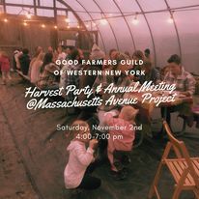
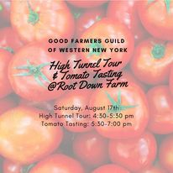
Example 1: GOOD FARMER'S GUILD
EDUCATIONAL EVENTS:
6-8 Annual Events
Mix of social and educational
Experiential: Typically held at farms in the community
Community-driven (potlucks)
Small group gatherings (20-30 people)
Evening + weekend events to accommodate busy schedules
Free to attend
OUTREACH:
Led by Directors
Connected by active social media, website, word of mouth
Notes:
The core of the Good Farmer’s Guild network is their educational events. They host 6-8 events each year, a mix of social and educational. These events are typically held at farms within the community and are no-cost to attend. They save on funds by promoting community-building activities, such as bring-your-own potlucks and community seed swaps. Most of their events are held in the evening or on weekends to accommodate working schedules. Their outreach to advertise these events is driven primarily through their social media, along with partner announcements and word of mouth. A member of the leadership team is responsible for promoting these events, while organizing and facilitating the events is shared by both the leadership team and the host farm. Typically, 20 people or less join for each event.

Slide 12
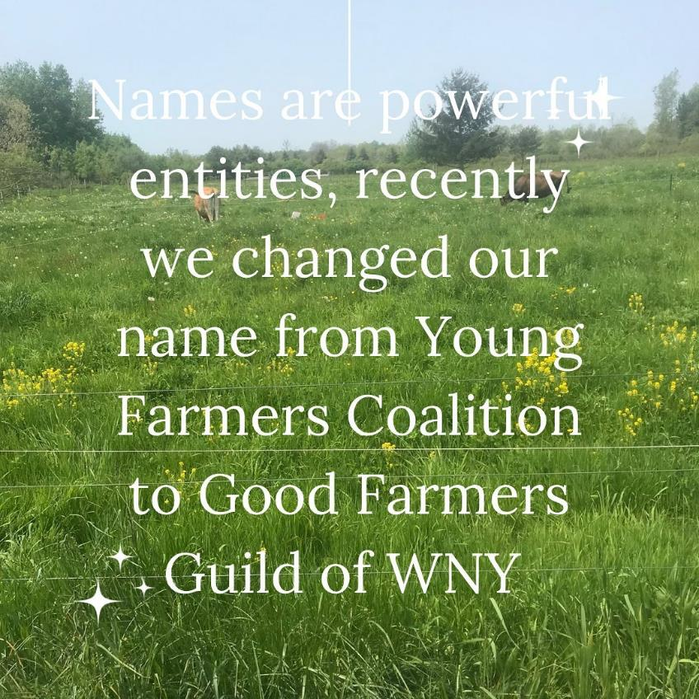
Example 1: GOOD FARMERS GUILD
SUCCESSION PLAN
A volunteer committee oversees the elected board. Each board member serves two-year terms, allowing them to cycle off to allow new members to be considered.
Originally formed as a branch of Young Farmer’s Coalition, the Good Farmer’s Guild has evolved over time as the needs of its members has changed.
Photo Credit: Good Farmers Guild of Western NY
Notes:
Last, let’s talk about succession planning. The Good Farmer’s Guild has embraced change and evolved from their original formation as a branch of the Young Farmer’s Coalition. This change was a result of listening to, and improving their services to their community. The leadership team is elected every two years, allowing new people to be considered. The group has also been able to secure funding that offsets costs of associated with their education and outreach.

Slide 13
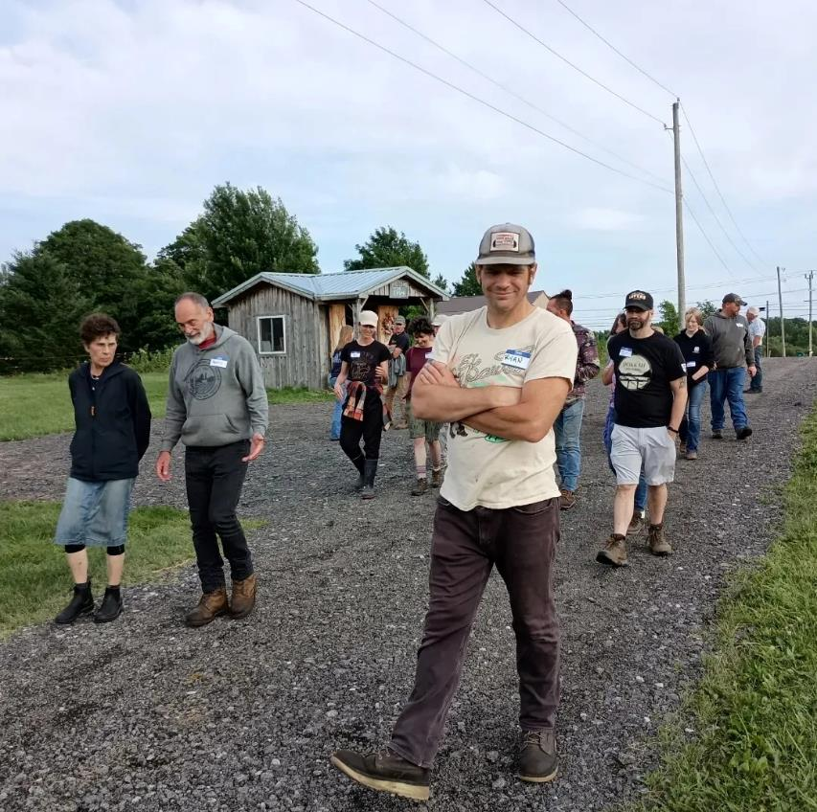
Example 1: GOOD FARMERS GUILD
What Makes it Successful:
Farmer-driven
Organized & dedicated leadership
Rotating & shared responsibilities
Free-to-attend educational events with interesting and timely topics
Frequent meetings & community-building activities
Connected & engaging online platforms
Farmer Field Day
Photo Credit: Good Farmers Guild of Western NY
Notes:
What makes this group successful? Number one, it is farmer-driven. Their leadership team is dedicated and organized, and they share responsibilities. The events are fun and free to attend, and focus on innovative and timely topics that are of interest to their beginning farmer community. The group is very good at hosting many events each year, which strengthens connection and keeps their community engaged. Last, they maintain and update a presence online, with a nicely designed website and active social media.

Slide 14
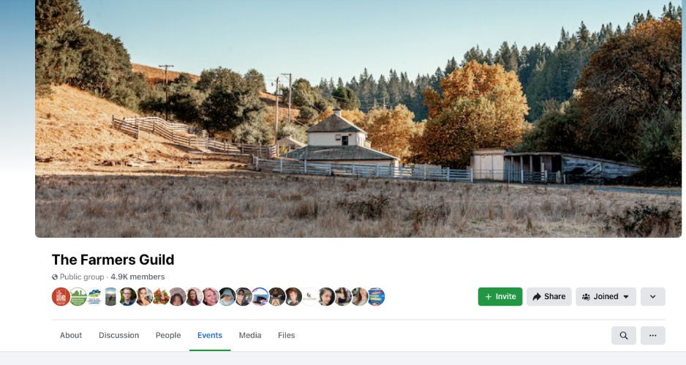
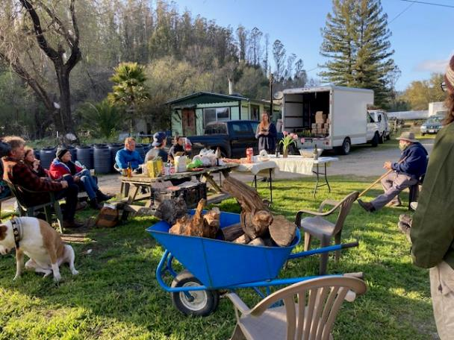
OTHERS LIKE IT
The Farmers Guild California
Regional chapters
Absorbed into non-profit org
Uses social media to leverage existing events
Coralitos Farmer Guild Meeting
Photo Credit: Caitlin Joseph
Notes:
The Farmers Guild of California used to be an independent farmer-led group, spearheaded by Evan Wiig, with chapters throughout the state that gathered farmers regularly to share meals and knowledge on each others’ farms. Some of these chapters still meet informally today after years of gathering. Evan, the group’s founder is now staff at the Community Alliance with Family Farmers, so the Farmers Guild got folded into the work of this non-profit organization that is focused on technical assistance and advocacy for small farms in CA. With nearly 5,000 members, The group lives on as a Facebook group with a critical mass of small farmers, ag service providers, and advocates, and it is an effective place to share questions for the group, events already happening, and policy action.

Slide 15
Example 2: AFT WOMEN FOR THE LAND SOUTHEAST COHORT
“I'm glad to be around other women who are in the struggle. So if anything, the resilience comes from me seeing other women who want to do it and they're willing to fight”
- Participant
Virginia Women for the Land Cohort
Photo Credit: Rebecca Drobis
Notes:
Our second example is an affinity group peer network. We’ll take a look at AFT’s Women for the Land Southeast Climate Cohort.

Slide 16
Example 2: AFT WOMEN FOR THE LAND SOUTHEAST COHORT
Focused on breaking down barriers for black women to improve their access technical and financial resources
Participants saw a larger community movement. One described “a rebirth of Black people being connected to the land.”
Participants used their land as a community gathering space to cultivate community and provide education around climate smart agricultural practices.
Notes:
This cohort was focused on breaking down barriers for black women in North Carolina to improve their access to technical and financial resources around climate-smart agriculture. The cohort formed a strong connection, which one participant described as, a rebirth of Black people being connected to the land.

Slide 17
Example 2: AFT WOMEN FOR THE LAND SOUTHEAST COHORT
Impacts:
Participants described changes in their production practices, including:
Widening rows to accommodate water
Changing the types of plants grown no-till farming
Use of row covers, vertical growing, and hydroponic growing
Companion planting to defend against pests.
“That's what I'm doing now [taking care of the soil], conserving, protecting, trying to take care of what we have because I realized we've got to have soil. We've got to have it, because that's the live thing and that's how we get plants, trees, everything."
- Participant
Notes:
In addition to cultivating a community, the network had real, on-the-ground impacts as a result of their shared knowledge. These included implementation of climate-smart practices such as widening rows to accommodate increased water from rain events, adopting no-till practices and changing their crops, the use of row covers, vertical growing, and hydroponics, and companion planting to defend against pests and diseases.

Slide 18
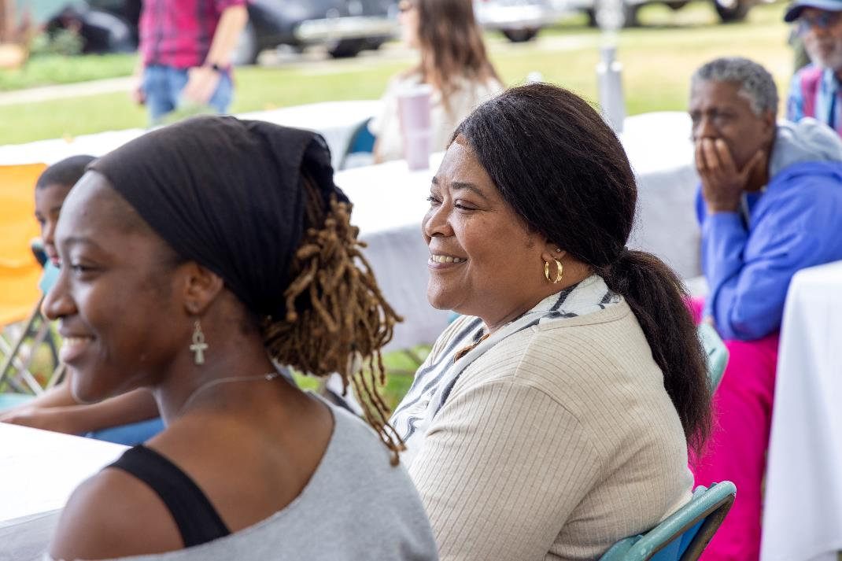
Example 2: AFT WOMEN FOR THE LAND SOUTHEAST COHORT
PEER COMMUNITY:
30 black women farmers and landowners located throughout North Carolina
Common interest in climate change adaptation and improving soil health on their land
North Carolina Women for the Land Cohort
Photo Credit: Rebecca Drobis
Notes:
This peer community consisted of 30 black women farmers and landowners in North Carolina. Membership was initiated through an application process. These participants came from a range of farming background, ages, and experience, but shared a common interest in climate adaptation and improving soil health on their land.

Slide 19
Example 2: AFT WOMEN FOR THE LAND SOUTHEAST COHORT
LEADERSHIP:
Led by AFT staff in partnership with local service providers
Advisory Committee to assist in recruiting and selecting participants
Regional Climate and Soil Health Advisors co-led educational sessions
Notes:
The leadership of this cohort was led by agricultural service providers, primarily AFT staff and local leaders. An advisory committee assisted in recruiting and selecting participants. And regional climate and soil health advisors co-led the educational sessions.

Slide 20
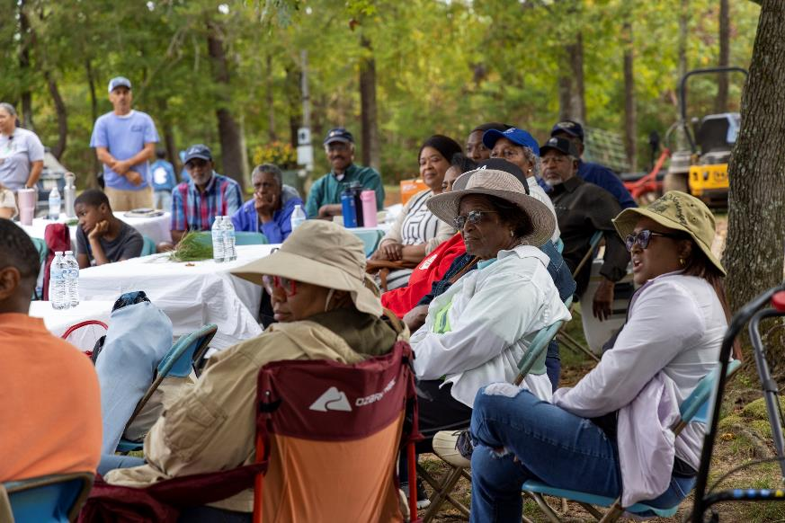
Example 2: AFT WOMEN FOR THE LAND SOUTHEAST COHORT
EDUCATIONAL EVENTS:
8 sessions held over one year
Sessions built upon knowledge gained
Primarily virtual, but in-person gatherings at the beginning and end of the session to build community
OUTREACH:
Participants were recruited through partners, social media, and word of mouth
Main communication via email
North Carolina Women for the Land Cohort
Photo Credit: Rebecca Drobis
Notes:
The cohort held 8 sessions over a one-year period, primarily in a virtual environment but with a few in-person events to build community. Outreach was advertised through social media, partner email lists, and word of mouth. After getting started, email was the primary method of communication between leadership and the cohort.

Slide 21
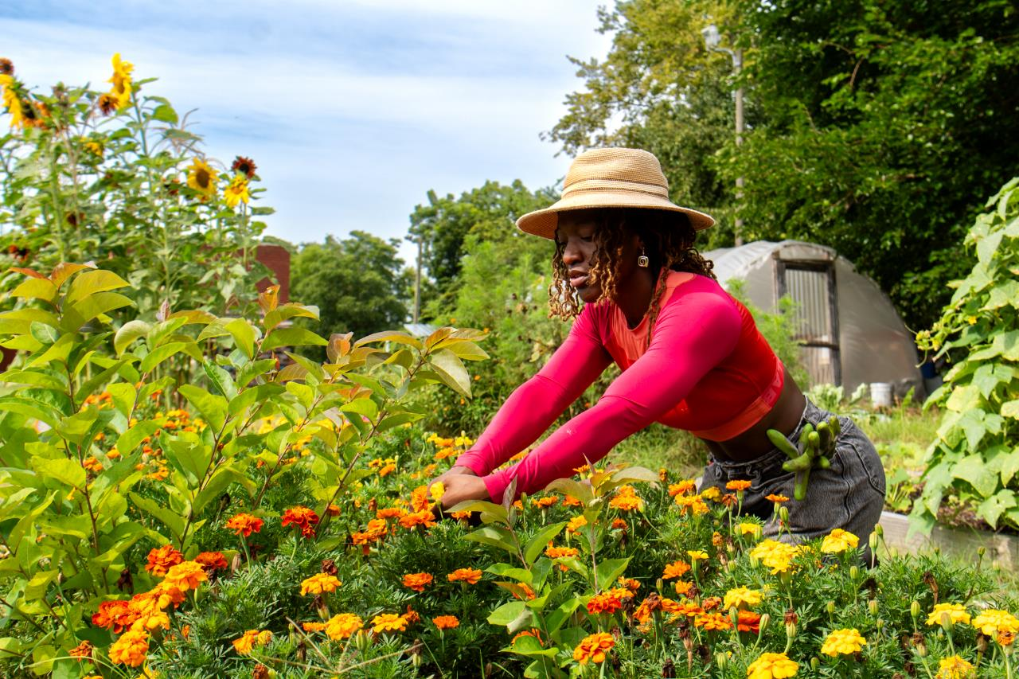
Example 2: AFT WOMEN FOR THE LAND SOUTHEAST COHORT
SUCCESSION PLAN:
This project was grant-funded and formal training ended after one year
But community connections and informal networking continued virtually after the project was completed
North Carolina Women for the Land Cohort
Photo Credit: Rebecca Drobis
Notes:
This project was funded by a grant and so formal training ended after one year. But the leadership team did their best to foster community and encouraged cohort members to connect virtually through email and social media after the project was completed.

Slide 22
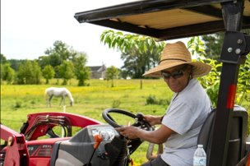
Example 2: AFT WOMEN FOR THE LAND SOUTHEAST COHORT
What makes it successful:
Common goals, common lived experiences
Understanding of local history
Emphasis on belonging alongside technical content
Participation, travel, and/or host stipends
Clear expectations: defined outcomes and value propositions
Respectful time commitments
Engaged partners who support outreach efforts
North Carolina Women for the Land Cohort
Photo Credit: Rebecca Drobis
Notes:
Let’s talk about why this affinity group peer network was successful. With any affinity group, this cohort shared common goals and common lived experiences. The emphasis on learning was more than just sharing technical content, but about fostering a sense of belonging and inclusion within a larger service provider ecosystem. Importantly, participants were compensated for their travel and hosts for the in-person events were provided with small stipends. This promotes a sense of worthiness and improves participation in this type of grant-funded network. From the start, there were clear expectations and defined outcomes that everyone was working towards. And lastly, this project couldn’t have happened without strong support from partners who facilitated outreach efforts and contributed knowledge, time, and resources.

Slide 23
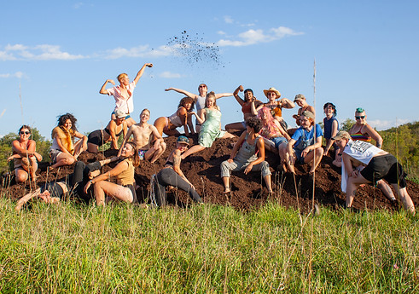
OTHERS LIKE IT
Queer Farmer Network
Website, social media, directory
Annual-ish in-person “convergences” emphasize community-building but also include skill-sharing
Women Caring for the Land (WFAN)
Women landowners in Iowa
15+ years running
Wisconsin Women in Conservation
Women landowners and farmers in Wisconsin
Leaders paid to host gatherings
Notes:
Here are three other examples of affinity group peer networks. The Queer Farmer Network is nationwide, hosting annual in-person convergences that emphasize community building and skill-sharing. Check out their website for more information. Women Caring for the Land (WFAN) is a long-standing women-centered agricultural network in Iowa. They were very influential in launching modern gendered peer networks to improve technical services to women landowners and farmers. And last there is the Wisconsin Women in Conservation, led by a network of service providers and providing events, training, and peer mentors, this group is very active throughout Wisconsin.

Slide 24
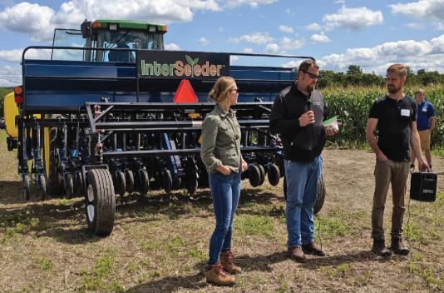
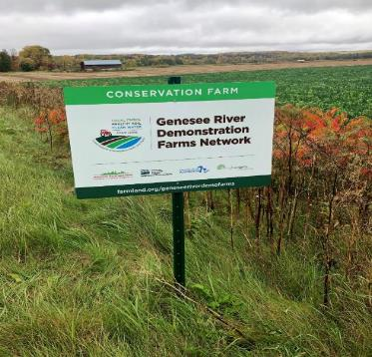
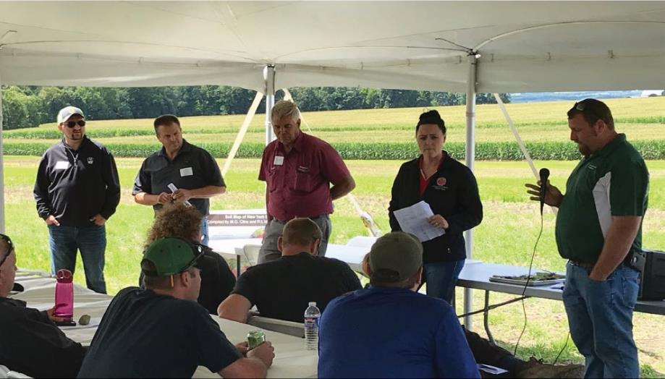
Example 3: GENESEE RIVER DEMONSTRATION FARM NETWORK
Led by Partner Organizations with Common Goals
Driven by sharing knowledge of innovative practices
Farmer-Leaders "Network Farms"
Broad Base of Knowledge-Seekers
2-4 Large Annual Gatherings
LOCATION:
Genesee River watershed, New York
New York Demonstration Farm Network
Photo Credit: Stephanie Castle
Notes:
Moving on to our third and final example of a peer network: the Genesee River Demonstration Farm Network. This network is the most structured example in this webinar. It was driven by sharing knowledge of innovative practices, requiring significant investment in research and multi-year trials. Led by partner organizations, and grant funded, this network relied on farmer-leaders to educate a broad base of knowledge seekers, establishing two levels of peer networks.

Slide 25
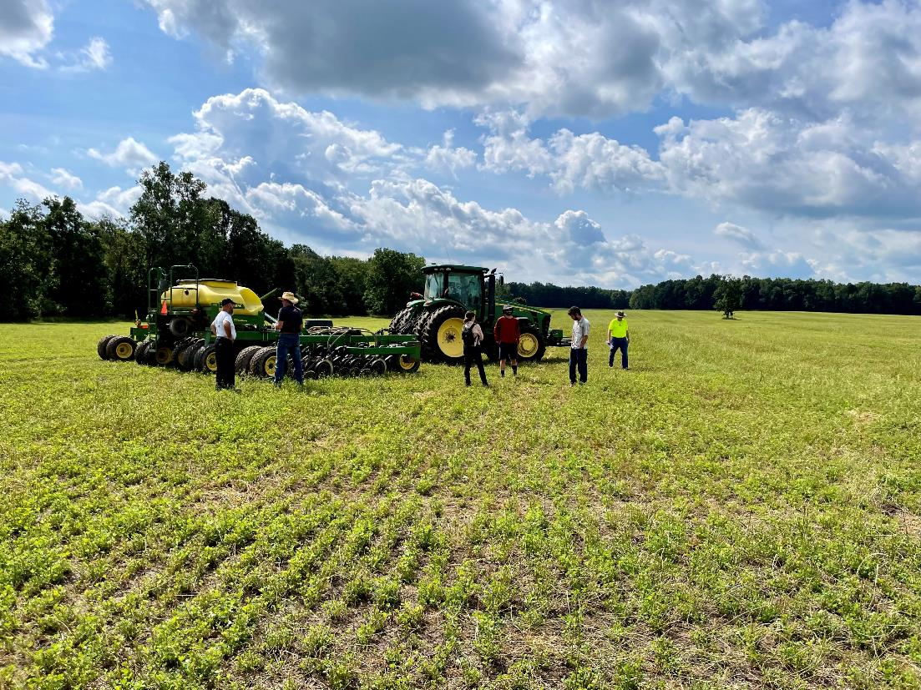
Example 3: Genesee River Demonstration Farm Network
PEER COMMUNITY:
500+ Farmers, aspiring farmers, service providers and researchers across western New York
Conservation-curious learning from early adopters/innovators
New York Demonstration Farm Network
Photo Credit: Stephanie Castle
Notes:
Here, the whole peer community was farmers and service providers invested in learning more and implementing sustainable agriculture in western New York. But, as said earlier, there were really two levels of peers: the early adopter “leaders” and the conservation-curious. These two peer groups interacted with one another and shared knowledge and resources, with the knowledge primarily passing from the early adopters to the conservation curious learners.

Slide 26
Example 3: Genesee River Demonstration Farm Network
LEADERSHIP: Led by a coalition of university researchers, non-profit staff, crop consultants, and USDA-NRCS
EDUCATIONAL EVENTS: 1 annual large (100+ attendee) field day with hands-on activities and invited expert speakers from outside the geographic area. Free to attend.
OUTREACH: Invitation by email and advertised through social media. Some advertisement through partner networks, too.
Notes:
A structured network requires funding and strong partnerships at the leadership level. Here, the leadership team was a coalition of university researchers, non-profit staff, independent crop consultants and UDSDA-NRCS. Educational events were big, welcoming over 100 attendees, and usually held once or twice a year. They were structured like a field day, usually held at one of the farmer-leaders’ farms, or Demonstration Farms, and had invited expert speakers and hands-on activities, such as cover crop test plots, equipment trials, soil pits, and demonstrations. These events were free to attend, as the cost to organize them was covered by grant funding. Outreach was extensive, inviting and organizing participants through email, social media, and partner emails. However, there was no dedicated space for participants to gather, ask questions, or share information outside of the formal annual field day events.

Slide 27
Example 3: Genesee River Demonstration Farm Network
MEASUREMENT OF IMPACT:
Potential reach of farmer-peers adopting new conservation practices: 150,000+ acres
Nearly 500 people connected to the Network
Field trials resulted in published reports and case studies
SUCCESSION PLAN:
Three-year funded project
Built strong relationships with partners and Demo Farms to allow continued partnership into the future
Model works well to establish new farms with new research goals
Notes:
How does a big network like this one measure their impact? The main reported impact was the reach, and potential reach of farmers adopting new conservation practices. In this case, estimated at over 150,000 acres. A secondary impact was the number of people connecting into the network to share skills and knowledge, and to learn. This was almost 500 people. Last, results from innovative research trials were published in reports and case studies and shared online. Now, succession planning: how does a project like this continue after grant funding has ended? Originally, this was a three-year project and built strong, lasting relationships between partners and the farmer-leaders involved with the research trials. This allowed new funding to investigate related topic areas, relying on a few key farmer-leaders. Not everyone was involved with continuing the research trials, but the same structure has followed, hosting a large outreach event and showcasing the innovations of select farmer-leaders. This model works really well when the goal is to trial research methods and innovative practices.

Slide 28
Example 3: GENESEE RIVER DEMONSTRATION FARM NETWORK
What makes it successful:
Clear vision of long term network goals
Strong leadership to organize events, research, and outreach
Secured funding to pay farmers, host events, set up research trials, etc.
Driven by innovation
New York Demonstration Farm Network
Photo Credit: Kevin Keenan
Notes:
This was a big undertaking. What made it successful? First, a clear and shared vision of long-term goals. The partner organizations and farmer-leaders all had to be on the same page for this. Strong an organized leadership to organize research trials, complex events, and widespread outreach was necessary. And of course, secured funding to pay farmer-leaders, host big events, and conduct replicable research trials that could illustrate results. All of this was driven by innovation.

Slide 29
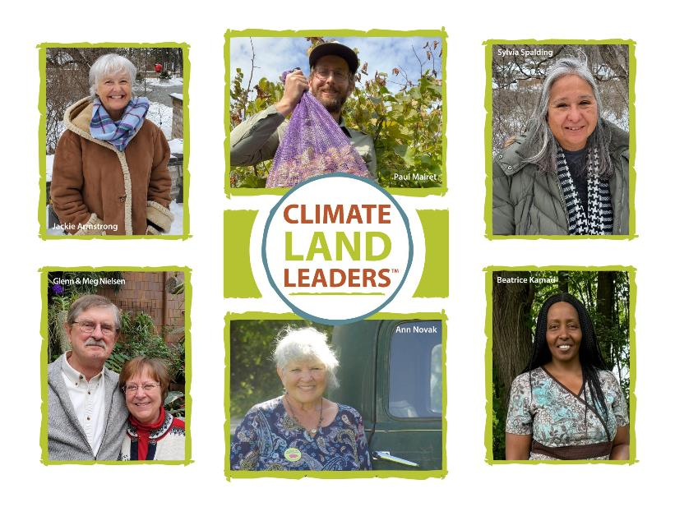
OTHERS LIKE IT
Climate Land Leaders Initiative
Members have shared goals
Across wider geographies (multiple states)
Application process and network login
Soil Health Management Planning Cohorts (AFT New England)
CT Specialty Crops; MA Specialty Crops; CT River Watershed Livestock Cohorts
Non-profit and research institution partnership. Strategy:
Build tools and resources that will last beyond project for farming community
Complement existing opportunities & programs
Notes:
Climate Land Leaders are working with compassion and commitment to address the climate crisis on their lands. As farmland and woodland owners, they are implementing ambitious conservation projects, sharing with and learning from each other, and serving as leaders on climate policy and equity initiatives.
Climate Land Leaders share three goals:
Reduce greenhouse gas emissions in their agricultural operations.
Sequester carbon in soils and biomass.
Ensure that our lands and farms are resilient in the face of a rapidly changing climate.

Slide 30
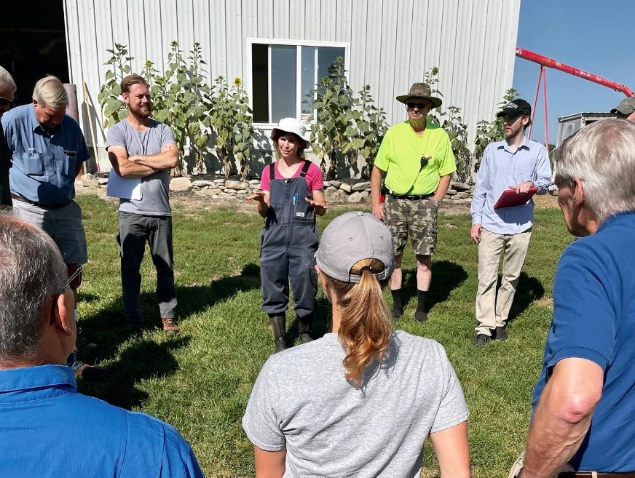
KEY TAKEAWAYS
Networks can be adaptable based on the needs of the community
All networks need a dedicated leader with a clear vision and shared goals
Social & educational events provide opportunities to build community and gain knowledge/skills
Outside funding offsets costs for outreach, participation, and research with less burden on the community
New York Demonstration Farm Network
Photo Credit: Stephanie Castle
Notes:
Let’s review some key takeaways about building your own peer network. First, know that networks can be adaptable based on the needs of your community. They can take many forms and be highly structured or informal. A key component, whatever form the network takes, is that there is a dedicated leader with a clear vision and shared goals. And that the vision and goals are communicated to participants. Incorporating social and educational events provide opportunities for knowledge sharing, skill development, and building community. And last, funding never hurts! Outside funding can offset costs for outreach, participation, and research with less burden on the participants to “pay their way”.
I hope this illuminates how peer networks look and the key components that drive their success. Thank you for your time and attention and best of luck launching your own network!

