Slide 1
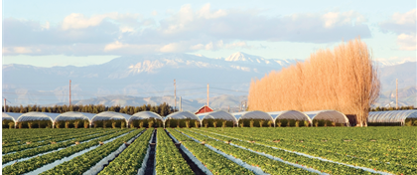
Transitioning Land to a New Generation
Assess Your Financial Situation and Build Your Team
Notes:
This module is the second of five consecutive modules—or workshops— in the Transitioning Land to a New Generation Curriculum, which designed to help participants gain the basic skills needed to participate in a farm, ranch or land transfer process.
This module prepares participants to assess their financial position and needs, and the position and needs of the other party, and identify key advisors to support the transfer process.
The Learning Objectives include:
Assign values to the assets included in the transfer.
Define key financial terms.
Identify common financial statements and learn how to use them.
Describe different kinds of advisors and what to look for when hiring them.
Trainer Instructions:
Review Module 2's Teaching Plan

Slide 2
Welcome
** TRAINERS: This slide is optional. Design it with information, such as:
names and photos of presenters
your logo
logos of any co-sponsors
Notes:
Welcome to this workshop. This is the second of 5 modules or workshops American Farmland Trust has created to help you get ready to be part of a farm or ranch transfer process.
We have found that most training on this about farm/ranch transfer and transfer cover succession and/or estate planning within farm families, and mostly from the point of view of the senior generation.
Since land transfers increasingly occur between non-relatives, we have tried to make our training as inclusive as possible: for those of you who come from farm families and for those who don’t, for younger producers and/or beginners as well as for land holders looking for someone to take on management of their land, their operation, or both.
It is designed especially for people who have land and/or farm or ranch business in mind and have at least started to talk with someone about transferring it – from young and beginning farmers and ranchers to landholders who may be retiring, or planning their estates, or who want to make land available for a new generation.
Trainer Instructions:
Have trainer(s)/presenter(s) introduce themselves
Review workshop agenda
Ask participants to introduce themselves

Slide 3
Acknowledgments
Transitioning Land to a New Generation was created by American Farmland Trust, supported by an Educational Enhancement grant from the USDA Beginning Farmer and Rancher Development Program.
Award # 2020-49400-33257
Thanks also to Farm Credit, the team of national experts in farmland transfer and access, and the members of American Farmland Trust.
Notes:
This curriculum was created by American Farmland Trust with support from a national Educational Team of advisors and a group of subject matter experts.
It was made possible by a grant from the USDA Beginning Farmer and Rancher Development Program Award #2020 - 49400 – 3325 with additional support from Farm Credit and the members of AFT.

Slide 4
Today You Will Learn To:
Assign
Assign values to the assets included in the transfer.
Identify
Identify common financial statements and learn how to use them.
Define
Define key financial terms.
Describe different kinds of advisors and what to look for when hiring them.
Describe
Notes:
This module prepares participants to assign values to assets included in the transfer and to make financial assessments to inform their farm or ranch transfer.
Participants will learn to define key financial terms, identify common financial statements and learn how to use them, and describe different kinds of advisors and what to look for when hiring them.
Participants will also assess their needs and assets and those of the other parties involved.

Slide 5
10 Key Steps in a Farm or Ranch Transfer
Assess finances.
Describe your values, vision, & goals.
Tell your story.
Create your support team.
Identify your needs.
Negotiate.
Choose which tools to use.
Identify and strengthen key relationships.
Finalize documents.
Outline and adapt your plan.
Notes:
There are series of steps in a farm or ranch transfer process. We have broken it down into 10 steps. You likely will take most if not all of them, but it is not a linear process, so while a certain amount of order makes sense, you likely will find you move forward and back several times before you are done.

Slide 6
Let’s Review SMART Goals
Choose a partner.
3 minutes: First partner describes their transfer situation and one of their SMART goals.
2 minutes: Second partner listens, reflects, and provides feedback on the SMARTness of the goals.
Switch roles.
Come back to the group and share observations.
Notes:
Motivation Activity
Refer to the SMART Goals Discussion Worksheet.
Trainer Instructions:
See Teaching Plan and the Training Manual for suggested activity steps.

Slide 7
Set “SMART” Goals
SMART goals are:
S = Specific
M = Measurable
A = Attainable
R = Results-Focused
T = Timely
Notes:
Setting useful goals can be difficult. They should be simple, yet specific enough to clearly define what you want to accomplish. They should cover the 5 Ws: Who, What, Where, When, and Why, as well as How.
Many people use the SMART goals framework to set useful and actionable goals. SMART goals are:
S = Specific well-defined and clear.
M= Measurable because when you measure results, you know whether (or not) you have achieved your goals.
A=Attainable and realistic enough that you can achieve them with time and effort.
R=Results-Focused meaning they include the resources, knowledge and time you need to reach your goals.
T=Timely or timebound, meaning linked to a realistic timeframe. A goal without a timeline is just a dream.
Let’s work through an example. A broad goal might be “To inherit my grandfather’s vegetable operation.” That’s a worthy goal to start. but it doesn’t answer the deeper SMART questions.
To make it more Specific you might refine the goal to be “To inherit my grandfather’s operation and produce a seasonally diverse mix of fruits and vegetables to sell at farmers markets and to local schools.”
To make that Measurable you might add: “Earn an annual gross income of $150,000, increase crop yields 5 percent by improving nutrient management, and increase sales by $25,000, by adding 2 farmers’ markets and a local school to the marketing portfolio.”
Then check to make sure these are all Attainable. Even if it’s a stretch, could you accomplish these things in 2 years? What resources do you need? Do you have them or what else do you need to get the help that you need?
Finally, make sure you have a realistic timeframe. For example: “To increase crop yields by 5 percent next year by improving nutrient management and pest control” or “To increase sales by $10,000, by reaching out to at least 25 new sales prospects in the coming 6 months”

Slide 8
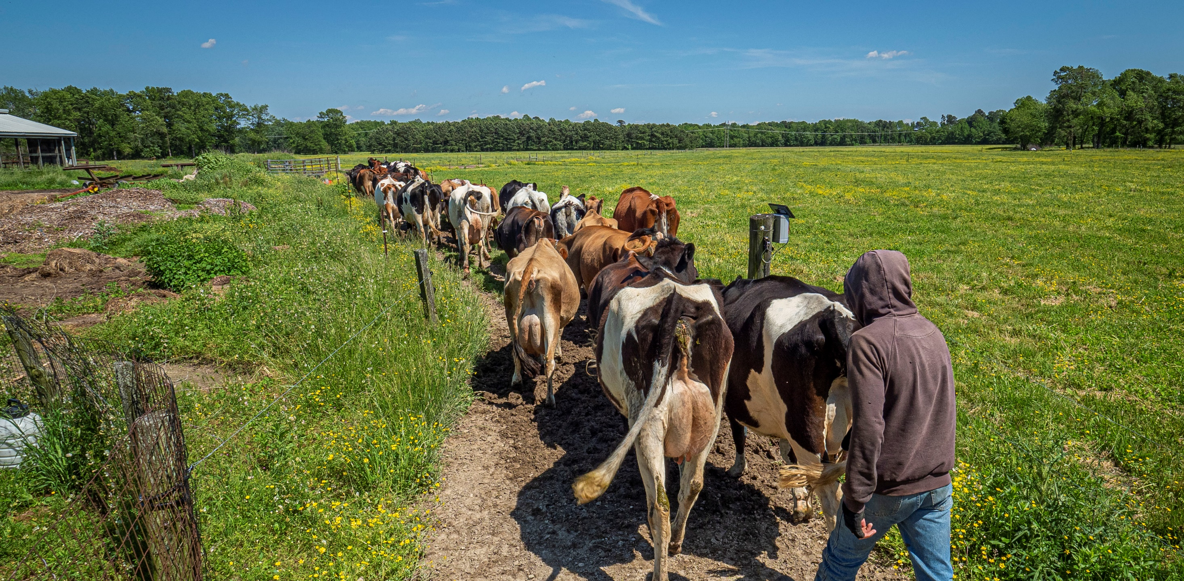
Part 1: Assess the Value of Assets Being Transferred
-
Notes:
Now that you’ve clarified your current situation, where you want to go, and what you need to get there, it’s time to think about how much it will cost or yield and whether you can afford it.

Slide 9
Assets are things of value
Assets may include:
Cash, savings, and real estate
Social networks and access to resources
Trademarks, market share, customer loyalty, skilled workers and managers
Position in a family, institution, or society
Land, buildings and equipment
Notes:
As a reminder, assets are all kinds of things that have value. Financial assets are things of value owned by individuals, corporations and organizations.
They can be tangible or physical things that you can touch, like land, buildings, and equipment. Tangible assets also include financial resources like a bank account.
Intangible assets are nonphysical things like trademarks, market share, customer loyalty and the skills of managers and employees.
Today we are going to focus on financial assets, or assets that can be reported on a balance sheet. We’re also going to touch on transfer of management if you are involved in a farm or ranch business transfer.
Financial assets include things like cash and savings, land and buildings, crops and livestock, equipment and inventories, and intangible property such as an established brand or a clients list.

Slide 10
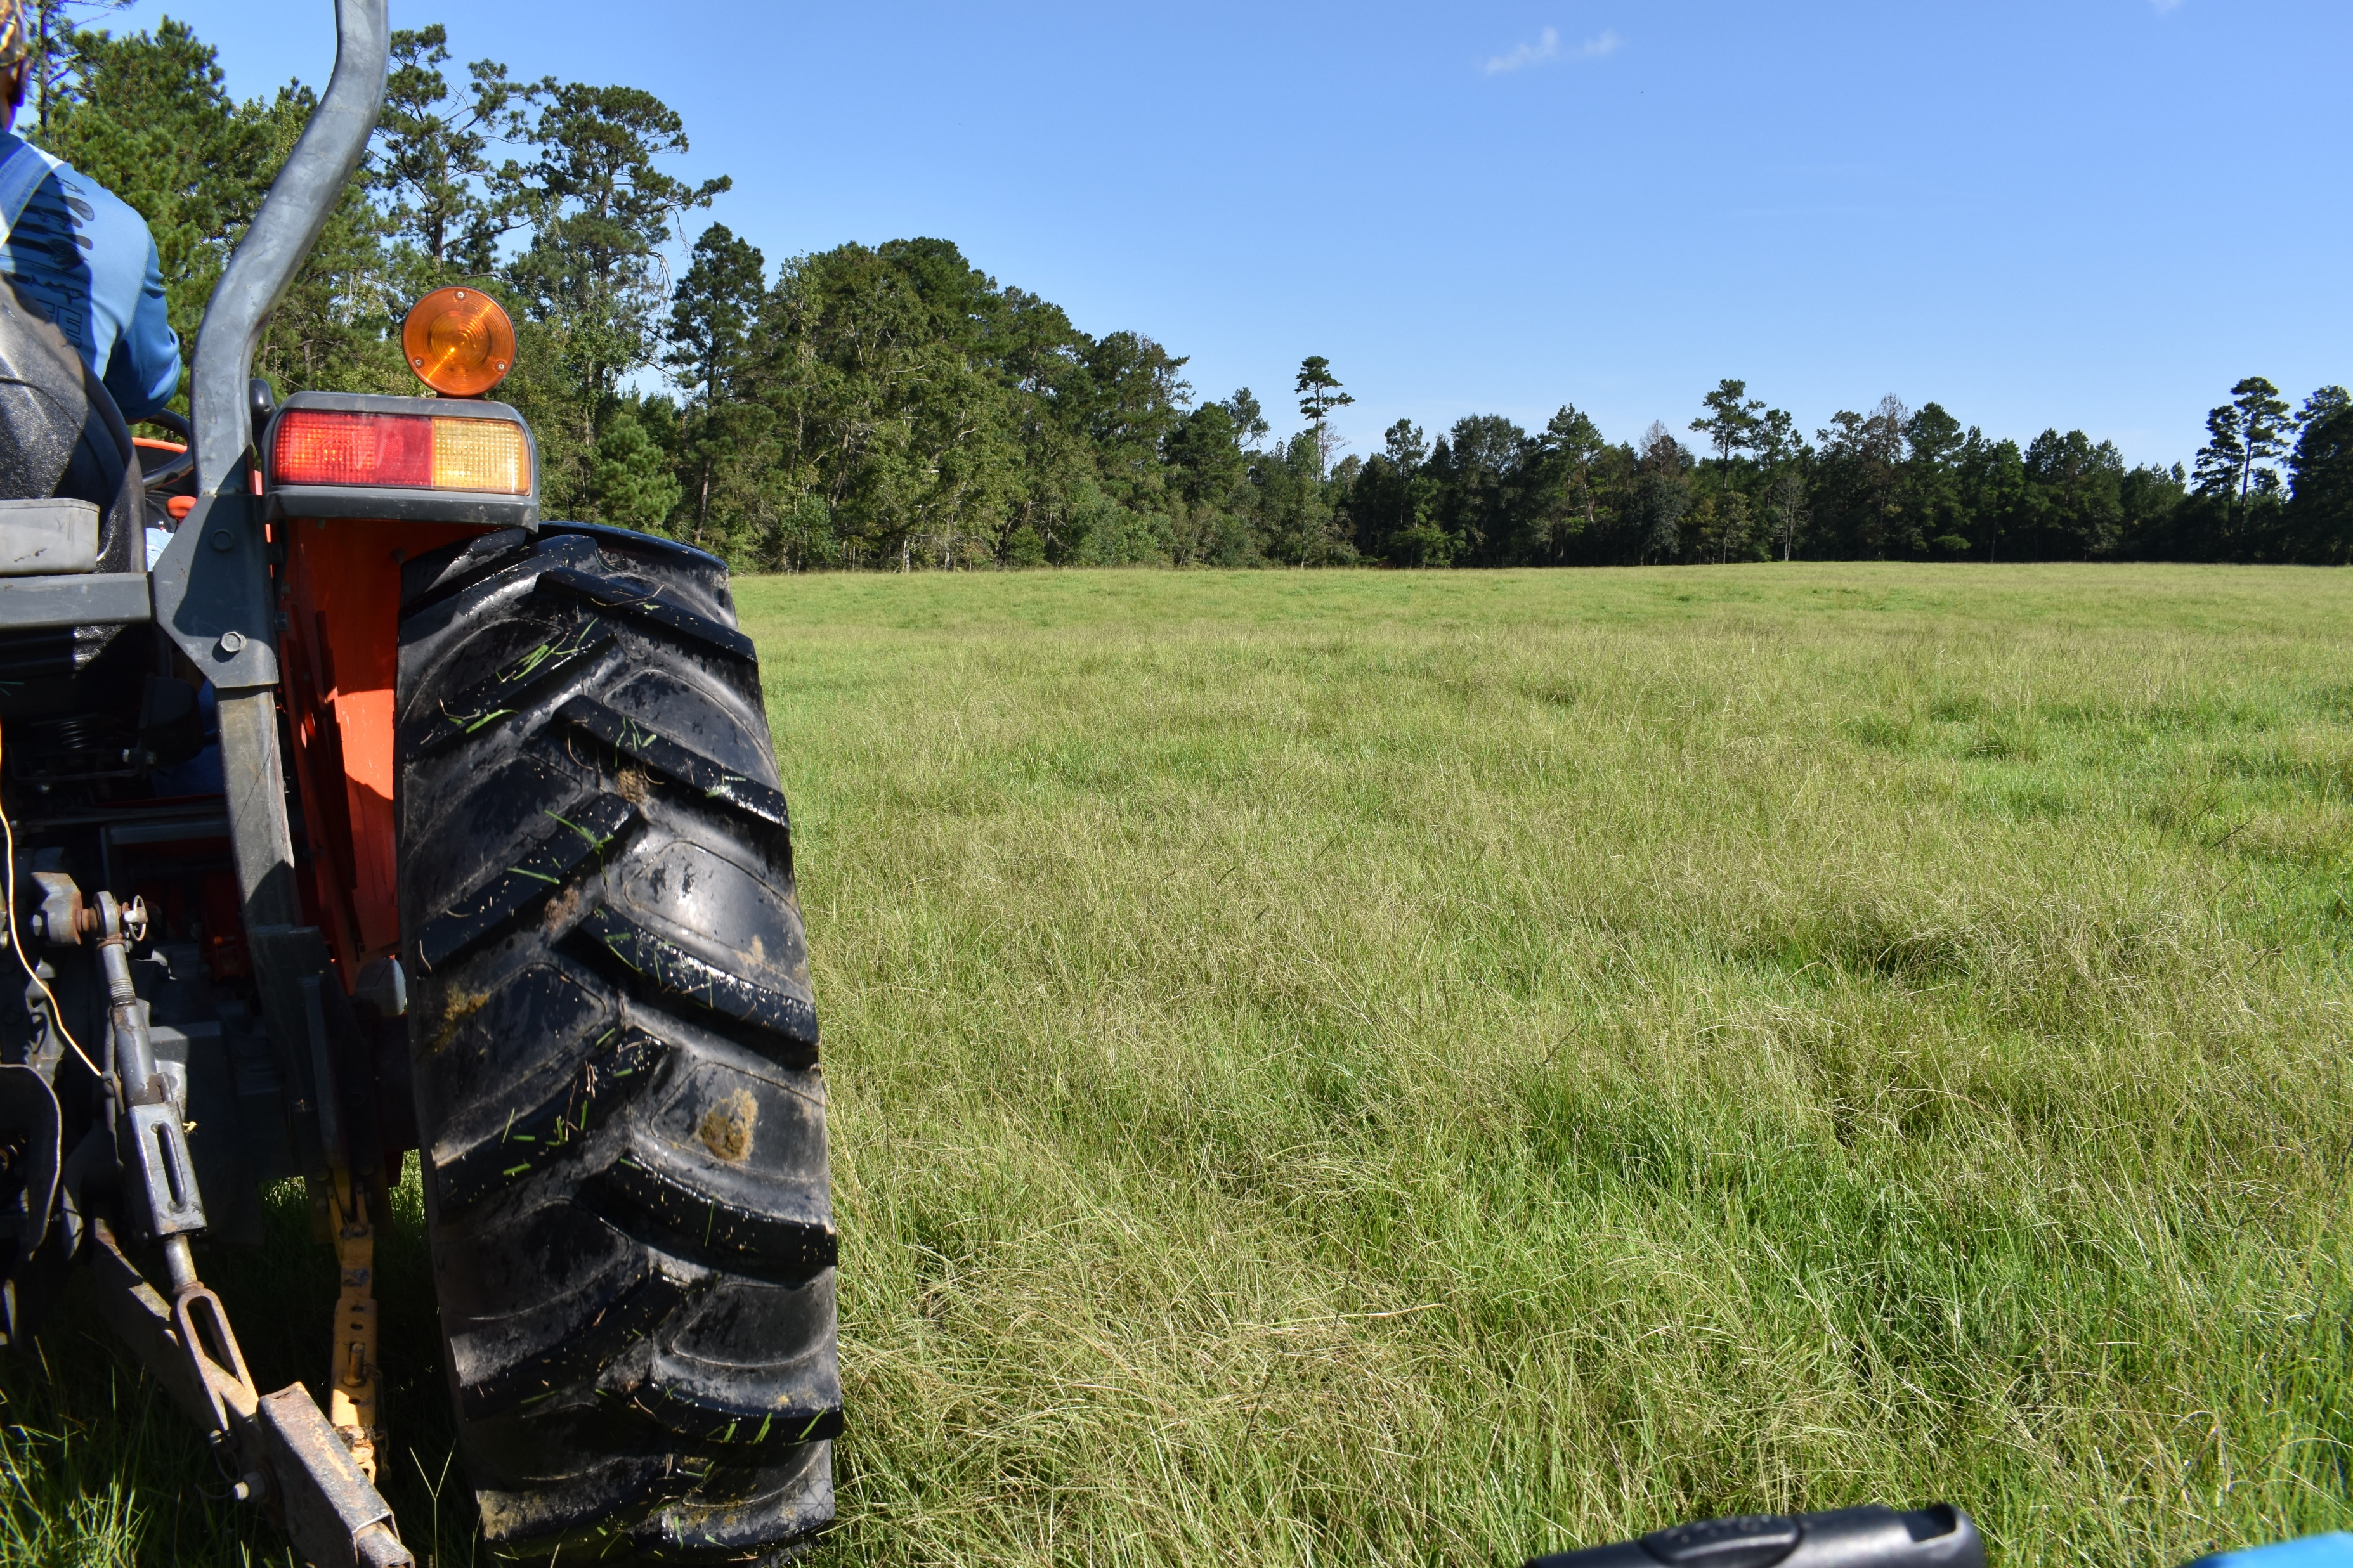
What is Being Transferred?
Land
and other tangible assets.
Management
and intangible assets.
Notes:
In the first workshop, we talked broadly about what is involved in a farm or ranch transfer: is it just raw land, or land with structures like a house, barns, sheds or fencing? What about the equipment? Or does the transfer include some aspect of the existing farm or ranch business?
The complexity of the transfer depends in part on the answers to these questions.
A transfer may just include land and/or other “tangible assets.” Tangible assets are physical property like buildings, fencing, equipment and so on.
It may include “intangible assets” like the business model, brand, customer list, patent, etc., which are not physical property. Intangible assets generally are valued only when they change hands.
Or the transfer may include both.

Slide 11
Transferring Land & Other Tangible Assets
Assess the value of the land.
No need to assess the business.
Assess the value of the buildings, equipment, etc.
Notes:
Transferring raw land and other tangible assets is the most straightforward type of transfer. The incoming farmer either leases, purchases, or receives a gift or inheritance of land, buildings, equipment, and so on.
For leases and sales, it boils down to the price of the assets. Reaching agreement on these values will be the focus of your conversations. For gifts and inheritances, you may need to determine the value of assets for tax purposes or to divvy up assets among family members and other heirs.
You can estimate the value of the land by obtaining data from the local property tax assessor, comparing recent sales of comparable land, or consulting with your local Extension office which often generates rental rates for specific areas and/or commodities. Also, USDA’s National Agricultural Statistics Service (NASS) which conducts the Census of Agriculture also publishes Land Values and Cash Rents annually. Finally, you can consult with a local real estate agent familiar with comparable sales and/or local rental rates.
To get a more definitive assessment, you will need to hire an appraiser.

Slide 12
Transferring an Ongoing Business
Assess alignment with goals
Estimate cost of any needed improvements
Assess profitability
Determine if business has value beyond its tangible assets
Notes:
Transferring an ongoing business is more complicated. If you’re involved in a transfer that includes the business be sure to:
1. Assess whether the existing business matches the incoming farmer's goals. For example, if an incoming farmer wants to grow a different crop, like converting from producing milk to raising vegetables, there may be a mismatch. The incoming farmer may not be able to use the current infrastructure even though the landowner thinks these assets have a lot of value. These are “sunk costs,” money that already has been spent and cannot be recovered. Landowners may be able to avoid sunk costs by salvaging assets or selling them to a third party.
2. Even if there is a match in terms of the type of operation, will any investments be needed to catch up on maintenance or upgrade equipment or facilities? This could affect how much the incoming farmer is willing to pay.
3. Is the business profitable? In the next section, we'll be covering key financial statements to help you evaluate this. Note, it can be especially hard to ask this of family members. Consider using scenario planning for what must change or might have to change.
4. Does the business have value beyond the tangible assets? This is unusual but possible. An example is a profitable retail garden center with an established customer base, skilled employees, and a known brand name. In this case, the intangible aspects of the business contribute value over and above the value of the tangible assets because it is a profitable business which the new owners can continue in its present form. Still, even in this case, the main value of the business may be in its real estate. Intangible assets could include existing contracts, customer lists and relationships, trademarks, trade secrets, water rights or other transferrable permits. If any are of use to the new owner, the two parties will need to agree on their value.
Determining the value of an ongoing business isn’t an exact science. There are a few different approaches to business valuation some based on financial statements we will cover in the next section.
Typically, this is based on the profitability of the existing business. This assessment is based on a review of key financial statements. A key consideration is whether profitability will transfer. (i.e. if the profit is too tied to the selling owner, such as personal business relationships, industry experience or unique talent, then that makes the business less valuable as an ongoing concern).

Slide 13
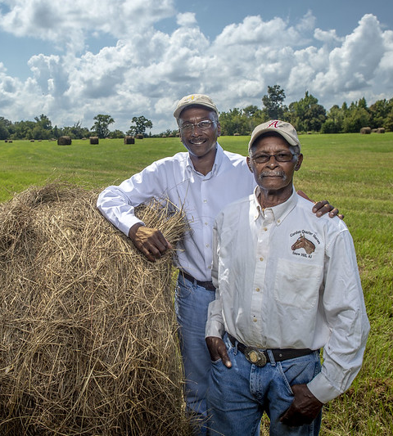
Transferring Management Experience
Decide how to share expertise and hand off decision-making:
Can happen over time
Should address all. aspects of the operation.
Notes:
Lastly, if your transfer includes the farm or ranch business you will have to decide how to handover management of the operation. This applies to all the parties involved (owners, incoming producers, family members working together or other arrangements).
This can be hard, so open and honest communication is critical!
Incoming farmers need to consider whether they have sufficient knowledge and experience to run the farm enterprise. Consider all aspects of the operation: planning, production, marketing, finances and labor.
Current owners need to think about whether they are willing to share their knowledge and expertise. If so, this can become part of the negotiation.
Both parties need to agree on how to hand over decision making for all the parts of the operation. Transferring management can happen all at once or over time. A gradual transfer could allow the incoming producers work side by side with the current owners for a specified period to help pass on essential information and skills.
We will be covering business tools used to transfer farm or ranch management in the next module. These include the way you structure your operation and contracts between business owners like Buy Sell and Operating Agreements.

Slide 14
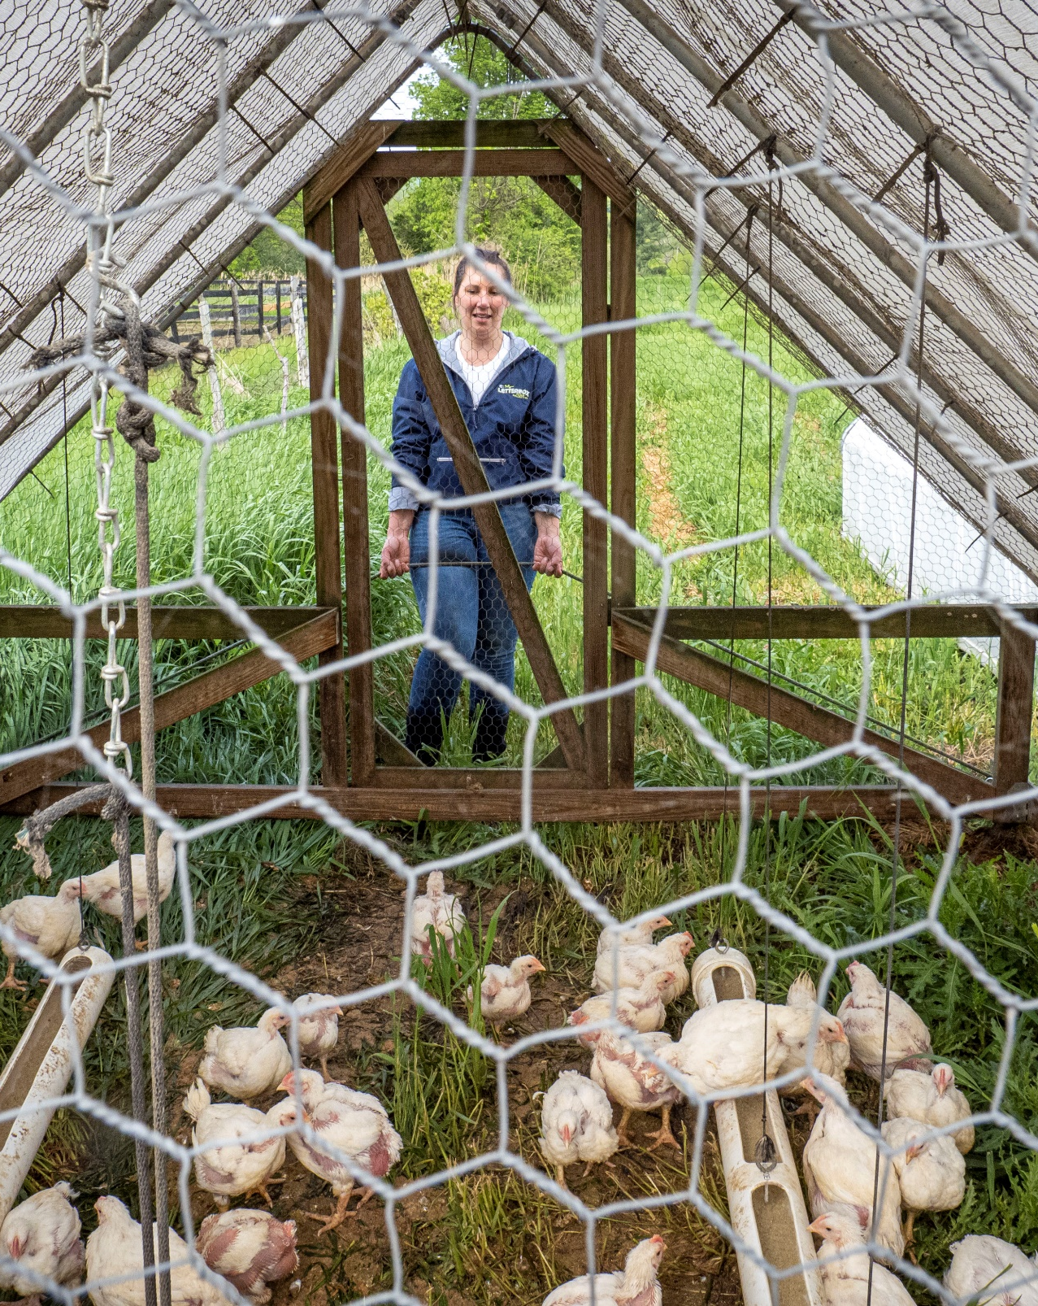
Inventory the Assets Being Exchanged
Notes:
Now it’s time to estimate the value of the assets involved in your transfer situation. In the first workshop, you listed the “stuff” you would like to acquire or transfer to help reach your goals. We are going to use the Asset Inventory Worksheet, to start assigning numbers to the items you identified.

Slide 15
Asset Inventory
Review the Asset Inventory Information Sheet.
Fill out the Asset Inventory Worksheet.
Share reflections with the group.
Notes:
Practice Activity
Take 10 minutes to review the Asset Inventory Information Sheet and fill out the Asset Inventory Worksheet.
List the assets to acquire or transfer. This might include land, buildings, equipment and/or aspects of the existing farm or ranch business. For each item, include a brief description. For example, if you want to acquire land, note the acres and the current land use. It might be 25 acres of cropland.
Consider the condition of each asset. Note which are in good working order and which would require money or time to make usable. You may need to hire professionals or consult with people in your network to make this assessment. If so, make a note.
Estimate the value of each asset. See the asset inventory worksheet for more information.
Which can you afford and which are the most essential to your business? Based on this information, prioritize these items. This can help you narrow down your list into the items that are most necessary as you move forward with conversations with the other party.
Now let’s go around the room and share any insights and reflections.
Trainer Instructions:
See Teaching Plan for instructions and the Training Manual for suggested activity steps.
Bring the group back together to share their insights reflections.

Slide 16
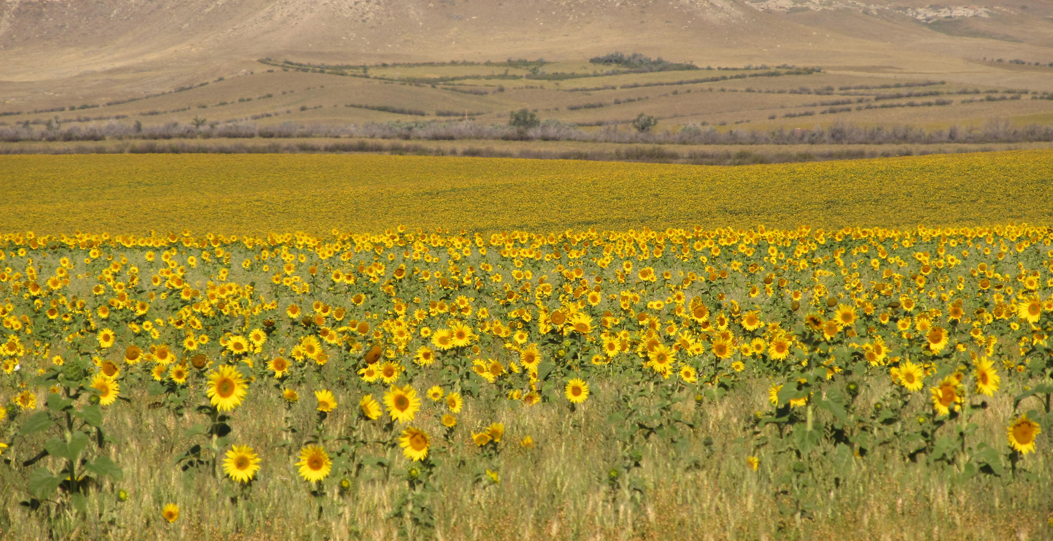
Part 2: Assess Your Financial Position
-
Notes:
Now that you’ve clarified your current situation and where you want to go, it’s time to think about what you need to get there.
How much will the transfer cost or yield?
The reason to assess your financial position is to establish informed consent—to know what you expect to put into the business and to know what you expect to get out of it.
The beginning farmer or rancher should be told that they may only be able to buy part of the business because of their financial position. And that is okay. Starting with pieces of the operation is a separate, valid way to enter farming. For example, a beginning farmer or rancher buying into a family business may be able to buy existing equipment but not be able to buy the land. Focus should then shift to controlling the land through leasing or right of first refusal that moves land ownership decisions to a future time when the beginning farmer or rancher can afford it.
Beyond informed consent, the next best reason to have accurate financials is to be able to ask for help. A Business Plan is a structured way to ask others for their help in achieving the beginning farmer or rancher’s objectives.

Slide 17
Assess Your Financial Position
Develop
Develop a personal balance sheet.
Obtain
Obtain a free credit report from: www.AnnualCreditReport.com
Inventory
Inventory debt and other liabilities.
Create
Draft
Draft a cash flow statement and budget.
Create an income statement.
Notes:
Now that you have some initial numbers it is important to assess your financial position to determine what you can afford! To do this, you will:
Create an up-to-date personal balance sheet;
Create an income statement; and
Create a cash flow statement and a budget (which is essentially a forward-looking cash flow statement).
I am going to walk through each financial statement and even get you started on developing a budget.
I will explain how you can use them to understand how much money you can put toward acquiring assets OR to understand your income stream and ability to meet financial obligations during retirement and demonstrate the profitability of your business. I’ll also talk about how you can use these same financial statements to evaluate the financial position of the other party to inform conversations during the farm transfer process.
Before we get started, I wanted to note that in order to assess your position it is also important to obtain a current credit report for yourself and any partners. You can get one for free from Annual Credit Report.com. I've added information about this website to the resource list. It’s critical to identify any negative information that may be on the report and be sure to correct or dispute any incorrect information before you go to a lender.
It's also important to inventory any debts or loans you may have. This is part of developing a balance sheet, but its good to list outstanding debts separately, so that you can include more information. In addition to the amount owed (which is what goes on the balance sheet), you will list out the specific terms--interest rates, length of commitment, and payments.

Slide 18
The Balance Sheet
Balance Sheet
Assets:
Savings | $3,000
Car | $10,000
Real Estate | $100,000
Total Assets: |  | $113,000
Liabilities:
Credit Card | $1,000
Mortgage | $50,000
Total Liabilities: |  | $51,000
Net Worth: |  | $62,000
The balance sheet is a snapshot
of all your assets and liabilities.
Notes:
Now let’s turn to the balance sheet. The balance sheet is a snapshot of the financial health of your personal accounts and/or your business at a specific point in time. It lists your assets—the things you own—and your liabilities—the amounts you owe to others. This is an example of a simple business balance sheet. Some farmers combine their business and personal balance sheets, others keep them separate.
This information helps you determine your bottom line. It is used by banks or creditors when you take out a loan or rent a piece of land.
Your farm transfer may require some kind of up-front investment, whether it is a purchase or lease. So, it is important to know and understand your net worth.
I've handed out a few sample balance sheets for you to review. I included different types of farm operations. Take a minute to see what is listed as an asset—the things owned by the producer that have value. For the vegetable producer, examples of assets include cash on hand in a checking account, accounts receivable, tractors and farm equipment, buildings and land. Now look at the listed liabilities. It includes accounts payable, the equipment loan and the mortgage.
Trainer Instructions:
See Teaching Plan for instructions and the Training Manual for suggested activity steps.

Slide 19
The Balance Sheet
Assets
What you own
Liabilities
What you owe
Net Worth
=
Notes:
Now take out the Balance Sheet Worksheet.
Take a couple of minutes to list all the things you own (whether they are financed or not), don’t worry if you don’t know exact dollar values – this can be researched and filled in later.
Now list out everything you owe to others: car loans, student loans, personal loans, mortgages, etc. Just jot down the most significant items. You can complete this at home.
Once you have listed your assets and liabilities you can determine your Net Worth (this is referred to as owner’s equity for a business). Subtracting the sum of your liabilities, what you owe from the total of all your assets.

Slide 20
How is the balance sheet used?
​Owners
To assess whether the incoming farmer has resources in hand for the acquisition of assets, transactions costs associated with an inheritance, and/or to make investments in the operation. ​
Incoming Producers
To evaluate how much the owner owes, which may affect the selling price.
​​
​
Notes:
Use a balance sheet to determine:
Whether the incoming farmer has resources in hand to put toward the acquisition of the assets, transactions costs associated with an inheritance, and/or investments in the operation (I.e., a down payment).
If you are an incoming farmer, the balance sheet could show you how much the owner owes. This will affect the selling price of the tangible assets. If you are buying the business, the balance sheet can help you evaluate its profitability.

Slide 21
The Income Statement
Income:
CSA Shares | $61,200
Farmer’s Market | 64,800
Fruit Sales | 8,400
Total Income | 134,400
Expenses:
COGS | $80,096
Overhead | 10,345
Owner Draw | 30,000
Total Expenses | 120,441
Net Income (Loss) | $13,959
The income statement details where your money comes from and where it goes.
Notes:
The income stated details where your money comes from and where it goes. It is also known as an earnings statement, or profit loss statement.
An income statement shows a business' net income or loss over a specific period of time.
The income statement will generate numbers that you can plug into the cash flow statement.

Slide 22
The Income Statement
Income
Revenues & Sales
Expenses
Supplies, payroll, etc.
Net Income
Notes:
Review the sample income statements. Look at the number of expense categories! When you create your own income statement, be sure you list all of the expenses for your farm or ranch operation.
Also note that loans are not classified as income. You didn’t earn this money. You borrowed it and will have to pay it back.
Once you have listed all of your expenses, you can subtract this from your income to determine your net income.

Slide 23
How is the income statement used?
​Owners
To determine how much income you need to replace after the transfer.
Incoming Producers
To assess the long-term value of the business
To show if the business is profitable.
To show if the business is profitable.
​​
​
Notes:
Use the income statement to assess :
Owners can use the income statements to determine how much income they need to replace after the transfer and to demonstrate to the incoming farmer that the business is profitable (and has value). If your transfer situation involves a farm or ranch business, it’s good to remember that it is easier to transfer a business that is profitable than one that is losing money. If the business is losing money, consider a simpler transfer of land and other tangible assets.
Incoming farmers can use their own income statement to decide how much income they need to draw from the farm business versus other streams of income. Use the income statement provided by the current owner to assess if the business is profitable and worth acquiring.

Slide 24
The Cash Flow Statement
Item | Amount
Cash from operations | $30,000
Cash from investments | (25,000)
Cash from financing | 35,000
Net change in cash | 40,000
The cash flow statement lists all sources and uses of cash.
Notes:
The cash flow statement shows where cash comes from and where it goes. It indicates how and when a farm/ranch operation pays its bills. It differs from the income statement because it includes all sources and uses of cash.
It has three components:
Cash flow from operations is money generated from your business activities;
Cash flow from investments tracks money from investment, and the purchase and sale of assets; and
Cash flow from financing tracks money received from or paid back to lenders.
Review the sample cash flow statements to see how income from operating activities compares to cash from other sources.

Slide 25
How is the cash flow statement used?
​Owners
To show the operation is viable and can generate cash to cover obligations.
Incoming Producers
To assess whether the business will generate or require cash
​​
​
Notes:
Use the cash flow statement to determine:
Owners can use the cash flow statement to determine if the operation generates enough cash from operations to cover new debt obligations.
Incoming farmers use the income statement of the current owner to determine whether the business is viable and has value beyond the value of the tangible assets.

Slide 26
Three Main Financial Statements
Balance Sheet: Tells you your current financial position.
Income Statement: Tells whether you are making or losing money in your enterprise.
Cash Flow Statement: Keeps track of where cash comes from and where it goes.
Notes:
To review, we talked about the three key financial statements:
The Balance Sheet, which tells you your current financial position;
The Income Statement, which tells whether you are making or losing money in your enterprise; and
The Cash Flow Statement, which keeps track of where cash comes from and where it goes.
If you can’t obtain these key financial statements for the other party, it’s a sign of less openness and trust and can make it harder to ensure that each party’s needs are met in the transfer.

Slide 27
Budget for Future Personal Needs
Expenses
Food and housing
Health Care
Education and/or
Retirement
Sources of Income
From farm/ranch business
From off farm job
Savings and investments
Notes:
Now that you understand your current financial position, think about your future financial needs.
Let’s start by considering your personal living expenses. These are the things you need to be able to afford with or without your farm or ranch business. Some of the big ones include:
Housing
Food and groceries
Health Care
Others might include:
Education
Retirement
Vacations and recreation
Next think about your future sources of income. How much do you expect to come from a farm enterprise versus from off-farm sources, including retirement accounts, if applicable.
The easiest way to develop your budget is to look at your past spending. Review your cash flow statement. Think about what is going to change with the new situation.

Slide 28
Budget for Future Business Needs
Expenses
Labor
Farm Inputs
Equipment
Farm Transfer Costs
Income
Retail sales
Government programs
Savings and investments
Wholesale sales
Notes:
Next, incoming farmers should budget future business expenses and revenues. You may already have this as part of your business plan. If you don’t, plug in expected sources of income and expenses into the business budget worksheet.
Key business expenses may include:
1. Labor
2. Farm inputs like seed and fertilizer
3. Equipment
In addition, be sure to detail the costs associated with the transfer. These may include:
1. Hiring professional advisors. You can get estimates from these professionals.
2. For the incoming farmer, purchase price of the land, other assets and potentially an existing business. Make sure you know how much the assets you want to acquire are worth. You may need to hire an appraiser.
3. For the exiting farmer, provisions for heirs.
4. Transaction costs like attorney’s fees, recording fees, taxes, financing costs, etc.
Record estimated streams of income from retail or wholesale sales and any income from government programs.

Slide 29
How is the budget used?
​Owners
To understand how much you need to net from the sale of assets to support future needs.
Incoming Producers
To assess how much income you can draw from the business
To determine if you have resources to cover the cost of professional advisors.
To see if off-farm income is needed
​​
​
Notes:
Use the budget to assess the following:
Current owners can use a budget to determine the amount they need to net from the sale of your assets to support future needs. Also, whether they have cash to cover the cost of advisors. If not, this could be built into the selling price.
Incoming farmers can use the budget to determine how much income they will need to draw from the farm business and whether it is sufficient to cover living expenses. Also, to learn whether they have money in hand or will need to borrow funds to acquire assets and/or cover transaction costs.

Slide 30
Build a Budget
Work individually to fill out the budget worksheet.
Share your thoughts about new expenses or income with you partner.
Note gaps.
Identify next steps.
Notes:
Practice Activity
We are going to practice building a budget using the Budget Worksheet. If a lot of your expenses remain the same after the transfer, you can use the information from your cash flow statement. But if things are going to change dramatically, you can start from scratch.
1. Take about 10 minutes to fill out your annual income and expenses. Be sure to include income and expenses from your transfer.
2. Halfway through, talk to your partner about new income or expenses related to the transfer. For new expenses, like acquiring assets or covering transaction costs, do you have money in hand or will you need to borrow money? Make notes. For new income, like the proceeds from the sale of assets or income from an operating agreement, is it enough to support your future needs?
3. Next, note places where you are missing information.
4. Take a minute to identify next steps.
To wrap up, the budget is another financial tool. It can help both parties plan for the costs of the transfer, which could include professional advisors, payments to acquire assets, debt service, and improvements in the operation. It can also help estimate how much income is needed from the farm to support personal financial needs. If there is a budget shortfall, the two parties may consider how the incoming farmer could acquire assets in stages. It can help the owner determine how much they need to get from the sale of their assets to support future needs.
Trainer Instructions:
See Teaching Plan for instructions and the Training Manual for suggested activity steps.

Slide 31
Financial Assessment Starts Conversations
Do you agree on the value of the assets?
Are you willing to share key financial information with the other party
What do you do about budget shortfalls?
Notes:
At the end of the day, working through the financial statements and creating a forward-looking budget helps both parties understand what they need from the transfer. It can also help you identify some of the critical conversations that need to happen to move the process forward. For example,
Do you agree on the value of the assets?
Are both parties willing to share financial information?
How can you reconcile shortfalls in future budgets?
As part of your homework, you’ll be trying to find out what the other party thinks assets involved in the transfer are worth. Places where the numbers are far apart will need further conversation. You will also be completing your budget and determining whether you have money in hand or need to borrow money to acquire assets or expertise OR whether proceeds from the sale of assets or income from an operating agreement is enough to support your future needs. This is another place where missing information may require further conversation with the other party.
We will be picking up these threads in Modules 4 and 5. Some of these conversations may be hard, and you may need professional support. Let’s talk about team members.

Slide 32
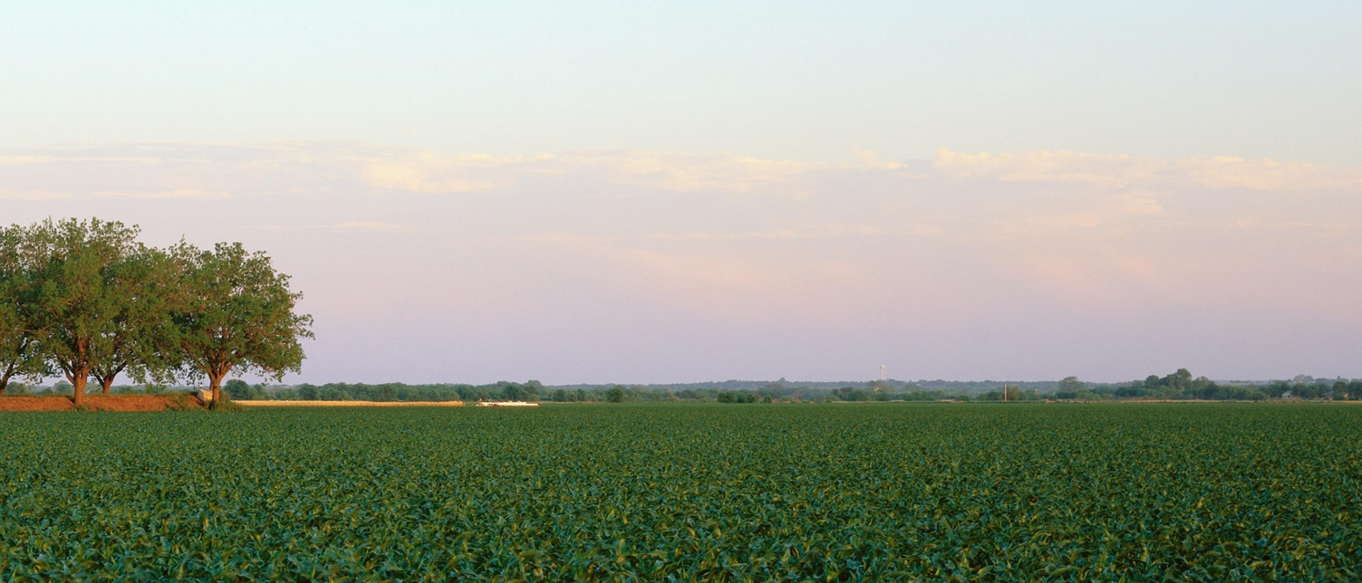
Part 3: Identify and Build Your Team
Notes:
In this section, we will identify and build your team.

Slide 33
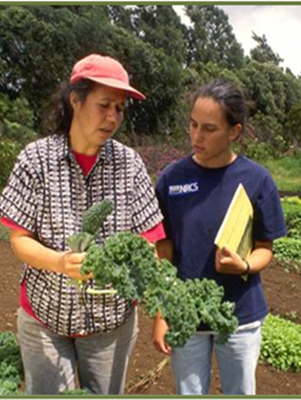
Who do you need on your team?
Accountant
Attorney
Appraiser
Financial Advisor
Mediator
Notes:
Given how much you need to know, and the reality that some information is hard to come by, and some conversations are hard to have, it is a good idea to consult with professional advisors to guide you through different parts of the farm or ranch transfer process. Transferring a farm or a ranch is a big commitment. It is important to pull together your own team who will protect your interests and help you navigate the process. Your advisors can help balance the power in your transfer situation.
As a start, these are some of the professionals you likely will want to work with. You may start with any one of these, but in the end you likely will work with several if not all of them. The following slides will cover each of them.
If you’re an incoming farmer or rancher, you may also want to engage a farm advisor to walk the property with you – someone like an Extension agent or from the Natural Resource Conservation Service (NRCS) or your local conservation district. You might even want to work with an engineer.

Slide 34
Work with a Qualified Accountant.
Look for someone:
you trust.
who listens to you.
who has farm tax experience.
Notes:
A Certified Public Accountant (CPA) or otherwise qualified accountant is a very important member of your team – not just to help you buy land but also going forward to help you manage your business and prepare your taxes. They can help you develop financial statements, understand your short- and long-term tax situation, and prepare your taxes.
Word of mouth is a great way to identify candidates. Talk to the people you know who are involved with agriculture in the area to help you find a suitable accountant. Ask around … Extension, Farm Bureau, Farm Credit or other farmers and ranchers are good sources.

Slide 35
Find an attorney who knows farm or ranch business.
Look for someone who is:
Licensed in your state.
Responsive.
Interested in and experienced with your situation.
Notes:
The right lawyer for you depends on a mix of the right experience, the right personality, and the right price of legal services. Here are some things to consider.
For starters, find someone experienced working with farmers and farm businesses.
Find out if they have experience working with the kind of operation you have or plan to have. You want someone who “gets” your operation, either because they have experience with similar clients or because they are very willing to learn and listen.
Also find someone who you feel comfortable asking questions of and talking to. If they don’t seem interested in understanding your business, or if you don’t feel listened to or heard, find someone else.
Also, make sure they’re responsive and get back to within a reasonable time frame. Don’t expect immediate responses to calls and emails, as your lawyer will likely be busy, so ask them how long they usually take to respond to clients, such as within 1-2 business days. The client-lawyer relationship is a two-way street. Lawyers are looking for clients that fit their law practice’s business model, and they are also generally looking to make sure their experience fits a client’s needs. If a lawyer declines to work with you, remember that it isn’t personal and ask for their recommendation for another lawyer that better fits your needs.
If you don’t have an attorney already, talk to other farmers in the area who have hired lawyers, especially those with similar types of operations to yours. If you belong to a farm organization, ask which lawyers frequently serve their members. If you know any lawyers yourself, ask them. Lawyers tend to know other lawyers. You also could call a law school clinic related to agriculture or you could see if the state’s bar association has a directory of lawyers licensed in the state, or a phone number you can call to ask for referrals.

Slide 36
Find an Appraiser who Really Knows the Market.
Find someone who is:
licensed in farm/ranch real estate.
knowledgeable about the local ag economy.
knows how local zoning and other policies affect ag land values.
https://www.asfmra.org/home
Notes:
There are several ways that appraisals are used in farm transfer situations. The most common are:
Negotiating a price;
Approaching a lender about a loan; and
In estate settlements.
Because assessing real estate values is as much art as science, it is a good idea to use a professional appraiser.
To determine a value, appraisers review local agricultural land values and other factors including the general economy, the local agricultural economy, comparable sales, how the land is used, and local policies like zoning.
When hiring an appraiser, look for someone who is licensed and knowledgeable about farm/ranch real estate, and local conditions. Word of mouth is a good way to find someone.
Another good way is through the American Society of Farm Managers and Rural Appraisers which has a “find an expert” service. ASFMRA is comprised of more than 2,100 of the top land appraisal and land management experts in the country.

Slide 37
Consult a Financial Advisor to assess past performance and plan for the future.
Look for someone:
with farm/ranch finance.
who listens and explains things clearly.
who you trust.
Notes:
Farmers and ranchers have many skills but finance usually isn’t one of them. While you may be great at running day-to-day operations, you may not spend much time analyzing past as well as current performance, much less making projections for the future. Yet these are important considerations for both parties in a farm/ranch transfer situation. Especially if your goals aren’t all financial, it takes skill and often diplomacy to plan for the future.
This is where a financial advisor can help. A financial advisor takes a neutral view of your operation and will give recommendations for investments, ways to cut back on expenditures, and help you anticipate future needs.
They can help you with cash flow analysis and tax planning.
When choosing a financial advisor, look for a certified financial planner.
Find someone who listens to you, communicates well, and has good interpersonal skills as well as education and experience. It’s really important to find someone you trust.
To find a financial advisor, you can contact your state or local Farm Bureau or Farm Credit institution. Commercial banks often offer financial planning or advising services, but depending on where you are located, they may not know much about agriculture.
As with the other potential advisors, it’s always good to ask other farmers or ranchers and people you know to find someone who is a good fit for your needs.

Slide 38
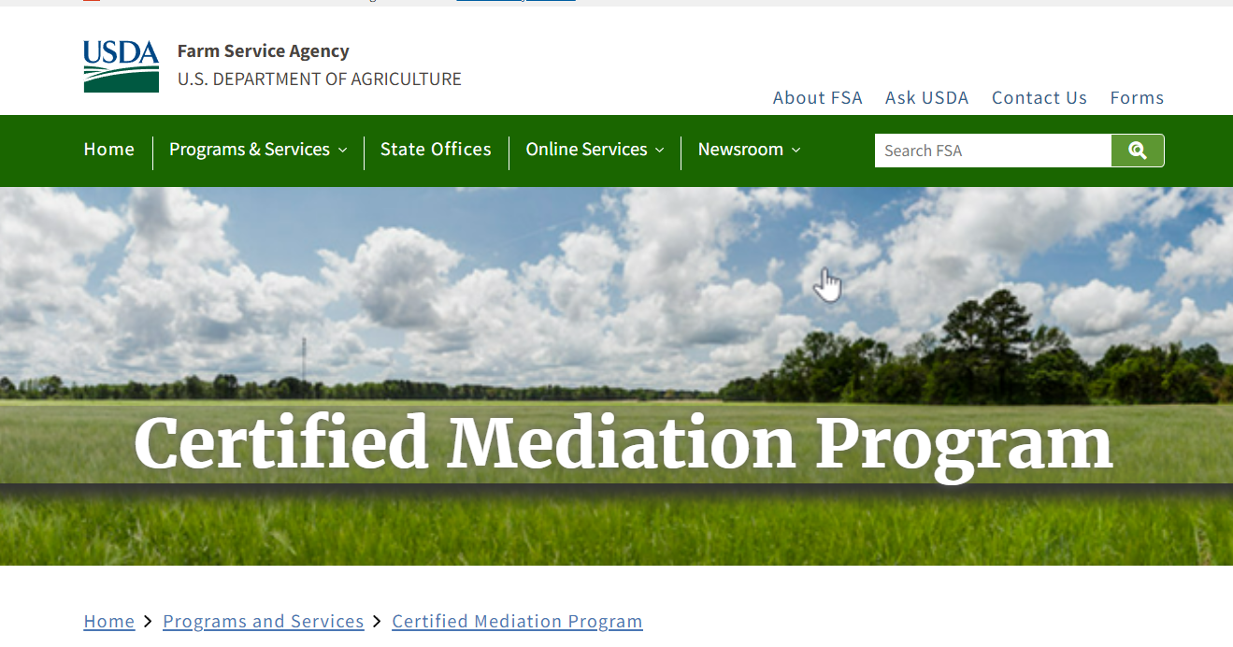
Find a mediator who is neutral and fair to all parties.
Look for someone:
with integrity and sensitivity.
who listens well.
who has strong communication skills.
who can define and clarify issues.
Notes:
Mediators are conflict management consultants who are perceived as neutral and fair. They are trained in communication and process skills, and to respect all parties involved in the conflict or dispute. They do not take sides, make judgements or issue decisions, but help guide the parties toward a win-win resolution.
Mediators help resolve problems that threaten farm transfer or a farm’s viability. These may be interpersonal or financial problems or emotional conflicts.
A mediator can be an important member of your team as conflicts are likely to occur and may derail the transfer or even the viability of the farm. They are especially helpful if the conflict is emotional, complex and escalating, or if your personal or professional position limits your ability to intervene.
When looking for a mediator, look for someone emotionally stable, who has integrity, and sensitivity. Look also for good interviewing skills, verbal and nonverbal communication, ability to listen, ability to define and clarify issues, problem-solving ability, and organization.
Through the Farm Service Agency (FSA) – USDA’s Certified Mediation Program provides resources and contact information for certified agricultural mediators by state.

Slide 39
Build your team
Review the Build your team worksheet
Notes:
Practice Activity
We will review and fill out the Build Your Team Worksheet to think about what kind of team you need to have a successful transfer
Trainer Instructions:
Participants review and fill out Build Your Team Worksheet.
Have participants share ideas and questions from their completed Build Your Team Worksheet.
Group share out on relevant professional contacts, advisors, local service providers and/or resources.

Slide 40
Wrap Up

Slide 41
10 Key Steps in a Farm or Ranch Transfer
Assess finances.
Describe your values, vision, & goals.
Tell your story.
Create your support team.
Identify your needs.
Negotiate.
Choose which tools to use.
Identify and strengthen key relationships.
Finalize documents.
Outline and adapt your plan.
Notes:
As a reminder as we begin to wrap-up, here are 10 key actions in farm or ranch transfer planning process. Remember, it’s not a linear process, and while a certain amount of order makes sense, you likely will find you move forward and back several times throughout the process.

Slide 42
Homework
Complete the Asset Inventory Worksheet
Complete the Budget Worksheet
Review the Glossary of Business and Financial Terms
Complete the Build Your Team Worksheet
Notes:
For your homework, try to find out what the other party thinks it is worth. Places where the numbers are far apart will need further conversation. Formal appraisals can fill in gaps and inform talks later in the process.
1. Complete the Asset Inventory Worksheet.
2. Complete the Budget Worksheet. Fill in any information gaps. Then use the table on the front to assess whether you have money in hand or need to borrow money to acquire assets or expertise OR whether proceeds from the sale of assets or income from an operating agreement is enough to support your future needs. For homework, identify information gaps. Missing information may require further conversation with the other party.
3. Review the Glossary of Business and Financial Terms
4. Complete the Build Your Team Worksheet.

Slide 43
**TRAINERS: Design this slide with information, such as:
Names and photos of presenters
Your logo and the logos of co-sponsors
Closing thoughts
Resources
Thank you
Notes:
Trainer Instructions:
Add your own closing notes.
Consider a casual networking time at the end of this workshop to give people time to socialize.

