Slide 1
Transitioning Land to a New Generation
Identify Business and Legal Tools
Notes:
This module is the third of five consecutive modules—or workshops— in the Transitioning Land to a New Generation Curriculum, which designed to help participants gain the basic skills needed to participate in a farm, ranch or land transfer process.
This module prepares participants to prepare to choose the tools they need to move the transfer process forward.
The Learning Objectives include:
Compare the various ways to transfer assets.
Identify the tools you need to participate in a farm or ranch transfer.
Use basic terms to communicate with legal and business advisors.
Trainer Instructions:
Review Module 3's Teaching Plan

Slide 2
Welcome
** TRAINERS: This slide is optional. Design it with information, such as:
names and photos of presenters
your logo
logos of any co-sponsors
Notes:
Welcome to this workshop. This is the third of 5 modules or workshops American Farmland Trust has created to help you get ready to be part of a farm or ranch transfer process.
We have found that most training on this about farm/ranch transfer and transfer cover succession and/or estate planning within farm families, and mostly from the point of view of the senior generation.
Since land transfers increasingly occur between non-relatives, we have tried to make our training as inclusive as possible: for those of you who come from farm families and for those who don’t, for younger producers and/or beginners as well as for land holders looking for someone to take on management of their land, their operation, or both.
It is designed especially for people who have a property in mind and have at least started to talk with someone about transferring it – from young and beginning farmers and ranchers to landholders who may be retiring, or planning their estates, or who want to make land available for a new generation.
Trainer Instructions:
Have trainer(s)/presenter(s) introduce themselves
Review workshop agenda
Ask participants to introduce themselves

Slide 3
Acknowledgments
Transitioning Land to a New Generation was created by American Farmland Trust, supported by an Educational Enhancement grant from the USDA Beginning Farmer and Rancher Development Program.
Award # 2020-49400-33257
Thanks also to Farm Credit, the team of national experts in farmland transfer and access, and the members of American Farmland Trust.
Notes:
This curriculum was created by American Farmland Trust with a lot of help from a national Educational Team of advisors and a wonderful group of subject matter experts.
It was made possible by a grant from the USDA Beginning Farmer and Rancher Development Program Award # 2020 - 49400 – 3325 with additional support from Farm Credit and the members of AFT.

Slide 4
Today You Will Learn To:
Compare
Compare the various ways to transfer assets.
Identify
Identify the tools you need to participate in a farm or ranch transfer.
Use
Use basic terms to communicate with legal and business advisors.
Notes:
This Module is meant to prepare you to work with legal and business advisors to move your transfer process forward. It is a high-level overview which introduces key concepts to help you consider topics and questions to discuss with your team down the road.
Building on Module 1, today you will decide which assets to include in your transfer situation, whether the transfer is raw land, or land and other physical assets, or if includes some or all of the farm or ranch business.
Based on which adventure you choose, you will learn about the main tools to plan a transfer and identify the ones you need to use.
Finally, because the legal language can be confusing, you also will learn key terms involved in farm ranch transfer so you can communicate with attorneys and others as you move through the transfer process.

Slide 5
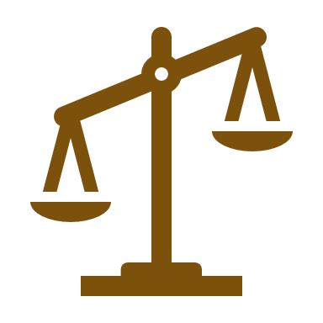
10 Key Steps in a Farm or Ranch Transfer
Assess finances.
Describe your values, vision, & goals.
Tell your story.
Create your support team.
Identify your needs.
Negotiate.
Choose which tools to use.
Identify and strengthen key relationships.
Finalize documents.
Outline and adapt your plan.
Notes:
There are series of steps in a farm or ranch transfer process. We have broken it down into 10 steps. You likely will take most if not all of them, but it is not a linear process, so while a certain amount of order makes sense, you likely will find you move forward and back several times before you are done.

Slide 6
Who and what are involved?
Consider your transfer situation:
Who is involved?
What assets would be included?
Share your answers with the group
Notes:
Motivation Activity
1. Ask participants to take 60 seconds to identify who is involved and what assets are involved in the transfer.
2. Ask them to share with a partner or the group. (Consider who is in the room and if there are delicate relationships).
3. If appropriate, summarize their answers on a flip chart ,white board, or screen share.
Whether you are the owner or the incoming producer, the legal and business tools you will use in your farm or ranch transfer depend on what you value as well as your goals and the assets being transferred.
In the first workshop, we talked broadly about what is involved in the process and pointed out the importance of being clear about what you are transferring: Is it just raw land, or the land with structures? Or are you involved with the transfer of all or some of the farm or ranch business, as well?
Diving deeper, are you considering tangible or physical assets like a house, barns, or fencing? Or intangible assets like client relationships, business reputation, or brand?
If the transfer is as complex as passing down or taking over an existing farm or ranch business along with other people, you will have to consider many people’s goals and needs to decide how assets will be shared.
It’s also important to be clear about who if involved or has a key stake in the process. Are you working with your family or with non-relatives or with both?

Slide 7
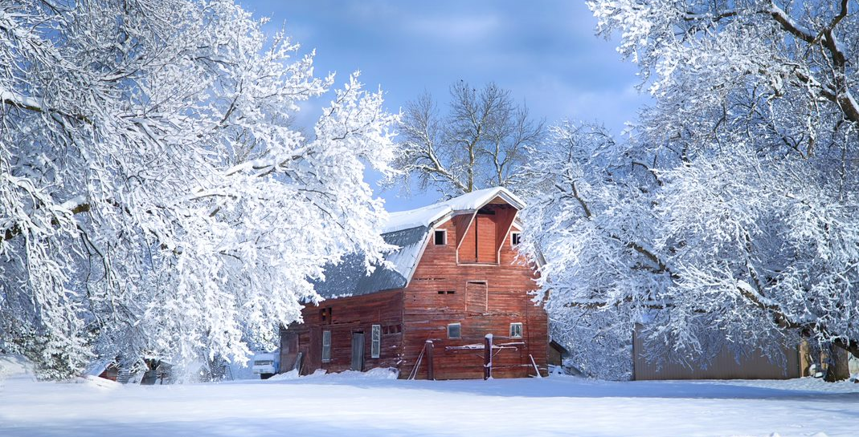
Part 1: Types of Transfer
-

Slide 8
4 Main Ways Assets May be Transferred
Gift
Sale
Inheritance
Lease
Notes:
There are four main ways to transfer assets—whether land, the farm/ranch business, or personal property like cash, investments or family heirlooms. These can stand on their own or be combined in various ways and include:
A gift or partial gift to person or to a trust.
2. A sale or partial sale to a person or a business entity.
Inheritance which usually is determined in a will. If the person dies without a will, the inheritance it’s considered intestate—something else I will talk about in a bit. If there is an estate plan it might include a trust as well as a will. Inheritance also can occur by operation of law (which includes joint accounts, and Transfers on Death).
4. Finally there’s a lease, which is a temporary transfer of some, but not all, of the rights of ownership. Leases also can be written with an option to purchase so they can lead to ownership.

Slide 9
What is a Gift?
A gift is an asset transfer where the giver receives no payment —or payment less than full market value in return.
Notes:
A gift is a transfer of an asset from one person to another where giver either receives no payment, or less than full market value payment, in return.
Gifting is a good way for owners to help a new generation gain access to land or a farm or ranch business if they can afford it and have someone they’d like to give it to.
Gifts can be full or partial and given to a person or trust.
They can include any kind of asset from land to the business to personal assets.
Gifts are also a way for owners to reduce the value of their estate to reduce the tax burden on their heirs.
Before making a gift, owners should find out if they will owe any taxes and if it will affect their application to Medicare.
Gifts are usually welcomed by the incoming producer, but the beginner should consider a couple of things:
Can they afford to pay any taxes that may be associated with the gift, including property taxes if the gift includes land and related property assets?
Do they feel comfortable receiving the gift? They can use the gift as the gift giver intended, or are comfortable making independent use of the gift?

Slide 10
What is a Sale?
A sale is an exchange between parties where the buyer pays the owner something to acquire assets, goods and/or services.
Notes:
A sale is a transaction between two or more parties in which the buyer receives tangible or intangible goods, services, or assets in exchange for money. In some cases, other assets are paid to a seller.
Sales are the most common type of exchange and can be used as part of an estate or succession plan or on their own.
Sales can be partial or discounted, made in installments or transferred gradually over time, and can include everything from equipment to raw land to the entire farm or ranch business.
A “bargain sale” is a type of discounted sale that can be useful in a farm or ranch transfer. In a bargain sale the land is sold at less than its fair market value. It is especially useful if the sale is to a land trust or other nonprofit organization by combining the income producing benefit of a sale with the tax reduction benefit of a charitable donation.
As a note, if the sale includes a business as well as assets like land, it is important to consider the structure of the business as well as its worth. Also, in this case, the sale employs a special type of contract called a "Buy-Sell Agreement“ which I will talk about in the next section.

Slide 11
What is Inheritance?
Inheritance is when land and other assets are passed on to heirs after the owner’s death.
Notes:
Inheritance refers to the transfer of property and other assets, as well as debts and obligations, after the owner dies. Usually this occurs within a farm family but not always. And because farms/ranches have emotion value beyond their financial or asset values, inheritance can lead to differences of opinions and conflicts. Working things out in advance through an estate or a succession plan can reduce the chance of disputes.
If a person dies without a will, that’s called intestate.

Slide 12
What is a Lease?
A lease is a transfer of land or other assets where a tenant pays the owner to use their assets for a long or short period of time.
Notes:
Ground leases and other long-term leases can be a useful tool in the farm/ranch transfer toolbox.

Slide 13
Choose your adventure!
Think about your transfer situation.
Will assets be transferred through gift, sale, inheritance, or lease?
Gift
Sale
Inheritance
Lease
Notes:
Practice Activity
1. Ask participants to “choose their adventure” and share with the class how assets may be transferred (through gift, sale, inheritance or lease).
2. On a flip chart , white board, or screen, write the four ways that assets may be transferred across the top.
3. As the participants share their responses, put a check mark or hash tag under the category that they will use. Leave space to add additional information during the next practice activity.

Slide 14
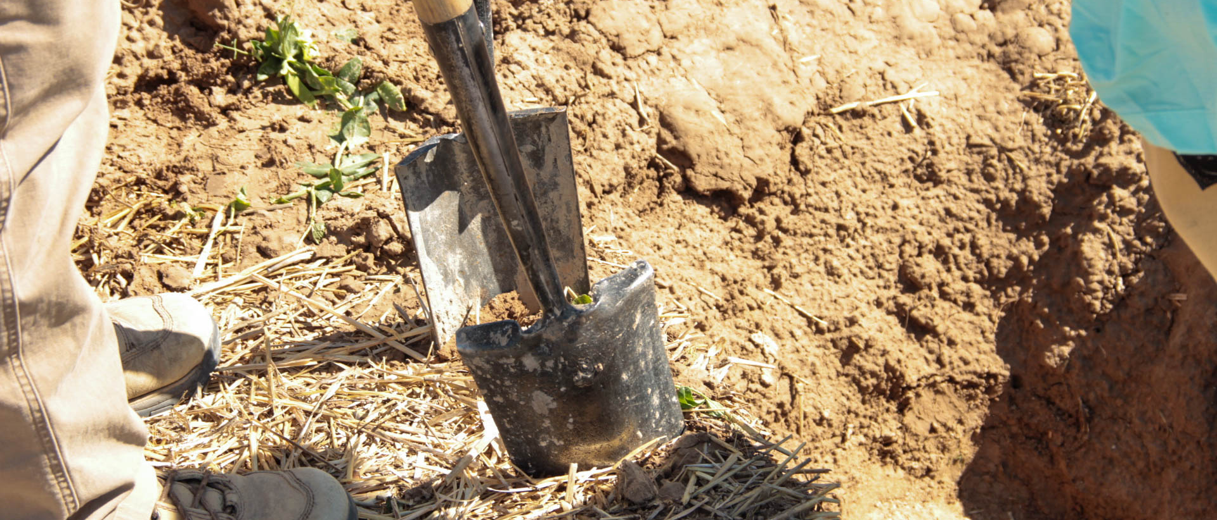
Part 2: Identify the Right Tools for Your Situation
-

Slide 15
Choose tools to support your values, goals and needs.
Different people have different perspectives.
One size does not fit all.
Tools can be used to achieve many things .
Notes:
Owners and incoming farmers/ranchers tend to have different perspectives and goals. Their values may be different as well. They can be especially different depending on if they are exiting vs. entering farming or ranching, and whether land, the business, and/or other assets are being transferred. This is one of the reasons it is important to know what you want to get out of the transfer situation, so you can choose the tools which advance your values, vision and goals.
In this section, I’m going to briefly explain the main tools used in transfer situations, when to use them, and toward what ends. Because each of the tools is a means to the end, the ones you choose will vary depending on your what you want to get out of the transfer as well as the outcomes the other party wants.
One size does not fit all. A cookie-cutter approach is unlikely to work in what are almost always very individualized situations. Here you will learn about the basic tools, and then you can decide what kinds of advisors you need. Be sure to stay focused on our own values and goals and respect those of the other party. This will help you achieve success.

Slide 16
Common Goals in Farm/Ranch Transfers
Transfer land and other fixed assets.
Transfer farm or ranch business management.
Provide financial security and peace of mind.
Notes:
Especially between non-relatives, the transfer often focuses on the land and potentially other assets. These other assets can be real estate – such as a house or barns– or things like fencing and equipment, crops, orchards, or livestock, or business assets like contracts or a clients list.
As a longtime ag economist liked to say, “management is the key”. This still is true today because farm and ranch businesses continue to operate on thin margins and are subject to variable market conditions and unpredictable weather.
If you are in a transfer situation that includes the farm or ranch business, it is important to transfer management skills and responsibility. This is best done over time. And because they generate income, business assets are usually transferred first.
But the business itself is not always worth transferring, or the entering producer wants to manage a different kind of farm or ranch than the exiting owner.
Usually, both parties share the goal of financial security and peace of mind. But these may mean different things to them depending on whether they are entering or exiting. So keep in mind the two-way street because any successful transfer should meet the needs of both parties.

Slide 17
Answer Who, What and When?
Within a family or between non-relatives?
During life or after death?
Land, other assets, or the whole farm/ ranch operation?
Notes:
What is your situation? Are you part of a farm or ranch family and the transfer will occur between relatives? Are you a retiring producer who doesn’t have an heir identified to take over your operation? Are you a beginning farmer or rancher who searching for land to start or expand your operation?
Depending on your situation, you will need to use different tools.
To choose which tools are right for you, think about when the transfer will happen – will it be during your life/the owner’s life or after death? Does the transfer include the business, other assets, or just raw land?
Beyond possible family members, who else is involved or has a stake in the outcome?
Are their other people’s needs you should consider?

Slide 18
Three categories of tools you might use depending on your needs.
Business tools
Estate planning tools
Succession tools
Notes:
Different tools address different issues from land transfer to transfer management of a farm or ranch business transfer, from financial security in retirement to estate planning.
Today I will provide a high-level introduction to the most common tools but once you have a general understanding and begin to tie the tools to your situation and goals, it is wise {important?} to work with a professional advisor to help you move forward with your transfer plan.

Slide 19
If a business is involved, management also needs to be transferred
The owner must hand off decision-making:
This can happen over time
It should address all aspects of the business including:
Planning
Production
Marketing
Finances
Labor
Notes:
If you’re involved in a transfer that includes the farm or ranch business, whether you are the owner, the incoming producer, many family members working together or some other arrangement, you will have to transfer management—including knowledge—either all at once or over time. This can be hard to do!
As the owner prepares to move on, the incoming producer must learn how to run the show. Often both generations work together for a while.
But whether all at once or gradually over time, the process requires the owner to hand over decision-making to someone else. This can be hard for both parties, so open and honest communication is critical.
The incoming producer needs to start taking over day-to-day decisions and may want to do this sooner rather than later. But the owner has made a big investment in the operation and may have trouble letting go.

Slide 20
Business Tools
Business structure
Buy-sell agreements
Operating Agreements
Notes:
Business tools include the way you structure your operation and contracts between business owners like Buy Sell and Operating Agreements.

Slide 21
Business structure supports the transfer of management as well as assets .
Limits Liability.
1
Eases transfer of ownership.
2
Allows transfer over time.
3
Notes:
Business structure can provide a way to manage and eventually transfer assets to someone else. It can separate ownership and management and allow gradual transfer over time.
It affects ownership of land and other assets as well as the people and activities involved in the farm/ranch operation.
It also influences daily operations, how decisions are made and the responsibilities of owners, managers and employees.
Business structure affects transfer in several ways. The most important is that it can limit liability. Next most important is it can ease the transfer of ownership interest. Finally, it can allow for gradual transfer over time.

Slide 22
There are 4 main types of business structure.
Sole proprietorships
Partnerships
Corporations – including cooperatives
Limited Liability Companies (LLCs)
Notes:
The four main types of businesses are sole proprietorship, partnerships, limited liability companies or LLCs and corporations.
Each has its advantages and disadvantages from a farm/ranch transfer perspective including different tax and legal implications.
Whether you are forming a business or if you already have or are working with someone who already has a business structure in place, it’s important to understand things like: Who owns what? Who makes business decisions? What are the liability concerns? And how is income taxed?
A sole proprietorships is the simplest, easiest and cheapest type of business to create. In a sole proprietorship the business is owned and run by one person and legally there is no difference between the owner and the business. Because of this, they don’t offer any liability protection to the owner–or in legal language “they have unlimited liability”– so the owner is solely responsible for all business activity, including lawsuits and debt. In a farm or ranch transfer situation, it is important to note that you can't transfer partial interests in a sole proprietorship while you can in other kinds of business entities. This makes it challenging to transfer different individual assets to different people.
A partnership is like a sole proprietorship, just between two or more people. In partnerships, owners may have equal stake and share liabilities. Like sole proprietorships, partnerships don’t offer liability protections. But it’s easier to transfer different assets between different parties than it is in a sole proprietorship.
Limited Liability Companies (or LLCs) are legally distinct from their owners and provide liability protections. The business can continue after the death of the owners, and it’s relatively easy to transfer partial interests in the business to other people. LLCs often are the structure of choice especially for small farms and ranches because they offer protections but are flexible and a good way to transfer both management and ownership.
All three of these are considered “pass-through entities” which means all partners need to claim their profits on their personal tax returns.
A corporation is an organization—usually a group of people or a company—authorized by the state to act as a single entity and recognized in law. It provides more protection for the owner or owners, but also more time and attention to form and maintain. There are 5 types of corporations, including cooperatives and nonprofit organizations, but we won’t go into that detail today. Review the Information Sheet to learn more.
These are only 4 of many business structure options.
Trainer Instructions:
See Resource Lists for additional business structure models.

Slide 23
Buy-Sell Agreements ensure an effective transfer of business assets.
They are contracts between business owners that spell out what will happen in the case of the 5 Ds:
Dissolution
Disability
Divorce
Death
Disaster
Notes:
Buy-Sell agreements help ensure an orderly transfer of farm and ranch assets. They spell out what will happen in the event of the 5 Ds: Dissolution, divorce, disability, disaster, and death.
Buy-sell agreements are contracts that require{enable?} one business owner to buy all or a portion of a shared business upon the retirement, death or disability of another business owner. The contract specifies who will buy the ownership interest, how much it will cost, when it will happen, and the terms of the sale.
No one likes to think about these things, especially at the beginning of a relationship. But it’s still important to address them.
Whether your business structure is a partnership, corporation or LLC, a buy/sell agreement can set the price and payment terms of a future buyout. As such, it also should address possible financing options.
There are four main ways to fund a buy-sell agreement: Savings, Insurance, Loans, and Luck (you know, the rich uncle or lottery.)
Long and short, Buy-Sell Agreements create a way to determine asset values, outline the process for transferring the business, and provide payment and/or financing terms. And they can be used to address both the farm/ranch business and the real estate.
Key provisions should address price (valuation), the transfer process/timetable, and payment terms/financing.

Slide 24
Operating Agreements are like contracts between people involved in the business.
They outline how a farm or ranch business operates including:
How income and expenses are shared.
How to handle someone leaving the business.
How to handle someone passing away.
Notes:
Operating agreements come in many forms including a partnership agreement, corporate bylaws, or and LLC operating agreement. – may be thought of as the contract both among the members of an entity with each
other and with the entity itself. Six states require LLCs to keep an operating agreement: California, Delaware, Maine, Missouri, Nebraska and New York. But even without a legal requirement, Farm Business Operating Agreements can benefit all farms and ranches, no matter what is their legal structure.
Farm Business Operating Agreements are used when two or more parties have a stake in a farm or ranch business by investing capital, contributing labor and management, and sharing income the farm/ranch business generates. However, while the income is shared, it is not necessarily shared equally. Usually each party receives a share based on the extent of their resources and other contributions. It’s up to the parties to decide how income is shared. Each party's income is used to pay for expenses including taxes and debt payments. The Operating Agreement spells out the terms so that the parties know what to expect and are treated fairly.
Farm Business Operating Agreements often are used between generations working together on a farm or ranch. In these cases, the senior party often supplies the land and other farm/ranch real estate assets, and the junior party more of the labor. Beyond that, there are many ways the parties share ownership of other assets, like equipment or livestock.
Perhaps the most important part of the Agreement is the discussion that takes place to create one. This is because it forces the parties to think about potential issues which may come up and resolve them before they turn into problems.

Slide 25
The Tools used for succession and estate planning are related.
Estate planning looks at the owner’s assets and plans for how control and ownership will transfer after death.
Succession planning looks at the owner’s assets during life or after death and plans for their transfer, including transfer of business management.
Notes:
Succession and estate planning can be seen as tools but here I will present as if they are a toolbox with a set of other tools that address different issues.
Estate planning generally refers to how assets pass on after death while succession planning looks at how assets will be transferred either after death OR during the asset holder’s lifetime.
Succession planning often is part of an estate plan but doesn’t have to be.
If a farm/ranch business is involved, succession planning also addresses the transfer of knowledge and management as well as assets.

Slide 26
Succession tools include the business tools plus:
Healthcare planning
Retirement planning
Conservation easements
Well-planned gifts
Notes:
As I said earlier, tools can be used for many things. In the case of farm or ranch succession, they may include business structure and buy-sell agreements, but also well-planned gifts, health care and retirement planning, along with long term leases and conservation easements.

Slide 27
Well-Planned Gifts
Well planned gifts are an effective way to transfer assets but need to be balanced with other strategies.
Can be tax free
Can Pay for “sweat” equity”
Can protect assets
Notes:
Well-planned gifts can be an effective way to transfer assets, and often are used in family farm transfers. But they need to be balanced with other strategies.
For farm transfer purposes, a gift is a lifetime asset transfer at less than market value, or where no payment is received.
A "bargain sale" is part sale part gift and can be a useful way to provide a discount to facilitate transfers outside of the family. But be careful, there may be tax implications.
As a frame of reference, the federal estate/gift tax exemption for 2022 is $12.06 million per person – so a couple can pass $24.12 million free of federal estate/gift tax. The annual federal gift tax exclusion for 2022 now $16,000 per recipient per year. Most states do not have gift taxes so this can provide an additional financial benefit. By contrast gift or bargain sales are not used that much even though the same tax benefits apply.
These numbers are indexed for inflation – meaning they increase periodically.

Slide 28
Retirement Planning
Focuses on sources of income and cash flow.
May also consider long term care.
Retirement calculators can help decide when to retire and how much you can afford to spend.
Notes:
Retirement can present cash flow problems so retirement planning usually focuses on income as well as cash flow.
Income can come from sources like Social Security, a pension, an IRA and/or a retirement fund. In a farm or ranch transfer situation, it is important for both parties to be aware of the need for ongoing income and ensure enough assets are protected to support the exiting landowner in retirement.
Retirement planning also should address how to stay active and healthy and prepare for the possibility of long-term or nursing home care in case it is needed.

Slide 29
Health Care Planning
Health insurance/Medicare
Long term care insurance
Medicaid
Health care proxy/living will
Notes:
Health care is a top concern for both owners and incoming farmers and ranchers and its potentially high costs should be addressed in the context of farm or ranch transfer.
Many older farmers worry about how they will pay for health care when they retire. This can have an impact on their transfer plans. Out of pocket health care costs often are the largest expense in retirement, especially if nursing home care is needed, so they must balance their goals for asset protection with potential health care needs.
Medicare is the federal health insurance program for people aged 65 or older and some younger people with disabilities or End-Stage Renal Disease. It provides several options including insurance just for hospitalization (Part A, usually free), medical (Part B, with a fee) and prescription drug insurance (Part D, also with a fee). Making choices for Parts B and D can be complicated so it is wise to consult with an advisor.
Health care also is a concern for incoming producers. Its high costs can affect their ability to afford land. Health insurance offers protection from high, unexpected costs in the case of a serious accident or illness. Most health insurance policies also cover some preventive services— like shots and screening tests—at low or no cost. Many farmers/ranchers have private insurance through an employer because either they or their spouse has an off-farm job. Others buy private insurance or receive insurance through the Affordable Care Act.
Medicaid is a federal and state program that help cover healthcare costs for people with limited income. It also offers benefits not normally covered by Medicare, including nursing home and personal care services.
A Health Care Proxy, or living will, is a document used to name a trusted person to serve as your proxy, or agent, and make health care decisions for you if you can’t speak for yourself.
Long term care insurance refers to a host of services that aren’t covered by regular health insurance, such as help with routine activities, like bathing, dressing or getting in and out of bed. It helps cover the costs of care for chronic medical conditions and disabilities. Most policies reimburse you for care in a variety of places including your home, a nursing home or an assisted living facility. Whether it’s the right choice for you depends on your situation and preferences but you should think about it because you can’t wait to decide until you need it.

Slide 30
Conservation easements can facilitate land transfer by:
Protecting land for farming or ranching.
1
Increasing affordability for a new farmer or rancher.
2
Creating equity for family who aren’t involved in the farm or ranch.
3
Funding retirement.
4
Notes:
A conservation easement is a deed restriction landowners voluntarily place on their property to protect conservation values such as farmland, wetlands, ground and surface water, wildlife habitat, historic sites and scenic views. An agricultural conservation easement protects working farmland, grassland and ranchland to keep it available for agriculture by restricting nonagricultural development and/or subdivision.
Agricultural easements can be donated or sold to a public Purchase of Agricultural Land Easement (aka Purchase of Development Rights) program.
Agricultural Conservation Easements can facilitate transfer by keeping land available for farming and ranching and reducing the speculative value of the land to its agricultural or “restricted” value. This makes it more affordable for a new farmer or rancher to buy.
Selling an agricultural conservation easement creates equity for family members who don’t want to farm by generating income for them while making the land available to family members who do.
It also can help fund the landowner’s retirement.

Slide 31
Long-term leases are an option.
Provide security
Support long-term planning
Can include:
A right of first refusal or
An option to purchase
Notes:
Land transfer is about more than land ownership. According to USDA, about 39 percent of farmland acres (in the contiguous 48 States) is rented. This is especially true of cropland, where more than half is rented, compared to just over a quarter of pastureland. So leasing—especially long-term leases—is an important tool. Leases can be transferred
Most leases are annual, hand-shake type leases. These short-term leases provide flexibility but little security and aren’t really a transfer tool. But long-term leases, which can be hard to come by, can be transferred, and also may include lease to own and other provisions which make leasing worth considering as a transfer tool.
When considering leases as a farm or ranch transfer tool, it’s a good idea to think about 5 year or longer-term leases. These can help:
Provide greater security for both the incoming producer and the landowner
Support a long-term planning horizon
They also may include rights of first refusal or an option to purchase as a path to ownership
And if the land isn’t already assessed for agriculture, they can help it qualify, reducing the landowner’s property taxes
Ground Leases are a promising option. A fairly new tool for agriculture, Ground Leases are very long-term leases where the tenant rents the land but can own any improvements they make to the property, such as building a barn or shed. Usually 50-99 years, and often transferable, they allow the tenant to build equity because they can sell the assets they’ve improved.

Slide 32
Estate Planning tools include the business and succession planning tools plus:
Trusts
Transfers on Death (TODs)
Life Insurance
Wills
Notes:
Estate planning is a process to ensure the orderly transfer of assets and liabilities at death. It may include a retirement or succession plan and it may be designed to reduce or eliminate estate (or death) taxes.
Successful estate planning and farm transfer require effective communication and a team effort—including financial, farm management, tax and legal expertise. Because plans must be tailored to individual circumstances, they must be designed to meet a variety of unique situations. We are not going to go into depth about the process here but will touch on the main tools used in an estate plan. In addition to the tools we’ve already discussed, estate planning tools include transfers on death—or TODs—wills, trusts and life insurance.
A good estate plan will put the right people in charge of the right things and give them the right information and legal authority. Often designed to avoid probate and minimize taxes, an estate plan should address personal and/or family goals, accommodate special needs, ensure peace of mind and potentially support the lifestyle of any heirs.

Slide 33
Wills are legal documents which spell out who receives what after the owner dies.
They should address "fair" vs. "equal."
They should be updated after major life events.
Having no will leads to “intestacy” where the state decides how to distribute assets.
Notes:
A will is a basic and important legal document that provides instructions on how an estate will be distributed after death. Its use should be coordinated with other tools and the owner’s other succession or estate planning efforts.
Wills should be updated periodically, especially after major life events like marriages, births, graduations, divorces etc. But even without a major event, most advisors suggest reviewing a will every five years or so.
When preparing a will, landowners often are faced with the challenge of deciding what is “fair” vs. “equal” for their heirs. If their goal is to pass their farm on to the next generation, they should think about what is fair instead of dividing their assets equally among heirs. Oklahoma State University created a statistical model which compares transfer strategies with their probability of success and found that while dividing assets equally is the most common farm succession strategy, these farms are the least likely to continue to the next generation.

Slide 34
Key Terms Used in Wills
Executor
Probate
Intestacy
Heirs' Property
Notes:
There’s some terminology which is important to understanding wills.
The executor is the person named in the will to manage and dispose of the assets.
Probate is the legal process to validate the will and allow assets to be distributed according to the instructions in the will.
Intestacy: Each state has an intestate formula that divides assets between surviving spouse and children when a deceased person dies without a valid will. Basic will requirements are set by state law. Intestacy leads many challenges, most notably heir’s property issues.
Heir’s property refers to land that’s been passed down without a will or other legal document proving ownership. This means that all the heirs own an undivided interest in the land whether they live there—or not, are farming it—or not, or even are aware of their ownership interest. It means that whoever does live and work the land must get approval from all relatives before doing things like building new structures, selling or mortgaging the property, or even applying for loans, disaster relief, and other benefits. Also, real estate developers can take the land through court-ordered sales.
Heirs’ property is best known for the way it affects African Americans in the Southeast, accounting for an estimated one-third of all Black-owned land. But it affects Hispanic populations in the Southwest, Tribes (where it’s known as fractional land), and is widespread throughout Appalachia.

Slide 35
“Transfer on Death” are will substitutes
Assets transfer automatically upon the death of the owner.
TODs can include:
Joint bank accounts.
Real estate with a right of survivorship.
Beneficiary designations.
Notes:
Also known as ”will substitutes,” the Transfer on Death or TOD designation is a simple and low-cost way to transfer assets like joint bank accounts, annuities, and life insurance as well as joint real estate owned with a survivorship rights– usually for spouses and other family members. The transfer occurs at the time of the person's death without the need for probate. It applies to assets that have a named beneficiary which gives the asset holder a way to specify how much of each of their assets to pass on to their designated beneficiaries.
While TODs often are not recommended by advisors because they only take effect at death so they don’t allow for gradual transfers, they are relatively simple to put into effect without additional actions such as creating a will or trust.

Slide 36
Trusts are legal arrangements where assets are managed by a trustee.
Trusts provide legal and asset protections.
They support heirs, receivers, or other beneficiaries.
Trusts can help:
Avoid probate.
Provide financial security.
Save time and paperwork.
Reduce taxes.
Notes:
Trusts are legal arrangements where assets are managed by a Trustee on behalf of heirs, receivers or other beneficiaries. They provide legal protection for the trustor's assets, ensure their assets are distributed according to their wishes, and can save time, by avoiding probate for a will, reduce paperwork and, in some cases, avoid or reduce inheritance or estate taxes. Owners often place their assets in trusts so they can receive professional management.
The Trust document spells out who will receive assets and when, and what happens to the assets when the Trust period ends. In this way they are used to transfer assets as well as providing financial security for surviving spouses, children and grandchildren.
Almost any kind of asset can be owned and managed by a trustee on behalf of a beneficiaries. But some assets are easier to manage–like stocks and bonds–than others—like farm or ranch land. Plus there are many kinds of trusts. So before using this tool, consult your accountant and/or attorney to choose the one best for your situation.

Slide 37
Life Insurance is a contract that pays a cash benefit at death.
It can support many transfer options such as:
Buy/sell agreements
Replacing asset values
Trusts
Legacy to nonfarm heirs
Estate taxes
Notes:
Life insurance – perhaps better thought of as ”Death” insurance – is a contract that pays a cash benefit at death. It can be an important tool for both business and personal goals and is often a key part of an estate plan.
There are two basic types of life insurance policies: Term and Whole Life. Term life insurance is a contract that pays benefits when the insured person dies during the term of the contract; it is the less expensive of the two kinds of insurance. Whole life insurance provides death benefits, which are similar to those of term insurance, and gradually builds cash value over time as premiums are paid. Life insurance can be used to fund buy/sell agreements, replace the value of assets that have transferred to another family member, establish trusts, provide for non-farm heirs, or pay estate taxes.

Slide 38
Terminology Quiz
Group up by type of transfer
As a group, complete the Terminology Quiz
Discuss which tools you will need for your transfer situation.
Report back to the group.
Gift
Sale
Inheritance
Lease
Notes:
Practice Activity
Conduct the terminology quiz or ask questions from the quiz or Glossary of Legal Terms and have participants raise their hands and answer them.
Trainer Instructions:
You may want to group participants by type of transfer.
Bring the group back together for a report out.

Slide 39
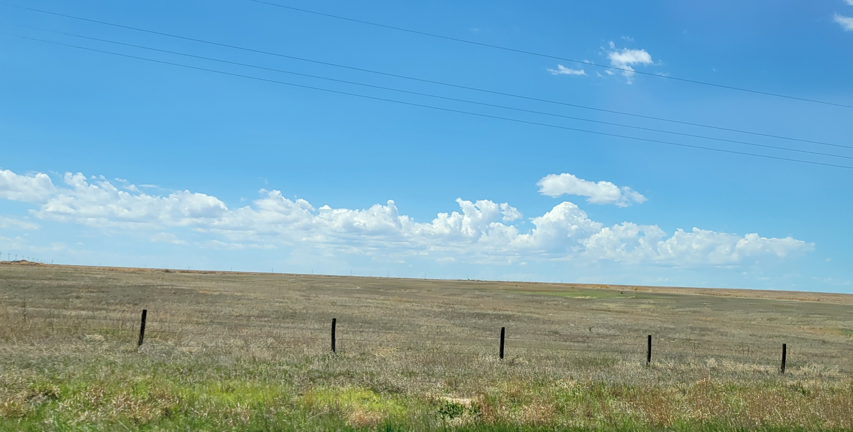
Part 3: Guideposts
-

Slide 40
Guideposts: Business Decisions
Has management been transferred—or is there a plan?
Are any agreements in place?
Is there financial transparency?
Notes:
How do you know if the process is on track?
If you are the incoming farmer or rancher, what steps has the owner taken to help you to take over management of the operation? Have they taken any steps to transfer land or other assets to you?
If you are the owner, what have you done to transfer management or assets? Have you planned for retirement? Does the incoming producer, employee, partner, or family member have the experience, skills, and desire to succeed?
These guideposts can serve as a review and status check on tangible progress in these areas. They give you benchmarks to look for to see if the process is on track and to ensure all the cards are on the table.
With respect to management transfer, it really boils down to the questions of:
Who makes the decisions and how are they made?
Who controls the finances and is that information readily shared with others? and
Are the decision-makers accountable to anyone else in the business?
Things to look for:
Level of responsibility of incoming producer(s);
If there is a written operating agreement, as well as things like standard operating procedures (SOPs), and job descriptions for employees if necessary; and
Is there financial transparency? Operational accountability?

Slide 41
Guideposts: Asset Transfer
Have you agreed which assets to transfer and how they are valued?
What is the timeline?
What tools will be used?
Is there a financing plan?
Are agreements in writing?
Notes:
Another Guidepost is whether any assets been transferred or at least if there is a plan to transfer assets.
It is important to nail down and be clear about all of the assets that will be transferred.
It also is important to have a timetable, preferably in writing; a way to objectively value the assets being transferred; and a plan to finance/pay for them.
If there are operating assets, they usually are transferred first, and land assets later.
Often it makes most sense for the transfer to be gradual, but the owner needs to do more than make a verbal promise.
The incoming producer must be able to make required payments.
The more specific the agreement, the better and it is best to get it in writing with assets clearly spelled out so everyone is on board with the details of which assets are being transferred and when.
There are lots of tools to use, which is another reason it is best if agreements are made in writing. For example, is there a written buy-sell agreement?
When it comes to transferring land, it is important to decide how it will be valued? Will it be a gift or assessed at fair market value (FMV) or some combination of the two?

Slide 42
Guideposts: Health Care & Income
Have you protected your assets?
How will you cover health care costs?
What are your sources of income?
Is there a retirement plan?
Do you have a health care proxy?
Notes:
Financial security and health care planning are among the most challenging issues for owners to address before they transfer their farm or ranch to an incoming producer.
They are also important considerations for the incoming producer.
Has the owner planned for retirement? Have they set aside enough assets to support it?
For the incoming producer, will the farm or ranch support all their expenses, or do they need off farm income?
If farm succession takes place in a family where multiple generations are involved in the operation, is there a plan to show the farm or ranch can support all of them? This is critical for both sides to the transfer.
What about health care costs? These can be a huge expense for owners and incoming producers. But especially if the landowner is stepping down from the farm or ranch business, is there a plan for asset protection and/or future health care/nursing home costs?
Beyond the cost of health care, do you have someone to speak for you and make health care decisions if you are unable to speak for yourself? A health care proxy is a document that names someone you trust as your agent to represent you in health care matters if you are unable to represent yourself. Health care proxies also are durable medical powers of attorney, appointment of a health care agent or health care surrogate.
These are perhaps the most challenging issues to address. In part they are challenging because there may be no good answer or strategy and trade-offs will be necessary.
Any transfer plan must be realistic and feasible. This is why it is good to have a professional team so you can get objective advice when you need it and to help you develop a "Plan B" just in case you miscalculated, or circumstances change as the process moves forward.

Slide 43
Guideposts: Estate Planning
Have owners addressed “fair vs. equal”?
Is there a trust?
Does the owner have life insurance?
Is there a will?
Notes:
Estate planning is important for both generations, but especially important for the landowner. As the landowner or asset holder, it is important to address “fair vs. equal” which I have mentioned before. Treating heirs fairly doesn’t mean treating them the same, but instead, treating them according to their needs. This is especially tricky if most of your assets are tied up in your farm or ranch, so it is important to communicate why your plan is the way it is and what legacy you choose to leave them.
A will is a good benchmark of whether or not any estate planning has occurred; if not a will, at least a TOD. Other tools to look for as signs of progress include trusts and life insurance.

Slide 44
Practice Activity
Break into pairs or small groups.
Take 10 minutes to use the guideposts to reflect on how things are progressing with your transfer and identify places where further conversations or working with an advisor would be useful .
Come back together to share your observations.
Notes:
Optional Practice Activity

Slide 45
Wrap Up

Slide 46
10 Key Steps in a Farm or Ranch Transfer
Assess finances.
Describe your values, vision, & goals.
Tell your story.
Create your support team.
Identify your needs.
Negotiate.
Choose which tools to use.
Identify and strengthen key relationships.
Finalize documents.
Outline and adapt your plan.
Notes:
As a reminder as we begin to wrap-up, here are 10 key actions in farm or ranch transfer planning process. Remember, it’s not a linear process, and while a certain amount of order makes sense, you likely will find you move forward and back several times throughout the process.

Slide 47
Homework
Complete the Farm or Ranch Transfer Guideposts Worksheet
Notes:
For your homework:
1. Complete the Farm or Ranch Transfer Guideposts Worksheet.

Slide 48
**TRAINERS: Design this slide with information, such as:
Names and photos of presenters
Your logo and the logos of co-sponsors
Closing thoughts
Resources
Thank you
Notes:
Trainer Instructions:
Add your own closing notes.
Consider a casual networking time at the end of this workshop to give people time to socialize.

