Slide 1
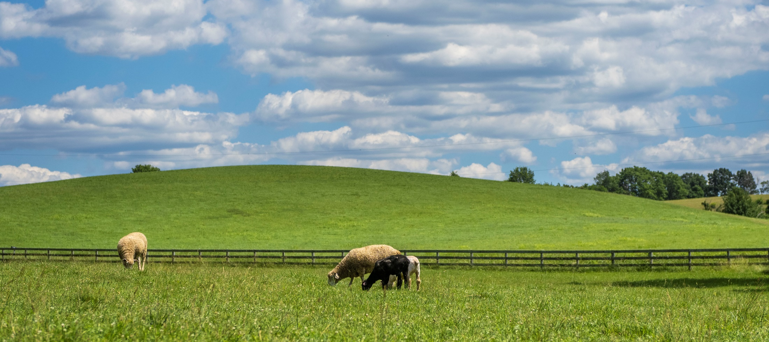
Transitioning Land to a New Generation
Case Studies

Slide 2
Acknowledgments
Transitioning Land to a New Generation was created by American Farmland Trust, supported by an Educational Enhancement grant from the USDA Beginning Farmer and Rancher Development Program.
Award # 2020-49400-33257
Thanks also to Farm Credit, the team of national experts in farmland transfer and access, and the members of American Farmland Trust.
Notes:
This curriculum was created by American Farmland Trust with support from a national Educational Team of advisors and a group of subject matter experts.
It was made possible by a grant from the USDA Beginning Farmer and Rancher Development Program Award #2020 - 49400 – 3325 with additional support from Farm Credit and the members of AFT.
I am delivering this curriculum today as a pilot training to field test these resources. At the end of the workshop, I will give you an evaluation form. Please complete it so you can let us know what worked, what didn’t work, and what we can do to make it better.

Slide 3
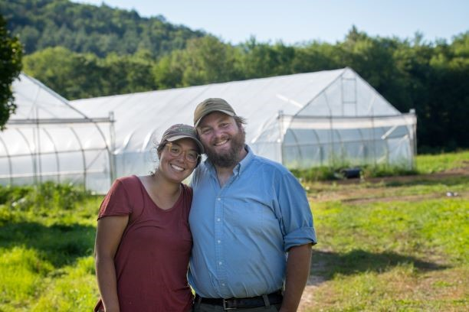
Old Road Farm
Granville, VT
Themes:
Land Access
Growing Practices
conservation
Prompt Questions:
What were Henry's major barriers to land access?
How do Henry's values drive his efforts on the farm?

Slide 4
Old Road Farm
Granville, VT
Notes:
You Tube Link: https://www.youtube.com/watch?v=9DOcpcamF00

Slide 5
Discussion
What were Henry's major barriers to land access?
How do Henry's values drive his efforts on the farm?

Slide 6
Muse 3 Farm
Greensburg, LA
Themes:
Family Relationships
Land Access
Generational Dynamics
Prompt Questions:
How do the Muse brothers work together to manage the planning and financial aspects of the farm?
How do the Muse brother's values drive their care of the land?

Slide 7
Muse 3 Farm
Greensburg, LA

Slide 8
Discussion
Prompt Questions:
How do the Muse brothers work together to manage the planning and financial aspects of the farm?
How do the Muse brother's values drive their care of the land?

Slide 9
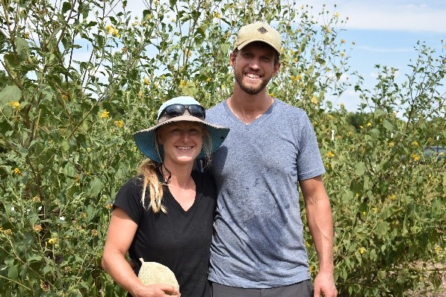
Resilient Growers Farm
Tulsa, OK
Themes:
Integrated Systems
Community Support
Setting Goals
Housing
Prompt Questions:
How do the values Rachel and Brent hold assist them in their farming goals?
How has support from the community helped them along the way? What relationships were crucial?

Slide 10
Resilient Growers Farm
Tulsa, OK

Slide 11
Discussion
Prompt Questions:
How do the values Rachel and Brent hold assist them in their farming goals?
How has support from the community helped them along the way? What relationships were crucial?

Slide 12
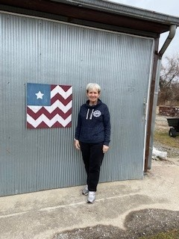
Post Potter Farm
Pittsburg, KS
Themes:
Land Inheritance
Family cooperation
Working with an attorney
Prompt Questions:
What challenges in transfer has Debbie encountered, and how can you avoid these challenges in your own transfer situation?
How does Debbie's support network assist in the transfer?
How does Debbie plan for a transfer with difficult conversations?

Slide 13
Post Potter Farm
Pittsburg, KS

Slide 14
Discussion
Prompt Questions:
What challenges in transfer has Debbie encountered, and how can you avoid these challenges in your own transfer situation?
How does Debbie's support network assist in the transfer?
How does Debbie plan for a transfer with difficult conversations?

Slide 15
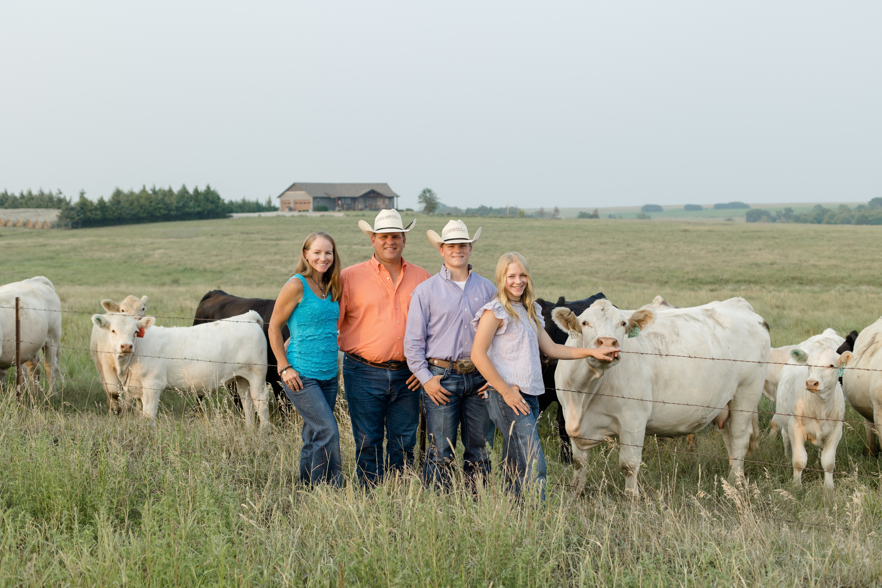
Schrader Ranch
Location: Wells, Kansas
Themes:
Building and Developing Relationships
Values in Farming
Good Communication
Prompt Questions:
How did the family leverage various relationships to further their goals on the land?
How have the values of the owners of Schrader Ranch impact the trajectory of their operation?

Slide 16
Schrader Ranch
Wells, Kansas

Slide 17
Discussion
How did the family leverage various relationships to further their goals on the land?
How have the values of the owners of Schrader Ranch impact the trajectory of their operation?

Slide 18
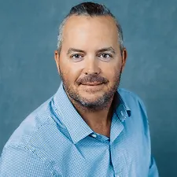
Jeff Caskey
Location
Themes:
Relationships with Landowners
Negotiation
Government Programs
Prompt Questions:
What strategies and methods did Jeff use to acquire new land to lease?
How do the members of Jeff's team and support network help him achieve his goals?

Slide 19
Caskey Ranch
Tishomingo, Oklahoma

Slide 20
Discussion
Prompt Questions:
What strategies and methods did Jeff use to acquire new land to lease?
How do the members of Jeff's team and support network help him achieve his goals?

Slide 21
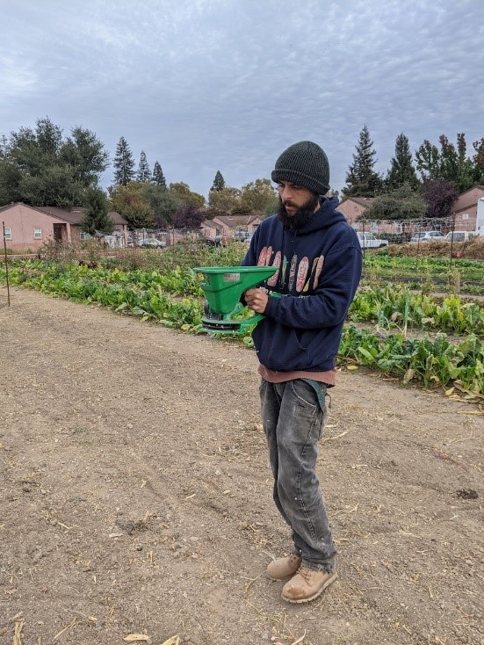
We Grow Urban Farm
Sacramento, CA
Themes:
Community Engagement
Sustainability: Economic
and Environmental
Business Planning
Prompt Questions:
How does Nelson use connections to various organizations to support the farm?
What values does Nelson hold that have in turn benefited the business as a whole?

Slide 22
We Grow Urban Farms
Sacramento, CA

Slide 23
Discussion
Prompt Questions:
How does Nelson use connections to various organizations to support the farm?
What values does Nelson hold that have in turn benefited the business as a whole?

Slide 24
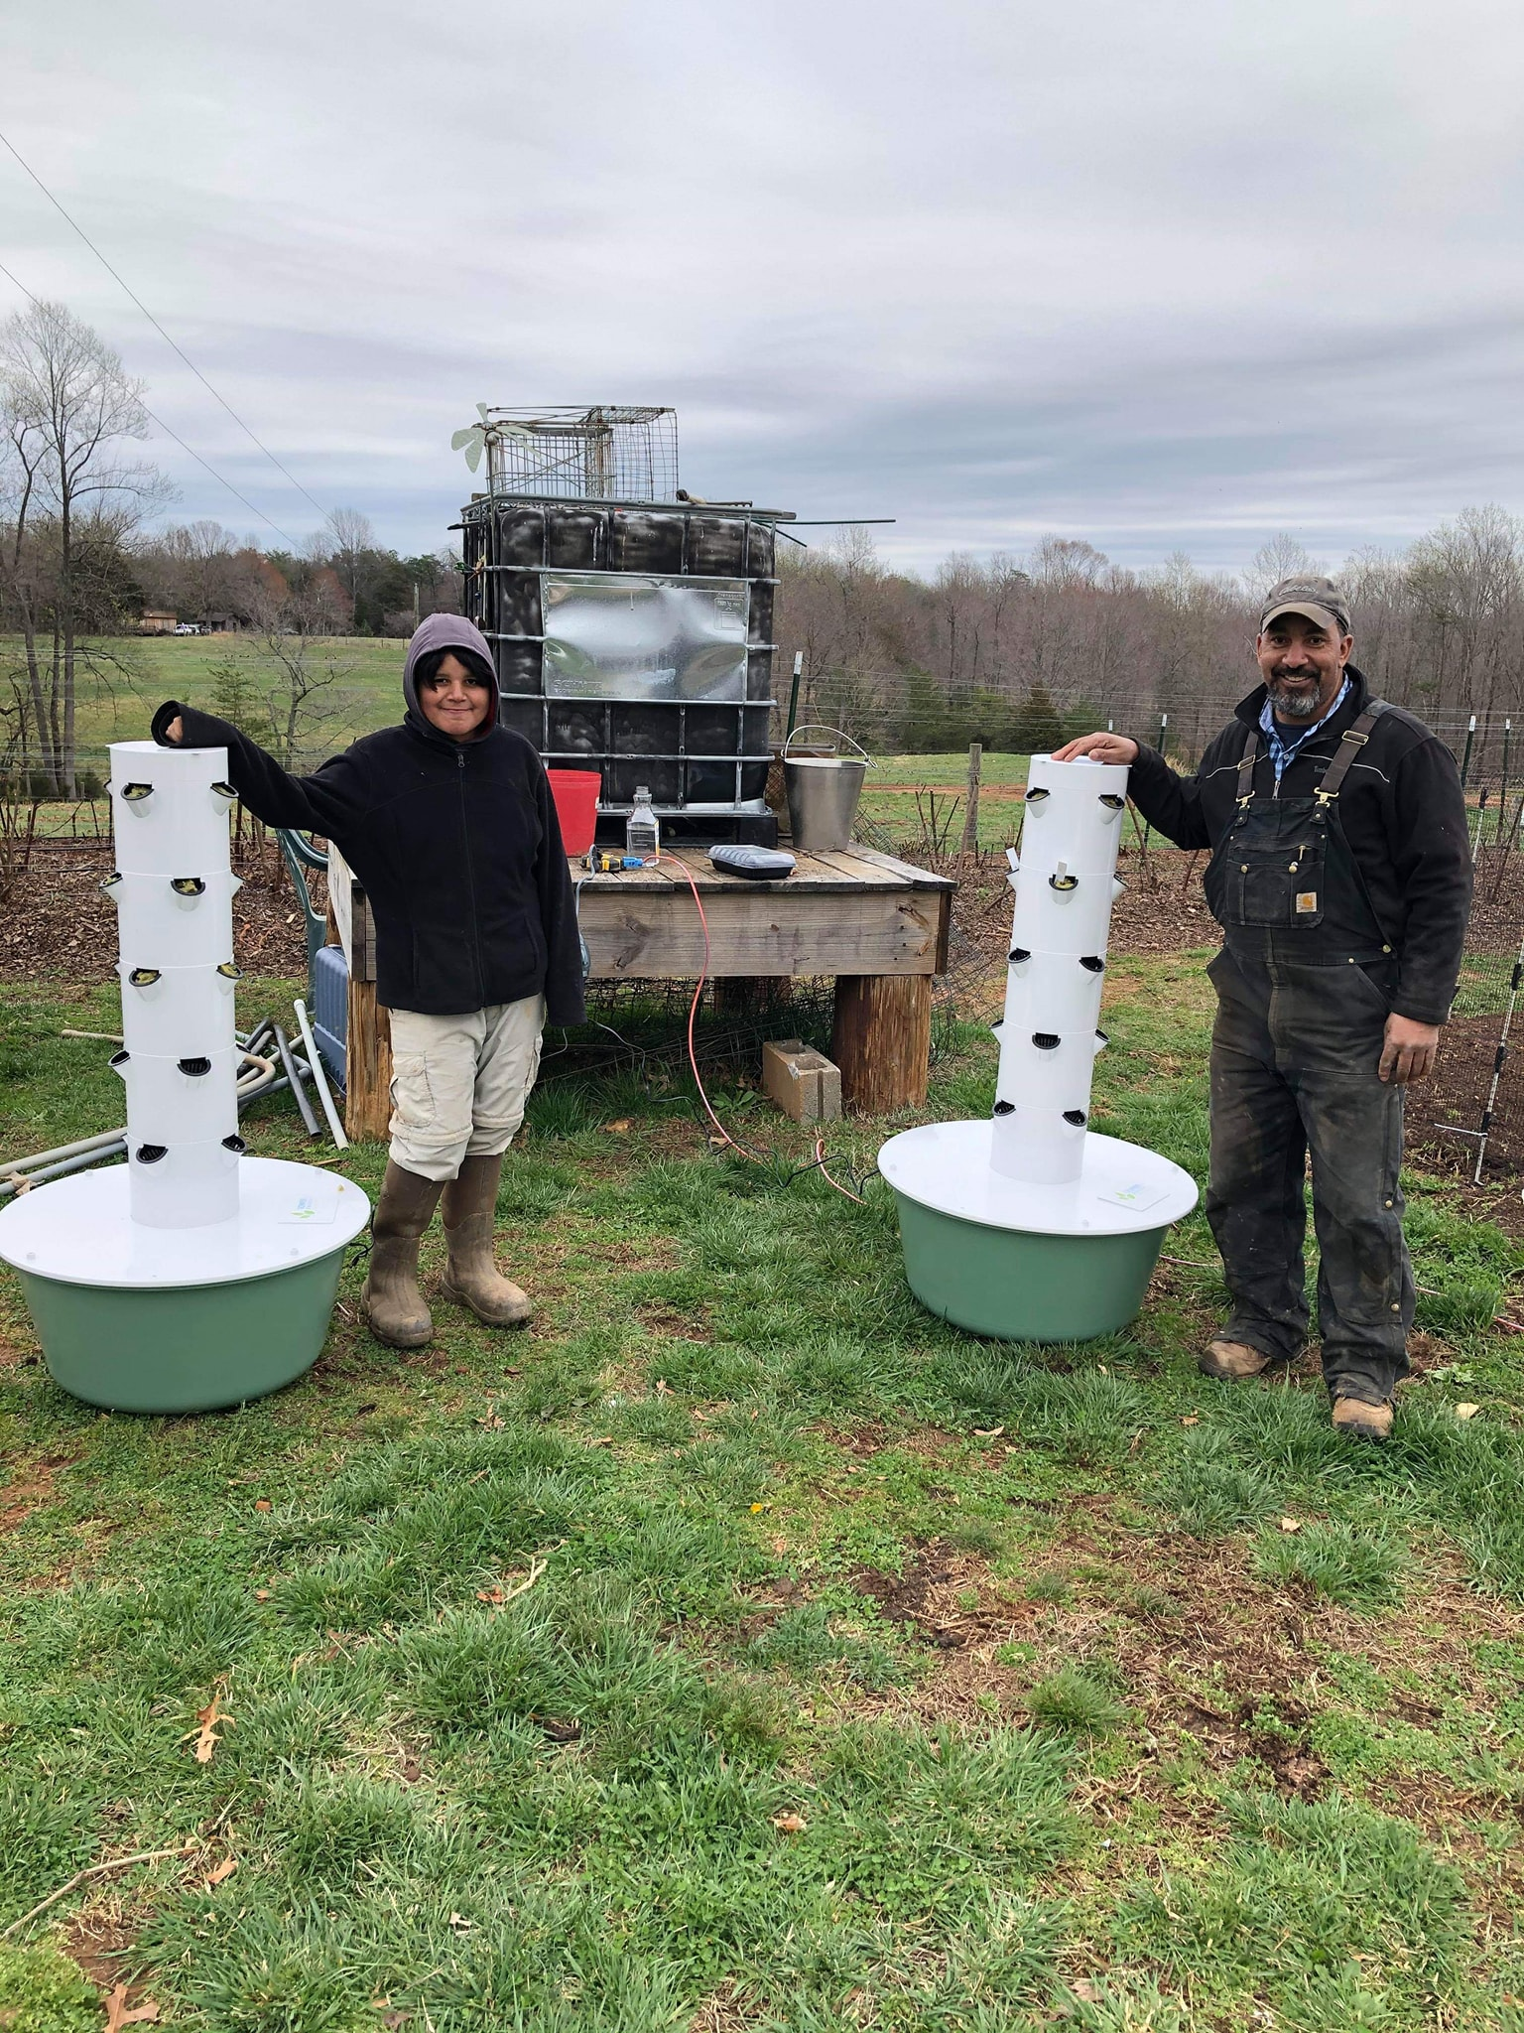
Cattle Run Farm
Ruckersville, VA
Themes:
Difficult Conversations
Planning for Transfer
Financial planning with family
Prompt Questions:
How did Cattle Run Farm diversify in order to provide financial sustainability for their family?
How did the Morton Family set up the farm legally to avoid conflict?
In what ways did the family plan ahead for transition?

Slide 25
Cattle Run Farm
Ruckersville, VA

Slide 26
Discussion
Prompt Questions:
How did Cattle Run Farm diversify in order to provide financial sustainability for their family?
How did the Morton Family set up the farm legally to avoid conflict?
In what ways did the family plan ahead for transition?

Slide 27
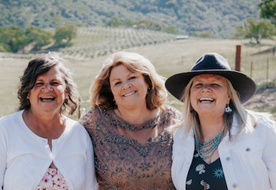
Three Calhoun Sisters Ranch
Livermore, CA
Themes:
Farm mediation
Communication skills within a transfer
Conservation Planning
Prompt Questions:
What were the multiple strategies the sisters used to communicate effectively?
How did the sister's passion for conservation and history drive the structure and organization of the property management?
How did the sisters prepare and stay organized for transfer?

Slide 28
Three Calhoun Sisters Ranch
Livermore, California

Slide 29
Discussion
Prompt Questions:
What were the multiple strategies the sisters used to communicate effectively?
How did the sister's passion for conservation and history drive the structure and organization of the property management?
How did the sisters prepare and stay organized for transfer?

Slide 30
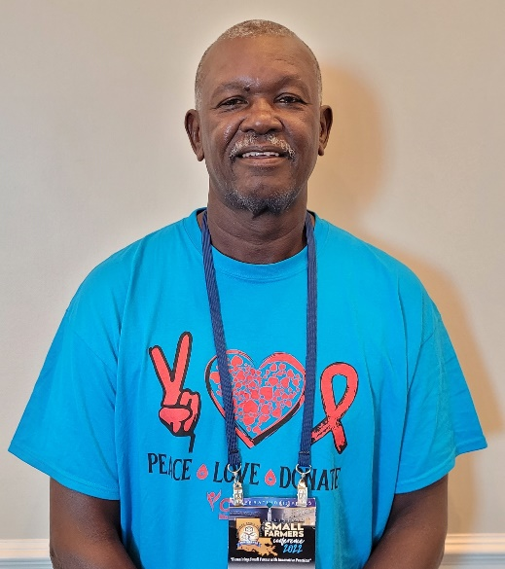
Larry Freeman
Greensburg, LA
Themes
Family Legacy
Heirs Property
Family Relationships
Long-term vision
Prompt Questions:
What strategies does Larry use to maintain good relationships with family he shares the land with?
How does the Heirs Property status of the property influence the transfer of the farm?
How do Larry's values influence his long-term vision for the farm?

Slide 31
Larry Freeman
Greensburg, LA

Slide 32
Discussion
Prompt Questions:
What strategies does Larry use to maintain good relationships with family he shares the land with?
How does the Heirs Property status of the property influence the transfer of the farm?
How do Larry's values influence his long-term vision for the farm?

