Slide 1
Transitioning Land to a New Generation
Prepare to Negotiate
Notes:
This module is the fifth, and final, of five consecutive modules—or workshops— in the Transitioning Land to a New Generation Curriculum, which designed to help participants gain the basic skills needed to participate in a farm, ranch or land transfer process.
This module prepares participants to negotiate a win-win agreement.

Slide 2
Welcome
** TRAINERS: This slide is optional. Design it with information, such as:
names and photos of presenters
your logo
logos of any co-sponsors
Notes:
Welcome to this workshop. This is the fifth, and final, of 5 modules or workshops American Farmland Trust has created to help you get ready to be part of a farm or ranch transfer process.
We have found that most training on this about farm/ranch transfer and transfer cover succession and/or estate planning within farm families, and mostly from the point of view of the senior generation.
Since land transfers increasingly occur between non-relatives, we have tried to make our training as inclusive as possible: for those of you who come from farm families and for those who don’t, for younger producers and/or beginners as well as for land holders looking for someone to take on management of their land, their operation, or both.
It is designed especially for people who have land and/or farm or ranch business in mind and have at least started to talk with someone about transferring it – from young and beginning farmers and ranchers to landholders who may be retiring, or planning their estates, or who want to make land available for a new generation.
Trainer Instructions:
Have trainer(s)/presenter(s) introduce themselves.
Review workshop agenda.
Ask participants to introduce themselves.

Slide 3
Acknowledgments
Transitioning Land to a New Generation was created by American Farmland Trust, supported by an Educational Enhancement grant from the USDA Beginning Farmer and Rancher Development Program.
Award # 2020-49400-33257
Thanks also to Farm Credit, the team of national experts in farmland transfer and access, and the members of American Farmland Trust.
Notes:
This curriculum was created by American Farmland Trust with a lot of help from a national Educational Team of advisors and a group of subject matter experts.
It was made possible by a grant from the USDA Beginning Farmer and Rancher Development Program Award # 2020 - 49400 – 3325 with additional support from Farm Credit and the members of AFT.
The content for this module was also created with extensive input from Claudia Kenney, Co-Director of the New York State Agricultural Mediation Program.

Slide 4
Today You Will Learn To:
Define
Prepare
Identify
Practice
Identify behaviors that maintain trust.
Practice effective communication skills to reach agreement.
Prepare to support your position.
Define who is involved and what you need from a negotiation.
Manage stress in negotiations.
Manage
Notes:
In Module 4 we learned how to adapt your story and practiced effective communication skills to build support for your farm or ranch transfer goals. In some instances, this type of persuasive communication – one that involves active sharing and listening – can help you achieve your goals. In other cases, you may not see eye-to-eye with a specific person involved in your transfer and it takes additional skills to prepare for and navigate through negotiations.
Today, we are going to build the knowledge and skills to support a win-win negotiation by:
Knowing who is involved and what you need from a negotiation.
Prepare yourself to support your position.
Identify behaviors that build trust.
Building off your understanding of effective and persuasive communication to practice skills specific to engaging in a negotiation.
Maintain calm in negotiations by managing stress.
These are the things we will talk about today. You can see these in your student learning plans.

Slide 5
10 Key Steps in a Farm or Ranch Transfer
Assess finances.
Describe your values, vision, & goals.
Tell your story.
Create your support team.
Identify your needs.
Negotiate.
Choose which tools to use.
Identify and strengthen key relationships.
Finalize documents.
Outline and adapt your plan.
Notes:
There are series of steps in a farm or ranch transfer process. We have broken it down into 10 steps. You likely will take most if not all of them, but it is not a linear process, so while a certain amount of order makes sense, you likely will find you move forward and back several times before you are done.
Today, we’ll be building upon other steps that have been addressed in other modules of the curriculum and focus directly on the key step of negotiation.

Slide 6
Where are you in the process?
Consider your farm or ranch transfer situation:
Have you started or do you anticipate a negotiation?
What are you negotiating for?
Who are you negotiating with?
Share your answers with the group.
Notes:
Motivation Activity
Each of you is likely in a different stage of identifying and preparing to negotiate. We are going to do a brief activity to see where everyone is starting from today.
Spend 2-3 minutes considering the following questions:
Have you started or do you anticipate a negotiation?
What are you negotiating for?
Who are you negotiating with?
If available, reference the Needs Assessment worksheet from Module 1 and the Financial Assets Inventory for Module 2 to help answer the questions.
We’ll then go around the room and each person take 30 seconds to share who they are negotiating with and what they are negotiating for. You may “pass” if the information is too sensitive to share.
Trainer Instructions:
You can point them to Prepare to Negotiate Worksheet – questions 1,4, and 5 ask these questions. They will have time later to fill in this worksheet.

Slide 7
Part 1: Set yourself up for successful negotiations
-
Notes:
Now that we have a sense of where you are in considering a negotiation, let’s jump in. Today we’ll focus on the key step in a farm or ranch transfer of negotiation.

Slide 8
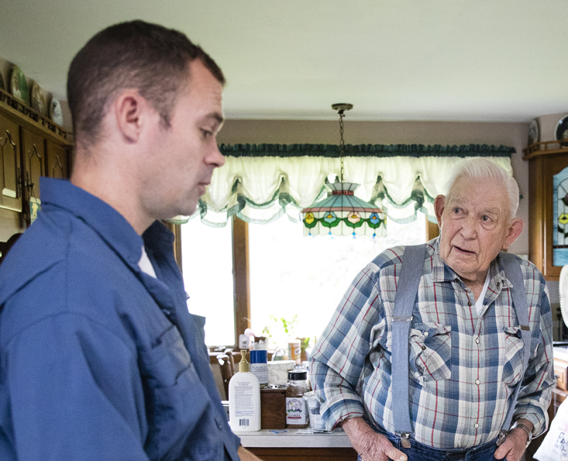
Negotiation
A strategic discussion designed to reach agreement.
Photo Credit: Rebecca Drobis
Notes:
Negotiation is a strategic discussion designed to reach an agreement. In a negotiation, each party tries to persuade the other to agree, or understand, their point of view. The goal of negotiation is to share ownership of the problem and ultimately the decision – meeting as many needs of each party as possible. Negotiation is often thought of as compromising – or each party giving something up to meet in the middle. But if we start to think of negotiation more as a collaboration, hopefully – more needs can be met.
Negotiation is an effort to get at what is priority and beneficial for both parties- a Win-Win Agreement. To achieve a Win-Win Agreement, each decision maker must consider all the needs involved. As you prepare for negotiation, explore all the needs on both sides so you have as much information as possible. When you get to the joint problem-solving part, more information is better.
Remember negotiation is a discussion, meaning not just one conversation. It often takes more than one conversation to reach the final outcome.
Before your farm/ranch transfer is complete, you likely will need to negotiate the terms of your agreement. This may take time and you may want to consult with or engage an advisor to help you. It is important to prepare for negotiations so you can reach a good agreement.
Let’s Review Part 4: Alignment of Needs in Module 1's Needs Assessment Worksheet to determine what all parties' involved bottom line might be and how to meet both your needs and the needs of those involved.
We’ll now walk through a number of key questions to consider.

Slide 9
WHAT are you negotiating for?
Want vs Need
Assets:
Land and tangible assets
Business and operating assets
Notes:
First, what are you negotiating for?
Start by identifying what you need in a negotiation.. Consider the following:
What needs have you identified to achieve your Values, Visions and Goals that will be impacted in a negotiation? (Review Needs Assessment worksheet from Module 1)
What are “wants” – or “nice to haves” but factors that are not essential needs –are part of the negotiation?
Review and clarify the specific assets you are negotiating for – in some cases it may be a slice of the overall transfer, in other cases the assets involved in negotiation could cover the entire transfer situation. (Review Needs Assessment and Assets Inventory worksheets from Module 1)

Slide 10
WHO is involved in the negotiation?
Landowners
Incoming farmer or rancher
Business Partners
Family
Others
Notes:
It is important to also consider who is involved in the negotiation?
Knowing who your audience is throughout your farm and ranch transfer process is central to preparing yourself for a negotiation. As in other parts of the process, a negotiation will involve individuals who play a role in the final outcome. You’ll also want to make sure the person or people you are negotiating with has the decision-making authority to address the needs you have identified and impact that outcome.
Understanding who you are working to reach agreement with and why they are key to the outcome is important. If accessible to you, you may wish to reference the Needs Assessment Worksheet from Module 1 and review the list of Key People to narrow in on who is or might be involved in a negotiation.

Slide 11
WHERE, WHEN and HOW might you plan to negotiate?
Build a flexible timeline.
Identify how decisions will be made.
Identify a location.
Notes:
Finally, setting matters. You will need to identify the best time and place to negotiate. ​
As we’ll discuss later on in this module, negotiations can sometimes be challenging and stressful conversations. You will want to consider the method, location and timing of negotiation conversations to support a productive environment. If a trusted third-party support professional, such as a mediator, is involved, you may consider meeting in their more neutral space. This may look different based upon how the decisions are being made as we discussed in the previous slide.
While you want to be mindful of specific deadlines you have identified to move the transfer along, it’s important to recognize that negotiations can often times involve multi conversations and, if a third party is involved, can be dependent on aligning many schedules. Build a timeline that acknowledges your needs but has some flexibility.
Reaching agreement implies that more than one party will be involved in a decision-making process. Understanding the type of group decision-making process that will best serve your needs and that of the key audience(s) involved will help set clear expectations towards a win-win agreement. We’ll dig into this point a bit more in the next slide.

Slide 12
How Group Decisions Are Made
Consultative | Democratic | Consensus | Delegative
Whole group discusses. | Whole group discusses. | Whole group discusses. | One person makes decision for the whole group.
One person decides. | Decision is made when some percentage agrees. | Decision is made when each member agrees. | One person decides.
Notes:
Since many big and small decisions are made throughout a farm transfer, it is helpful to set expectations among group members for how decisions will be made. Having a decision-making process can help specify not only how decisions will be made, but also how people will be involved, and where, when and how to plan the negotiation conversation. .
Often a mix of group decision-making processes is used. You may use some or all of the following decision-making processes as you work together to reach agreement:
Consultative: A decision is made by one person after the group has discussed ideas and potential solutions.
Democratic: The whole group discusses the issues and is involved in deciding the outcome. A decision is made when some percentage of the group agrees.
Consensus: The whole group discusses the issues and potential solutions. A decision is reached when each member supports the decision and agrees to uphold their role in its implementation. If one person does not support the decision, the group does not yet have consensus.
Delegative: One person or part of the group issues a decision for the whole group.
In any of these situations, someone will need to initiative the process. Make sure that is clear from the start – and it could be you!

Slide 13
Prioritize Your Needs
Acceptable Outcome
Point to
Walk Away
Ideal Outcome
Notes:
Trainer Instructions: Reference the Needs Assessment worksheet from Module 1 as appropriate for your audience. The activities in this section will build on that.
Even after you have separated your wants from your needs and identified critical assets, there is still a range of outcomes that can help reach those needs. To better understand this range, it’s important to prioritize needs and pinpoint what is non-negotiable – that is, what is absolutely needed – to achieve your values, visions, and goals.
You can start with mapping out the ideal outcome and what that negotiation result looks like where all of your needs are met.
However, as mentioned earlier, negotiations will likely involve some give and take and so you will also need to prioritize your needs to consider what you might be willing to give up. What is less critical to reach an acceptable outcome? This can help you to reach a midpoint outcome that is positive for both parties and supports a “win-win” even if you are not reaching the ideal outcome. Finally, consider what you cannot give up – those non-negotiables – to know at which point you may need to walk away.
There is space in Part 3 of the Prepare to Negotiate worksheet to group what is an ideal outcome for you with your negotiable and nonnegotiable needs. Prioritizing your needs will help you clarify that with the other party – so you can be an active collaborator in the process.

Slide 14
Prepare to Negotiate Worksheet
Complete the Prepare to Negotiate worksheet.
Refer to: Vision and Values Worksheet
SMART Goals worksheet
Needs Assessment Worksheet
Asset Inventory Worksheet
Notes:
Practice Activity
Using the Prepare to Negotiation worksheet Parts 1,2,3; spend 15 minutes working on your own (or with a partner/group) to answer the following questions:
What are you negotiating for ?
Who are you negotiating with ?
Where, when, and how might you plan to negotiate?
In Module 1 we worked on Vision, Values and Goals, Financial Assets Inventory, and Needs Assessment Worksheets. If you have completed those you may want to look back at them now.
Some of these questions you may want to come back to later, and that’s okay. This is meant to get you pointed in the right direction and you’ll likely want to follow up on this later.
If you have questions while working on them, ask!

Slide 15
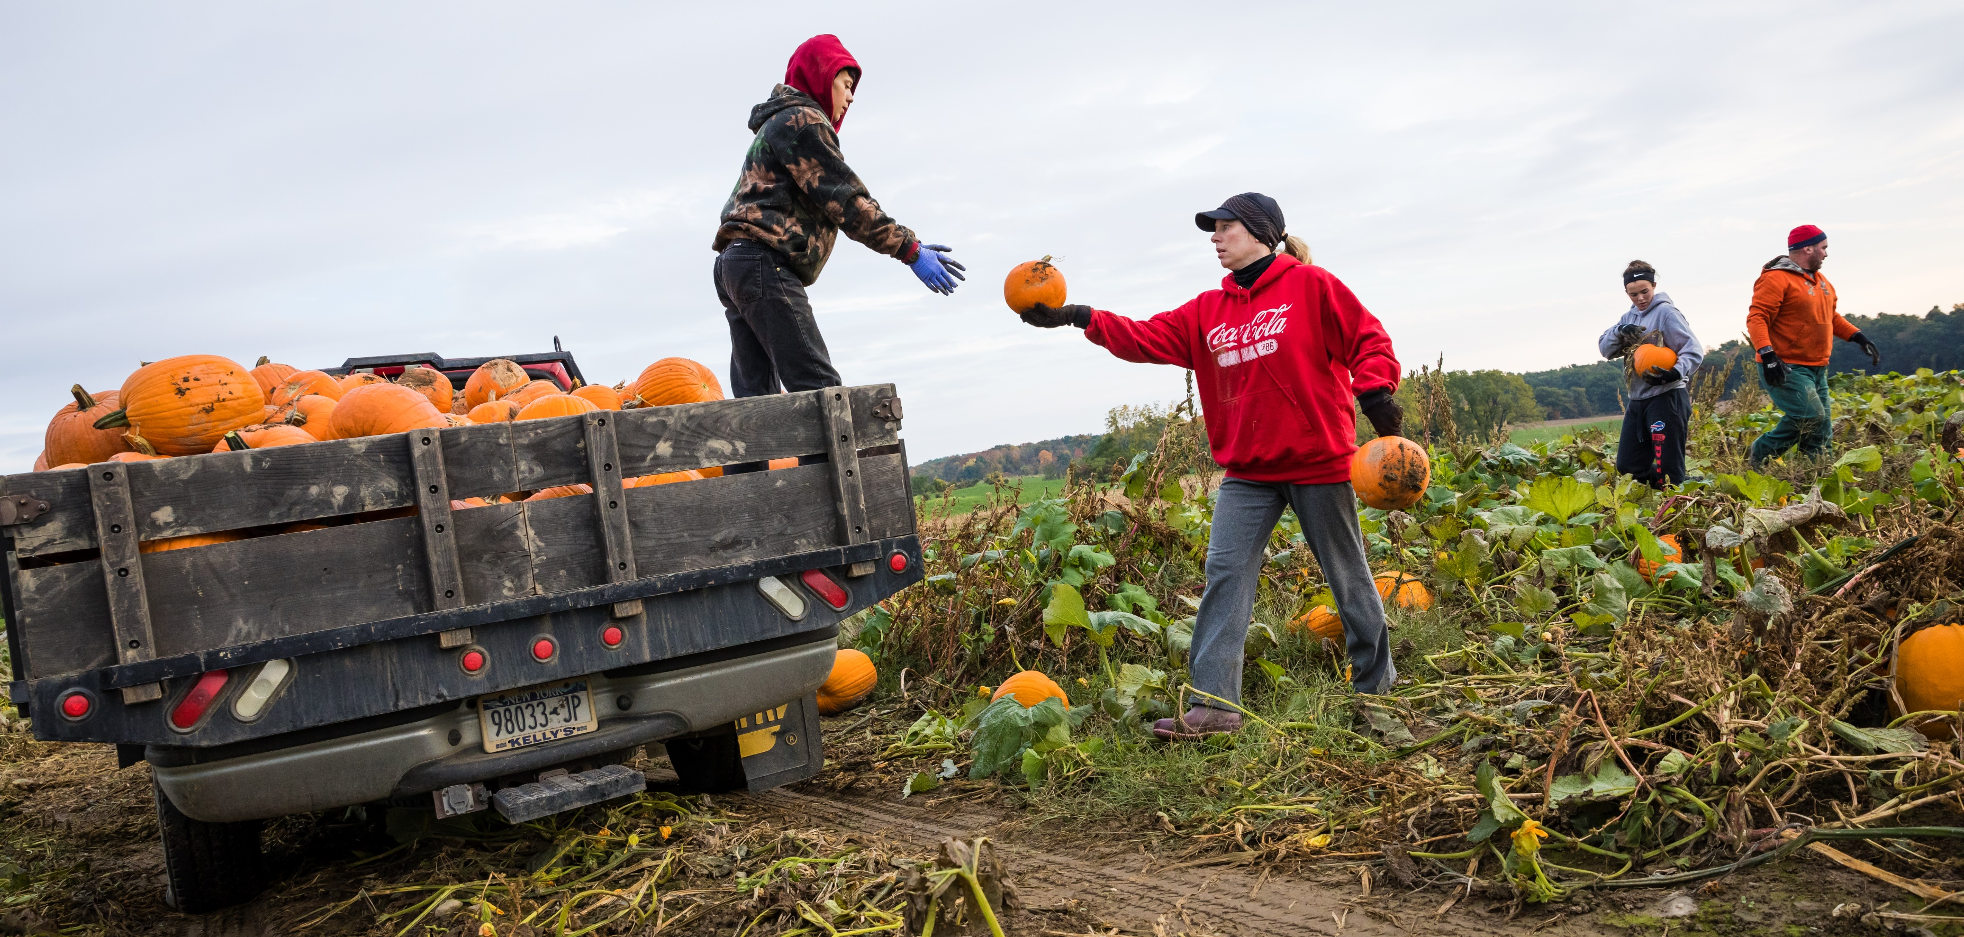
Part 2: Skills to Reach Agreement
-
Notes:
Now that you are starting to prepare, we’ll talk about the skills – particularly communication skills that will help support a positive negotiation.

Slide 16
Sustaining Relationships to Get to a “Win-Win”
Maintain trust.
Communicate effectively.
Consider the other’s point of view.
Notes:
Negotiation conversations are typically not the first interaction you have with the person or persons involved as decision makers in a farm or ranch transfer. Negotiations are a discussion, often involving multiple and sometimes very difficult conversations. It takes time, preparation, and care.
In Module 1, we introduced three components to building and strengthening relationships that are adapted here to support strong relationships during negotiations. Sustaining healthy relationships that you have worked to build throughout the process will improve your chances of success and lead to better outcomes for all the parties involved.
To get to a “win-win” agreement, you will want to revisit key behaviors that not only build but maintain trust, take into account the point of view of others that are part of the decision-making process, and practice skills that support effective communication.
We’ll touch on all these points today but spend a little more time on the skills to communicate effectively.

Slide 17
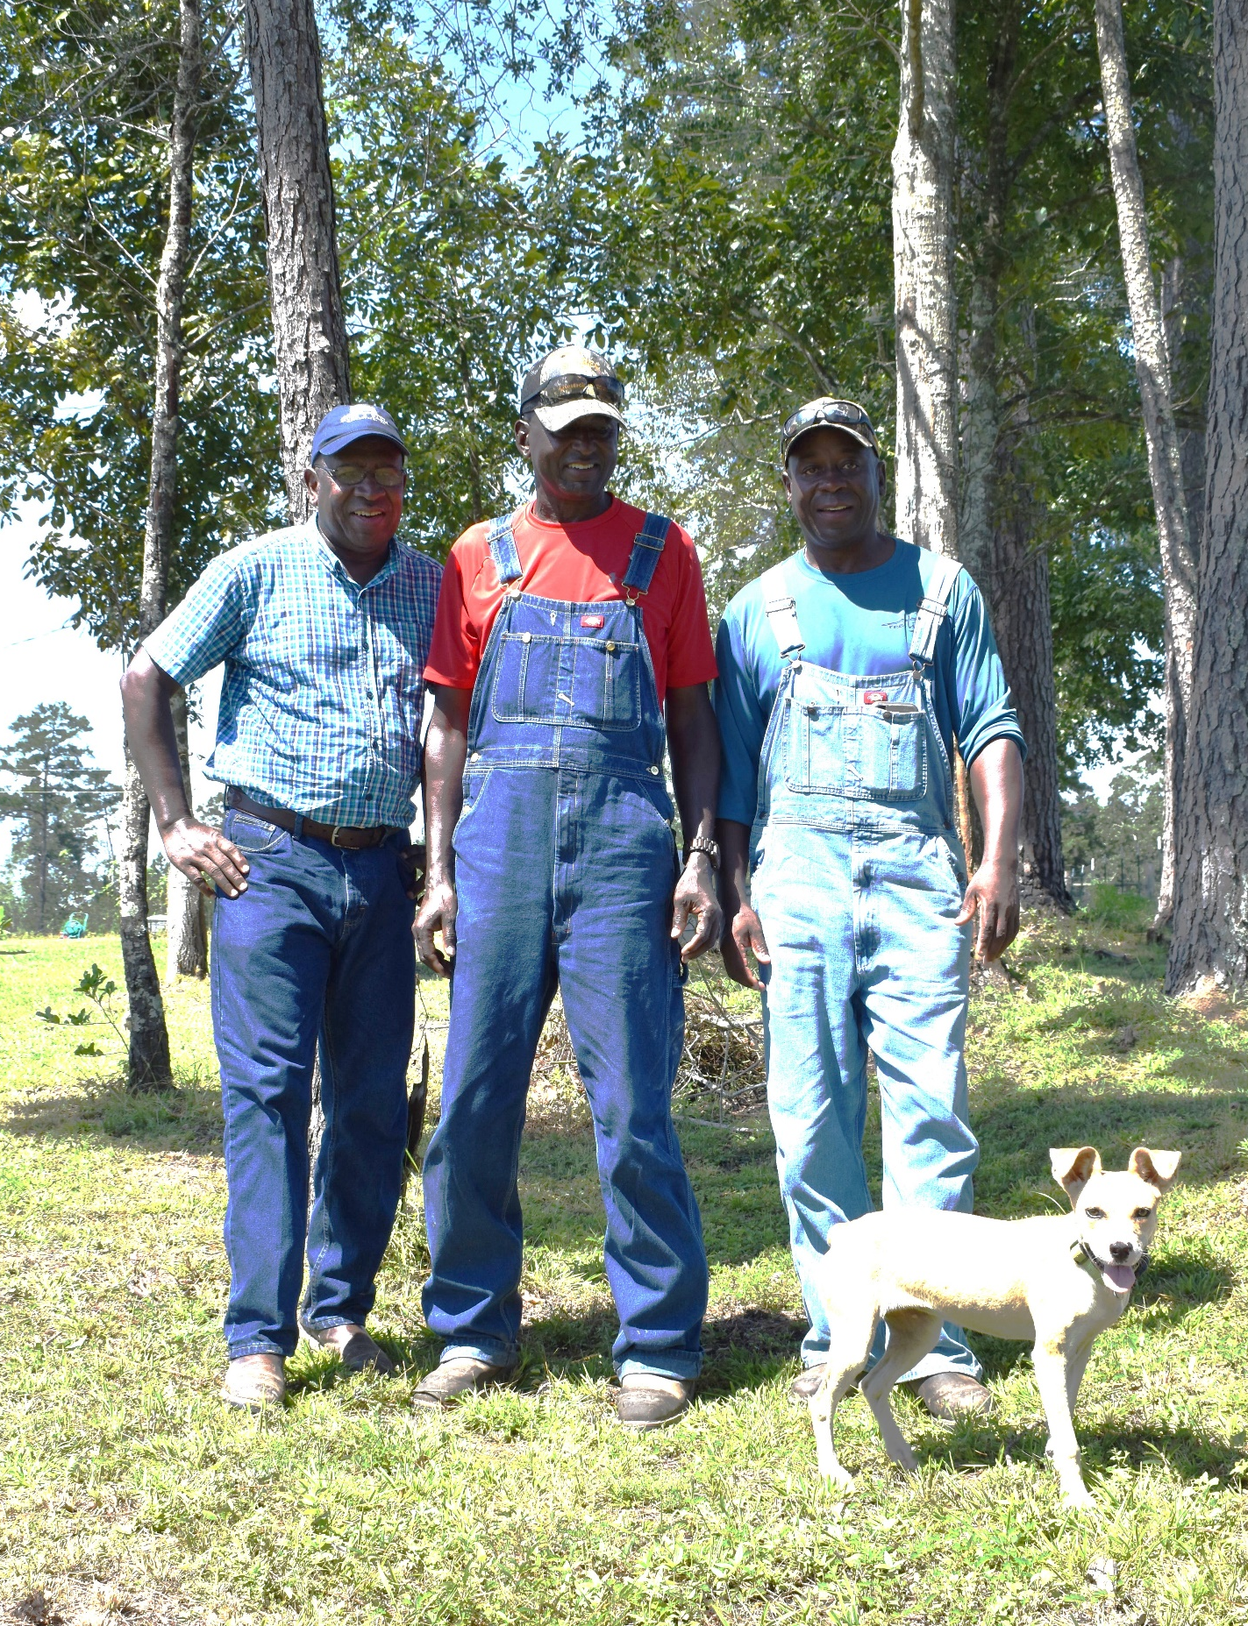
Behaviors to Build and Maintain Trust
Tell the truth
Be transparent
Show respect
Be accountable
Face reality
Keep promises
Give appreciation
Notes:
In Module 1, we reviewed these seven actions or behaviors that are important to build trust in farm and ranch transfer situations. (Review M1 – Skills to Build Trust Information Sheet that describes these behaviors). Tied to considering point of view and communicating effectively, we see them as building blocks that lead to successful business dealings, conversations, and negotiations.
As we review this list, think about scenarios of where trust is important, specifically in negotiations. What kinds of actions support these behaviors? What stories or examples can you think of where you felt these were present – or where were they absent?
Tell the Truth: As you consider what you need out of a negotiation, it’s important to be honest with yourself and with others. Only by letting others know where you stand and being truthful will you have the chance to move towards agreement that has mutual needs and interests in mind.
Show Respect: Engaged listening and a consideration of others needs are ways to show respect. No matter how group decisions are being made, make sure not to talk over people or ignore others even if you might disagree with them.
Be Transparent: Be open about what you want and need and what you plan to do, especially when your actions affect other people involved in your transfer. Negotiations are not meant to “beat” the other people involved or to into a “win-lose” situation. Withholding important details might result in a negative outcome for both parties involved.
Face Reality: A transfer process that leads to the need for negotiations means you may have hit a few bumps in the road – and that is ok! You will likely have more than one tough conversation and avoiding them doesn’t make the need for them go away! So, it is important to name the issues you need to deal with and address challenges before they turn into problems.
Be Accountable: You won’t get everything right along the way and that is ok. But do take responsibility for your actions and words. Apologize for any missteps or mistakes.
Keep Promises: Keep your word. Don’t overextend and commit to doing things you will not or cannot do just to reach agreement.
Give Appreciation: While it’s important to bring your needs and experience to a negotiation, it’s important to also bring humility. Give credit where credit is due. Show you care. It’s usually a tough conversation for all parties involved.
Trainer Instructions:
You can describe a scenario of trust or ask for input from the group.

Slide 18
Consider the Other Person’s Point of View
Appreciate cultural and generational differences.
Put yourself in the other person’s shoes.
Practice empathy.
Look for common ground.
Notes:
As was introduced in Module 1, it is important to understand the point of view of the other people involved in your farm or ranch transfer situation. Be clear about what you want and need but consider the other party.
First, it helps to gain consensus by coming in with an open mind and empathy for them. This can help reduce stress and support a positive outcome.
It’s a good idea to consider the other person’s needs. What do you know about the them and their cultural and generational differences?
Put yourself in their shoes and try to understand where they are coming from: What do they need? What is their point of view? If you don’t know, you can ask. ​
Looking for common ground is especially important to negotiations. Try to find the overlap between your wants and needs and theirs so you both benefit from the transfer.
We will come back to this idea later in this section. But first let’s go into the third part of sustaining relationships which is Communicate Effectively.

Slide 19
Communicate Effectively for Negotiations
Listen for meaning.
Pay attention to feelings and needs.
Be ready to receive information and respond.
Share your needs and feelings.
Communicate what you want but seek to gain consensus.
Consider the other person’s needs.
Understand next steps and when to:
arrive at a decision,
pause, or
walk away.
Notes:
The basis of a good negotiation is good self expression and good listening. In Module 1 we introduced how to strengthen key relationships by building trust, communicating effectively, and understanding other’s point of view. In Module 4 we expanded on skills to communicate effectively by adapting your story to your different audience sand understanding verbal and non-verbal communications in order to build support for your goals. In negotiation – practicing these skills all together will support a better outcome – ideally a “win-win” outcome that benefits everyone involved.
Listen, listen, listen. In a negotiation, it’s a good idea to spend more time listening than talking. ​Listen to understand the other person’s needs and feelings as negotiations can pull both out.
Share. It is important prepare carefully before you enter into a negotiation. Be clear about your needs and be able to state them concisely. You should start by laying out the full scope of what you want but also bring a willingness to compromise. Everyone is coming in with their own needs to be met. This means making sure you know the minimum outcome you’re willing to accept based on the needs you have prioritized. Depending on your situation – being open and honest about the feelings you have around the situation will help others’ understand your point of view. Don’t worry - we are going to practice connecting our needs to feelings in a clear and practical way. So if sharing your feelings is new or uncomfortable for you – you’ll walk away today with some tools to practice with.
Understand. The verbal and non-verbal communication cycle that is part of listening and sharing will also help you understand the next steps from each conversation in the negotiation discussion. It is ok if agreement is not reached in the first meeting. Both parties may need time between conversations to process their feelings or what the other party said. And if you cannot get to a place where your non-negotiable needs can be met, it is ok to walk away.
So, let’s dive into these communication skills to use when negotiating to get to a win-win agreement.
​
​​

Slide 20
To listen for meaning, reflect what you hear and make guesses for…
Feelings
Needs
Calm
Lonely
Happy
Comfort
Cooperation
Community
**To guess say: “I’m wondering if ….”
Notes:
When people express their feelings and needs – you can reflect them back to show you heard and understood them. This is a way to practice communication skills as well as understanding another person’s point of view.
Even when people don’t express feelings or needs we can be curious about what they might be feeling and needing. We can listen for what they might be feeling and needing and make guesses.
We have spent time talking about our needs assessment. With those, we focused on the more physical or tangible needs– such as a house, or land. The needs listed here on the Communicate to Reach Agreement worksheet are grouped by Well-Being, Connection, and Self-Expression. They address a different kind of human need and while they are related to the more physical needs of you farm or ranch transfer, they are different – but no less important to recognize. These needs can be harder to first recognize and then express. But they are important to listen for (in yourself and others) – as they may help you understand others’ reactions and responses.
Trainer Instructions: Encourage dialogue with participants while you walk through the following example.
Looking at the lists of needs and feelings in your worksheets - Let’s make some guesses about what feelings and needs may be underlying the following statement:
“You should run the business the way I have.”
What feelings and needs could be underlying this statement? Take a moment and jot down some guesses. Use the list of feelings and needs to help you identify them.
Connect the feelings with a need you imagine the speaker may be having.
I would like to hear some matches with putting the two together into a sentence. Here is an example:
“I am wondering if you are feeling impatient and really wanting to know you will have some stability and security during the transfer. ”
Notice the way I started this with – “I’m wondering” … This is the guessing part and is more disarming. If you state what you think people feel or need – they might feel defense and less open to telling you more.
Let’s hear a few of your guesses….
What happens next? Now that you have made a guess- the speaker will verify or offer other information which will help you understand what is most important to them. Your guess may not land- that’s ok just listen and reflect back the new information the speaker shares.
“No, I am not impatient, I am really worried that we won’t be able to have the farm change hands in a way that provides stability for the people who work here.”
What are some other examples? (Ask for or suggest other statements that come up in farm or ranch transfers).
Great. We’ll come back to naming needs and feelings again. But first a few more thoughts on listening.
Trainer Instructions: Hand out / reference the Communicate to Reach Agreement Worksheet. Give participants a couple of minutes to review the lists of feelings and needs.
One of the most effective skills we can practice in healthy relationships is listening. Being able listening for meaning and reflecting back what we hear is something we can practice. And it is an important part of negotiations. In difficult conversations, meaning often goes beyond words to include identified needs and feelings, stated or unstated.

Slide 21
Listening includes paying attention to Non-Verbal Communication.
Consider body language.
Be aware of facial expressions.
Watch for eye contact.
Observe physical space.
Notes:
You might be familiar with the expressions “to wear your heart on your sleeve.” As it alludes to, non-verbal communications can oftentimes reveal our feelings before we verbalize them. So, what role does body language, or non-verbal communications, play in negotiations? How does it help to maintain healthy relationships even if the topic brings challenging feelings to the surface?
Here are a few non-verbal communication skills to keep in mind as you listen for meaning to understand needs and feelings.
Consider body language. Think about what feelings you convey through movement. This may be unconscious. Do you tend to nod or shake your head to indicate you’re listening? Do you cover your face with your hands when frustrated? Do you move your hands and arms in the air when you are excited? You can watch for others to get a sense for how they are feeling in the situation. What is the other person’s body movement telling you?
Watch for eye contact. Eye contact is tricky because it means different things in different cultures and can be affected by age and gender. It also means different things in different conversations. Generally, it is a sign of confidence, honesty, and respect. If a conversation has more conflict or charged emotions – too much eye contact can be seen as threatening or make people uncomfortable. It’s good to pay attention.
Be aware of facial expressions. Facial expressions often are thought to be universally understood. While that may not be entirely true, most cultures share some basic facial expressions like surprise and happiness, anger and fear. Watching other’s facial expressions will help you understand how they might be feeling.
Observe physical space. We all have different comfort with physical space. This comfort is determined by culture, the situation, and the closeness of the relationship. Physical space can communicate nonverbal messages, including signals of affection, aggression or dominance. It’s important to observe movement in physical space to comprehend needs and feelings.
There is a lot to listening besides just not talking. To be an active listener remember these things and what we talked about guessing for meaning. Listening and expressing usually happen back and forth – so part of listening is also clarifying and asking for more information. Now, let’s look at the more expressive side of effective communication.

Slide 22
Use effective communication skills.
Share your needs and feelings.
Make requests, not demands.
Take a Pause. Respond instead of react.
Notes:
We are going to practice a few tricks to be a more effective at communicating what you want while working to gain consensus in a negotiation.
As was introduced in Module 1 and detailed in Module 4, verbal communication is the use of words, written or spoken. We will discuss these skills in more detail in the following slides but at quick glance;
Sharing your needs and feelings – helps you to clarify for yourself but also helps others know how to meet your needs. We’ve talked about how to listen for them, but now we’ll practice saying them as well.
Making requests not demands - Invite people into a conversation to build consensus by making requests, not demands. We will practice this.
Take a Pause. Respond instead of react. - Negotiations are part of a longer process and communicating effectively will require you to respond thoughtfully rather than reacting emotionally - especially if you are having a stressful interaction and need to maintain a strong relationship through multiple conversations. Knowing when to speak can be as powerful as the words you verbalize.
Now, let’s practice some of these skills together.

Slide 23
Share your needs and feelings.
Feelings
Needs
Calm
Lonely
Happy
Comfort
Cooperation
Community
Notes:
Mini practice activity (15 minutes)
Trainer Instructions:
Walk them through using the worksheet as much as you need to. If there is time for it, create space to share as a group or in pairs. Question 7. of part 2 asks them questions to follow if they are sharing out loud.
We’ll start off with the skill of sharing. We’ve already talked about listening for meaning by looking for others’ feelings and needs. Now we’re going to work on expressing some of our own. For some of you this may come very naturally and be part of how you already communicate and for others this practice can be challenging. Regardless of how comfortable you are saying how you feel and what you need, clarifying it for others is a helpful step in negotiations – but also other conversations.
Take another look at your Communicate to Reach Agreement worksheet. Take a few minutes to think about part 1 and 2. Write your answers if you want to.
Group reflection option:
Ask questions such as:
How did it feel to say these to another person?
How do you think you can use this skill in life/negotiations situation?

Slide 24
To support effective negotiations, make a request - not a demand.
An effective request is
specific,
doable, and
meant to result in a positive action
Notes:
Now we’ll talk about our second skill – making effective requests instead of demands. You can follow along with this section in Part 3 of Communicate to Reach Agreement Worksheet
Requests are how we attempt to meet our needs in collaboration with others.
Though many of our needs are met in collaboration with others, no one is responsible for meeting our needs- that responsibility is ours. We make requests of ourselves or others to meet our needs.
Making a connection is key to building relationships. An effective communicator asks for things in a way that the other person can understand. Making clear requests is a skill that will lead to positive outcomes.
A formula for an effective request is specific, doable, and meant to result in a positive action. A positive action is what you want someone to do rather than what don’t want them to do.
This is not to say demands are never appropriate. You may need to make them sometimes. But for our purposes here we want to work on shifting demanding statements into requests, so the receiver is more likely to be open to what you are saying. A listener will be more willing to hear what you have to say if they don’t feel like they need to protect or defend themselves.
How do we know if we are making a request or a demand?
The general rule of using “I” instead of “You” is a good start.
Starting off with “You are doing this”, or “You should do this…” tends to make people defensive.
Start conversations with “I” instead of “You”. Stating your experience and perspective will help people relate to you and understand where you are coming from.

Slide 25
Turn demands into requests
“You should manage the farm the way I have.”
“You should use no till practices to combat climate change.”
Start with “I” (hear/need/want).
Notes:
Start with turning “you” into “I” Statements.
Let’s look at these demands as an example.
You should run the business the way I have.
You should use no till practices to combat climate change.
Let’s start with just changing them from You should – to I want.
I want you to run the business the way I have.
I want you to use no till practices to combat climate change.
Trainer Instructions:
Ask for suggestions from the group.

Slide 26
To support effective negotiations, make a request for…
Connection – (Ask for or give empathy)
Solution – (A way to meet your needs)
*Remember an effective request is
Specific
Doable
Meant to result in a positive action
Notes:
Changing “You” to “I” in conversations is a simple step to practice and easy to remember. Let’s go into conversation set – ups a little deeper now.
How can we add more information so that the person we are talking to can do something about what you need? - How can we make our requests specific, doable, positive actions?
We can build connection with the other person(s) and ask for a solution that meets our needs.
To make a connection, say more about how you are feeling and what you needs are. You can also simply recognize they have their own feelings and needs about the situation as well. Connecting with another person – asking for and giving empathy is a helpful skill in negotiations.
To ask for a solution, say more about what you need. What is a simple action someone could take to meet your need.
Let’s put it all together – using the example “You should manage the farm the way I have”. Let’s put ourselves in their shoes and use I feel…

Slide 27
Turn demands into requests.
CONNECTION
Feelings & Needs:
“I’m afraid there won’t be enough income to support my retirement plan. I need to feel secure that that will be taken care of. ”
SOLUTION
Preference:
“I want you to run the business the way I have.”
Request:
“Can we set up a time to talk through the pros and cons of this idea? “
Notes:
Here is an example of turning a demand into a request by asking for connection and a solution.
CONNECTION:
Feelings and needs - How is the person feeling about this. Using an I statement?
Example: I’m afraid there won’t be enough income to support my retirement plan. I need to feel secure that it will be taken care of.
“ I feel this and I need that” are offering a connection.
? How else could someone offer a connection using this statement?
SOLUTION:
Your preferences : - What is a more acceptable option or alternative that will meet your needs?
Example: I want you to run the business the way I have.
? How else could someone state a preference?
Your request – A specific, doable, positive action.
“Would you be willing to…”
Example: Can we set up a time to talk through the pros and cons of this idea?
? How else could someone offer a solution?
A connection is statement – this is how I am feeling and why. And a request statement. I want this… and a positive, simple action. Can we set up a time to talk.
Setting up a conversation this way will help the person you are talking to understand what they can do to help you meet your needs. But it is just the start of a conversation and informed decision making requires good information.
With a request, there is a willingness to learn more, even if the first answer is a no. As you think about how to make requests, also consider your intention behind it. What will you do if you hear no answer or if the person is not immediately receptive to your idea? Even if you speak your request as nicely as possible – you may still hear no. If you have made a true request – you can ask for more information to find out the reason behind the no, so you have more information to work from.
Question 4 in Part 3 of your Communicate to Reach Agreement worksheet has space for you to think about how you would prepare for a no. Preparing yourself for a no answer will help you learn more if you hear it in the moment.

Slide 28
Respond to have more constructive conversations. Don’t React.
Respond
Assertive / Constructive Behaviors
Happens slowly. Weighs long-term effects.
Considers the well-being of self and others.
Stays in line with core values.
React
Passive or Aggressive Behaviors
Based on the moment. No long-term consideration
Driven by beliefs, biases & prejudices
Done “without thinking”
Information Source: Community Forward SF
Notes:
Now last, but not least we’re going to talk about our third skill – which is turning reactions into thoughtful responses.
As has been mentioned throughout this module, negotiations are rarely a single, stand-alone conversation; they are a discussion that often includes many conversations. As such, it’s important to ensure you are communicating in ways – both verbal and non-verbal – that invite constructive conversation over time and that connect to the foundation of strong relationships you have built through trust behaviors and considering point of views.
Just as you listen for meaning by tuning into the feelings and needs you understand from others involved in a negotiation, how you present yourself leaves an impression on them. Each conversation presents a chance to listen and share while a constructive, consensus building conversation goes a step further to respond instead of react.
Reactions tend to go like this: Something happens. You panic. Then you proceed.
Responses tend to go like this: Something happens. You Pause. You Process. You Plan. Then you proceed.
Trainer Instructions: Give examples and scenarios of farm or ranch related scenarios where someone reacts poorly. Invite group discussion on how the situation could have been different and what one can do to take a pause and respond instead of react. The next slide walks them through the steps of moving from react to respond.
OPTION: Watch video on Practical Tips on How To Respond Instead of React – (5 minutes) - https://www.happyandauthentic.com/practical-tips-on-how-to-respond-rather-than-react/?doing_wp_cron=1638407520.7757909297943115234375%E2%80%8B%E2%80%8B

Slide 29
Choose to respond.
“Between stimulus and response there is a space. In that space is our power to choose our response. In our response lies our growth and our freedom.”
-Viktor Frankl
Notes:
This is a quote from Viktor Frankl, who survived Nazi concentration camps and went on to create foundational work in the field of psychology.
He reminds us that we have a choice to make when we communicate – or in his words experience a stimulation.
Response is a skill that may take a while to learn especially for those who tend to react quickly.
Reaction is not a bad or negative thing in and of itself – but in negotiation, or in a heated moment, a reaction can cause damage to relationships or get in the way of getting our needs met.
The space between stimulus and your response - gives you a chance to make a response that is wiser. The goal of this self awareness is to have more choice about how you show up and what you say. Let’s walk through some steps now to help you practice moving from reaction to response.

Slide 30
Move from react to respond.
Think of a time when you are reactive.
Take a long slow breath.
Notice physical sensations.
Notice feelings.
Connect your feelings to your needs.
Notes:
Here are some steps to remember that will help you move from react to respond.
1. Start by thinking of a time that you are reactive. Something triggers you and you feel like you need to fight, or run, or you just freeze. (Take a moment to let them picture the scenario).
2. Take a long slow breath. Think about taking this pause in the moment of reaction.
3. Notice any physical sensations you are having. Are you fists clenched, are your shoulders tight, is you stomach queasy? What nonverbal ques are you sending in this moment?
4. Notice your feelings. Are you angry, afraid, worried, mad? You can refer back to your list of feelings if it’s helpful.
5. And now – building on the work you’ve already done, connect your feelings to your needs. What are you longing for in this moment of reaction?
Trainer Instructions: If time allows, lead a group discussion on how people might remember these steps in the moment of reaction. Check in on how people are feeling after having gone through that exercise.

Slide 31
Consider Another’s Point of View
Complete Part 4 of the Communicate to Reach Agreement worksheet.
Share your thoughts with a partner or the group.
Notes:
Practice Activity [15 minutes]
Alright. We’ve talked about a lot here. We started this segment with concepts to sustain relationships through Building Trust, Considering the Other Person’s Point of View, and then we spent a lot of time with how to Communicate Effectively in a negotiation. We covered sharing your needs and feelings, Making requests instead of demands, and turning reactions into responses. Now we’re going to put it all together to considering the other person’s point of view.
Using Part 4 of the Communicate to Reach Agreement worksheet, work through considering the other person’s point of view on the situation you are thinking about.
Trainer OPTION: Group people into pairs or small groups or have them work through it on their own and come back as a group to reflect.

Slide 32
Part 3: Manage Stress in Negotiations
Maintain Calm – To Reach Agreement
Notes:
Hopefully, the skills we just learned and practiced to reach agreement will minimize stress. And yet, given that negotiations arise from difference in needs, these discussions can be difficult and stressful.
A farm or ranch transfer, and the conversations and negotiations to support it, are stressful enough. But you may also encounter other challenging situations. Among them: The 5 D’s. Death​, Disease and Disability​, Debt​, Divorce, Disagreement.
Although today we are considering managing stress and maintaining calm in the context of negotiations, the knowledge and skills can be applied to these and other challenging situations you might face.

Slide 33
Brains on Stress
Narrowed perception
Focused on threats
Limited ability to communicate or make clear decisions
Notes:
Understanding what happens to our brains when we are stressed helps us to understand what we can do when we or someone we are communicating with is not in agreement or loses their cool.
When we are in a stressed state, we can’t access the part of our brain that rules logic and reasoning. It narrows our perception, limiting our ability to take in and absorb new information.
We can look inward and lay blame externally, limiting our ability to be empathetic and see a situation from another’s point of view.
It can also limit our ability to communicate effectively.
Like in a situation we thought about with our react and respond exercise, brains on stress can defer to a fight, flight, or freeze reaction.
Altogether, your brain on stress can lead to behaviors that break down trust.

Slide 34
How do you get out of a stressful state?
Name feelings, needs, physical sensations.
Take a break. Distract.
Be with someone who understands.
Reframe to the big picture.
Notes:
Trainer Instructions: Hand out or reference the Address Stressful Conversations Worksheet. Participants can follow along here.
In a negotiation conversation, managing stress can help you retain your decision-making role. You can utilize the skills you have already learned for reaching agreement to manage stress in negotiation. You can also remember these steps to get out of the state of alarm.
These are a few core skills we can use when we are in a state or alarm or when we are working with someone who is in a state of alarm.
Practicing these skills before you are stressed, will help you as you get ready for challenging conversations and negotiation.
Name feelings, needs, physical sensations, and emotions. – This should sound familiar. You have a nice long list of feelings to choose from. We also practiced naming physical sensations as part of moving from react to respond. Moving from react to respond alone can be a stress management tool – but these are a few other tricks.
Distract. Take a break. – It’s ok to pause. Sometimes you need to walk away in a moment to cool down and to reach the longer-term goal.
Be with someone who understands. – This may require outside, professional support or a trusted friend.
Reframe to the big picture – details that might be points of tension can feel less heavy when taken in a broader context. Try shifting to look at a bigger context – a career instead of a job, overall health, the impact on family or friends and not just on yourself or the other person.
Let’s talk about each of these in a little more detail.

Slide 35
Name feelings, needs, physical sensations.
Feelings
Needs
Calm
Lonely
Happy
Comfort
Cooperation
Community
Notes:
This slide should look familiar to you today. In addition to being an effective communication skill, naming what is going on for you internally (your feelings, physical sensations, emotions) can help you navigate a stressful moment.
You can follow along in the Address Stressful Conversations Worksheet. Looking at the first question, - take a moment to think about a situation in your transfer that is causing you some stress. You can write it down if you like.
Trainer Instructions: Pause while they picture their situation.
Now take a moment to think about or write down how you are feeling physically, emotionally.
Would anyone feel comfortable sharing something about how they are feeling? No pressure.

Slide 36
Take a break. Distract.
How can you ask for a break?
What can you do to distract yourself?
Notes:
Trainer Instructions: Guide a discussion on ways to distract or step away from a stressful situation. Participants can use the worksheet to write down ideas or share them with the group.
You can write down your ideas on the second question in your worksheet. Sharing with the group is welcome but not necessary.
At what point should you take a break, or walk away?
Thinking of the same scenario – imagine how would take a break. Or step away. How would you ask for or suggest a break in a way that will keep the conversation open. Could we use what we learned in effective communication? – Think about your situation – and think about how you would like to suggest a break if things get heated.
What could you distract yourself with or what would you do to shift you mind to something else?
Some ideas:
Go for a walk
Hobbies
Friends
Reading

Slide 37
Be with someone who understands
Someone with integrity and sensitivity.
Who listens well.
Has strong communication skills.
Who can define and clarify issues.
Notes:
As in any step of the farm transfer process, its important to identify a team and lean on those team members at the right moment. In a negotiation process, it can be helpful to work with a mediator, a professional that is trained to work through stressful situations as a neutral ally. Mediators seek solutions that are fair to all parties.
You may find a list of trained agriculture mediators in the student resource list. Be sure to keep in mind the following qualities. You’ll want to ensure you find:
Someone with integrity and sensitivity.
Who listens well.
Has strong communication skills.
Who can define and clarify issues.
Keep in mind, a mediator may not be needed and you may need someone outside of the situation all together as a support network.
Trainer Instructions: If time allows, lead a group discussion on where people find support. Provide participants with the student resource list and encourage sharing ideas among the group. They can list their ideas in the Addressing Stressful Conversations worksheet (question 3).

Slide 38
Reframe to the big picture.
Notes:
Trainer Instructions: Ask participant to continue thinking of their same scenario. Now ask them to try and zoom out. They can add some thoughts in the Addressing Stressful Conversation worksheet (question 4).
Reframe to their bigger picture.– Details that might be points of tension can feel less heavy when taken in a broader context. Try shifting to look at a bigger context – a career instead of a job, overall health, the impact on family or friends and not just on yourself or the other person.
Refer back to when you originally identified what you are negotiating for – this started with revisiting your values, visions, goals and needs. In stressful situations, when our brain has narrowed its perception, we can forget to zoom out and see the bigger picture. Move out of the mindset of scarcity. There is a lot of possibility that rests between an ideal and an acceptable outcome that is easy to lose sight of when tensions are high.
You can write down your ideas in your worksheets.
If anyone feels like sharing, I welcome you to.
Trainer Instructions: You can provide scenarios or suggest ideas. Encourage participants to revisit their vision, values and goals from Module 1.

Slide 39
Practice Getting out of the State of Alarm
Review the Address Stressful Conversations Worksheet.
Individually or with a partner/small group-
Work through Part 2: How will you adjust to keep moving forward?
Notes:
Trainer Instructions:
For 10 minutes, allow participants to work alone or with a partner on Part 2 of the worksheet. This section focuses on how to adjust plans and work through stressful conversations. If time allows you can ask for group reflection after they have worked through this section.
We have been thinking about a stressful conversation and ways to reduce stress or get out of the state of alarm. Continuing to reframe to the big picture, let’s take about 10 minutes to work through Part 2 of the Address Stressful Conversations worksheet. You can work alone if you prefer – or with a partner or group.

Slide 40
Wrap Up
Notes:
We’ve covered a lot today and over the rest of this course. One more time for good measure – these are skills that need practice to be more effective.

Slide 41
Group Reflection
What’s next?
Who do you need to talk to?
What do you need to prepare?
Who can you lean on for support?
What will an ideal outcome look like?
Notes:
Trainer Instructions: Bring the group together for a brief closing discussion. Focus the conversation on What is Next?
The next steps are going to be different for everyone.
What will a successful negotiation look like for you and what are one or two next steps to get you there?
Look back to the Prepare to Negotiate Worksheet. Page 5 has a timeline – you can write down some thoughts there. There is also a basic checklist to help you think about preparing for the next steps.
Would anyone like to share the next steps they are thinking about? Or answer any of the questions on the slide?

Slide 42
Homework Suggestions
Complete the Prepare to Negotiate Worksheet.
Complete the Communicate to Reach Agreement Worksheet.
Complete Address Stressful Conversations Worksheet.
Plan to readjust
Letter writing activity
Revisit your vision, values and goals and practice sharing them with a partner.
Plan to take a next step in your process.
Notes:
You may want to finish or come back to some of the worksheets we worked through today. We didn’t cover it in the session, but in the Address Stressful Conversations Worksheet there is a letter writing prompt to help you get stressful feelings off your chest.
Another good practice after this workshop is to revisit your vision, values, and goals that are covered in Module 1. Practice sharing those with a partner or practice sharing that with someone involved in the transfer.
The most important part is that you try to take one step toward your ideal or even acceptable outcome.

Slide 43
10 Key Steps in a Farm or Ranch Transfer
Assess finances.
Describe your values, vision, & goals.
Tell your story.
Create your support team.
Identify your needs.
Negotiate.
Choose which tools to use.
Identify and strengthen key relationships.
Finalize documents.
Outline and adapt your plan.
Notes:
As a reminder, there are series of steps in a farm or ranch transfer process. We have broken it down into 10 steps. You likely will take most if not all of them, but it is not a linear process, so while a certain amount of order makes sense, you likely will find you move forward and back several times before you are done.
There may still be steps in between Negotiate and Finalize Documents. You may have to negotiate multiple times before you get to an acceptable outcome. You may want to go back to any of the previous steps to refine, adapt, or clarify. But if you’re at the step of negotiate, you’re close. Keep your eye on your vision and values and keep setting goals. Set up your support network to get you across the finish line.

Slide 44
**TRAINERS: Design this slide with information, such as:
Names and photos of presenters
Your logo and the logos of co-sponsors
Closing thoughts
Resources
Thank you
Notes:
We’ve covered a lot today and over the rest of this course. One more time for good measure – these are skills that need practice to be more effective. Look back to your workbook for reminders and continue to add to it as you think about and progress through your transfer.
Trainer Instructions:
Add your own closing notes.
Consider a casual networking time at the end of this workshop to give people time to socialize.

