Slide 1
Transitioning Land to a New Generation
Prepare to Tell Your Story
Notes:
This module is the fourth of five consecutive modules—or workshops— in the Transitioning Land to a New Generation Curriculum, which designed to help participants gain the basic skills needed to participate in a farm, ranch or land transfer process.
This module prepares participants to communicate your values, visions and goals for your farm transfer situation to a specific audience. Participants will use effective verbal and nonverbal communication to tell their story.
The Learning Objectives include:
Learn how to use your values, visions, and goals to tell a story.
Discuss effective communication for different audiences.
Identify who you will tell your story to and why.
Outline how and where you will share your story.
Adapt your story to different audiences.
Trainer Instructions:
Review Module 4's Teaching Plan

Slide 2
Welcome
** TRAINERS: This slide is optional. Design it with information, such as:
names and photos of presenters
your logo
logos of any co-sponsors
Notes:
Welcome to this workshop. This is the fourth of 5 modules or workshops American Farmland Trust has created to help you get ready to be part of a farm or ranch transfer process.
Since land transfers increasingly occur between non-relatives, we have tried to make our training as inclusive as possible: for those of you who come from farm families and for those who don’t, for younger producers and/or beginners as well as for land holders looking for someone to take on management of their land, their operation, or both.
It is designed especially for people who have land and/or farm or ranch business in mind and have at least started to talk with someone about transferring it – from young and beginning farmers and ranchers to landholders who may be retiring, or planning their estates, or who want to make land available for a new generation.
Trainer Instructions:
Have trainer(s)/presenter(s) introduce themselves
Review workshop agenda
Ask participants to introduce themselves

Slide 3
Acknowledgments
Transitioning Land to a New Generation was created by American Farmland Trust, supported by an Educational Enhancement grant from the USDA Beginning Farmer and Rancher Development Program.
Award # 2020-49400-33257
Thanks also to Farm Credit, the team of national experts in farmland transfer and access, and the members of American Farmland Trust.
Notes:
This curriculum was created by American Farmland Trust with a lot of help from a national Educational Team of advisors and a group of subject matter experts.
It was made possible by a grant from the USDA Beginning Farmer and Rancher Development Program Award # 2020 - 49400 – 3325 with additional support from Farm Credit and the members of AFT.

Slide 4
INTRODUCTION ACTIVITY
Introduce yourself to the group
Your name
Pronouns***picture of people waving:)
Where you are from
Sell the group on _INSERT NAME OF RANDOM OBJECT
Notes:
Trainer Instructions:
The goal of this introduction activity is to set a fun and joyful tone for the workshop. This workshop can evoke different emotions, but we want to start of by getting people comfortable in the space and with the group. You can adapt our suggested activity to suit your audience, but keep in mind these basic ideas:
The activity should help participants get comfortable sharing an idea and practice speaking to the group.
The activity should be fun because it will help them explore the edges of their comfort zones, which they will need to do in selling their stories and ideas.
The activity should help participants get to know each other and set a tone for removing communication barriers where they may exist.
In preparation for the workshop, using our suggestion:
Select and bring a random object to pass around the introduction circle.
Such as a rock, a seashell, something agricultural, everyday items, or an item people may not know it’s use.
Decide what prompts you will use for introductions and add them to the slide.
Prepare how you will describe and give an example of “selling” the random object.
For example: With a seashell – I am Lou, I use they/them pronouns, I am from Oklahoma, and this is a seashell. But it’s no regular seashell. If you keep this shell in your pocket while you work, you’re certain to have healthy crops all year long.
Suggested Introduction Activity
- Set the group up in a circle.
If able, ask participants to stand and face the group as they introduce themselves.
Participants will pass the random object as they introduce themselves.
Encourage them to follow the prompts on the slide.

Slide 5
10 Key Steps in a Farm or Ranch Transfer
Assess finances.
Describe your values, vision, & goals.
Tell your story.
Create your support team.
Identify your needs.
Negotiate.
Choose which tools to use.
Identify and strengthen key relationships.
Finalize documents.
Outline and adapt your plan.
Notes:
There are series of steps in a farm or ranch transfer process. We have broken it down into 10 steps. You likely will take most if not all of them, but it is not a linear process, so while a certain amount of order makes sense, you likely will find you move forward and back several times before you are done.

Slide 6
Today You Will Explore Telling Your Story:
Identify
Adapt your story to different audiences.
Identify who you will tell your story to and why.
Outline
Adapt
Outline how and where you will share your story.
Learn
Learn how to use your values, vision, and goals to tell a story.
Discuss
Discuss effective communication for different audiences.
Notes:
Today we are going to talk about strategies that support effective communication skills to prepare you to present your vision, values and goals to different audiences.
You’ll expels ways create and tell your unique story.
We will:
Explore ways to use your values, vision, and goals to tell a story. We want to support your goals and help create constructive conversations and relationships to keep your farm/ranch transfer moving.
Identify who you are speaking with and why – What key relationships are you sharing your story with and why are you having this conversation.
Outline how and where you will share your story – How and where you are having conversations may inform how you will tell your story. We’ll think through scenarios to help you plan.
Practice effective communication skills based on who you are talking to– How will you convey your values, visions and goals in a way that is compelling to the specific person or people you are meeting with? An
Adapt your values, vision, and goal statements to different audiences – Different people respond differently so you’ll want to be able to adapt your story based on who you are talking to.

Slide 7
MOTIVATION ACTIVITY
Pair: Break into pairs.
Share: Use the photo to share your vision of your farm or ranch and why you are here today.
Clarify: Listeners can ask questions and presenter can clarify.
Switch and Repeat
Notes:
Motivation Activity
Trainer Instructions:
Assign participants to bring in their own images that are meaningful to them and that represent why they are pursing farming/ranching/ transfer planning. It’s also a good idea to bring in some options in case someone forgets. Magazines, seed catalogs, or other images will all work.
The goal of the activity if for them to express their vision for their farm or ranch and why they are in the workshop.
Use and reference Values, Vision and Goals Worksheet from Module 1, if applicable.
You will want to adapt the time for your audience, but generally this should be a shorter activity.
If participants have already developed a farm or ranch vision statement (from Module 1), they could read that to their partner and talk about why they are participating today.
_______
In this module, we’ll focus on and practice 2 key communication skills that are specifically important for farm/ranch transfers. Listening to yourself and others – and expressing yourself clearly and authentically.
We’ll get started today with an activity:
Break into pairs or groups of three
Each person will share why they chose their photo and how it represents their goals and overall vision.
After the first-person shares, the listeners will ask clarifying questions and the presenter can practice clarifying their goals.
Switch and repeat

Slide 8
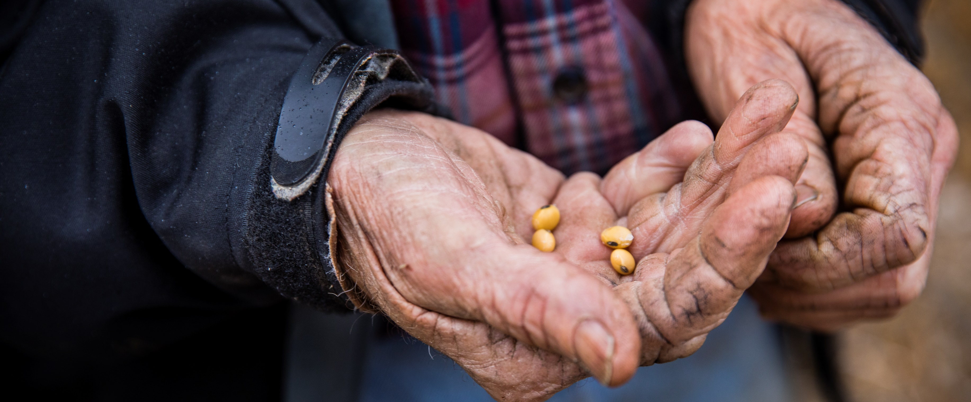
Your Story is Important
Telling a compelling story is an important step in transferring or accessing land.
Notes:
Your story is important. And to reach your goals, you’ll have to share who you are, what you want, and what you need with others in a way that is compelling to them.
For some, sharing your story can be energizing and exciting; for others, it can be daunting and nerve-wracking. In either case, it takes time, careful preparation and practice to present your vision, values and goals to help achieve your farm transfer goals.
Today we’ll walk through, creating a story from your values, vision, and goals and prepare to adapt your story based on who you are talking to. We’ll practice writing and saying your story to partners in the workshop.

Slide 9
Part 1: Create Your Story
“I dream of a world guided by a lens of stories rooted in the revelations of science and framed with an indigenous worldview – stories in which matter and spirit are both given voice.”
— Robin Wall Kimmerer, Braiding Sweet Grass
Notes:
Trainer Instructions:
You can choose a different quote here. Prepare for how you want to set your specific audience up for storytelling.

Slide 10
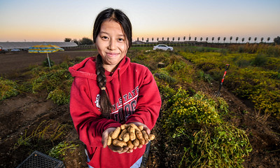
Key Elements to Create Your Story
Who you are
What you bring
What you want
What you need
Your ideal outcome
Notes:
"A story communicates fear, hope, and anxiety, and because we can feel it, we get the moral not just as a concept, but as a teaching of our hearts.
That’s the power of story.“-Marshall Ganz
Why is it important to tell your story? How does this relate to your farm/ranch goals?
(Option for group discussion here).
The storytelling process is one that can lead to remarkable clarity and synchronicity with each other. When you have two or more parties coming together to work toward a farm or ranch transfer – it’s important they can find commonalities, build empathy, and develop understanding of each other's visions, values, goals, wants, and needs.
If you are not used to promoting yourself, it will take some practice.
The first step is to pull together the core elements of your story:
Who you are – Not just your name and what you do, but what are your values and where do you come from. (Refer to the Values Information Sheet and Vision, Values and Goals Worksheet in Module 1)
What you bring – What are you bringing to the story? What are your assets? Assets are not necessarily financial. Consider your skills and connections as an asset you bring. Refer to Assets Inventory in Module 1)
What you want – What are your goals? (Refer to the SMART Goals Worksheet in Module 1)
What is your ideal outcome? : What is your vision for your farm or ranch?
What you need – Need may depend on who you are presenting to. You will eventually want to think about what you need from someone you are speaking directly to. (Refer to the Needs Assessment Worksheet in Module 1). You may also want to express some of the challenges you face in getting what you want, depending on the audience.
Authenticity is important; you have these tools to orient you – be yourself and own your story.

Slide 11
Practice Activity
Explore ways to tell your story
Write a Letter to Share your Story
Notes:
Trainer Instructions:
Give participants time to work on their letter using the Letter to the Land Worksheet.
Depending on who your participants are – give about 10-15 minutes for this activity.
For English language learners, or limited literacy learners – you could adapt this activity to be an interview where one person asks the other the questions in the worksheet. People can ask and answer in their preferred language and if they are comfortable, you could record them discussing so they have record of their work.
______________
The goal of this activity is to start creating and expressing your story by writing a letter. In this activity you can express anything you want to about your story. Think of it more as a brainstorming. Later, we’ll work on adapting your story to a more specific audience. After you have had a chance to write your letter, you will practice reading it out loud to a partner.

Slide 12
Practice Activity
Read Your Letter to a Partner
Line up in two lines facing each other
In pairs, take turns reading your letter.
Line shifts to change partners
Repeat
Notes:
Trainer Instructions:
The goal of this activity is to support participants to practice reading their letters (or saying their stories out loud) to partners in the class. The idea is for them to be able to read it at least twice. Depending on the size of the class and your audience, they may be able to read in multiple times.
Activity Instructions:
Line up in two lines facing each other. OR For virtual workshop plan random breakout rooms for pairs.
Decide who reads first then take turns reading your letter/story.
Once both partners have read their stories, the lines will shift so participants are facing new partners and repeat readings.

Slide 13
Break
Notes:
Trainer Instructions:
This is a good time to give participants a short break. Decide how long your break should be and give participants that time to step away.

Slide 14
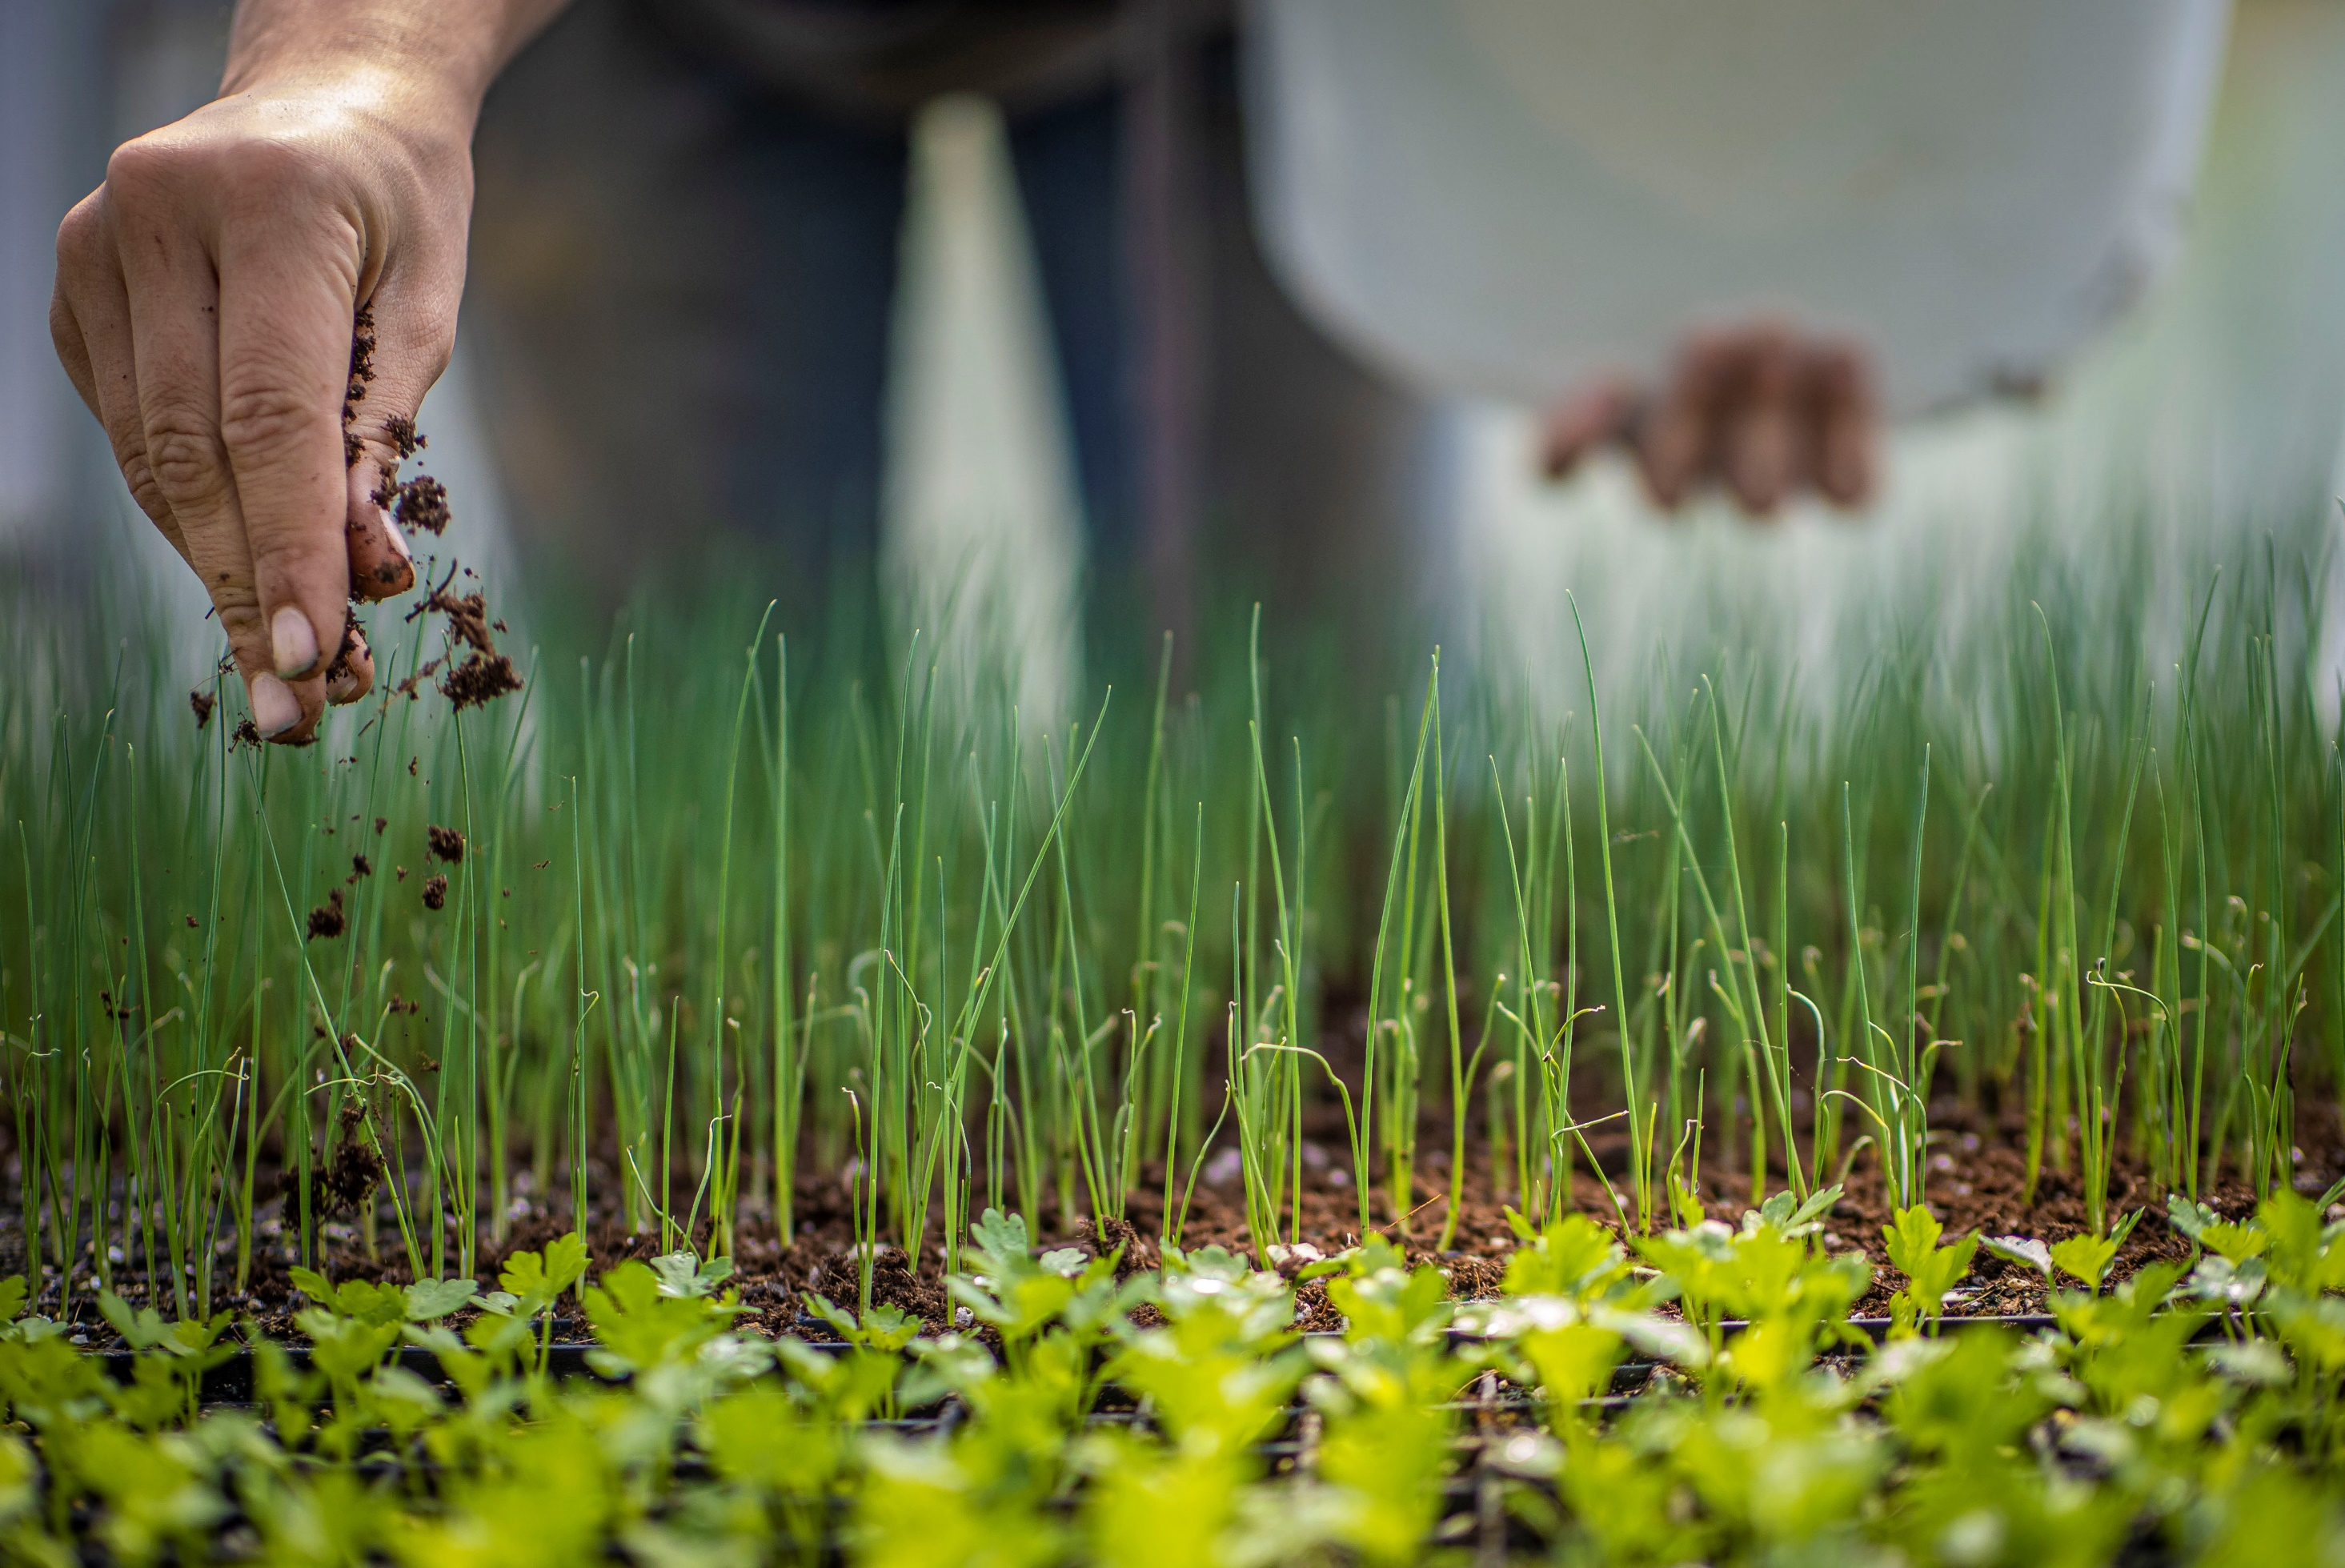
Part 2: Practice effective communication skills to tell your story.
Notes:
Effective communication will vary based on who you are talking to. Different people, situations, and cultures all have various factors that will determine how you can communicate most effectively. We’ll talk through some communication basics and think about the different scenarios you may be in during a transfer process. Then we’ll work to think about how you may refine your story based on who you are talking to.
Trainer Instructions:
Give examples of ways effective communication can be different in different scenarios.
You can also ask for input from the audience.
Different scenarios may include:
A conversation with a lender or investor
A conversation with a farmer or rancher who has been tended land they inherited
A conversation with a non-operating land-owner
A conversation with a land seeker.

Slide 15
Communication is a process of giving and receiving to share information and meaning.
We express a message.
We listen to learn and respond.
Repeat to understand and clarify.
Notes:
What is communications and why are we talking about it?
Communication is the process of exchanging information. It involves the person who is expressing themselves, the message or information they want to share, and the people who are listening and receiving their message.
The act of sharing information is expressing, the act of receiving the information is listening. The message is the information and meaning of what is said. In a healthy conversation, each person plays both roles.
This may sound simple, in truth it’s quite complex because communication is affected by so many things: Feelings, culture, power, generational preferences as well as the channels through which the message is shared: in the spoken word, as gestures, over email or a message, or around the kitchen table.
Effective communication skills take time to develop. Honing the skills you learn today will take practice for the rest of your lives. And while some conversations are hard, everyone can improve how they communicate to improve understanding and achieve positive outcomes.

Slide 16
What is Verbal Communication?
Informal conversations
Formal conversations
Formal writing (Business plan)
Casual writing (Social media, thank you letters)
The use of words, written or spoken
Notes:
We express ourselves in two main ways: through verbal and non-verbal communication.
The first, verbal communication, is the use of words to express message and meaning. Verbal communication includes the spoken and the written word. In the context of this workshop – verbal communication would be sharing your story with an audience. We’ve practiced both writing and speaking already today. In a farm or ranch transfer, you’ll likely practice all of these forms of verbal communication.
We adapt communication to both formal and informal situations. For example, we use verbal communication formally in meetings such as in talking to a lender, elected official, or reporter, and informally in personal conversations with family and friends.
We use it formally when we write letters, plans, and business agreements. And we use it informally—even casually in texts and social media posts.
Knowing when to use different types of communication will depend on who you are speaking with which we’ll talk more about later.
Trainer Instructions:
Optional Group Reflection: Would anyone like to share the different kinds of verbal communication you have or expect to have with your those involved in your transfer?

Slide 17
Verbal Communication Skills for Sharing Your Compelling Story
Choose the ideal channel.
Use simple, clear language.
Know what you want to say.
Proofread or practice and edit.
Notes:
Consider your audience and choose the ideal channel: It is important to think about your audience. What is their preferred means of communication? Is it appropriate for the message you want to give them? How you write a text or talk casually is very different from a letter and even more different from a press release, a formal presentation, or a farm or ranch business plan. Is the message simple or is it a difficult conversation?
What are channels? They are different ways we communicate - text, email, letters, social media, phone calls, kitchen table conversations. – It’s especially important to choose the ideal channel for who you are talking to and what you are talking about. The channel you choose, should reflect who you are writing or speaking to, why and what you are communicating. Some conversations may just need to be started with a written – but really are a request for something in person.
Know what you want to say: Map out what you want to say before you start writing or verbalizing your values, vision and goals. For more formal writing, it is a good idea to start with an outline that includes topic sentences for the main points you want to make. Whether sitting down one-on-one or presenting more formally, start with a bullet point list of the key information you need to convey.
Use Simple and Clear Language: Use simple, specific language and avoid jargon. Whenever possible use short, familiar words. Simplifying your language and being clear will support you in telling a compelling story. When you can, try to use active language. Active language puts you (the subject) in front of the action (the verb). For example – Passive language would say “The corn was harvested by me.” – Active language would say “I harvested the corn. Or I am harvesting the corn.”
Proofread or Practice and Edit: Good writing comes from good editing and revisions. No matter how skillful you are, edit and revise your work for simple language, active verbs, legibility and mistakes. Check for spelling or grammatical errors and don’t rely on spell check. Re read it to make sure before you send or share what you’ve written that it clearly and effectively communicates what you intend to say. With writing you have the opportunity to make sure what you write easy to read. Again, this depends on the channel: how you format writing for a web page is different from an email, a report or a plan. But in general, allow for white space, choose fonts that are simple and large enough to be easy to read.
If sharing verbally, practice, practice, practice! Follow your talking points and pay attention to how you tell your story. Are certain words or phrases tripping you up? Adjust them. If you need to have a more formal conversation, be sure to time yourself and revise your talking points if you are filling up too little or two much time.
Remember: You can always choose to share or delete. Timing is important for sharing written thoughts. You may also just want to write to process a difficult experience. You can always use writing to get something off your chest and then not send it. You can use this to remind yourself of your feelings later or delete it. Remember written words can be damaging if they are sent while someone is upset. Expressing frustrations in writing can be starting point for editing it once emotions have settled down. Writing can be an effective stress reliever and allow you to say things that may need more time for you to process. If you do decide to send it – pause, think, choose the right channel and timing, use simple language, and edit. This process may be helpful ahead of a difficult conversation as well.
Whether written or spoken expression, verbal communication to make progress in a farm / ranch transfers can take many forms and both take time to prepare.
From business plans to emails and social media – written expression gives you a chance to pause and think and edit what you want to say as well as an opportunity to process what you receive.
While verbal communication typically occurs in more “real-time,” the same skills can be applied to approach a conversation if you are prepared to present, to listen and to process.

Slide 18
What is Non-Verbal Communications?
Eye contact and facial expressions.
Greetings.
The use of body language
How we enter a space.
Notes:
The second way we communicate is through non-verbal communication. It is what is not being said in a situation and can sometimes be more informative of how a conversation is going. It’s both important in what you are expressing and what you are receiving from others. Bringing awareness to your own body language will help you be a more effective communicator. And learning to read other people’s body language will help you respond effectively.
It is important to remember that Non-Verbal Communication is very different based on your cultural background and gender. None are right or wrong but can be easily misinterpreted especially when people are coming from vastly different places.
Farmers and Ranchers are probably all experts in non-verbal communication whether it’s intentional or not. Think about rhythm and activities of farming. They are often silent. People often work alongside each other, or with animals, without a lot of talking. A lot of learning on farms and ranches happens by watching and observing without the use of words.
Trainer instructions:
Consider taking a moment of silence at some point in the discussion of non-verbal communication.
Optional group reflection: What kinds of nonverbal communications happen on a farm? What kinds of non-verbal communication do you expect to encounter in a farm or ranch transfer?
Examples: - Leaning into a conversation or away from it. Arms folded. Different facial expressions.

Slide 19
Non-Verbal Communication Tips for Sharing Your Compelling Story
Know your audience.
Pay attention to body language
Choose when and when not to make eye contact.
Bring awareness to facial expressions
Notes:
What role does body language, or non-verbal communications play? Here are a few thoughts to keep in mind as you prepare to share your story.
Know your audience. The nuances of body language affect different people, different cultures, different generations in different ways. How other people read your body language and how you read theirs is influenced by what you know about them and what they know about you. In a farm/ ranch transfer you may need to talk to an accountant. You may need to talk to family, or a land trust. Pay attention to who they are and how they respond to you from the first greeting on. If you don’t know what puts them at ease, mirror them.
Pay attention to body language. To observe your own, think about what you are saying through movement. This may be unconscious. Do you tend to nod or shake your head to indicate you’re listening? Do you gesture with your hands while you talk? How do you enter a room? Do you lean forward or tend to lean back in a conversation? You can watch for other’s to get a sense for how they are feeling in the situation. What is the other person’s body movement telling you? Do they lean toward or away from you when they speak? Do they sit up straight, or do they slouch?
Chose when to make eye contact. Eye contact is tricky because it means different things in different cultures and can be affected by age and gender. It also means different things in different conversations. Generally, it is a sign of confidence, honesty, and respect. For example, keeping eye contact in a conversation with a banker, will be seen positively. If a conversation has more conflict or charged emotions – too much eye contact can be seen as threatening or make people uncomfortable. Research has shown that eye contact builds bonds and empathy between people by activating the limbic mirror system in our brains. It’s good to know when to use it and when to look away. Making eye contact isn’t always easy. It can feel awkward especially if you don’t know the other person well. If it makes you uncomfortable, practice with someone you know.
Bring awareness to facial expressions. Facial expressions often are thought to be universally understood. While that may not be entirely true, most cultures share some basic facial expressions like surprise and happiness, anger and fear. Infants learn to read faces before spoken language, so it is really engrained in us to understand faces. Often our faces may say what our words cannot. Watching other’s facial expressions will help you understand how they might be feeling. At the same time, be aware of what your own face might be expressing.
How do we know that that person we are taking away what we want them to take away? Through their body language ? Through their questions/responses.
How do we know when someone is open and receptive to your ideas.
GIVE EXAMPLES OF engaged or not engaged?

Slide 20
Listening is the most powerful part of effective communication.
Be present
Pay attention
to meaning
Reflect back
what you hear
Notes:
Listening is the most powerful part of communication.
We have 2 ears and 1 mouth. ☺
Listening is the act of receiving information and one of the most important skills you can have. It gives you information and helps you understand what is important to another person. It also helps you prepare for to share your story, enter negotiations and can help avoid conflicts and misunderstandings.
Listening well involves three things:
Being Present: Really paying attention to what the other person is trying to say takes some focus and intention. To be present, quiet your own thoughts. Don’t start preparing a response until the other person has finished speaking. While listening to their words, also listen to the rhythm and tones they are using and their body language. You can show the speaker that you are listening by looking at them, nodding your head, keeping your body language open.
Listening For or Paying Attention to Understand Meaning: It also is important to listen for the meaning behind the words, for what the person is really trying to say. Listen for what they value, what they need and how they feel. In a farm/ranch transfer situation, listening for meaning may take many conversations and happen over years.
Reflecting Back What You Hear: Finally, reflect it back and clarify what you hear. You can summarize what you’ve heard by saying things like “Sounds like what you’re saying is….” or “What I hear you say is ... “ or “I like your idea to ... “ Ask them to clarify anything you don’t understand. The trick is not to add your own experience or judgement about their situation, but to listen to their experience.

Slide 21
Who defines effective communication ?
How do you receive information best?
How does someone communicate something effectively to you?
How do you communicate best?
Ask the same questions for how your audiences communicate.
Notes:
Practice Activity
Trainer Instructions:
Encourage participants to think about what is effective communication to them and what is effective to their audience(s). Ask them to give specific examples of verbal and non-verbal communications.
The goal is to give people an opportunity to embrace the fact that we all communicate differently and honor that people will approach communication differently. Encourage finding commonalities even when definitions of communication may be different.
Acknowledge that this process may be frustrating for people of color, for women, people with disabilities, people who are coming to farming with little experience and who traditionally have been left out of land ownership and capital opportunities. It can also be frustrating for people who may just communicate differently. “Effective” communication can be a place where people get frustrated and give up on pursuing their vision or continuing a negotiation. Allow for space to express those frustrations if they occur and focus back on the importance of participants’ authentic stories and finding commonalities in communication. Farming/ranching and the love of it – can be a good way to find commonalities and build empathy.
Popcorn discussion:
Use questions like:
How do you receive information best?
How does someone communicate something well to you?
How do you communicate best?
Based on your communication skills, how might someone else support you?
And now consider who your audience(s) may be
How might they receive information?
What might they consider effective?
How might they best communicate?

Slide 22
Part 3: Identify who you will tell your story to and why
How and where will you share your story?
Notes:
In Modules 2 and 3, we discussed people who have an interest or a stake in your farm transfer situation as well as the supportive team you will build to help you bring your vision to life. Their point of view, current situation, and relationship to you are all different and it’s important to understand whom you are telling your story as you prepare to do so.
Trainer Instructions:
In this Part 2, participants can follow along with their Prepare to Tell Your Story Worksheet.
At any point, in this section you can ask for audience input on their audience – who, why, what, where, when, and how.

Slide 23
WHO needs to understand your vision and goals and WHY?
Which of your key people?
Who on your team?
Landowners
Incoming farmer or rancher
Lenders
Business Partners
Family
Friends
Community Leaders
Lender
Attorney
Mediator
Consultants
Financial Advisor
Notes:
Your key relationship are the people who have a major interest—or stake—in your farm/ranch transfer. These could include the landowner(s) who hold the assets involved in the transfer, the incoming producer(s) who will acquire them, and other people affected by the situation: Family members, employees, vendors, maybe even neighbors or community members.
Your Team members are the people who can advise you and help you reach your goals, like an accountant or an attorney. You may have started Your Team Worksheet in Module 2.
Understanding who you are preparing to share your story with and why they are a key audience to communicate with is important. Who you are talking to will determine how and what you prepare. You may need to present your vision to a lender, or an organization who owns land. Or you may need to talk about your vision and goals with your family or a land holder in the community. If you are a landowner, you may need to share your vision to an and organization or lender, or an incoming producer– who may or may not be related to you.

Slide 24
WHAT do you need to know about your audience(s)?
● What do they know about you and your vision?
● What do they want or need?
● What is their generational and cultural Point of View.
Notes:
How you adapt your visions, values and goals is dependent on your audience.
What do you need to know about your audience?
What do they want or need?
What is their generational and cultural point of view.

Slide 25
WHERE, WHEN and HOW might you reach your audience(s)?
Determine what timeline you need.
Different communication channels require different preparation.
Where will you meet?
Notes:
Once you have narrowed in on you audience and what you understand of their knowledge and interests, you need to identify where, when and how you will plan to communicate with them.
As you better refine effectively reaching your audience, keep in mind any specific deadlines you need to hit. For instance, if you hope to have completed a transition by the start of the next growing season, you may have a different need in August than you do in February.
Based on audience preferences, and to make sure your advance your goals within the timeframe you need, you may have to prepare to use different types of communications channels. For example – websites, business plans, formal letters, phone calls, in-person meetings.
We’ll work more on this in the next in the workshop.

Slide 26
Practice Activity
Complete Pages 1 and 2 of the Prepare to Tell Your Story Worksheet
Notes:
Trainer Instructions:
Give participants time to fill out page 1 of the Prepare to Tell Your Story Worksheet. The goal of this section is to help them identify the audiences they may need conversations with, what they might know about them and ways they may want to communicate with them.
If there is time, you can open up for discussion and ideas among the group.
For English language learners or limited literacy learners, the table on page 1 may be overwhelming. You can adapt it to be a discussion and role-playing activity. You can provide examples of the types of “Who” may be involved. Discuss the “why” the “character” and the “values” then assign two students to have a conversation assuming the different roles.

Slide 27
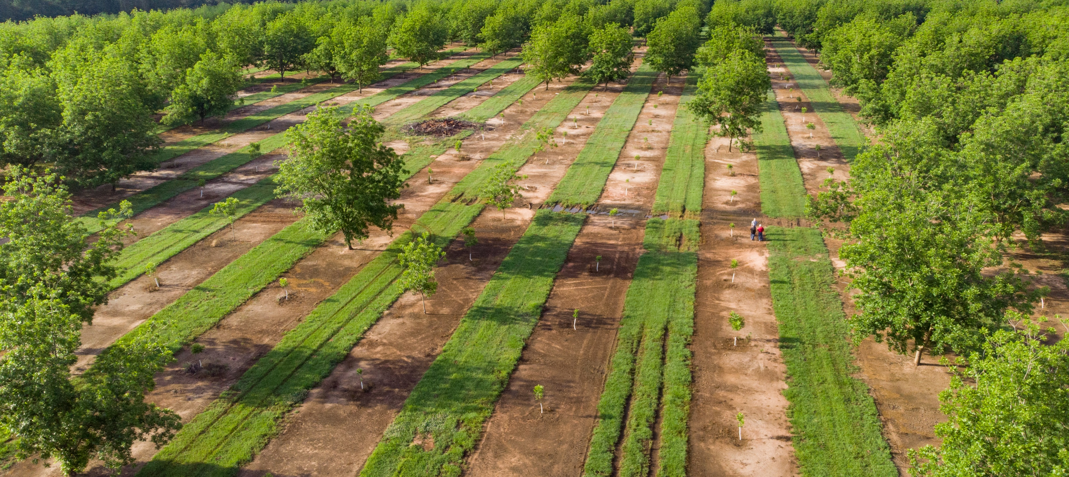
Part 4: Adapt Your Story to Different Audiences
To tell a compelling story
Notes:
Now that you’ve clarified your who needs to understand your values, visions and goals, along with considerations on how to prepare, now it’s time to consider and practice how to adapt and refine your story based on the specific audience or audiences you are trying to reach.

Slide 28
Adapting is refining, not changing
Focus
Audience
Inspire
Action towards goals
attention
Notes:
In the Prepare to Tell Your Story Worksheet. You thought about: Who are your audiences? Who needs to hear your story? And What do you know about them?
Whether it’s to a bank, community member, or family member, it’s important to be able to share your values, visions, goals and your story in a way that resonates with your audience while staying true to who you are.
Depending on your audience and the type of presentation you are making, you may have a minute or less, or have plenty of time to present the full picture. The elements of your story that you focus on or how you deliver your story might change with different audiences because of who they are but also because of what actions you want them to take.
Adapting how to you tell your story does not change your values, visions and goals for an audience but rather focuses their attention on the elements most important to the role that they will play in your farm or ranch transfer process.
Depending on who you are talking to, you may also want to bring a business plan, or image to focus their attention – especially if an action is time sensitive. This can help bring your vision to life and tell your story in a compelling way. (Remember the image activity we used at the beginning of this workshop).
As you think about adapting your story, think about what with inspire this particular person or people to give you the support you would like from them.
Trainer Instructions:
Optional: Provide an example – going to adapt an refine if talking to lender vs a family member, a neighbors vs. someone they don’t know.
Especially for people of color, women, and all people who have been excluded from land and capital opportunities – being their authentic selves can be sensitive if they have experienced discrimination. Based on your audience, consider how to acknowledge this and how to make space to verbalize these challenges

Slide 29
Inspire Your Audience with Compelling Communication
Understand your audience and what you want them to do.
Express your values, visions and goals clearly.
Engage from the start authentically.
Be yourself and share your passion.
Be open and honest about your vision and mission.
Keep it simple.
Listen for verbal and non-verbal responses.
Notes:
Trainer Instructions
Especially for people of color, women, and all people who have been excluded from land and capital opportunities – being their authentic selves can be sensitive if they have experienced discrimination. Based on your audience, consider how to acknowledge this and how to make space to verbalize these challenges.
______________
To inspire your audience toward action you will want to practice the effective communication skills we talked about earlier.
Good verbal skills; choosing the ideal channel, using simple language, knowing what you want to say, and proofing or practicing.
AND good nonverbal skills of; knowing your audience, being aware of body language, facial expressions and eye contact.
Those basic skills will help. But to inspire action you also want to be compelling to your specific audience. To achieve your goals, you will adapt your story and present it in a way that not only informs but also inspires.
In land transfer, you want to communicate to convince your audience to support your goals and take actions in alignment with your values and vision.
UNDERSTAND: As we learned earlier, you must start with understanding: Who is your audience and why are you presenting to them? What do you want from them? What do they want? How will your ideas satisfy their needs?
EXPRESS: Being yourself is critical. This can be one of the hardest parts depending on your comfort and the dynamics of a situation. It helps to start with a personal story that illustrates what you want your audience to take away from your conversation. The more passion you can show, the more you are likely to hold their attention. It may also help to use visual images because they trigger empathy in a way that words or facts and figures can’t. When you are presenting your ideas remember to keep it honest and positive. Enthusiasm and clarity will do you good. However you adapt your story, you must express your ideas clearly and simply. Simplicity will help your audience understand you and what you want them to do. So, try keep it simple and explain things clearly.
LISTEN: So much of communication is about what is heard. Listen so that your communication is responsive. Listen to what they are saying both in their words and in their body language.
Communication is not a one-way street; it’s a dialogue. While it’s important to prepare what you want to say, it’s equally important pay attention to your audience and be ready to receive feedback and questions.

Slide 30
Key Elements to Create Your Story
Who you are
What you bring
What you want
What you need
Your ideal outcome
Notes:
We are going to move into practicing refining your story to a specific audience. As a reminder – these are the key elements of your story. We practiced working through these in your letter to supporters. You can refer to what you already created here but this time, you will outline what you would like to say to a specific person or people. You’ve already identified various audiences, so now you will choose which one

Slide 31
Practice Communicating to Your Audience
Complete the Adapt Your Story Worksheet
Pair up with someone in class.
Describe your audience and setting or channel.
Use your outline to share your story to your partner.
Switch places and repeat.
After you both have finished, reflect on the skills each partner used well, and which they could improve upon if any.
(Use the Communication Skills Check List to discuss successful communication skills and areas of improvement).
Notes:
Application Activity
Trainer Instructions:
This activity should take about 30-45 minutes depending on your audience you may want to make more or less time.
______
Now that we have created stories, considered effective communication for different audiences, and discussed compelling communication strategies, you’re going to adapt your story to a specific audience that you need to have a conversation with..
First, Complete the Adapt Your Story Worksheet
Refer to the first page of Prepare to Tell Your Story Worksheet
Then we’ll practice again with a partner.
Pair up with someone in class.
Using the first page of the Worksheet, describe the audience you are imagining and the setting you would be in if you were presenting to them.
Use the outline you create to take about 3 minutes to present your story to your partner.
Listeners - use the Communication Skills Checklist on the back of the worksheet to remind you of the skills we’ve talked about today.
Switch places and repeat.
After you both have finished, reflect on the strategies each partner used well, and which they could improve upon if any. Use the Communication Skills Check List to take notes.

Slide 32
Wrap Up

Slide 33
Homework
Practice telling your story –with a friend or record and watch.
Refine your vision statement and talking points.
Complete the timeline and priorities on Prepare to Tell Your Story Worksheet
Notes:
This module prepared you to create and tell your story. These skills take time! Keep returning to the module worksheets and activities to keep practicing telling and owning your story. You may want to practice telling your story to different audiences.
For homework ideas:
Practice telling your story –with a friend or record and watch.
Refine your vision statement and talking points.
Complete the timeline at the end of the Prepare to Tell Your Story Worksheet

Slide 34
10 Key Steps in a Farm or Ranch Transfer
Assess finances.
Describe your values, vision, & goals.
Tell your story.
Create your support team.
Identify your needs.
Negotiate.
Choose which tools to use.
Identify and strengthen key relationships.
Finalize documents.
Outline and adapt your plan.
Notes:
The transfer process can take time – sometimes years. Be patient and continue to refine your story as you go.
As a reminder, here are series of steps in a farm or ranch transfer process. We have broken it down into 10 steps. You likely will take most if not all of them, but it is not a linear process, so while a certain amount of order makes sense, you likely will find you move forward and back several times before you are done.
Your story is an important part of this process. It can be a good place to come back to if you are getting frustrated with the pace or unknowns of the process. Reconnecting to why you are doing what you do can be good motivation to keep pursuing your vision.

Slide 35
**TRAINERS: Design this slide with information, such as:
Names and photos of presenters
Your logo and the logos of co-sponsors
Closing thoughts
Resources
Thank you
Notes:
Trainer Instructions:
Add your own closing notes.
Consider a casual networking time at the end of this workshop to give people time to socialize.

