Slide 1
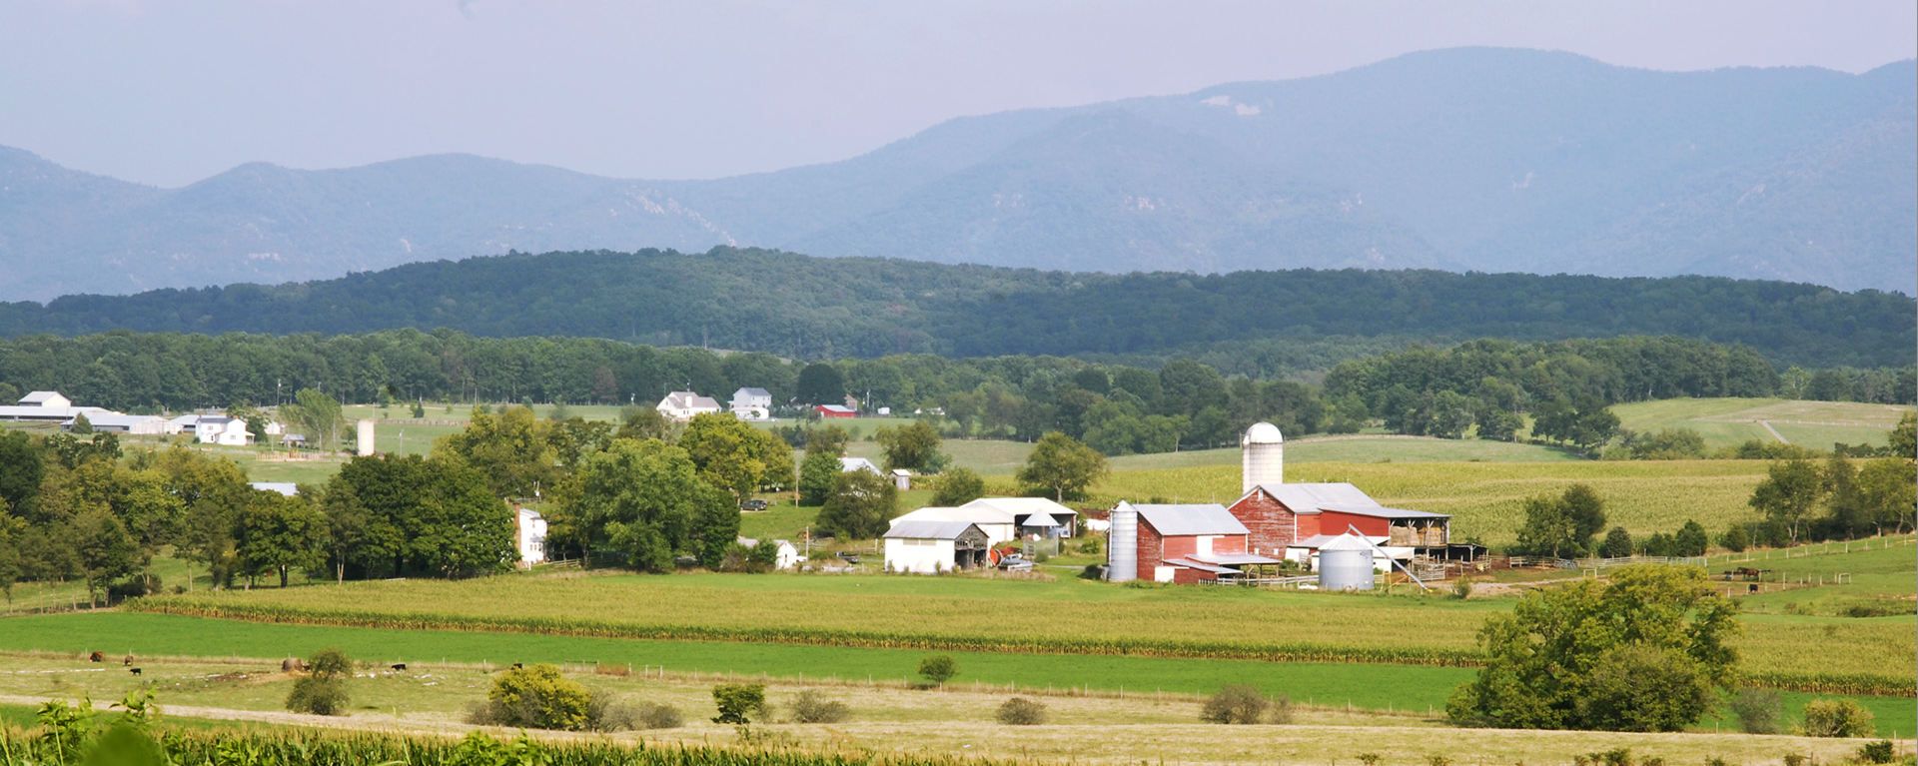
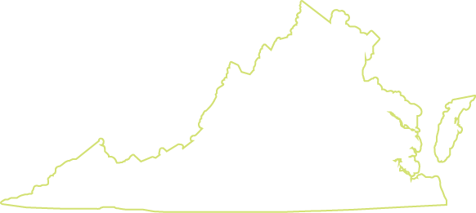
Planning for Agriculture in Virginia

Slide 2
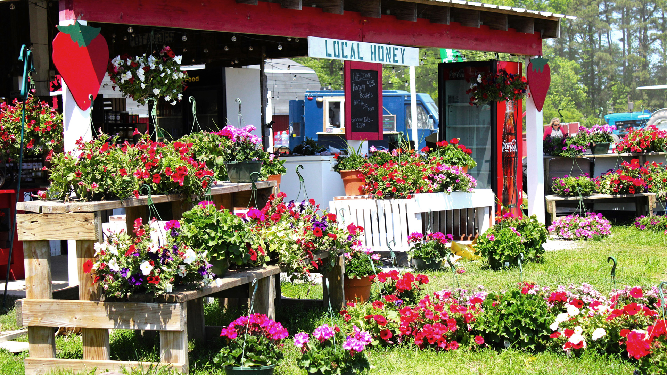
Agricultural Viability
Notes:
Farming is a cornerstone of Virginia’s economy. As the state’s largest private industry, agriculture contributes more than $82 billion per year in total economic impact—and more than $100 billion when combined with forestry.
Yet many farms and farmers are struggling economically. Virginia lost 18 percent of its farms between 2012 and 2022, according to the Census of Agriculture. The number of large farms increased while small and midsize operations declined, consistent with the national trend toward consolidation.
This trend is a concern given the many economic, environmental, and agricultural benefits that come with thriving agricultural communities.
To sustain these benefits, it is important for communities to meaningfully support agriculture by creating opportunities so that a diverse range of types and scales of agriculture can thrive. Below are several strategies, programs, and approaches that local governments can use to strengthen agricultural economies.

Slide 3
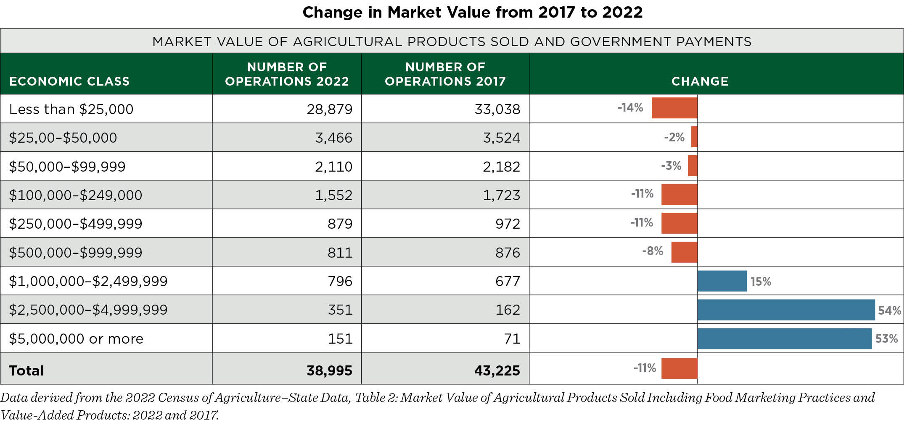
Notes:
As important as agriculture is to the Commonwealth, many small and mid-sized farms are struggling to survive.
This chart illustrates those struggles as farms with market value under $1 million all declined in number between the 2017 and 2022 Census’ of Agriculture while the very largest farms increased.
Farms in the $100,000 - $249,000 and $250,000 to $499,000 categories, and those with less than $25,000 in sales declined the most.
The farms that increased the most had market value of $2.5 or $5 million or more – increasing by 53% and 54% respectively.

Slide 4
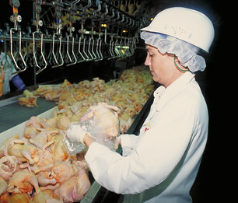
Agriculture & Forestry Industry Development Fund
Supports value-added processing and agribusiness development
Discretionary economic development incentive
Grants are awarded to towns and counties and have a match requirement
Four funding tracks: facility grants, planning grants, infrastructure grants, and blue catfish grants
Notes:
The Governor’s Agriculture and Forestry Industries Development Fund is a discretionary, performance-based economic development incentive specifically for agriculture and forestry value-added or processing projects.
Its purpose is to support agribusiness development at all scales, but it prioritizes controlled environment agriculture (indoor farming), meat processing, aquaculture and forestry, which have been identified as target growth opportunities.
According to the Virginia Department of Agriculture and Consumer Services, between 2012 and 2022, over $12 million of AFID grants were awarded to incentivize 125 projects to assist new and expanding Virginia companies that have committed to creating 4,065 jobs, generated $1,466,825,067 in capital investments, and facilitated the purchase of $1,434,416,595 of Virginia grown products.
Some AFID grants also support planning efforts to enhance the economic viability of agriculture and forestry.
AFID grants are awarded to a political subdivision—such as a town or county—for the benefit of a company or shared-use facility. Funding is awarded with a match requirement (generally 1:1) and based on the expectation that the grant is necessary to the success of the new or expanding facility and thus critical to supporting the local agricultural community.
The grant amount and terms are determined by the Secretary of Agriculture and Forestry and approved by the Governor.
AFID grants have four tracks:
“AFID Facility” grants incentivize new and expanding agribusinesses. The maximum grant allowed to any one project is capped at $500,000. In unique circumstances, this limit may be exceeded for projects that are determined to be of statewide or regional importance. Facility grants require localities to contribute a dollar for dollar (1:1) match in cash or in-kind.
“AFID Planning” grants support innovative local efforts to assist agriculture and forestry-based businesses and encourage local governments and the ag/forestry community to work together to integrate working land industries into community economic development activities. They can support planning for agriculture and the development of local policies and programs to support agriculture and protect farmland. A single locality can apply for up to $20,000 and a multi-locality applicant can apply for up to $35,000 per grant. Planning grants usually require a 1:1 match, but economically distressed localities may be eligible for a reduced 2:1 match.
“AFID Infrastructure” grants support large capital projects for community infrastructure that supports local food production and sustainable agriculture. The maximum award per grant is $50,000 and requires a 1:1 match. At least 50% of the match must be in cash and newly committed to the project. The rest may be in kind or composed of other funds. Localities are encouraged to work with small farmers, food producers, local food systems advocates, and others interested in building their community’s local food and farming infrastructure. They require an equal cash match from the locality, with reduced match available for economically distressed localities.
“AFID Blue Catfish” grants support the processing, flash freezing, and infrastructure of invasive blue catfish species. The maximum award is $250,000 and at least 50% of the total project costs must come from non-federal matching funds.

Slide 5
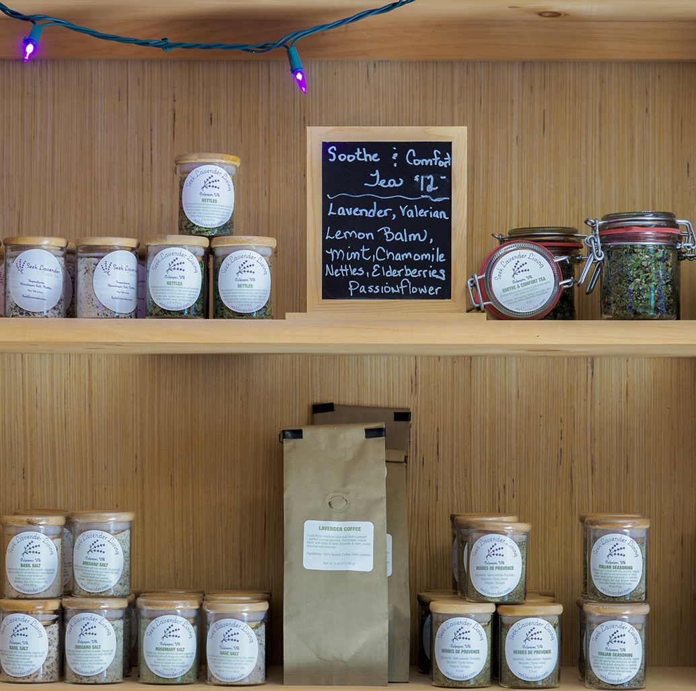
Agricultural Development and Marketing Support
Bolstering agriculture with market opportunities
VDACS Division of Marketing and Development
VA Food Access Investment Fund
Local government support
Notes:
Beyond the governor’s Agriculture and Forestry Industries Development Fund, the Virginia Department of Agriculture and Consumer Services helps producers identify appropriate markets for their products, both domestically and abroad.
VDACS’s Division of Marketing and Development serves producers, commodity boards and associations, retailers, and buyers through its field offices, which are located throughout the state, and overseas.
Its Office of Agriculture and Forestry Development has several programs to provide economic development assistance to farm, food, and forestry businesses, and maintains a list of financing resources for agribusinesses.
The Virginia Food Access Investment Fund awards grants to businesses and nonprofit organizations to expand access to fresh food in underserved communities. Local governments can consider encouraging entities and organizations in their area to apply.
Local governments can create their own agricultural economic development and marketing programs by creating guides to local farm products, establishing farmers’ markets, and investing in processing and distribution infrastructure.

Slide 6
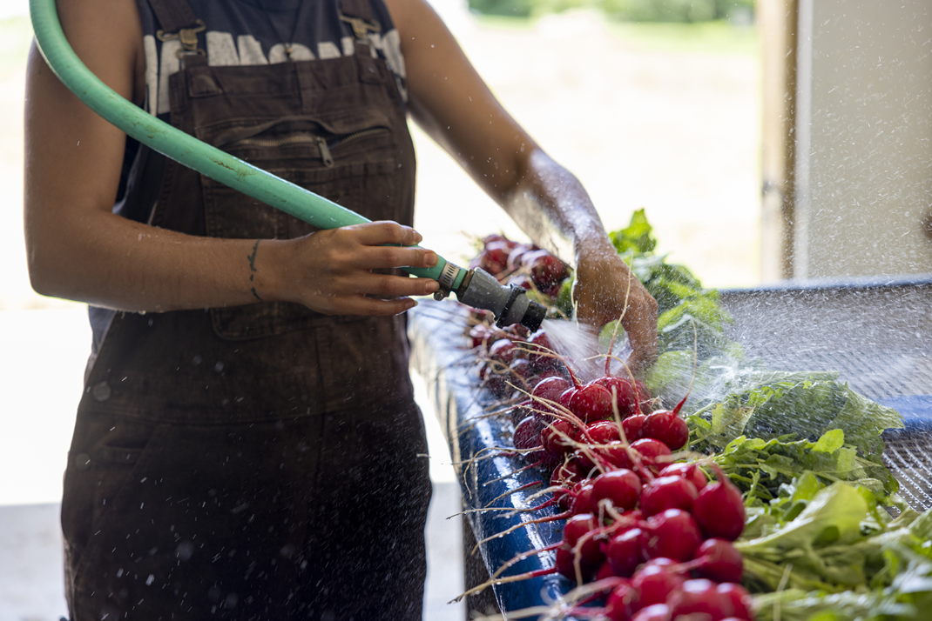
Community Food Processing
Protecting health and safety while expanding market opportunities for local farmers
Virginia’s food and drink law requires inspections and permits for food manufacturers, storage, and retail establishment
The AFID infrastructure program provides grants
Local governments and Boards of Health can pass zoning and other ordinances to support and licensing regulations to control
Notes:
Virginia has several state laws that govern food processing and community food facilities.
The Code of Virginia Chapter 51. Food and Drink Law requires inspections and permits for food manufacturers, food storage warehouses, and retail food
establishments.
Facilities that manufacture, process, pack, or hold food for sale must abide by Virginia’s Food Laws as well as local regulations such as zoning and licensing.
Virginia Department of Agriculture and Consumer Services (VDACS) AFID Infrastructure program provides grants to support community facilities like commercial kitchens, food hubs, and other value-added facilities (See Agriculture and Forestry Industry Development Grants fact sheet)
Code of Virginia, § 3.2-108.2 provides financial incentives and technical assistance to slaughter and meat-processing facilities.
Local governments and boards of health also can pass zoning and other ordinances to guide the development of community food and agriculture facilities.
The purpose of these laws and regulations is to protect health and safety while encouraging value-added processing, retail sales, and expanded market opportunities for Virginia grown food and agriculture products. They enhance economic opportunities and can improve quality of life in rural communities by financing, constructing, and inspecting facilities.

Slide 7
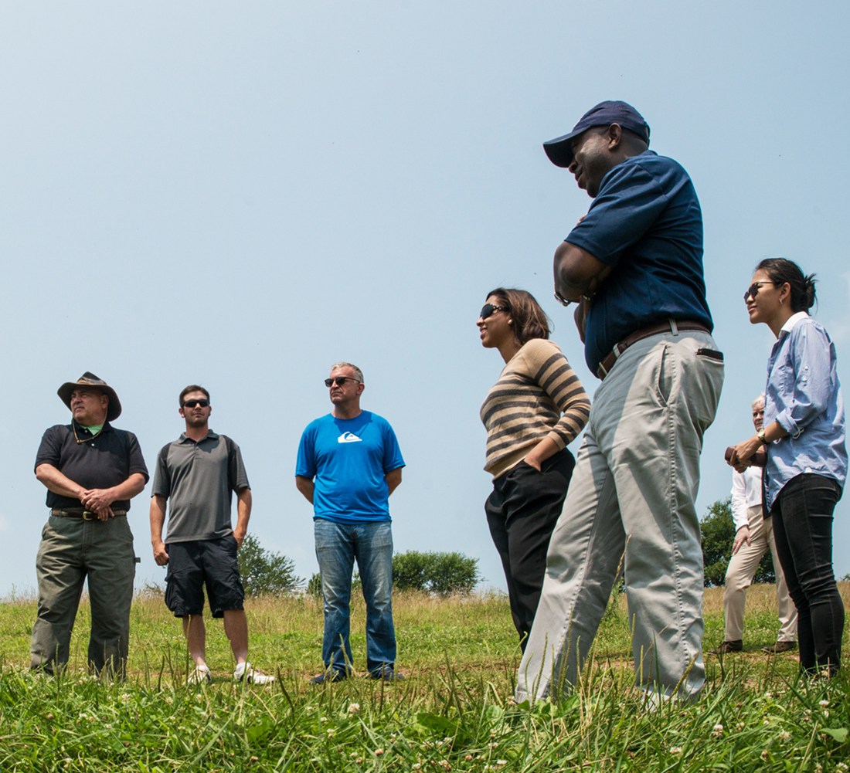
Agricultural Boards, Committees and Staff
Giving farmers a voice in local decisions
AFD Committees
Farm Bureau Committees
Agricultural collaboratives
Agricultural Development Staff
Notes:
There are several ways communities can give local farmers a voice in local decision making. They can form agricultural boards and committees, and they can hire development staff.
Virginia Code § 15.2-4304 requires local governments to establish agricultural and forestal district (AFD) advisory committees as soon as they receive their first application. AFD committees advise Boards of Supervisors and Planning Commissions on additions to, withdrawals from, and reviews of AFD districts. They landowners engaged in farming or forestal production, other local landowners, the commissioner of revenue or the local government’s chief property assessment officer, and a member of the local governing body.
Even without forming an agricultural and forestal district, boards of supervisors can create advisory boards, commissions, and committees to promote agriculture as an industry, develop and implement plans to sustain agriculture and rural economies, increase farm viability, and provide advice and recommendations to local governments on agricultural issues.
Some Virginia counties schedule regular meetings with representatives from different local government departments that touch or influence agriculture, sometimes calling these groups agriculture collaboratives. (See Fauquier County Agriculture Collaborative profile.)
Meeting regularly can create opportunities for frequent communication and minimize misunderstandings and missed opportunities.
Each community comprises their own agriculture collaboratives including departments and organizations such as Economic Development; Cooperative Extension; Soil and Water Conservation Districts; Planning and Zoning; Community Development; Environmental Services; Finance; Tourism; County Administration and so on.
Virginia Farm Bureau has volunteer advisory committees on about a dozen specific agricultural industries, like dairy, peanuts, and feed grains. Farm Bureau committees identify commodity-specific issues and make legislative recommendations to address their members’ concerns.
Communities can hire agricultural development officers—sometimes agricultural economic development directors to support the farming community. Some counties have dedicated funding to hire agricultural development staff to focus on agriculture-focused economic development opportunities. They help farmers apply for grants, host public engagement events, lead local marketing efforts, and more. (See the Grayson County Agriculture Economic Development Director profile.)
Communities can hire staff and establish agricultural boards and committees through local bylaws, codes, and ordinances. Generally, the Board of Supervisors will appoint committee members and may designate subcommittees. Specific departments may hire agricultural development officers, or the jurisdiction may create a new department focused on agricultural development.

Slide 8
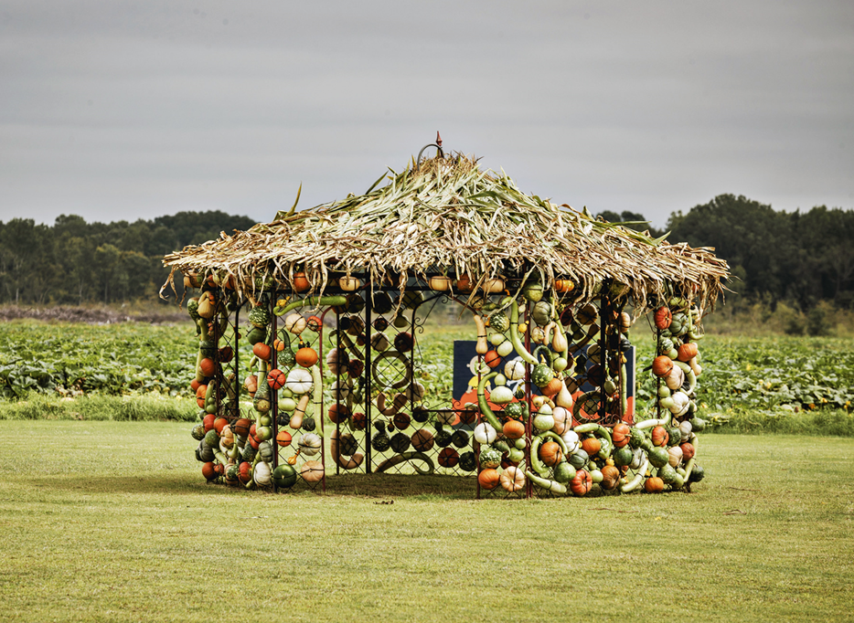
Agritourism
Creating opportunities for on-farm education and entertainment
Virginia defines agritourism as “any activity carried out on a farm or ranch that allows members of the general public, for recreational, entertainment, or educational purposes, to view or enjoy rural activities, including farming, wineries, ranching, horseback riding, historical, cultural, harvest-your-own activities, or natural activities and attractions.”
Notes:
Agritourism combines agricultural production with farm entertainment and/or education to attract visitors to the farm. Usually pursued to diversify farm income, it also stimulates rural tourism.
Virginia addresses agritourism in Virginia Code Chapter 64, defining it broadly to include “any activity carried out on a farm or ranch that allows members of the general public, for recreational, entertainment, or educational purposes, to view or enjoy rural activities, including farming, wineries, ranching, horseback riding, historical, cultural, harvest-your-own activities, or natural activities and attractions.
The Code of Virginia also limits liability on these operations and authorizes local governments to regulate agritourism activities that substantially affect public health, safety, and general welfare.
The law requires agritourism professionals to post visible warning signs, directional signs, and “off limit” areas to receive liability protection for injuries or deaths caused by inherent risks of agritourism activities.

Slide 9
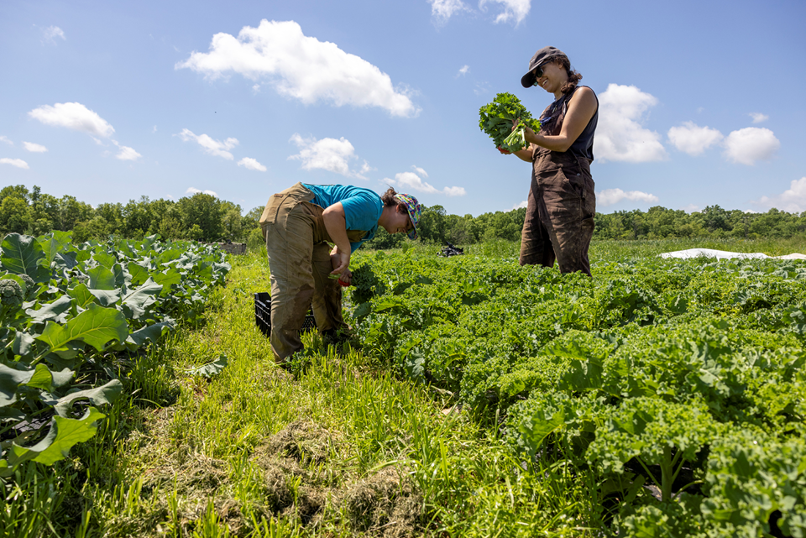
Farm Link
Connecting farmland seekers with farmland owners
Searchable farm listings website
Staff to provide information and assistance with leases, business plans, farm taxes, conservation, and more
Certified Farm Seeker program to give beginners a leg up
Notes:
Farm Link programs facilitate land access by connecting farmland seekers with retiring farmers and other farmland owners. Most provide a matchmaking website with a searchable database to facilitate connections. Some go further to include educational resources, mixers, mentoring, referrals, and technical assistance.
Virginia’s Farm Link is a program of the Virginia Department of Agriculture and Consumer Services.
Established in Virginia Code § 10.1-1119.4, it was authorized in 2008 to help facilitate transfers of agricultural properties and operations. It has a searchable, online database and provides staff to help prepare business plans and provide research and information on innovative farming methods and techniques, financial, marketing, and other matters.
The program is designed to help retiring farmers and landowners transfer their farms to beginning and expanding farmers who want to acquire land, equipment, and information on farming practices and farm business management.
It has a free website to link existing farm owners with farm seekers. The website offers a resources tab with relevant information on topics including farm leases, business planning, conservation, farm transition, resource providers, and so on. It also includes listings of upcoming workshops on topics ranging from filing farm taxes to farm equipment and safety to heirs’ property.
Based on feedback from users, in 2012, the program created a Certified Farm Seeker program to help farm seekers demonstrate their knowledge and skills to farm owners.
In partnership with Virginia Farm Bureau and the Virginia Beginning Farmer and Rancher Coalition, the CFS program helps seekers demonstrate that they have on-farm experience, a resume to show their experience level, and a farm business plan. While all seekers are free to use the site, CFS seekers display the CFS logo on their user profile, which gives them a leg up.

Slide 10

Farm to School Programs
Increasing local food in school cafeterias
Schools, distributors, and farmers work together to increase access to healthy, Virginia-grown food
Students learn about the seasonality of farm products and receive hands-on learning
Program promotes the benefits of protecting farmland, expands market opportunities, and boosts farm sales
Notes:
The Virginia Farm to School program promotes opportunities for schools, distributors, and growers to work together to increase the volume of and access to locally grown foods served in school cafeterias and dining halls at all levels of education.
It increases access to fresh, healthy, Virginia-grown food while providing hands-on learning opportunities in a variety of school settings.
Created to teach students about the seasonality of farm products, it promotes the importance of supporting local agriculture and the benefits of protecting farmland.
The program also expands market opportunities and boosts sales of local farm products. In school year 2022-2023, 88% of the state’s School Food Authorities participated in the program in at least some capacity.
According to the Virginia Department of Education, Farm to School has significantly increased the volume of locally grown food served in school cafeterias, providing farmers with a consistent market and raising awareness about the value of Virginia-grown products.
Farm to School programs are supported by Agriculture in the Classroom (AITC) through hands-on learning, AITC-designed lessons and resources, and educator training to support core subjects and uphold the Virginia Standards of Learning.

Slide 11
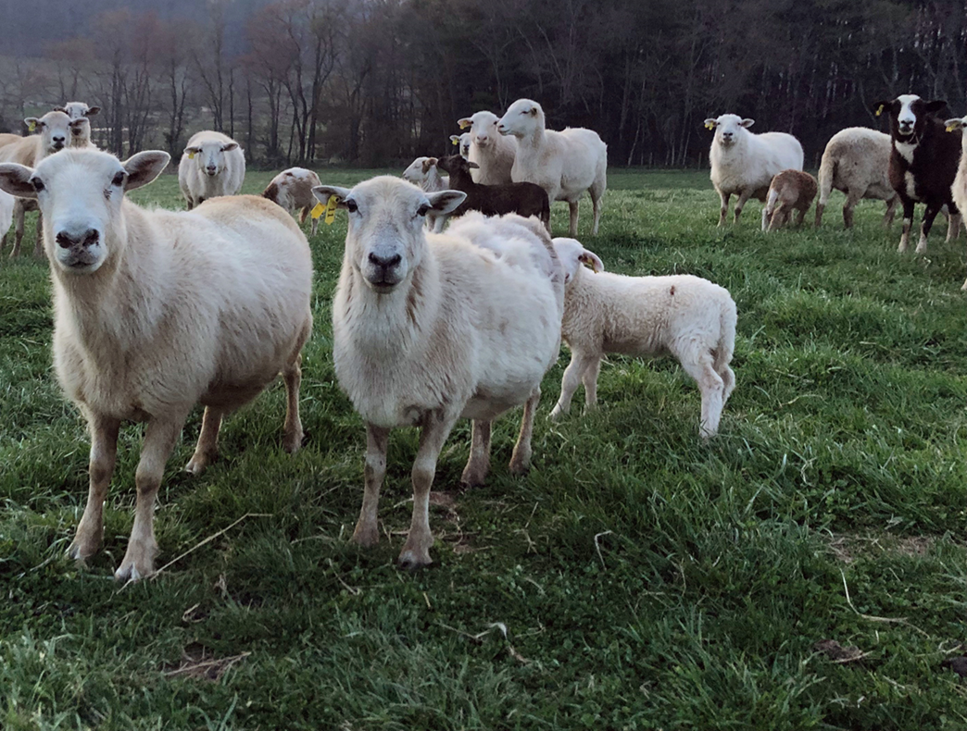
Right to Farm
Protecting farmers from frivolous nuisance suits
Virginia law protects farms in an agricultural district or zone which follow best management practices
It limits local government from enacting unreasonable zoning or other ordinances that restrict farming and
It limits who is authorized to file suit
Notes:
When new residents move into farming communities, they often do not expect the sounds, smells, noises, dust, insects and sprays that come with agriculture. Right-to-Farm laws protect established farmers from nuisance suits filed by neighbors who seek to stop or change farming operations.
Kansas enacted the first Right-to-Farm law in 1963 to protect feedlots from litigation. Today, every state has passed a Right-to-Farm law to protect qualifying farmers from lawsuits, nuisance complaints, and unreasonable regulations.
In Virginia the Right-to-Farm Act applies to agricultural operations located in an area zoned as an agricultural district or classification who are in “substantial compliance” with laws and regulations and who follow best agricultural management practices.
The Act limits local governments from enacting zoning or other ordinances that unreasonably restrict or regulate farming practices or structures in an agricultural district or classification unless such restrictions bear a relationship to the health, safety, and general welfare of its citizens.
Localities may adopt requirements like setbacks and minimum area requirements, so long as they do not unreasonably interfere with farming operations.
Recent amendments limit filing a nuisance suit to people with an ownership interest in the property and prevent suits from people who knew about the farm when their occupancy began.
If the agricultural operation is found liable, damages are limited to the reduction of the fair market value of the property of the person filing suit.

Slide 12
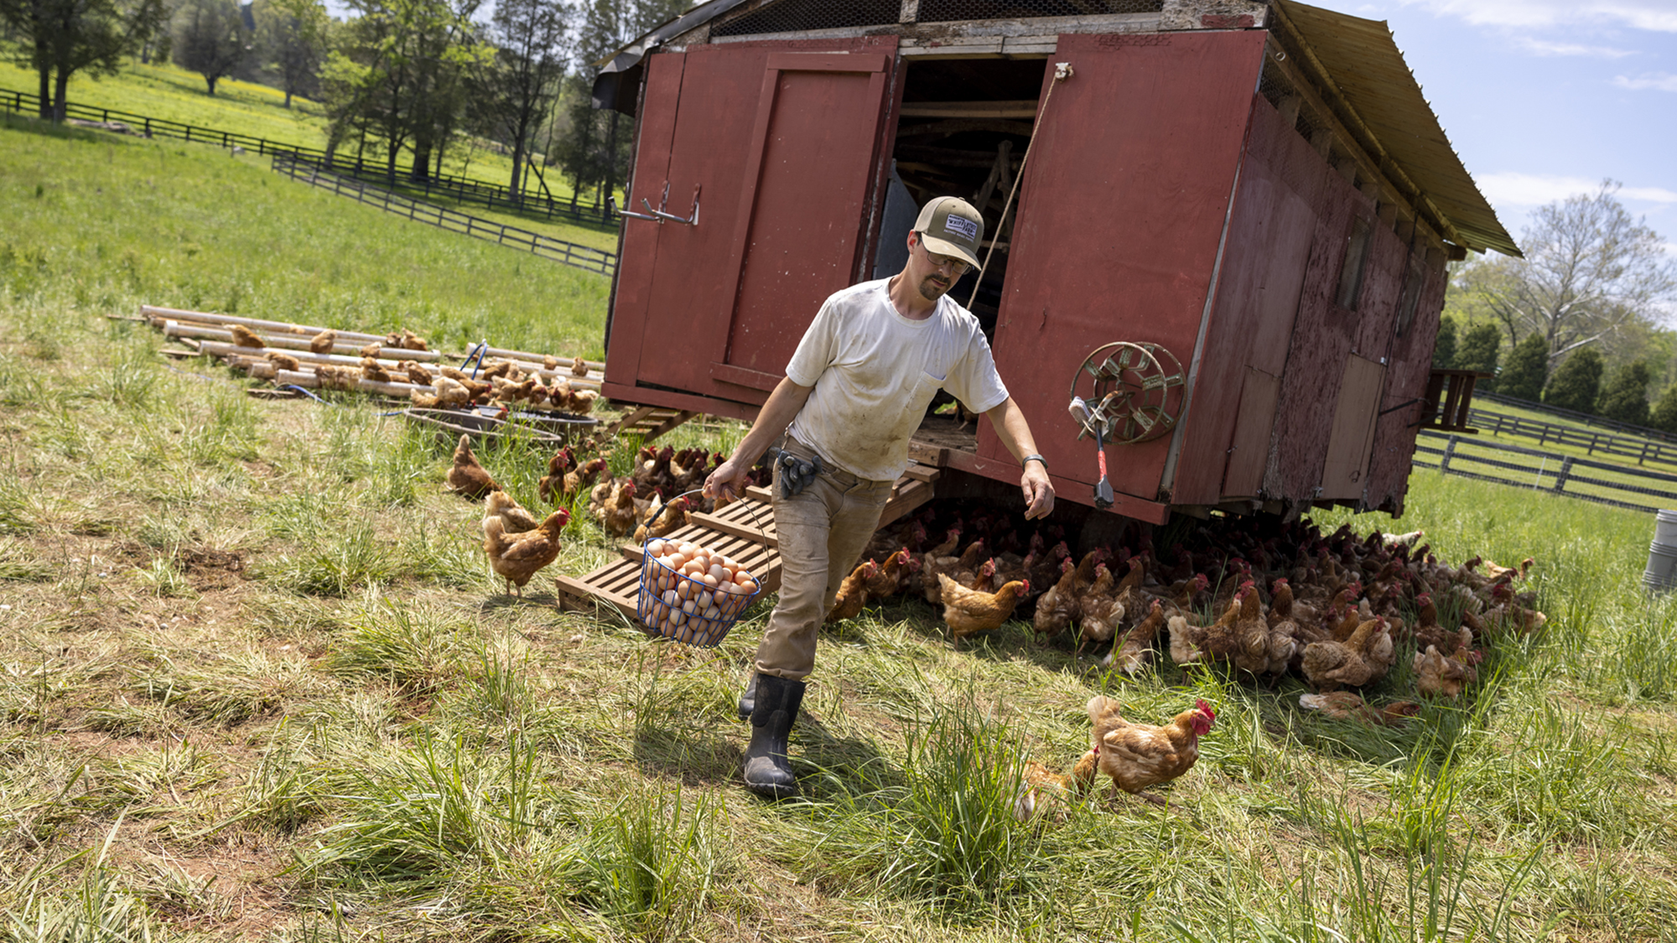
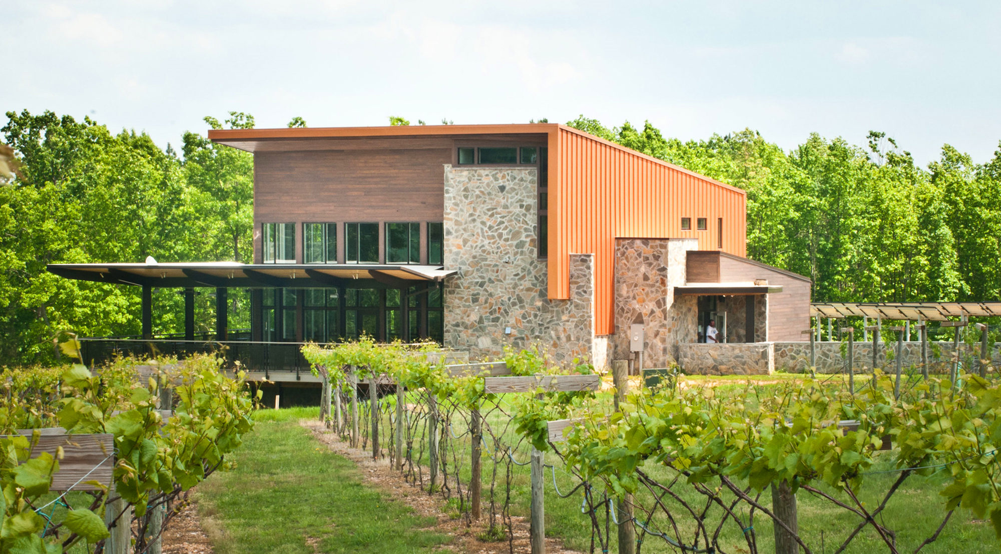
Zoning to Support Farms
Agritourism
Composting
Farm Labor Housing
Retail Marketing
Signage
Value Added Processing
Notes:
Zoning can be used to support farm enterprises and value-added activities. Ordinances define agricultural uses and can be used to determine whether activities like agritourism, commercial composting, farm stands, riding stables, wineries, or value-added processing are allowed by right or are considered accessory (subordinate to agriculture but related) or ancillary (unrelated). They also determine when uses are conditional and/or require special permitting.
Once defined, ordinances usually include performance standards to guide the appearance, intensity, scale, and scope of the built environment.
The Code of Virginia §3.2-640 defines a farm as land used for the production, cultivation, growing, harvesting, or processing of agricultural products. Agricultural products are broadly defined to include “livestock, aquaculture, poultry, horticultural, floricultural, viticulture, silvicultural, or other farm crops” but also include agritourism.
Given this definition, accessory uses would include marketing-related activities like value-added processing or a farm stand.
Agritourism is considered agriculture in the Commonwealth, but the Code of Virginia does not provide criteria to guide assessing its impacts. So, some communities have created zoning provisions to establish standards and/or to require special permits for certain types of activities.
Standards and permitting often are based on acreage requirements and number of attendees, and to address food trucks, vehicle trips, traffic, and other concerns related to health, safety, and general welfare.
Composting combines organic wastes in rows, piles, or vessels, and includes things like leaves and yard waste, manures, wood chips, and discarded food. Adding compost to the soil improves its fertility and has other environmental benefits. (See Composting Fact Sheet).
Some farms compost their own waste while others handle municipal leaves and other organic materials as a source of extra income. Zoning ordinances can address the size and scale of composting operations, determine what wastes can be composted, and create policies to mitigate odors and pests.
Commercial composting facilities generally are regulated by state as well as local governments because they have larger impacts and require plan approval and setbacks especially if in or near residential zones.
Local governments also may consider regulations to prevent stormwater runoff, and to screen large sites from public view.
Farm Labor Housing ordinances vary widely but generally are flexible so long as standards uphold public health and safety laws. They may allow mobile homes, cabins, or other temporary housing for seasonal workers, or allow building a second or third house on farm without triggering subdivision regulations.
Housing provided through the federal H2A program must meet state and local health and safety standards. If they don’t, federal standards are applied.
Employers are responsible for complying with applicable standards, including those that require cleaning.
On-Farm Energy Production: Wind turbines, solar arrays, and methane digesters supply farms with renewable energy and in some cases can be sold to utilities for additional income. By adapting roofs and other structures, ditches and other marginal land, they can augment farm income without undermining the farm’s purpose.
Utility-scale energy production, especially solar, requires significantly more land and is a more complex issue. Thus, zoning frequently allows energy production for agricultural use by right but is more restrictive about commercial installations (See Mitigating the Impacts of Solar Siting fact sheet).
Retail Marketing includes on-farm sales through farm stands, Community Supported Agriculture (CSA), and other forms of direct marketing, including things like famers’ markets in public spaces. Ordinances address the scale, scope, and seasonality of different types of operations, what kinds of products can be sold, and how much must be produced on the farm. They also address issues such as road setbacks, parking, lighting, and signage. These issues are especially important to address for year-round farm stores and CSAs, which require parking and infrastructure requirements to accommodate shoppers and farm-share pick up.
Farmers markets which occur in public spaces may be seasonal in a park or parking lot, or year-round in a permanent structure. Ordinances can assign how, when, and where these markets operate. Some communities have a straightforward permitting process and allow farmers’ markets by right across all or multiple zones. Others require a special permit and restrict them to commercial, mixed use, or other specified zones. Ordinances also may regulate signage, parking, and whether entertainment or the sale of local crafts are allowed.
Mobile markets operate like farmers markets on wheels, often serving communities with limited access to fresh, local food. Communities may have specific ordinances for these markets or simply extend farmers’ market regulations.Some ordinances dictate the size or grade of allowable vehicles, but usually they are allowed in parking lots of facilities with public access.
Value-Added Processing may occur on farm or in a community kitchen or incubator which provide shared use of processing equipment so farmers can add value to their products. These operations must comply with state and local health ordinances and sanitary regulations.
Wineries, Breweries, and Distilleries are another way farmers add value to their products. While producing and harvesting fruit and grains are considered agricultural, processing them into alcoholic beverages like wine, beer, and spirts are not. Instead, they are regulated under Virginia Code §4.1-206. Zoning determines which types of activities are allowed where, whether by-right, and if they require a special permit.
Signage takes many forms. Zoning can address both permanent and seasonal signs and billboards to promote the location of local farms. Setbacks may be required, especially for permanent signs. Ordinances usually define their size and placement, what materials can be used and how much illumination—if any—is allowed.

