Slide 1
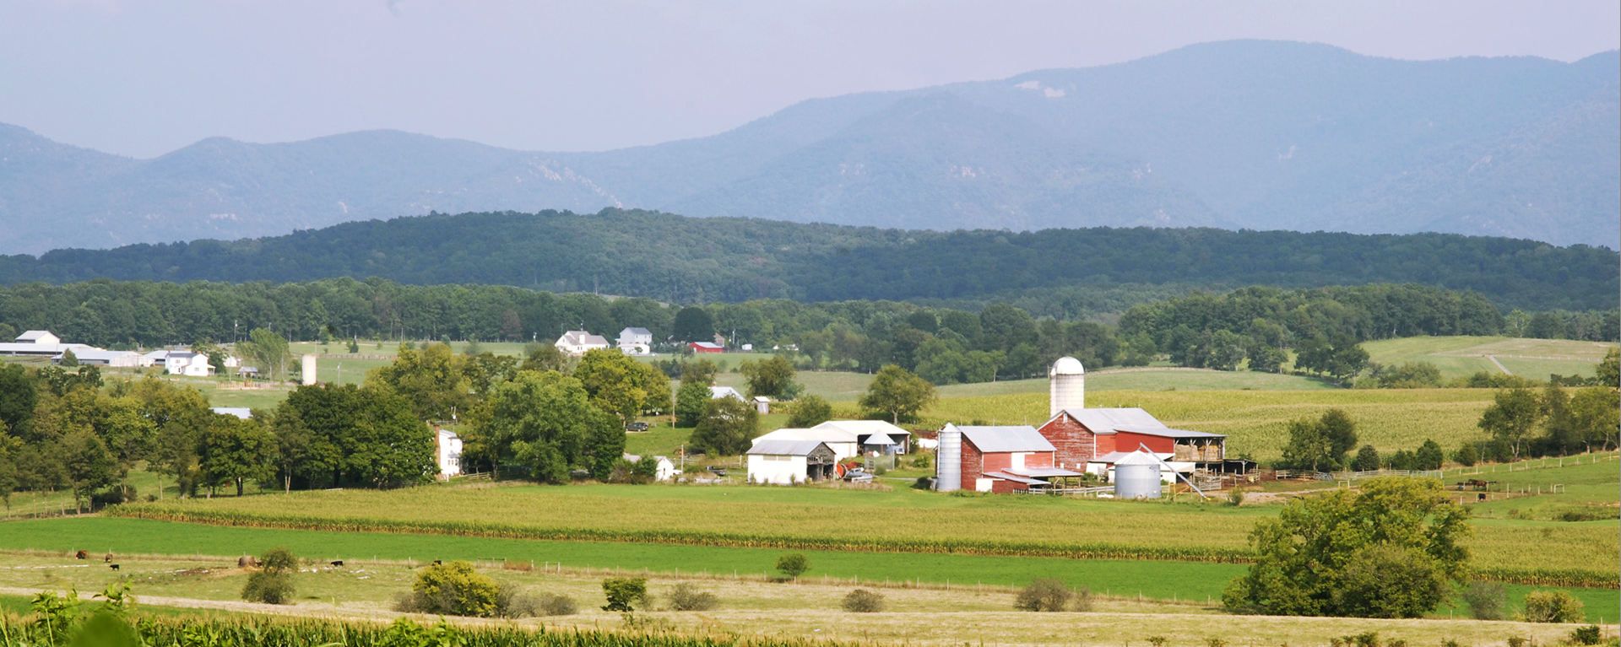
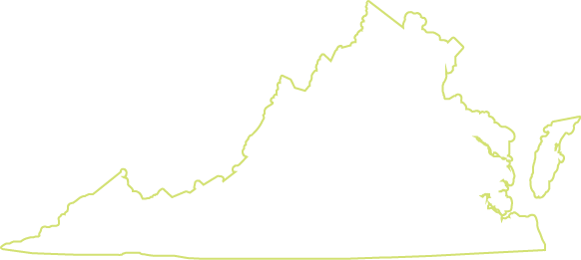
Planning for Agriculture in Virginia

Slide 2
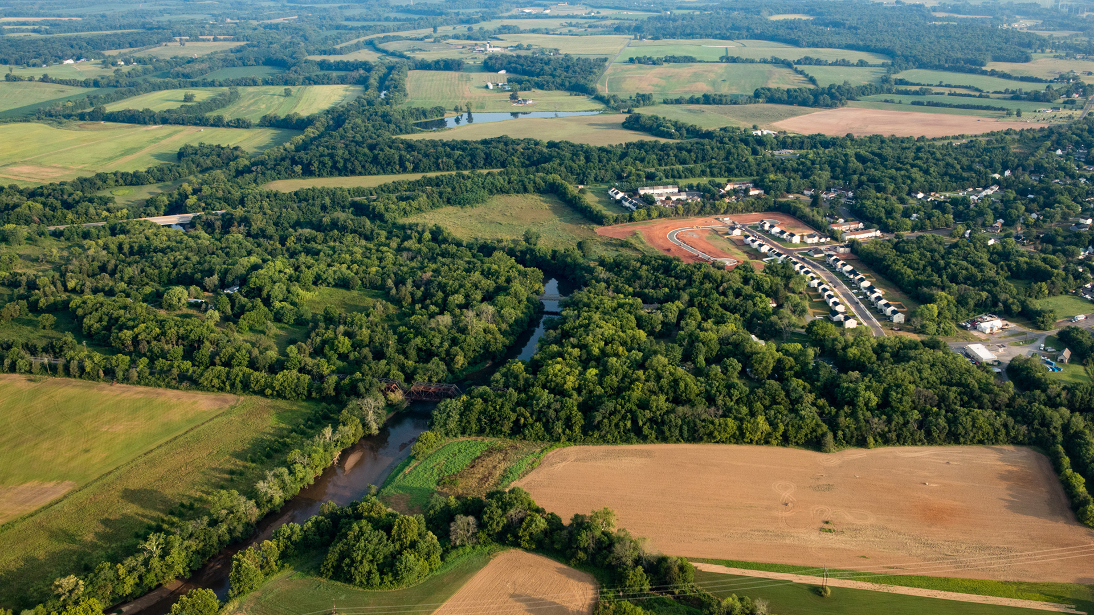
Farmland Protection & Thoughtful Growth
Notes:
Virginia’s farmland is under threat. Between 2001 and 2016, 340,000 acres of Virginia’s farmland were converted to development—enough land to generate $164 million in annual agricultural revenue. Nearly a third of this land was “Nationally Significant,” meaning it was the highest quality farmland in the nation.
Most of the farmland loss came from sporadic, low-density residential development. While not always immediately visible, extensive low-density development can lead to suburbanization over time, making agriculture less viable. Building on AFT’s Farms Under Threat analyses, it projects that 50 counties (or county-equivalents) could lose more than 10 percent of their farmland by 2040—with 18 counties projected to lose more than 10,000 acres each.
By protecting farmland and pursuing thoughtful growth, communities can retain productive farmland while accommodating other public needs, like affordable housing, efficient transportation, and renewable energy. The series of strategies and policies that follow offer various ways that local leaders can ensure a future agriculture by retaining and protecting their farmland base.
The first set of tools is related to protecting farmland for farming.
The second set is related to thoughtful growth.

Slide 3
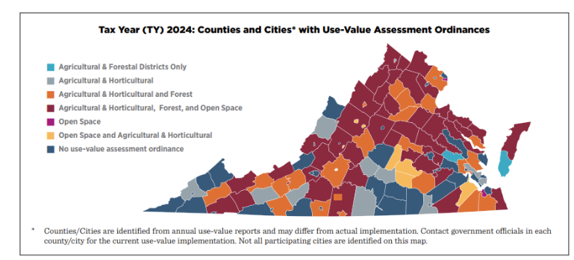
Use-Value Assessment
Taxes farmland as farmland
Local governments may choose to assess agricultural, horticultural, forestry, and open space at current use value–instead of potential use for development
If there is a change to non-qualifying use, enrolled land may be assessed roll-back taxes and penalties
Eligibility requirements include:
5 consecutive years of qualifying use
5 acres excluding a 1-acre house site
Land used for hay, grain, crops, or pasture and minimum numbers for livestock and poultry
Notes:
Virginia’s Use Assessment program is intended to ensure a reliable supply of agricultural, horticultural, and forest products, while also preserving open spaces.
The Code of Virginia § 58.1-3230 - § 58.1-3244 allows any county, city, or town which has adopted a land-use plan to assess four categories of eligible land at its current use value, including agricultural, horticultural, forestry, and open space. Unlike many of the other 48 states with similar programs, adopting use-value taxation is voluntary and the locality does not have to adopt all four categories.
If a jurisdiction does not have a program, land enrolled in an agricultural or forestal district still may qualify.
Established in 1972, every year Virginia’s State Land Evaluation Advisory Council provides localities with suggested tax rates for each of these categories. SLEAC contracts with the Department of Agricultural and Applied Economics at Virginia Tech to develop assessment estimates of land in agricultural and horticultural uses. Once approved, these become the state’s recommended estimates for commissioners and assessors to use in their programs.
To qualify for the program, land must meet eligibility requirements, including:
Being devoted to a qualifying use for at least five consecutive years
Being at least five acres, excluding a one-acre house site
Being used for hay, grain, crops, or pasture
If used for pasture, having a minimum number of livestock, such as one head of cattle per five acres, or five swine or sheep per five acres, or 66 turkeys or 100 chickens per five acres
If there is a change in acreage or to a nonqualifying use, land enrolled in a use-value program may be assessed roll-back taxes and penalties.

Slide 4
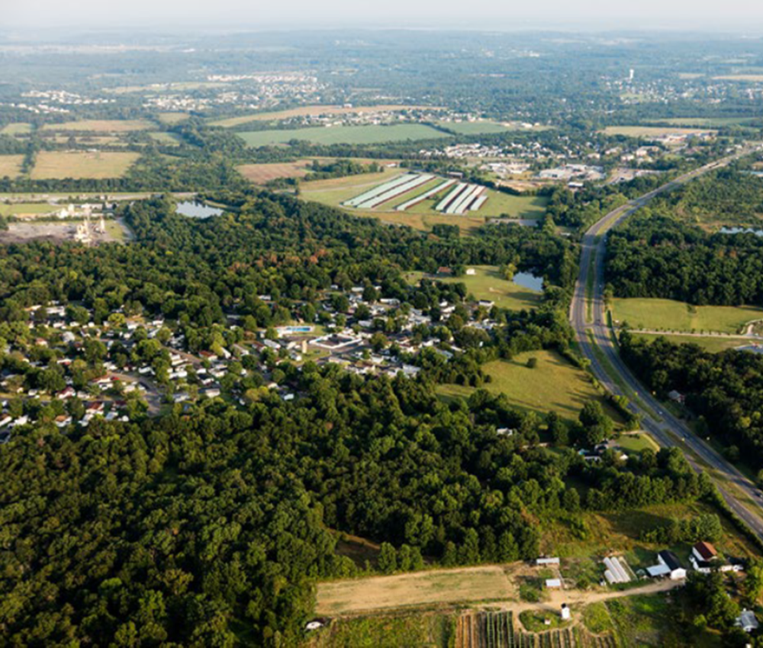
Agricultural and Forestal Districts
Incentivize conserving, protecting, and improving Virginia’s working lands
Eligible landowners elect to enroll land for 4 – 10 years with an option to renew
In exchange, they receive use value assessment and protection from eminent domain
They also are protected from local laws that unreasonably restrict their operations
Notes:
The Virginia General Assembly passed the Agricultural and Forestal Districts Act in 1977 to conserve, protect, and improve the state’s working lands to produce food and other farm and forest products, and to conserve and protect them as valued natural and ecological resources.
It is a voluntary, incentive-based response to development pressure. One of the main incentives is use value assessment allowing land to be taxed at its current agricultural value not its potential value for development. Others include protection from eminent domain and from local laws that unreasonably restrict agricultural (and forestal) operations.
Eligible landowners may enroll some – or all – of their land for between four and 10 years. They can renew their enrollment at the end of the term. They also may add parcels to an existing district at any time by following the process for creating a new district.
Once enrolled, subdivision is only allowed to provide for more intensive farm or forestal production, or to provide dwellings for immediate family and/or anyone who earns a substantial part of their income from their operation.
Local governments may review their districts and—with the recommendations of the local advisory committee and the planning commission—determine whether to terminate, modify or continue the district.

Slide 5
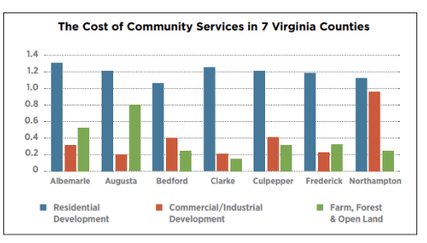
Cost of Community Services Studies
Find Farm, Forest and Open Lands Help Balance Community Coffers
On average, across 7 Virginia counties
Farm, Forest and Open lands received 42¢ of public services for every $1 paid in taxes and fees
Residential land uses received $1.20 of public services for every $1 paid in taxes and fees
Like commercial and industrial land uses, local revenues from working and open lands help offset the cost of services to residential development
Notes:
Cost of Community Services (COCS) studies are a case study approach used to determine the fiscal contribution of local land uses. They are a snapshot in time of a local government’s costs versus revenues for major land uses over the course of a recent tax year. COCS studies provide a baseline of current information to help local officials make informed land use and policy decisions, especially in communities where farmland is a significant land use, but which lack the resources to conduct a large fiscal impact analysis.
Unlike typical fiscal analyses, they assess farmland and other working and open lands along with residential, commercial, and industrial development. They do not predict the impact of future growth.
Seven county COCS studies in Virginia all found the same thing: farmland, forestal land and open space contribute more tax revenues than they receive back in public services—including land enrolled in Use Assessment programs. As the chart on the slide illustrates, working and open lands contribute in a similar way to commercial and industrial development. Residential development always demands more in services than it contributes in tax and other revenues.
They are a good justification for Use Assessment and other farmland protection programs.

Slide 6
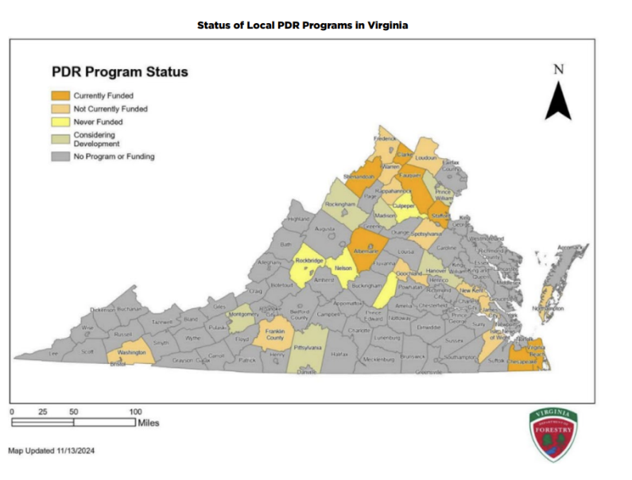
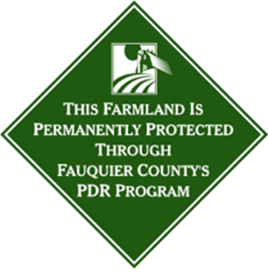
Purchase of Development Rights
Protect farmland for farming forever
Programs pay willing landowners to limit development on farmland
Virginia’s program is administered through the Office of Working Lands in the Department of Forestry
Local governments must create a PDR ordinance or resolution and provide a 1:1 match to access state funds
Notes:
Purchase of Development Rights (PDR) programs protect farmland for farming forever. Based on the principle that private property rights can be donated, transferred, limited, and/or sold, PDR programs pay willing landowners to restrict non-farm development on their land.
They achieve this by using an agricultural conservation easement—a voluntary and flexible legal agreement. In some states, these programs are called Purchase of Agricultural Conservation Easements or PACE.
In 2001, Virginia created the Office of Farmland Preservation to help local governments develop PDR programs to protect farmland and the agricultural industry by retaining a critical mass of farmland parcels that comprise economically viable farming operations.
In 2008, the program expanded to create the Farmland Preservation Fund, which allocates state matching funds to local PDR programs.
In 2024, the Office of Farmland Preservation was moved to the Department of Forestry, merging with DOF’s existing easement program and creating the Office of Working Lands.
To apply, localities must codify a PDR program by ordinance or resolution. The Office of Working Lands reviews their proposals to ensure they meet state guidelines. Guidelines include providing information on project ranking, monitoring and stewardship, and education and outreach, among other things.
Additionally, the Farmland Preservation Fund requires a 1:1 match from the locality to access state funds.

Slide 7
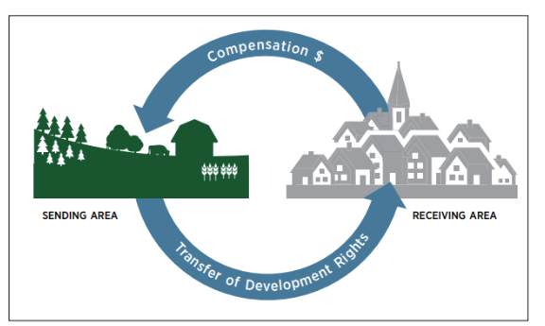
Transfer of Development Rights
Market incentives to protect farmland and promote thoughtful growth
Developers pay willing landowners to limit development on farmland in exchange for the right to build at higher density in areas where development is preferred
Once established, sending area restrictions are binding to current and future landowners, protecting the land in perpetuity
Notes:
Transfer of development rights (TDR) programs create market incentives to shift development from designated “sending areas” to “receiving areas” where increased development is preferred.
They compensate landowners who sell development rights on farmland in the sending areas and offer incentives to developers to build in receiving areas. Incentives typically include things like density bonuses, reduced parking requirements, or regulatory flexibility.
Virginia enacted its law in 2006. Directed primarily at local zoning, it allows county-city relationships as long as local governments approve it.
Landowners who sell rights may use them to build at a higher density in the receiving area or sell them to a developer to use in the receiving area.
Once established, sending area restrictions are binding to both current and future landowners, protecting the land in perpetuity
Local governments must give notice and hold a public hearing before adopting or amending a TDR ordinance. Ordinances must identify sending and receiving areas with a map or other description, indicate the minimum acreage and reduction in density of the sending property, and assess the infrastructure in the receiving area.

Slide 8
Comprehensive Plans
Promote public health and safety and prepare communities for future needs
Comp Plans:
Analyze trends and conditions
Provide a long-term vision to guide physical development and transportation
Serve as the foundation for local policies like zoning
Notes:
In Virginia, comprehensive land use plans are a legally mandated, long-range policy document each local government creates to promote public health and safety and prepare for future needs. Local governments must adopt Comp Plans, review them, and potentially update them every five years.
Comp plans outline the future vision, goals, and strategies for community growth and development, guiding decisions on land use, housing, infrastructure, and resource preservation. They direct “a coordinated, adjusted, and harmonious development of the territory which will, in accordance with present and probable future needs and resources, best promote the health, safety, morals, order, convenience, prosperity and general welfare of the inhabitants, including the elderly and persons with disabilities.” They can be a useful tool for promoting agriculture and protecting farmland.
Plans include analyses of conditions and trends, provide a long-term vision for the community, and can include more-detailed ordinances that define, direct, and regulate acceptable land uses. The foundation for local policies like zoning and subdivision ordinances so long as they are consistent with overall state law.

Slide 9
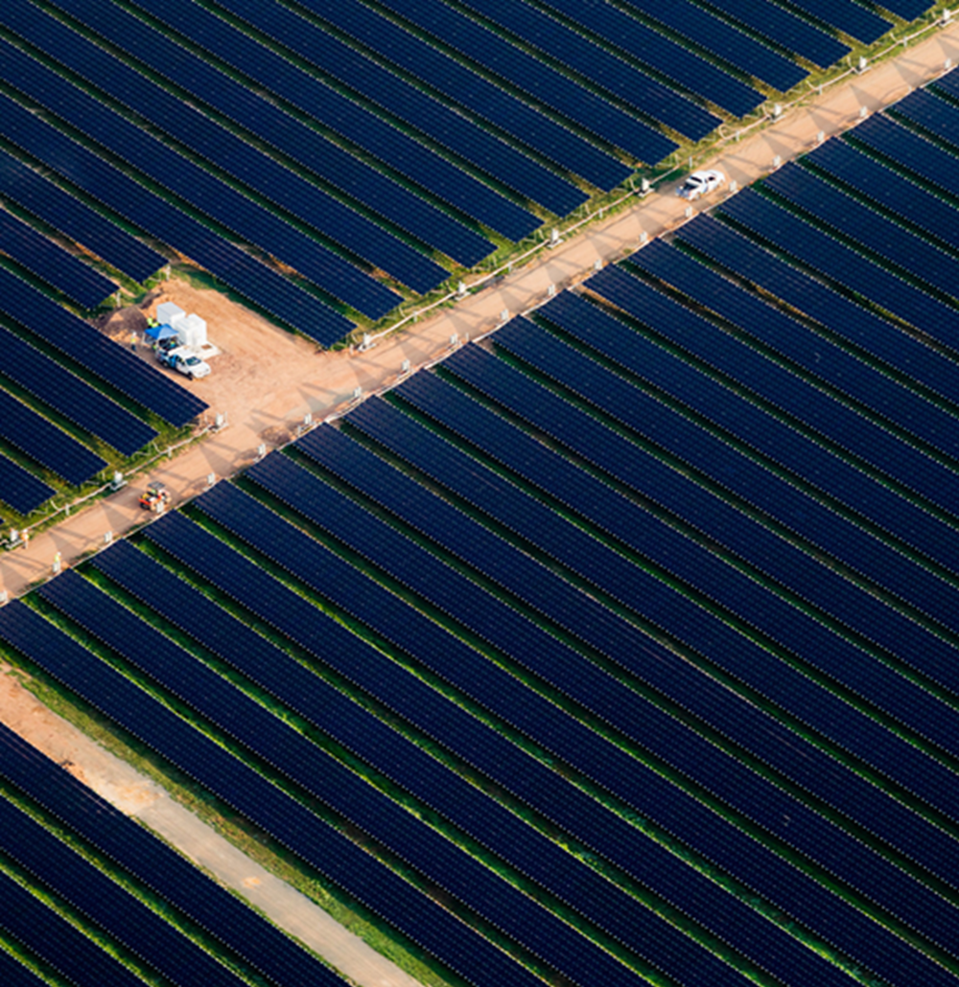
Addressing Utility Solar Siting on Farmland
By requiring mitigation plans
Since 2016, ~40% of Virginia’s utility-scale solar construction occurred on farmland
To lessen the impacts, mitigation plans are required for projects that disrupt more than 10 acres of prime farmland
DEQ is developing regulations to implement these requirements
Notes:
Virginia is among the top 10 states in solar energy production. Most of the boom involves land-based arrays often developed on prime farmland, which tends to be flat, unshaded, well-drained, and close to existing grid infrastructure. Research from Virginia Commonwealth University shows that since 2016, around 40% of Virginia’s utility-scale solar construction occurred on farmland. In response, Virginia is one of a few states working to mitigate the impacts of utility-scale solar development on agriculture.
Virginia Executive Order Forty-Three set goals for renewable energy production. It was followed by the Virginia Clean Economy Act (VCEA) which amended state regulation of electric utilities to reduce carbon emissions. The VCEA established a mandatory renewable portfolio standard which is driving the creation of new solar arrays.
Subsequently, House Bill 206 passed to address the impacts of these new policies. It requires a mitigation plan for energy projects that the Department of Environmental Quality (DEQ) determines will have a significant adverse impact on natural and historic resources including arrays that disrupt more than 10 acres of prime agricultural soils. DEQ is developing regulations to implement these requirements.
The goals of Executive Order Forty-Three and the VCEA are to power 100% of Virginia’s electric system with renewable energy sources by 2050. House Bill 206 seeks to mitigate significantly adverse impacts these may have on natural and historic resources. Combined, these pieces of legislation are meant to advance renewable energy in a sustainable and responsible way.

Slide 10
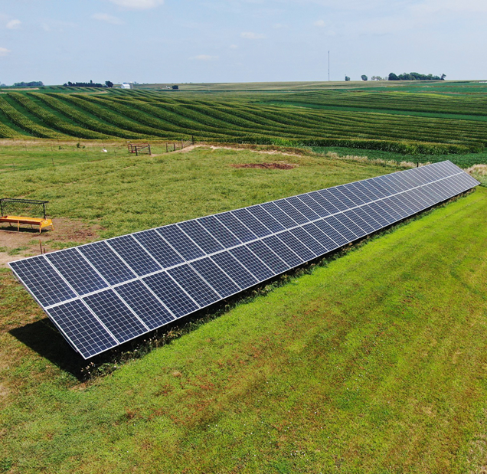
Local Government Role in Siting Solar Arrays
Several codes govern local authority
Must be consistent with state policy
Provide reasonable siting criteria including for buffers and setbacks
Limit noise
Address decommissioning
Agricultural property owners may install solar panels to serve their own energy needs so long as they comply with local zoning and design requirements
Notes:
Local ordinances must be consistent with state policy, provide reasonable siting criteria, include reasonable requirements for buffers and setbacks, limit noise,
and address generation facility decommissioning.
Agricultural property owners may install solar panels to serve their own property needs, provided that installations comply with local zoning, height and setback requirements, and any local historic, architectural, or corridor protections. These conditions apply to both roof and ground mounted panels.
Several codes govern local authority and decision making around utility-scale solar facilities:
Virginia Code § 15.2-2288.7 allows localities to provide by-right authority to install solar arrays in any zoning classification and to require permits to guide disposal of solar panels.
Virginia Code § 15.2-2241.2 directs bonding provisions for decommissioning of solar energy equipment, facilities, or devices and includes reasonable restoration including soil stabilization and revegetation of disturbed ground cover.
Virginia Code § 15.2-2288.8 provides special exceptions for solar photovoltaic projects so that localities may grant special exception including in their zoning ordinances for any solar photovoltaic (electric energy) project or energy storage project.
Virginia Code—Article 7.3 governs siting of solar and energy storage projects. It gives host localities powers to hire and pay experts, negotiate and enter into siting agreements with agreed-upon terms and conditions, including mitigation, compensation to pay for capital needs, and assistance to deploy broadband.

Slide 11
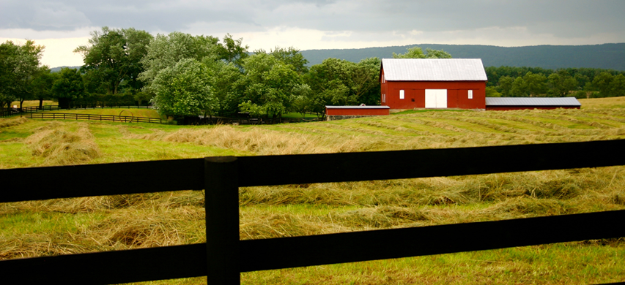
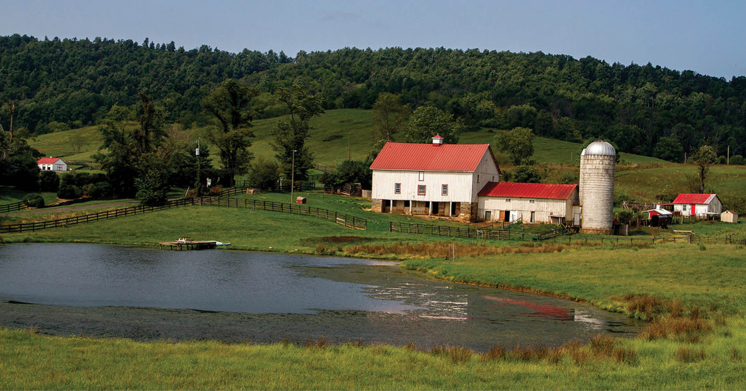
Zoning
Regulates the what, where and how of local land uses
Ag overlay zones can strengthen protections
May provide for farmland preservation and conservation
Implements policies from a comprehensive plan
Notes:
Zoning is the most common local land use policy. It defines and regulates the “what, where, and how” of different land uses. Its purpose is to protect community health, safety and general welfare.
Virginia’s zoning ordinances are detailed in depth in the Code of Virginia and include things that support agriculture such as safety from fires and floods, creating attractive communities, and providing for the preservation of agricultural and forestal lands.
Code of Virginia Code, Chapter 22: Planning, Subdivision of Land and Zoning authorizes the creation of local planning commissions and requires local governments to adopt a Comprehensive Plan which lays the foundation for zoning and other local ordinances. This gives local governments authority to designate areas for various types of land use, development, and density, along with classifying territory as agricultural.
They can implement these policies by adopting zoning standards.
The Code addresses some issues that directly affect agriculture. For example, zoning ordinances to be drawn and applied with reasonable considerations for the conservation of natural resources and the preservation of agricultural and forestal land.
County governing bodies have jurisdiction over unincorporated territory, whereas cities and towns governments have jurisdiction over their incorporated areas.
When directed by local governments, local planning commissions propose zoning ordinances. They must prepare supporting documents, including maps, that show the division of territory into districts and text to describe applicable regulations.

Slide 12
Zoning to Protect Farmland
Limits activities that interfere with commercial farm production
May or may not regulate lot size
Sets standards for accessory and ancillary uses
Defines agriculture as the preferred land use
Notes:
Many communities have large-lot rural residential or rural-agricultural zones that allow farming activities but do not prioritize them. While some small farms may survive in these zones, they do not protect agricultural land. Instead, they often fragment the agricultural land base and lay the ground for future urbanization.
Zoning to protect farmland defines agriculture as the preferred land use and limits activities that interfere with commercial farm production. It sets performance standards for accessory and ancillary uses and may or may not regulate lot size. It generally addresses things like buffers, setbacks and secondary uses:
Buffers are often vegetative to reduce the spread of dust, noise, smells, or to protect soils, waterways, and sensitive habitats from agricultural runoff.
Setbacks refer to the physical distance between a building and property line, a road or a natural resource like a wetland.
Accessory uses serve but are secondary to a zone’s primary land use. Examples include things like greenhouses or a farm stand.
Ancillary uses are not related to the zone’s primary land use but do not interfere with it. Examples include things like renting office space in an outbuilding or leasing land to hunters.
The following approaches can be used to protect farmland for farming and promote thoughtful growth.
Agricultural Protection Zones: designed to protect high quality soils and support the farm economy, Agricultural Protection Zoning directs new development away from areas with working farms and towards settled areas with community infrastructure. It can take many forms (see Zoning to Protect Farmland fact sheet for details)
Agricultural Overlay Zones: Agricultural overlay can be used to create, strengthen, or waive existing provisions without redrafting entire zoning ordinances. They can be more—or less restrictive than the base zone and often are created to reduce conflicts between farmers and non-farm neighbors and/or to identify priority areas within zones to support the business of agriculture. Most protect high quality soils and support the farm economy especially in zones where agriculture is not a preferred land use. They also may allow associated commercial, marketing, and light industrial uses like farmers markets, farm supply and equipment enterprises, value-added processing, or as a Transfer of Development Rights sending zone.
Other types of zones include:
Urban agriculture zones which addresses farming on rooftops, vacant lots and small parcels, as well as rooftops;
Enterprise zones which are created to support distinct, economically distressed parts of a county, city or town; and
Targeted Development Areas which designate areas for various types of use, density, and overall development in select specific areas intended for development and growth, based on the jurisdiction’s own criteria. Buffers and Setbacks create space between farms and non-farm neighbors and are used to reduce conflicts, trespassing, and vandalism. They also protect natural resources.

Slide 13
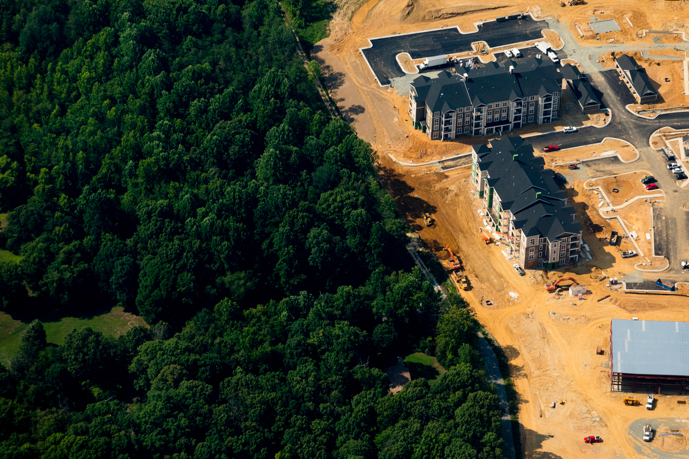
Urban Development Areas Promote efficient land use
UDAs are:
Voluntary and optional
Appropriate for high density development and to meet projected needs for at least 10 years
Designated by local governments, identified in comp plans, and updated every 5 years
Notes:
Urban Development Areas promote efficient land use. Often called Urban Growth Boundaries or Urban Service Areas, they identify areas to encourage development and areas to protect to support rural land uses. Higher density and mixed-use developments take place inside the urban development boundary and receive robust public services. Agriculture, forestry, and other low density land uses occur outside the boundary and receive limited public services.
In 2007, Virginia passed legislation to require high growth localities to designate urban development areas to concentrate new development in places with adequate infrastructure. The code was amended in 2012 to define UDAs more broadly, make them optional, and increase eligibility for funding.
Today UDAs are voluntary and optional, designated by local governments, identified in comprehensive plans, shown on future land use maps, and reviewed every five years. They are used to promote transportation-efficient development, attract new development, and encourage local economic development. They open doors to state funding opportunities and planning assistance.
They must be appropriate areas for higher density development due to public infrastructure such as transportation facilities and public water and sewer, eligible for infill or redevelopment, and incorporate Traditional Neighborhood Design which fosters mixed land uses, walkability, and multiple forms of transportation.
Areas must be sufficient to meet the projected development needs for at least 10 but not more than 20 years.
Any locality may amend its comprehensive plan to incorporate one or more UDAs.

Slide 14
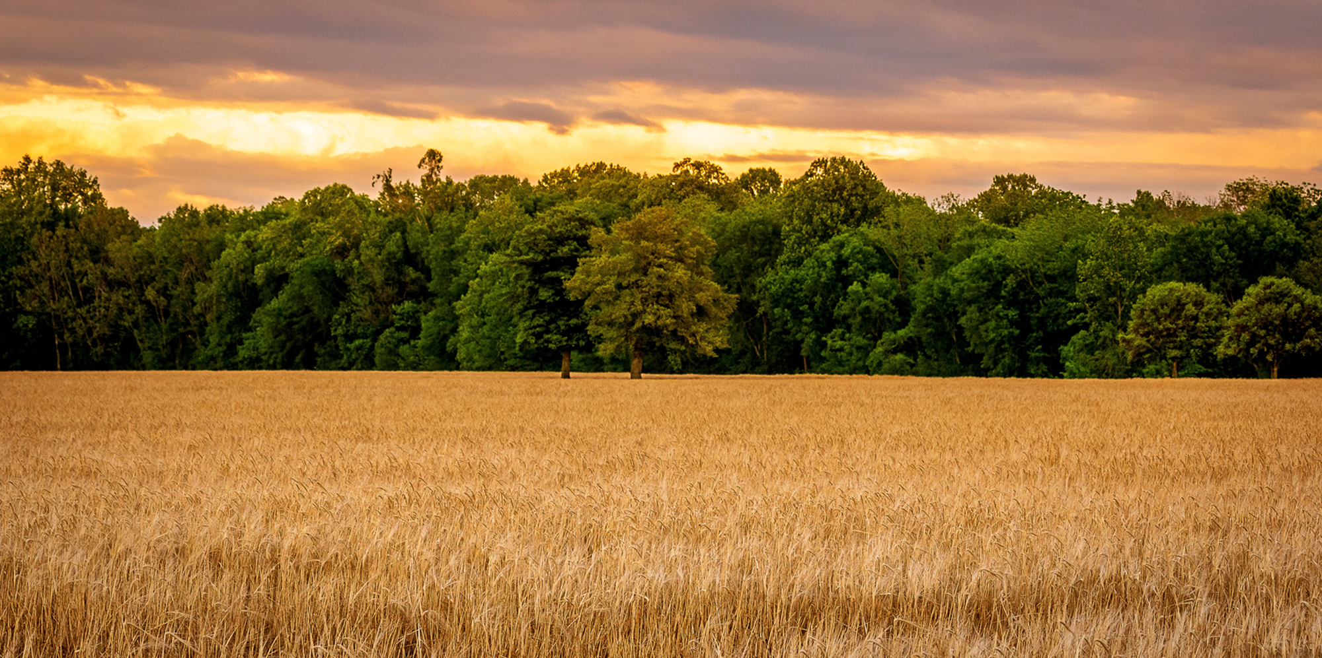
https://farmlandinfo.org/planning-for-agriculture-in-virginia/#farmland-protection

