Slide 1
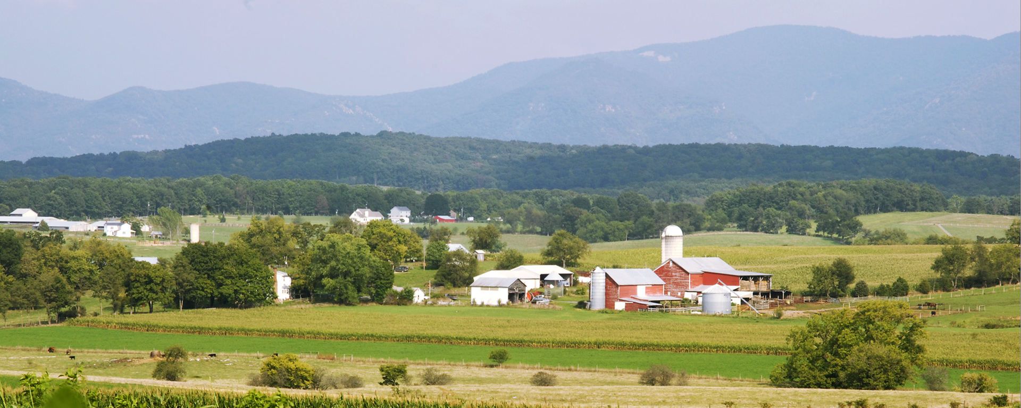

Planning for Agriculture in Virginia

Slide 2
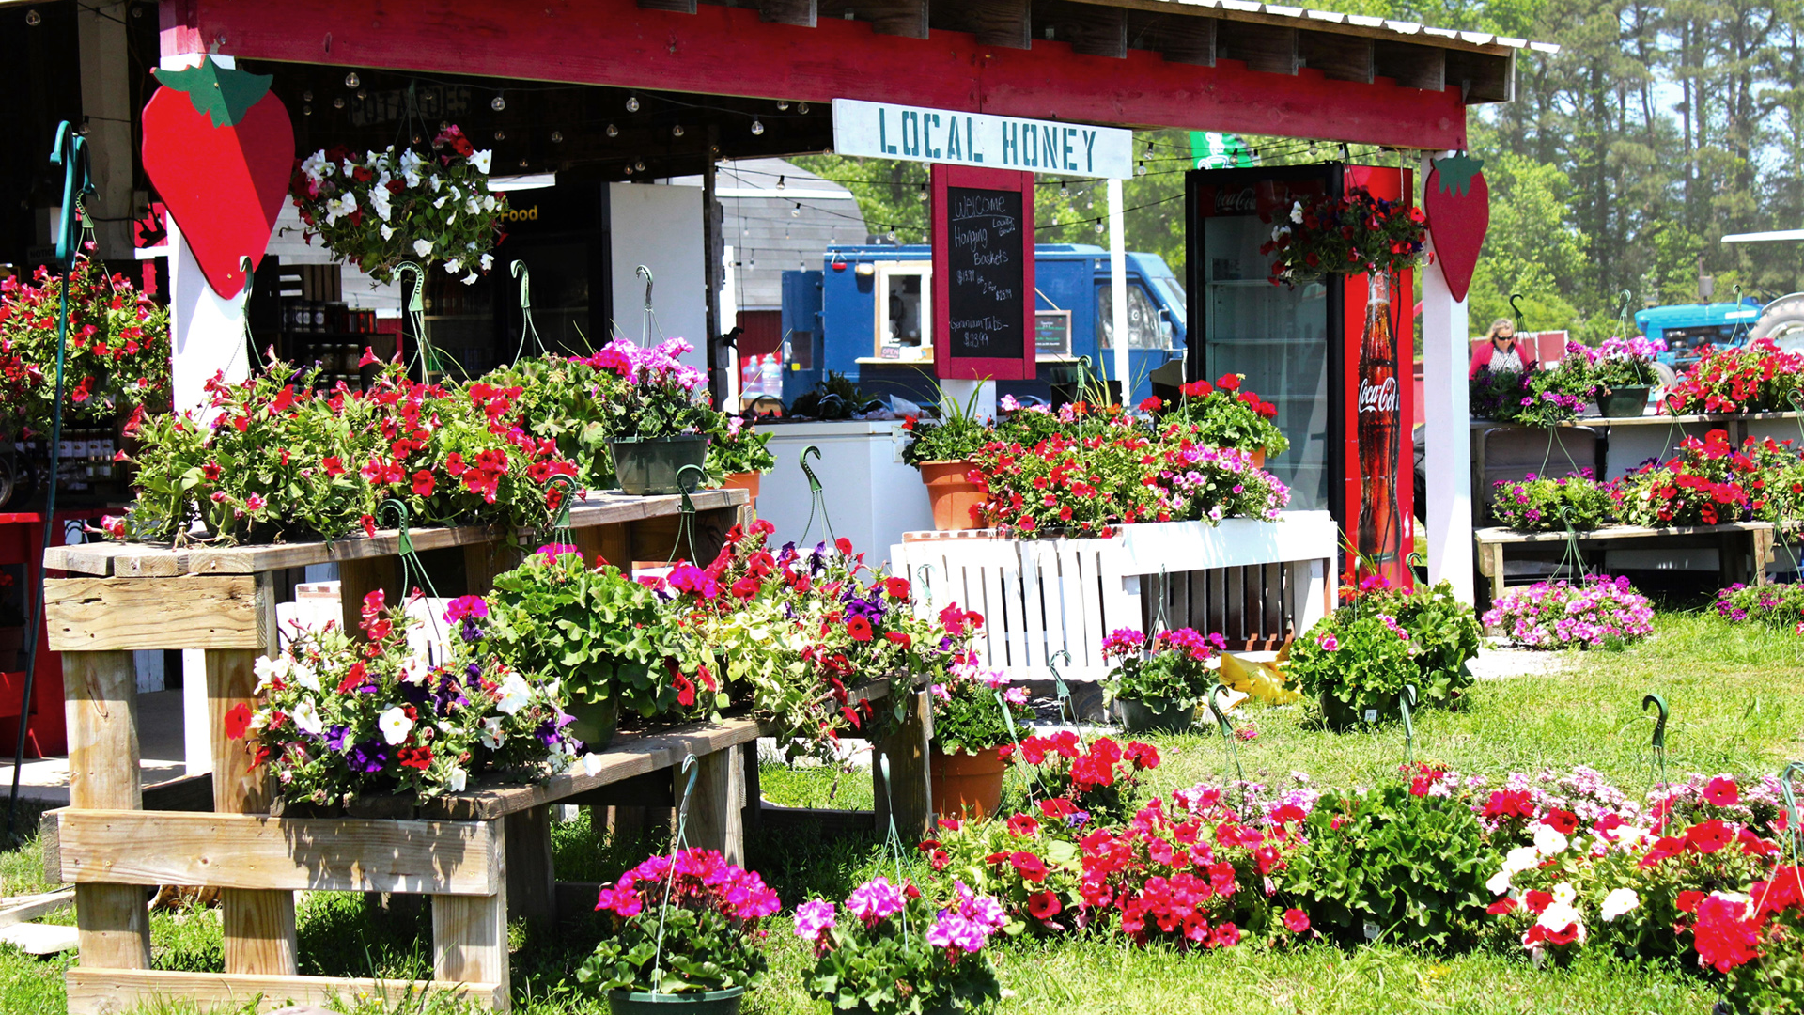
Why Plan for Agriculture?

Slide 3
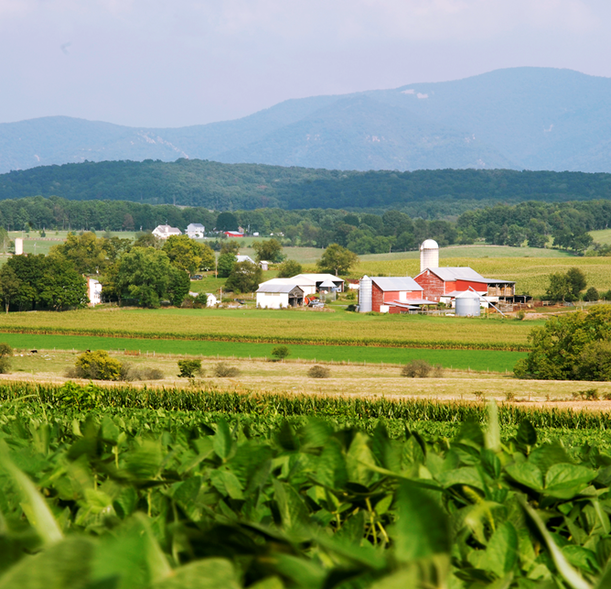
Farming and Farmland Provide Great Value
Agriculture is an economic engine: globally, domestically, and locally
Farmland helps balance a community’s tax base and is an essential natural resource
Farming is Important to Virginia’s History and Character
Notes:
Virginia has a long and diverse agricultural history. Since its early settlement, farmers have grown tobacco, peanuts, cotton, and raised livestock. Agriculture has always been a significant contributor to the economy of the Commonwealth and remains the state’s largest private industry.
Farmland is the foundation of economic engine – effectively the industry’s factory floor where crops and livestock are grown, raised, and harvested.

Slide 4
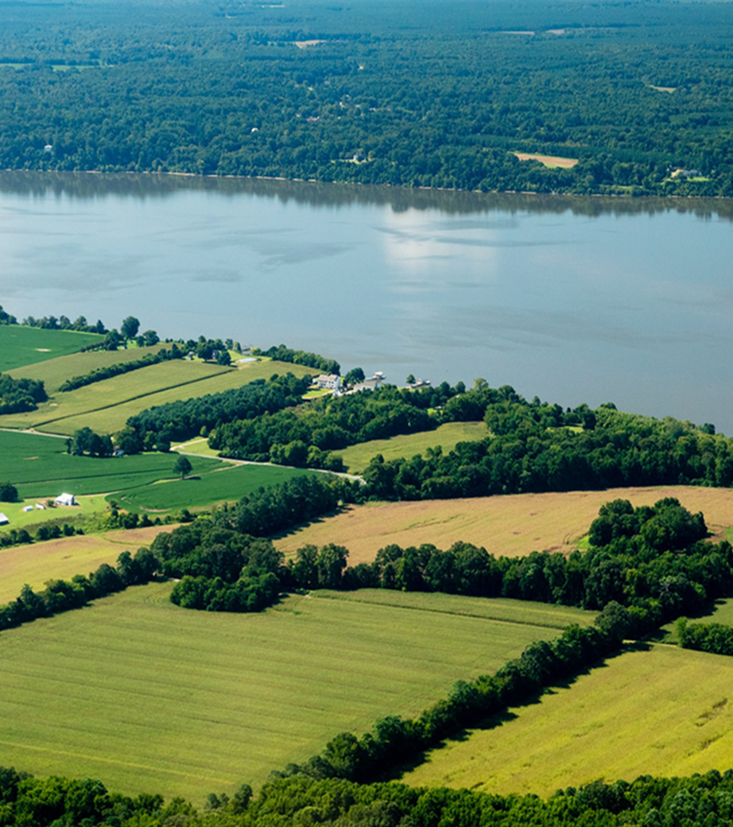
Agriculture is a Cornerstone of the Commonwealth’s Economy
It is Virginia’s largest private industry:
38,995 farms produce a market value of ~ $5.5 billion
Agriculture has a total economic impact of over $80 billion
Supporting 380,000 jobs from farms and support businesses that process, distribute, and market farm products
Notes:
Agriculture is the cornerstone of Virgina’s economy.
Among the nation’s most diverse farming sectors, 38,995 farms produced a market value of nearly $5.5 billion in 2022.
Leading the way are its top three commodities:
broilers with $1.6B of farm cash receipts,
cattle and calves with $482M, and
turkeys with $454M.
Including the added value of goods and services, agriculture has a total annual economic impact of over $80 billion—about 7.4% of Virginia’s GDP.
It supports over 380,000 jobs from the farms themselves and the support businesses that process, market, and distribute farm products.
In addition, for every dollar invested on the ground, federal conservation dollars added value of about $1.10 to Virginia’s economy.
And a study of the total economic activity stimulated by Virginia’s agritourism sector estimated it at approximately $2.2 billion.
As the Commonwealth’s largest private industry, the health of Virginia’s cities, counties, and towns depends on a thriving agricultural economy.

Slide 5
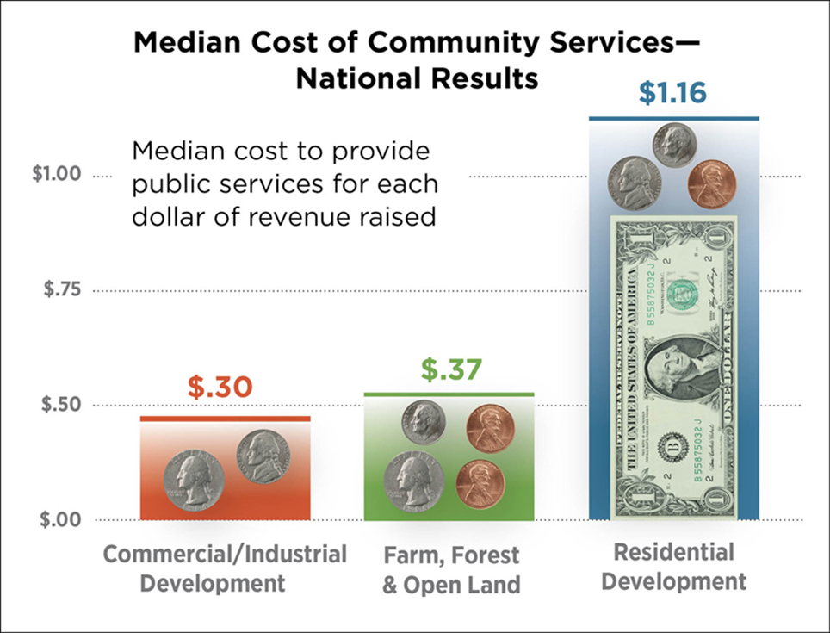
Farmland Helps Balance a Community’s Tax Base
7 Virginia studies found that farmland, forestal land, and open space received 42¢ in public services for every $1 generated
Including land enrolled in use assessment programs
Residential development received $1.20 in services for every $1 generated
Notes:
Virginia’s farmland supports the local tax base.
On average, across seven Virginia counties, every dollar of property tax revenue generated by working and open lands only required 42 cents back in community services, whereas every dollar from residential development required $1.20 back in services.
These findings are consistent with those from more than 150 Cost of Community Service Studies (COCS) from across the country.
As the chart on the slide shows, farmland contributes more property tax revenue than it receives back in public services, even when land is enrolled in Use Assessment programs.
In contrast, residential development costs more in services than it provides in revenues.
Like commercial/industrial land uses, farmland helps balance community coffers and keep property taxes down.

Slide 6
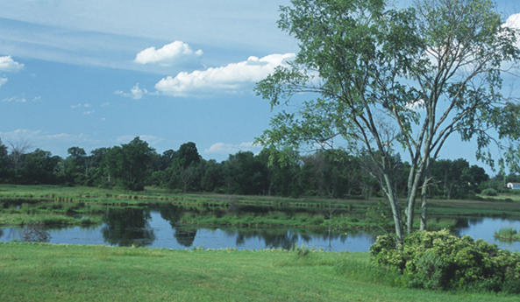
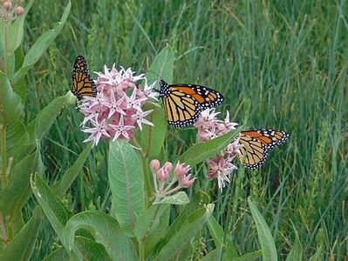
Farmland is an Essential Natural Resource
Provides clean drinking water and green infrastructure
Helps suppress wildfires
Mitigates a changing climate
Provides wildlife and pollinator habitat
And more!
Notes:
Virginia’s 7.3 million acres of farmland are a vital natural resource.
They absorb and filter stormwater and help defend against a changing climate. A California study found that farmland emits 58–70 times fewer greenhouse gases (GHGs) per acre than developed land; in New York, a similar study found that farmland emits 66 times fewer
GHGs per acre than developed land.
Diversified farming systems and conservation practices offer many ecological benefits—from soil fertility and pollination
to wildlife habitat, clean drinking water and fire suppression.
Further, well-managed farmland enhances biodiversity without diminishing yields.

Slide 7
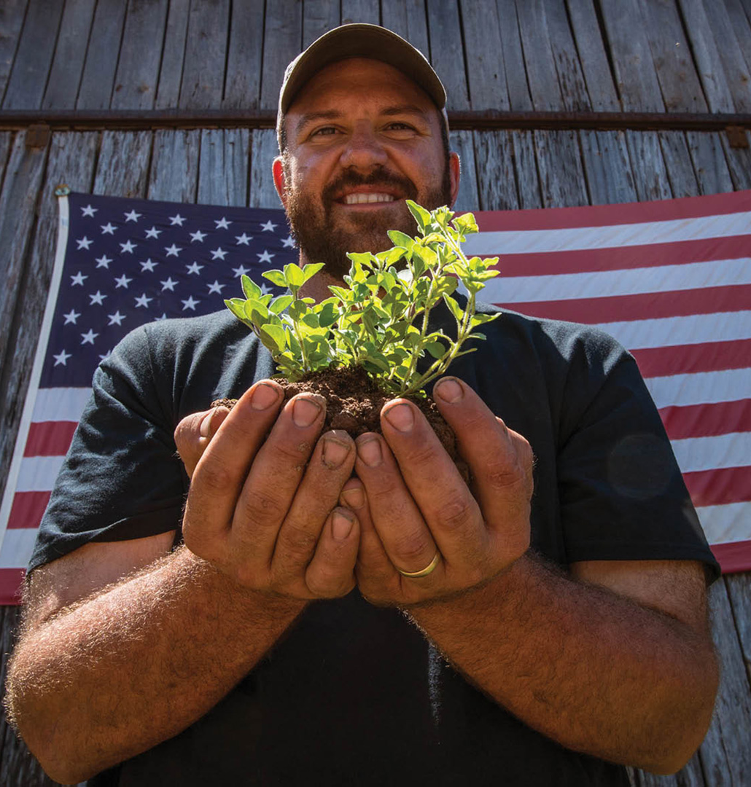
Farming is Part of Virginia’s Legacy and Rural Character
From the nation’s “founding farmers” who called Virginia home, to the valiant agrarians who farm today, agriculture is vital to Virginia’s heritage, a source of pride for its people, and a legacy to pass on to future generations
Notes:
Farmers and farmland have had an indelible impact on Virginia’s communities.
Beyond economics, they provide scenic landscapes and sustain rural culture. Whether in the mountains of Southwest Virginia, the
rolling hills of the Shenandoah Valley, the rich soils of the Tidewater area, or the Piedmont’s fertile plateaus, they are integral
to Virginia’s character and history.
American democracy was founded on the principal that people can own property and make a living from the land.
From Washington, Jefferson, and Madison—the nation’s “founding farmers” who called Virginia home—to the diverse agrarians who farm today, agriculture is the foundation of our food systems and a hallmark of distinctive rural landscapes.
Vital to Virginia’s heritage, it is a source of pride for its people and a legacy to pass on to future generations.

Slide 8
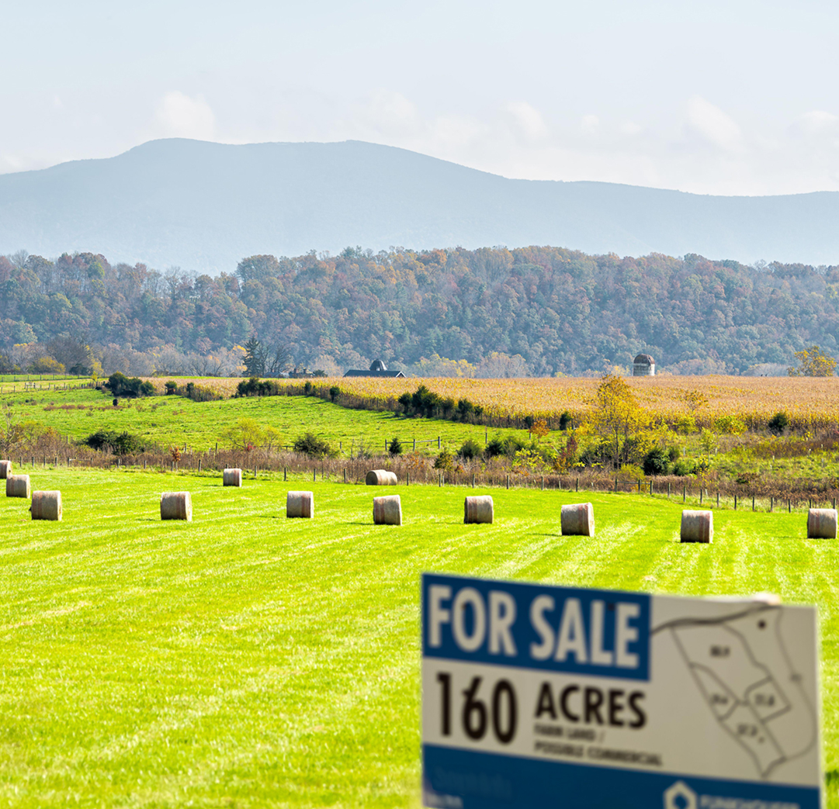
Despite these Benefits, Virginia’s Farms Face an Uncertain Future
Virginia lost 18% of its farms between 2012 and 2022.
The remaining farms are tested by many things, especially:
Competition for land
Economic pressures
Extreme weather events
Notes:
Virginia agriculture faces an uncertain future.
It lost 18% of its farms between 2012 and 2022, largely due to a decline in small farms.
More than 80% of its farms have less than $50,000 in annual sales.
The remaining farms are threatened by:
- Competition for land from real estate development and consolidating farm operations,
- Economic pressures including volatile markets, labor shortages, supply chain disruptions, and
consolidation both within agriculture and agricultural markets,
- Extreme weather events and environmental pressures
- Among other factors.

Slide 9
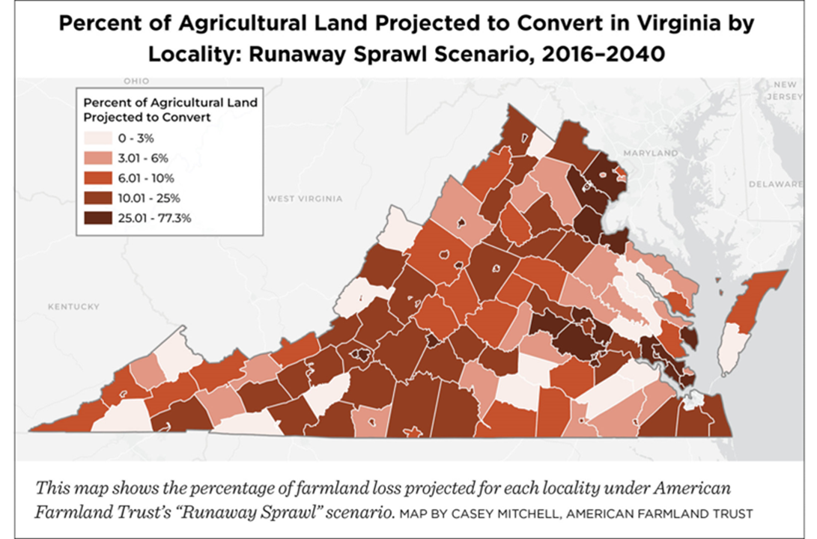
Real Estate Development
Scattered, large lot residential development
Utility-scale solar arrays
Warehouses
Data centers
Notes:
According to AFT research, Virginia ranks sixth nationally in the percentage of farmland converted to low density residential development—and 11th for overall farmland conversion.
Nearly half of the conversion occurred on the state’s best quality farmland.
Beyond scattered, large lot housing development, utility scale solar, warehouses, and data centers are consuming large swaths of farmland across the state.
For example, Northern Virginia is the nation’s largest hub of data centers. Dubbed “Data Center Alley,” it has over 100 data centers which house hardware to store, process, manage, and deliver large amounts of data. As more people, businesses, and government agencies use Artificial Intelligence and adopt digital technologies, data centers will continue to grow.
As the map on the slide highlights, without thoughtful planning, these various pressures will drive run-away sprawl and the conversion of another 836,200 acres of Virginia’s farmland by 2040. Clearly, some counties will be hit harder than others.
But with better land use planning and farmland protection, that number could be reduced by more than half a million acres.

Slide 10
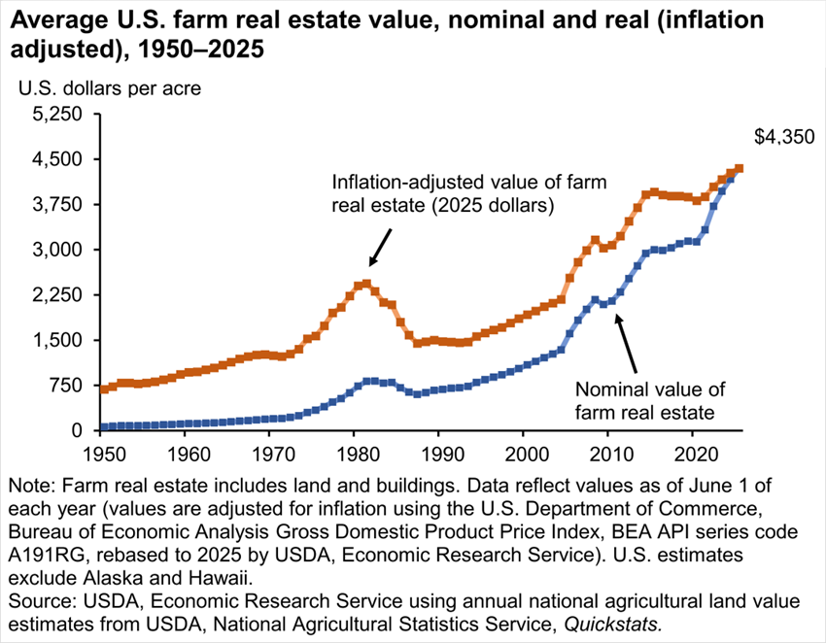
Farm Real Estate Value has Soared Across the U.S.
Virginia’s Farmland Values Rose Dramatically between 2012 and 2024
Average cropland values up 100%
from $3,000/acre to $6,000/acre
Average pastureland up ~180%
From $2,300 to $5,800
Notes:
Given these pressures, across the country farm real estate values are rising fast—up 10.4% from 2023 to 2024 and 35.4% since 2014.
Virginia is no exception. In 2025, cropland values reached an average of $6170/acre and pasture $5300 according to USDA National Agricultural Statistical Service (NASS).
This makes it hard for small farmers to expand and for young and beginning farmers to secure land and enter the field.

Slide 11
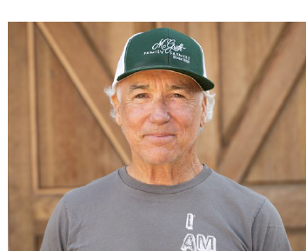
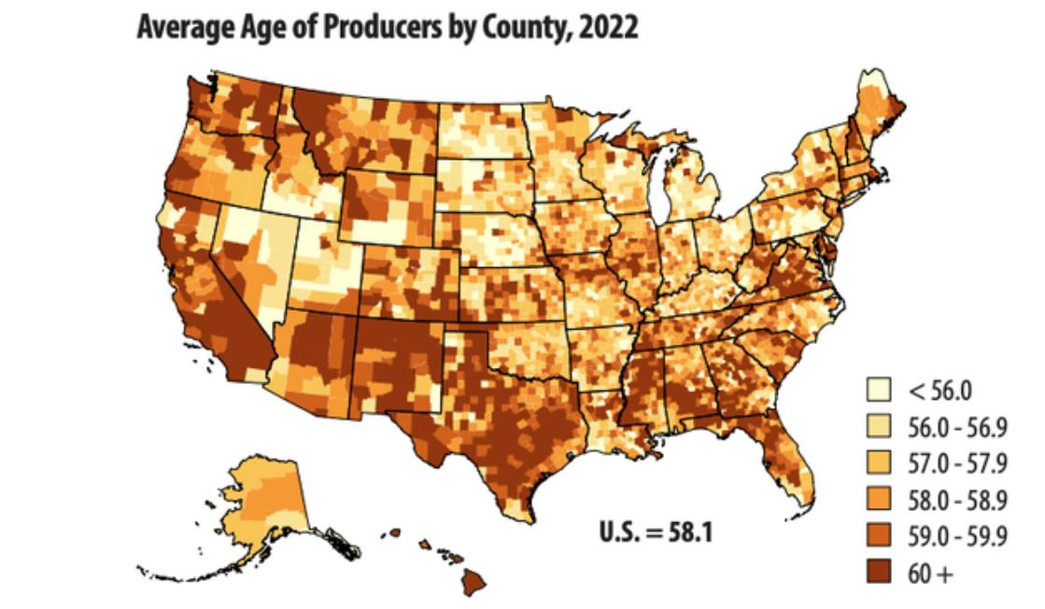
40% of Virginia’s Farmers are 65 or older, 8% are Under 35 – Who will Farm in the Future?
Notes:
According to NASS, the average age of Virginia’s farmers was 59.2 years old in 2022—up from 57.2 in 2012—continuing a multi-decade trend of an aging farming population in Virginia and across the country.
The 2022 Census also showed that 25.7% were in the 55-64 age bracket and 25.2% of Virginia farmers were ages 65-74.
Including farmers aged 75 and more, 40% of Virginia’s farmers are age 65 and older.
With only 8% under age 35, forcing urgent questions about who will farm in the future.
While the number of beginning farmers increased almost 8% from 2017, their average age was 48.6—younger than the average of all farmers, but still middle-aged.

Slide 12
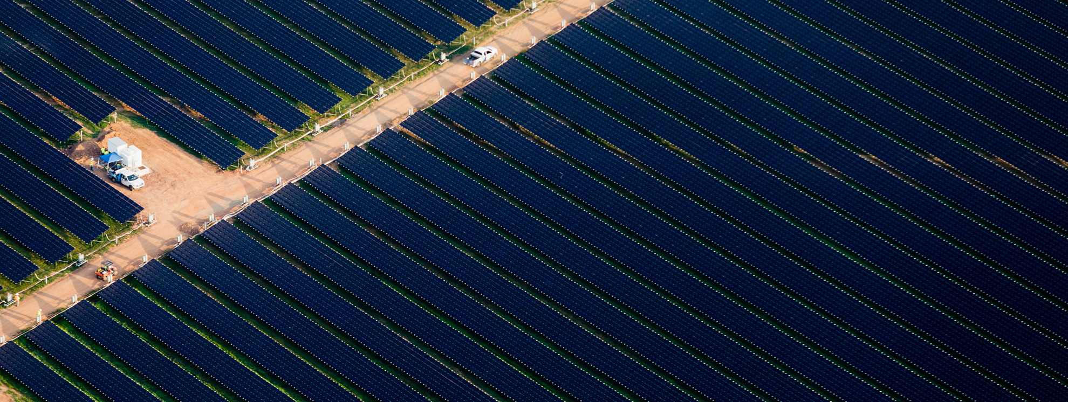
A Failure to Plan is a Plan to Fail!
Notes:
Planning for agriculture lifts up a community’s agricultural assets and addresses its threats.
With community support, vision, and a proactive game plan, Virginia’s vital agricultural sector can meet the challenges of the 21st century and continue to provide a wide range of benefits to its people and communities.
Planning is a process to create a road map for actions and decisions to achieve a future vision.
In the public sector, planning is a profession and practice to optimize the health, safety, and wellbeing of people in communities.
It occurs at many levels, from cities and towns to counties, states, and regions.
And it encompasses a wide range of specialties: from land use, transportation, and housing to economic development, hazard mitigation, and historic preservation, among many others.
Planning for agriculture is a way to sustain Virginia’s farms, farmers, and farmland and help them thrive.
Toward these ends, it relies on the active participation of the people it most effects—especially farmers. (See How to Plan for Agriculture in Virginia.)

Slide 13
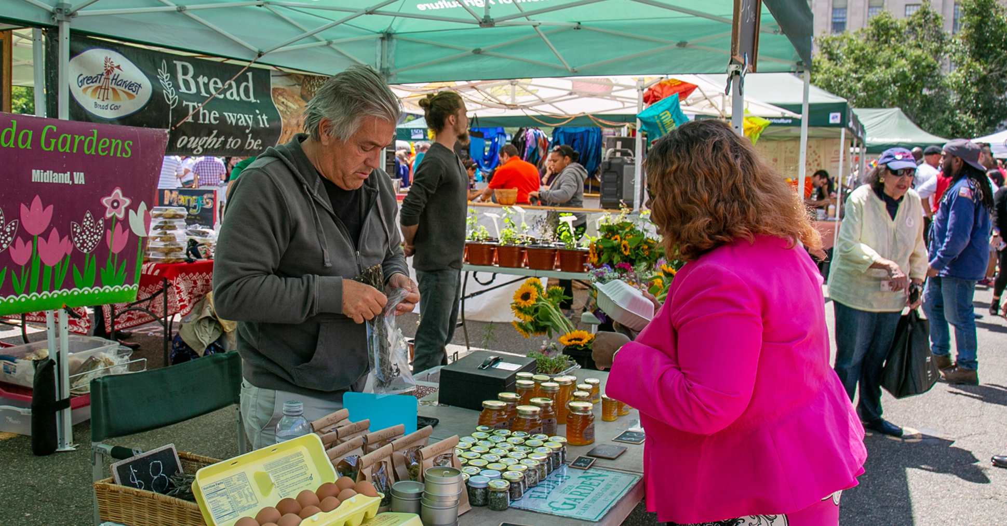
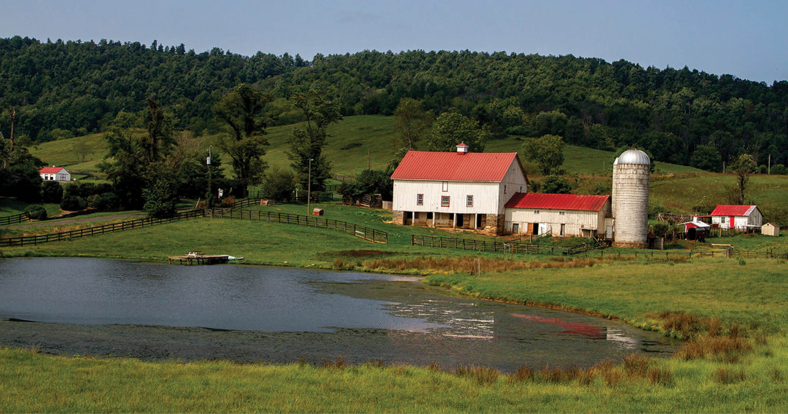
Planning for Agriculture
Supports agricultural viability
Protects farmland
Encourages conservation
Sustains community wellbeing
Notes:
Addressed either as a stand-alone activity or as an element in other kinds of plans, planning for agriculture offers a path forward to retain and protect farmland, strengthen agricultural viability, and conserve natural resources. In the process, it helps sustain community health and well being.
Plans for agriculture are based on a community’s shared vision for the future.
They can steer new real estate development away from working farms, reduce regulatory barriers, identify market opportunities and infrastructure needs, and protect soil and water.
They can also respond to the larger social, economic, and environmental issues which affect agriculture.
These issues are connected and complex, so it is important to align planning for agriculture with other state and local planning activities.

Slide 14
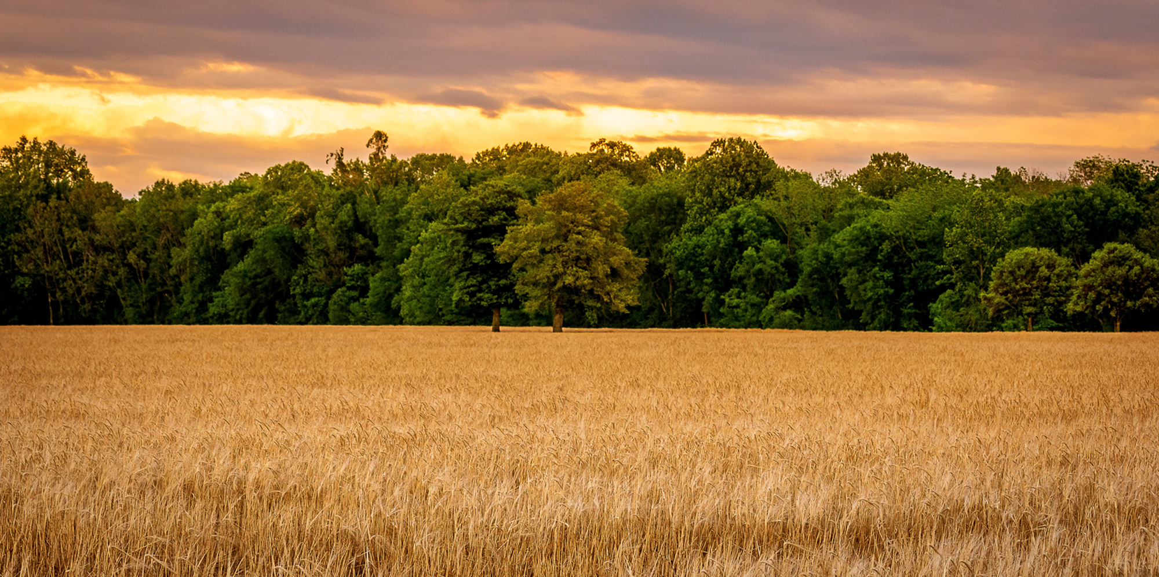
For more information, contact: Alex Duprey aduprey@farmland.org
Check out the Toolkit at: https://farmland.org/planning-for-agriculture-in-virginia

