Slide 1
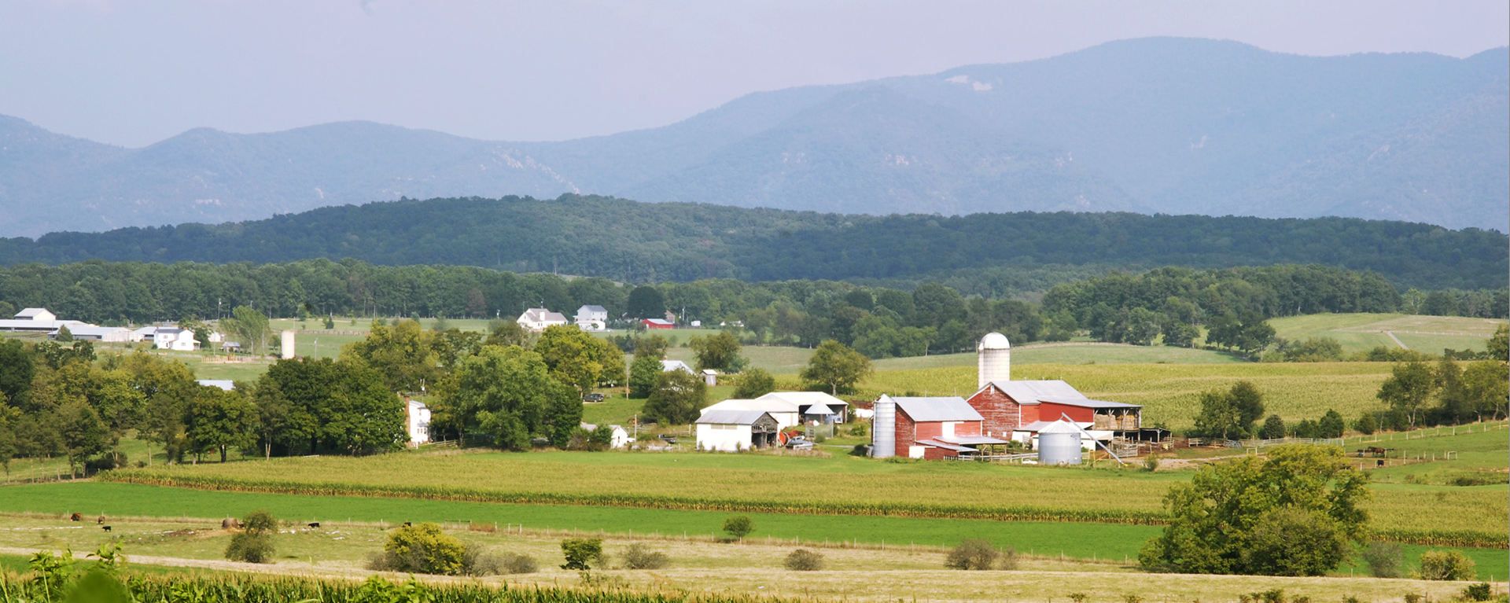
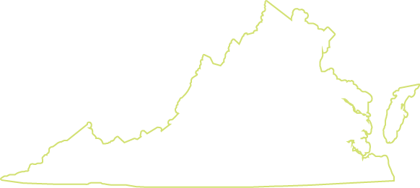
Planning for Agriculture in Virginia

Slide 2
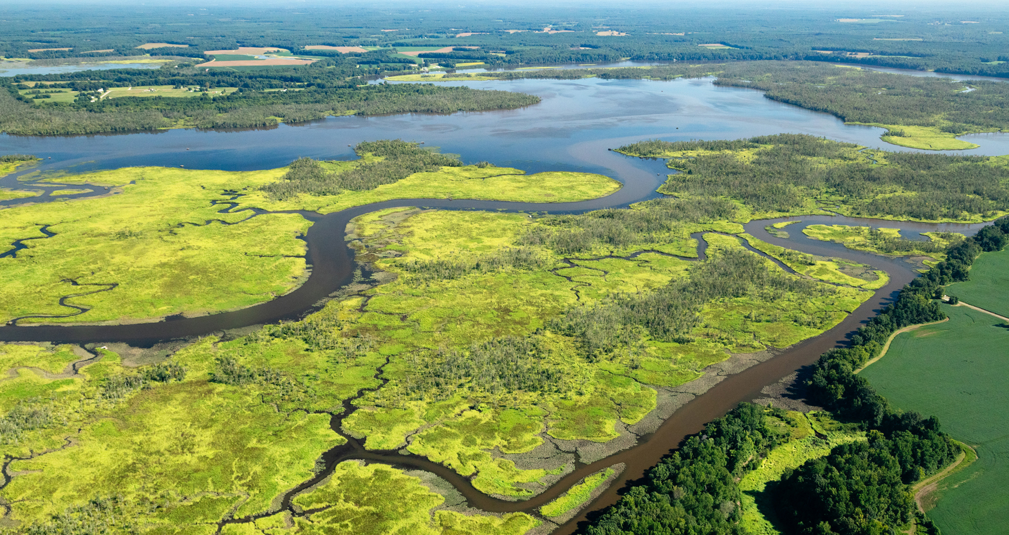
Conservation Agriculture
Notes:
Conservation agriculture builds healthy soils, supports clean water, and provides habitat for biodiversity. It helps agriculture prepare for and manage disruptions from increasingly volatile weather and changing climatic conditions—severe droughts, flooding, and record high temperatures that harm livestock, reduce crop yields, and create dangerous working conditions.
Practices that enhance resilience pay off financially over the long-term improving farmers chances of success.
Federal and state programs provide most of the support for conservation adoption, but local governments have a role to play.

Slide 3
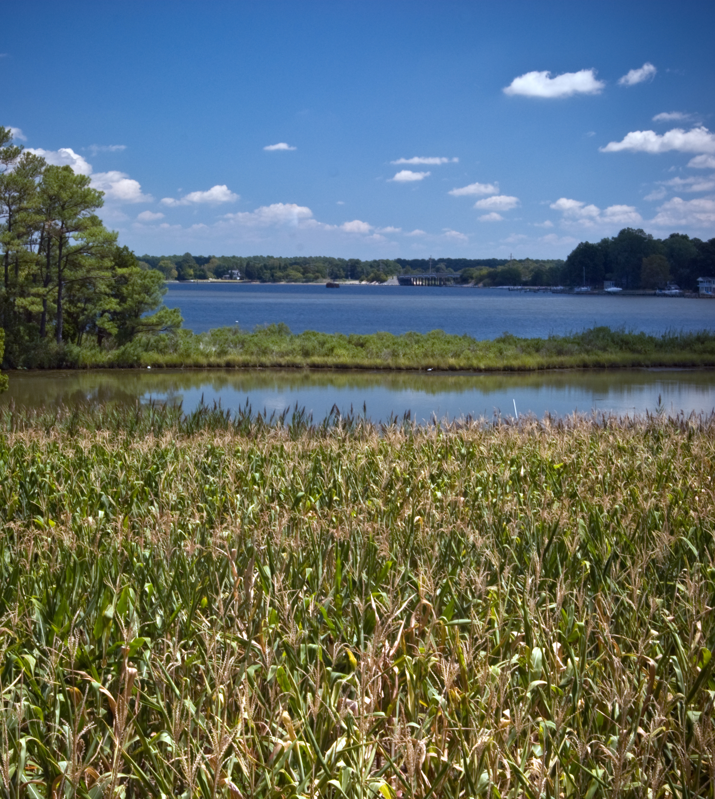
Chesapeake Bay Act
Protecting and improving the Bay’s water quality with effective land use management
> 80 communities that border the Bay ensure development and land use decisions protect water quality
They map boundaries and incorporate protection measures into comp plans and local policies
They develop and carry out Watershed Implementation Plans
Notes:
With a massive watershed that spreads across over 64,000 miles, the Chesapeake Bay supports more than 17 million people across six states. A multitude of rivers and streams feed the Bay and carry pollutants.
Since the 1980s, the Bay has been on EPA’s “dirty waters” list. To address Virginia’s impacts on the Bay, the state Assembly enacted the Chesapeake Bay Preservation Act in 1988 to manage nonpoint source pollution.
It is a comprehensive approach to addresses the impacts of land use planning and development on water quality in the Chesapeake Bay Preservation Area.
It creates a direct relationship between local land use and protecting water quality and expands local authority to manage water quality within CBPAs.
Following a long history of Bay clean-up efforts, in 2014, Virginia, Delaware, the District of Columbia, Maryland, Pennsylvania, New York, West Virginia, the Chesapeake Bay Commission, and the EPA all signed the Chesapeake Bay Watershed Agreement. Representatives from each of the states, officials from other federal agencies, local governments, and citizens meet regularly to carry out the Agreement’s policies which include clear goals, outcomes, and a timeline to restore the health of the Bay, its tributaries, and surrounding lands.
The Bay Act program protects and improves water quality in the Chesapeake Bay by requiring the implementation of effective land use management practices. Effecting more than 80 counties, cities, and towns in Virginia that border the Bay’s tidal waters, the Act requires them to adopt individually tailored programs to ensure land use and development in CBPAs protect state water quality.
Local governments determine and map CBPA boundaries within their jurisdictions, develop Bay protection measures, and incorporate those measures into their comprehensive plans, zoning, and subdivision ordinances.
They are help develop and carry out Watershed Implementation Plans (WIPs) to reduce pollution and participate in various Chesapeake Bay Program workgroups and in regional water quality monitoring to assess progress towards Bay restoration goals.
They work with the Department of Environmental Quality (DEQ) and other partners to reduce loads of nitrogen, phosphorus, and sediment flowing into the Bay. DEQ provides policy guidance and local program oversight.
Each Bay Act locality has a DEQ program liaison who provides one-on-one technical assistance and assists with program compliance.
State agencies are required to be consistent with local comprehensive plans and ordinances adopted to comply with local Bay Act requirement

Slide 4
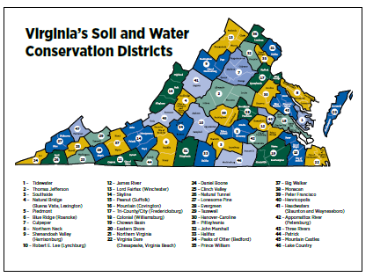
Soil & Water Conservation Districts
Conserving Virginia’s natural resources through outreach, education, and technical and financial assistance
Virginia authorized SWCDs in 1938 as political subdivisions of state government
Today 47 districts operate in the Commonwealth supported by state and local funds
They deliver resources to landowners and communities for conservation planning and practices
Notes:
Soil and Water Conservation Districts (SWCDs) were established after the devastating Dust Bowl in the 1930s to prevent soil erosion and floods, conserve soil resources, and use, conserve, and dispose of water. Today, SWCDs develop locally driven solutions to a wide variety of natural resource concerns.
They are established by state law and governed by local leaders. District staff work with landowners and local governments to conserve and manage natural resources. They provide services from conservation planning and implementation to public education and land protection.
In 1938, the Virginia General Assembly authorized the creation of Soil and Water Conservation Districts and recognized them as political subdivisions of state government. The Code of Virginia (chapter5) defines their role and authorities, as well as the composition of the Virginia Soil and Water Conservation Board, which provides financial support, coordination, and information exchange to the districts.
Today, 47 SWCDs serve most localities in the Commonwealth. They employ more than 150 full- and parttime staff who provide outreach and education as well as technical and financial assistance to landowners and the public on topics such as soil stewardship, water quality, and agricultural conservation.
Their mission is to conserve state and local conservation resources by developing and implementing programs to conserve soil and water resources, control erosion, and prevent pollution.
Virginia’s SWCDs are supported by state funds appropriated by the General Assembly, and local funds from county, city, and town governments. They also receive grants, donations, and other sources of revenue. Operating funds are administered through a grant agreement between the Department of Conservation and Recreation and individual districts.
District staff work closely with DCR and foster cooperative working relationships with federal, state, and local agencies.
Each district is directed by an elected board of directors who serve four-year terms.
Staff provide resources to farmers who want to adopt conservation practices and promote conservation through outreach and education like field days, public meetings, and classroom education. They also provide technical expertise to help landowners and communities protect natural resources and prevent nonpoint source pollution.

Slide 5
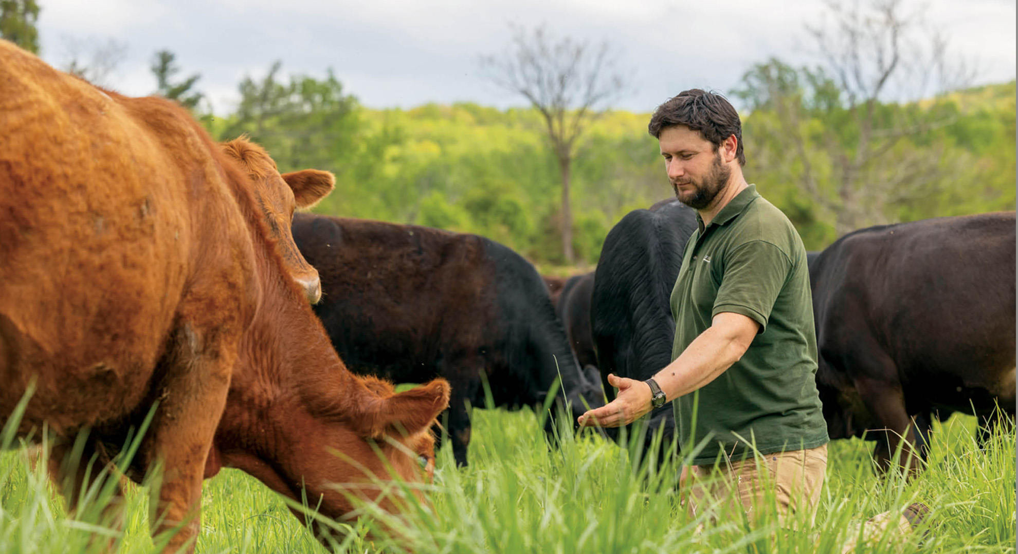
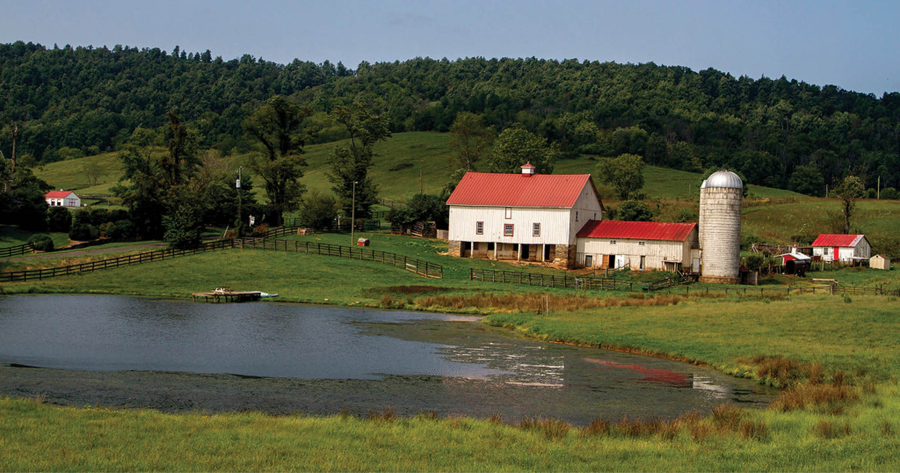
Farmer Mentor Programs Helping farmers learn through peer-to-peer networks
Virginia Forage and Grassland Council’s Farmer-to-Farmer Mentor Program
Virginia No-Till Alliance’s VANTAGE Farmer Mentor Program
Virginia Tech’s Eastern Shore crop producers mentoring network
Virginia Tech & NRCS Integrated Conservation Agronomy Farmer Mentoring Program
Virginia Soil Health Coalition’s Virginia Farmer Mentor Network
Notes:
Virginia has many different farmer mentor programs. Some operate only within a specific geographic area, while others operate statewide. Some focus on advancing soil health practices while others offer more generalized support. Most are operated by nonprofit organizations or Cooperative Extension at Virginia Tech.
Farmer mentor programs in general offer experiential education, provide one-on-one business coaching, training, and other learning opportunities. Most pair experienced farmers with young and beginning farmers, transferring valuable expertise from one generation to the next. Others help established farmers increase profitability and learn new skills.
Still others focus on conservation and improving farming practices, which are the programs covered here.
Farmers benefit from a wide variety of both formal and informal educational programming from soil health field days to peer-to-peer learning.
Some of main farmer mentor programs include:
Virginia Soil Health Coalition’s “Virginia Farmer Mentor Network” helps connect experienced farmers with other farmers to increase the adoption of practices that boost soil health and increase production. This program operates statewide.
Virginia Forage and Grassland Council’s “Farmer-to-Farmer Mentor Program” pairs “experienced grazers with new or beginner grazers to help them implement prescribed grazing practices and techniques. This program is especially active in the Chesapeake Bay Watershed.
Virginia No-Till Alliance’s “VANTAGE Farmer Mentor Program” connects farmers who have extensive experience with cover crop and no-till practices with farmers who are less familiar with these practices to boost soil health and crop production. The program is particularly active in the Shenandoah Valley.
Virginia Tech’s Eastern Shore Agricultural Research and Extension Center leads a mentoring network among crop producers in their region. Virginia Tech also works with the Virginia Natural Resources Conservation Service to co-lead the statewide “Integrated Conservation Agronomy Farmer Mentoring Program,” which provides for informal conversations between farmers with flexibility in communication frequency, duration, and method.

Slide 6
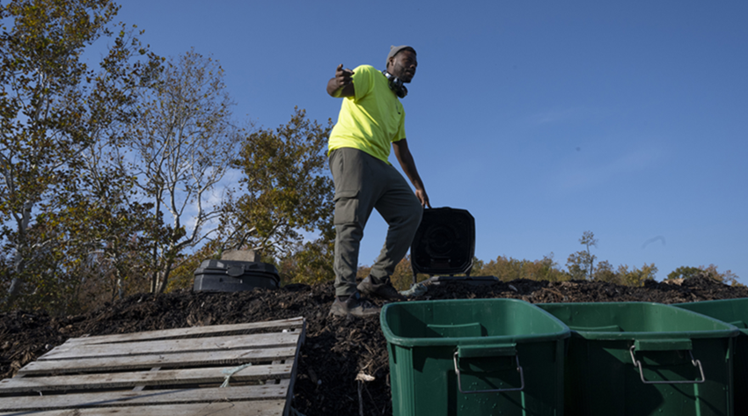
Composting
Recycling organic waste to improve environmental quality
Several Virginia state laws establish standards for handling compost and sludge
Composting usually is allowed on farms as an accessory use
Local governments can address setbacks, buffers, screening etc. through zoning and ordinances
Notes:
Composting recycles organic waste by combining products like leaves, wood chips, food, and manures into piles, rows, or vessels. Once these materials breakdown into compost, they can be added to soil to improve its fertility, promoting healthier crops and reducing the need for chemical fertilizers. Compost also stores carbon and improves water retention in soils and reduces methane emissions by keeping organic waste out of landfills.
Farmers who compost farm wastes or work with local governments to compost municipal leaves and other organic matter can use the compost to improve their own soil fertility, and they can sell it as a soil amendment product, creating an added revenue stream.
In Virginia, Solid Waste Management Regulations, the Virginia Pollution Abatement Permit Regulation, and Sewage Collection and Treatment Regulations all govern composting operations. Administrative Code 9VAC25-790-570 applies to the design and operation of conventional sludge composting including buffers, grading, and measures to control odors. The purpose of these laws is to establish standards, procedures, and requirements in handling compost and sludge to protect public health, public safety, the environment, and natural resources.
The VSMR has the most application to agriculture. It applies to acceptance of yard waste, feedstocks, and manures from herbivores that are generated off site so long as they do not pose a nuisance or present a potential threat to human health or the environment. It allows agricultural exemptions so long as operations follow procedures, requirements and other regulatory criteria.
It provides requirements for siting, design, construction, operation, maintenance, closure, and post-closure care of solid waste management facilities.
Composting is allowed on farms as an accessory use so long as certain requirements are met. For example, the composting area must be 300 feet from a property boundary and 1,000 feet from an occupied building.
Local governments have limited authority to regulate composting but can address setbacks, buffers, screening, and so on through zoning and other local ordinances. Farmers can work with local officials to compost municipal leaves and other organic yard waste and several Virginia cities have developed composting programs to collect food scraps and dispose of them in a sustainable way.

