Slide 1

Survey of State PACE
Programs Graphics
The graphics in these slides show the results of the Farmland Information Center’s latest survey of state purchase of agricultural conservation easement (PACE) programs. Programs reported on activity in calendar year 2024.
These visuals are available for use with proper attribution to AFT’s Farmland Information Center. Suggestions for additional visuals can be submitted to the FIC via this online form.
December 2025

Slide 2
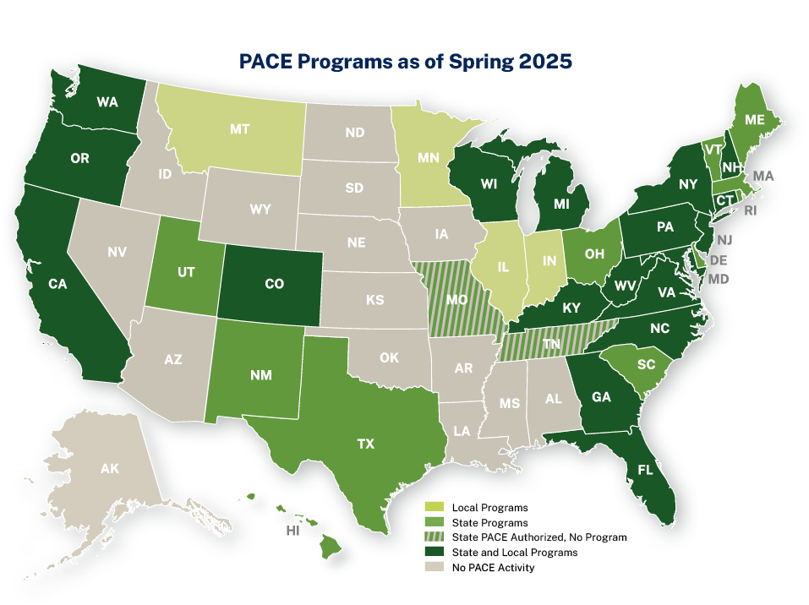

Notes:
AFT’s Farmland Information Center (FIC) conducts a survey of state purchase of agricultural conservation easement (PACE) programs annually and a survey of local PACE programs every four years. This map shows the states with state and/or local PACE programs.
As of spring 2025, 35 states have had active state and/or local PACE programs. There are currently 37 active state PACE programs in 29 states; some states have more than one PACE program.​ Two additional states—Missouri and, more recently, Tennessee—have authorized PACE programs but do not yet have funding. Four further states have only local-level PACE programs. Nationwide, there are at least 108 local-level PACE programs. Montana and Alabama no longer have active state-level programs but are included on the state PACE table because they have funded easement purchases in the past.​

Slide 3
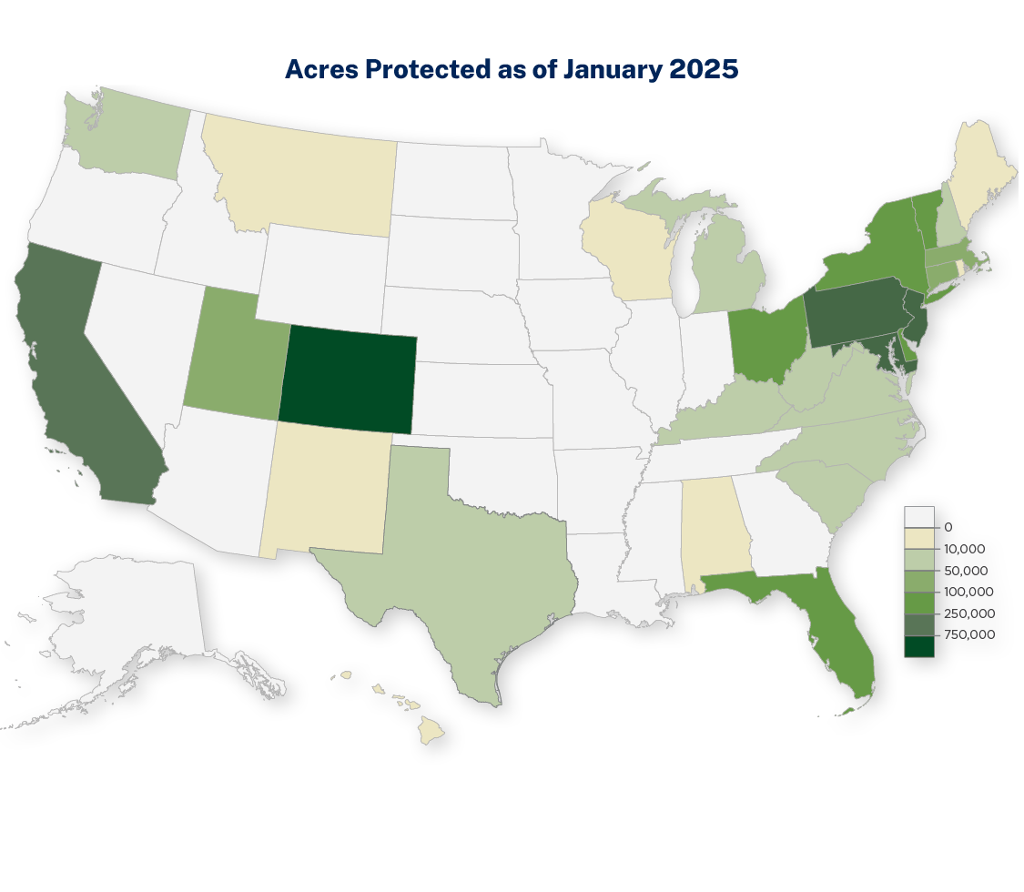

Slide 4
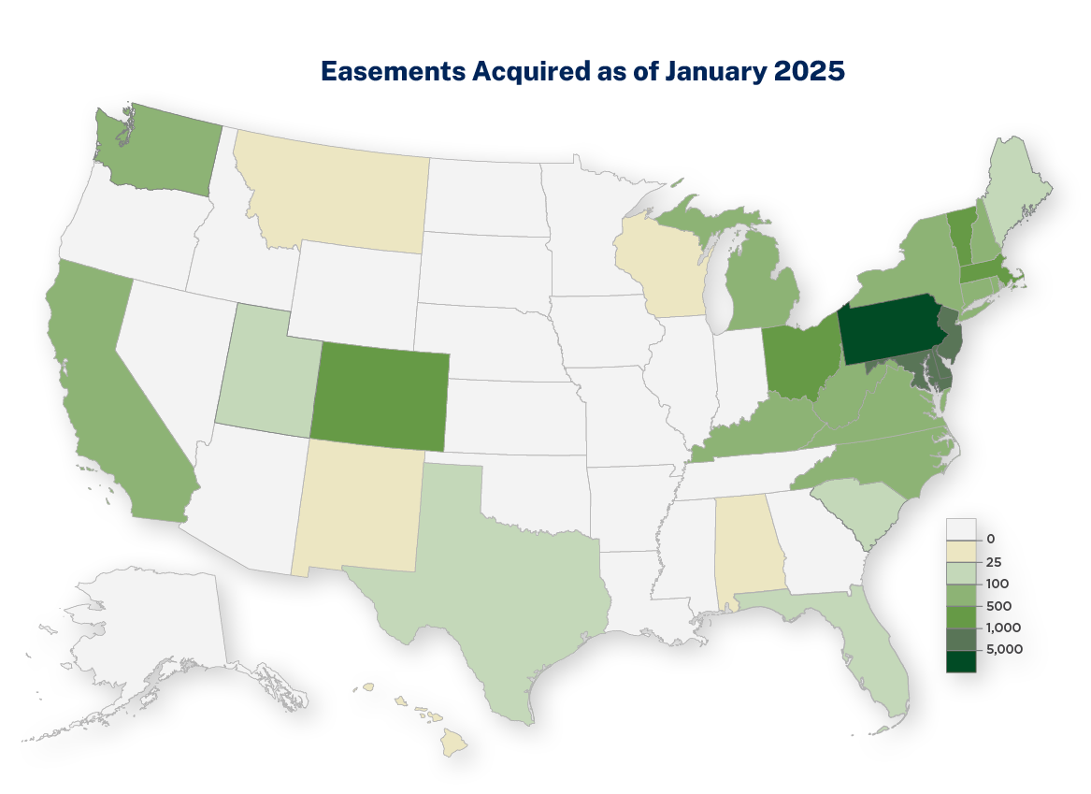

Slide 5
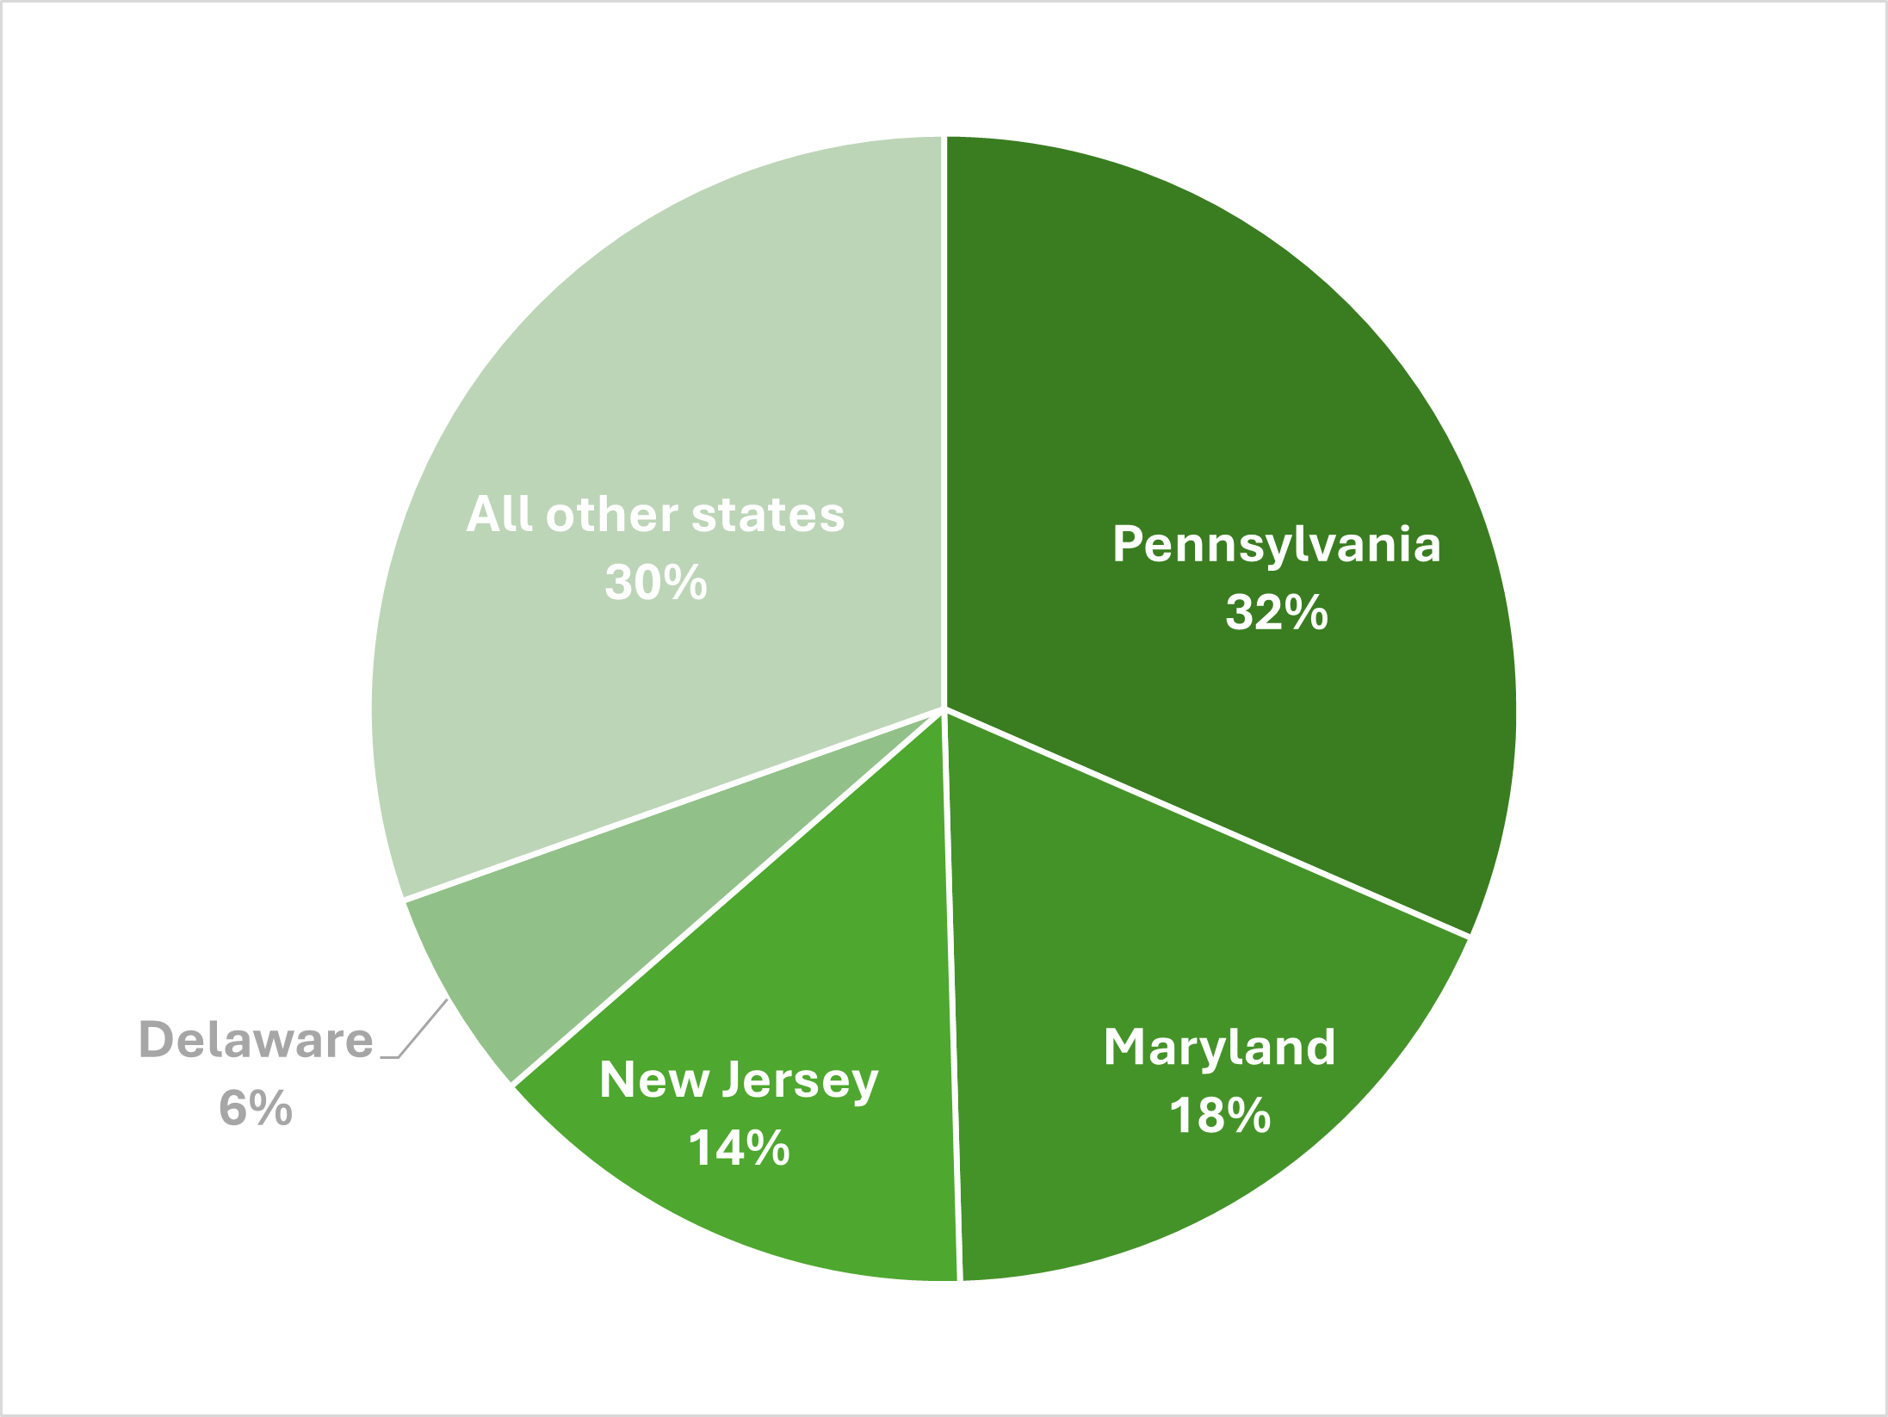
Proportion of All Easements Acquired with the Assistance of State PACE Programs, through 2024

Slide 6
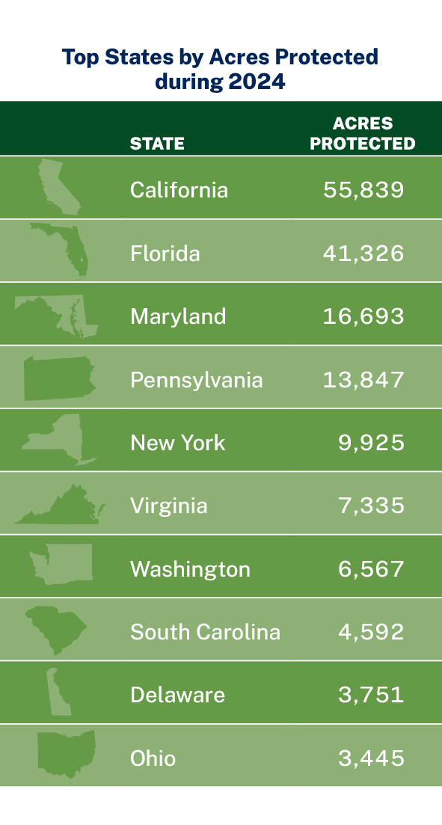

Slide 7
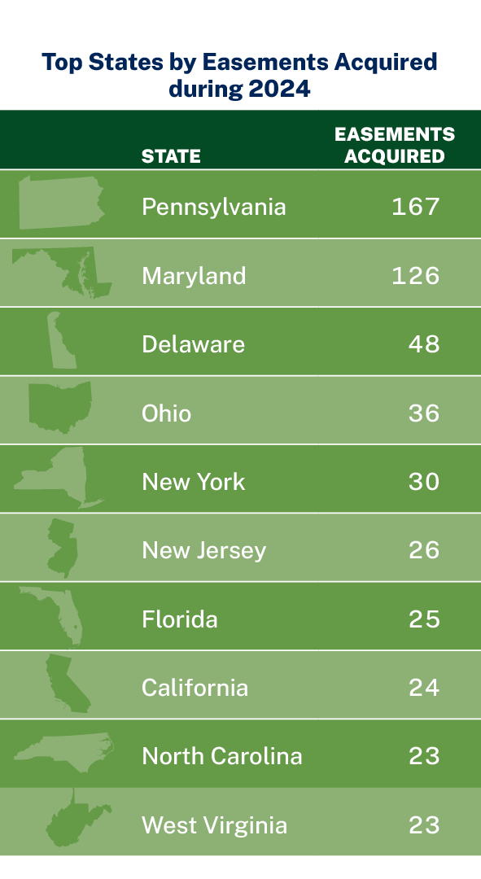

Slide 8
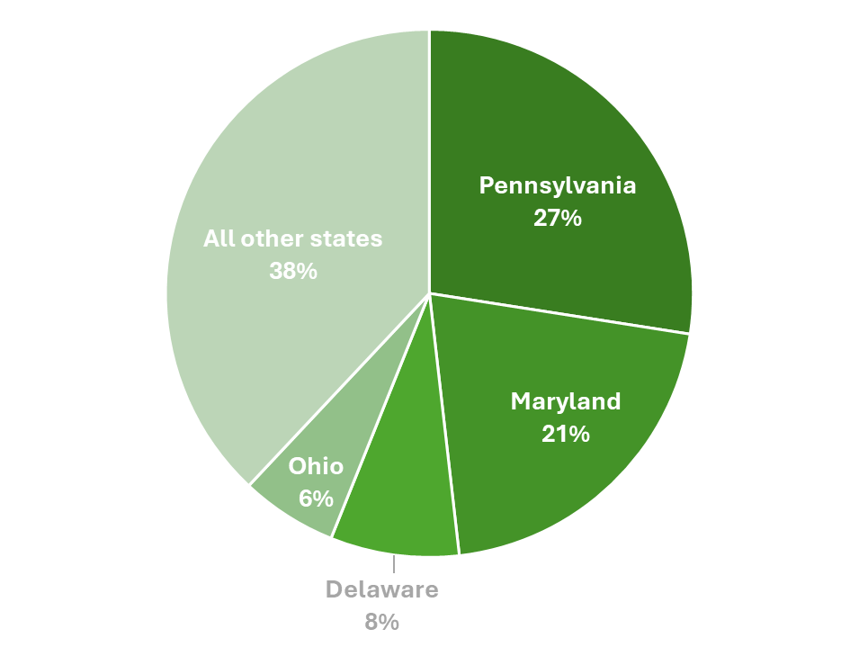
Proportion of Easements Acquired with the
Assistance of State PACE Programs in 2024

