Slide 1
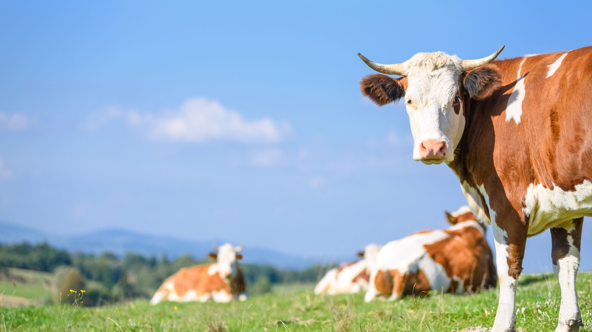
Incorporating Livestock

Slide 2
Lesson Vocabulary
Manure
Stocking Rate
Organic Matter
Over-grazing

Slide 3
Interest Approach
What is it like to own an animal?
What things do you think you need to own an animal?
What work goes into owning this animal?
Where would you keep this animal?
Notes:
To start the lesson, ask students to write for 2 minutes about owning an animal. This could be a pet they have themselves or what they think it might be like to own an animal. What things would they need to own this animal? What work goes into owning this animal? Where would they keep this animal?, etc.

Slide 4
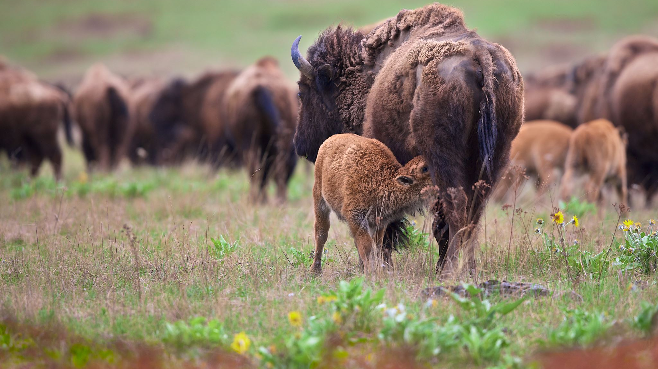
Grazing Animals
Animals have been a part of the land for centuries
Large buffalo and antelope grazed the lands
Farmsteads were created as families used animals to meet their needs
The growth of certain crops such as corn, soybean, and wheat in the Midwest have seen the decline of raising grazing animals
Notes:
Animals have been a part of the land for centuries. Back before settlers moved to America, large buffalo and antelope herds grazed the land. Over time, people have inhabited the land that was once home to grazing animals. For years, farmsteads were home to various animals to meet the farm family's needs. However, as pressure increased on farmers to provide more food, fiber and fuel to everyone, farmers became more specialized in growing certain crops, such as corn and soybeans as seen in the Midwest and have often stopped raising animals as well. Today we will explore why and how livestock can be beneficial to the land and some of the barriers to having livestock.

Slide 5

Grazing Cycle
Livestock deposit manure while grazing
There are many benefits to manure on cropland
Manure can increase soil productivity
Manure can increase soil organic matter and soil microorganisms
Increase phosphorus, potassium, calcium, and magnesium in topsoil
Increase nitrate nitrogen, calcium and magnesium in subsoils
Manured soils can be more porous and have lower bulk density
Notes:
Livestock deposit manure while grazing, and the benefits of manure on cropland have been known for thousands of years. Research has verified and quantified the impacts of manure. For example, Douglas Edmeades reviewed long-term comparisons of manure and fertilizer and showed that both have very large effects on soil productivity as shown by crop yields. Also, adding manure to soils was shown in these studies to increase organic matter and soil microorganisms; increase phosphorus, potassium, calcium, and magnesium in topsoils; and increase nitrate nitrogen, calcium, and magnesium in subsoils. Manured soils also were shown to be more porous and have lower bulk density (a measure of compaction) and higher aggregate stability than fertilized soils (2003). At the levels used in these studies, there was no significant difference in crop yields between fertilized and manured soils. However, as prices of fertilizer rise, economics may favor the use of manure, particularly if that manure is applied directly by the animals as they are grazing in a controlled way.

Slide 6
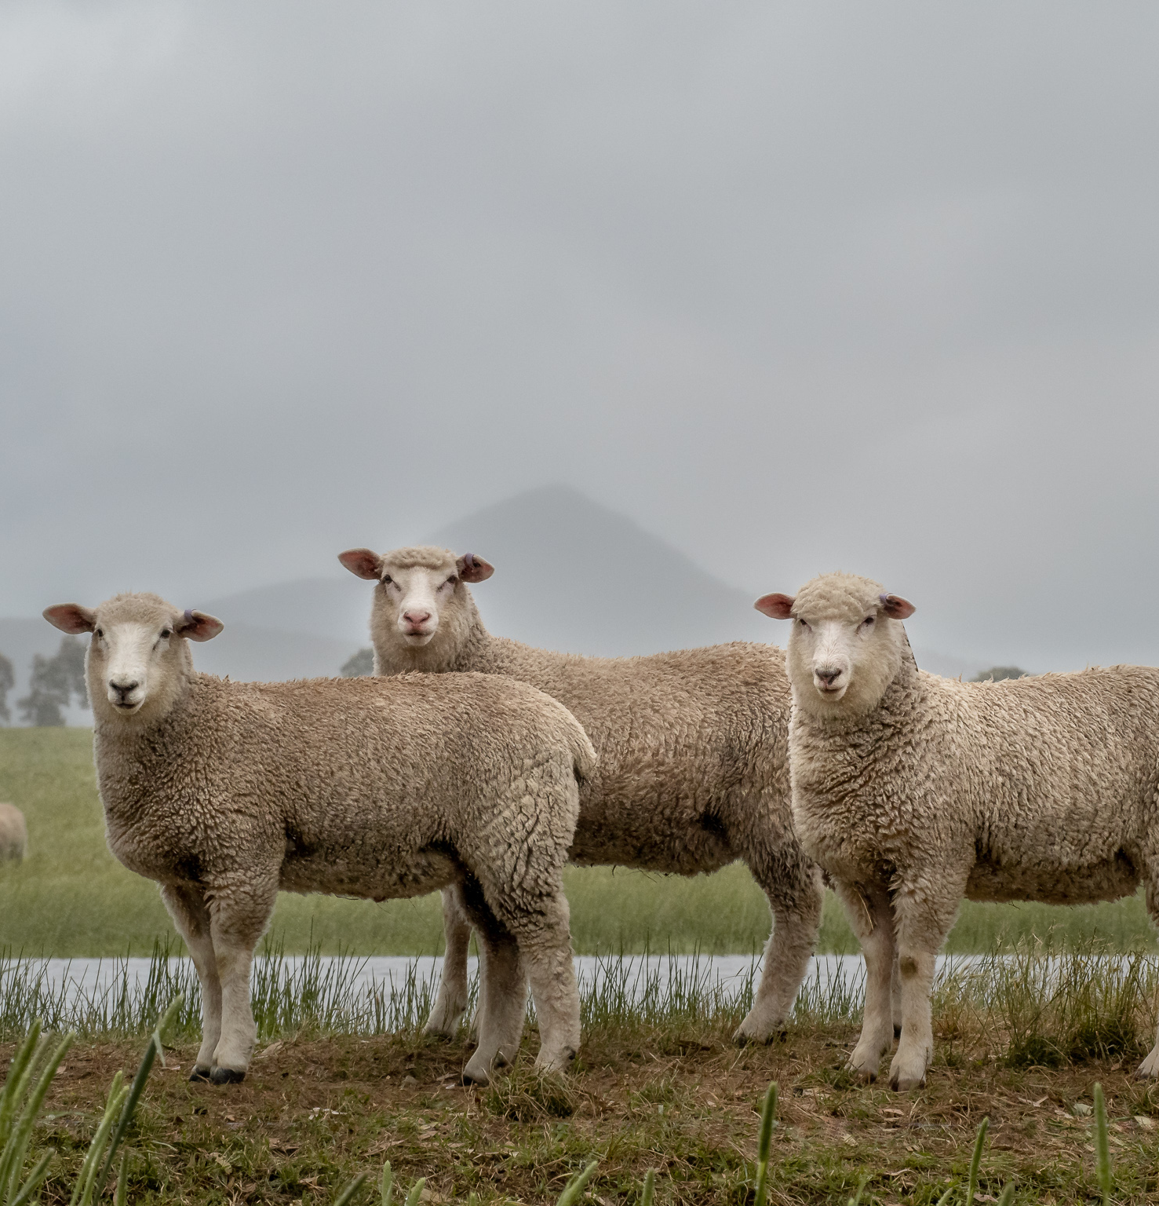
Livestock
Animals can solve problems through their natural habits – eating
Grazing animals like sheep can ear nuisance weeds in cropping fields
They can consume over ripe vegetables and fruits to reduce waste
In Kansas, farmers use cattle to graze corn fields after harvest to reduce volunteer plants in the next crop season
Notes:
Animals can solve problems for farmers by doing what they do naturally - eating. Grazing animals, particularly sheep and goats, can eat weeds that can be a nuisance in cropping fields. By eating the weeds, the animals can also remove habitat and larvae for pests, such as the alfalfa weevil and wheat sawfly. Livestock can also consume over-ripe vegetables and fruit and reduce waste. In Kansas, farmers often also use cattle to graze corn fields after harvest to reduce volunteer plants in the next crop season.

Slide 7
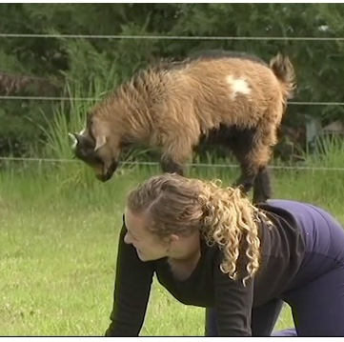
Cost Savings
Cheap manure can be found through dairy, hog, and poultry facilities
They bring additional income through selling their offspring, meat, eggs, or fiber
They can provide services, such as using goats to clean up brush and woody encroachment areas
Of course… Goat Yoga
This Photo by Unknown Author is licensed under CC BY-SA
Notes:
(Integrating Livestock and Crops: Improving Soil, Solving Problems, Increasing Income – ATTRA – Sustainable Agriculture (ncat.org)) In many cases, manure can be found cheaply or even free to farmers for their fields from livestock feedlots, hog and poultry facilities and other places that must remove animal waste for animal health reasons.
additionally, livestock can provide farmers with an additional revenue stream by selling their offspring, meat, eggs, or fiber. Livestock can also provide a service; for example, goats have been used to clean up brush and woody encroachment areas. In some cases, farmers can also save money on fertilizer, pesticides and herbicides because livestock can supplement or reduce the need for these inputs.

Slide 8
Resting
An important part of livestock grazing is incorporating rest
When you rotate where the grazing occurs you give the plant critical rest for regrowth which is around 45 days
This encourages healthy soil and leaving adequate amounts of cover on the soil surface
75% of soil coverage allows for reduced carbon and moisture loss
Notes:
One important part of having livestock in your cropping system along with your pastureland or range is incorporating rest- time for the land to recover from grazing. That rest is critical to plant growth which requires around 45 days before you re-graze the plants to encourage healthy soil.
Leaving an adequate amount of cover on the soil surface is critical from an erosion standpoint and to reduce carbon and moisture loss. You need at least 75% of the soil to be covered. This will be dead cover and or living cover to protect the soil surface for microbial communities and to feed them for nutrient cycling for your following crop.

Slide 9
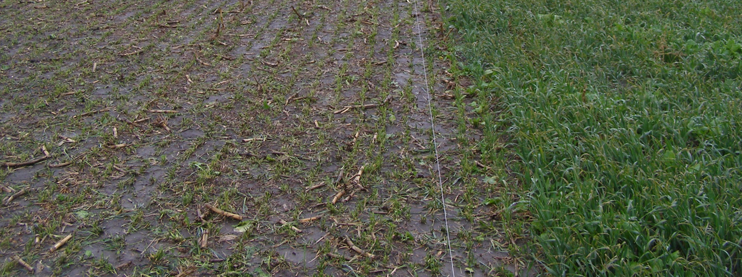
Overgrazing
Over grazed on the left
Ungrazed on the right
Notes:
Example of grazing over grazed on the left un grazed on the right , what are some things that can be done to reduce the amount of over grazing?

Slide 10
Stocking Rate
The number of specific kinds and classes of animals grazing on a piece of land together for a specific time
Type of animal: Horse, Cow, Goat, Sheep, Pig
Class of animal: Lactating, breeding
Forage needs: plant and nutrient availability
Notes:
Stocking rate is a large component of grazing livestock. It is the number of specific kinds and classes of animals grazing or using a unit of land for a specific time period. If a person exceeds the stocking rate, animals will overgraze the area and create additional problems associated with bare soil. Farmers and ranchers must take many factors into consideration when determining how many livestock can be on a piece of land, including, but not limited to: type of animal, class of animal (lactating, breeding, etc), soil type, type of forage and nutrient density, water and rainfall.

Slide 11
Discussion Point: Why don’t all farmers have livestock?
Notes:
But, if livestock are so beneficial and stocking rate can be managed, why do not all farmers have livestock? A similar question can be asked as to why not all people have pets. (Return to interest approach if needed. Some farmers do not enjoy animals nor have time to care for them. Cost is also a major factor in acquiring livestock. Not just the cost of the animal, but other costs as well. What other costs are involved in raising livestock? (Start a list at the front of the room. Anticipate and guide students through the following list: fencing, water, housing, feed when grazing is not available, medical costs, etc)

Slide 12
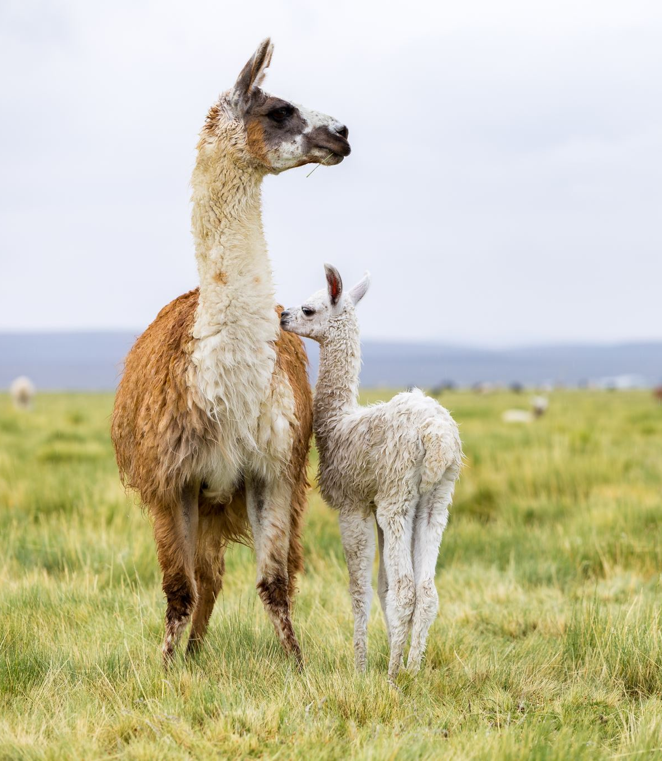
Livestock Cons
Some farmers may not enjoy animals or have time to care for them
Cost is a major factor in acquiring livestock
Not just the cost of the animal but what costs are associated with owning and caring for livestock?
Some farming systems are not equipped to handle livestock integration
Notes:
Some farmers do not enjoy animals nor have time to care for them. Cost is also a major factor in acquiring livestock. Not just the cost of the animal, but other costs as well. What other costs are involved in raising livestock? (Start a list at the front of the room. Anticipate and guide students through the following list: fencing, water, housing, feed when grazing is not available, medical costs, etc)

Slide 13
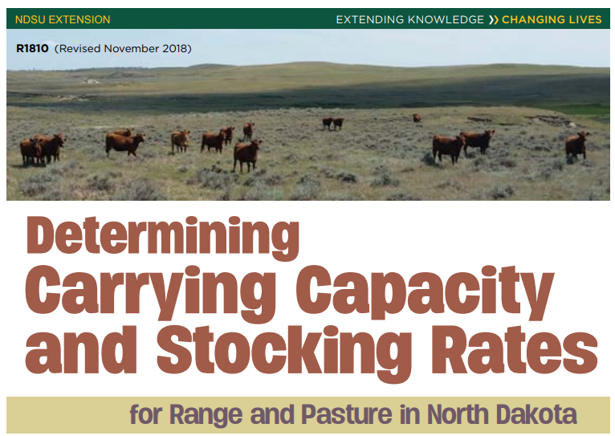
Bonus Activity: Read and Complete Activity
Notes:
https://www.nrcs.usda.gov/sites/default/files/2022-10/Determining%20Carry%20Capacity%20and%20Stocking%20Rates%20_ND.pdf

Slide 14
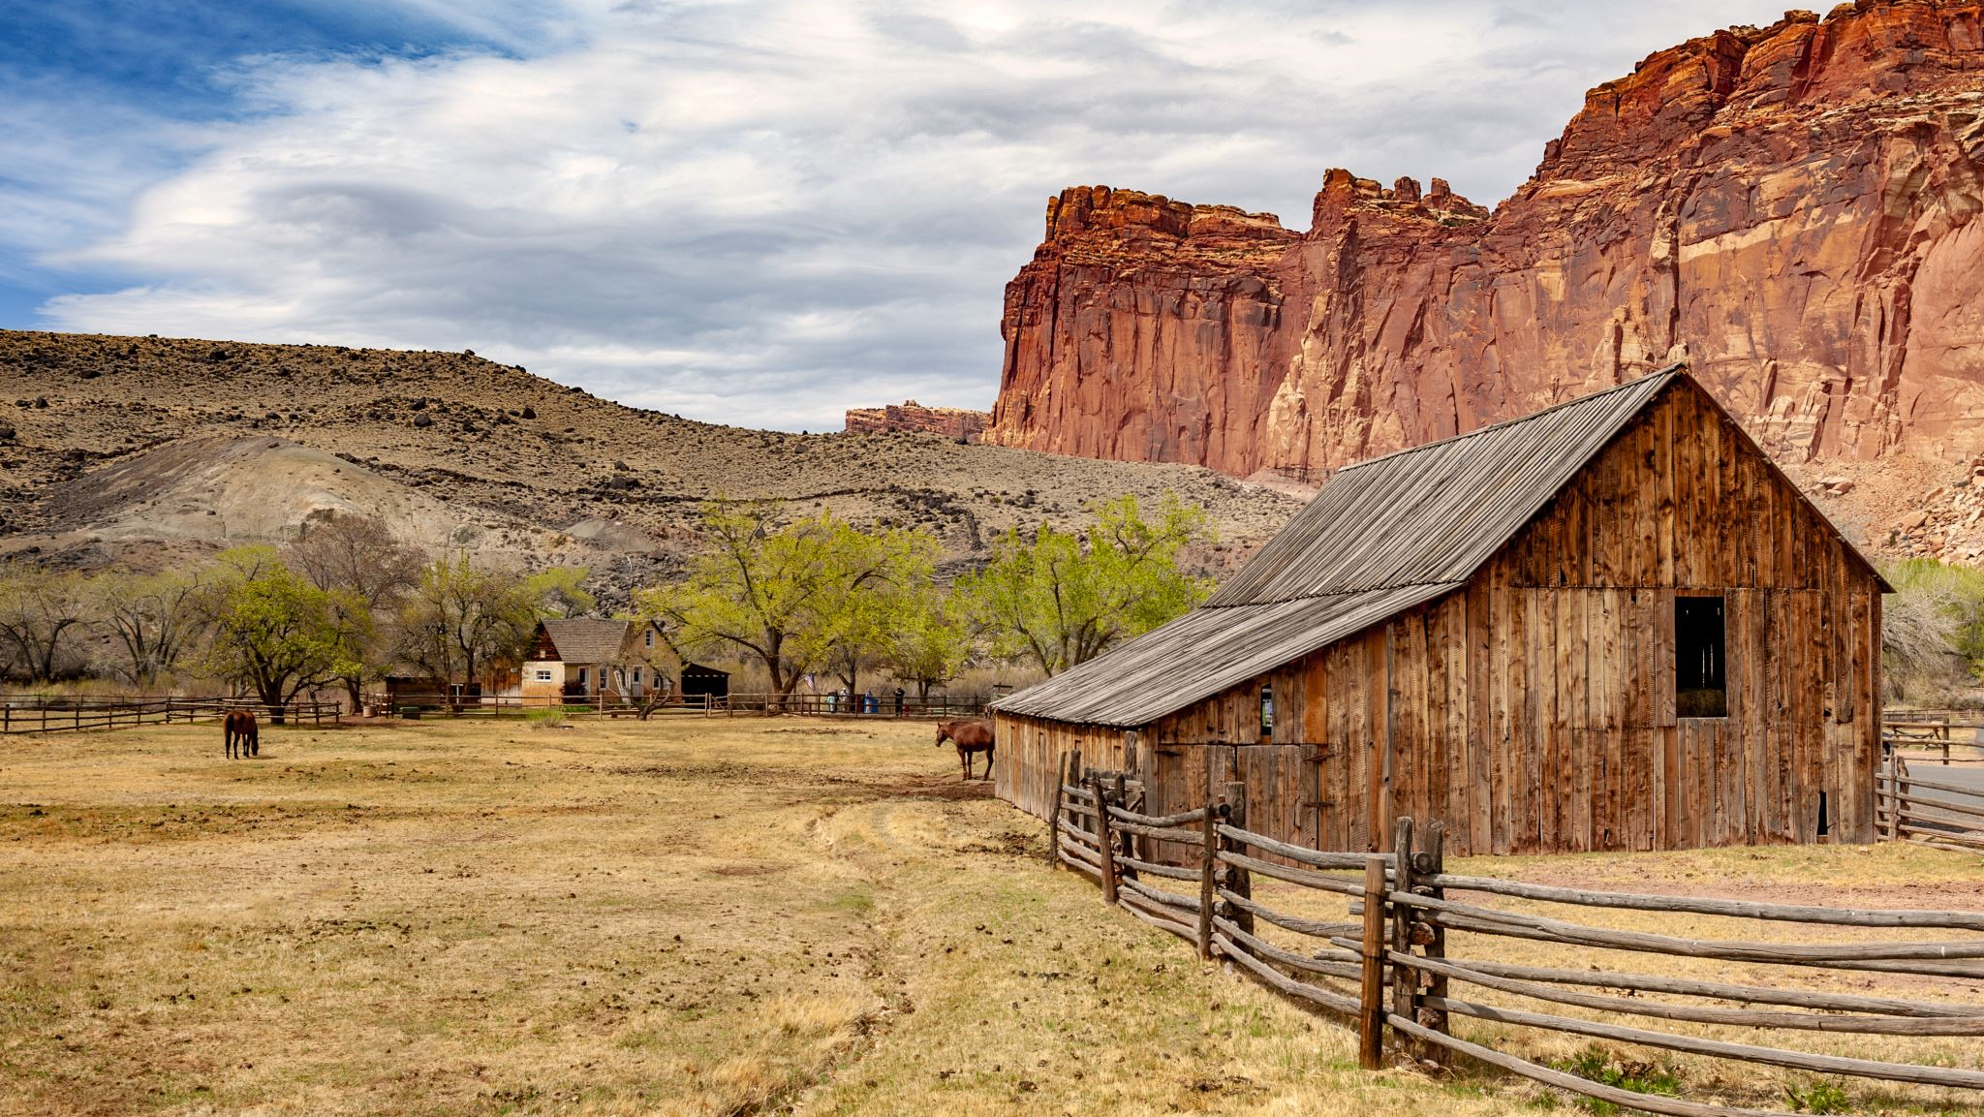
Interest Approach: Case Studies
Notes:
Use the case studies (Integrating Livestock and Crops: Improving Soil, Solving Problems, Increasing Income – ATTRA – Sustainable Agriculture (ncat.org)), pair students up. Each pairing should have 2 different case studies- 1 for each student. Ask students to read their case study, highlight essential information and share with their partner at the end. Every student will then have essential information from 2 case studies on incorporating livestock.

Slide 15
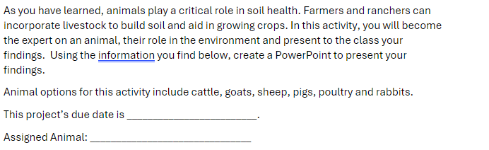
Livestock Research
Notes:
Students will complete research for different types of livestock for the next project. It is recommended to spend this class period researching and answering questions and one class period allowing students to present their results to the class.
Animals for research include: Goats, Sheep, Cattle, Chickens, Hogs

Slide 16
Livestock Presentations

