Slide 1
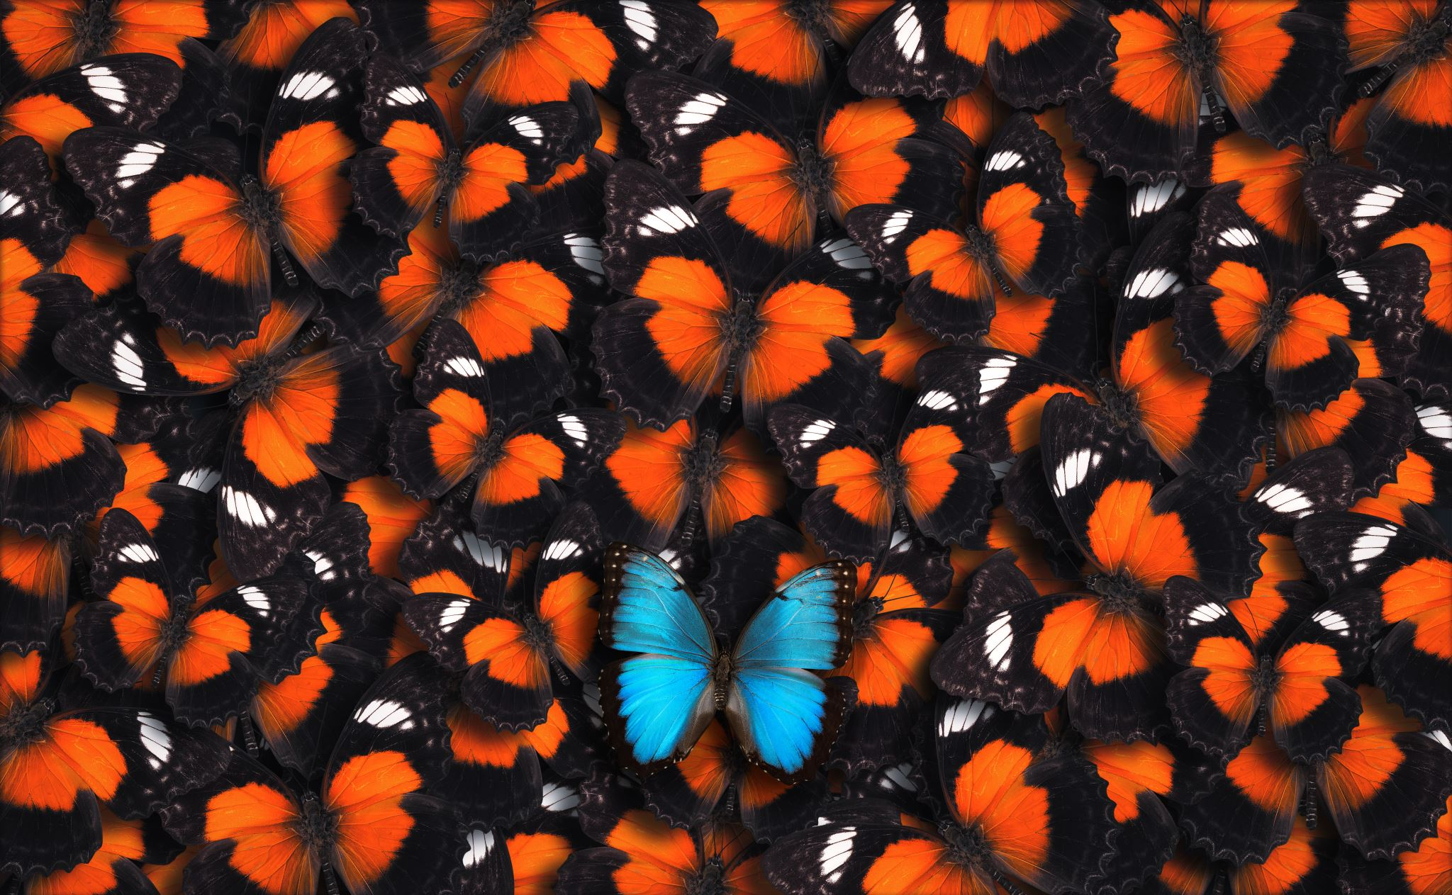
Increasing Biodiversity

Slide 2
Lesson Vocabulary
Food Web
Trophic Levels
Biodiversity
Pollinators
Apiculture
Nutrient Cycling
Autotroph
Consumer
Detritivore

Slide 3
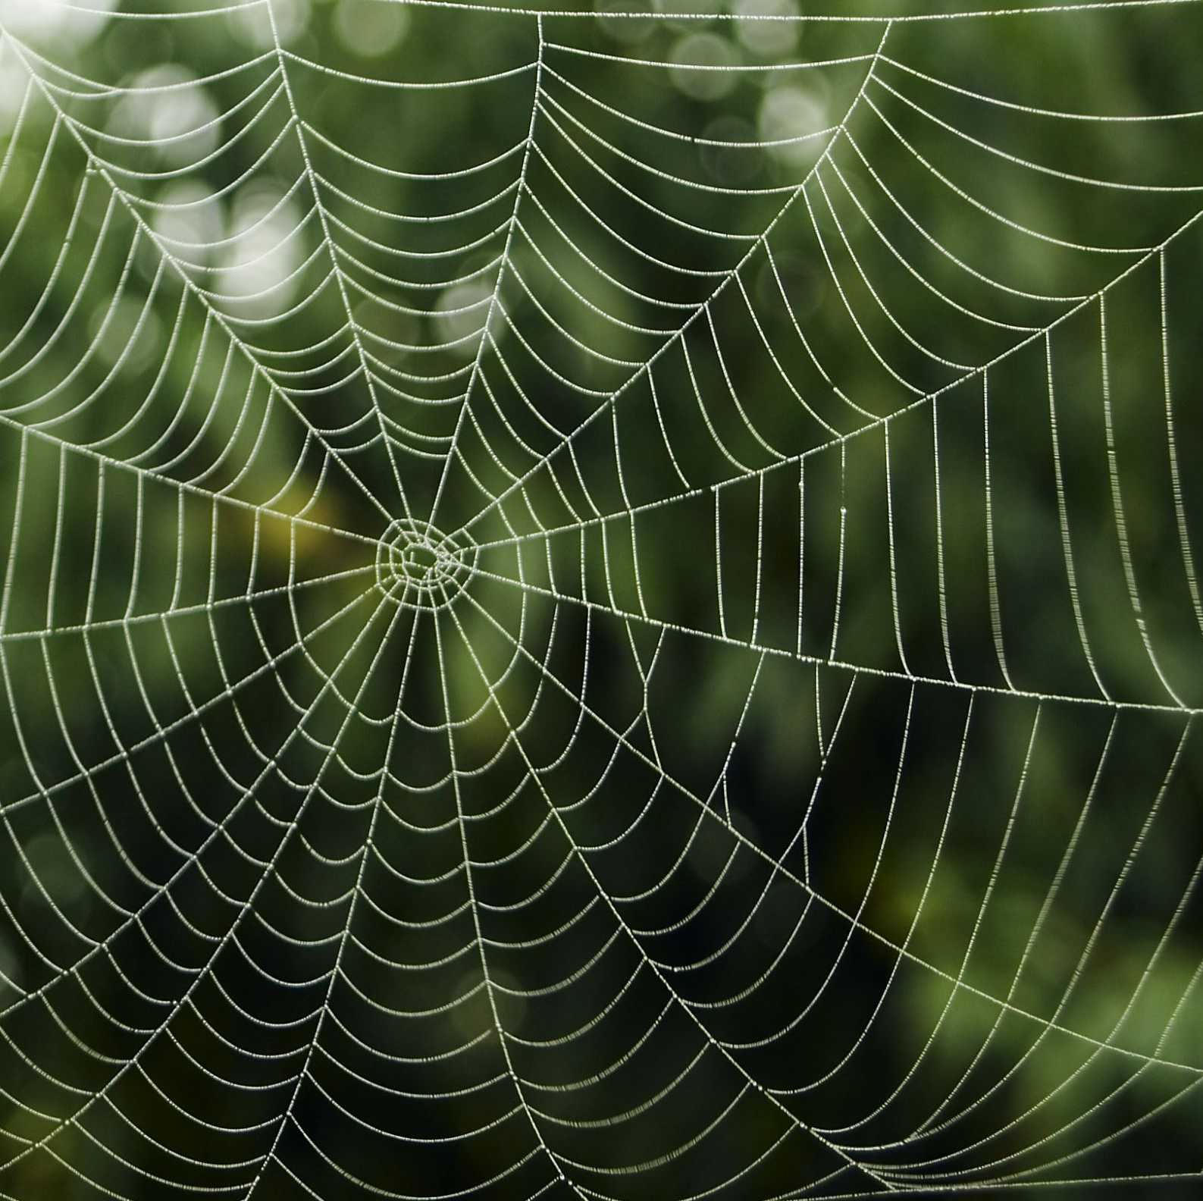
Interest Approach
7 minutes
Draw your best food web
Challenge: draw the biggest food web

Slide 4
Biodiversity
The variety of life forms within a given ecosystem
Life forms include all the plants, animals, and microorganisms
Each form has their own exudates, secretions or waste products
Healthy management includes full biodiversity
Notes:
This lesson is likely to review a lot of aspects but will tie into the benefits of biodiversity on the soil. The NRCS definition of Biodiversity is the variety of life forms within a given ecosystem or farm field. The different life forms include all the plants, animals and microorganisms that are present. Each life form includes their own unique set of exudates, secretions or waste products that further contribute to increased diversity. Healthy management systems are full of biodiversity.

Slide 5
Increasing Diversity
Includes increasing plant diversity
Integration of additional animals
Microbial diversity
Nutrient diversity
Notes:
Increases in diversity can be achieved through various approaches, including plant diversity (through diversified crop rotations and cover crop mixes), integration of grazing animals (e.g. livestock) into the system. It includes animals living within the soil or microbial diversity, as well as direct additions with biological amendments.

Slide 6

Food Webs
Made from all the food chains within a single ecosystem
Depict the transfer of energy and nutrients
Categories within the food web are called trophic levels
Notes:
Food webs consist of all the food chains in a single ecosystem. Food chains depict the transfer of energy and nutrients as they move through the ecosystem. There are different categories within the food web called trophic levels.

Slide 7
Trophic Levels
Producers
Autotrophs: make their own food and not dependent on other organisms for their food
Consumers
Organisms that need to consume other organisms for energy
Decomposers
Detritivores: organisms who cycle waste back into the system
Notes:
These trophic levels are producers, consumers, and decomposers. Producers make up the first trophic level. They consist of autotrophs, which are organisms that can make their own food and do not depend on any other organisms for nutrition. Most commonly, these are plants.

Slide 8
Consumers
Primary Consumers
Herbivores: exclusively consumer producers
Secondary Consumers
Carnivores and omnivores: consume primary consumers
Tertiary Consumers
Consume secondary consumers
Apex Predators
Top consumers that have no natural predators outside of humans
Notes:
Consumers are the second trophic level. They consist of organisms that need to consume other organisms for energy. Primary consumers are herbivores, as they exclusively consume producers. Secondary consumers are carnivores and omnivores as they consume primary consumers. Tertiary consumers eat secondary consumers. Apex predators are the top consumers that have no other natural predators outside of humans.

Slide 9
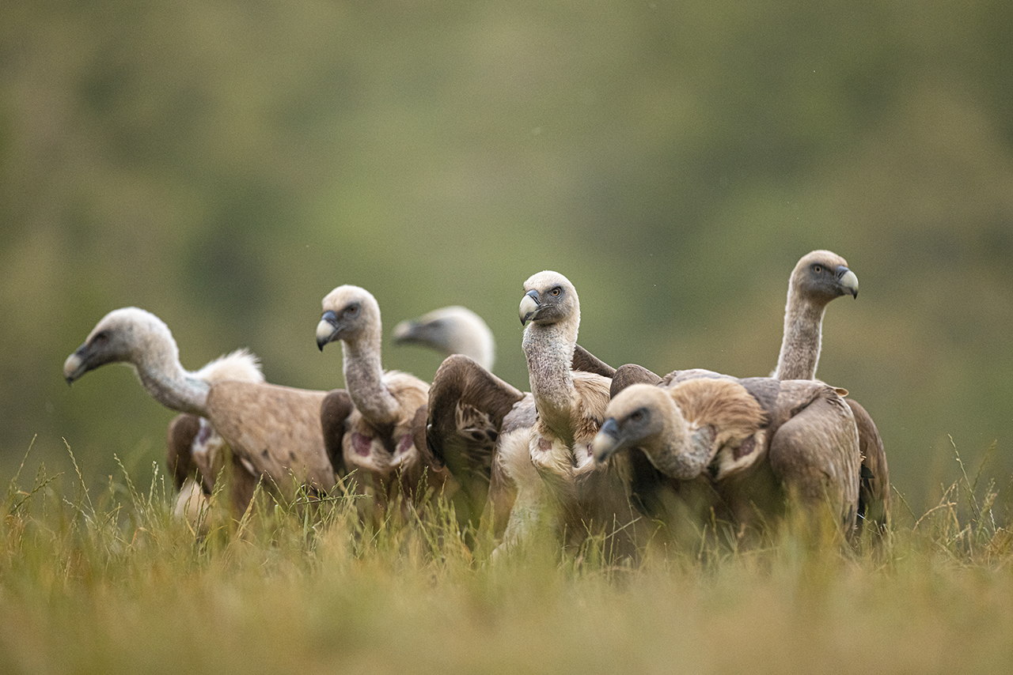
Detritivores and Decomposers
Organisms that eat nonliving plant and animal remains
Include scavengers: vultures, fungi and bacteria
Cycle waste back into the soil
Foster the growth of autotrophs
Notes:
Detritivores and decomposers are the organisms that eat nonliving plant and animal remains. These include scavengers such as vultures, or fungi and bacteria that live in the soil. These organisms cycle waste back into the soil, which in turn fosters the growth of autotrophs, starting the whole cycle back over.

Slide 10

Biodiversity
Supports every level of the food web
Supports the habitats for all species
Includes food sources and aboveground diversification of plants and animals and belowground microbes
Diversification stimulates benefits through breaking the cycle of disease, providing habitats for pollinators, wildlife, beneficial predators and stimulates plant growth
Notes:
Biodiversity supports every level of the food web. Biodiversity supports the habitats for all species in every level of the food web. Each organism can be supported in their unique environment through the creation of ecosystems of all types and sizes. Diversity not only refers to food sources, but also aboveground diversification of plants and animals, as well as microbial diversification underground. Diversification stimulates a host of additional benefits including breaking disease cycles, providing habitat for pollinators, wildlife, and beneficial predators, and stimulating plant growth.

Slide 11
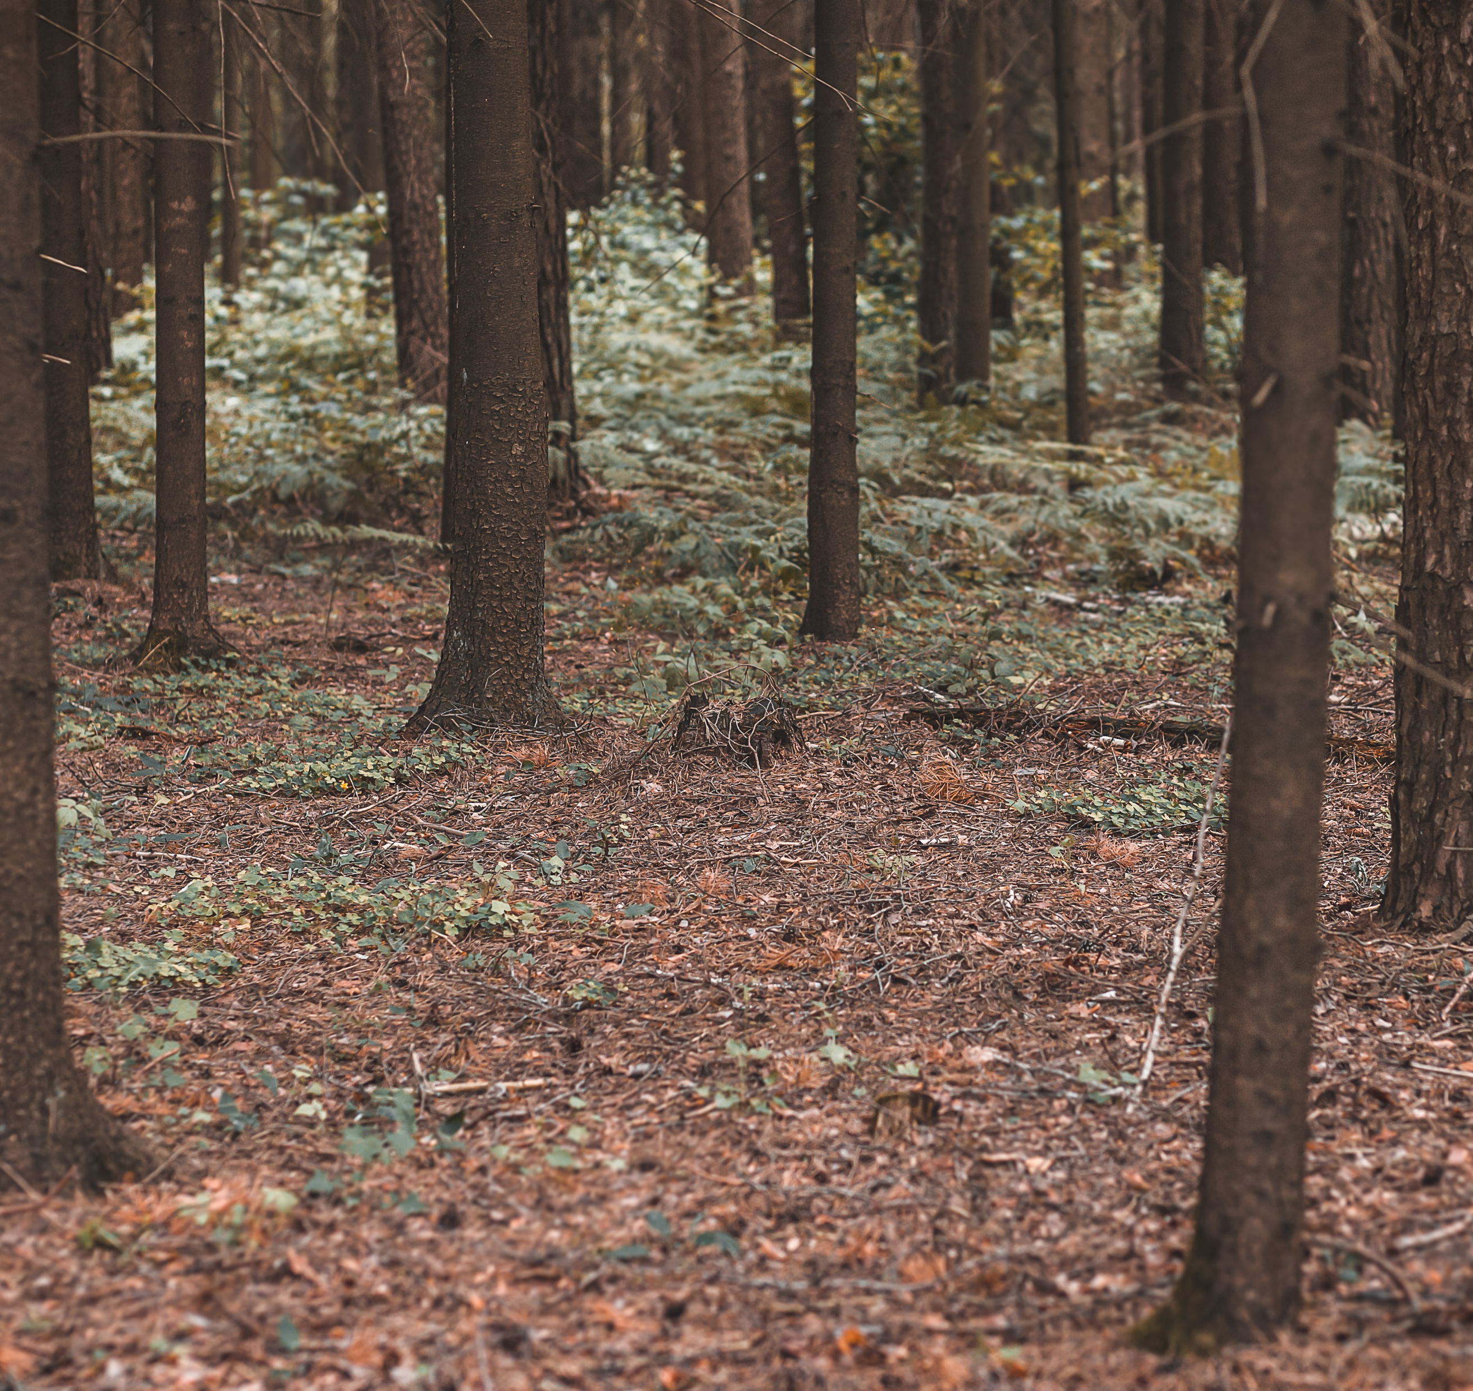
Soil Biodiversity
Soil is built of the detritivores
One teaspoon of topsoil contains up to 6 billion microorganisms
The soil is the foundation of the food web
It recycles biomass and cycles nutrients
Worms, microorganisms, bacteria, and fungi
Disruptions at this level impact the entire food web
Notes:
Soil biodiversity is created from the various types of life that exist within and above the soil. This can include bacteria, fungi, earthworms, beetles, ants, and termites. A teaspoon of topsoil typically contains up to 6 billion microorganisms. Soil is the most biologically diverse material on earth.

Slide 12
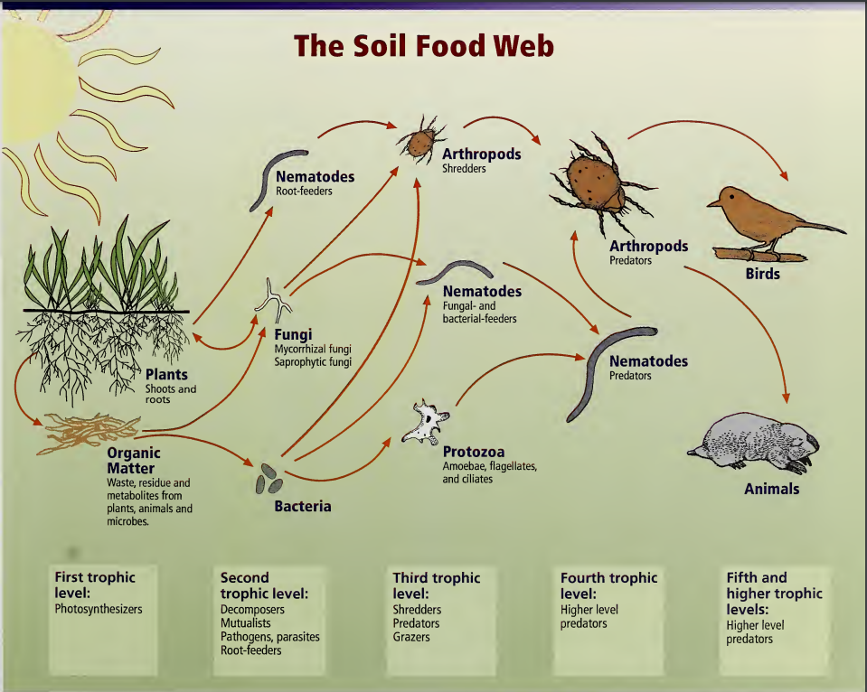
Notes:
The soil is responsible for recycling the biomass within the food web. Worms, microorganisms, bacteria and fungi are all responsible for putting nutrients back into the soil. Disruptions within this level of the food web impact the entire ecosystem. This is also true for apex predators. All the organisms within the soil interact with each other through cycles and predator-prey relationships. It’s all about eating and being eaten.

Slide 13
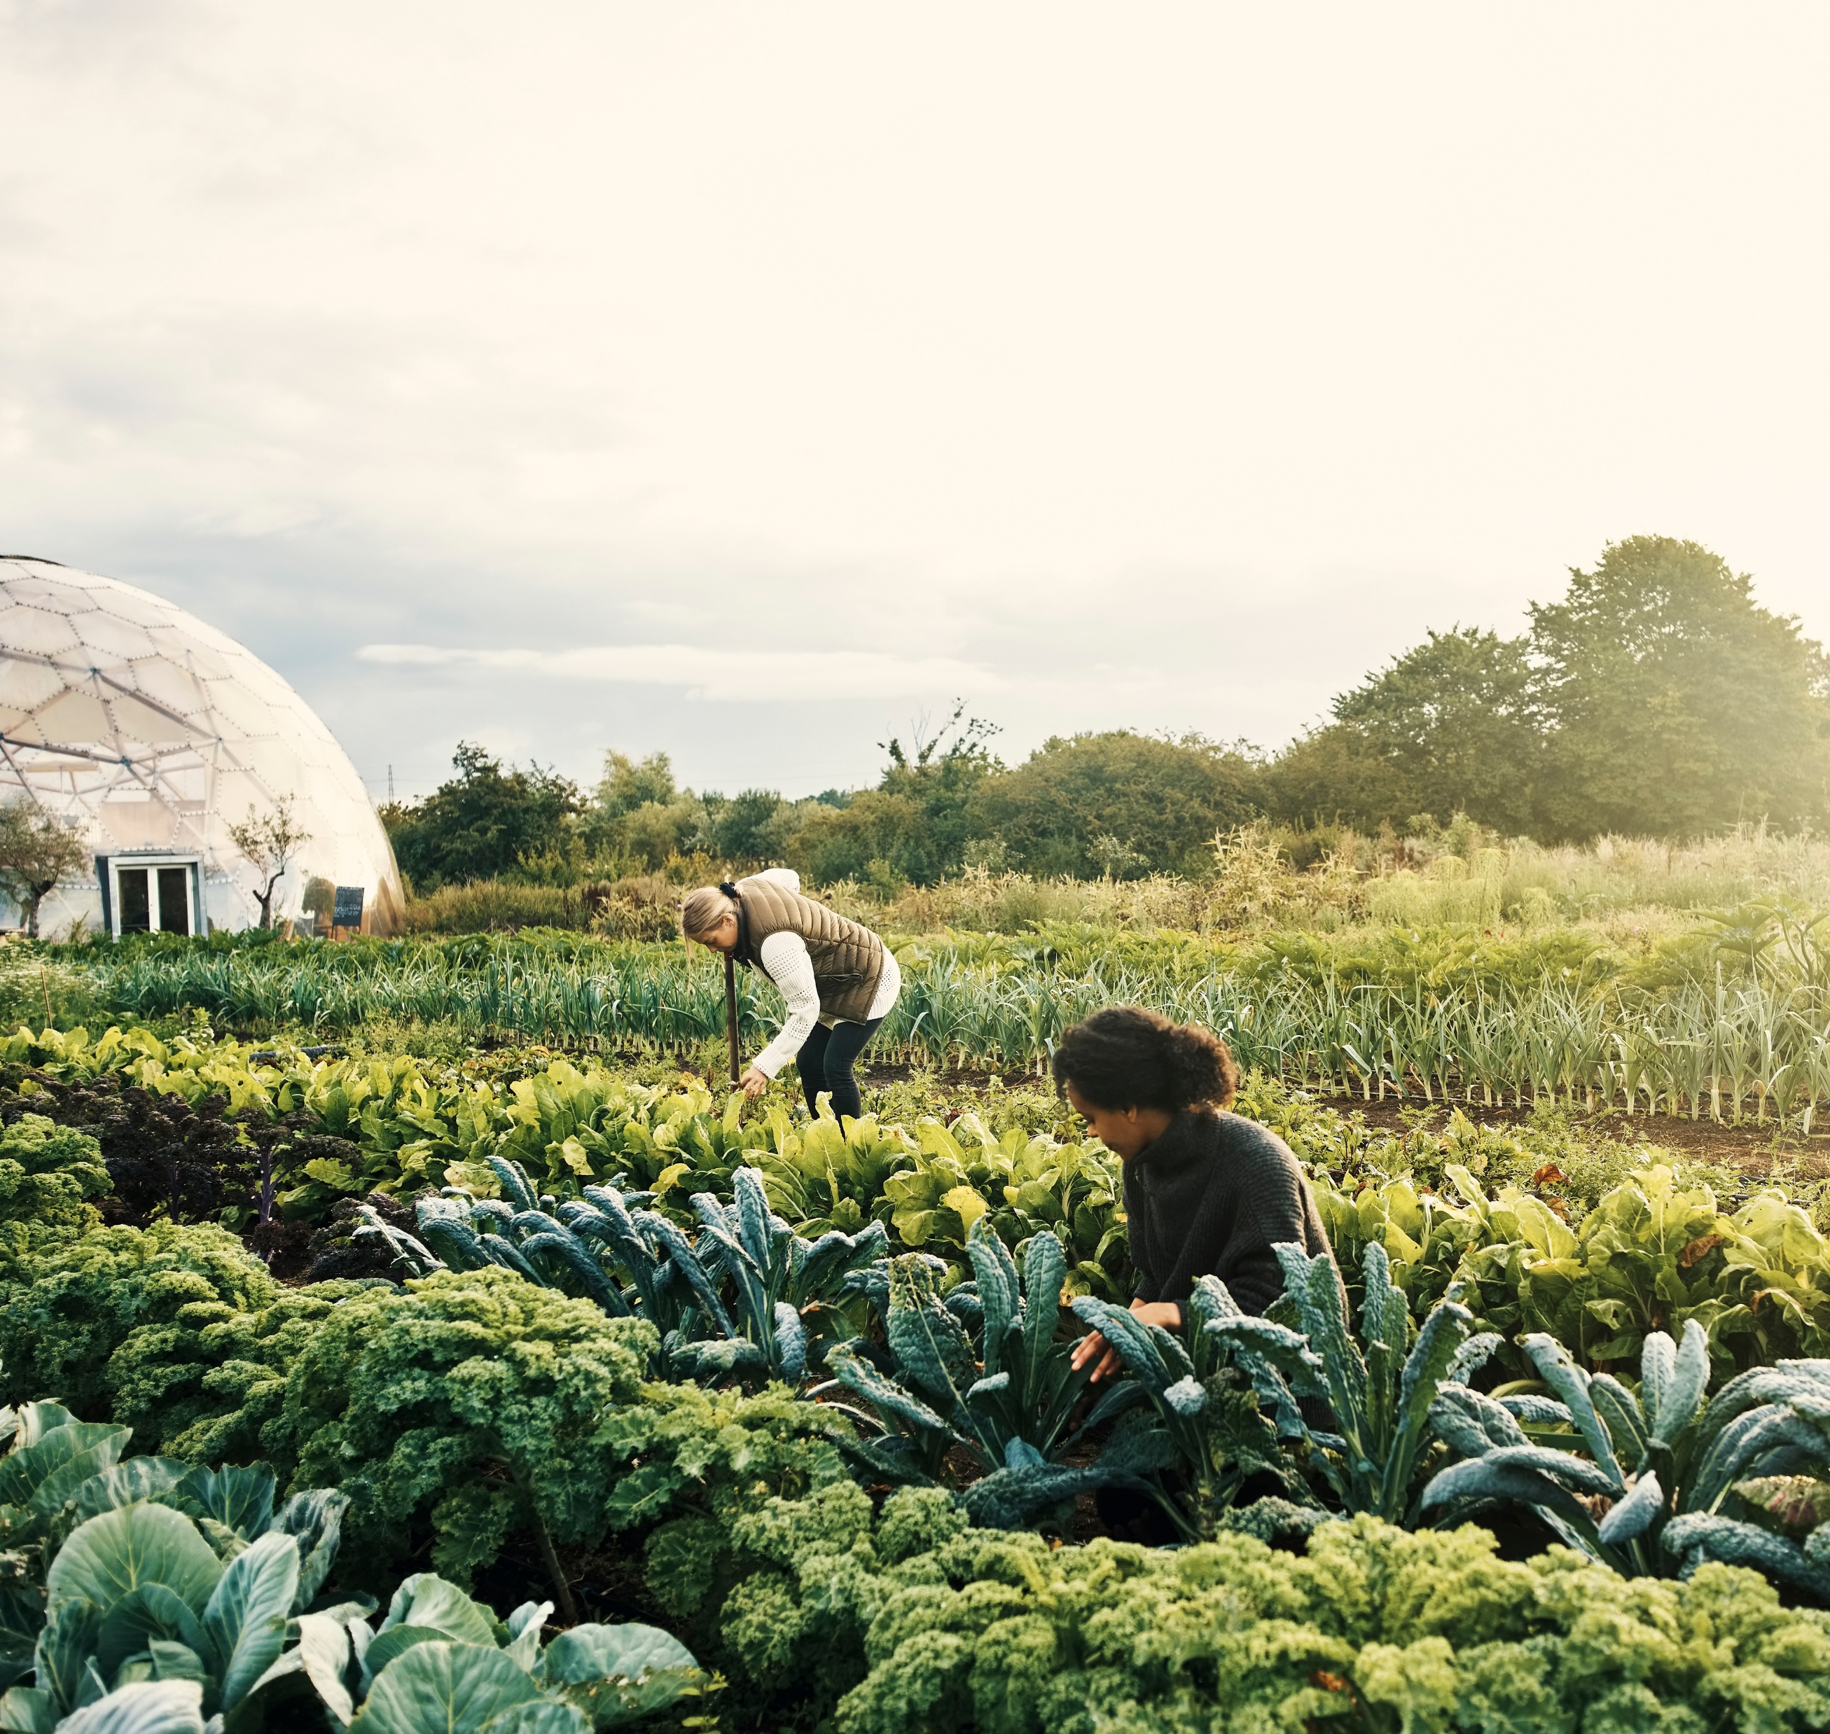
Farming Biodiversity
Rotating the crops grown in the same field
Leaving field borders with native grasses and plants
Leaving trees along fence lines
Incorporating woody draws
Incorporating grazing animals such as hooved mammals
Notes:
Farming with biodiversity can look like rotating between crops grown in the same field, leaving field borders enriched with native grasses and flowering plants, not bulldozing out trees along fence lines or in woody draws and the incorporation of grazing animals

Slide 14
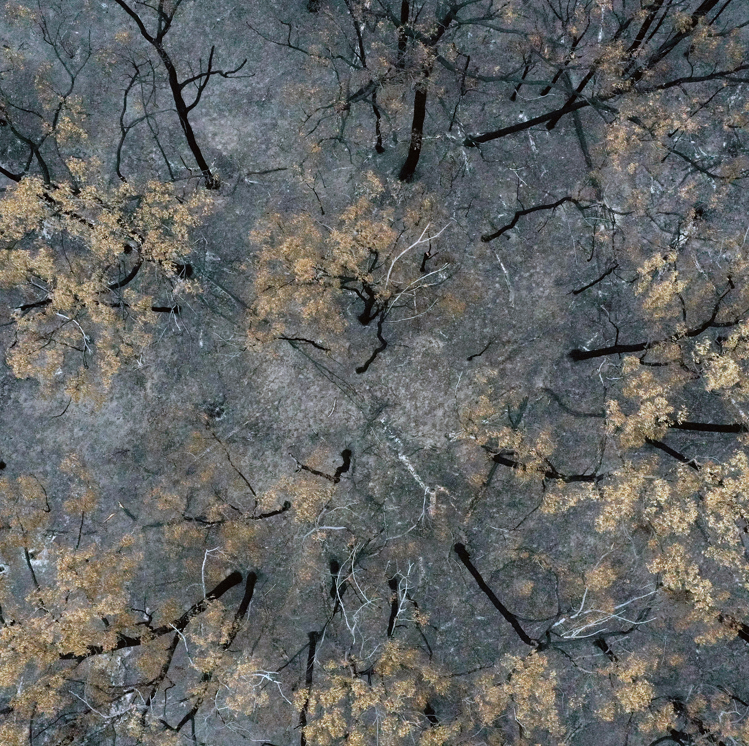
Farming Biodiversity Benefits
Optimize nutrient cycling
Improved water quality and quantity
Can help with weed control through increasing crop competitiveness
Disrupts weed, pest, and pathogen cycles
Creates additional habitats to foster beneficial insects
Notes:
This can optimize nutrient cycling, improve water quality and quantity, as different crops use and produce different nutrients. Additionally, it can control weeds through the varying competitiveness of crops against different weed species and disrupt pest and/or pathogen lifecycles. Incorporating various crops to cycle nutrients into the soil can help better overall growth of autotrophs. Secondly, greater crop diversity provides more habitats to foster beneficial insects. Insects are key to pollination, but specific predatory insect species are also important in mitigating pests harmful to crops. It is important to have all levels of the food web participating for the overall stability of the system. We also need to add diversity to the cover crop mixes we use within rotations, single species or monocultures have less of an impact on above and below ground biodiversity.

Slide 15
Diversity and Adaptation

Slide 16
Diverse Ecosystems
Adapt to changes in conditions
Includes weather changes, diseases, and overall climate change
Increased biodiversity in crops and cover crops create natural control of pests and disease
Introducing livestock can bring fresh nutrients from their waste and help control weeds
Planting a grazing crop expands the rotation and diversity of the soil microbiome
Notes:
Diverse ecosystems lead to better adaptation to changes in conditions. This can include weather changes, diseases, and overall climate change. The greater biodiversity in crops and cover crop mixes, the greater the ability for natural control of pests and disease. This can also include rotational grazing on plots of land as well. Introducing livestock into a field can bring in fresh nutrients from their waste and help control weed species. Planting a grazing crop would expand the rotation and letting it grow enough to graze will increase the diversity in the soil microbiome.

Slide 17
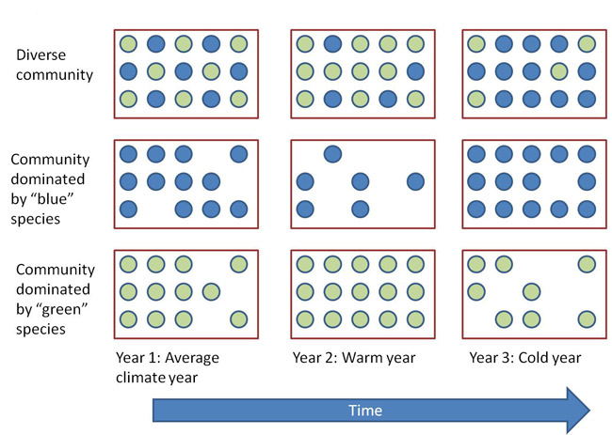
Notes:
Figure 1: Conceptual diagram showing how increasing diversity can stabilize ecosystem functioning
Each rectangle represents a plant community containing individuals of either blue or green species and the total number of individuals corresponds to the productivity of the ecosystem. Green species increase in abundance in warm years, whereas blue species increase in abundance in cold years such that a community containing only blue or green species will fluctuate in biomass when there is interannual climate variability. In contrast, in the community containing both green and blue individuals, the decrease in one species is compensated for by an increase in the other species, thus creating stability in ecosystem productivity between years. Note also that, on average, the diverse community exhibits higher productivity than either single-species community. This pattern could occur if blue or green species are active at slightly different times, such that competition between the two species is reduced. This difference in when species are active leads to complimentary resource utilization and can increase total productivity of the ecosystem.
© 2011 Nature Education All rights reserved.

Slide 18
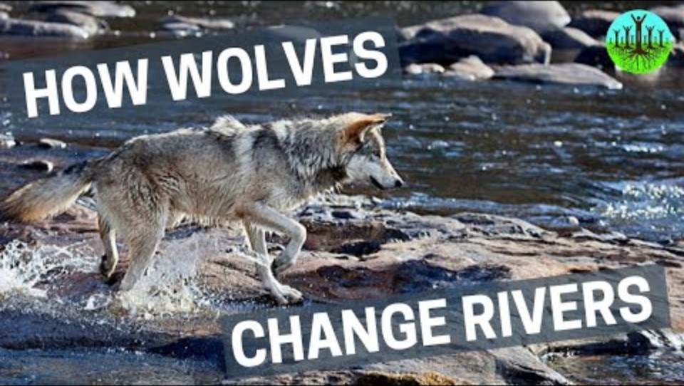
Optional Discussion Point

Slide 19
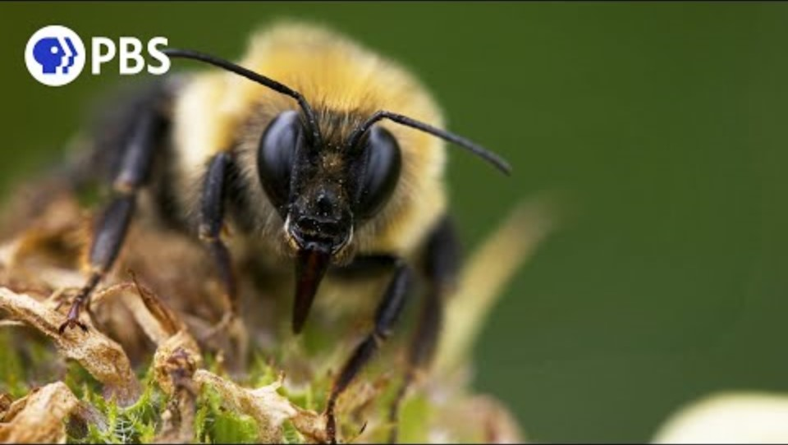
Interest Approach
Notes:
After watching the video, instruct students to write for one minute about how agriculture impacts AND is impacted by pollinators, such as the bees in the video. Discuss student thoughts as a group.

Slide 20
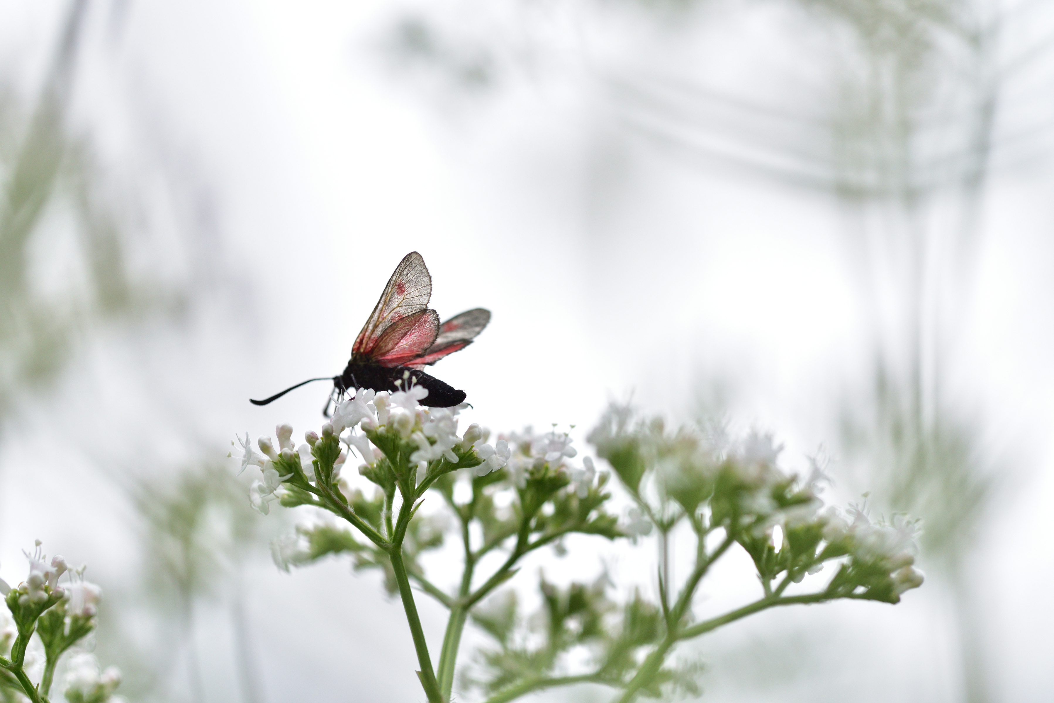
Pollinators
Move pollen grains from flower to flower
Over 200,000 species of animals act as pollinators
1,000 are hummingbirds, bats, and small mammals
The rest are beetles, ants, wasps, butterflies, and moths
Notes:
Pollinators are very important to agriculture. Pollinators move the pollen grains from flower to flower. Over 200,000 species of animals act as pollinators, and of those, about 1,000 are hummingbirds, bats and small mammals (Source: USDA Forest Service). The rest are insects, such as beetles, bees, ants, wasps, butterflies, and moths. What is pollination?

Slide 21
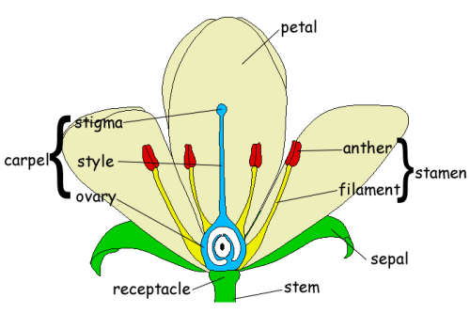
Pollination
This Photo by Unknown Author is licensed under CC BY-SA-NC
Pollination is the transfer of pollen to a stigma, ovule, flower, or plant to allow fertilization
Most flowers require the assistance of pollinators to produce seeds and fruit
80% of all flowering plants and over three-quarters of the staple crop plants that feed humankind rely on animal pollinators
Notes:
What is pollination? According to the Oxford Dictionary, pollination is the transfer of pollen to a stigma, ovule, flower, or plant to allow fertilization. Most plants require the assistance of pollinators to produce seeds and fruit. About 80% of all flowering plants and over three-quarters of the staple crop plants that feed humankind rely on animal pollinators (USDA Forest Service).

Slide 22
The Value of Pollination
In the US the value of pollination for agricultural crops is $10 billion annually
Globally pollination services are valued at $3 trillion
Half the world’s diet of fats and oils come from animal-pollinated plants
150 food crops in the US depend on pollinators including almost all fruit and grain crops
Notes:
In the United States alone, pollination of agricultural crops is valued at 10 billion dollars annually. Globally, pollination services are likely worth more than 3 trillion dollars.
More than half of the world’s diet of fats and oils come from animal-pollinated plants (oil palm, canola, sunflowers, etc.). More than 150 food crops in the U.S. depend on pollinators, including almost all fruit and grain crops. The USDA estimated that crops dependent on pollination are worth more than 10 billion dollars per year.

Slide 23
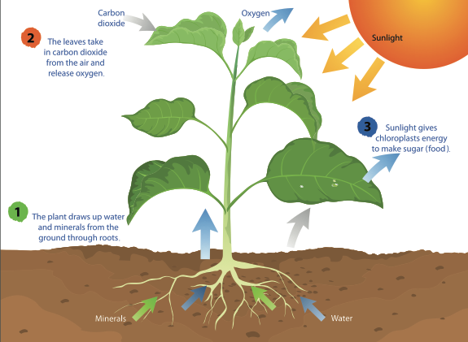
Flowering plants produce breathable oxygen
Utilize carbon dioxide produced by plants and animals through respiration
Carbon dioxide levels have been rapidly increasing
Pollinators are key to plant reproduction
Plants help purify water and prevent erosion through root growth
Notes:
Flowering plants produce breathable oxygen by utilizing the carbon dioxide produced by plants and animals as they respire. However, levels of carbon dioxide in the atmosphere have been rapidly increasing in the last century due to increased burning of fossil fuels and destruction of vital forests – the “earth’s lungs.” Pollinators are key to reproduction of wild plants in our fragmented global landscape. Without them, existing populations of plants would decline, even if soil, air, nutrients, and other life-sustaining elements were available. Flowering plants help to purify water and prevent erosion through roots that holds the soil in place, and foliage that buffers the impact of rain as it falls to the earth. The water cycle depends on plants to return moisture to the atmosphere, and plants depend on pollinators to help them reproduce. (USDA Forest Service)
Some farmers seek government assistance to diversify their farm and plant areas where pollinators will be attracted to. The Conservation Reserve Program (CRP) is an example of one way the government can provide funds for farmers to plant areas that are attractive to pollinators.

Slide 24
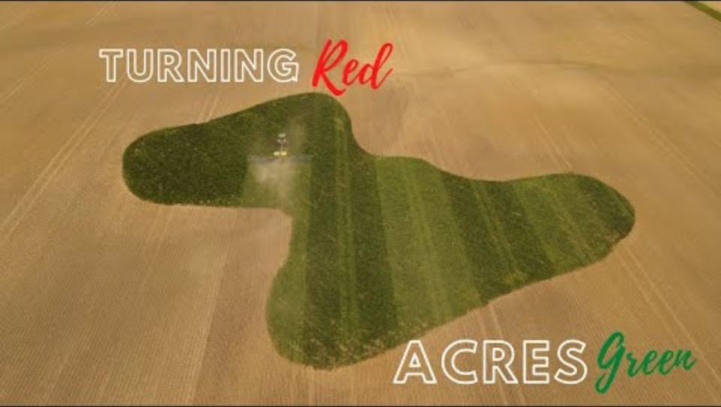
Activity:
Notes:
Let’s watch this video (https://www.youtube.com/watch?v=JpPhLj-0Db0) about how a farmer is using technology to diversify the farm and increase pollination. As you watch the video, consider: 1.) What technology makes this possible? 2.) From an economics perspective, are there benefits to the farm?

Slide 25
Discussion Point: How Pollinators Interact on Farms
Notes:
Somewhere between 75% and 95% [1] of all flowering plants on the earth need help with pollination – they need pollinators. Pollinators provide pollination services to over 180,000 different plant species and more than 1200 crops. That means that 1 out of every three bites of food you eat is there because of pollinators [2, 3]. If we want to talk dollars and cents, pollinators add 217 billion dollars to the global economy [4,5], and honey bees alone are responsible for between 1.2 and 5.4 billion dollars in agricultural productivity in the United States [6].
https://www.pollinator.org/pollinators#:~:text=Birds%2C%20bats%2C%20bees%2C%20butterflies,resources%20by%20helping%20plants%20reproduce.

Slide 26
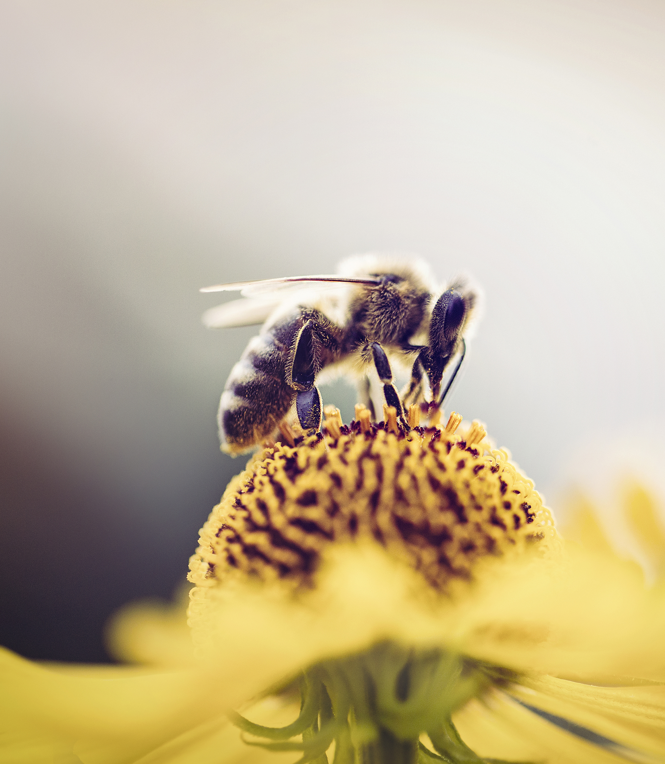
Interest Approach
Yesterday we discussed pollinators and their importance, specifically within agriculture. Where do you think pollinators fall in the food chain? How about the food web? Why do you think that?
Notes:
Ask students to take out a piece of paper to journal their thoughts to this question: Yesterday, we discussed pollinators and their importance, specifically within agriculture. Where do you think pollinators fall in a food chain? How about a food web? Why do you think that?

Slide 27

ACTIVITY
Divide students into groups of 2-3
1. Identify 3 species of pollinators that they wish to attract.
2. Identify 2 species of plants they would like to plant that would attract EACH of the pollinators (6 in total).
3. List the 4+ benefits of the pollinator habitat on their school, home and community.
Notes:
Dividing students into groups of 2-3, give each group a large (11x17’ or poster board) paper. Provide a variety of crayons, colored pencils, markers,etc. A computer may be used to help identify specific pollinators and what plants attract them. Ask students to design a pollinator habitat for your school, home or community. Use the following as guidance:
1. Identify 3 species of pollinators that they wish to attract.
2. Identify 2 species of plants they would like to plant that would attract EACH of the pollinators (6 in total).
3. List the 4+ benefits of the pollinator habitat on their school, home and community.
Draw the pollinator habitat and answer these questions on the poster board.

Slide 28
Classroom Walk
Notes:
Time to walk around and view all posters!

