Slide 1
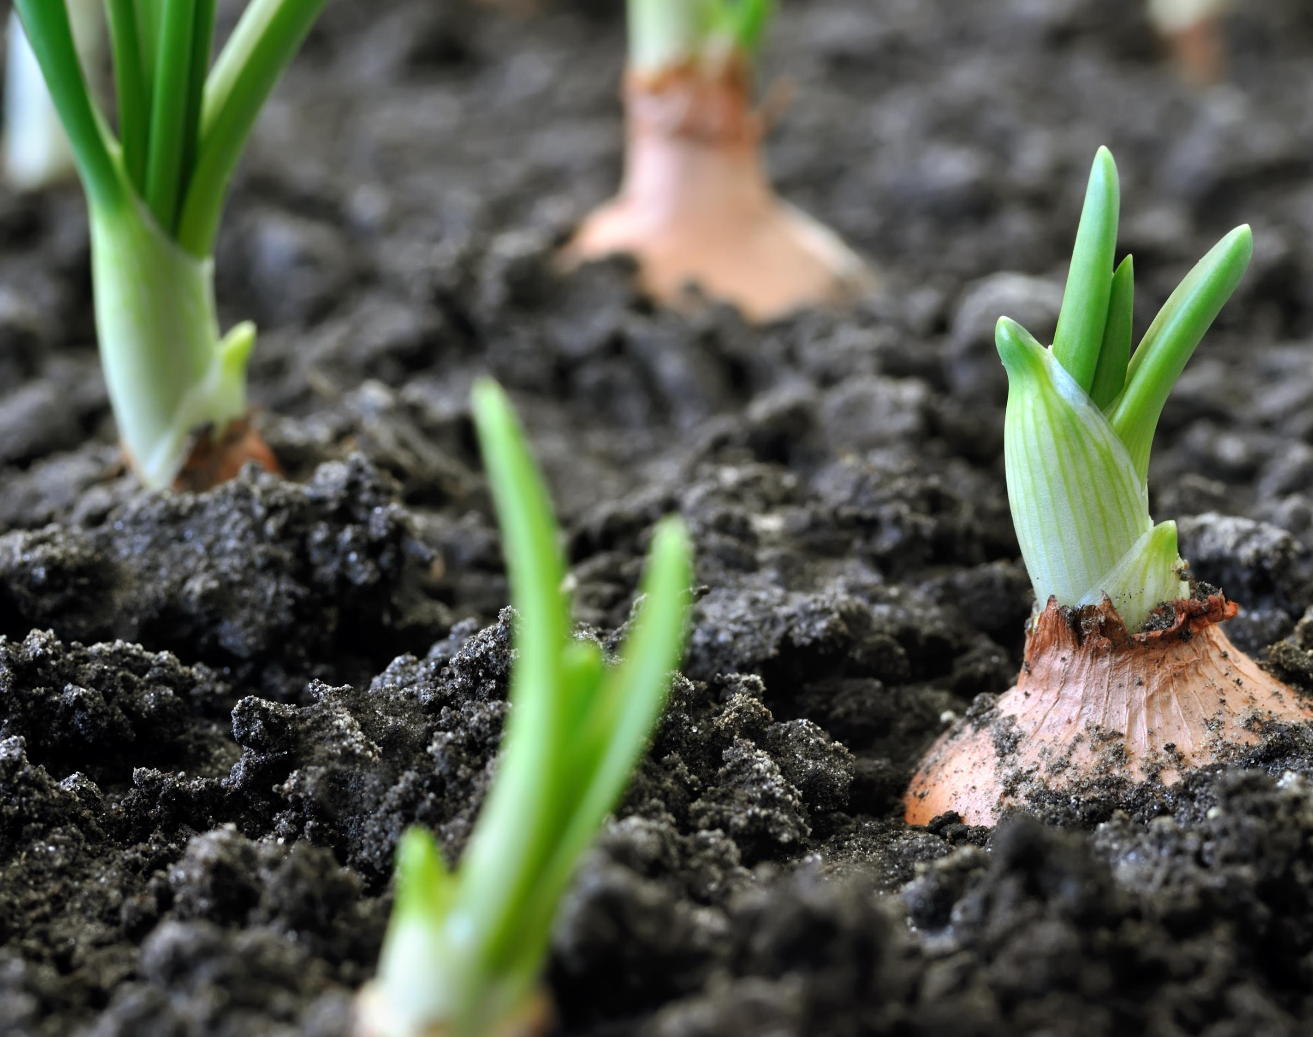
Introduction to Soils

Slide 2
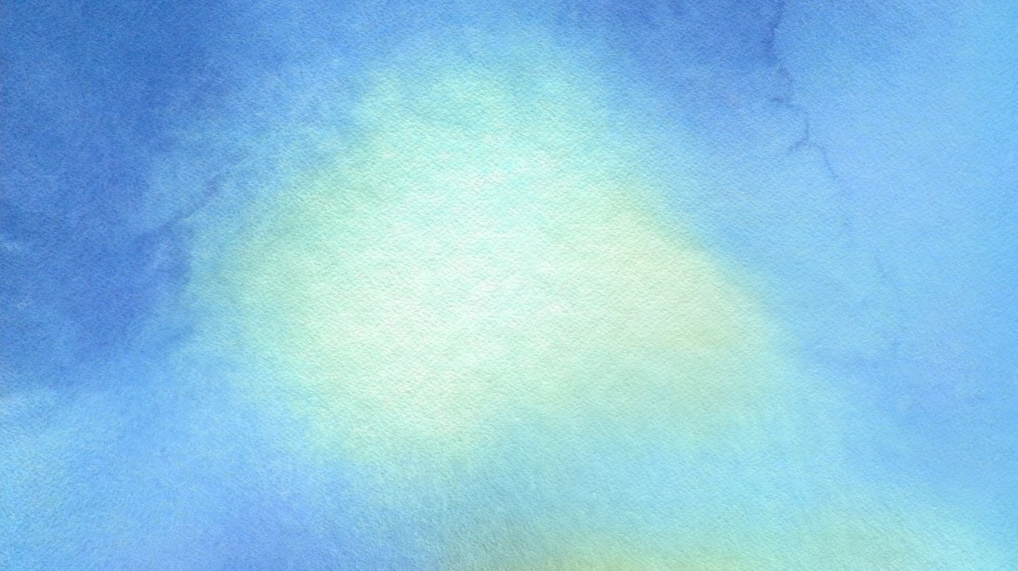
Lesson Vocabulary
Soil components
Sand
Silt
Clay
Loam
Texture
Soil Horizons
Organic Matter
Soil pH
Porosity
Permeability
Aggregate
Soil Formation Factors (parent material, climate, biological factors, topography and time)

Slide 3
Interest Approach: Soil
What do we KNOW?
What do we WANT to know?
What have we LEARNED?

Slide 4
Today’s Vocabulary
Soil Texture
Sand
Silt
Clay
Porosity
Permeability

Slide 5
Soils and Regenerative Agriculture
Soil is living and nonliving
The nonliving parts of soil include sand, silt, and clay
The nonliving parts of soil comprise the soil texture
Soil texture varies by the percentage of sand, silt and clay making up the soil
Notes:
To start our lesson on regenerative agriculture, we must start at the basis for all life - soil. Soil is composed of both living and nonliving materials. Today, we are going to discuss the non-living particles which comprises soil texture. Soil texture refers to the proportion of sand, silt, and clay sized particles in the soil.

Slide 6
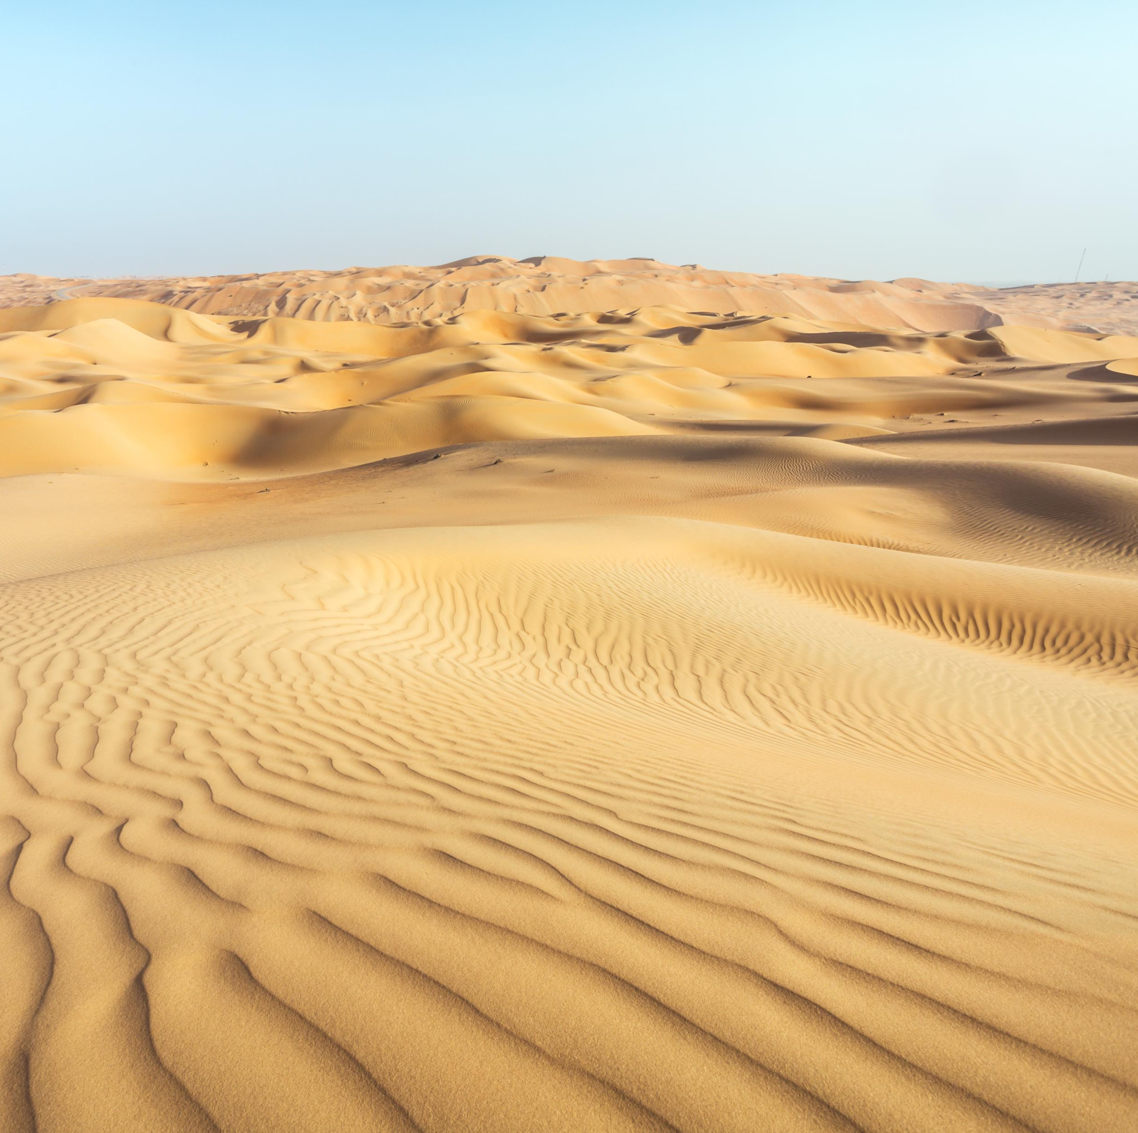
Sand
The largest particle in soil
Ranges from 2.0-0.05 mm in diameter
It is the easiest particle to foil in soil
Notes:
Sand is the largest particle in soil. Some soils are composed mostly of sand - think of sandy beaches. Sand ranges in size from 2.0 to 0.05mm in diameter. It is often the easiest particle to feel in soil. Pass sample of sand around classroom. Ask students to describe the feel of sand; for larger classrooms or to save time; ask one student to feel and describe to the class.

Slide 7
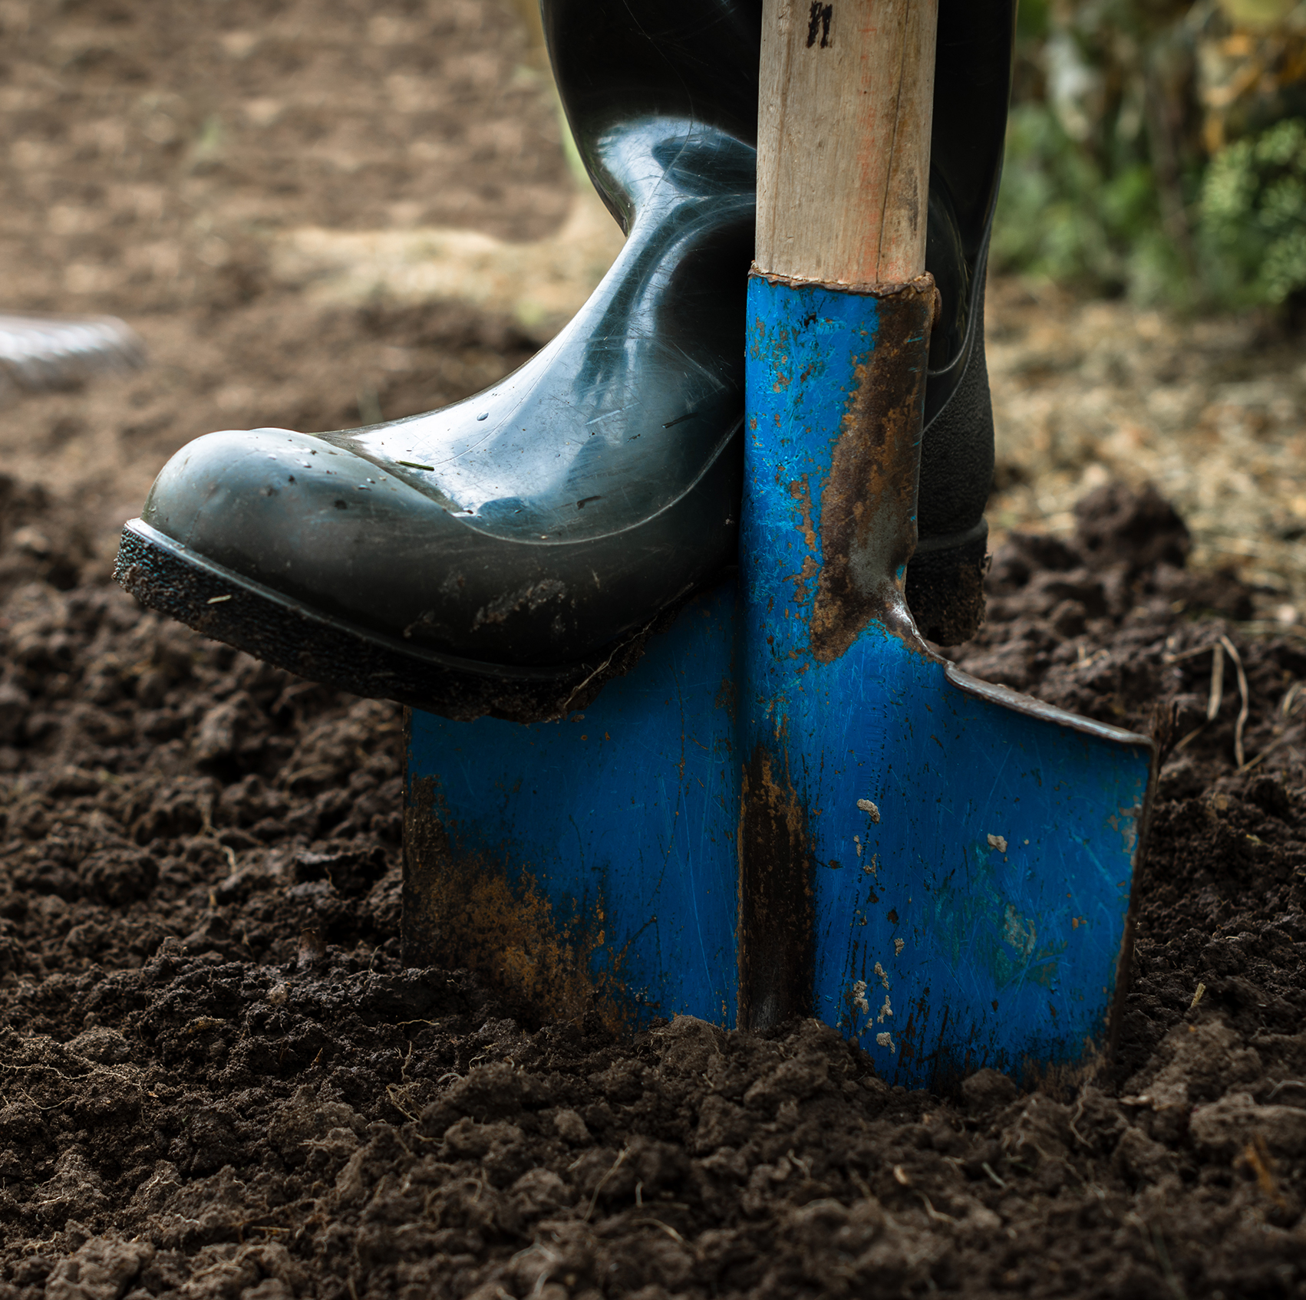
Silt
Ranges in size from 0.05-0.002 mm in diameter
Some soils can be comprised of almost entirely silt

Slide 8
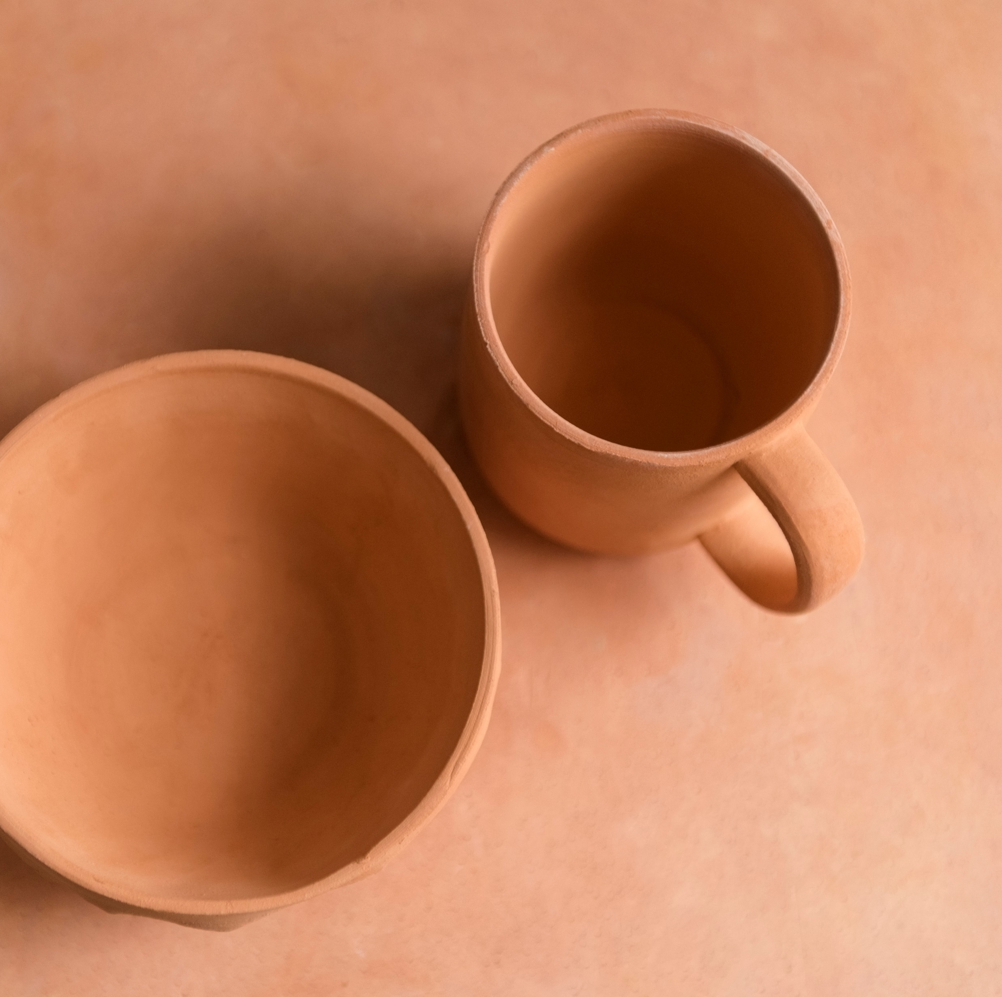
Clay
The smallest particle in soil
Diameter of clay is less than 0.002mm
It is the easiest to compact
It has been used to make pots and other ornamental pieces due to the ability to compact it and squeeze the air out of the spaces between the particles
Notes:
Clay is the smallest particle in soil. Clay has a diameter of less than 0.002mm, making it the smallest. It is also the particle that is the easiest to compact. Clay has often been used throughout history to make pots and other ornamental pieces. When you think of compaction, clay can be smooshed together due to their small size to make clay pots, which allows very little air to exist between the particles. If you compare that to sand, a lot of air can exist around the particle making it difficult to smoosh together. Pass sample of clay around classroom. Ask students to describe the feel of clay; for larger classrooms or to save time; ask one student to feel and describe to the class.

Slide 9
Porosity and Permeability
Porosity
Permeability
The number of pores, or open spaces between soil particles
Fine textured soil is more porous
Increase in porosity = increase in water absorption
The connectivity of the pore spaces
Water runs through permeable soil readily
Can you guess which of the three samples has a high degree of porosity? Permeability?
Notes:
Porosity and Permeability. Porosity is the amount of pores, or open space between soil particles. Fine textured soil has more pore space than coarse textured because more particles can be included in a unit volume as compared to larger ones. Soils with a high degree of porosity means that water is more readily absorbed. Permeability is the amount of connectivity between soil pores. Soils with a high degree of permeability means that water runs through quite easily. Can you guess which of these three samples has a high degree of porosity? (Clay) How about permeability? (Sand) We will continue to visit this topic as we move throughout this unit.

Slide 10
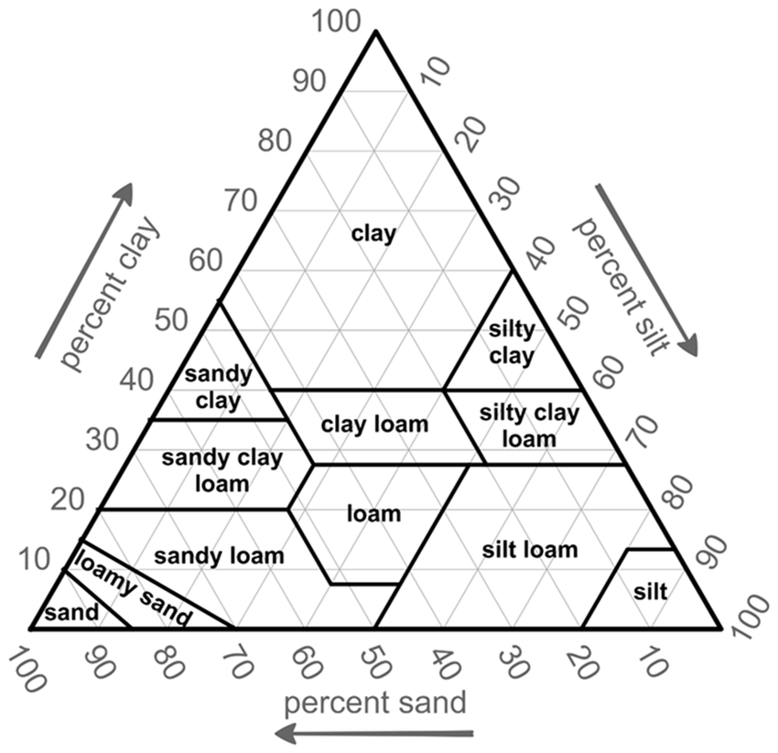
Soil Texture Triangle
Do you see these examples as they are here in your community?
Most of the time they are combined to give soil its texture
If we had a soil that is 65% sand, 30% clay and 5% silt we would have?
Notes:
Now, you have seen three soil particles, but do these samples look like soil you see in a field, yard or even around our community? No, because these particles rarely exist as the sole component in a soil. Most of the time, they are combined as percentages of relative amounts that give soil its texture. Here is the soil texture triangle. Pass around soil texture triangle provided. You can also use the link provided by NRCS if you prefer to have a digital version. Ask students what they notice about the triangle.
The soil texture triangle has three sides, representing percentages of the three soil particles we have discussed. It also has types of texture by percentage within the triangle. For example, if we have soil that is 65% sand, 30% clay, and 5% silt- we have sandy clay loam. Provide students with several more examples to practice using the soil texture triangle.
Loam is defined as material having equal parts sand, silt and clay

Slide 11

Homework
Collect soil samples from your home, school, and community
Notes:
Ask students to bring in different types of soil from their home, school or community. Teachers are advised to keep multiple soil samples in their classroom for tomorrow’s activity. You may also ONLY provide the soil samples and skip homework for students.

Slide 12

Interest Approach
Look at the soils brought in by your classmates.
Can we guess what the soil is made of?

Slide 13
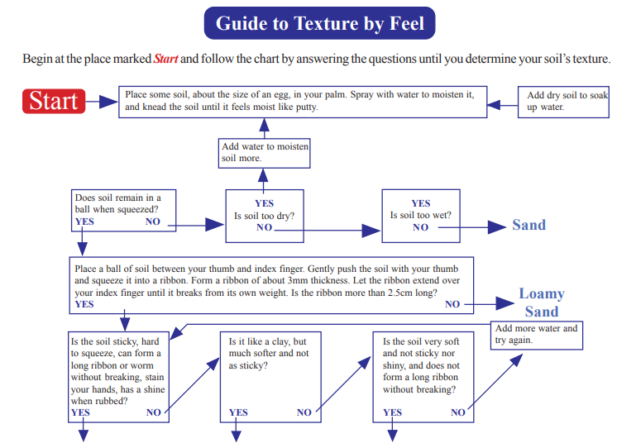
Notes:
https://www.nrcs.usda.gov/sites/default/files/2023-10/SOIL_QUALITY_SITE_ASSESSMENT_CARD.pdf

Slide 14
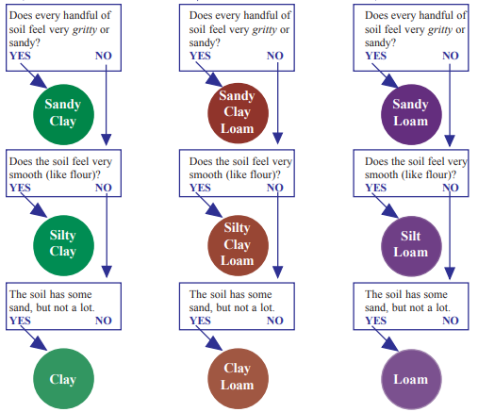
Notes:
https://www.nrcs.usda.gov/sites/default/files/2023-10/SOIL_QUALITY_SITE_ASSESSMENT_CARD.pdf

Slide 15
Review
Soil is made up of sand, silt, and clay
These make up soil texture and the various percentages the type of soil texture
Compare the soil samples brought in for today to the samples we looked at yesterday, what are the differences? Similarities?
Notes:
Yesterday, we learned that soil is made up of clay, silt and sand by observing those components and by using the soil texture triangle. But we also learned that soil doesn’t usually look like any of those components. Why do you think that soil, like we see in our activity this morning, looks different than the samples we saw yesterday? (anticipate answers like “it is black/brown, there are other things like roots in it, etc) Well, to answer that question, we must look at several factors that influence what soil looks like.
Today, we will discuss soil horizons and formation factors.

Slide 16
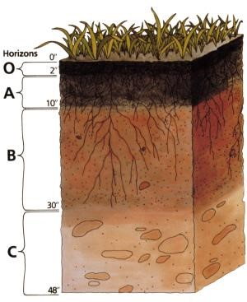
Soil Horizons
Soil Horizons are soil layers that differ in properties, such as color, texture, structure, thickness, and chemical and mineral content
O, A, E, B, C, and R identify the horizons
Notes:
Soil Horizons are soil layers that differ in many properties, including color, texture, structure, thickness, chemical/mineral content. Soil scientists use the letters O, A, E, B, C, and R to identify the horizons. However, not all soils have each horizon, and the thickness of each horizon can vary greatly from the picture seen here.

Slide 17
Soil Horizons
O: organic and includes organic materials from leaves in forests and dead plant material and prairies
A: topsoil and is mostly minerals from parent material and organic matter added. It is where plants, soil organisms, and roots grow
E: eluviated horizon which is leached from clay minerals and organic matter. It is more sandy
B: subsoil horizon rich in minerals that moved down from A and E, it is not present in all soils
C: parent material which all soil is developed from, it contains soil and rock
R: bedrock
Notes:
The “O” horizon stands for organic and includes organic materials from leaves in forests and dead plant material and prairies. Where might we see soil that does not have an “O” layer? (anticipate answers such as top of a mountain or in areas where plants may not grow). The A horizon or topsoil is mostly minerals from parent material and organic matter added. It’s a good place for plants, soil organisms and roots to grow. E is the eluviated horizon, it is leached of clay and minerals and organic matter and is sandier and lighter in color than the A horizon, you may not find it in every soil type. The B or subsoil horizon is rich in minerals that moved down from the A and E horizons, also not present in all soils. C is the parent material which all soil developed from. It contains soil and rock from the lower layer of bedrock. R or bedrock is a rock mass that forms the parent material for some soils if close enough to the surface to weather or contact with lichens or moss. These horizons represent the physical, biological and chemical processes that soils went through during development.

Slide 18
Formation Factors
Parent Material
Climate
Topography
Time
Biological Activity

Slide 19
Parent Material
The type of rock or mineral the soil is formed from
Bedrock is a type of parent material
Soils form from materials that have moved from elsewhere via wind, ice and water
Windblown “loess” is recently deposited silty loam material
Glacial till is material moved by glaciers
Alluvium is sediment along the rivers and the texture is determined by the speed of the river
Notes:
Parent material is the type of rock or mineral in which the soil was formed. The material could have been bedrock that weathered in place. These “residual” soils have the same general chemistry as original rocks. More commonly, soils form from materials that have moved from elsewhere. Wind, ice, or water can all move soils and frequently do. Windblown “loess” is common in the Midwest, which buries glacial till in many areas. Glacial till is a material ground up and moved by a glacier. Alluvium is sediment along the rivers that have different textures depending on the speed of the river.

Slide 20

Climate
The weather conditions that prevail in the area over a general or long period of time
Temperature and moisture influence the speed of chemical reactions: Influences decomposition and weathering
Soils develop faster in warm and moist climates and slower in cold arid climates
Notes:
Climate is the weather conditions prevailing in an area, in general or over a long period (Oxford Dictionary). Temperature and moisture influence the speed of chemical reactions, which help control how fast rocks weather and dead organisms decompose. Soils develop faster in warm, moist climates and slowest in cold arid ones.

Slide 21
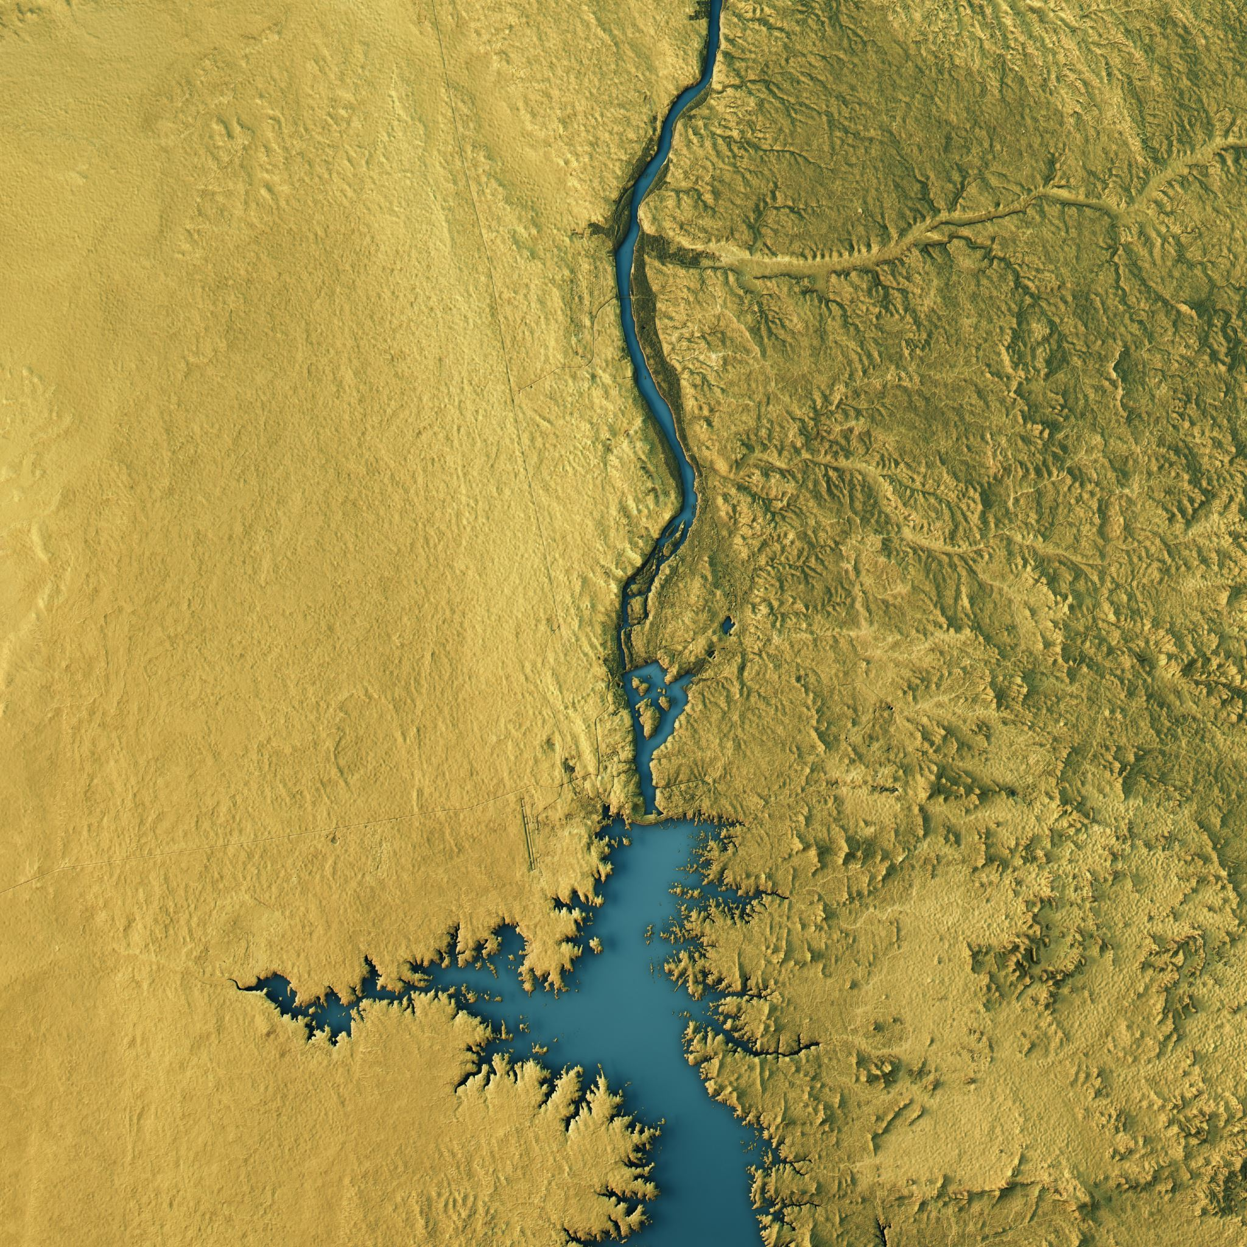
Topography
The arrangement of natural and artificial features of an area
Shape of land and direction determines how the sun and water impact the soil
Deeper soils form at the bottom of a hill compared to the top due to gravity and weathering
Notes:
Topography is the arrangement of the natural and artificial physical features of an area (Oxford dictionary). The shape of the land and the direction it faces make a difference in how much sunlight the soil gets and how much water it keeps. Deeper soils form at the bottom of a hill than at the top because gravity and water move particles down the slope.

Slide 22
Time
Soil formation is continuous
Their features will reflect the formation factors
They are constantly changing
Older soils have had longer to develop and differ from younger soils
Notes:
Time also affects the soil. Over time, soils exhibit features that reflect the other forming factors. Soil formation processes are continuous. Soil is nearly always changing due to other formation factors. Older soils differ from younger soils because they have had longer to develop.

Slide 23
Biological Factors
Plants
Animals
Microorganisms
Humans
Notes:
However, we haven’t discussed the last soil formation factor. This factor is one that we will spend the most time on in this unit as it involves our management actions as it relates to soil. The last soil formation factor is biological factors.
Plants, animals, micro-organisms and humans affect soil formation. Let’s brainstorm ways that humans, animals, plants and micro-organisms affect soil.
Create 4 columns on the board. Label each column “humans” “animals” “plants” and “micro-organisms.” Facilitate discussion with the class and add ways that biological factors affect soil. Below is a sample graph, but it is not all inclusive. Encourage thoughts about ways these biological factors interact together to form soils.

Slide 24

Interest Approach: Think Pair Share
Consider
Consider the table we created yesterday: Biological Factors that affect soil
Create
Create a table of your own and see if you can think of two additional ways that plants, animals, humans, and microorganisms affect soil
Discuss
Discuss with the person sitting next to you
Notes:
Consider the table we created yesterday. Create a table of your own and add two additional ways that plants, animals, humans and micro-organisms might affect the soil. (Give approximately 1 minute to do this) Now, let’s share your ideas with the person sitting next to you (teachers may assign partners as needed instead. Give approximately 1 minute here). Now, would anyone like to share their partner’s ideas with the class? (write ideas on the graph from yesterday).

Slide 25
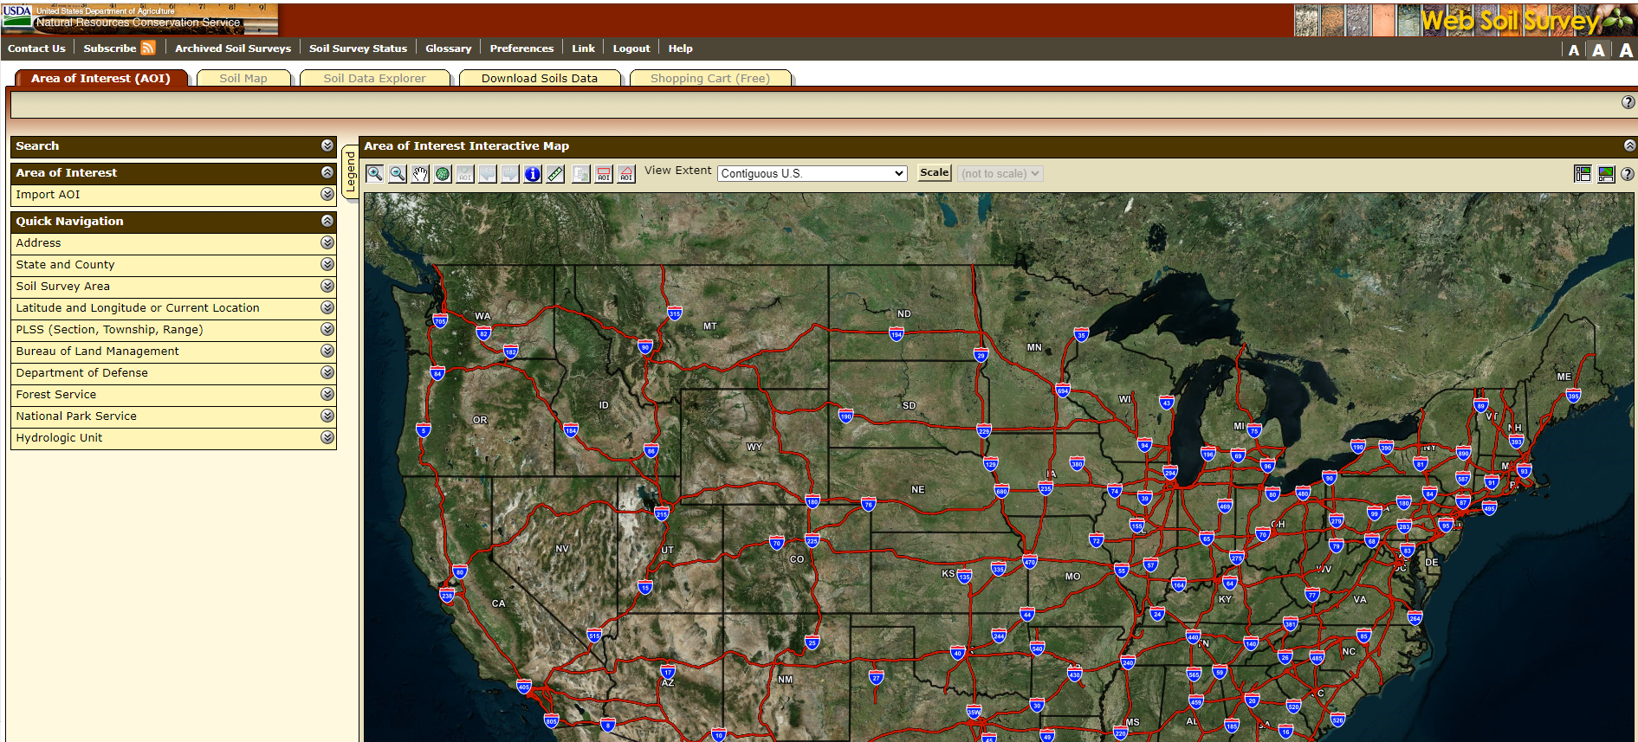
USDA Web Soil Survey Scavenger Hunt
Notes:
For today’s lesson, we are going to complete a scavenger hunt using the USDA’s Web Soil Survey. There are a lot of uses for this database, but today we are going to explore soil types around our school, home and national interests. Pass out the scavenger hunt worksheet.
Tour of the Website (10 minutes) Teachers should familiarize themselves with the functions of the website prior to teaching the lesson.
Students should complete the worksheet/scavenger hunt. ~30 minutes. (Time may vary by student/ability level. An idea to expand this activity is to allow additional time to explore the website or students can present their findings to a group or the class.)

Slide 26

Interest Approach
Think about building a house.
To build a house what do you need?
What structural components build a strong house?
Notes:
Think of building a house. To build a house, what things would you need? What kind of structural components would a person need to build a strong house? Write for 2 minutes about how you would build a structurally strong house.

Slide 27
Soil Structure
Soil is made up of components
Soil particles act like bricks to create structure
The “glue” that holds soil together comes from microbial glues, roots, and fungal hyphae
Arrangement of components creates windows, doors, rooms
The cover on the surface acts as the roof
Notes:
Soil has structure, it is made up of components that when they work together, they provide different materials like when you build a house. The soil particles which are like bricks when they all come together, they build a structure like a home. The glue and nails that holds all the soils together is aggregation and comes from soil biology or microbial glues, roots, fungal hyphae that stabilize the soil structure and creates a series of rooms windows and doorways. The arrangement of the different components creates windows, doors and rooms. The cover on the surface acts as a roof.

Slide 28
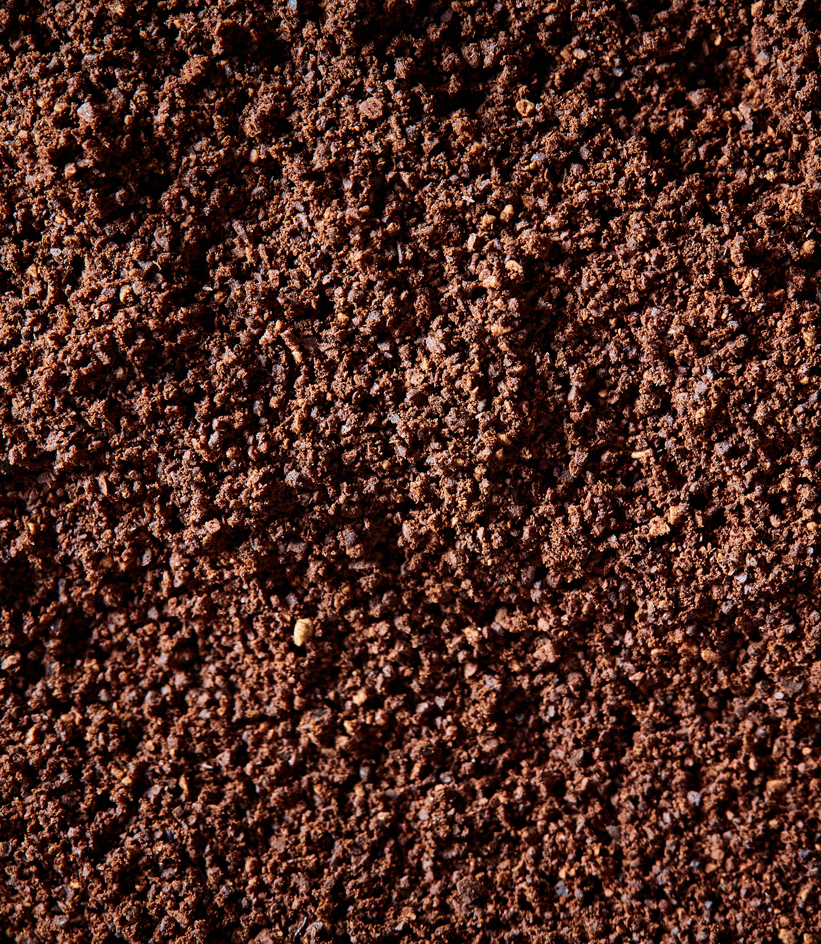
Structure
Spatial arrangement of soil particles creates peds or aggregates
The particles (sand, silt, clay) bind together
The shape is determined by texture and the conditions in which they were formed
Wetting, drying, freezing, thawing, interference of plant roots and people
The pore spaces between aggregates is filled by water, soil animals, and air
Notes:
Soil structure is the spatial arrangement of soil particles into small clumps, called peds or aggregates. Soil particles (sand, silt, clay and even organic matter and biology) bind together to form these peds or aggregates. Peds or aggregates have various shapes depending on their texture and on the conditions in which they formed: getting wet and drying out or freezing and thawing, plant roots and from the interference of people. They can resemble balls, blocks, columns, and plates. In between the peds are spaces or pores where water, air and soil animals move and live.

Slide 29
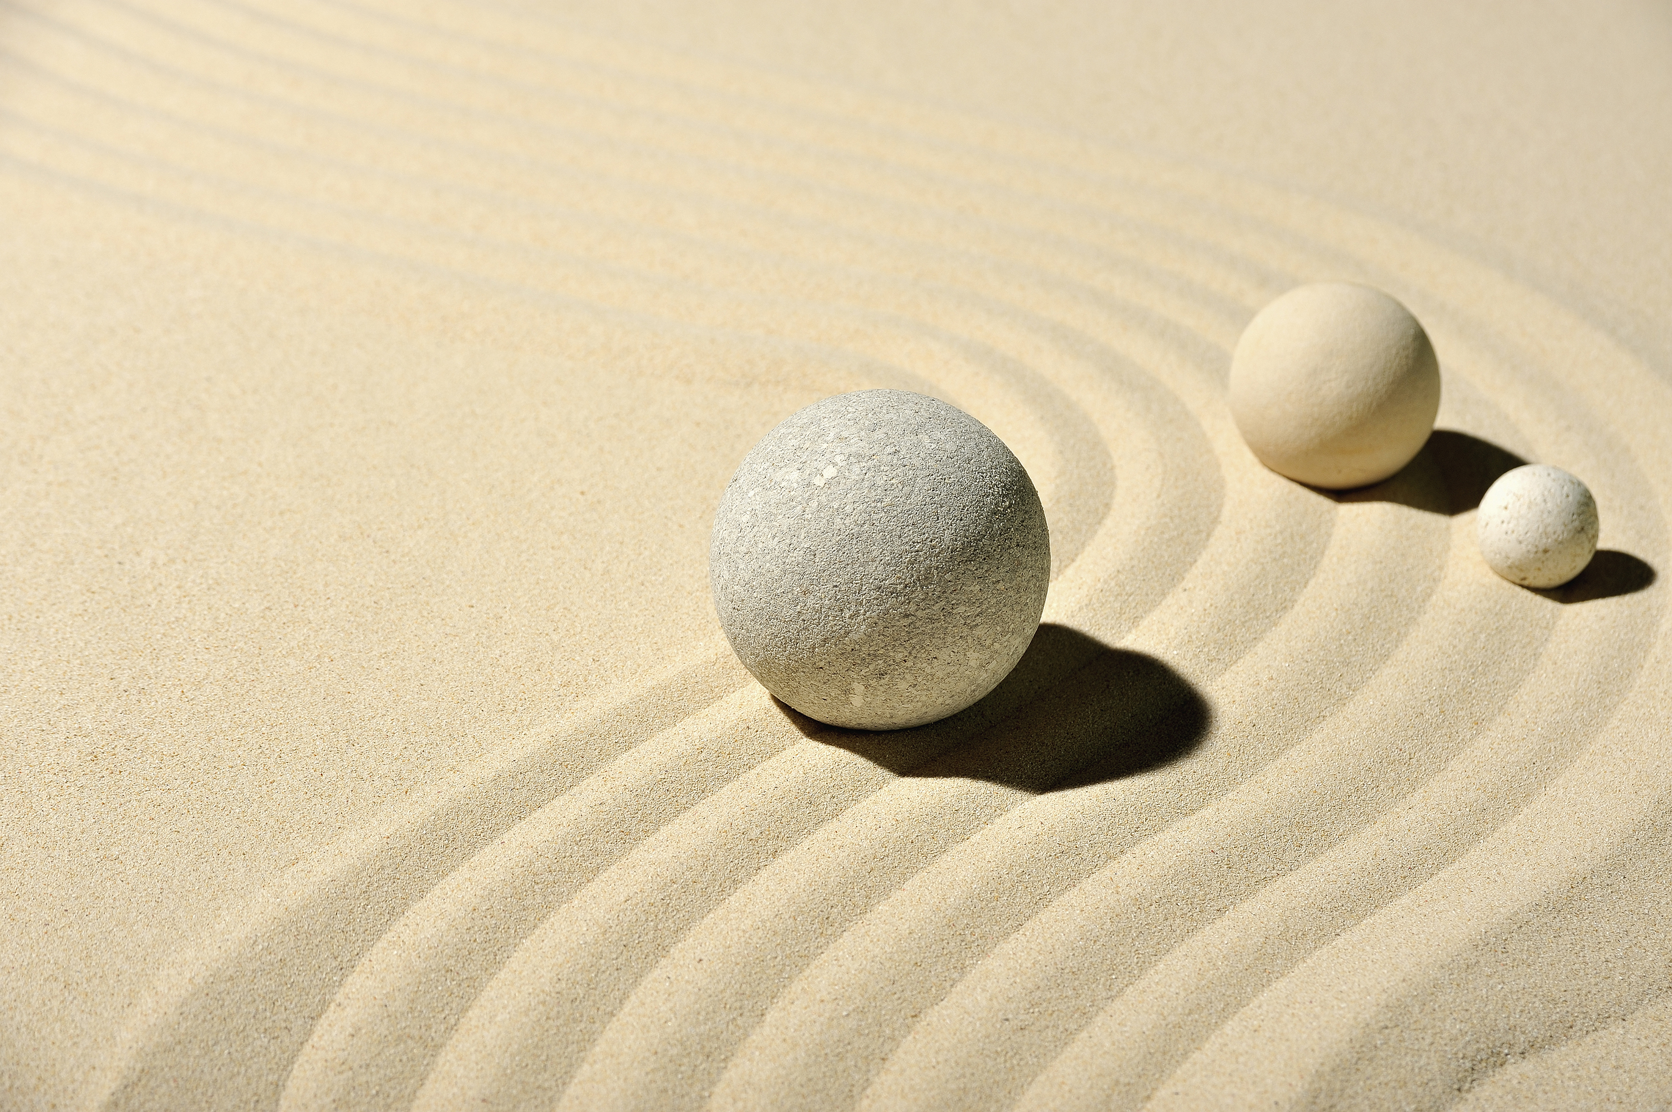
Structureless soil
Single grained with no aggregation or ped formation
Sandy beach or crop field that blows in the wind
Lots of clay that compacts to have no pore space
Notes:
Some soil structures are considered structureless, for example, single-grained where there is no aggregation or ped formation. Consider your sandy beach or a crop field that is blowing in the wind as single grained. Some that are composed of mostly clay can compact together to form massive structure, there is no pore space.

Slide 30
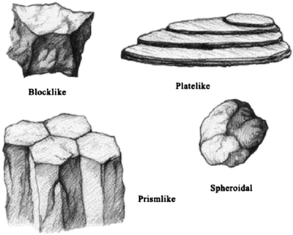
Soil Ped Shapes
Notes:
The four-principal soil ped shapes are spheroidal, platy, prism-like and blocklike.
Picture https://link.springer.com/chapter/10.1007/978-94-007-5663-2_5

Slide 31
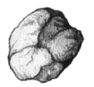
Spherodial
Granular or crumb
  Depends on pore space
  Crumb – more pore space
Predominately found in the A Horizon
Typically range in diameter from 1mm – 10mm
Notes:
The spheroidal can be granular or crumb depending on poor space and are found predominately in the A horizon. They range from less than 1 mm to 10 mm in diameter.

Slide 32

Platelike Structure
Relative thin horizontal sheets
Exist in the E horizon primarily
Can be found in the A horizon from compaction
Ranges in thickness from 1mm – 10mm
Notes:
Natural platelike structure, relative thin horizontal sheet like peds, will be found in the E horizon. You can also find it at the surface in the A horizon when compaction occurs due to man’s interference. Platy structure often is created by man from tillage during wet periods or overgrazing and are a product of time and space, or too many animals in too long of a period it ranges in thickness from 1mm to up to 10mm.

Slide 33
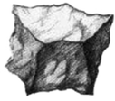
Block-like
Most common in the B Horizon
Can be found in the A Horizon when beneficial farming practices are used (reduced tillage, cover cropping)
Rough shaped and irregular
Angular or subangular
Range in size from 5mm – 50mm across
Notes:
Block-like structure is mostly common in the B horizon but can also be seen in the A horizon when someone stops tilling and starts adding cover crops or eliminates pesticides and uses green manure as a resource that is disked in.
Blocky peds are irregular, rough, and shaped like a die. They can be described as angular, when the edges of the peds are sharp and the faces of the peds are distinct, or they can be subangular. Subangular peds have some rounding of the edges like they have been shaved off. They can range in size from 5 to 50mm across.

Slide 34
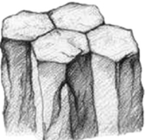
Prism-like
Columnar or prismatic
Pillarlike peds that range in size from 10mm 500mm in diameter
Columnar is pillar like with the tops rounded off
  Indicative of saline soils
Flat tops are called prismatic
  Indicative of clay and arid environments in the B horizon
Allow for deep percolation of water
Notes:
Prism-like structure is either termed columnar or prismatic. They are characterized by vertically orient prisms or pillarlike peds that vary in size among different soils. They can be around 10 to 500 mm in diameter. Columnar which is a pillar like ped with the tops of the pillar being rounded off. These can be indicative of saline soils. When the top of the pillar is flat that is termed prismatic. It is many times associated with swelling type clay. It is indicative of soils in semi-arid or arid environments in the B horizon. These types of structure allow deep percolation of water into the ground and plant roots can then find the edges of these prisms and follow it down to find nutrients. In humid regions prismatic structure sometimes occurs in poorly drained soils.

Slide 35
To Review
Soils are described by the type of structure
Structures can be very fine, fine, medium coarse, very coarse
Defined by degree of development: structureless, weak structure, moderate structure, strong structure
Best to define structure in dry soils as wet soils swell and will be less defined
Notes:
When describing these types of structures, a soil scientist will describe the type as above and from Very fine, fine, medium coarse to very coarse and the degree of the development or how prevalent they appear as structureless, strong, moderate or weak. It’s best to observe this when the soil is dry. When they are wet the peds will swell and the distinction will disappear or be less defined.

