Slide 1
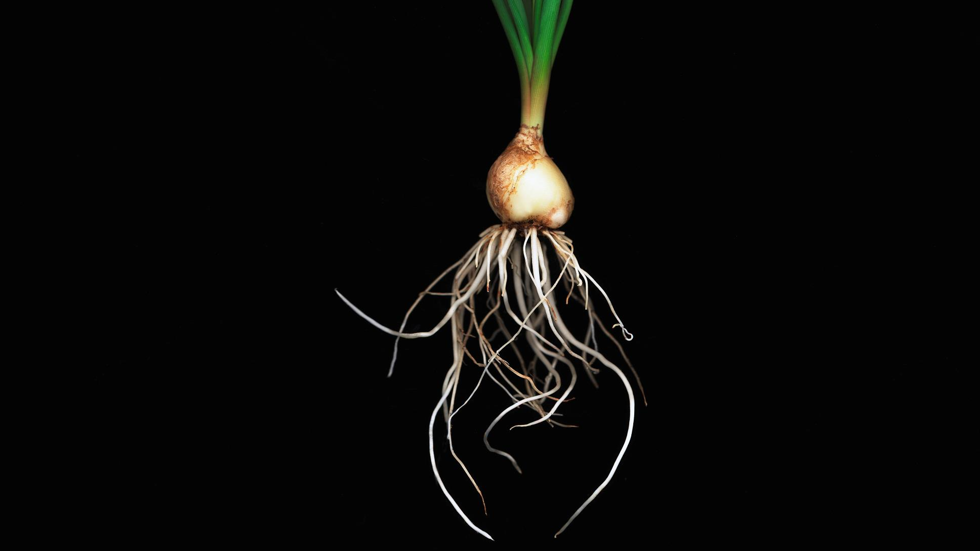
Living Roots

Slide 2
Lesson Vocabulary
Mycorrhizal Fungi
Symbiosis
Nutrient Efficiency
Fibrous
Taproot
Cover Crop
Overwintering

Slide 3
Interest Approach: Guess the Plant
Notes:
Write the following names on the board (Sun hemp, hairy vetch, cowpea, alfalfa, yellow-blossom sweet clover) with space to attach (with magnets) pictures of roots with the corresponding name of a cover crop. Challenge students to work together to match the roots to the name of the cover crop. (Alternate activity: show students the photos one at a time and have them guess by writing it down at their workstation)

Slide 4
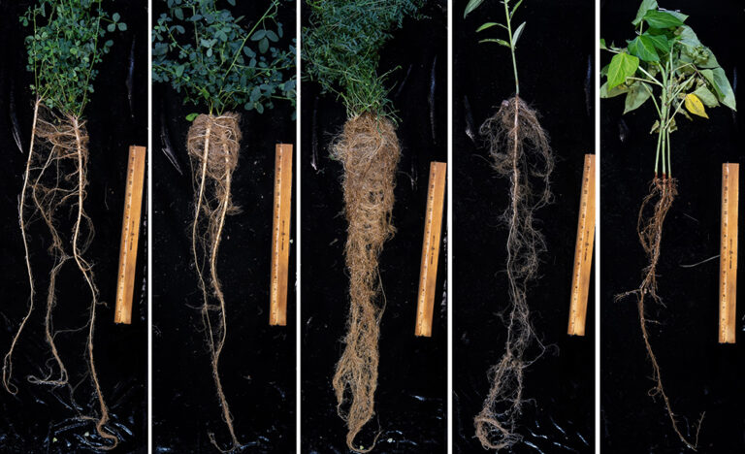
Notes:
Root systems of five legume cover crops at early stages of growth (two months in a greenhouse). From left: alfalfa (winter perennial), yellow-blossom sweet clover (winter biennial), hairy vetch (winter annual), sunn hemp and cowpea (summer/tropical annual). Photos by Joseph Amsili.
Write the following names on the board (Sun hemp, hairy vetch, cowpea, alfalfa, yellow-blossom sweet clover) with space to attach (with magnets) pictures of roots with the corresponding name of a cover crop. Challenge students to work together to match the roots to the name of the cover crop. (Alternate activity: show students the photos one at a time and have them guess by writing it down at their workstation)

Slide 5
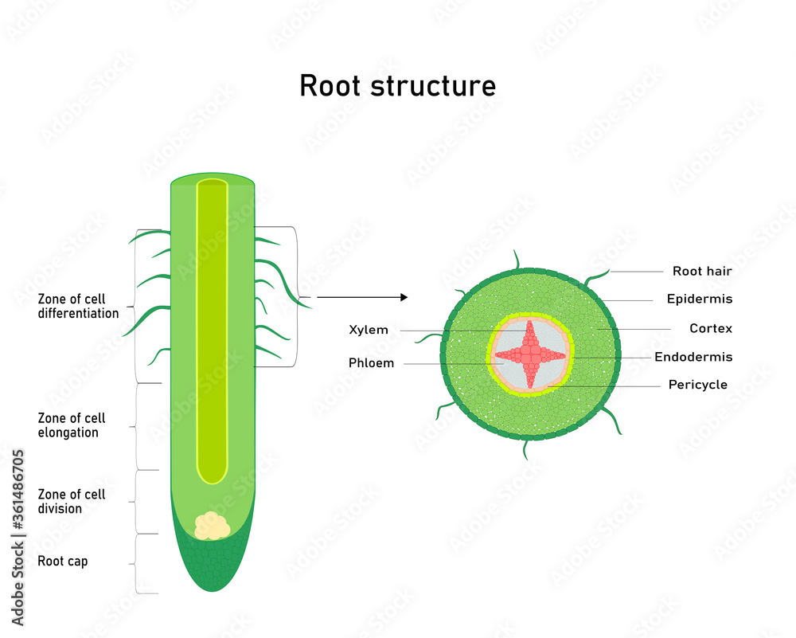
Zone of cell differentiation – where the plant cells acquire their fate features
Zone of cell elongation – cells increase their length, growing the root
Zone of cell division – actively dividing cells that are undifferentiated
Root Cap – tissue at the tip of the root
Xylem – vascular tissue responsible for water and mineral transport
Phloem – vascular tissue responsible for nutrient transport
Root Hair – sponge for nutrient and water absorption
Epidermis - outermost layer of cells for the plant
Cortex – undifferentiated cell types in the plant root
Endodermis – innermost layer of the plant root
Pericycle – layer of cells that surrounds the vascular tissue
Notes:
First, review root structure. A root is made up of many components, and these are vital to the root function for the plant. Zone of cell differentiation – where the plant cells acquire their fate features. Zone of cell elongation – cells increase their length, growing the root. Zone of cell division – actively dividing cells that are undifferentiated. Root Cap – tissue at the tip of the root. Xylem – vascular tissue responsible for water and mineral transport. Phloem – vascular tissue responsible for nutrient transport. Root Hair – sponge for nutrient and water absorption. Epidermis - the outermost layer of cells for the plant. Cortex – undifferentiated cell types in the plant root. Endodermis – innermost layer of the plant root. Pericycle – layer of cells that surrounds the vascular tissue. The zone of elongation is important for the root to grow towards the water source.

Slide 6

Absorption
Plants absorb water from the soil through osmosis
Osmosis – movement of water molecules from areas of high concentration to low concentration
Roots have the ability to grow towards wet spots in the soil – hydrotropism
Notes:
The root hairs are important for nutrient and water absorption within the plant. Plants absorb water and nutrients from the soil through osmosis. This is the movement of water from areas of high concentration to low concentration. The ability of roots to grow towards soil that is wet or moist is called hydrotropism.

Slide 7

Nutrient Storage
Roots swell and store high-energy compounds like starch and sugar
Typically focus on high-energy carbohydrates
Notes:
https://open.lib.umn.edu/horticulture/chapter/3-3-roots/
Roots will swell to store high energy compounds like starch or sugar, think about a potato. Other roots will focus on proteins and nutrients but typically they are storing high energy carbohydrates.

Slide 8
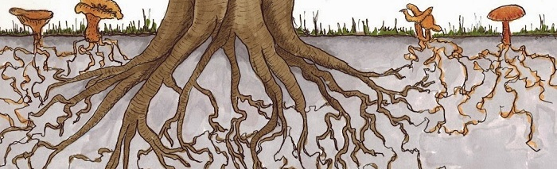
Symbiotic Relationships
Roots have a symbiotic relationship with mycorrhizal fungi
Symbiotic relationships are mutually beneficial to both organisms participating
Mycorrhiza “fungus root”
Plants supply fungi with sugars and carbon and in return receives water and/or nutrients in return
Root exudates solubilize mineral nutrients for plants
There are two types of Mycorrhizae – based on location
  Inside the roots
  Outside the roots
This Photo by Unknown Author is licensed under CC BY-NC
Notes:
https://extension.okstate.edu/fact-sheets/mycorrhizal-fungi.html#:~:text=Mycorrhiza%2C%20which%20means%20%E2%80%9Cfungus%2D,and%2For%20nutrients%20in%20return.
Roots have a symbiotic relationship with mycorrhizal fungi. In a symbiotic relationship both parties are actively participating, and the relationship is mutually beneficial. Mycorrhiza means fungus root. The natural infection of this fungus supplies the roots with sugars and carbon and receives water and nutrients in return. The excretions, exudates, from roots supply the plants with mineral nutrients it can actively use. There are two types of Mycorrhizae, and they are classified based on their location, inside the root or outside the root.

Slide 9
Root Systems
Provide anchorage – part of plant growth
Interact with the soil – anchor soil down in place
Deterrent for wind and water erosion
Notes:
Plants play an important role in building soil and improving soil quality, especially through their root systems. Scientists recognize that plants have various types, including fibrous and taproots. There are other types of roots, but for our lesson today- we will discuss these two types.

Slide 10
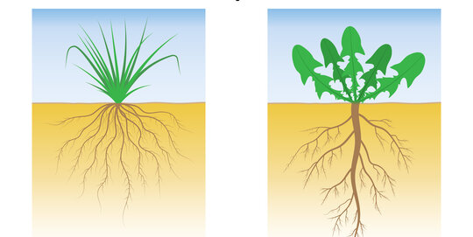
Types of Roots: Fibrous vs. Taproots

Slide 11

Fibrous
Thin
Branchlike
Spread in various directions from the base of the plant
Typically grasses, wheat, race, corn, have a fibrous root system
Cacti typically have a fibrous root system as well
Notes:
Fibrous roots are thin, branch-like roots that spread out in various directions from the plant's base. Many grasses, like wheat, rice and corn have a fibrous root system. Most cacti do as well. What might be the advantages of having a fibrous root system? (anticipate answers, such as can be broad reaching, lots of “branching”, etc)

Slide 12
Discussion Point: What are some advantages of having a fibrous root system?
Notes:
(anticipate answers, such as can be broad reaching, lots of “branching”, etc)

Slide 13
Taproot
Straight tapering root growing vertically downward
Forms at the center and subsidiary rootlets spring
Carrots, beets, radishes all have taproot systems
Notes:
A taproot is a straight, tapering root growing vertically downward and forming the center from which subsidiary rootlets spring. Carrots, beets and radishes all have a taproot system. What might be the advantages of having a taproot system?

Slide 14
Discussion Point: What are the advantages to having a taproot system?
Notes:
A taproot is a straight, tapering root growing vertically downward and forming the center from which subsidiary rootlets spring. Carrots, beets and radishes all have a taproot system. What might be the advantages of having a taproot system? (anticipate answers, such as “ability to go straight down”, a sturdy central root, etc)

Slide 15
To Review
Both root types provide anchorage
Roots help to anchor the plant and the soil
Roots hold water in place
Roots absorb nutrients from the soil
Notes:
Both types of roots provide anchorage, which we know is part of plant growth. However, plants also benefit the soil in multiple ways. First, the roots help anchor the soil down as well - a great deterrent for wind and water erosion. The roots hold the soil in place as wind or water passes. Additionally, roots absorb nutrients, such as nitrogen from the soil. Absorption is important to farmers, particularly because nutrients help plants grow. If additional nutrients are not present in the soil or roots cannot absorb them, farmers must apply fertilizer to their crops. Fertilizers are an additional cost to the farmers.

Slide 16
Optional Activity
Why do you think this plant’s roots look the way they do?
Notes:
Optional activity: If season and time allows, allow students to look at different roots of various growing plants to observe differences in root structure. Ask posing questions, such as “why do you think this plants roots look the way they do?”

Slide 17

Optional Activity: Midwest Cover Crop Tool

Slide 18
Interest Approach
Read the article
Highlight information relevant to roots
Key take aways
Notes:
Pass out USDA ERS - Cover Crops Can Influence Soil Health, Even Within the First Few Years After Adoption and highlighters to students. Ask students to read the passage and highlight information from the article that appears relevant to what they know about roots. Discuss the key takeaways from article first with partners then as a class. (Although the article is short in length, it is highly technical reading- be prepared to assist students through some technical information as they read.)

Slide 19
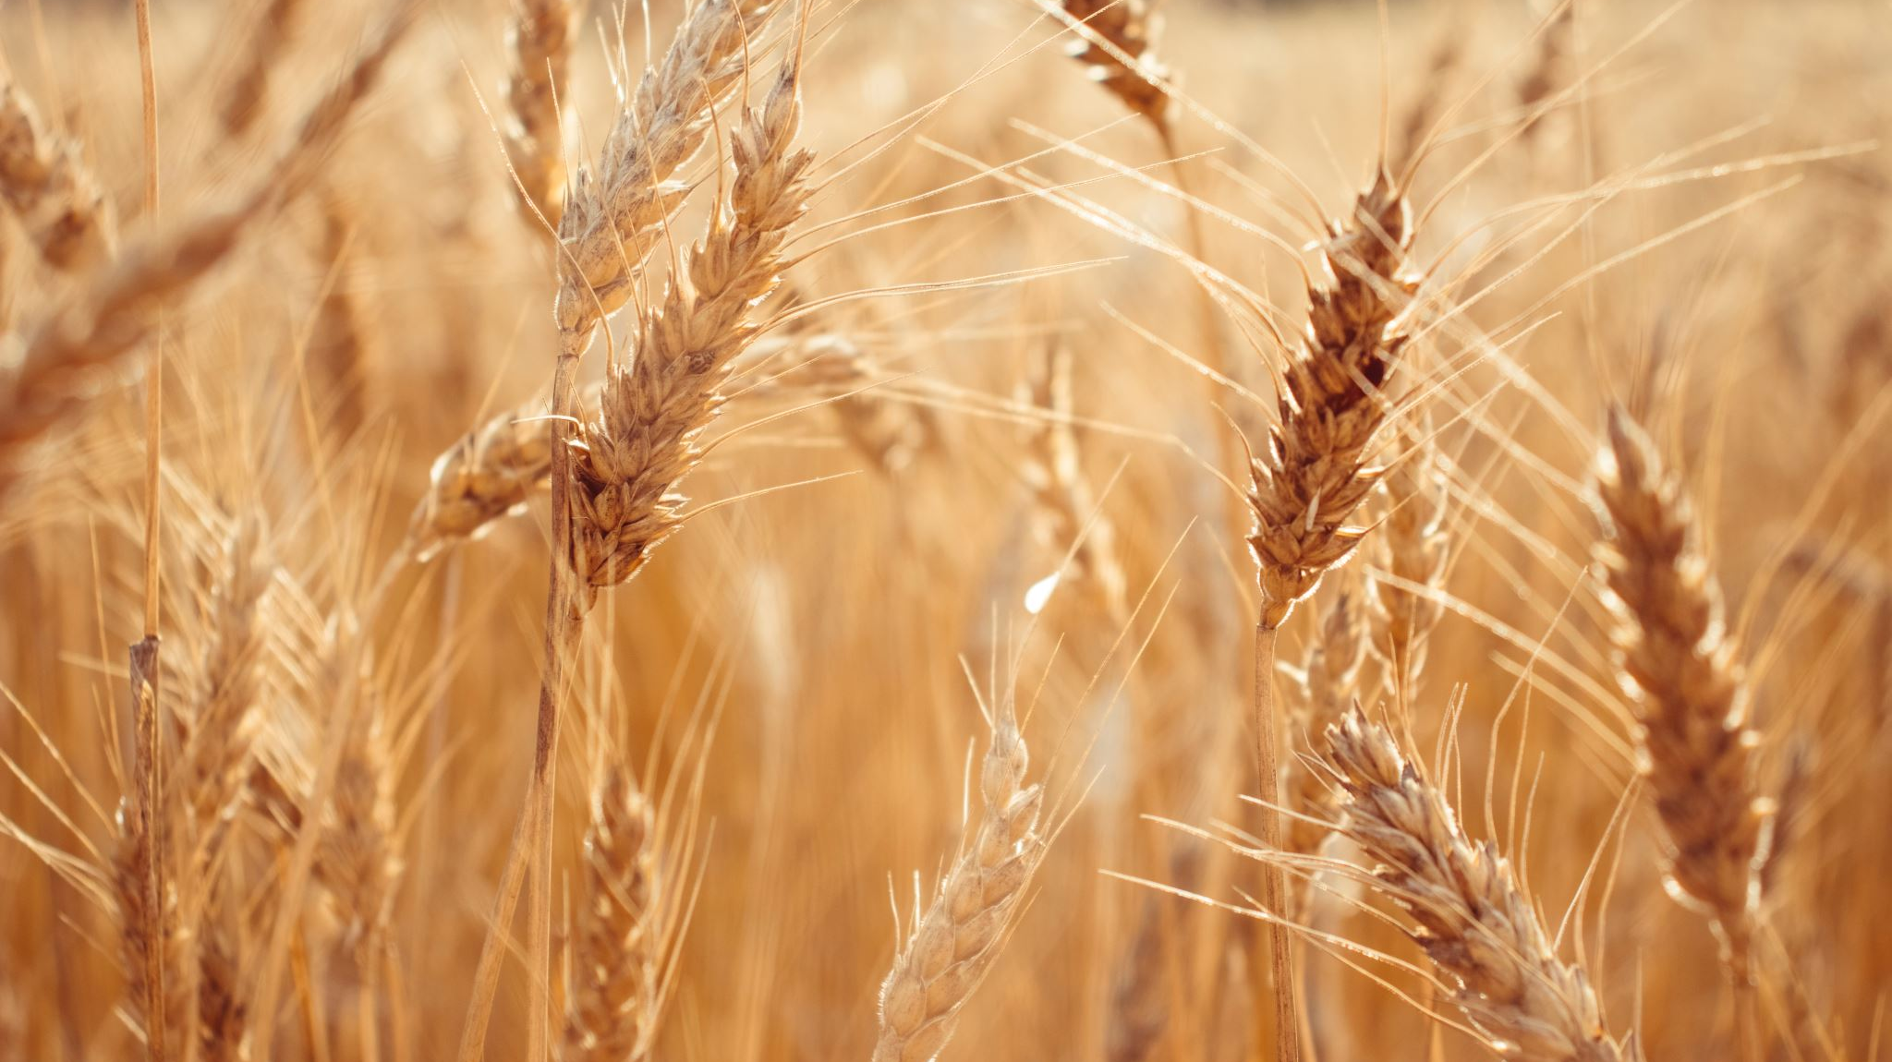
Cover Crops: What is a Cover Crop?
Notes:
Grown to cover the soil
Can be incorporated into the soil for later enrichment

Slide 20
Benefits
Symbiotic relationship between the soil and microorganisms
Prevent nutrient loss
Increase soil organic matter
Suppress weeds
Disrupt plant pest cycles
Provide secretions to feed the soil biology throughout the year
Provide carbohydrates and organic amino acids which are a part of the diet of many lifeforms
Notes:
As we read, cover crops can influence soil health. But what is a cover crop? A cover crop is any crop grown to cover the soil and may be incorporated into the soil later for enrichment. From what we learned yesterday about living roots, what might be some of the benefits of cover crops? Cover crops hold soil in place, often between cash crops. They help provide symbiotic relationships between the soil and microorganisms. They can also prevent nutrient loss, increase soil organic matter, suppress weeds, and disrupt plant pest cycles. They provide secretions that help feed soil biology throughout the year. They provide carbohydrates and organic and amino acids which are part of the diet of many lifeforms in the soil and above the soil. The exudates leaked out by roots help solubilize mineral nutrients for plants. Root hairs which are the direct result of bacteria from inside the plant being expelled out through the cortex also assist with formation of aggregates by entangling and enmeshing soil.

Slide 21
Discussion Point: From what we learned yesterday about living roots, what might be some of the benefits of cover crops?
Notes:
We learned yesterday about living roots, what might be some of the benefits of cover crops? Cover crops hold soil in place, often between cash crops. They help provide symbiotic relationships between the soil and microorganisms. They can also prevent nutrient loss, increase soil organic matter, suppress weeds, and disrupt plant pest cycles. They provide secretions that help feed soil biology throughout the year. They provide carbohydrates and organic and amino acids which are part of the diet of many lifeforms in the soil and above the soil. The exudates leaked out by roots help solubilize mineral nutrients for plants. Root hairs which are the direct result of bacteria from inside the plant being expelled out through the cortex also assist with formation of aggregates by entangling and enmeshing soil.

Slide 22

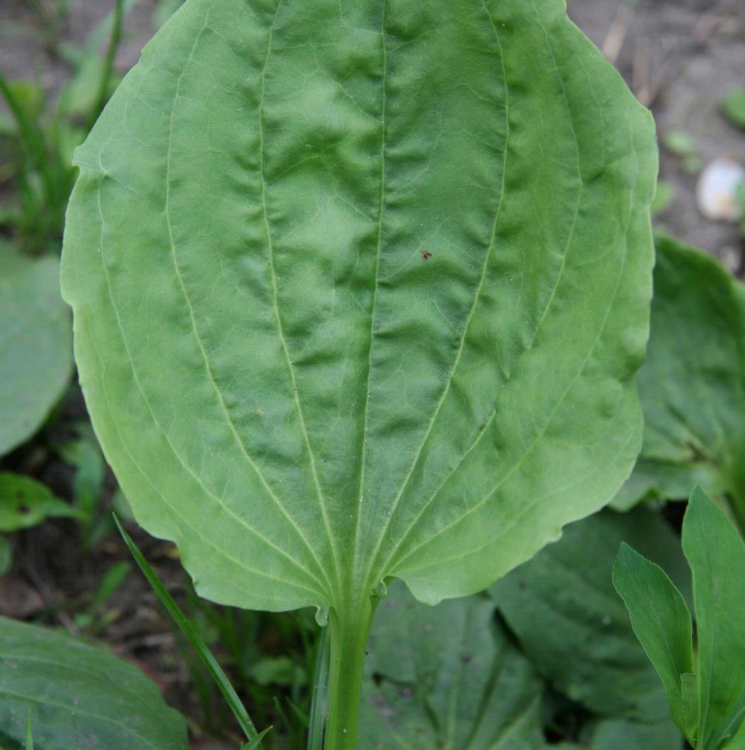
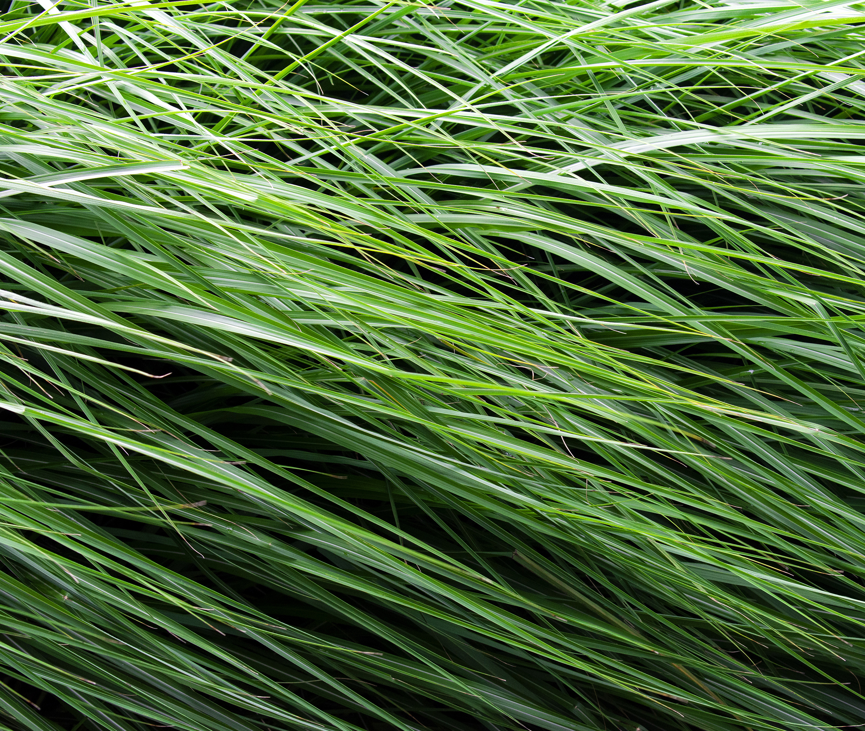
Cover Crop Varieties
Grasses
Legumes
Broadleaves
This Photo by Unknown Author is licensed under CC BY-NC
Notes:
Let’s explore a few different types of cover crops. Generally, they are broken down into- grasses, legumes and broadleaves, which can be cool season or warm season.

Slide 23
Types of Cover Crops
Cool Season
Warm Season
Germinate when soil temp reaches 40 degrees
Require cold to germinate and flower
Can tolerate cold at or below freezing
Require soil temp above 50 degrees
Very susceptible to frost damage
Will die if sustained cold below 32 degrees
Only flower during the warm part of the year
Notes:
The seasonality of plants is the time of year that they grow the best. Cool season plants germinate when soil temperature reaches 40 degrees and many times require a cold period to germinate and flower. They can tolerate cold weather at or below freezing. Warm season plants require soil temperature to be above 50 degrees or more and are very susceptible to frost damage and will die if sustained cold temperature below 32 degrees occur. They will only flower during the warm part of the year.

Slide 24

Grasses
Build soil health due to root mass
Suppress weeds due to their dense growing population
Fight compaction
Can be used as forage for livestock
Notes:
These cover crops are often the most common types of cover crops planted by farmers as their growing seasons often fit between commodity crops, such as corn and soybeans. Grass cover crops help build soil health due to the root mass often accompanied by them. They also can help suppress weeds due to their dense growing population and help fight compaction. Weed suppression means preventing weeds from growing in an area, which can be helpful to farmers. Compaction can have a negative effect on a growing crop as the soil is too hard for plants to grow or the roots of a plant have to work hard to go around the compacted area.

Slide 25
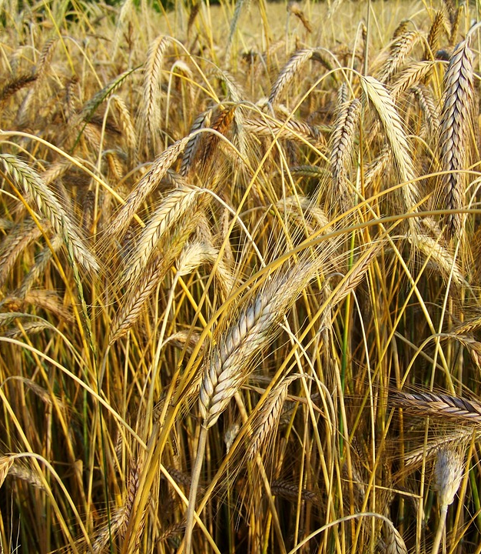
Cool Season Grasses
Rye
Winter Wheat
Barley
Oats
Annual Ryegrass
Triticale
Notes:
Grasses- Cover crops such as rye, winter wheat, barley, oats, annual ryegrass and triticale are cool season grasses.

Slide 26
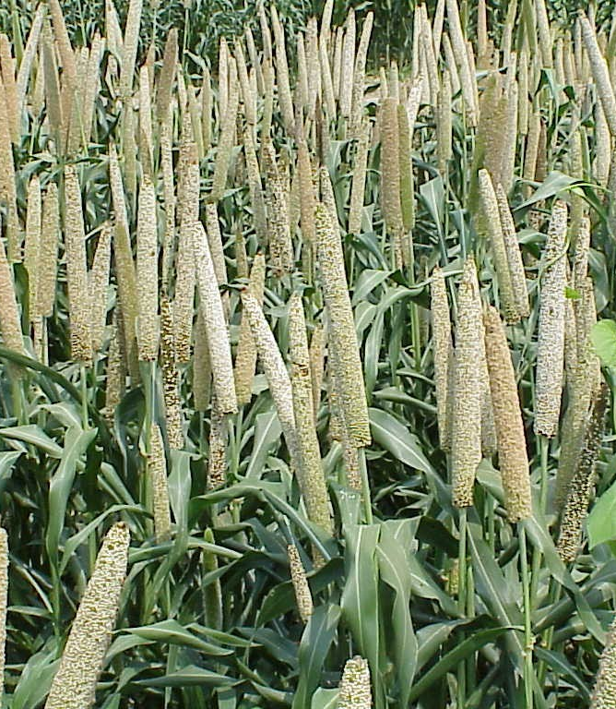
Warm Season Grasses
Sorghum/Sudan
Teff
Pearl millet
German millet
Proso millet
Forage sorghum
Corn
This Photo by Unknown Author is licensed under CC BY-SA
Notes:
Warm season grasses that can be planted if your corn or soybean planting fails or after wheat are sorghum/sudan, teff, pearl millet, German millet, proso millet, and forage sorghum. These can also be used as a forage component following wheat or when a crop failure has occurred.

Slide 27
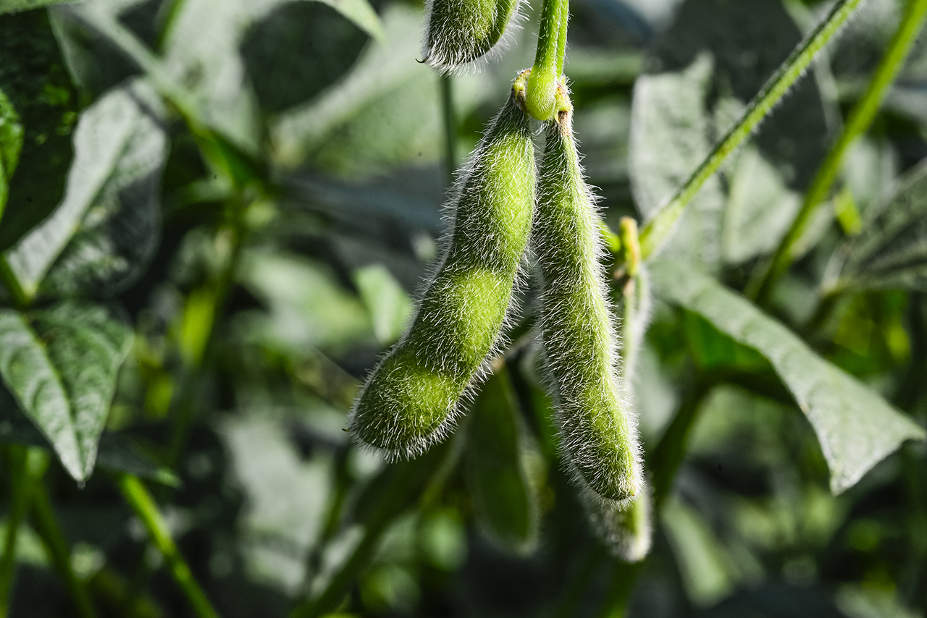
Legumes
Fix atmospheric nitrogen for subsequent crops
Attract beneficial insects
Build soil matter
Prevent erosion
Notes:
Legumes can benefit soil by fixing atmospheric nitrogen (N) for subsequent crops. They can also attract beneficial insects, build soil matter and prevent erosion.

Slide 28
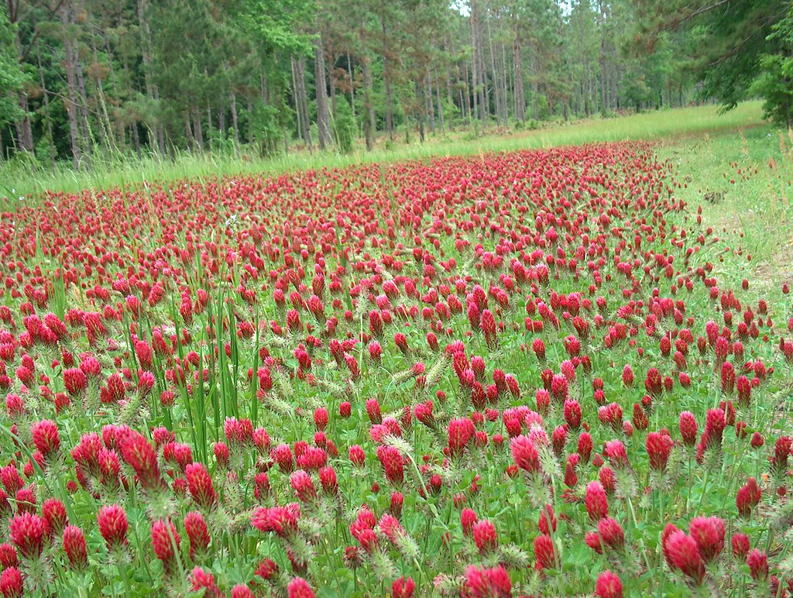
Cool Season Legumes
Hairy Vetch
Crimson, red, white, blansa, berseem clover
Sweet clover
Alfafa
Fababeans
Chickpeas
Lentils
Field peas
This Photo by Unknown Author is licensed under CC BY-ND
Notes:
Cover crops such as hairy vetch, crimson, red, white, blansa, berseem clover and Sweetclover, alfalfa, fababeans, chickpeas and lentils and field peas are considered cool season legumes.

Slide 29
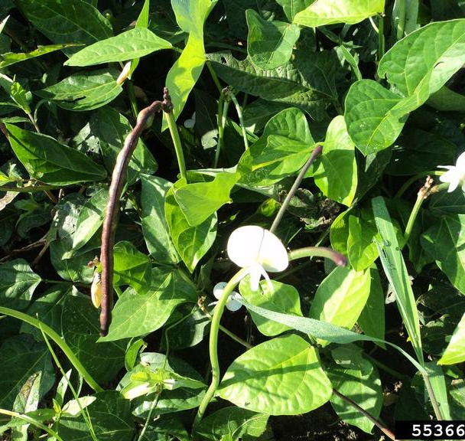
Warm Season Legumes
Cowpeas
Mungbeans
Forage soybeans
Sunhemp
Partridge pea
Lablab
Peanuts
This Photo by Unknown Author is licensed under CC BY
Notes:
Warm season legumes are cowpeas, mungbeans, forage soybeans, sunnhemp, partridge pea, lablab, and peanuts.

Slide 30
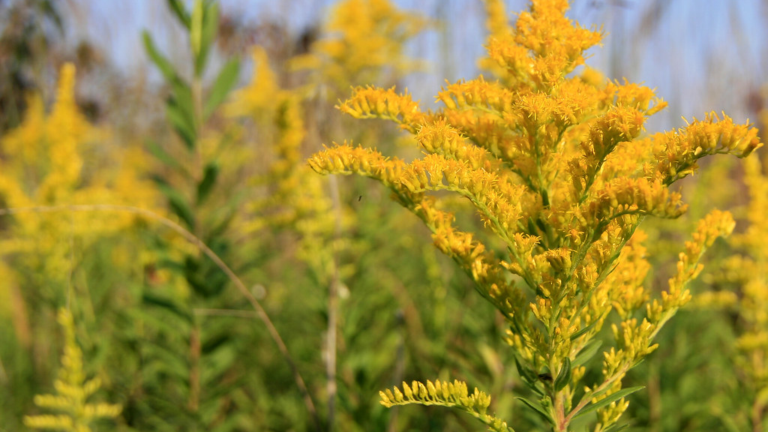
Broadleaves
Forbs that offer biodiversity
Perennial forbs include coneflowers, asters, goldenrod
This Photo by Unknown Author is licensed under CC BY-SA-NC
Notes:
Photo – goldenrod
Cover crops can also include forbs, which are broadleaf plants that offer biodiversity. Examples of forbs include coneflowers, asters and goldenrod in a perennial system.

Slide 31
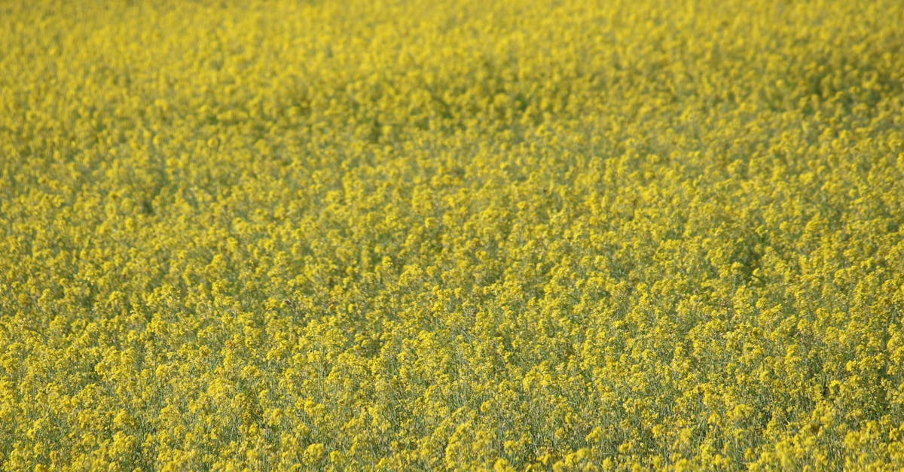
Cool Season Forbs – day dependent
Mustard
Turnips
Radish
Kale
Flax
Camelina
Phacelia
Rapeseed
Notes:
Picture – mustard
Cool season forbs include, mustards, turnips, radish, kale, flax, camelina, phacelia, and rapeseed many are day dependent on when they flower so planting them in the late summer during august is a better option, so you don’t get them going to seed.

Slide 32

Warm Season Forbs
Buckweat
Chicory
Safflower
Sunflowers
Notes:
Picture – sunflower
Warm season plants that are grown after wheat or after a crop failure in a mix are buckwheat, chicory, safflower and sunflowers.

Slide 33
Cover Crop Selection
Must consider climate
Growing season of crops
Needs of those crops – pollination, livestock feed, nutrient needs
Equipment that they have or will need
Cost of seed
What they are planting before and after the cover crop
Notes:
How do farmers select which cover crops to use? There are many factors that farmers consider when thinking about cover crops. Farmers often will look at the growing season of current crops. For example, in the Midwest, many farmers plant a corn-soybean rotation. Corn and soybean typically grow from May to October in most parts of this area. A farmer might consider growing a crop that can be planted in the fall, overwinter, and be harvested or terminated in early spring. Some farmers may consider planting a cover crop alongside their crops to increase pollination or use the cover crop to feed livestock. Farmers also must consider what equipment they have for planting and harvesting cover crops. While some farmers may choose to grow cover crops alongside their other crops, many will need to factor in how to end the cover crop’s growing season. Farmers may need to use chemicals or specialized equipment, such as a roller crimper or flail mower to kill the cover crops. Some cover crops can also be winter killed by cold in some areas these include the warm season grass, legumes and broadleaf plants. Additional factors, such as cost of the seed and available funding programs, may also play a role in cover crop decisions for farmers.

Slide 34
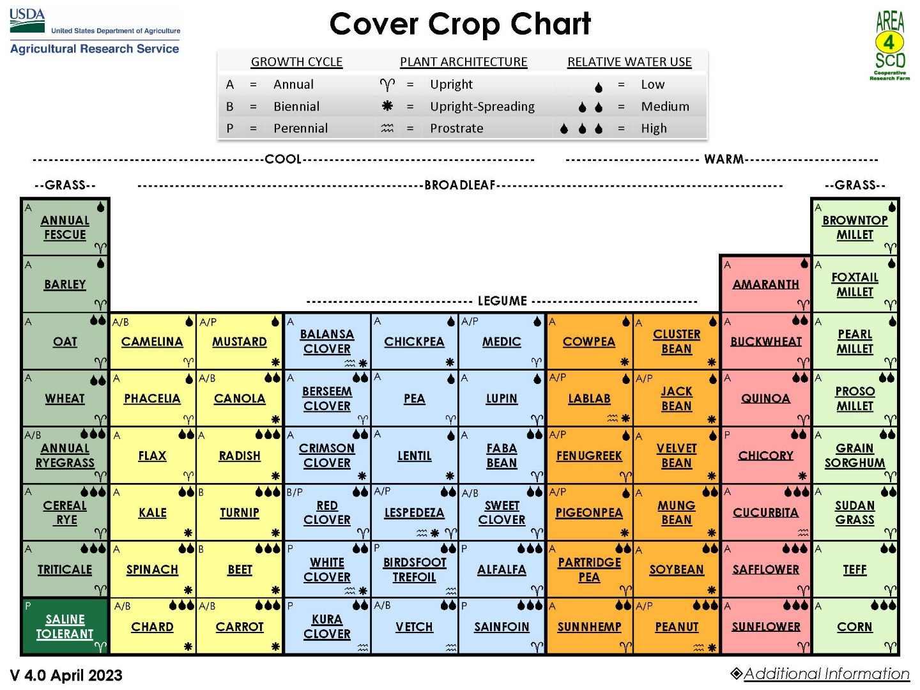
Notes:
The cover crop chart is separated into cool and warm season crops. The grasses, legumes, and broadleaves that we discussed in this lesson, this list is far more inclusive. We can also see their growth cycle: annual (meaning they complete their life cycle in one growing season and then die), perennial (plants that persist for multiple years and survive growing season to growing season), and biennial (live two years growing vegetation in the first and blooming in the second). Their architecture, how they grow either as an upright plant, they spread wide, or long prostrate close to the ground. Relative water use low, medium to high. This tool is great for farmers to determine how a cover crop could work into their system and the needs of that system

Slide 35
Interest Approach: Chemistry Review
C
N
Notes:
Chemistry Review Warm Up! Today, we are going to be using chemistry when discussing soil health. What does C (draw on board) stand for? N? (look for answers Carbon and Nitrogen) Ask students to do a 1 minute write about what they know about Carbon and Nitrogen. It is important to understand that some students may not have taken a chemistry class yet- that is not needed, but this activity will help you be able to set them up for success and also gauge their chemistry knowledge.

Slide 36
Interest Approach:
Chemistry Review/Warm Up
Notes:
Chemistry Review Warm Up! Today, we are going to be using chemistry when discussing soil health. What does C (draw on board) stand for? N? (look for answers Carbon and Nitrogen) Ask students to do a 1 minute write about what they know about Carbon and Nitrogen. It is important to understand that some students may not have taken a chemistry class yet- that is not needed, but this activity will help you be able to set them up for success and also gauge their chemistry knowledge.

Slide 37
Nutrients
Adding in any of these cover crops changes the nutrient content of the soil
These crops use different nutrients and can tie them up
Crops add different nutrients to the soil
This must be considered when choosing cover crops
Notes:
When we consider adding more plants to a cropping system either before or after a crop plant, we need to consider that we may have issues with nutrient tie up. That can be a good thing if we over apply nutrients, as they can scavenge them, but it can also be detrimental to the following crop depending on the growth stage of the cover crop that is to be terminated prior to planting. This growth stage is critical to nutrient availability or unavailability during cropping.

Slide 38

Carbon to Nitrogen Ration (C:N)
Ratio of the mass of carbon to the mass of nitrogen in a substance
Example C:N of 10:1 means there is 10 units of carbon for each unit of nitrogen
The C:N ratio effects crop residue decomposition and crop nutrient cycling
Key to crop rotations is understanding this system
Notes:
All plants have a Carbon to nitrogen ratio (show example on cover crop chart from ARS). Carbon to Nitrogen ratio (C:N) is a ratio of the mass of carbon to the mass of nitrogen in a substance. For example, a C:N of 10:1 means there is ten units of carbon for each unit of nitrogen in the substance. Since the C:N ratio of everything in and on the soil can have a significant effect on crop residue decomposition, particularly residue cover on the soil and crop nutrient cycling (predominantly nitrogen), it is important to understand these ratios when planning crop rotations and the use of cover crops in agricultural systems.

Slide 39
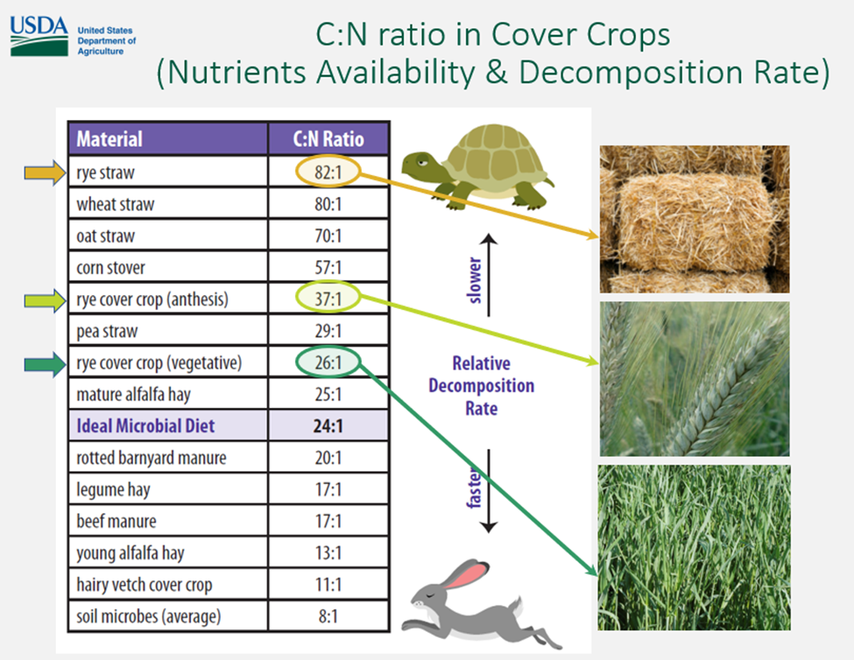
Example
The higher the ratio, the slower the decomposition rate
Soil microbes average at 8:1 and the ideal diet is 24:1
Microorganisms must acquire enough carbon and nitrogen from the environment to maintain that ratio
Notes:
Here is typical scenario in cropping systems that contain corn or beans and a cool season cover crop is used. Depending on if you plant corn, you will need nitrogen to be available to that plant and microbes are involved in breaking down all the plant biomass on the surface and the roots in the soil. To do that, they need a low carbon to nitrogen ratio of material or additional nitrogen to do so.

Slide 40
C:N Continued
Soil microorganisms burn carbon as a source of energy
Not all carbon remains in the body
To acquire the necessary carbon and nitrogen to stay alive, its ideal diet is 24:1 C:N
16 parts carbon are used for energy and 8 parts maintenance
Notes:
Soil microorganisms have a C:N ratio near 8:1. They must acquire enough carbon and nitrogen from the environment in which they live to maintain that ratio of carbon and nitrogen in their bodies. Because soil microorganisms burn carbon as a source of energy, not all of the carbon a soil microorganism eats remains in its body; a certain amount is lost as carbon dioxide during respiration. To acquire the carbon and nitrogen a soil microorganism needs to stay alive (body maintenance + energy) it needs a diet with a C:N ratio near 24:1, with 16 parts of carbon used for energy and eight parts for maintenance. It is this C:N ratio (24:1) that rules the soil!

Slide 41
Changing the Ratio
Mature
Mature alfalfa hay (with a C:N ration of 25:1)
Soil
Soil microorganisms consume quickly and with no excess C or N leftover (microorganisms need 24:1)
Balance
Perfect balance for microorganisms
Notes:
If foodstuff such as mature alfalfa hay (C:N ratio of 25:1) is added to the soil (see Table 1), the soil microorganisms will consume it relatively quickly with essentially no excess carbon or nitrogen left over. The hay has an almost perfect balance of carbon to nitrogen that soil microorganisms (24:1) need. The process of eating these nutrients involves mineralization or immobilization.

Slide 42
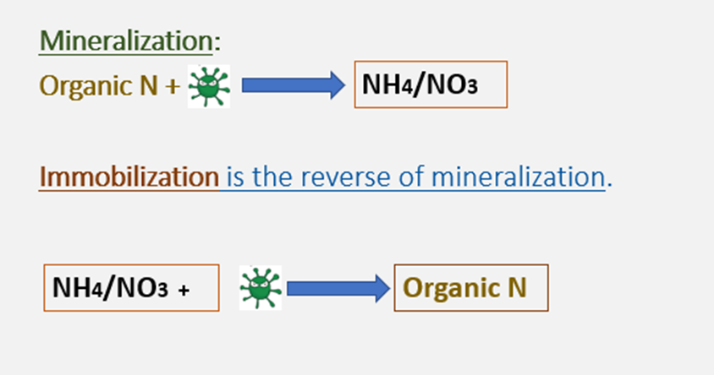
Mineralization vs. Immobilization
Mineralization: a process which microbes decompose organic N from compost, manure, residues, etc
Mineralization rates varies based on soil temp, moisture, and amount of oxygen in the soil
Immobilization: the reverse of mineralization
Immobilization is the process in which nitrate and ammonium are taken up by soil organisms and therefore become unavailable to crops
Notes:
Mineralization is the process by which microbes decompose organic N from manure, organic matter and crop residues to ammonium. Because it is a biological process, rates of mineralization vary with soil temperature, moisture and the amount of oxygen in the soil (aeration).
Immobilization is the reverse of mineralization. All living things require N; therefore microorganisms in the soil compete with crops for N. Immobilization refers to the process in which nitrate and ammonium are taken up by soil organisms and therefore become unavailable to crops.This is only a small part of the process but I think it gives you a basic idea of how life, death and mineralization works in that Rhizosphere.

Slide 43
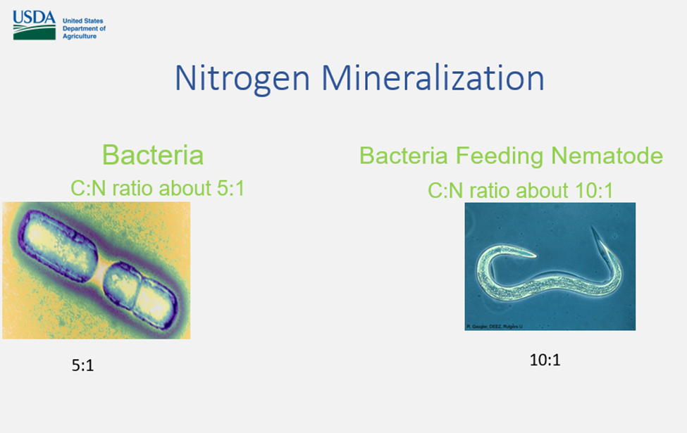
Everything is made up of differing amounts of carbon and nitrogen.
C/N ratios vary between species but generally Bacteria have a lower C/N ratio than a Nematode.

Slide 44
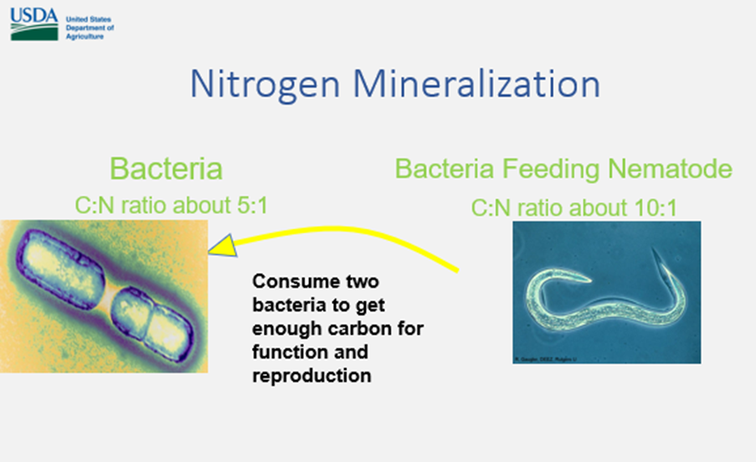
Bacteria are around 5:1 and a Nematode, which eats the bacteria, is 10:1. A Nematode will need to eat two Bacteria to get 10 units of Carbon but it only needs one of the Nitrogen units.

Slide 45
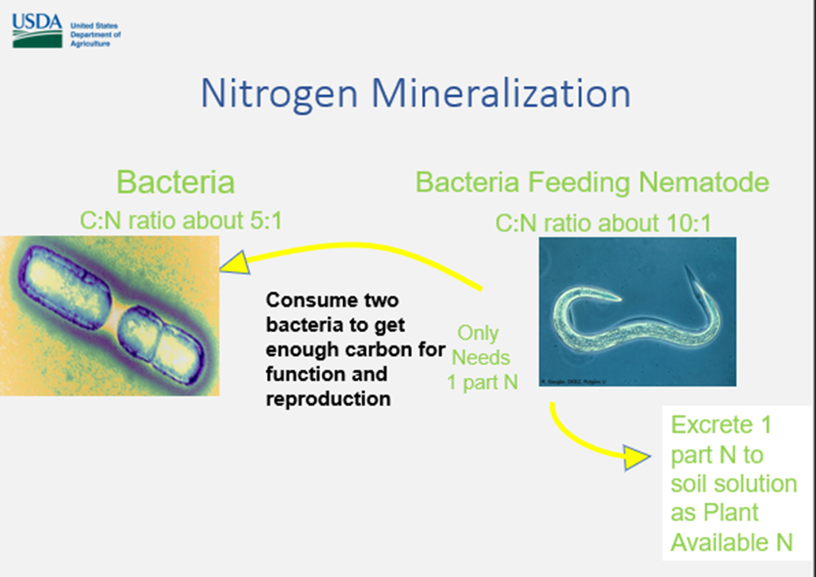
The Nematode excretes the extra Nitrogen into the soil in a form that a plant can very readily take up. That is exactly what we want to happen if there is a plant there to take up that Nitrogen. This scenario works best after a low carbon to nitrogen mix is planted before planting a high carbon to nitrogen plan like corn or wheat.
Notes:
So, he excretes the extra into the soil in a form that a plant can very readily take up. That is exactly what we want to happen if there is a plant there to take up that Nitrogen. This scenario works best after a low carbon to nitrogen mix is planted before planting a high carbon to nitrogen plant like corn or wheat. This helps to reduce nitrogen losses after a crop is harvested.

Slide 46
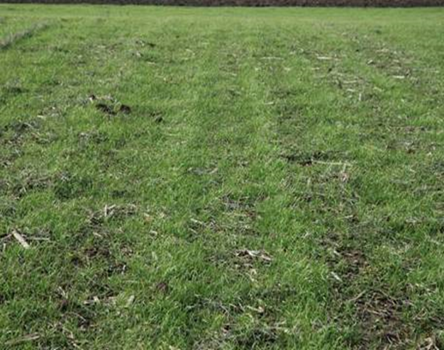
See the areas that are striped and look like there is more plant growth why is this?
Notes:
Hint – there was a previous crop planted on this field
(because the cereal rye is capturing the leftover nutrients in that row where the crop was previously planted)
Nitrate mineralized from crop residues and soil organic matter is highly soluble through the winter
Nitrogen leaching can be significant even without fall N applications

Slide 47
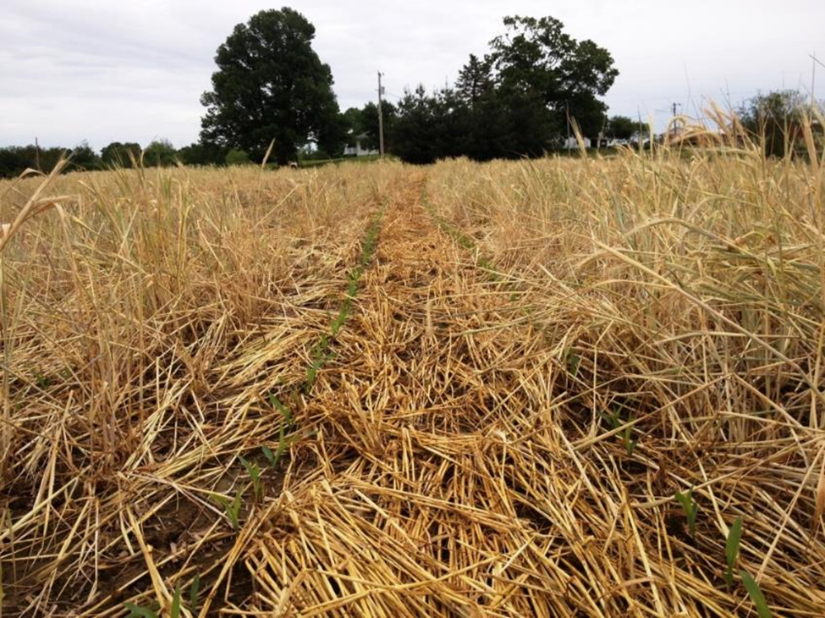
If we were to plant corn into this high carbon to nitrogen ratio residue the opposite would happen.

Slide 48
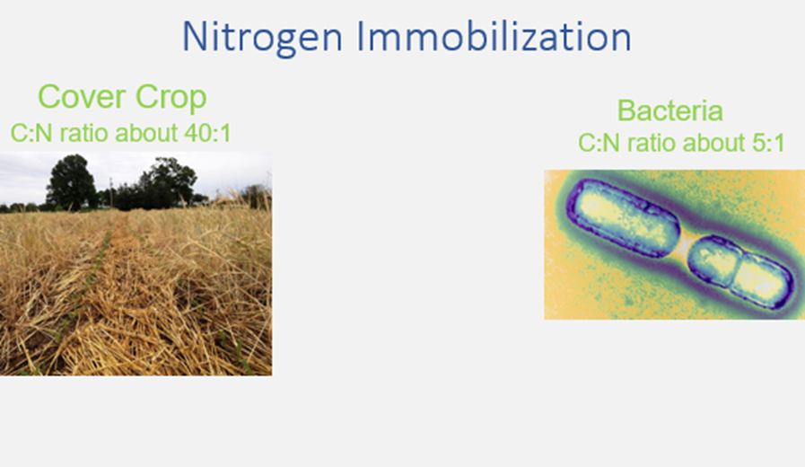
The microbes in the soil will get all their carbon but will use up all N from the bacteria and will begin to consume the N in the soil
Notes:
In this scenario, the microbe takes his five carbons and one nitrogen, but there is a lot of carbon left over. So, if we exponentially multiply this out over billions of microbes, they will get their carbon, but the N is gone so they start working on the Nitrogen in the soil and your cereal rye that comes up in this residue will be starved for N.

Slide 49
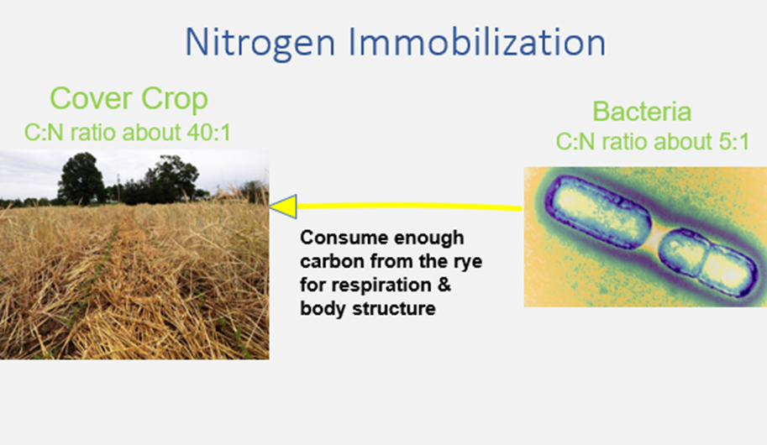
The cereal rye that comes up will be starved for N
Leads to needing additional N or to plant a cover that has a lower C:N ratio
Notes:
Therefore, you need to either feed additional N or you need to plant a lower C:N ratio cover or a combination of the two. In the case of Organic when you turn the green under you have a quick food source available for microbes and this process is sped up. You have excited the microbes by adding O2 in the soil and gave them a food source so you need something that will feed that system N asap. I.E. composted manure, fish emulsion etc.

Slide 50
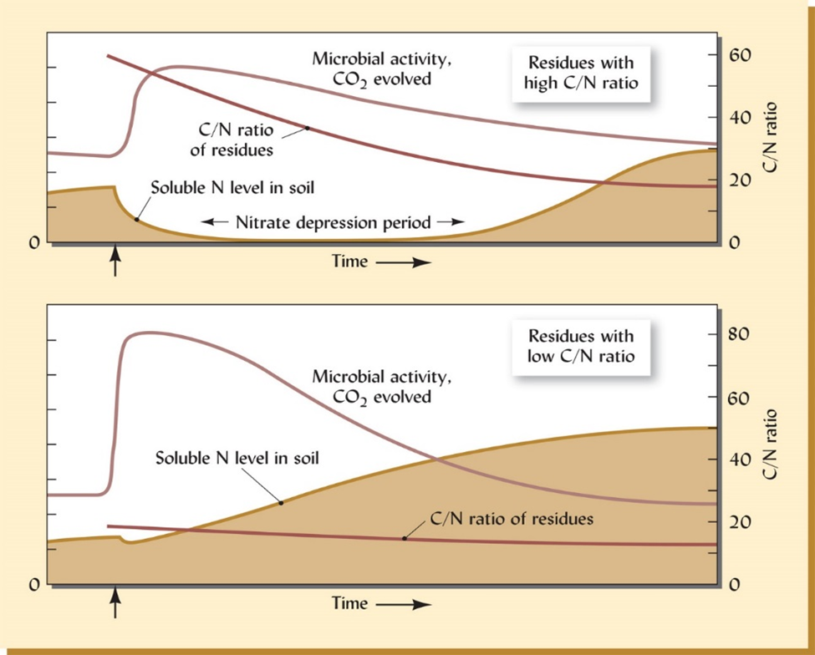
Notes:
Changes in microbial activity in soluble nitrogen level and residual c/n ratio following the addition of either high (upper figure, think corn stover or mature small grains) or low (lower figure, think legumes or other forbs) c/n ratio organic materials. Where the c/n ratio of added residue is above 25, microbes digesting the residues must supplement the nitrogen contained in the residues with soluble nitrogen from the soil. During the resulting nitrate depression period, competition between higher plants and microbes would be severe enough to cause nitrogen deficiency in the plants. Note that in both case soluble N in the soil ultimately increase from its original level once the decomposition process has run its course. The trends shown are for soils without growing plants, which if present, would continually remove a portion of the soluble nitrogen as soon as it is released.
The carbon to nitrogen ratios and immobilization and mineralization are a critical component to a farmer. It determines the fertility program and also the cover crops that need to be in either a mix or a single species.

Slide 51
Microbe Math
If we planted a mixture of plants how could we impact the Carbon and Nitrogen Ratios?

