Slide 1

Maximizing Cover

Slide 2
Lesson Vocabulary
Erosion
Crusting
Living Cover
Dead Cover
Water Holding Capacity
Mulch
Cover Crops
Residue

Slide 3
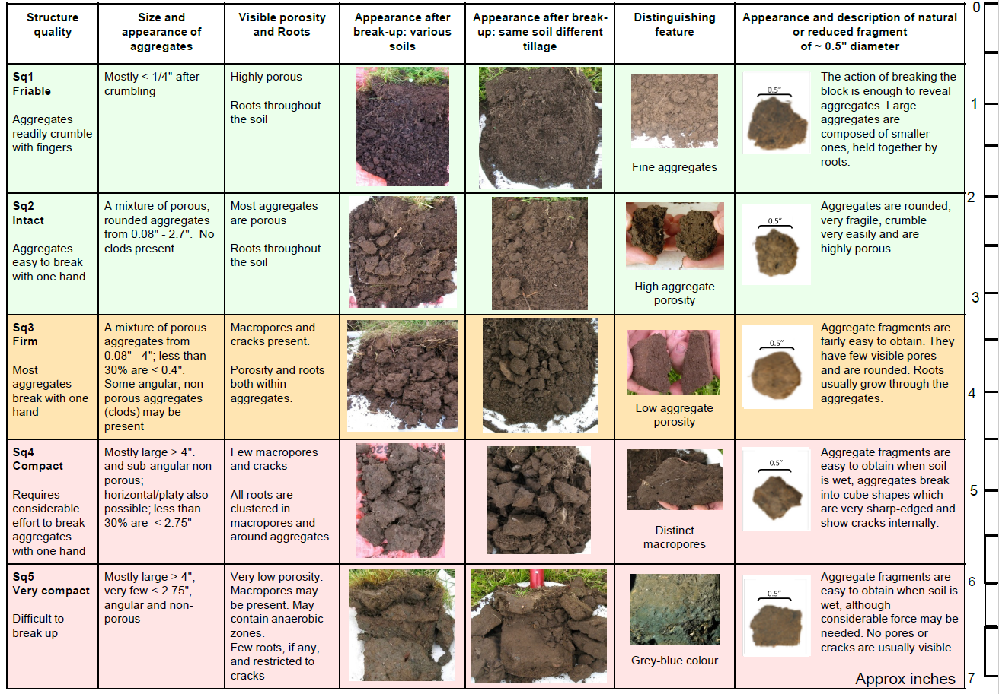
Interest Approach: Vess Score Card Activity
Notes:
Activity: Use the vess score card to dig small 1-foot-deep mini pits. Take a small spade cut along the edge of the pit to pull out and look at. Follow the instructions on the Vess card for scoring. Use a field that has had full tillage year after year, a field that was in no till and a field that is in grass to compare and score. In urban settings look for an area that has had construction recently, a lawn that is mowed very frequently, one that is left to grow and not mown often, a garden that is rototilled and if you can a garden that is using notill to compare. You could also use a foot path vs. the grass adjacent to it.

Slide 4
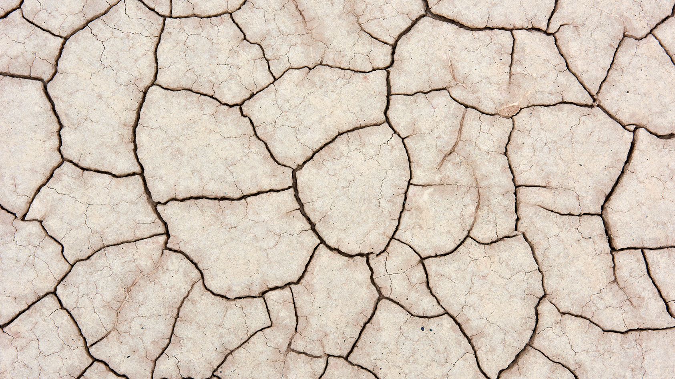
Threats to Uncovered Soil
Loss of water through evaporation
Erosion due to rain or wind
Crop competition from weed species
Crusting of the soil top layer
Notes:
Keeping the soil covered year-round will protect it from various threats. Those threats could be loss of water through evaporation, erosion due to rain and wind, and competition from weed species. There are multiple ways to keep soil covered, but typically, maximizing cover refers to either cover crops and/or mulching.

Slide 5
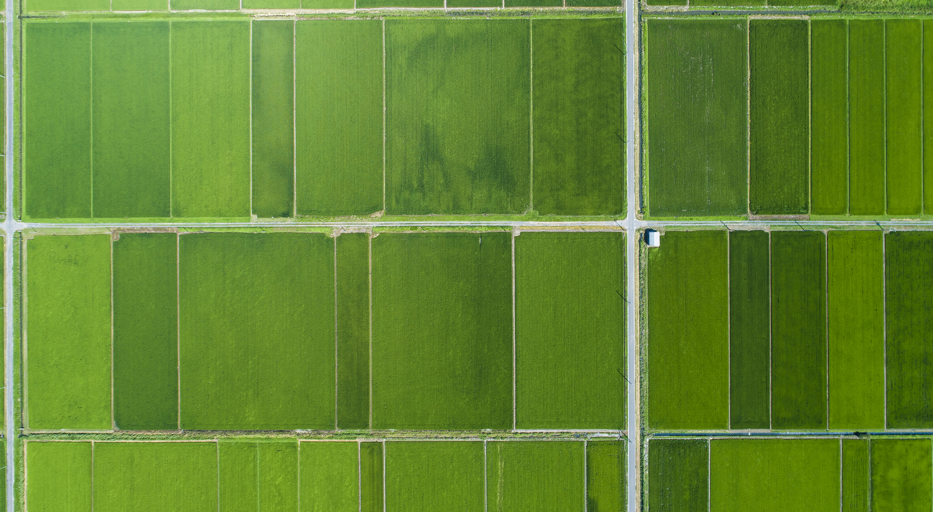
Soil Cover
Prevents erosion through holding the soil in place
Reduces evaporation through conserving moisture
Prevents crusting of the top layer
  Soil crusting is the loss of aggregate stability of the top layer of soil
Notes:
Maximizing cover prevents soil erosion by holding the soil in place and protecting the soil against wind and rain. Keeping the soil covered can conserve soil moisture through increasing water infiltration and reducing evaporation. The less soil is exposed to the sun, the less water will be lost, and the risk of soil crusting will decrease. Soil crusting occurs when there is a breakdown of the structural aggregates from flowing water, rainfall, or freezing and thawing of bare soil. Soil crusting is concerning as it can limit seedling emergence, reduce oxygen diffusion to seedlings, increase water runoff, limit water evaporation and infiltration, and increase wind erosion. Cover crops also help retain nutrients otherwise lost through soil erosion and runoff, improving water quality.

Slide 6
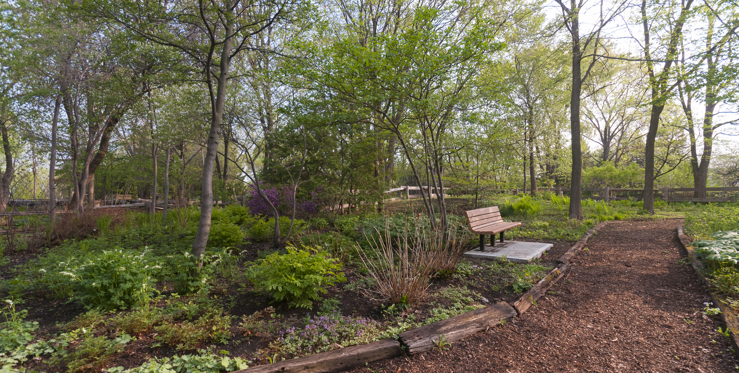
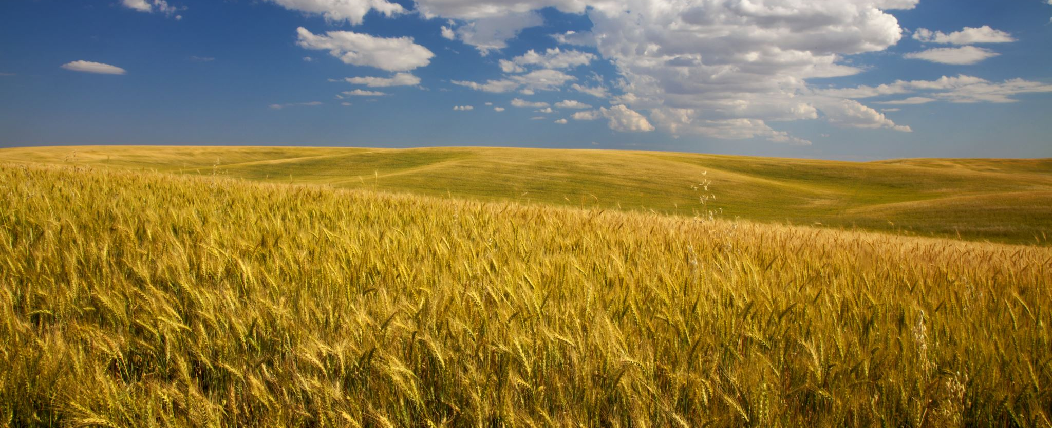
Types of Cover
Living Cover
  Cover crops
Dead Cover
  Mulch
  Residue
Notes:
There are two main types of soil cover, living cover and dead cover. Living cover refers to cover crops, and dead cover refers to soil mulching or residue.

Slide 7
Discussion Point: What do we remember about the benefits of cover crops providing a living root?
Notes:
Cover crops are one-way farmers can maximize cover on their fields. We have discussed cover crops in previous lessons. What do we remember about the benefits of cover crops providing a living root? (reducing erosion, increase nutrient cycling, nitrogen fixation, increased water infiltration and storage) How might cover crops benefit the top of the soil as well? (look for answers like limiting soil crusting, increased water infiltration, reducing evaporation, keeping the ground shaded, providing a food resource to insects and soil biota)

Slide 8
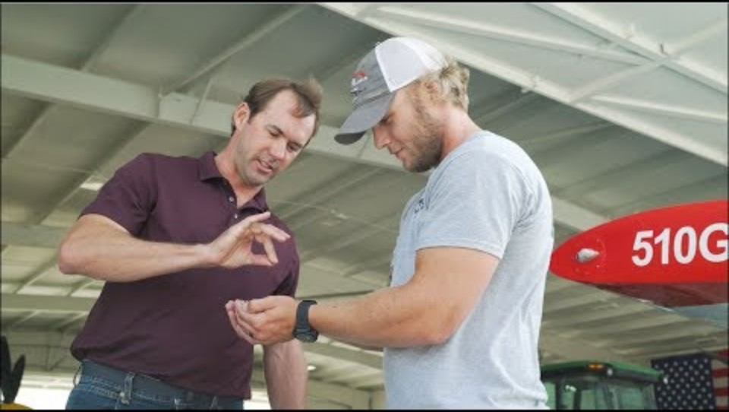
NRCS Review of Cover Crops

Slide 9
Cover Crops as Cover
Living roots hold the soil in place
Growth on the surface can limit evaporation
Thick growth, such as a rye, can suppress weeds
Notes:
Cover crops are living cover and provide ecosystem benefits including reducing erosion, increasing nutrient cycling, and nitrogen fixation. They can also intercept radiation and insulate the soil surface to moderate soil temperatures. Cover crops increase soil water capture and limit soil water evaporation. They do use soil water, which can impact the cash crop and needs to be considered based on the climate, but without them as part of the rotation you will not see improved soil function.

Slide 10
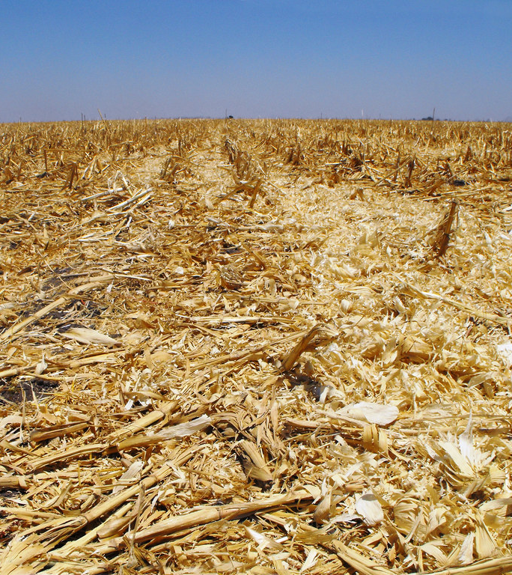
Dead Cover: Mulch and Residue
Residue: plant materials left on the field after harvest
Mulch: protective layer of material spread on top of the soil
Both protect from wind and water erosion
Both can suppress weeds
Both can impact soil temperatures
Both can inhibit evaporation
This Photo by Unknown Author is licensed under CC BY-SA-NC
Notes:
In farming, dead cover is oftentimes the residue left on the field after harvest. This residue will break down on the soil surface and can release nutrients back into the soil. The soil organisms will then further break down those nutrients and make them available for plants to use again.
Mulch is a protective layer of material spread on top of the soil. It helps conserve water and extend water availability. Mulch also protects soil from wind and water erosion, suppresses weeds, and moderates temperature extremes. Areas around the main crop can be mulched to suppress weeds. Soil temperature drives seed germination and seedling emergence. It directly affects plant growth and the activity of soil organisms. The same temperatures we like from 50-90 degrees are the same that soil biota and plants perform best. Nitrification, soil moisture, aeration, and nutrient availability are also impacted by soil temperature. The more the soil is covered the less area exposed to the sun for evaporation. This will allow for water to better infiltrate into the soil profile.

Slide 11

Why Does it Matter?
Microbial and Nutrient activity in the soil can be impacted by:
  Soil temperature
  Soil water holding capacity
  Extreme weather changes
Uncovered soil is susceptible to increased temperatures, lack of water, and erosion threats
Directly impacts the growth of crops within that soil
Notes:
It is important to keep the soil covered because microbial and nutrient activity in the soil is impacted by soil temperature, soil water holding capacity, and extreme weather changes. Uncovered soil will be more susceptible to increased temperature, drought, and weather and erosion threats. This is important to farmers because this will impact the overall growth of their crops in the soil.

Slide 12
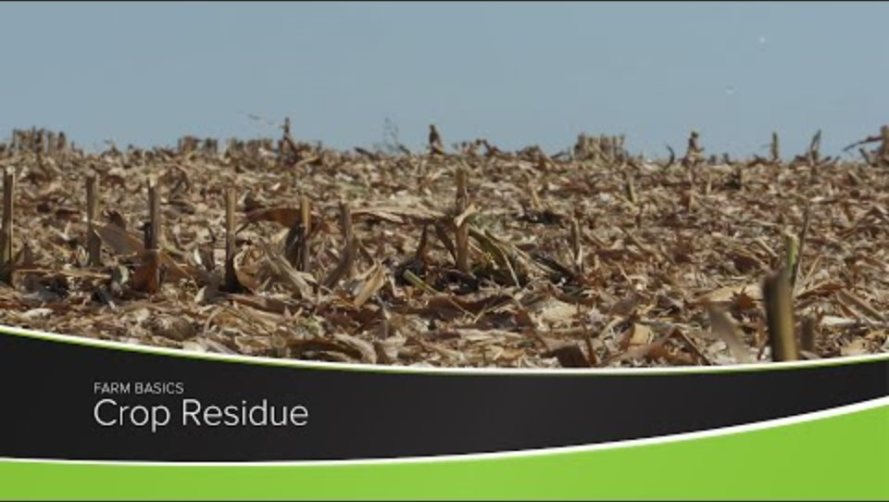
Crop Residue

Slide 13
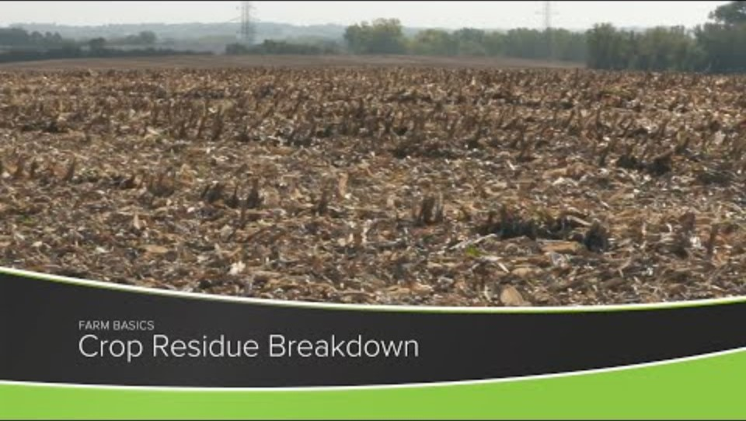
Residue Breakdown

Slide 14
Discussion
Benefits of residue as cover
Challenges of residue
Notes:
Break the students into two groups, or break small groups in half, whatever is easier. Have half the students discuss the or list out the benefits of leaving residue on the field at the end of the harvest based on all the information that has been discussed and shown in the video. Have the other students discuss or list out the challenges from leaving residue and the potential problems discussed and shown in the video
Come together in the class setting to list out the pros and cons of residue and open for discussion
Ultimately it comes down to the farmer having to decide what works best for their rotation, and depending on the microbial activity, location of the farm, soil temp leaving residue may or may not work for that farmer. There are benefits, but if the cons outweigh the benefits, they won’t leave it and could harvest for silage if they choose to leave it they could graze it or leave it as residue cover to be planted in.

Slide 15
Interest Approach: Mid-Point Check In
What I Learned
Questions I Have
Notes:
Midpoint Check-In. Hand each student two sticky notes - one to write their key takeaway from this unit so far and one to write a question they still have about soil health. Students should not print their name on the sticky note. Once all students have written on their sticky notes - instruct them to place them under the appropriate category at the front of the room. Teachers should write “What I learned” and “Questions I have” in separate areas at the front of the room for students to stick their sticky notes to.
As students return to their seat, observe the “Questions I have” side first. If students have related questions, arrange them together while reading them out loud. Once arranged, move to the “What I have learned” section. If any of the “What I learned” answers a question from the other side, discuss those first. Leave the sticky notes at the front of the board throughout the lesson. Refer to these questions as you work through the lesson if they align.

Slide 16
In-Class Labs: Rainfall Simulator
Notes:
Pass out student worksheet. Instruct students to hypothesize what might happen with each of the samples, given what they currently know about cover on soil.

Slide 17
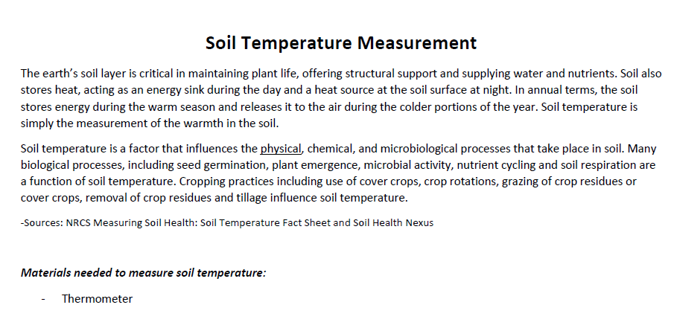


Slide 18
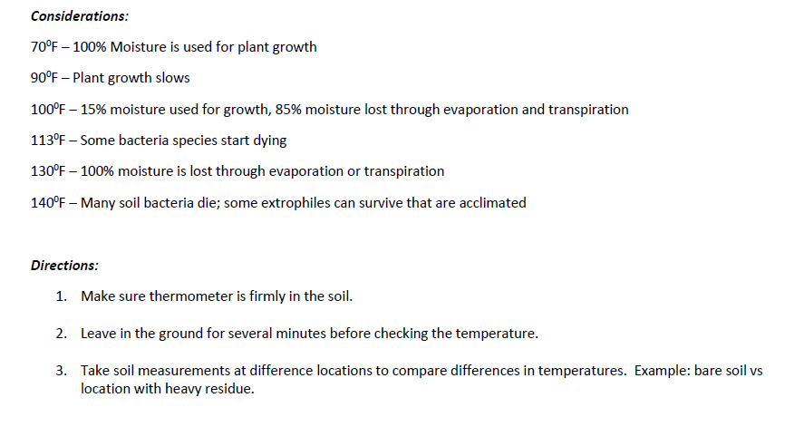

Slide 19
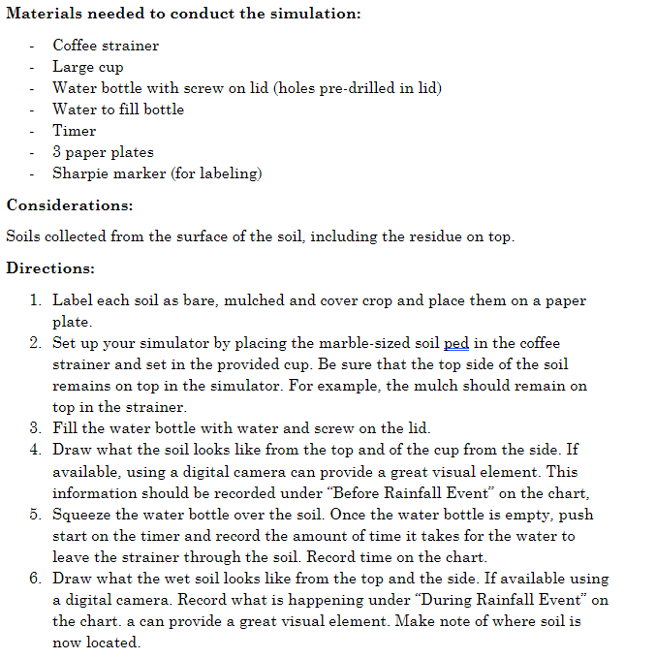

Slide 20
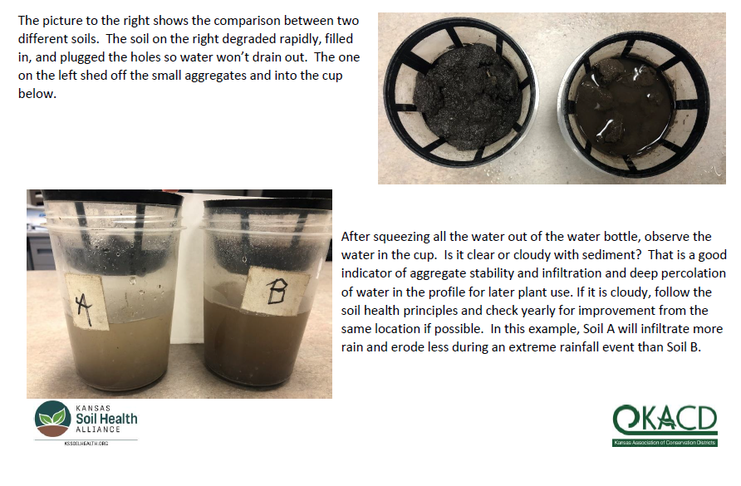

Slide 21
Lab Questions
Did the soil samples react the same way to the addition of water? Explain.
Which sample would have the most water runoff? Explain.
What happened to the water in the large cup/jar? Explain.
Which soil is more apt to resist erosion during a rainstorm? Explain.
Given your area's current weather conditions, which of these practices would make the most sense for a farmer to implement given your test results?

