Slide 1
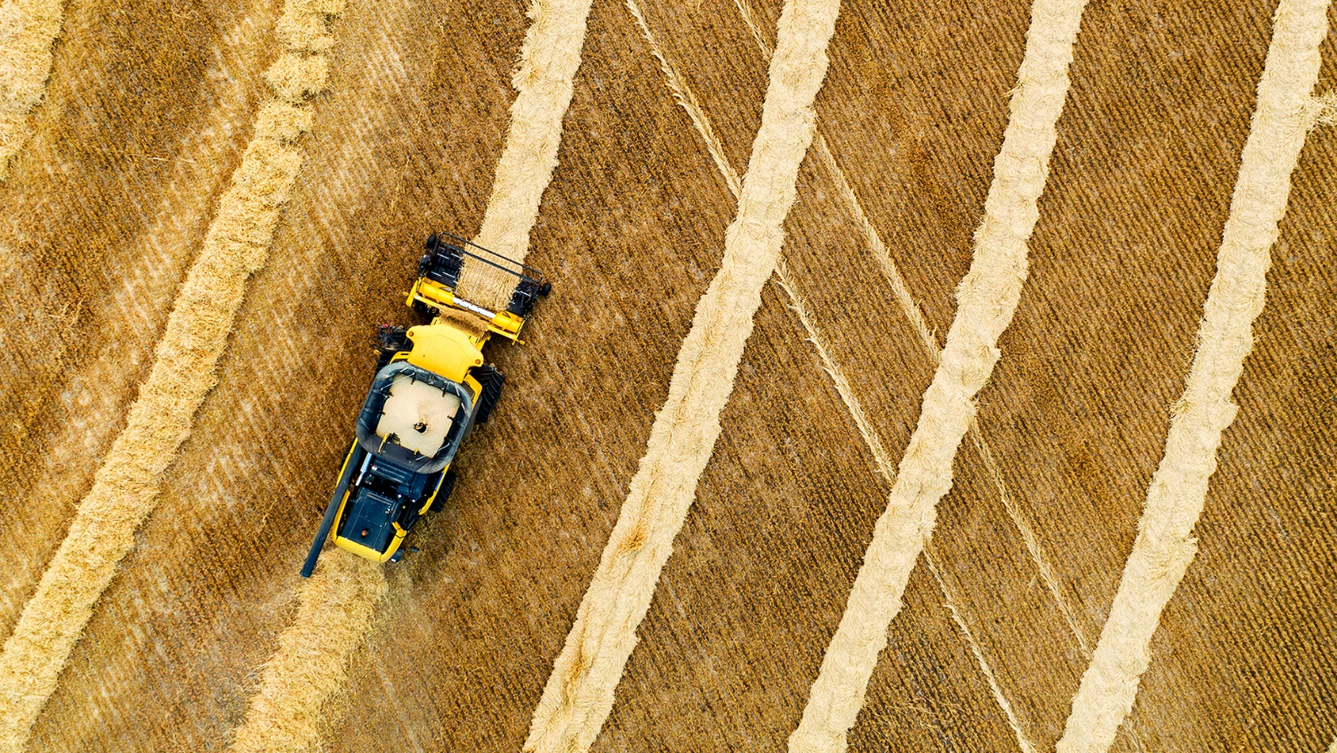
Minimizing Disturbance

Slide 2
Lesson Vocabulary
Tillage
Soil Movement
Compaction
Chemical Disturbance
Biological Disturbance
Food Webs
Water Holding Capacity
Infiltration
Aggregate Stability
Aggregate

Slide 3
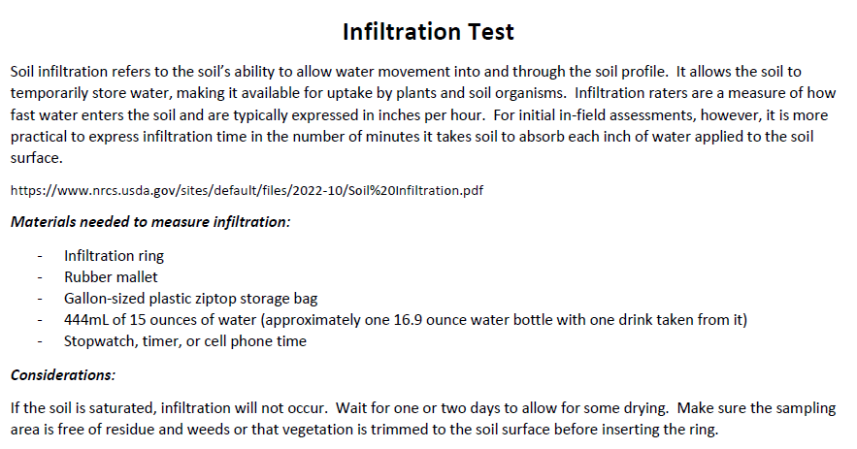
Interest Approach: Infiltration Test

Slide 4
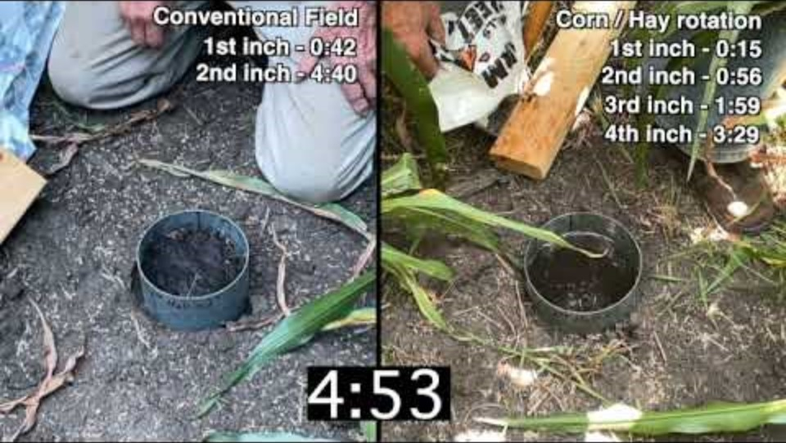

Slide 5
Interest Approach: What have we learned so far?
Types of materials that make up soil?
How do these materials interact with each other?
Differences in infiltration we observed in the video?
Notes:
Ask students to write down what they have learned about soil so far. What types of material make up soil? How do those materials interact with each other? How could this contribute to the differences in infiltration that they observed (in person or via the video).

Slide 6
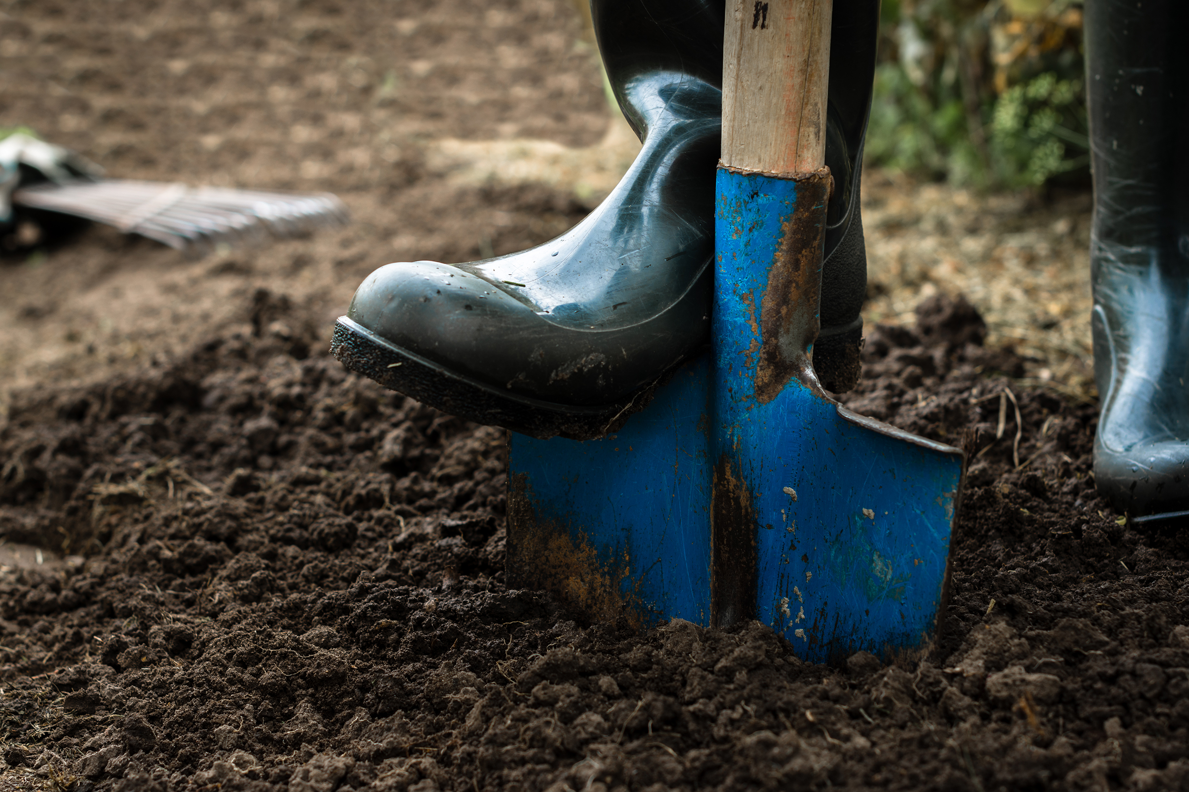
Aggregates
Clumps of soil made from sand, silt, or clay
Soil structure is specific to the size, shape, and arrangement of aggregates
Aggregates are arranged in layers
Well aggregated soils drain better
From the video, which soil was better aggregated?
Notes:
Aggregates are clumps or units of soil made of sand, silt, and clay. Soil structure is specific to the size, shape, and arrangement of the soil aggregates and the pore spaces between them. These aggregates are arranged in layers within the soil. Well aggregated soils will have the ability to drain better, as they have larger spaces between them.

Slide 7
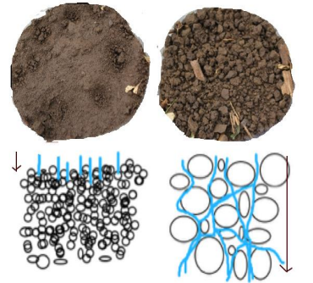
Aggregate Stability
Stable particles break down less and decrease erosion
Well structured soils have an increase water holding capacity
Poor soil structure leads to compaction, erosion, crusting, runoff and poor root development
Notes:
Aggregate stability is important because stable particles are less inclined to collapse into smaller pieces. This decreases erosion, and the power of erosion. These well-structured soils, have a higher water holding capacity, are less prone to collapse, and compaction. Soils with poor structure will likely cause more problems. Problems such as compaction, erosion, crusting, runoff, and poor root development. When aggregates collapse, they fill the pore spaces, restricting permeability as they become sealed off. This also limits a plant’s roots from developing deep into the soil.

Slide 8
Properties that Affect Aggregate Stability
Soil Texture
Climate
Organic Matter
Availability of Soil Organisms
Frequency and Intensity of rainfall
Notes:
There are many properties that affect aggregate stability. Soil texture, climate, organic matter, and availability of soil organisms. Silt and clay bind particles together better than sand. (opportunity to reference previous lessons on soil intros). Plants, animals, and soil microbes provide the glue (glomalin coats and protects and poly saccharides bubblegum like, root exudates which are sticky ) that holds soil together. Diverse and active organisms work together to improve aggregate stability through secreting compounds. These aggregates are very delicate and can turn over within 27 days, if not protected.(Six et al. 2004).
Frequency and intensity of rainfall also impact aggregate stability. Aggregates can be broken down by intense rainfall events. Warmer weather also impacts the rate of decomposition in the soil. Faster decomposition can lead to a loss of aggregate stability, through the loss of soil organic matter.

Slide 9
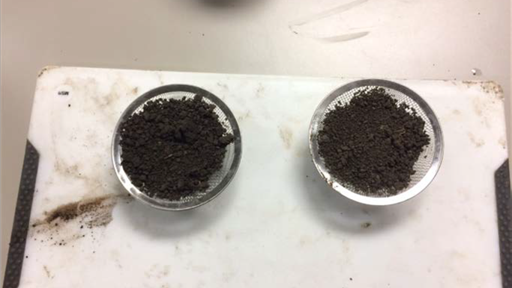
Activity! Aggregate Stability Test
Step 1: Place an even about of surface soil from each management system into the sink strainers
Notes:
Start with two similar soils that have different long term management. In this example we used an Askarben Silty Clay Loam soil with two different management systems that are side by side on the University of Nebraska Rogers Memorial farm near Lincoln. One was managed under continuous no-till since 1981 along with cover crops for the past 10 years with a corn-soybean rotation and the other has the same rotation except it has been managed under a conventional tillage system and no cover crops since 1981

Slide 10
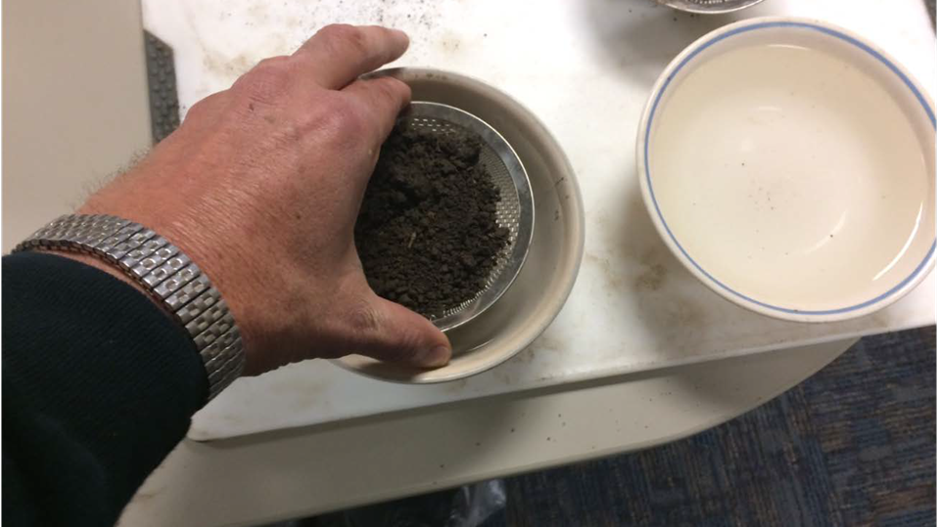
Step 2: Immerse strainer in bowl or mason jar

Slide 11
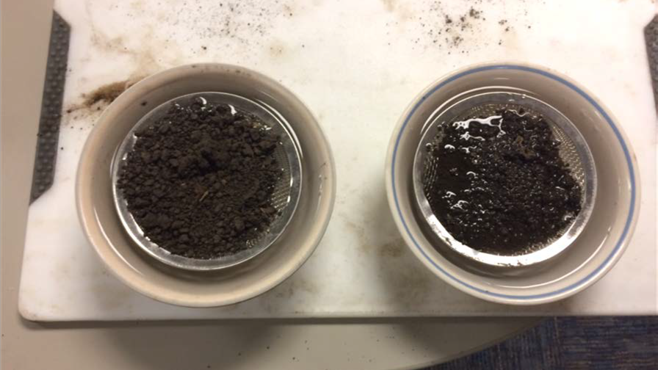
Step 3: Leave strainer of soil in bowl of water until each one is fully saturated (add extra water as necessary

Slide 12
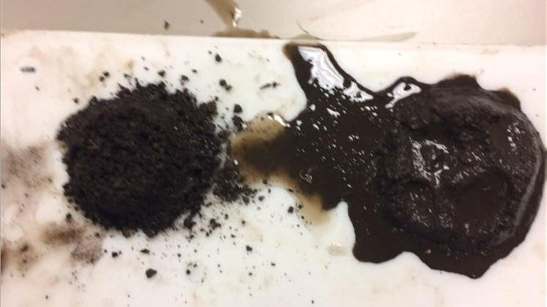
Step 4: Turn the strainers upside down on the cutting board
Notes:
The long term no-till retains its structure because of superior aggregate stabilt versus the conventional tillage soil loses its structure because it has poor aggregate stability after being saturated (pudding-like). Turn the board sideways so you can observe how the soil and water move. Allow the students to touch and feel the differences
Discussion points:
Improved soil structure
Aggregate stability
Improved air exchange
Improved nutrient cycling
Avoiding anaerobic conditions
Denitrification
Runoff erosion benefits
Crusting

Slide 13
Interest Approach: Disturbance
What does disturbance mean in relationship to soil?
What is non-agricultural disturbance?
What is agricultural disturbance?
Notes:
Students should journal for 2 minutes answering these three questions: From what we know about soil, what does it mean to disturb soil? What is a non-agricultural disturbance? What is an agricultural disturbance? Once students have finished, discuss as a class what disturbance means in relationship to soil and answer the above questions as a class.

Slide 14
Soil Disturbance
Biological
Chemical
Physical
Impacts the biological communities in the soil
Changes in the soil chemistry
Disturbing the soil layers physically
Notes:
Farmers must work to minimize disturbance to keep the soil healthy. Soil disturbance can occur in three different forms: biological, chemical, and physical. Biological disturbance impacts the biological communities utilizing the soil. Whether that is the plant currently growing or the microbes that live in the soil. Chemical disturbance is the over application of nutrients or pesticides. This disrupts the soil food web and functions. Physical disturbance can occur in tillage and other physical disturbances of the soil layers.

Slide 15
Biological Disturbances
Overgrazing and mowing a lawn
Loss of green tissue limits the plant’s ability to photosynthesize
Decreases productivity and interactions between the plant’s roots and soil microbiome
Introducing biologicals
Different species compositions can take over the native soil biology
Suffers from increased erosion exposure, increased soil temp, and decrease of root growth
Notes:
Biological disturbances in agriculture can occur via overgrazing, outside of agriculture this can look like over mowing a lawn. The loss of green tissue limits the plant’s ability to photosynthesize. This overall reduces the productivity of that plant in the soil and the interactions between that plant’s roots and the soil microbiome. One more way soil can be biologically disturbed is by adding biologicals that are sold in a jug. They have different species composition and can be consumed rapidly by the current soil biology or take over and eliminate native soil biology. Soil biology suffers from increased erosion exposure, increased soil temperature, and decreased root growth and exudates.

Slide 16
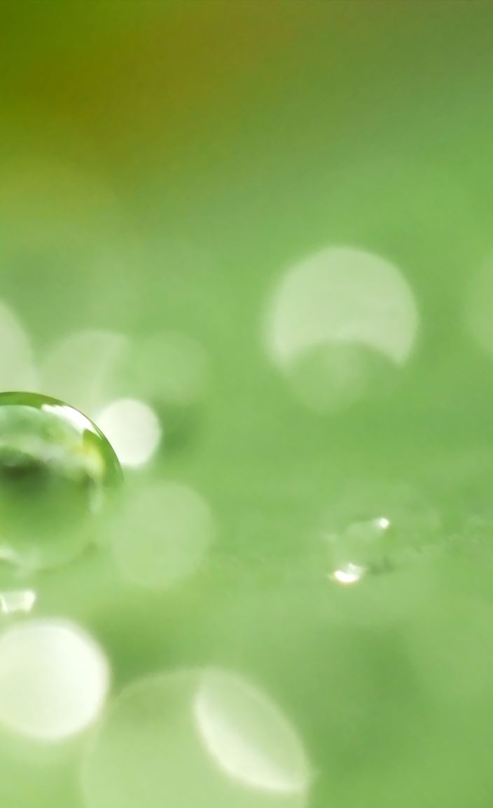
Chemical Disturbance
Overapplication of inputs
Fertilizer
Pesticide
Fungicide
Notes:
Chemical disturbance is the overapplication of inputs. Those chemical inputs can be fertilizers or pesticides. The overapplication of fertilizers can disrupt the natural soil food web through unequal distribution of chemicals. Overapplication of pesticides like fungicide, some herbicides, and insecticides can wipe out the soil microbiome completely. However, can be needed to control pests that would wipe out a farmer’s crop or disease if it is a particularly bad year for it.

Slide 17
Physical Disturbance
Soil mixing with Oxygen releases excess CO2 in the atmosphere
Reduces Soil Organic Matter
Mineralizes nutrients quickly
Breaks down soil aggregates and the pore spaces between them
Examples:
  Naturally occurring: Earthquakes, Erosion, Glaciers, Fire, Drought, Floods, Tornadoes and Hurricanes
  Agricultural: Tillage
Notes:
Physical disturbance occurs naturally in nature. Earthquakes, erosion, and the movement of glaciers across the landscape. Fire is a biological and physical disturbance as well, such as extreme weather conditions as drought, floods, and tornadoes. In an agricultural setting physical disturbance is tillage. Strip, reduced, and conventional tillage disrupts the soil. Tillage physically breaks down the soil aggregates and destroys root and earthworm channels as well as the pore spaces between the soil aggregates. The soil mixing with oxygen releases excess carbon dioxide into the atmosphere. This also reduces overall soil organic matter and quickly mineralizes nutrients in a short burst rather than allowed to mineralize slowly over a season and feed the crop.

Slide 18
Discussion Point: If soil disturbance is harmful to soil life, why would a farmer use pesticides, fungicides, herbicides, or tillage?
Notes:
It is important to note that growing food, fiber and fuel will require the soil to be disturbed, but working to minimize the disturbance is the goal.
Conversation: there is a balance that has to be struck in order for a farmer to do their job effectively while still maintaining the soil health. There are trade offs to consider when looking at the methods that farmers use
Tillage methods can be reduced
Integrated pest management – controlling the problems that are specific to your type of farming or your type of pests
“Pests are any organisms (including plants and animals) that pose health, environmental, economic, or aesthetic risks. An organism that is a pest in one environment may be benign or beneficial in others. IPM is relevant in all areas where pests may exist, including agriculture, forests, parks, wildlife refuges, and military bases, as well as residential and public areas, such as schools and public housing.
IPM provides economic, health, and environmental benefits. IPM practitioners use knowledge of pest and host biology in combination with biological and environmental monitoring to respond to pest problems with management tactics designed to:
prevent unacceptable levels of pest damage;
minimize the risk to people, property, infrastructure, natural resources, and the environment; and
reduce the evolution of pest resistance to pesticides and other pest management practices.”
https://www.usda.gov/oce/pest/integrated-pest-management

Slide 19
Real-Life Example
A corn farmer goes to check his field before planting his corn. He already purchased the seed for $300 a bag. A weed is growing in the field at a fast rate. The farmer is afraid that if the weed is left unchecked- it will completely shadow out his young corn plants, killing them and cost him thousands of dollars (remember- he already paid for the corn seed!). Which should he do- nothing, spray the field with a herbicide, or till the soil?

Slide 20
What should the farmer do?
Option 1: Farmer does nothing
Option 2: Farmer sprays the weeds with an herbicide
Option 3: Farmer tills his field
Pros?
Cons?
Notes:
Draw a table like the one below on the board and discuss, as a class, the pros and cons and ultimately what the farmer should do. Examples are listed for guidance. Consider economic variables. In reality, the goal of the activity is NOT to decide which one the farmer should do, but understand the amount of variables farmers may be working with to make these decisions.
What should the farmer do?
Pros
Cons
Option 1: Farmer does nothing
Soil remains undisturbed
Weeds “shadow” out his corn crop
Option 2: Farmer sprays the weeds with a herbicide
Weeds are killed
Soil is not compacted as much as tilling
Chemical can be expensive
Option 3: Farmer tills his field
Weeds are killed
Likely a cheap fix
Fuel is expensive to pull tillage equipment
Compaction from equipment

Slide 21

Optional Extension Activity

Slide 22
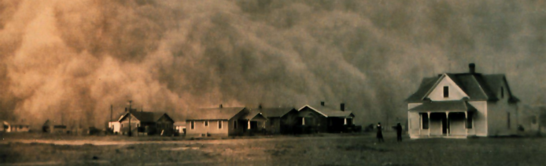
Interest Approach: Dust Bowl
History Brief: the Dust Bowl - YouTube
This Photo by Unknown Author is licensed under CC BY-SA
Notes:
Once finished, have students answer this question by journaling: Could the Dust Bowl happen again? Why or Why Not? Discuss opinions. Remind students how management decisions led to the Dust Bowl.

Slide 23
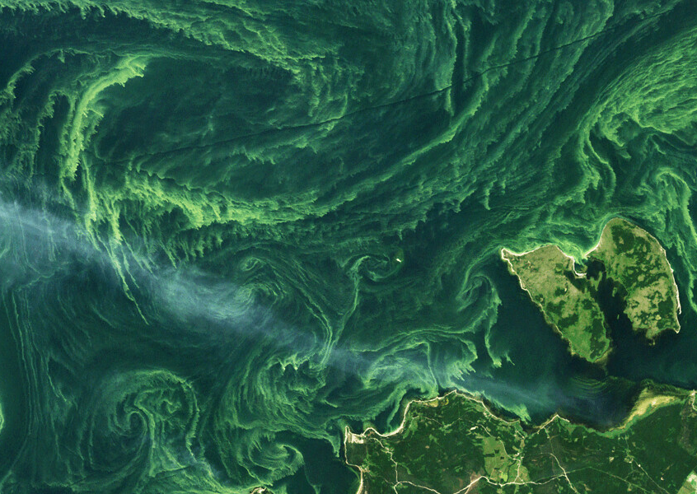
Erosion: Wind, Water
Earthen materials worn away and transported over time
Opposite of deposition
Erosion occurs to the top layer of soil – topsoil
60% of soil washed away ends up in lakes, streams, and rivers
  This includes materials trapped in the sediment
  Chemical products
This Photo by Unknown Author is licensed under CC BY
Notes:
Erosion is the process in which earthen materials are worn away and transported over time by natural forces (water and wind). Erosion is the opposite of deposition. The top layer of soil, known as topsoil, is the fertile life-giving layer. When the topsoil is exposed to strong winds, hard rains, and flowing water, erosion occurs. Overgrazing of animals can also lead to large areas of soil being uncovered and susceptible. About 60% of the soil that is washed away ends up in streams, lakes, and rivers, as well as whatever has been applied to the soil and is trapped within the sediment. These nutrients and agrochemicals can lead to harmful fish-kills and algal blooms. Highway construction and home construction can also lead to the loss of topsoil and massive erosion.

Slide 24
Types of Erosion
Sheet
Rill
Gully
Splash
Wind
Notes:
There are multiple forms of water erosion across landscapes. Sheet erosion, rill erosion, gully erosion, and bank erosion.

Slide 25
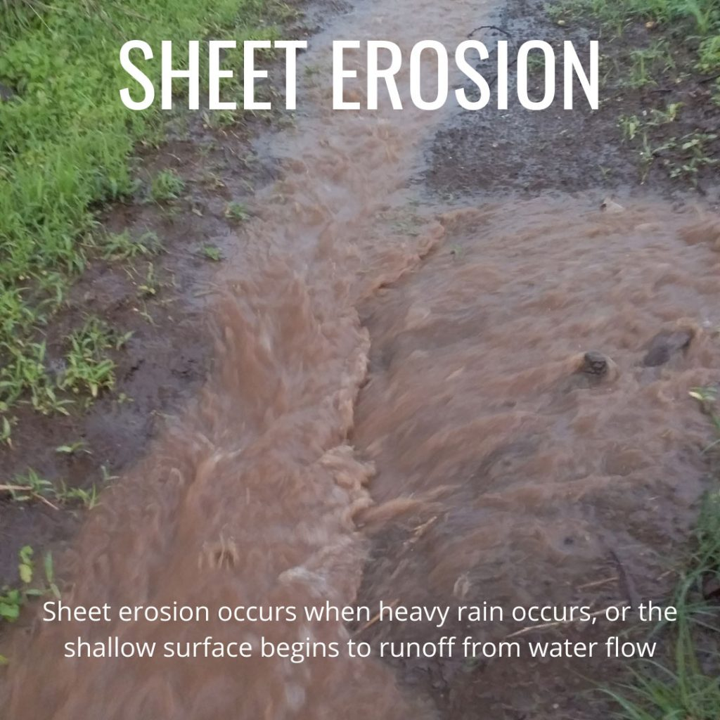

Slide 26
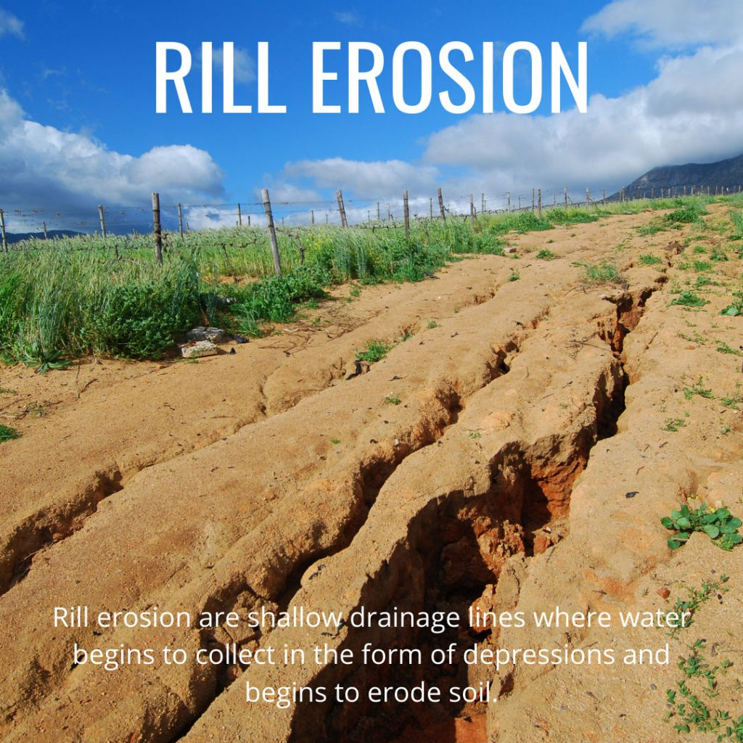

Slide 27
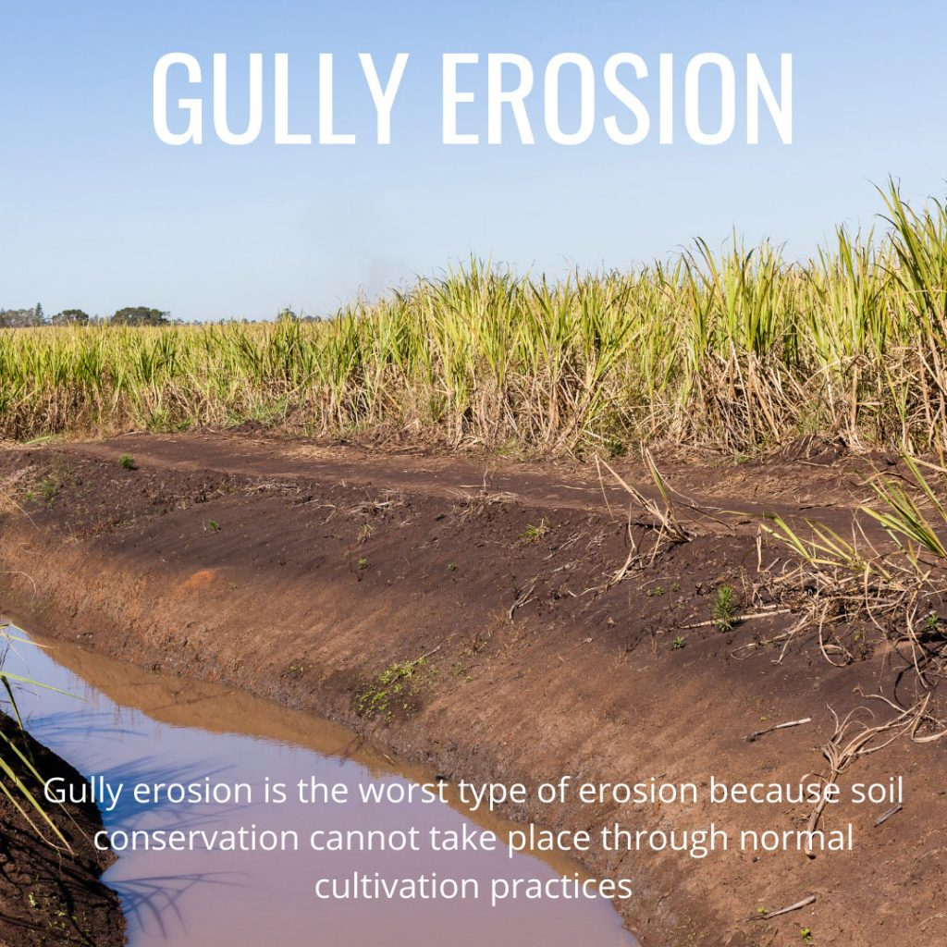
Notes:
Also known as bank erosion

Slide 28
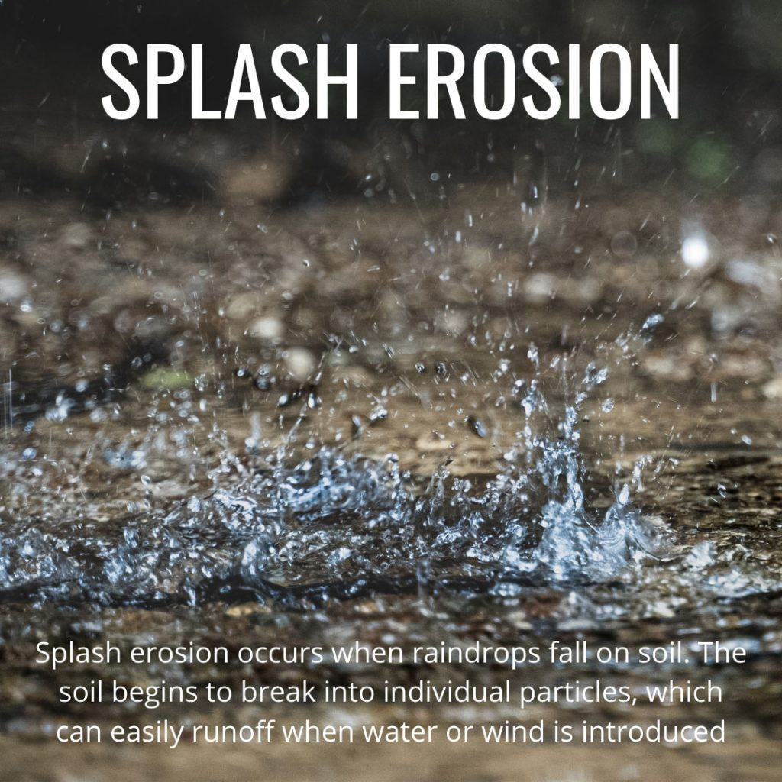

Slide 29
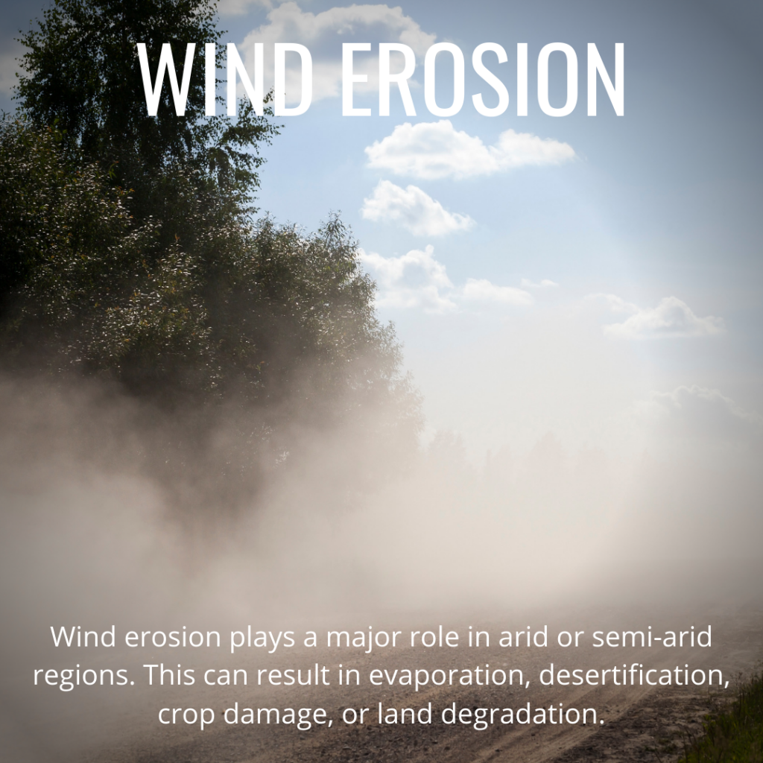

Slide 30
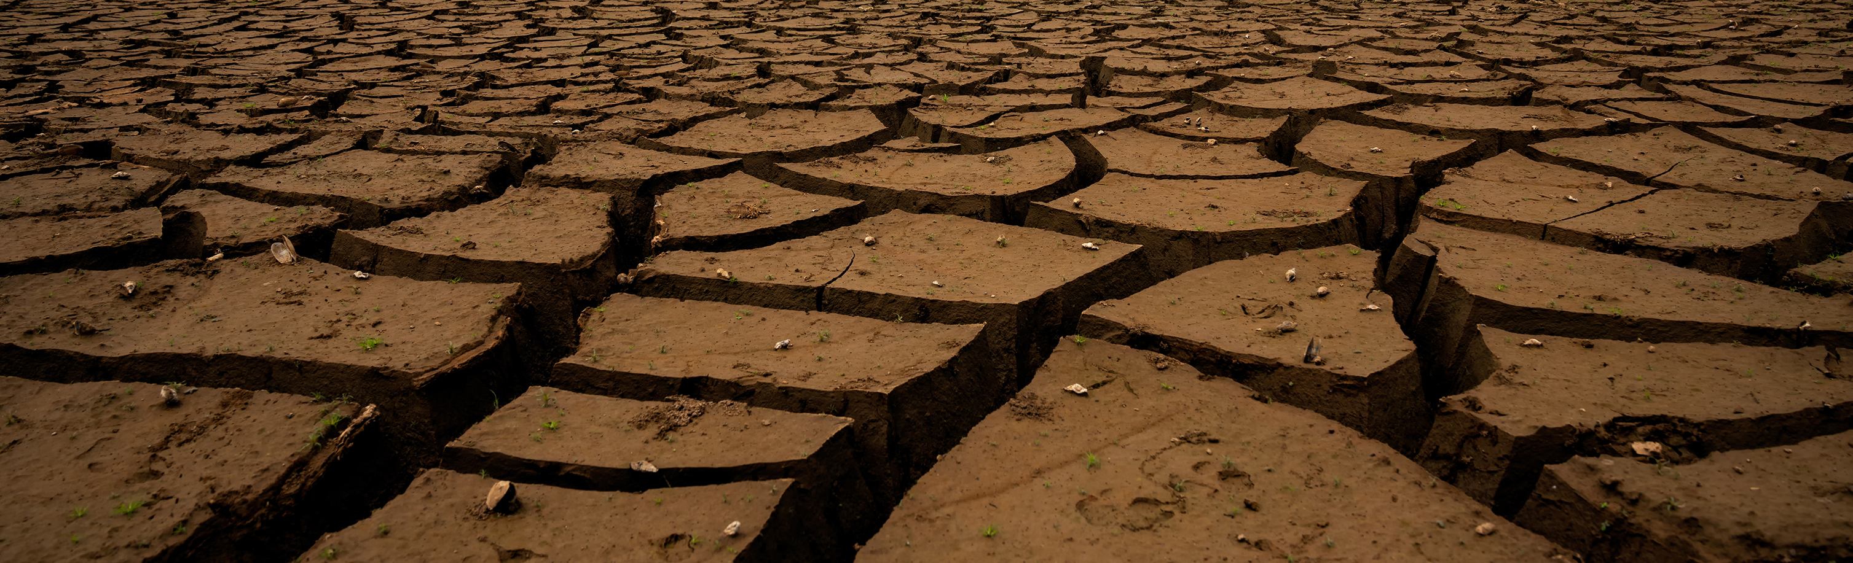
Erodible Soils
Loose and dry
Lack of vegetation
Lack of aggregate stability
Lack of water infiltration and water holding capacity
Notes:
Soil types that are more likely to be loose, dry, and fine are more likely to be erodible. Vegetation makes soil far less susceptible to erosion. Like water erosion, wind erosion occurs when wind picks up the soil and deposits it elsewhere. Wind erosion also impacts overall air quality and visibility which can lead to health risks.

Slide 31
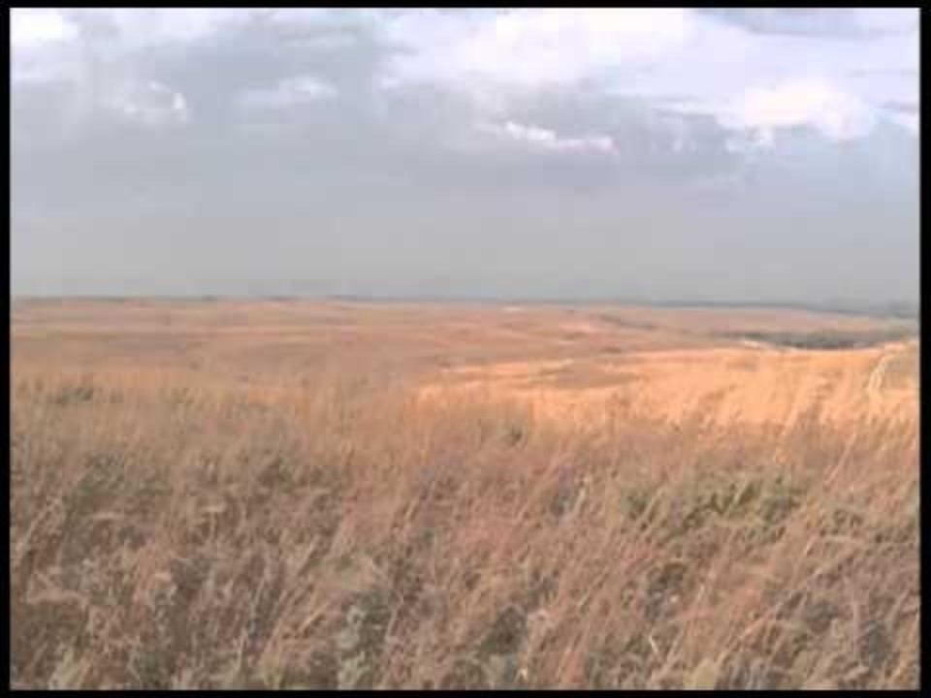
Wind Erosion: The Problem

Slide 32
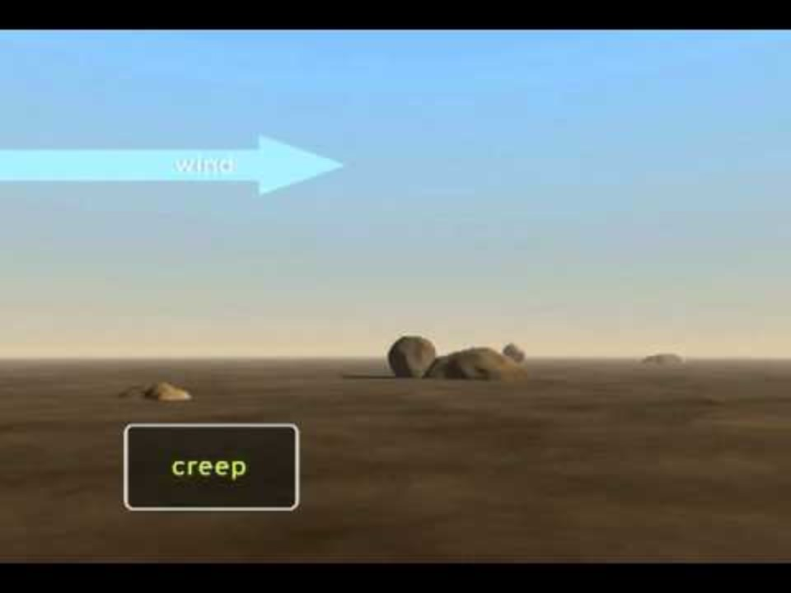
Wind Erosion

Slide 33
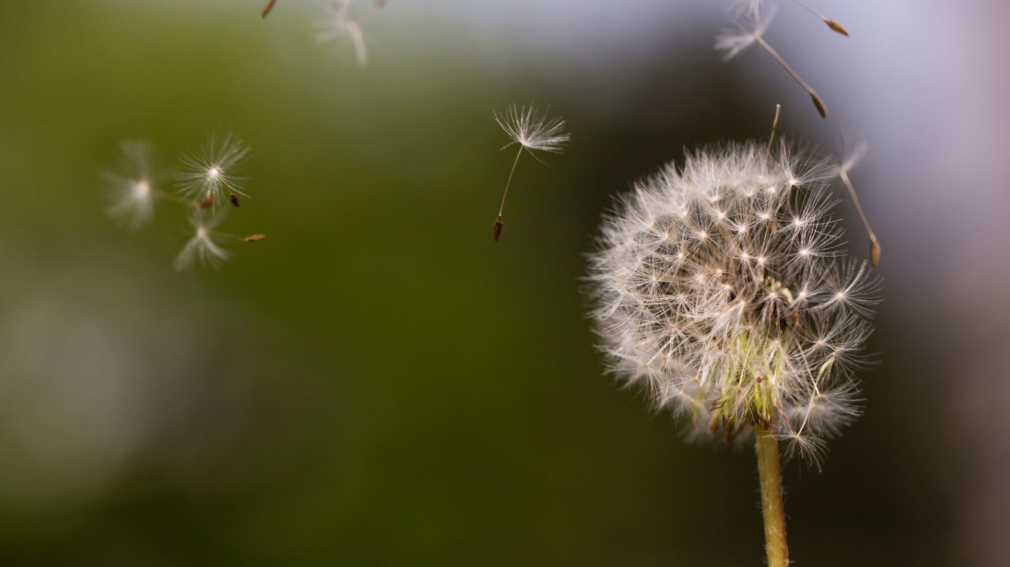
Activity! Wind Simulator

Slide 34
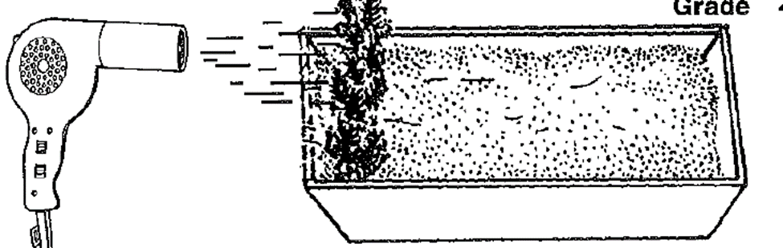
Wind Simulator
Materials: Variable speed blow dryer with a flat sheet pan no more than 4 inch high in height, soil with good aggregation vs poor aggregation from a regularly tilled field, white paper with cooking spray, wind barriers (you can cut very small branches no more than 2-4 inches in height to poke in the soil.
Procedure: Set the panful of soil on a table, place a drop cloth on the floor or tarp if indoors to reduce mess. Place the paper down on the table, to the right of the pan as shown below in the photo. Coat the surface of the paper with cooking spray.

Slide 35
Soil Movement
Saltation: bunches of soil particles moving across the surface
Saltating particles leave the surface and hit the surface farther down the pan
Creep: particles bump into more and more in motion
Increased force across the surface makes the saltation rough across the surface and suspend particles of clay
Notes:
Turn on the hair dryer first at a very low speed notice with no branches on it. Notice how the soil moves right at the end of the hair dryer. Focus on the three types of soil movement. Saltation is the bunch of soil particles across the surface of the soil in the pan, as the saltating particles leave the surface and hit the surface further down the pan we have creep the particles it bumps into puts more particles in motion. Turn up the hair dryer. As more force across the surface is exerted saltation can come into contact with surface roughening and you get suspension or fine particles of clay disperse into the atmosphere and will land on the paper at the end of the pan. Do the same above with the no till pan and discuss the difference.

Slide 36
Wind Barriers
How does the barrier impact the movement of the soil?
What does covering the soil do?
Notes:
Now place the vertical barriers or little branches as seen above and turn on the blow dryer first low then make it go higher and move closer to the pan. What impact does the barrier have on the soil? What will the barrier do besides slow down wind? Discuss the principles of keeping the soil covered, how it keeps soil particles in place and allows increased moisture which is resistant to wind erosion.

Slide 37
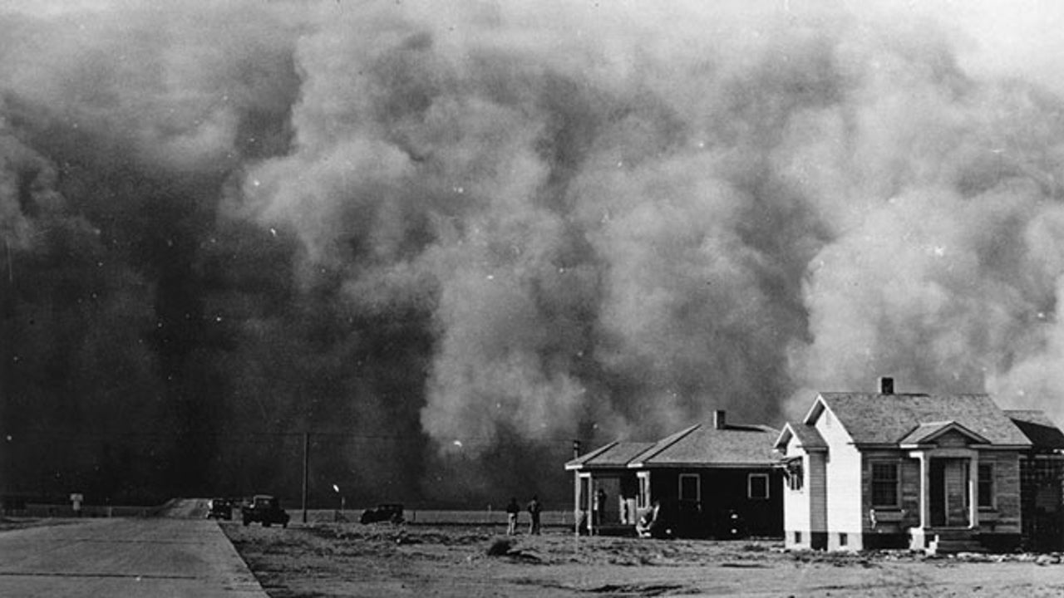
Extended Opportunity: Social Studies/American History
Dust Bowl
Lead to the development of the Civilian Conservation Corps
Hugh Hammond Bennet (Father of Soil Conservation) introduced new farming methods with support from President Roosevelt
This Photo by Unknown Author is licensed under CC BY-SA
Notes:
https://www.aaas.org/dust-bowl-wake-call-environmental-practices#:~:text=Some%20of%20the%20new%20methods,of%20the%20new%20farming%20methods

