Slide 1
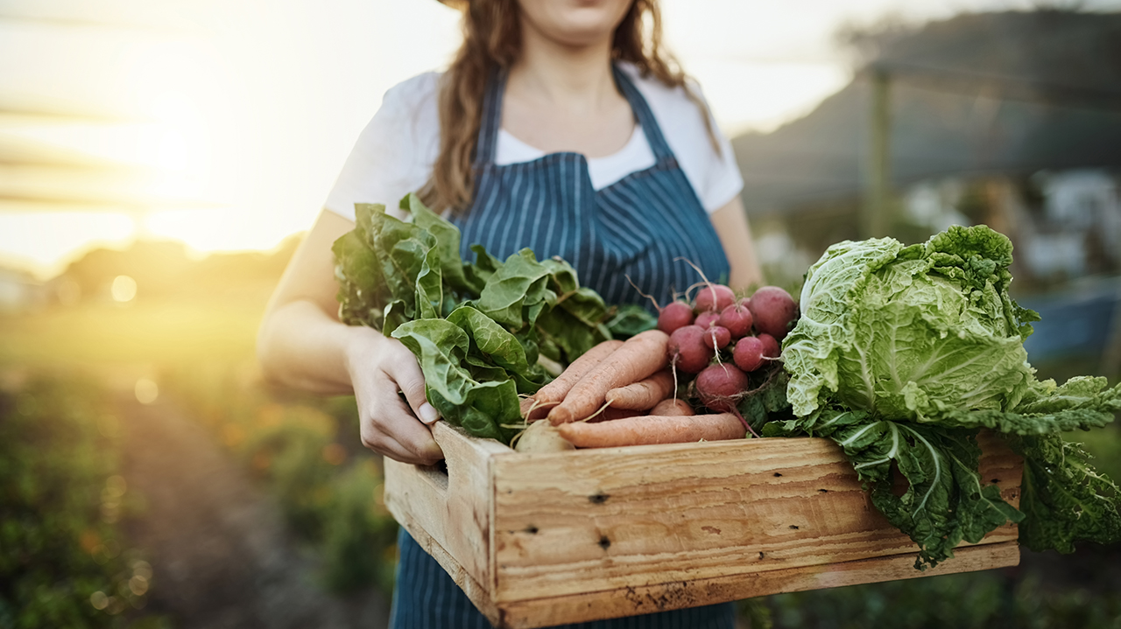
Urban Agriculture

Slide 2
Lesson Vocabulary
Urban
Small Space Farming
Hydroponics
Raised Beds
Community Garden
Soil Contamination
Container Gardening
Farmers Market

Slide 3
Interest Approach:
Think: Does anyone in your family grow fruit and vegetables? Plants?
Pair: Turn to your neighbor and discuss
Share: Share out your experience and similarities or differences to your neighbor

Slide 4
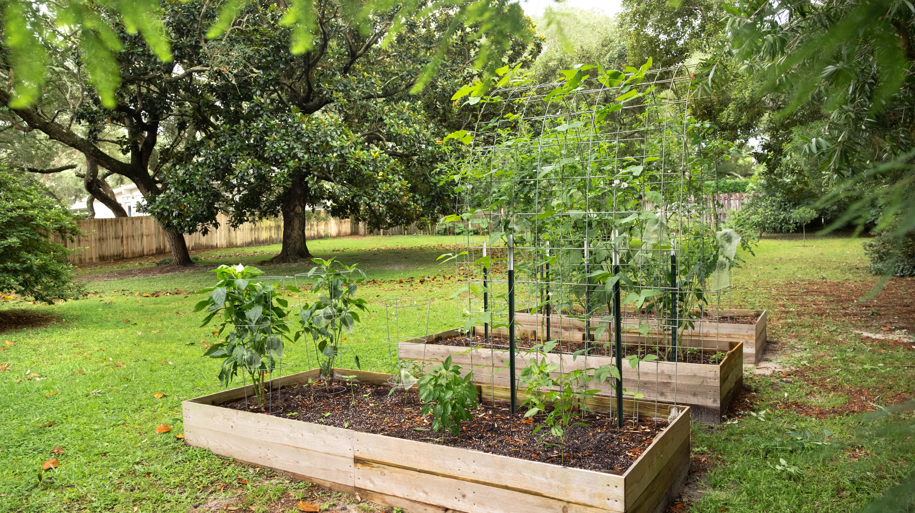
History of Urban Agriculture
WWI – war gardens → WWII rebranded as victory gardens
Victory gardens were intended to increase production of fresh fruits and vegetables in the community
Encouraged storage and preservation of surplus for the goods to be shared
Community gardens were established for those who could not have a home garden in their urban space
The goal of wartime gardens was to free up resources from agriculture to the war effort
In 1939 more than $200 million worth of vegetables were grown in 4.8 million farm home gardens
In 1944 18.5 million gardeners had Victory Gardens and supported 40% of the nations vegetable production during that time
Notes:
Urban agriculture has been around for a long time. During WWI there were War Gardens and during WWII they were rebranded as Victory Gardens. The Victory Garden program was intended to increase production of fresh fruits and vegetables in the community. It encouraged storage and preservation of surplus and for the goods to be shared within the communities. Community gardens were established for those who could not have a home garden in their urban space. The goal of these wartime gardens was to free up resources, redirecting them from agricultural to war efforts. In 1939 more than $200 million worth of vegetables were grown in 4.8 million farm home gardens. In 1944 18.5 million gardeners took part in Victory Gardens, supporting 40% of the nation's fresh vegetables during that time.

Slide 5
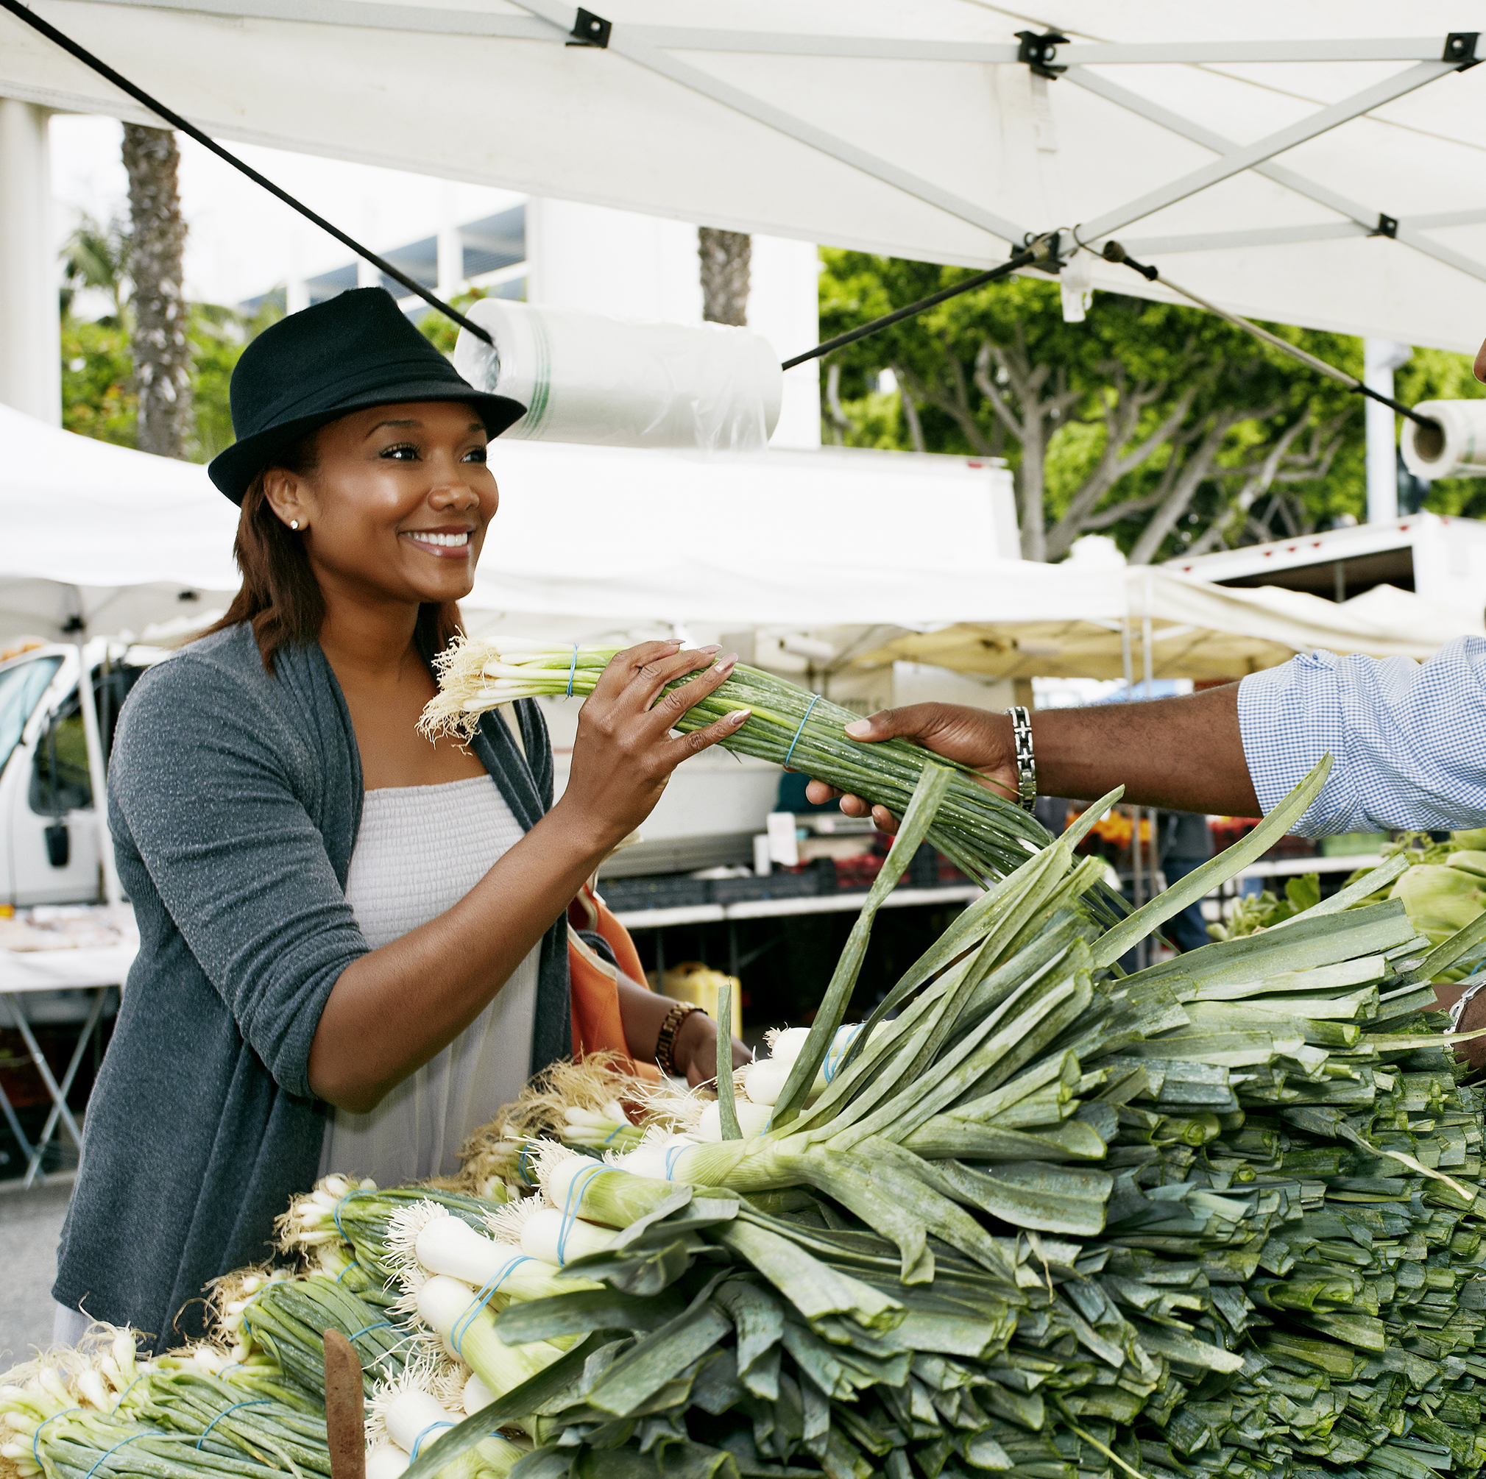
Urban
Today, urban means belonging to a city or town
Urban ag allows the development of environmental, economic, and social benefits to surrounding communities
Farmers Markets have increased local availability of produce
Notes:
Today, urban means belonging to or relating to a city or town. Urban agriculture allows for the development of environmental, economic and social benefits to surrounding communities. The popularity of farmers' markets has greatly increased the local availability of produce, especially in communities where residents do not have access to healthy produce

Slide 6
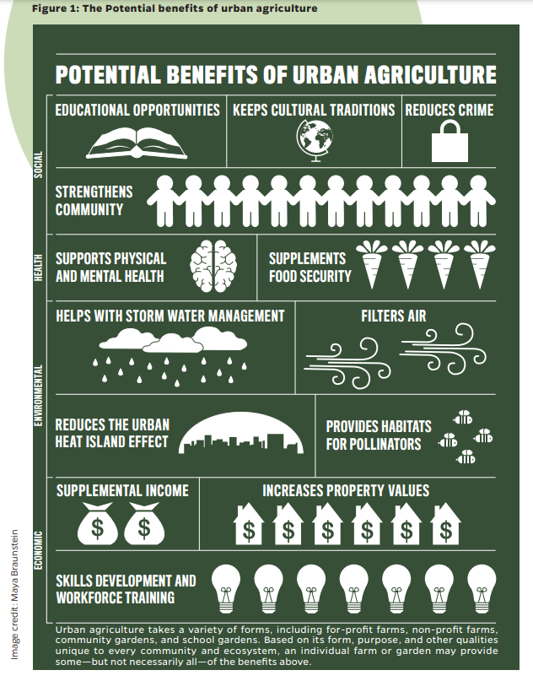
Benefits of Urban Ag
Notes:
https://clf.jhsph.edu/sites/default/files/2021-06/the-safe-urban-harvests-study-an-assessment-of-urban-farms-and-community-gardens-in-baltimore-city.pdf
There are many potential benefits of urban agriculture. On top of the educational and environmental benefits, there are community benefits as well. In areas with limited access to grocery store produce, it can provide access to fresh food. It can be a place of community gathering as well as providing supplemental income for those who can sell produce in their community or at farmers markets.

Slide 7
Methods for Urban Ag
Just like conventional agriculture, urban agriculture has to consider soil health
Urban soils sometimes have to deal with contamination such as heavy metals and lead
Urban soils also have dealt with compaction from people and machines and the removal of topsoil from construction
Notes:
Just like conventional agriculture, urban agriculture must consider the soil. Unlike conventional agriculture, urban agriculture oftentimes deals with more heavy metal and/or lead contamination. This is due to the former industrial use of land in urban spaces. Additionally, urban soils can vary even more than rural ones. They also can have issues from compaction from machines and construction. A lot of times construction removes the topsoil layer. This contamination cannot be remediated through nutrient cycling, and many times it is unsafe to grow directly in the soil in urban spaces. This is why urban agriculture often takes place in containers or raised beds. Other areas of urban land and greenspace have been successfully managed as gardens for a long time.

Slide 8
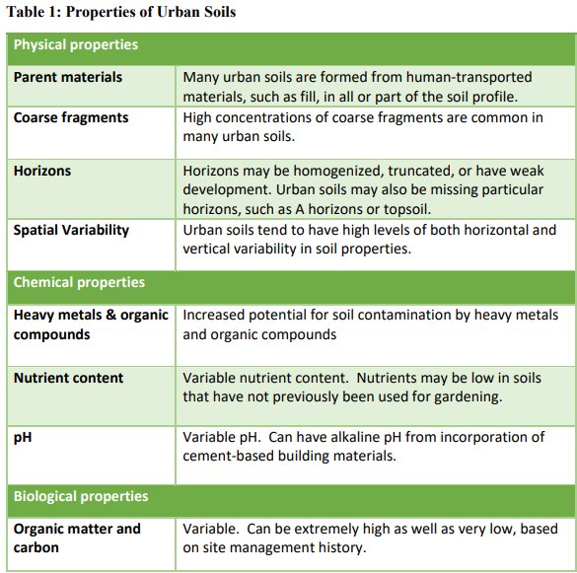
Properties of Urban Soils
Notes:
https://directives.nrcs.usda.gov//sites/default/files2/1716469390/TN%20470-SH-02%20Basics%20of%20Urban%20Soil%20Health.pdf
There are a variety of characteristics of urban soils. They vary by location but also by the type of activities that have occurred there. Urban soils can range from long term green space to highly altered construction zones. Depending on the horizontal and vertical zones in the soil there can be stark differences. Topsoil has been removed and transferred across different locations within cities. This greatly impacts the soil horizon depending on the activities that have occurred on that piece of land.

Slide 9
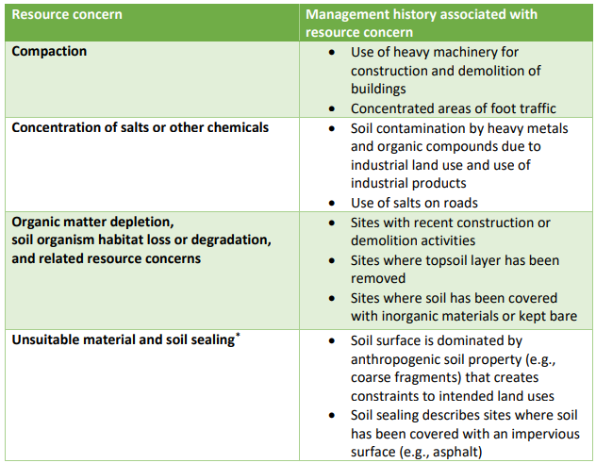
Resource Concerns for Urban Soils
Notes:
https://directives.nrcs.usda.gov//sites/default/files2/1716469390/TN%20470-SH-02%20Basics%20of%20Urban%20Soil%20Health.pdf
Compaction is a frequent problem in urban soils because there is more heavy machinery that moves across them for construction purposes. Due to the location and type of use of that soil or what has been on that property previously there can be salts or other chemicals. The salt from the road can run off into the soil making it difficult for plants to grow, and chemicals that can be dangerous to grow in. Depending on what has happened to that soil over time there could be little to no organic matter or even topsoil. Also depending on the site there could be more impervious materials than pervious. Meaning, there is little water infiltration or no place to put plants into the ground. This is often why urban agriculture occurs in raised beds where soil is brought in, and plants are grown above the surface of the ground.

Slide 10
Soil Contamination
People are exposed to contaminated soils through ingestion
Breathing in dust, ingesting soils through their hands, small children playing in the soil
Covering bare soil with mulch or living plants can reduce exposure
Using raised beds is a way to get around planting directly into contaminated soil
Notes:
The main way people are exposed to contaminated soils is direct ingestion of the soil by breathing in dust or ingesting soil on their hands, small children eating soil, etc. Simple methods for reducing exposure and risk are to “Cover bare soil” with mulch or living plants (mulch unused soil) and as you mention use constructed raised beds with imported materials.

Slide 11
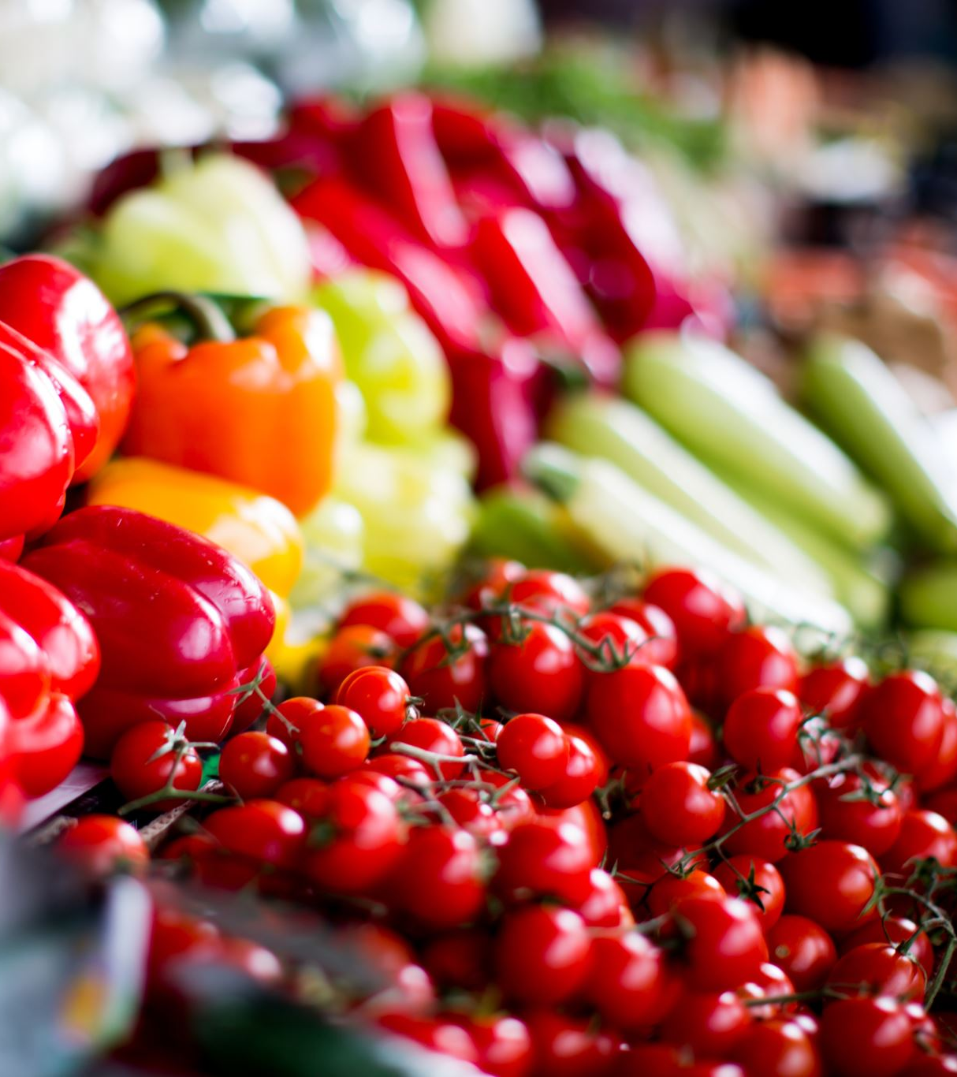
Activity!
Farmers market Search
See how many farmers markets are around you!
Notes:
http://ohioproud.org/farm-markets-all/farmers-market-search/
https://www.fromthelandofkansas.com/market/list

Slide 12
Interest Approach: Conservation Practice for Soil Health in Urban and Small-Scale Agriculture
Notes:
https://directives.nrcs.usda.gov//sites/default/files2/1714580563/TN%20470-04%20Conservation%20Practices%20for%20Soil%20Health%20in%20Urban%20and%20Small%20Scale%20Agriculture.pdf

Slide 13
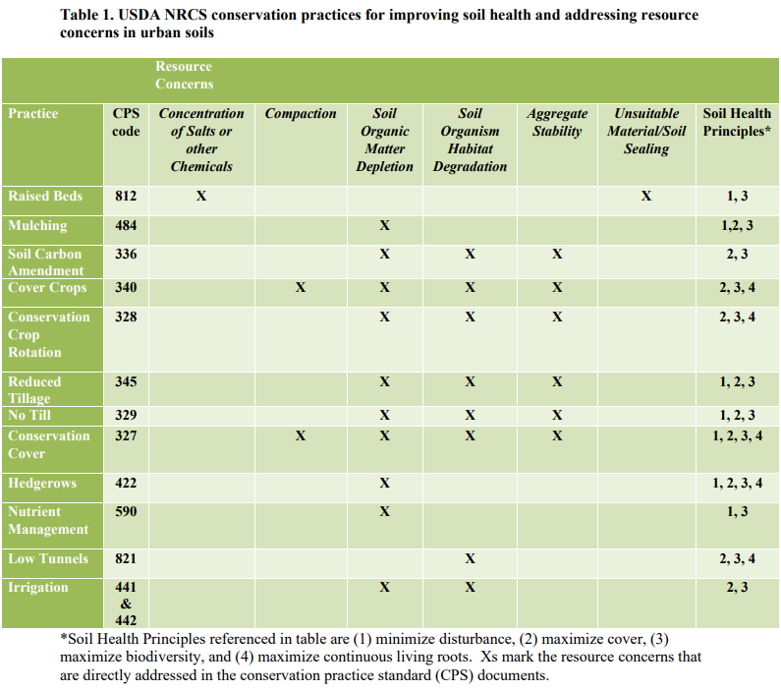
Ways to Address Urban Ag Resource Concerns
Notes:
https://directives.nrcs.usda.gov//sites/default/files2/1714580563/TN%20470-04%20Conservation%20Practices%20for%20Soil%20Health%20in%20Urban%20and%20Small%20Scale%20Agriculture.pdf
Review the chart and discuss what has been covered in the curriculum so far. This would include conservation cover, mulching, cover crops, crop rotation, tillage, and nutrient management. There are many similarities to soil health management in urban agriculture even if the challenges to the soil are different to start out with.

Slide 14
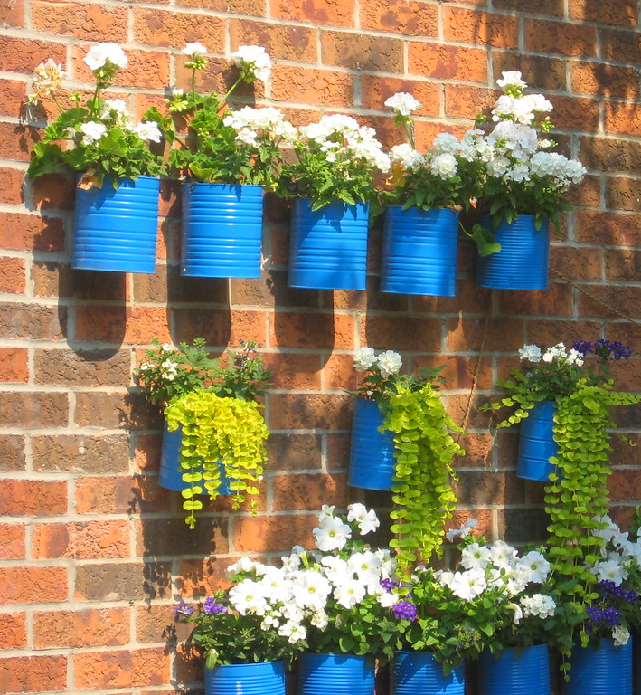
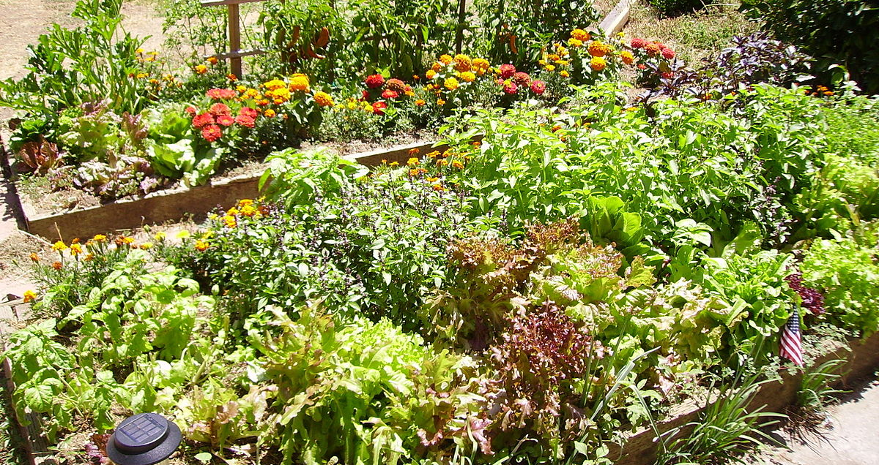
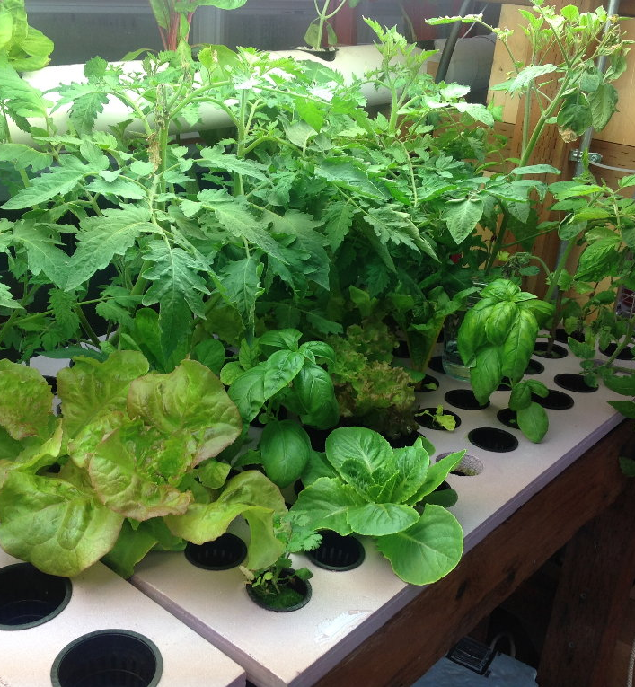
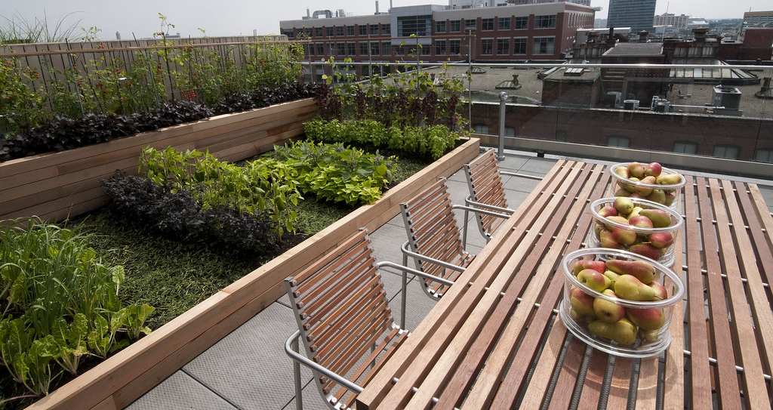
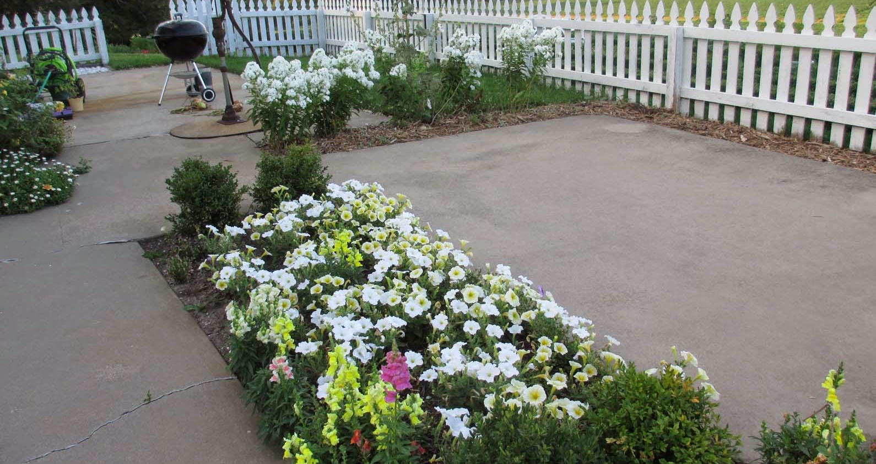
Types of Urban Agriculture
This Photo by Unknown Author is licensed under CC BY-SA
This Photo by Unknown Author is licensed under CC BY-SA-NC
This Photo by Unknown Author is licensed under CC BY-SA-NC
This Photo by Unknown Author is licensed under CC BY-SA
This Photo by Unknown Author is licensed under CC BY
Notes:
Urban agriculture can look like patio gardens in gallon tubs and raised beds, rooftop gardens, hydroponic productions, or community gardens in a vacant city lot. Zoning can be an issue within urban farming. Most cities have strong restrictions on raising animals within the city for production purposes, which can limit urban farming to plant production.

Slide 15
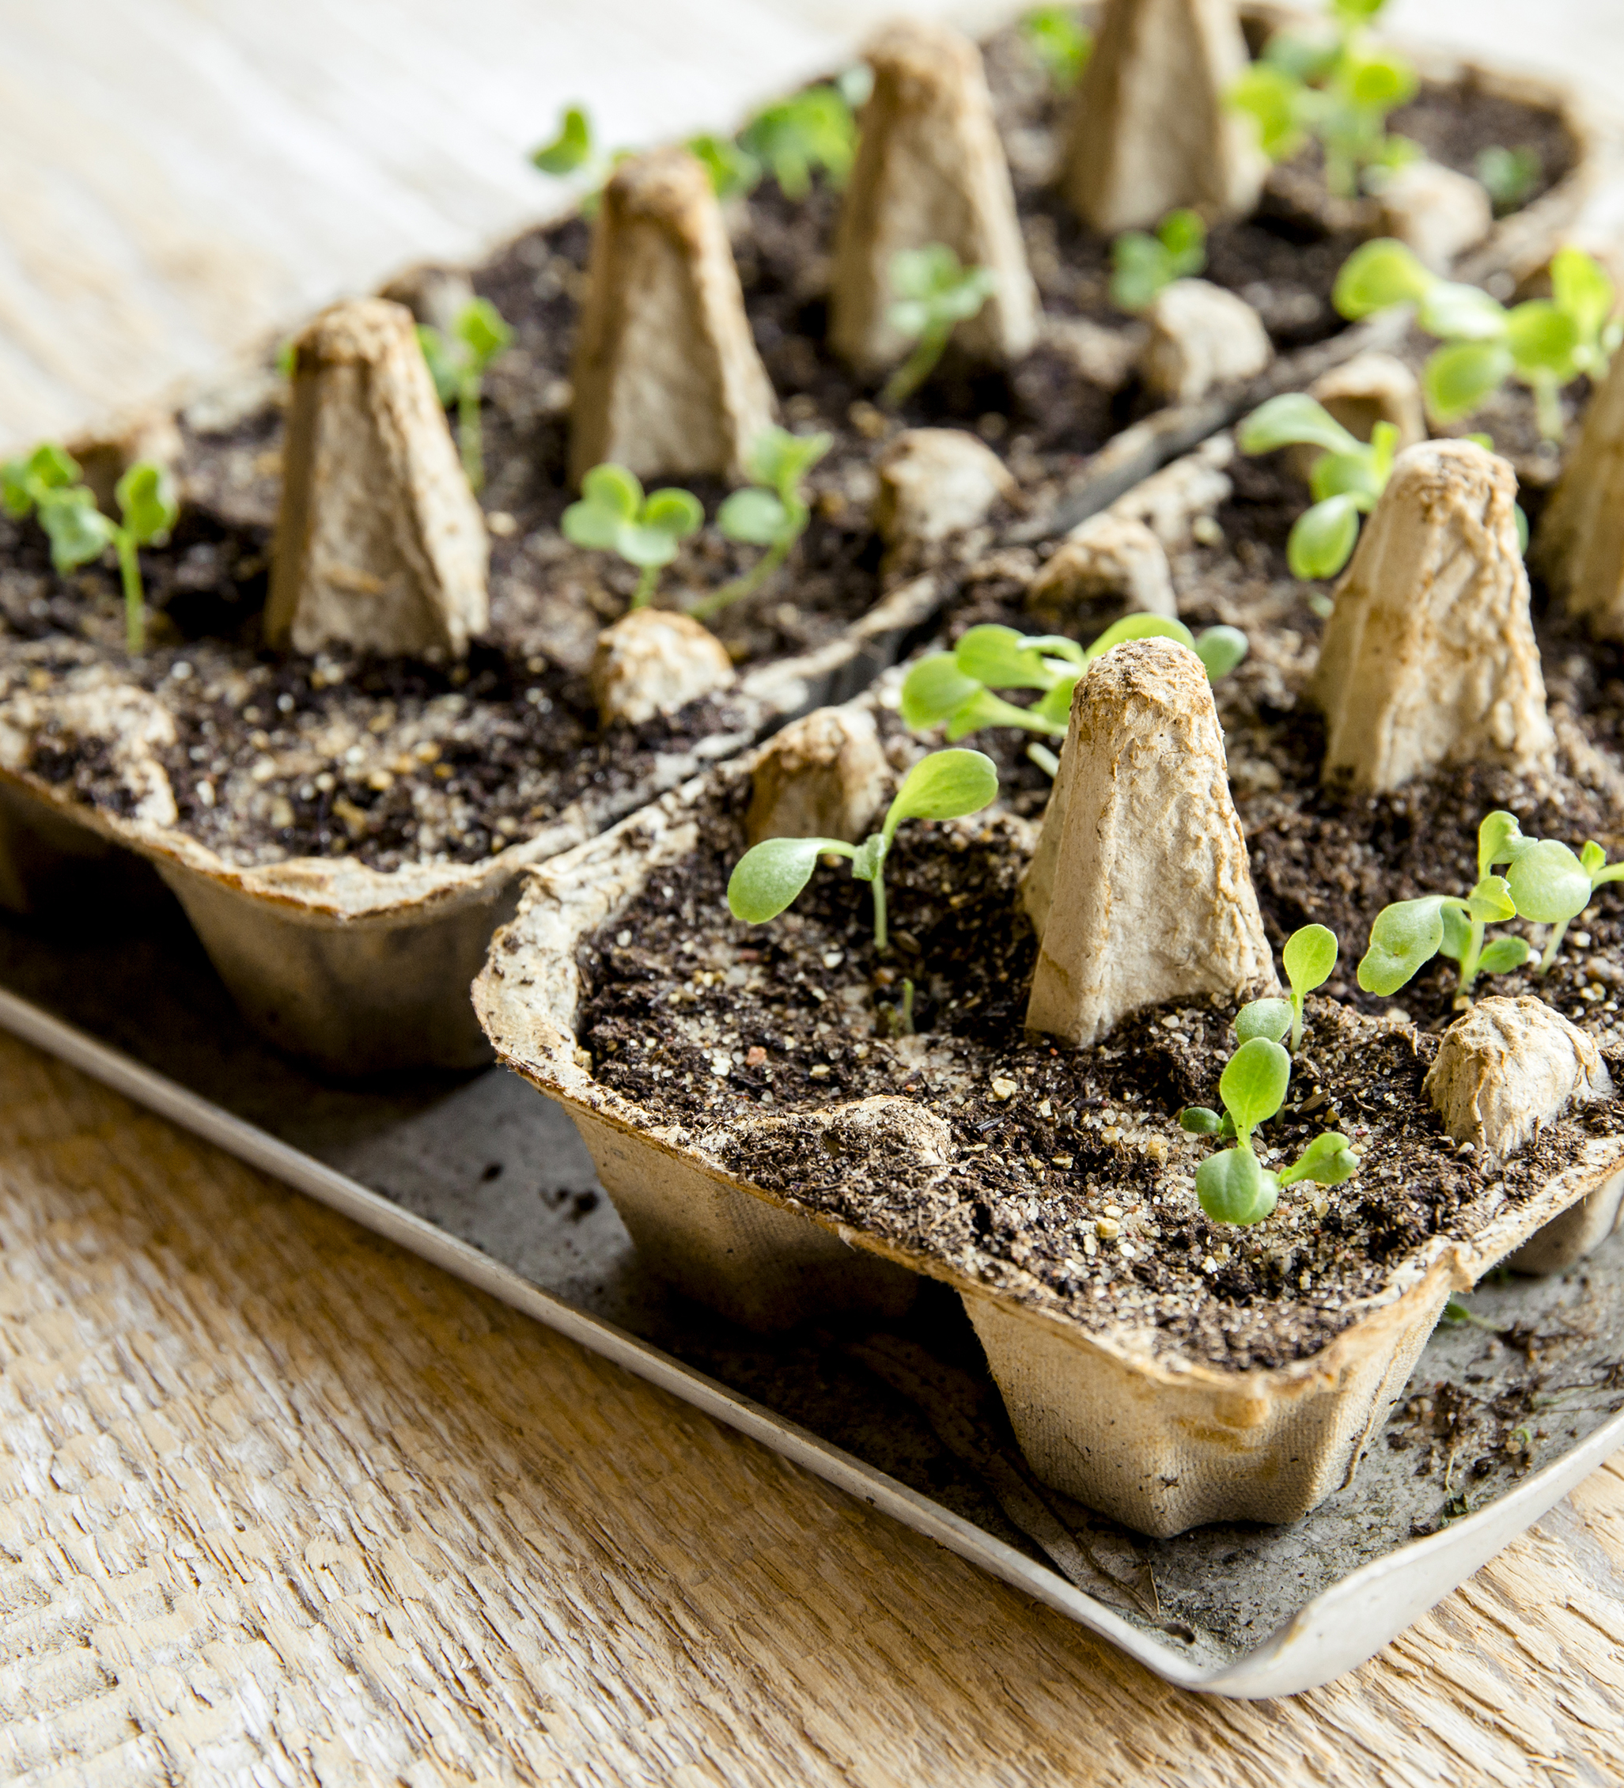
Container Gardening
Using various containers to grow produce
Basic considerations for container gardening
Space
Water Source
Sunlight
Drainage
Container material
Notes:
Container gardening uses various containers to grow plants. There are some basic considerations when considering container gardening. These include space, water source, sunlight, drainage, and container material. Within space restrictions, it is also important to consider north-south vs. east-west locations to ensure eight hours of sunlight; a water source that is close to where the plants will be grown; and drainage for plants within containers or raised beds. The material of the container or bed is also extremely important for growing food items. Treated lumber is durable but has chemicals that can leach into the soil and be unsafe. Water access is also key to urban agriculture production. Vacant lots may not have water access established, and treated water is not ideal for plant use.

Slide 16
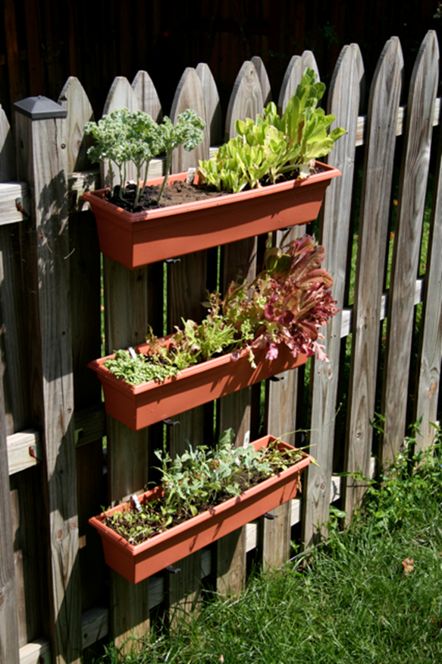
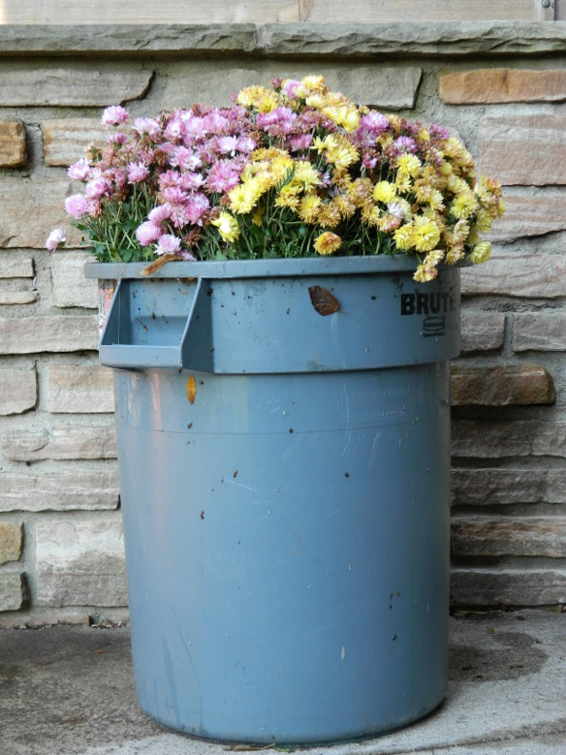
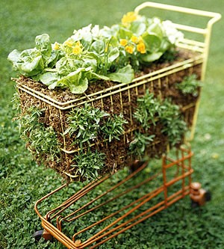
Container Gardening
This Photo by Unknown Author is licensed under CC BY-SA-NC
This Photo by Unknown Author is licensed under CC BY-NC-ND
Notes:
Great if there is limited space such as a patio and you do not want to grow food in the ground
There are many types of containers that can be used in container gardening and space oftentimes determines the type of container that will be used. Raised beds are considered another type of above ground container, but it will take up additional space. Some pros of raised beds include ease of use, overcoming physical limitations of stooping over, fewer pests, different styles, and can be filled with soil if there are soil concerns at the location. The material the raised bed is made from needs to be considered. The different woods versus treated or untreated wood will have different life expectancies. Using a plastic liner versus metal or plastic beds can also impact the soil and live expectancy of the bed.

Slide 17
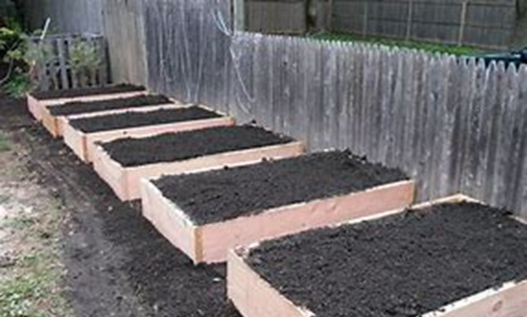
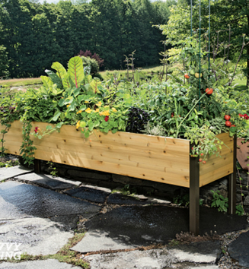
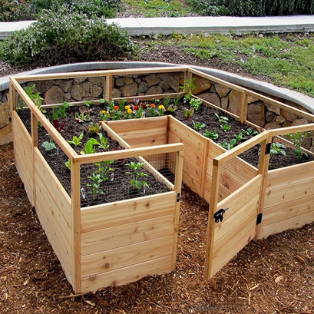
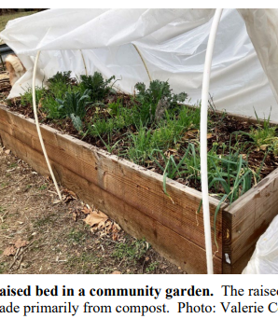
Raised Beds
Notes:
Ease of use, overcome physical limitations, fewer pests, different styles
Western Red Cedar life expectancy about 10-20 years
Pine, Spruce, Fir life expectancy about 3-7 years
CCA Treated is not to be used
AQC Treated lumber use is up to the individual See attached link to web site for this product: https://extension.oregonstate.edu/gardening/techniques/raised-bed-lumber-pressure-treated-safe
Eastern White Cedar life expectancy about 10-20 years
Pond bed liners life expectancy about 10-20 years for elevated beds
Painted steel frames with regular maintenance life expectancy about 10-30 years for elevated beds
Plywood Bottoms on elevated beds life expectancy with pond liners 8-15 years
Credit Joe Lansing

Slide 18
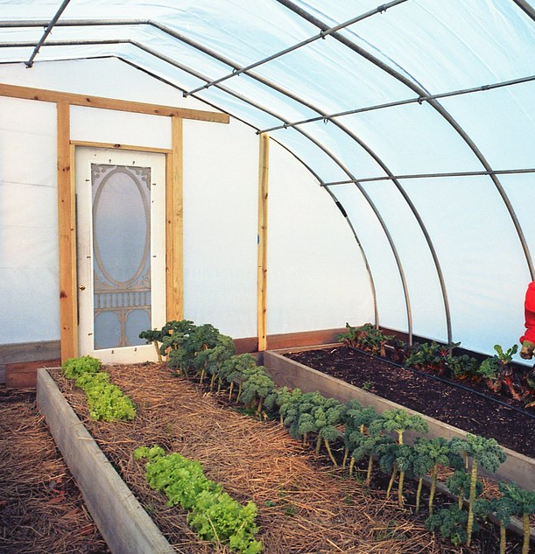
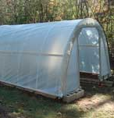
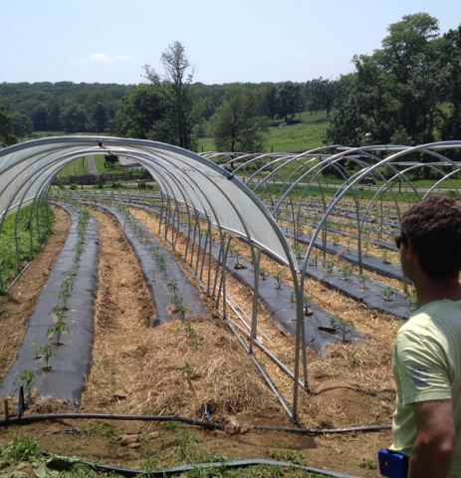
Hoop House / High Tunnels
This Photo by Unknown Author is licensed under CC BY-NC-ND
This Photo by Unknown Author is licensed under CC BY-SA-NC
This Photo by Unknown Author is licensed under CC BY
Notes:
Hoop houses or high tunnels are used to extend the growing season and are typically seen in fruit and vegetable growing. They are passively ventilated, heated by solar, and can hold head and humidity. They are a more affordable option compared to a greenhouse as the structure is not as permanent. The controlled environment can be beneficial to increasing productivity and consistency of crops. Management of crops in a high tunnel will differ from out in a field, or even a raised bed. It will not get as cold inside the hoop house; daily watering is necessary as there will never be direct rainfall and the humidity in the structure can impact the plants.

Slide 19
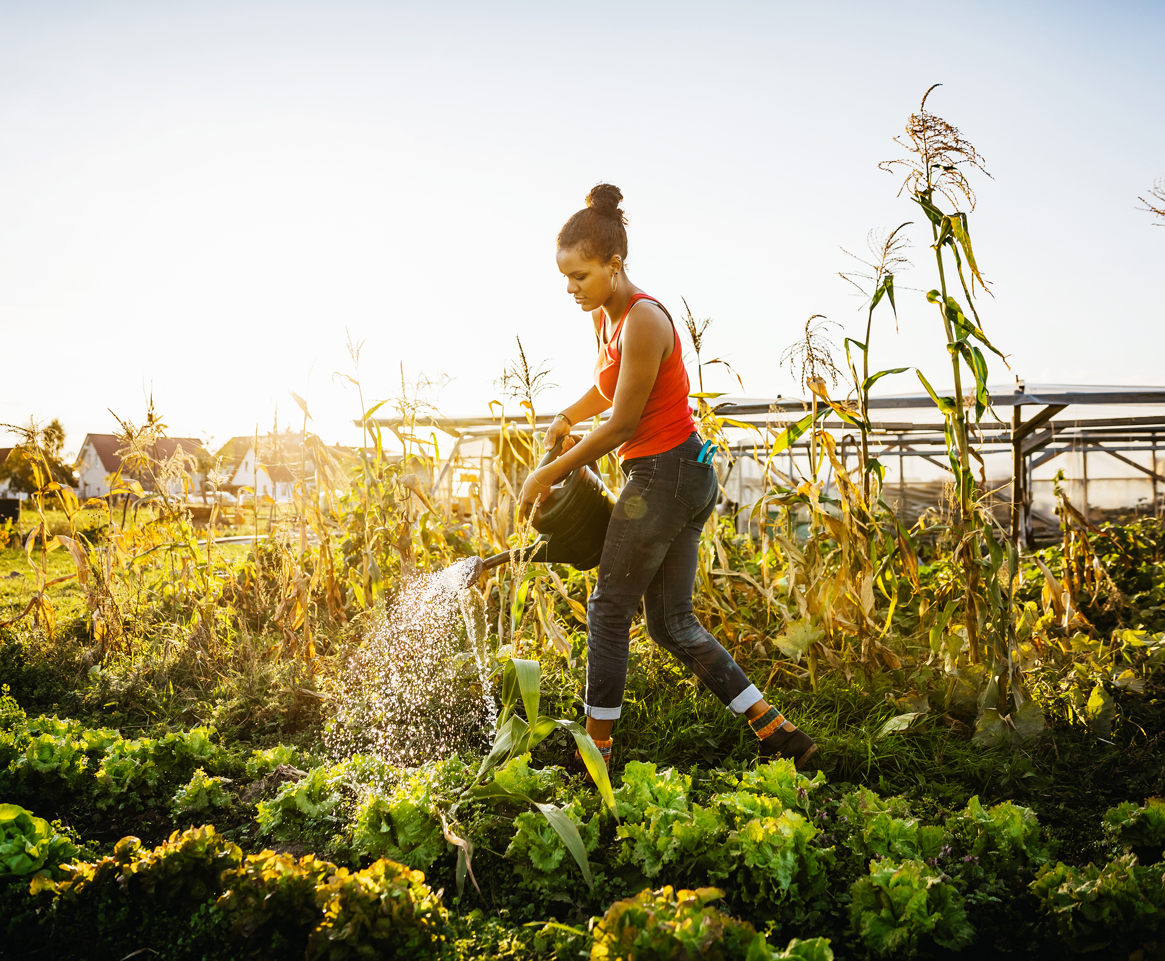

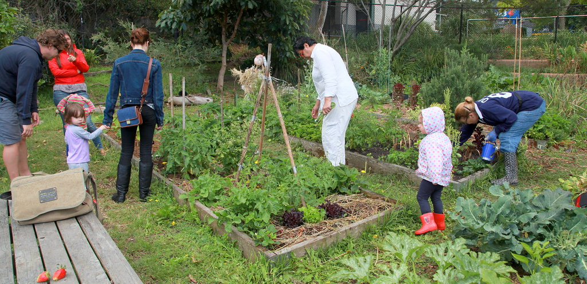
Community Gardens
This Photo by Unknown Author is licensed under CC BY
Notes:
Community gardens can be used to provide local produce and a place to grow food for the neighborhood. These are usually in local spaces and use a combination of in ground planting, raised beds, and container gardening. Many places are now implementing rooftop gardens, which are often designed using raised beds, when there is not a central location available in a city. Schools are also implementing more community growing spaces to teach students about growing their own food.

Slide 20
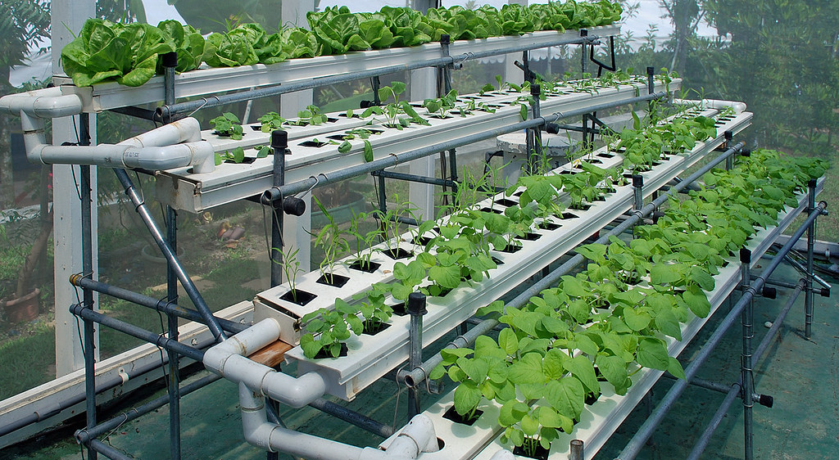
Hydroponics: Growing plants in a nutrient water solution instead of soil
This Photo by Unknown Author is licensed under CC BY-SA-NC

Slide 21
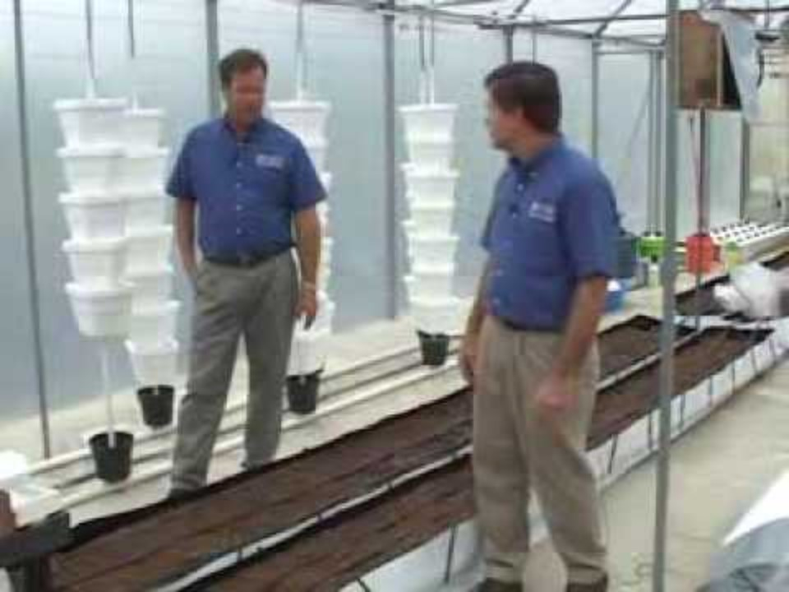
Soilless Systems and Containers

Slide 22
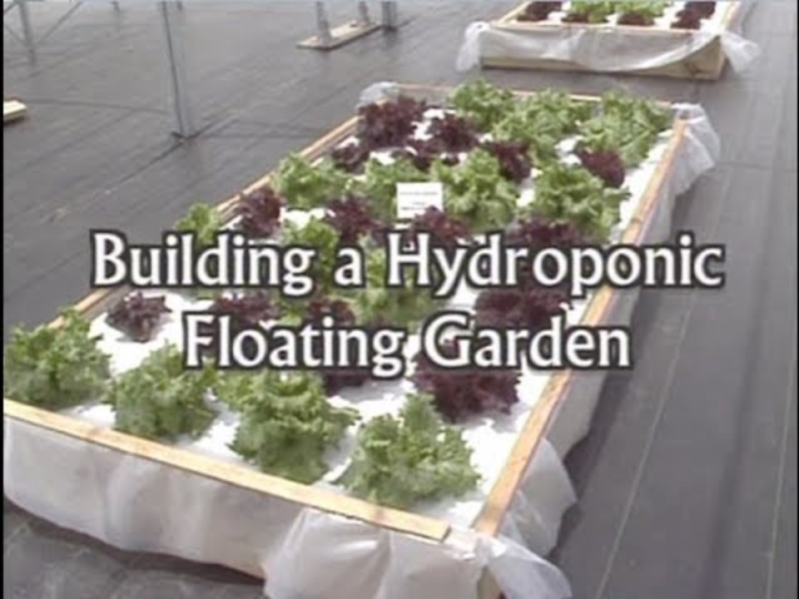
Floating Hydroponic Garden

Slide 23
Activity!
Today we are going to plant the small hydroponic garden with herb seeds
Let’s compare the similarities and differences of this kit to the large-scale hydroponics we observed in the video.
Notes:
Review the virtual field day videos, soilless systems and containers and floating hydroponic garden. Allow for discussion on the pros and cons of a system like this. Expect answers like “good if you cannot access soil, bad because it is expensive to implement and feed water and nutrients into.” Plant the pod in the home grow kit provided. Discuss the similarities and differences between this system and the systems observed in the virtual field day.

Slide 24

Interest Approach: Have you ever seen livestock animals in the city?
Notes:
Turn to your neighbor, have you ever seen farm animals in a city? What animals do you typically see in the city? Have or can these animals be farm animals?

Slide 25
Urban Agriculture Livestock Integration
Bees
Sheep
Goats
Chickens
Rabbits
Ducks
Notes:
Urban agriculture livestock can range from raising bees for honey to having a lot with cows or goats. Most communities regulate residential livestock through zoning laws and development codes. Typical urban livestock includes chickens, ducks, bees, rabbits, and sometimes goats.

Slide 26
Urban Livestock Limitations
Size and space restrictions
Zoning regulations
Nuisance complaints
Feed supply
Processing facilities
Notes:
The largest limitation for urban livestock, outside of zoning regulations, is space restrictions. Close neighbors means that individuals are responsible for limiting nuisance situations. Additionally, challenges such as feed supply and lack of processing facilities can limit someone’s ability to successfully farm livestock.

Slide 27
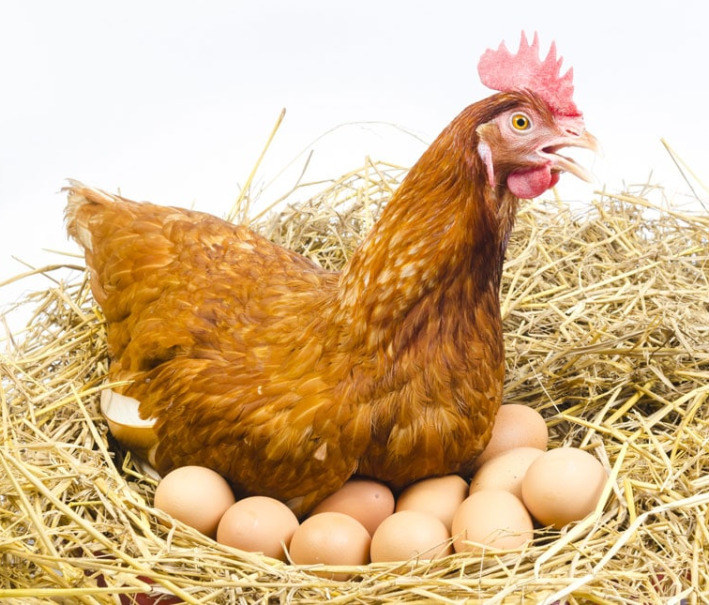
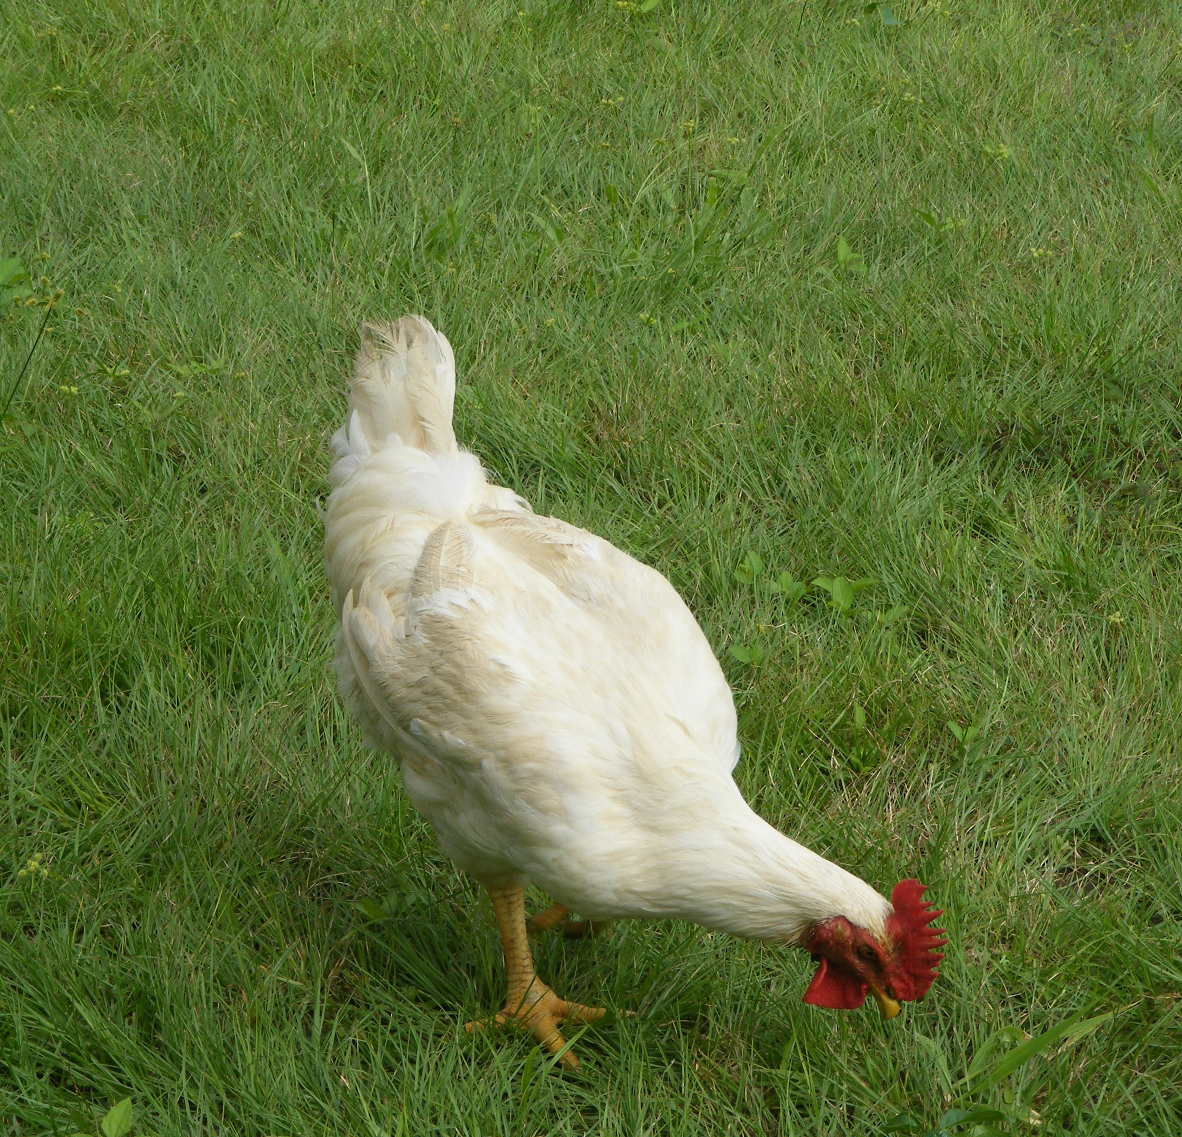
Chickens
Meat chickens
Egg chickens
Social/educational chickens
Isolated production chickens
This Photo by Unknown Author is licensed under CC BY-NC-ND
Notes:
Considerations for chickens include space limitations, purpose of the chicken, egg or meat, and number of chickens to include. The different breeds of chicken can serve multiple purposes. Additionally, different chicken breeds may respond to different climates. There are also chickens that have different temperaments if they are going to be interacted with, family or children, versus left out in pasture alone more often.

Slide 28
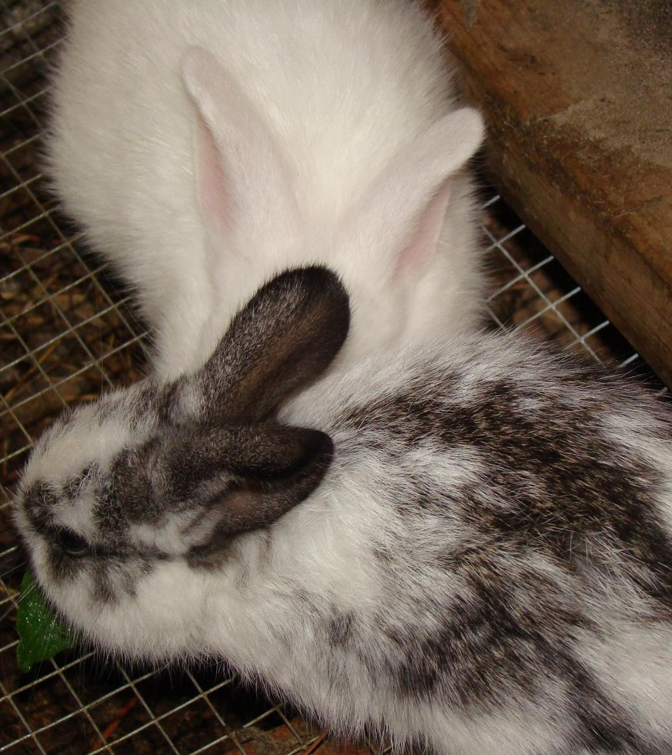
Rabbits
Do not take up much room
Quiet
Fur, manure, and meat production
Also commonly had as pets
Diet variety
This Photo by Unknown Author is licensed under CC BY-NC
Notes:
Rabbits are another common livestock in urban agriculture. Rabbits are popular because they are quiet, do not require much room, and can be used for multiple purposes. Rabbits can be used for fur, manure, as pets, and for their meat. Unlike other manures, rabbit manure does not require composting before use on the soil. It is easy to spread and use on a small scale, unlike larger hooved animals.
Rabbits are very versatile when it comes to their diets. Hay and pellet feed are typically used for rabbit feed, but also dandelions, clover and other things can be fed to them. Like other animals in the rodent families, rabbits constantly need to be chewing on things to dull their teeth down. Bark and branches are great options for rabbits to chew on.

Slide 29
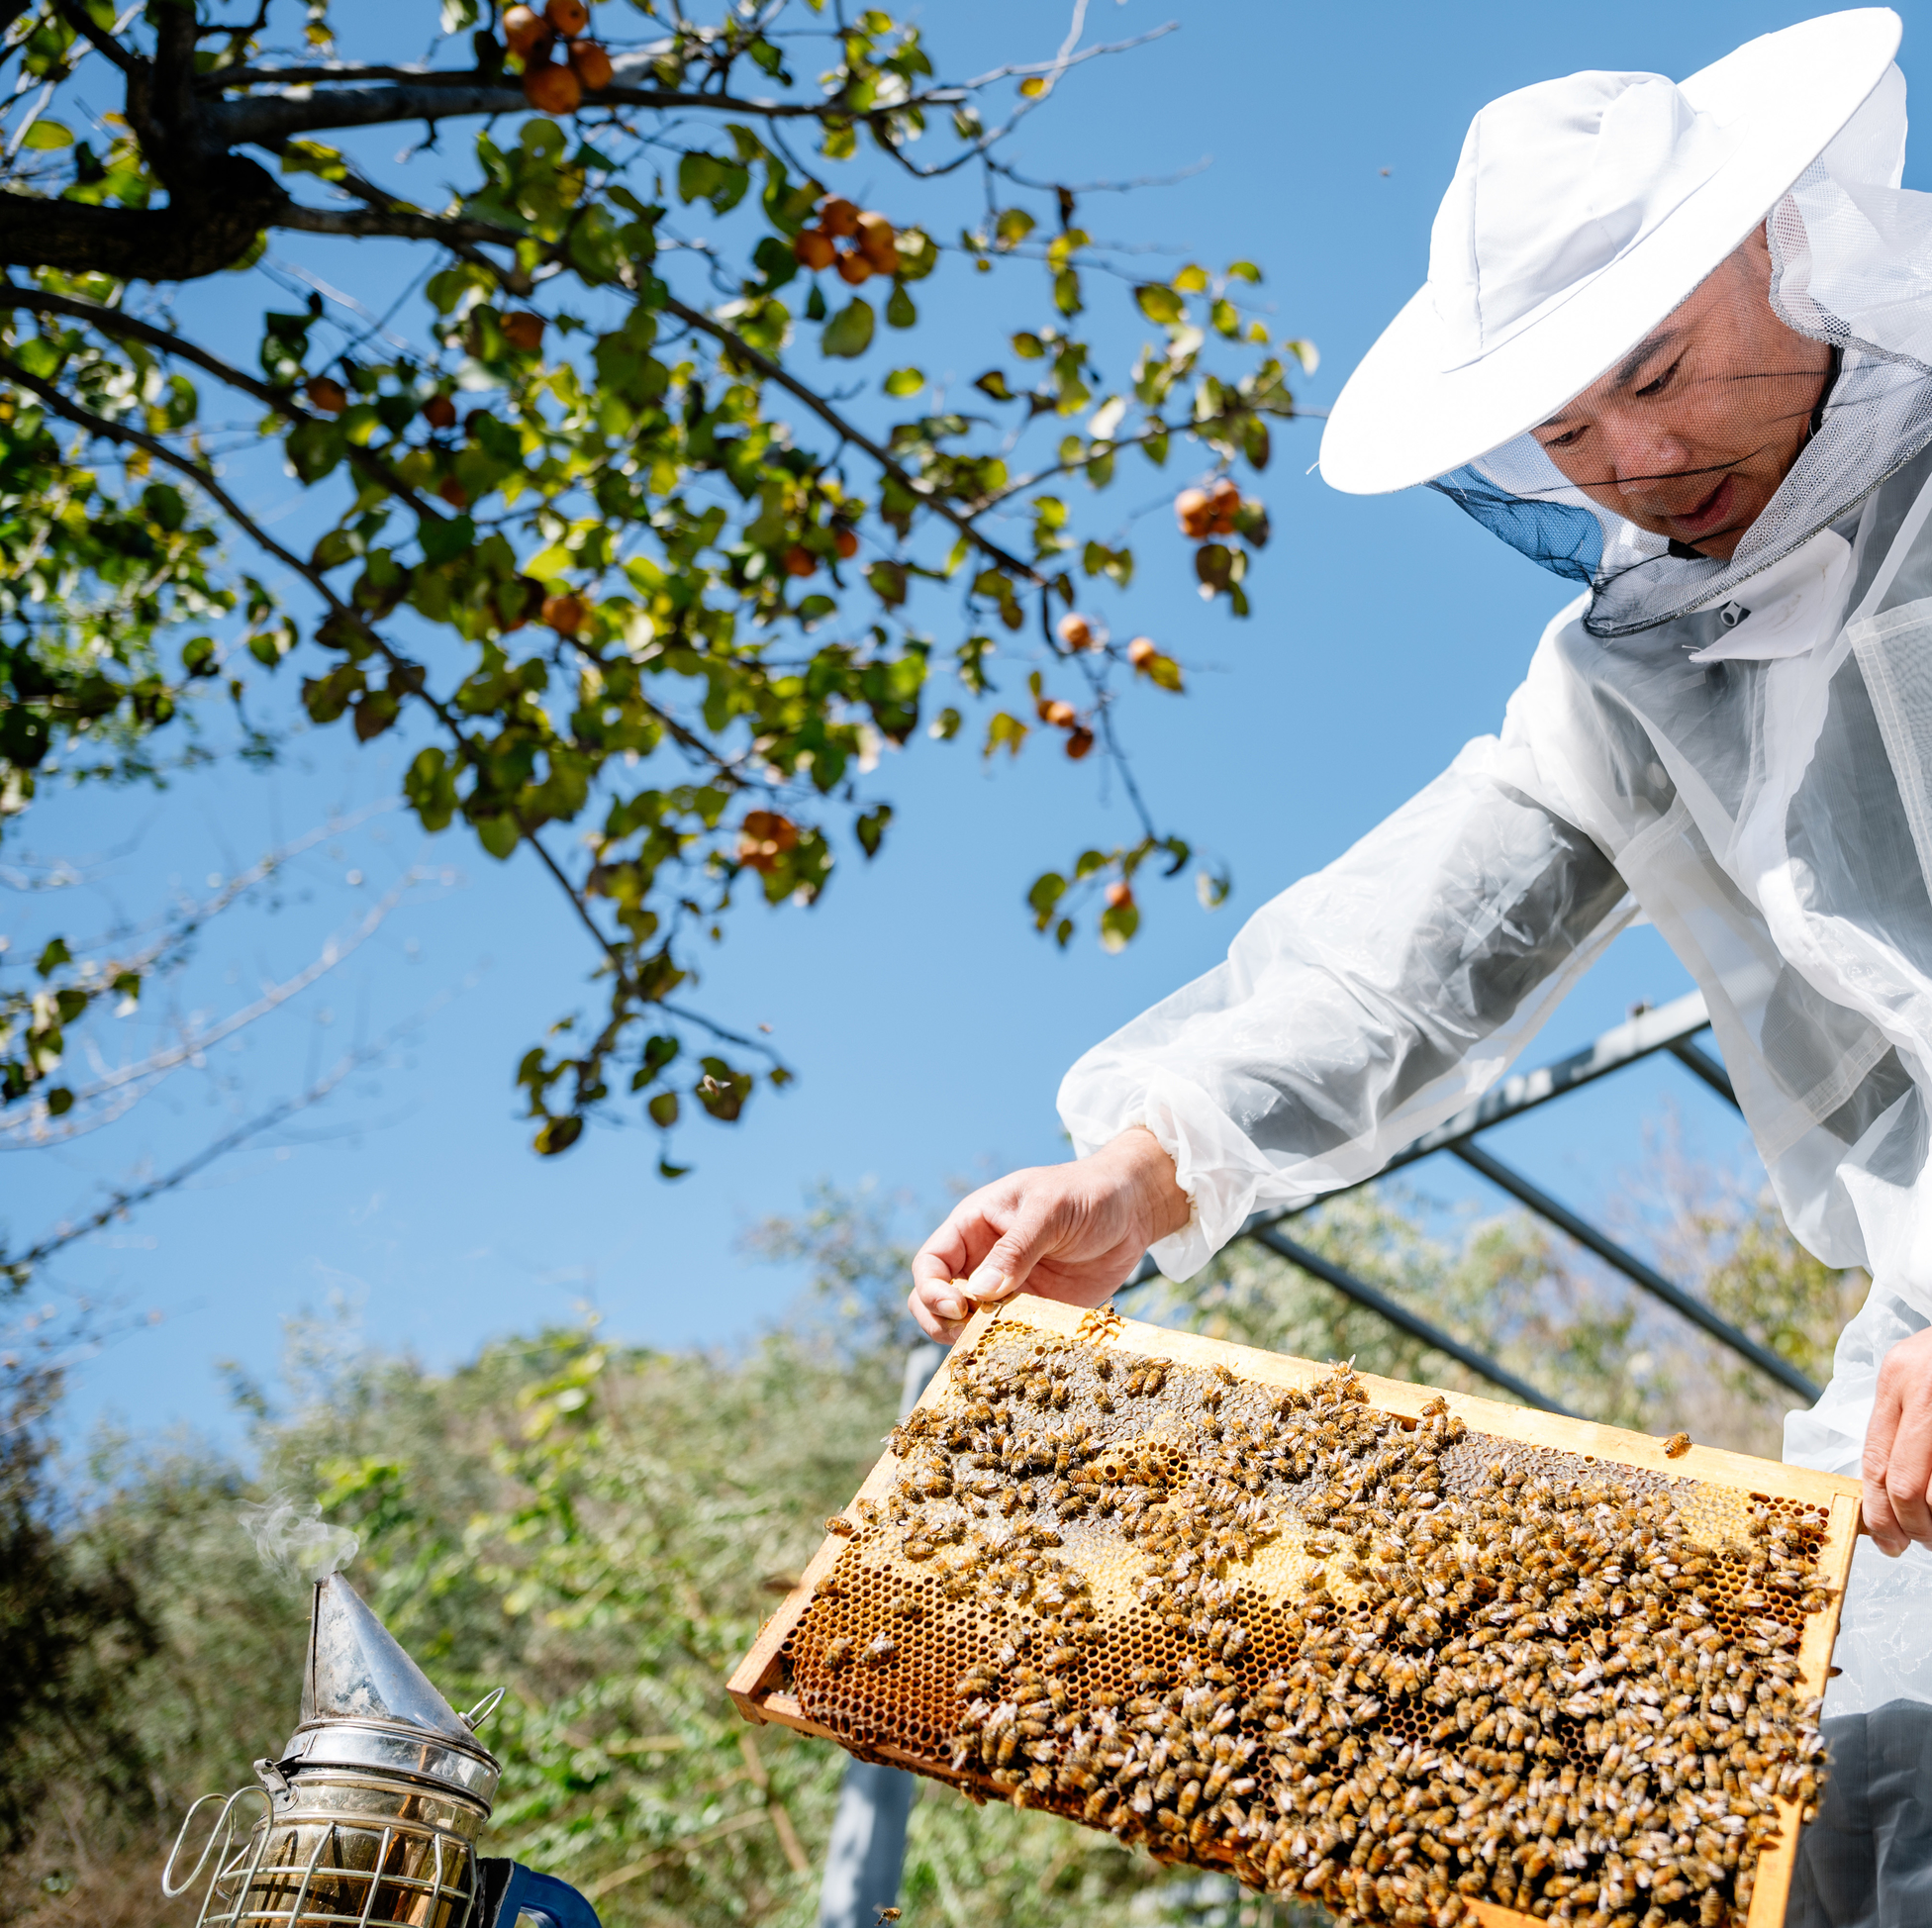
Bees
Keeping of bees is called Apiculture
Historic relationship in beekeeping
There are over 4,000 native bee species in North America
Honeybees are not native to North America
Colonies can grow as large as 40,000 to 60,000
Notes:
Bees are a common livestock animal. There is evidence that the relationship between humans and bees is 17,000 years old. There are 4,000 native bees in North America, but honeybees are most discussed even though they are not native to North America and were imported from Europe. The technical term for beekeeping is Apiculture. Honeybees must consume 17-20 points of honey to biochemically produce a pound of beeswax. The average honeybee will only produce up to 1/12th of a teaspoon of honey in its lifetime, which is why we see populous colonies of up to 40,000 or 60,000 bees.

Slide 30
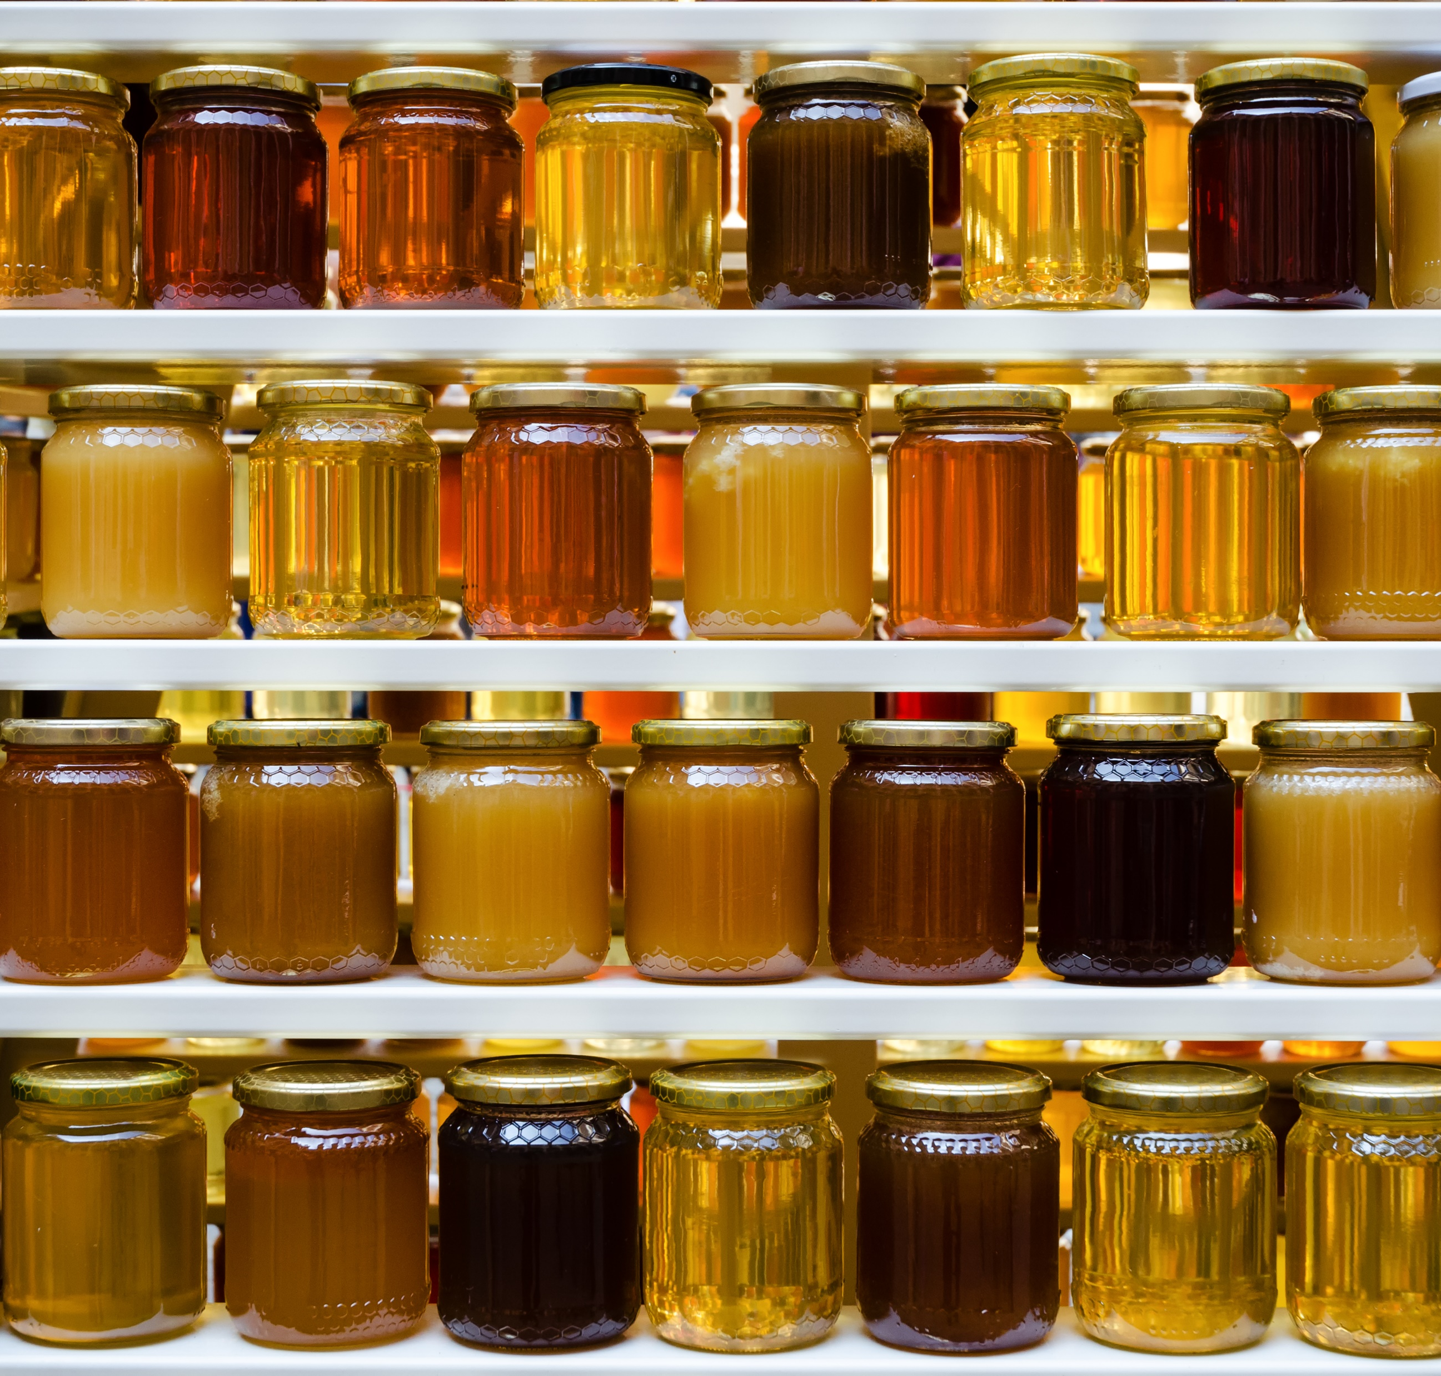
Honey
Bees collect flower nectar
Nectar is stored in the honeycomb
Nectar breaks down into simple sugars
The evaporation and storage process creates honey
Average hives produce 55 pounds of surplus honey per year
Notes:
Honey is created as bees collect flower nectar and store it in the honeycomb. The nectar is broken down into simple sugars. Evaporation causes the nectar to become honey. An average hive will produce about 55 pounds of surplus honey a year.

Slide 31
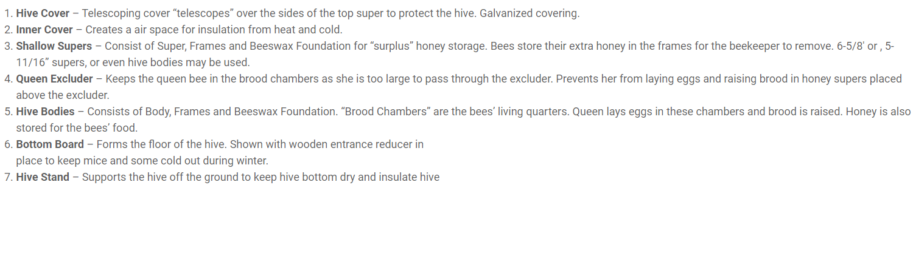
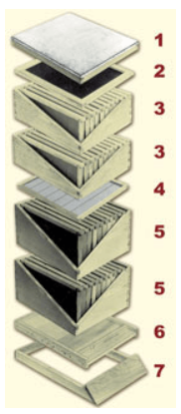
Beehive Components
Notes:
Bees are kept in hives, and these hives can vary greatly in size. Modern beehives have multiple layers. There is a hive cover, which covers the top and sides of the hive. The inner cover, which creates and insulating air space. Shallow supers, for surplus honey storage. Queen excluder keeps the queen separated so her eggs are not laid in the honey super. Hive bodies are brood chambers where the queen will lay her eggs and raise the brood. There is a bottom board which insulates the bottom of the hive. Typically, there is a stand to keep the hive off the ground as well.

Slide 32
Other Urban Livestock
Goats
Cows
Ducks
Sheep
Pigs
Notes:
Depending on the areas and zoning rules, some people can have larger livestock such as sheep, goats, and cows. Their needs in urban agriculture may include finding a reliable feed source, fencing, area for the animal, nuisance complaints from noise or smell, and shelter options. The needs of larger livestock can be harder to meet in an urban setting, which is typically why poultry, rabbits, and bees are more frequently seen in urban areas.

Slide 33
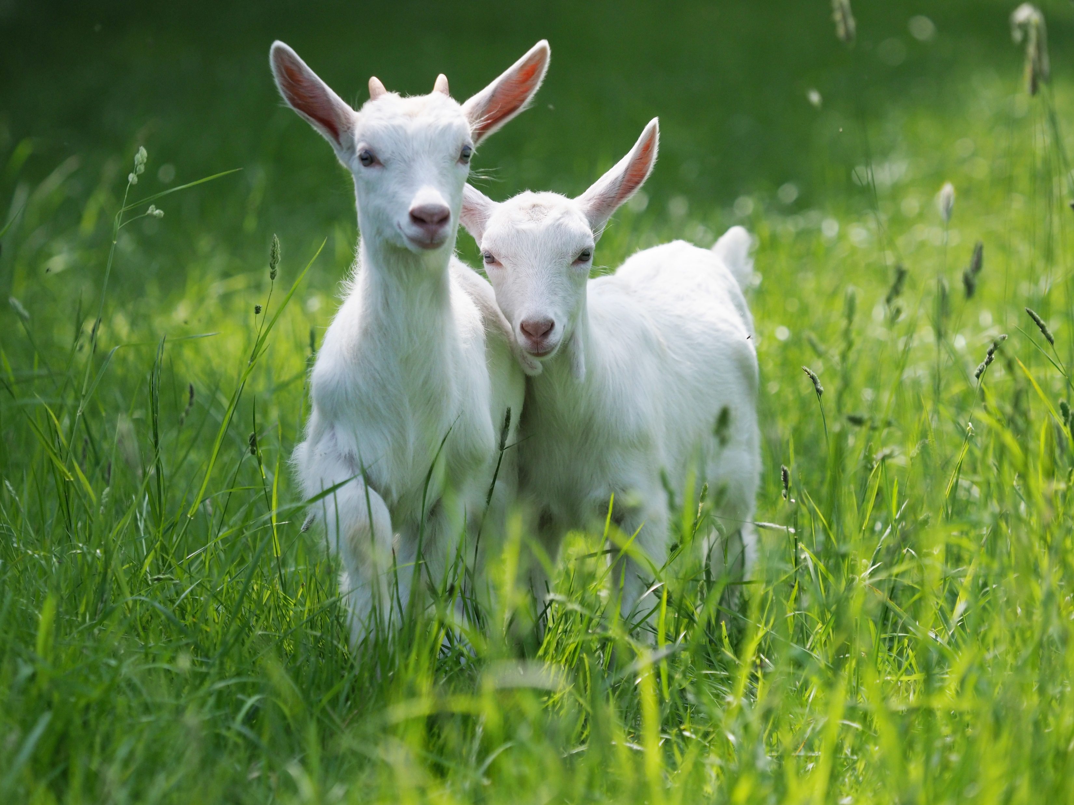
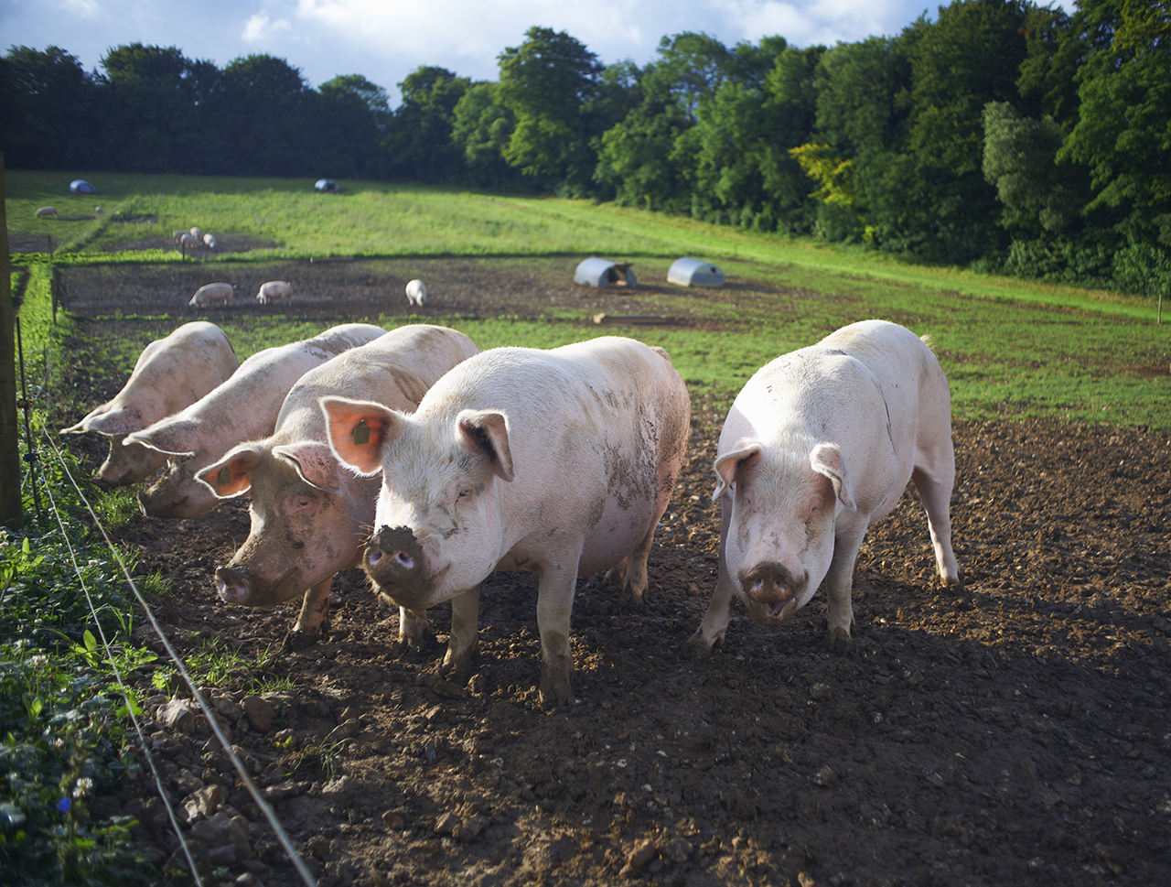
Area Needed for Livestock
Animal | Minimum Area Needed for Animal
Cow | 1.5-2 acre (65340-87120 square feet)
Pig | 8 square feet
Goat | 200 square feet
Sheep | .5 acre (21780 square feet)
Notes:
Depending on the areas and zoning rules, some people can have larger livestock such as sheep, goats, and cows. Their needs in urban agriculture may include finding a reliable feed source, fencing, area for the animal, nuisance complaints from noise or smell, and shelter options. The needs of larger livestock can be harder to meet in an urban setting, which is typically why poultry, rabbits, and bees are more frequently seen in urban areas. Typically for cows, 1.5-2 acres is needed to feed a cow calf pair for up to a year, and that can be challenging to acquire in an urban setting. Pigs need about 8 square feet per pig, which is not a lot of space however pigs will root and can significantly change the landscape of where they are kept. Goats typically need 200 square feet each. A sheep will need about half an acre to graze.

Slide 34
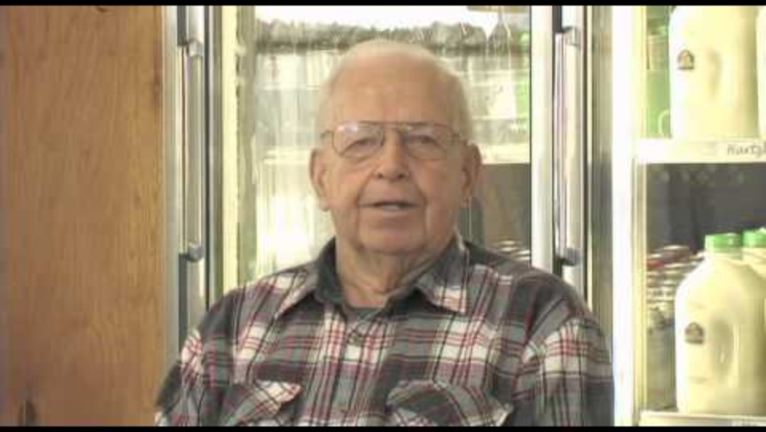
Extension Activity: Polycultures: Food where we live
Notes:
This film (54 minutes) covers social considerations related to urban agriculture
Made in Cleveland and Northern Ohio
Issues with the American Food System
2010 (discuss changes 14 years later, or similarities)

